Slide 1
SI100B Tutourial-1
TA: Zijie Chen, Shiyi Liu, Guorui Cui

Slide 2
Content
MCU 、esp32 、device introduction
(Thought matters!!!)
Software installation and use
（UpyCraft & Multisim）

Slide 3

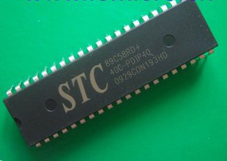
MCU
单片集成电路芯片
RAM
I/O口
T/C
ROM
Interrupt system
CPU
clock circuit

Slide 4
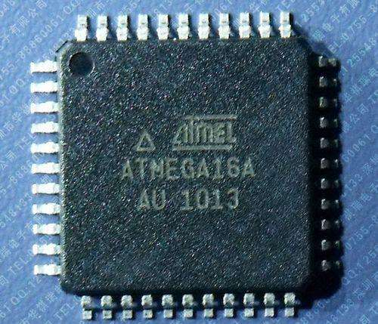
RAM
I/O口
ROM
T/C
总 线
中断控制
系统
CPU
时钟产生
电路

Slide 5
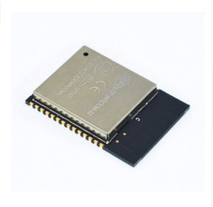
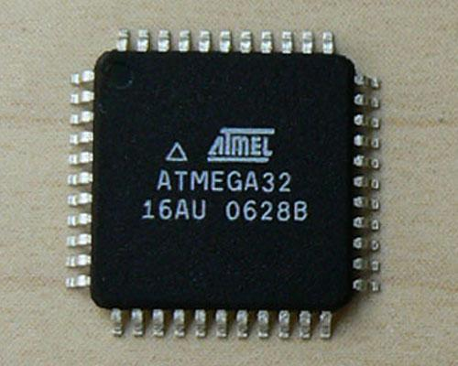
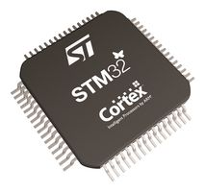
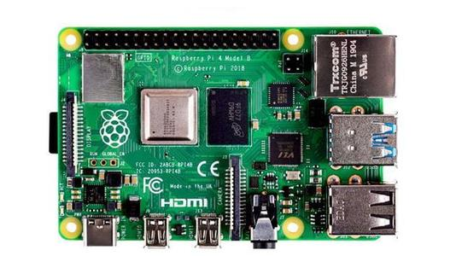
MCU
Minimum system
serial
esp32
（32 bit）
51/arduino microchip
(8 bit)
MSP430
（16 bit）
STM32
（32 bit）
raspberry pi
（64 bit）
FPGA
parallel

Slide 6
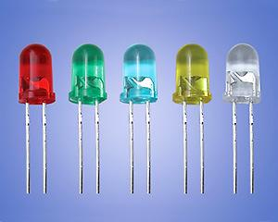
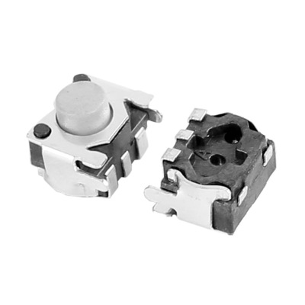
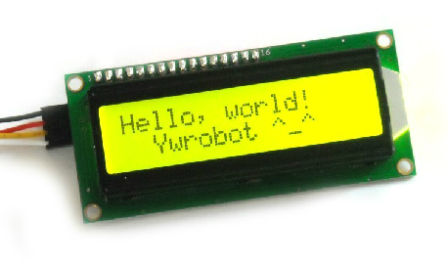
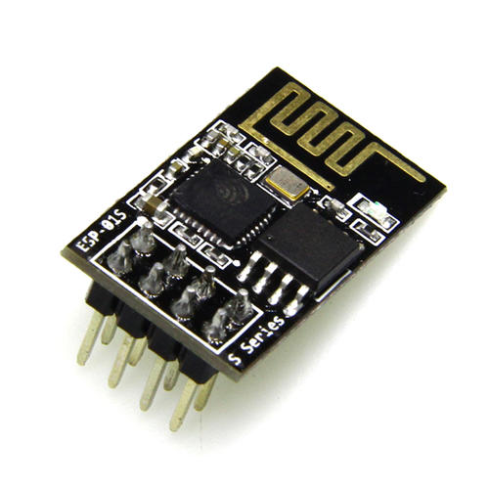
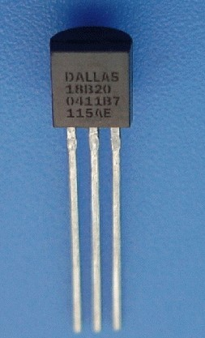
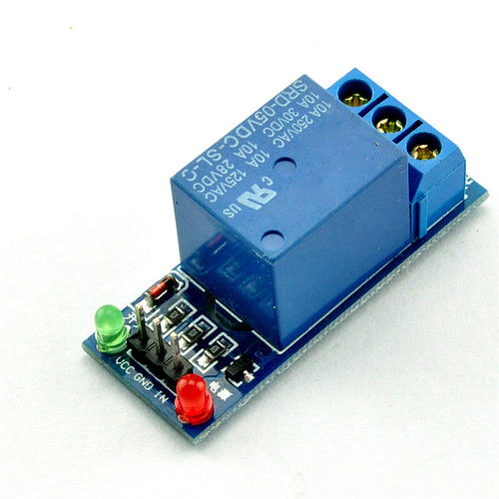
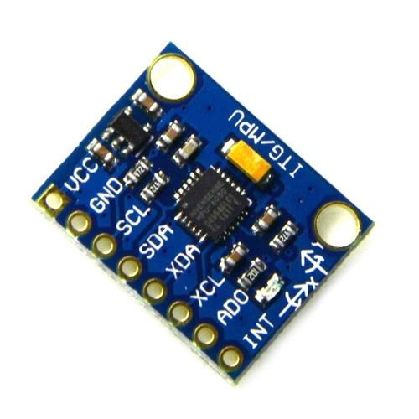
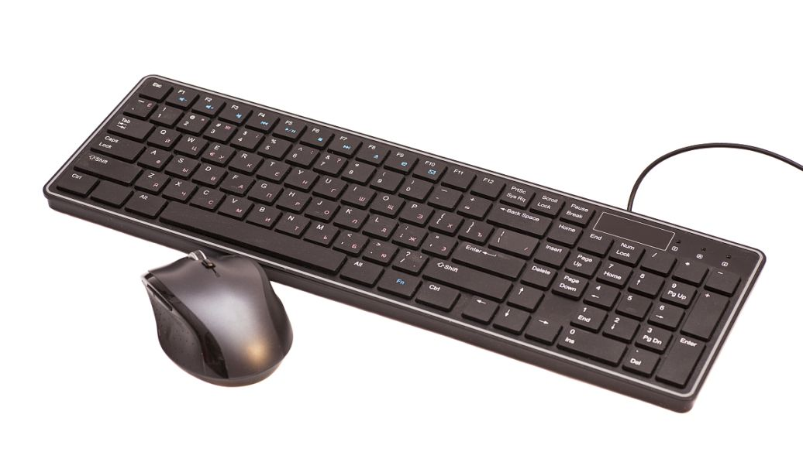
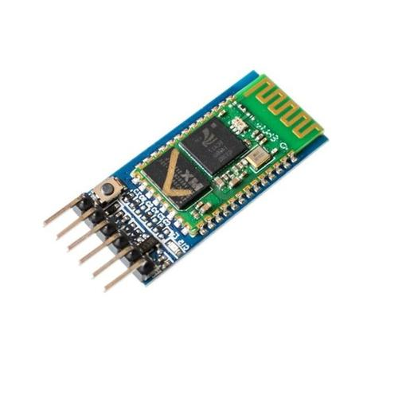
The essence of MCU Development
The Utilization of the internal resource of MCU
The Control of I/O port
Serial port、T/C、interrupt
The use of several peripherals
......

Slide 7
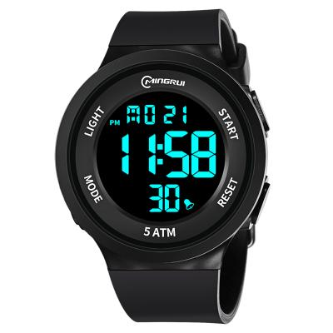

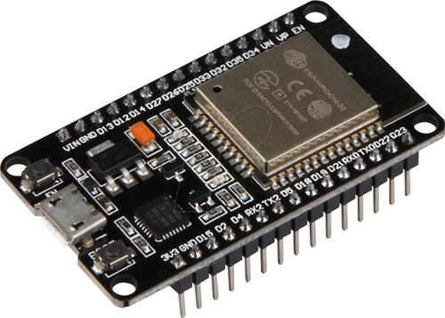

Slide 8
The process of MCU Development
Programming on IDE
initialization
while True：
{
......
}
Debug
programing language: C 、C++ 、micropython......
IDE: Keil 、arduino 、UpyCraft/Thonny......

Slide 9
Brief introduction
ADC、DAC
PWM
FSM
b站杜洋的stm32教学

Slide 10
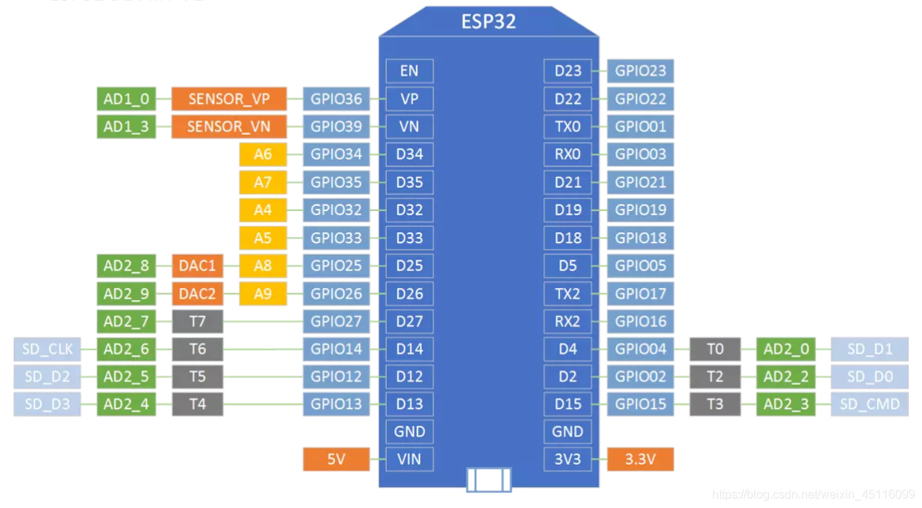
esp32

Slide 11
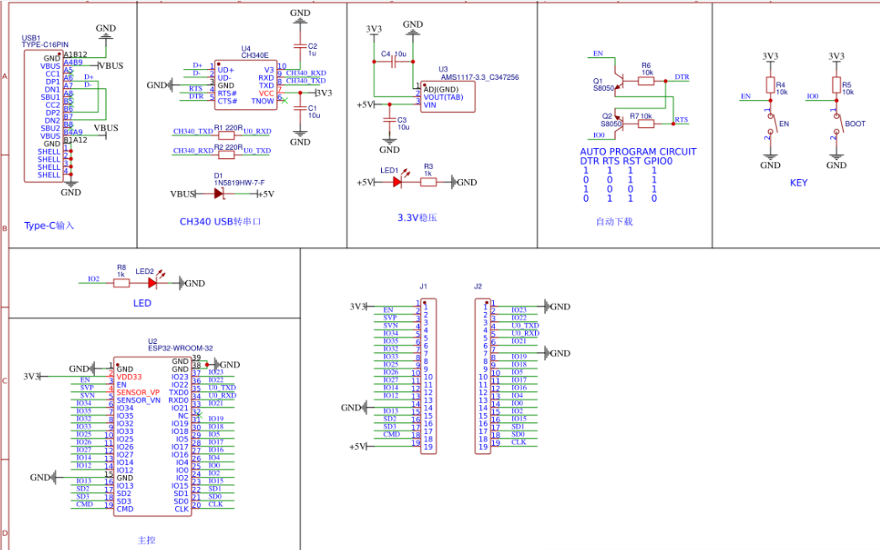

Slide 12
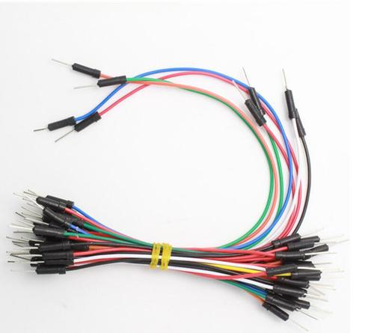
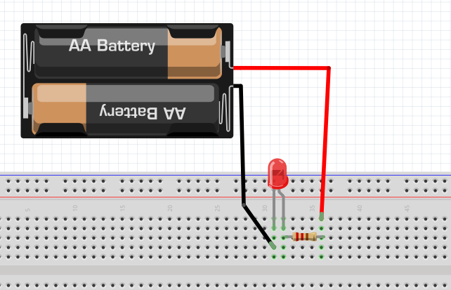
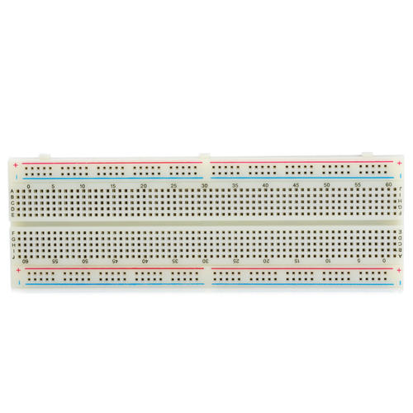
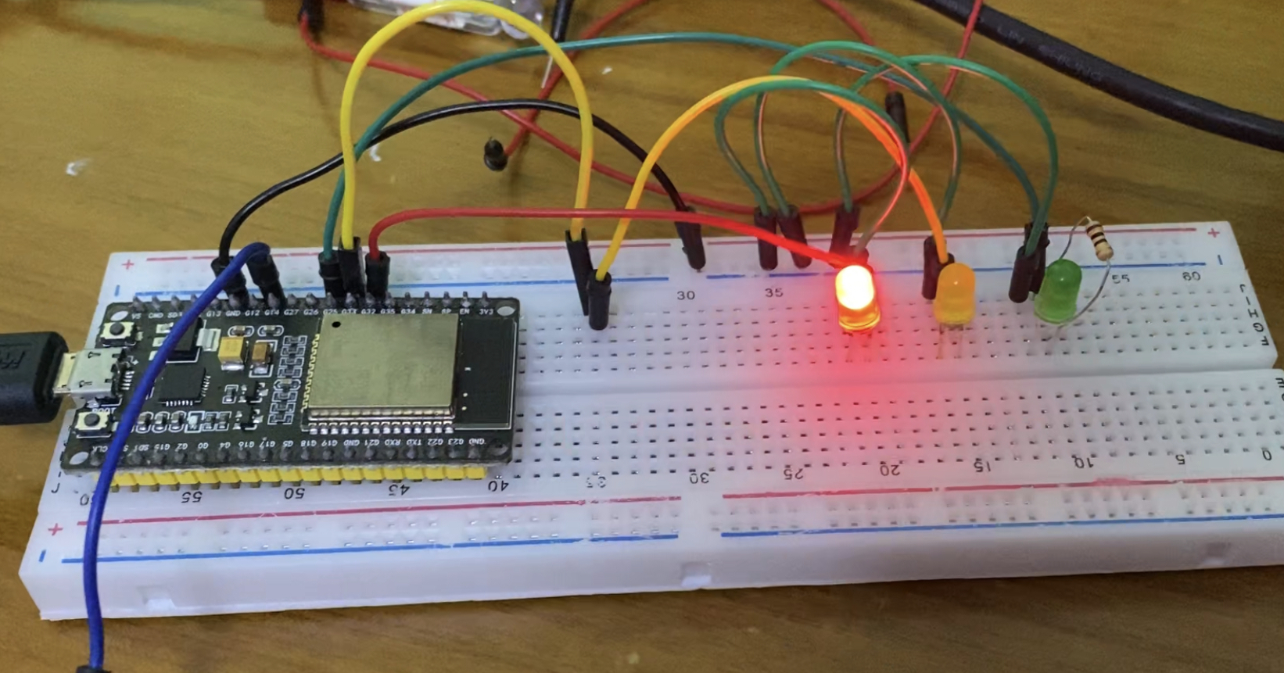
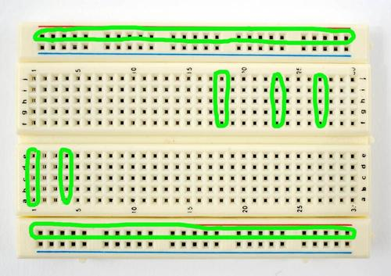
Bread board

Slide 13
Q & A

Slide 14
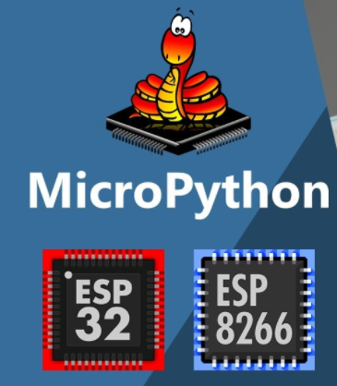
UpyCraft（micropython）

Slide 15
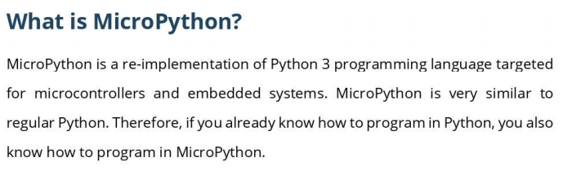

Slide 16
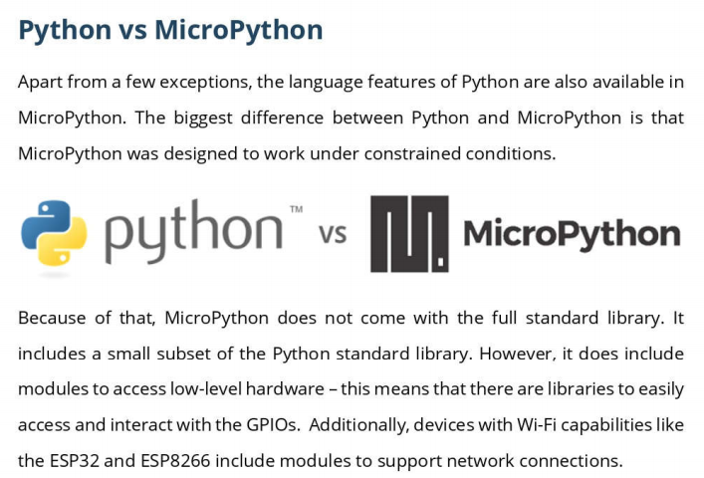

Slide 17
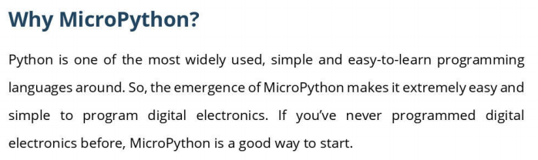

Slide 18
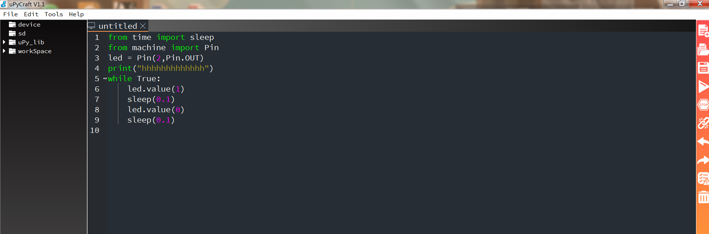
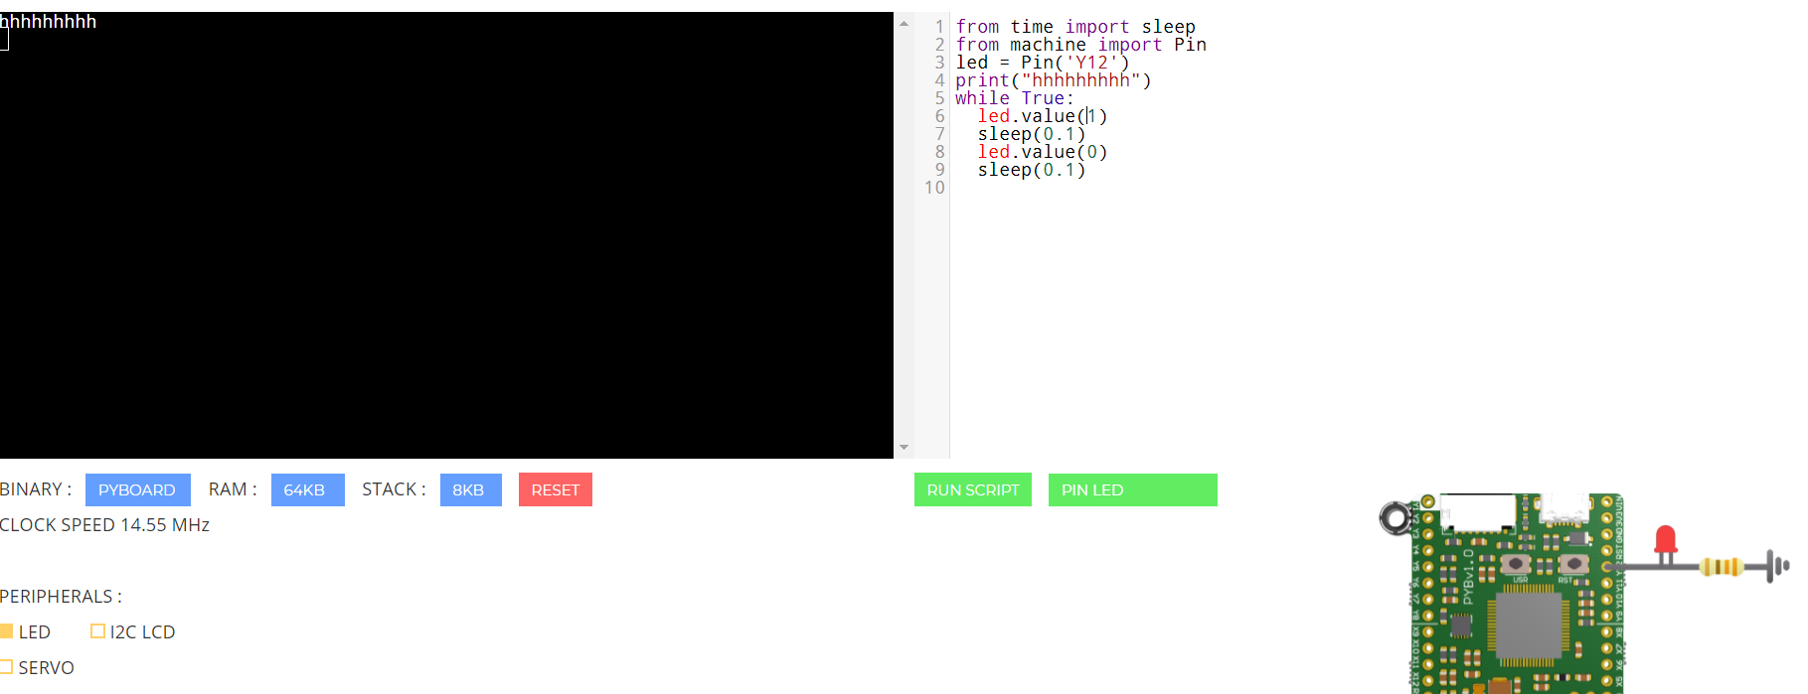
Teach you how to blink the light in detail.

Slide 19

Multisim
（circuit）
Multisim is industry-standard SPICE simulation and circuit design
software for analog, digital, and power electronics in education
and research.

Slide 20
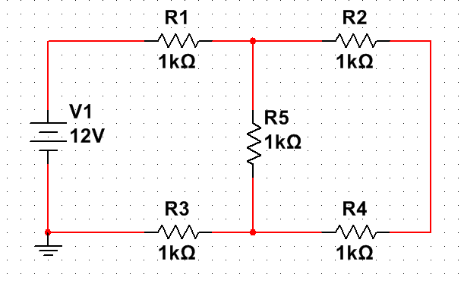
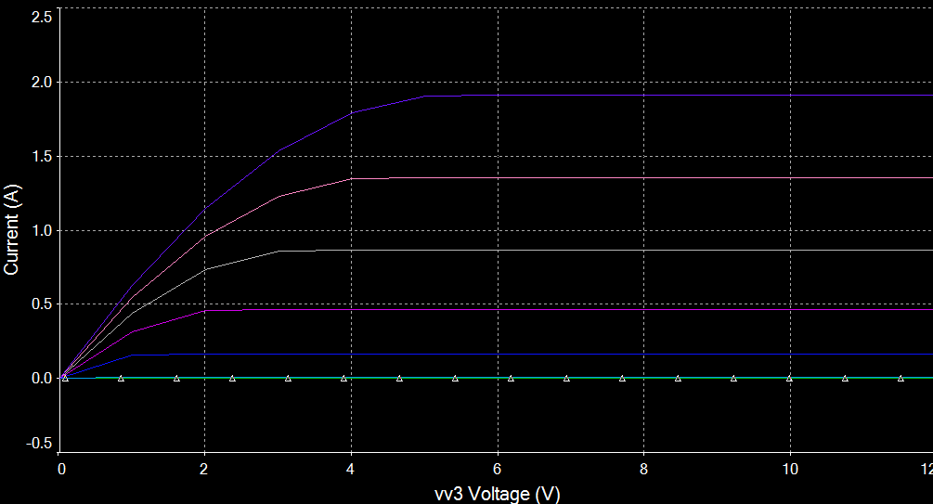
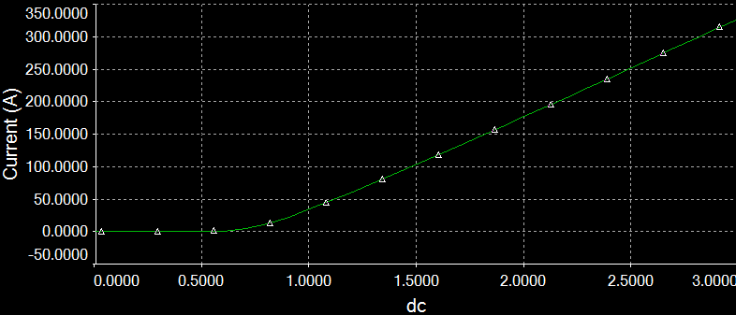
Teach you how to use Multisim in detail.
1、Verify KCL、KVL.
2、Measure the output characteristic curve
of Diode and NMOS.

Slide 21
Q & A

Slide 22



