Slide 1

SI100B Introduction to Information Science and Technology (Python Programming)
高盛华
School of Information Science and Technology
ShanghaiTech University
Slides credited to Prof Haipeng Zhang

Slide 2
Learning Objectives
Exception handling
File operations
Modules

Slide 3
The assert statement
Input numerator:1
Input denominator:0
Traceback (most recent call last):
…
File "C:\Users\Desktop\hello.py", line 2, in Div
assert y!=0, "denominator is 0"
AssertionError: denominator is 0
Input/Output
Notes:
断言

Slide 4
Errors and Exceptions
There are (at least) two distinguishable kinds of errors
Syntax errors: a.k.a. parsing errors, most common one
Exceptions: errors detected during execution
>>> while True print('Hello world')
File "<stdin>", line 1
while True print('Hello world')
^
SyntaxError: invalid syntax
>>> 10 * (1/0)
Traceback (most recent call last):
File "<stdin>", line 1, in <module>
ZeroDivisionError: division by zero

Slide 5
Handling Exceptions
Improve robustness and fault tolerance
User-friendly error message
Try statement
while True:
try:
x = int(input("Please enter a number: "))
break
except ValueError:
print("Oops! That was no valid number. Try again...")

Slide 6
If-Else vs. Exception Handling
It is better to use exception handling than if-else
Catch precise exception
Proper exception handling for different exception

Slide 7
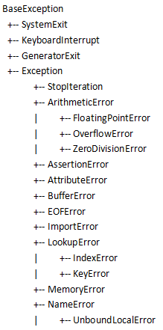
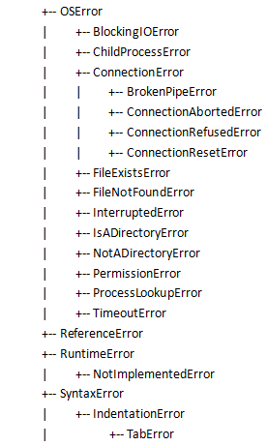
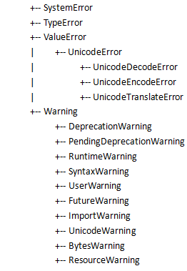
Exception hierarchy

Slide 8
The try statement
try_stmt ::= try1_stmt | try2_stmt
try1_stmt ::= "try" ":" suite
"finally" ":" suite
try2_stmt ::= "try" ":" suite
"except" [expression ["as" identifier]] ":" suite
.…..
"except" [expression ["as" identifier]] ":" suite
["else" ":" suite]
["finally" ":" suite]

Slide 9
The try statement
try:
suite
finally:
suite
There is no exception handler
But, the finally suite is always executed before leaving the try statement
The finally clause is useful for releasing external resources (such as files or network connections), regardless of whether the use of the resource was successful

Slide 10
The try statement
try: suite
except expression [as e1]: suite
……
except [expression [as en]]: suite
[else: suite]
[finally: suite]
If there no finally clause, then it contains at least one except clause
The last except can omit the expression, in this case, it will catch all the possible exception

Slide 11
The try statement
try: suite
except expression [as e1]: suite
……
except expression [as en]: suite
[else: suite]
[finally: suite]
If no exception occurs in the try clause, no exception handler is executed,
but else clause is executed if no exception, no return, continue, or break statement was executed in try clause
Exceptions in the else clause are not handled by the preceding except clauses

Slide 12
The try statement
try: suite
except expression [as e1]: suite
……
except expression [as en]: suite
[else: suite]
[finally: suite]
When an exception occurs in the try suite, a search for an exception handler is started from the except clauses in turn until one is found that matches the exception (type-checking)

Slide 13
The try statement
try: suite
except expression [as e1]: suite
……
except expression [as en]: suite
[else: suite]
[finally: suite]
If no except clause matches the exception in the current try block, the search continues in the surrounding code and on the invocation stack

Slide 14
The try statement
try: suite
except expression [as e1]: suite
……
except expression [as en]: suite
[else: suite]
[finally: suite]
When a matching except clause is found, the except clause’s suite is executed
When the end of this block is reached, execution continues normally after the entire try statement

Slide 15
The try statement
try: suite
except expression [as e1]: suite
……
except expression [as en]: suite
[else: suite]
[finally: suite]
If finally is present, it is always executed

Slide 16
The try statement
Output
try-1
try-2
else
finally
>>>
If finally is present,
it is always executed

Slide 17
The try statement
Output
Raise here
try-1
except
finally
after foo
>>>
If finally is present, it is always executed even if there is return

Slide 18
The try statement
Output
try-1
finally
Traceback (most recent call last):
…
ZeroDivisionError: division by zero
>>>

Slide 19
The try statement
def foo(a,b):
try:
print("try-1")
x = a/b
print("try-2")
except AssertionError:
print("except-1")
return
finally:
print("finally-1")
try:
foo(1,0)
except ZeroDivisionError:
print("except-2")
else:
print("else-2")
finally:
print("finally-2")
Output
try-1
finally-1
except-2
finally-2
>>>
Surrounding finally is also executed

Slide 20
The try statement
def foo(a,b):
try:
print("try-1")
x = a/b
print("try-2")
except AssertionError:
print("except-1")
return
finally:
print("finally-1")
try:
foo(1,0)
except IndexError:
print("except-2")
else:
print("else-2")
finally:
print("finally-2")
Output
try-1
finally-1
finally-2
Traceback (most recent call last):
…
ZeroDivisionError: division by zero
Surrounding finally is also executed

Slide 21
Exception hierarchy

Slide 22
The try statement
x = [1,2,3]
try:
print(x[0])
print(x[3])
except IndexError:
print("Out of range")
try:
print(x[0])
print(x[3])
except LookupError:
print("Out of range")
Output
1
Out of range
1
Out of range
>>>
Can be more specific

Slide 23
Learning Objectives
Exception handling
File operations
Modules

Slide 24
Open a file
Before we can read the contents of the file we must tell Python which file we are going to work with and what we will be doing with the file
This is done with the open() function
open() returns a “file handle” - a variable used to perform operations on the file

Slide 25
Open()
Syntax
file_handler_variable = open(filename, mode)
returns a handle use to manipulate the file
filename is a string (a string variable or a string constant)
mode is optional and should be 'r' if we are planning reading the file and 'w' if we are going to write to the file.

Slide 26
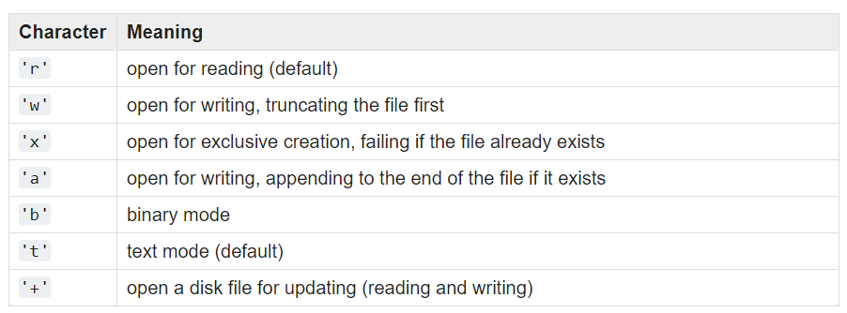
Open() modes
https://docs.python.org/3/library/functions.html#open

Slide 27
File handler as a sequence
A file handle open for read can be treated as a sequence of strings where each line in the file is a string in the sequence
We can use the for statement to iterate through a sequence
Remember - a sequence is an ordered set
xfile = open('mbox.txt')
for line in xfile:
print(line)

Slide 28
Read the ‘whole’ file
We can read the whole file (newlines and all) into a single string.
>>> fh = open('mbox.txt')
>>> inp = fh.read()
>>> fh.close()
>>> print(len(inp))
94626
>>> print(inp[:20])
A text file (sometim

Slide 29
Read file into a list
We can use readlines() to get a list.
Each element in the list is a line.
>>> fh = open('mbox.txt')
>>> lines = fh.readlines()
>>> fh.close()
>>> print(len(lines))
4
>>> print(inp[:2])
['the first line', 'the second line']

Slide 30
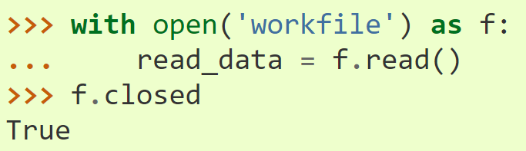
Read using the with keyword
A good practice - the file is properly closed after its suite finishes.

Slide 31
File write
The write() method writes any string to an open file.
The write() method does not add a newline character ('\n') to the end of the string
>>> fh = open('test.txt', 'w')
>>> fh.write(‘Python is great\nI like Python’)
>>> fh.close()
Python is great
I like Python

Slide 32
Other file operations
Python os module provides methods that help you perform file-processing operations, such as renaming and deleting files.
To use this module you need to import it first and then you can call any related functions.
import os
os.rename(current_file_name, new_file_name)
os.remove(file_name)
os.mkdir(newdir)
os.listdir(path)
…

Slide 33
Learning Objectives
Exception handling
File operations
Modules

Slide 34
Modules
As your program gets longer,
You may want to split it into several files for easier maintenance.
You may also want to use a handy function that you’ve written before without copying its definition into the current program

Slide 35
Modules
A module is a file containing Python definitions and statements
The file name is the module name
ModuleName.py
Within a module, the module’s name (as a string) is available as the value of the global variable __name__
To use a module,
import ModuleName
To access names in the module,
ModuleName.Name

Slide 36
Modules
import math
Use sqrt
function from module math

Slide 37
Modules
To list all the names in an module and how to use these names
import moduleName
dir(moduleName)
help(moduleName)
Import only needed names via
from ModuleName import n₁,n₂,...,n_{k}

Slide 38
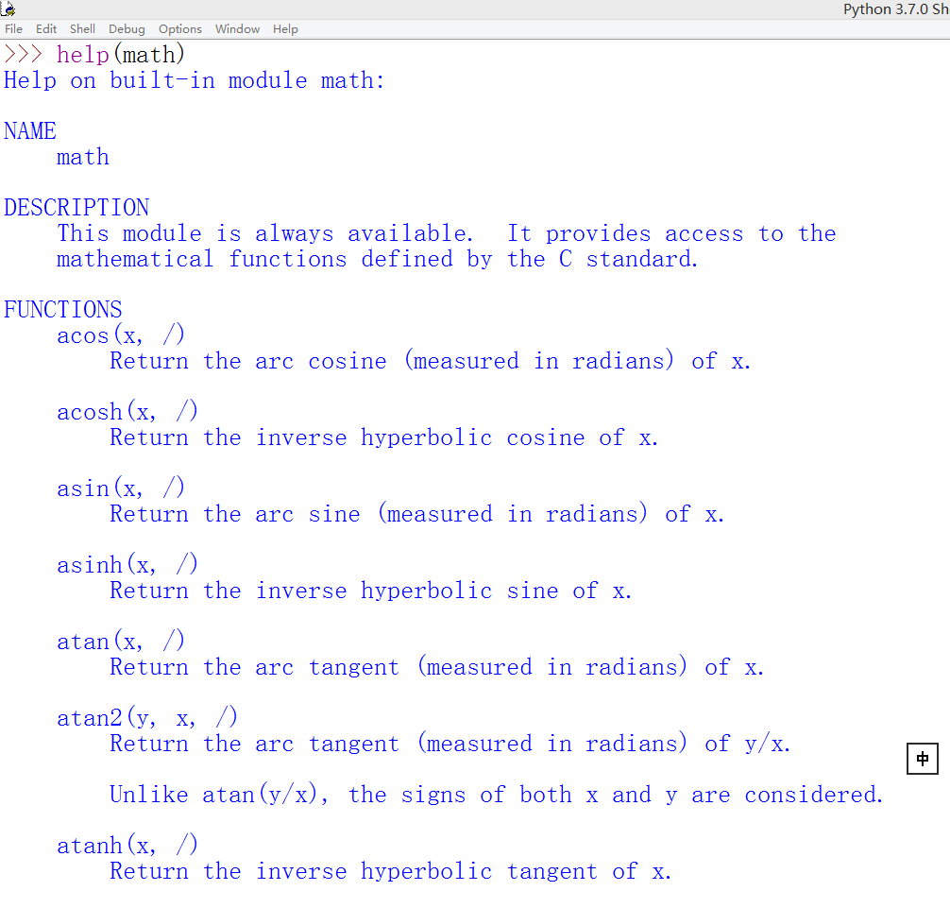
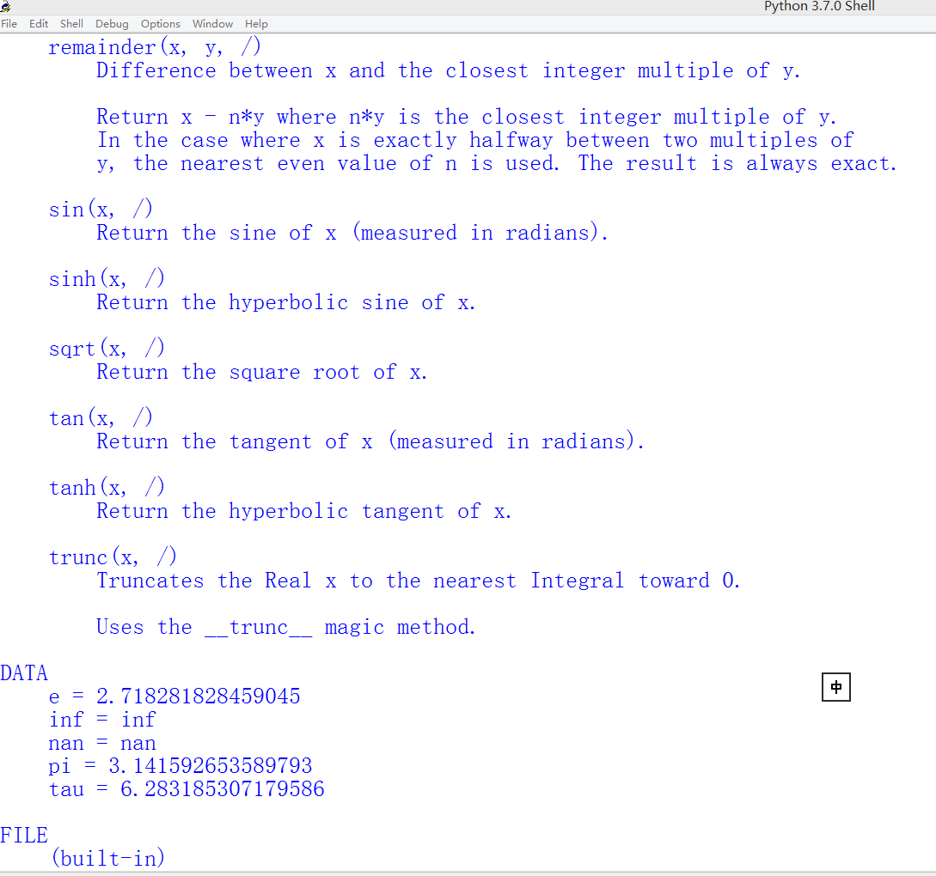
help(math)
These are ‘’’comments’’’ in the math.py produced by Docstring

Slide 39
Modules
There are lots of modules in Python
Compiled-in modules: list all compiled-in module names via the sys module
import sys
sys.builtin_module_names
All built-in modules:
https://docs.python.org/3/py-modindex.html

Slide 40
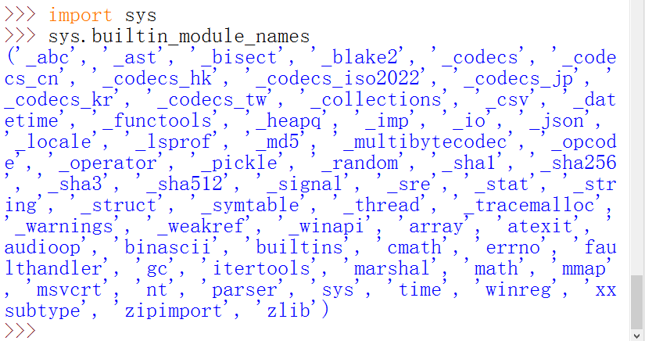
Compiled-in Modules

Slide 41
Modules
There are lots of modules in Python
Compiled-in modules: list all compiled-in module names via the sys module
import sys
sys.builtin_module_names
All built-in modules:
Third-party modules/packages, a package consists of several modules
Manage third-party modules/package
Look up at the website https://pypi.org/
https://docs.python.org/3/py-modindex.html

Slide 42
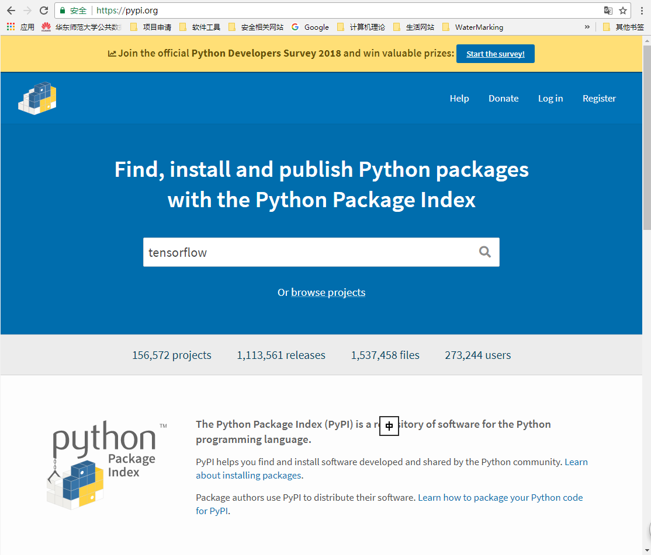
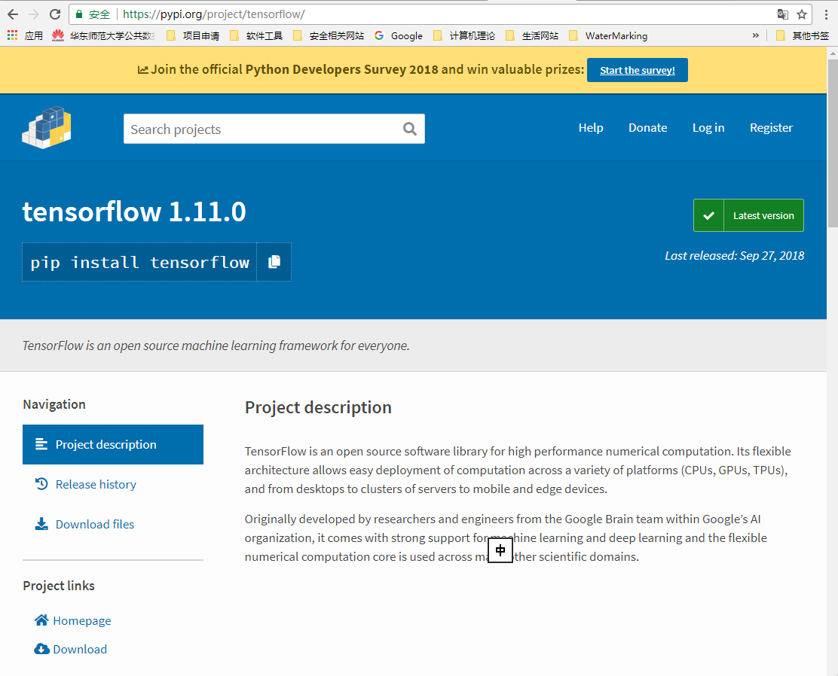

Slide 43
Manage third-parity modules/packages
Usage:
pip <command> [options] (in shell/cmd, not in python)
Find more packages at https://pypi.org/.
pip commands | description
pip download SomePackage[==version] | Download Some package, but not install
pip freeze [> requirements.txt] | Output installed packages in requirements format
pip list | list installed packages
pip install SomePackage[==version] | Install packages (online)
pip install SomePackage.whl | Install packages via whl files(offline)
pip install package1 package2 ... | Install package1、package2… (online)
pip install -r requirements.txt | Install packages list in requirements.txt file
pip install --upgrade SomePackage | Upgrade SomePackage
pip uninstall SomePackage[==version] | Uninstall SomePackage
Other install ways: setuptools , easy_install

Slide 44
Modules
Create our own module module_example.py
def func1(x):
...
def func2(x):

Slide 45
Modules
import module:
import module_example
Use modules via "name space":
>>> module_example.func1(1000)
>>> module_example.__name__
'module_example'
can give it a local name:
>>> fff = module_example.func1
>>> fff(500)

Slide 46
Module search path
When a module named module_example is imported, the interpreter first searches for a built-in module with that name.
If not found, it searches for a file named module_example.py in a list of directories given by the variable sys.path. sys.path is initialized from these locations:
The directory containing the input script (or the current directory when no file is specified).
PYTHONPATH environment variable.
The installation-dependent default.
import sys
print(sys.path)
['C:\\Users\\HP', 'D:\\Anaconda3\\python37.zip', 'D:\\Anaconda3\\DLLs', 'D:\\Anaconda3\\lib', 'D:\\Anaconda3', '', 'D:\\Anaconda3\\lib\\site-packages', 'D:\\Anaconda3\\lib\\site-packages\\win32', 'D:\\Anaconda3\\lib\\site-packages\\win32\\lib', 'D:\\Anaconda3\\lib\\site-packages\\Pythonwin', 'D:\\Anaconda3\\lib\\site-packages\\IPython\\extensions', 'C:\\Users\\HP\\.ipython']

Slide 47
Readings (recommended)
The Python Tutorial
7. Input and Output
8. Errors and Exceptions
6. Modules

Slide 48
Recap
Exception handling
File operations
Modules
Notes:
循环
函数

