Slide 1
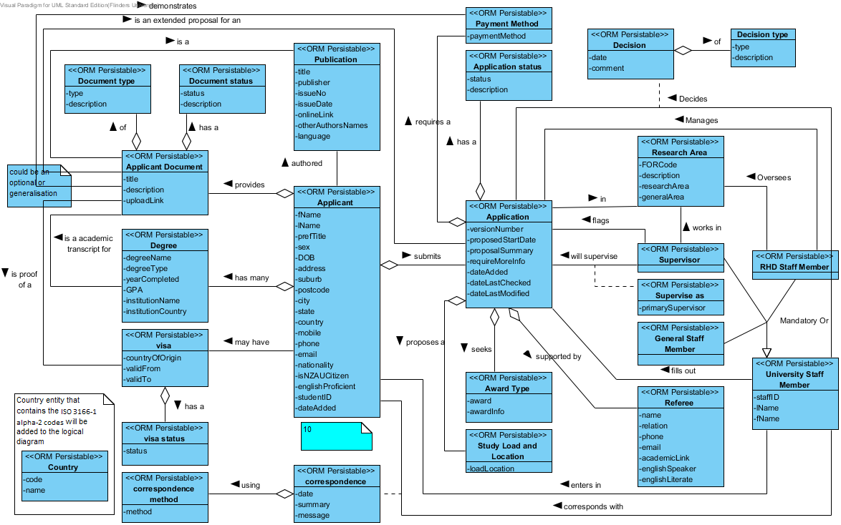
i, k
l
o, t
n
a
q
a, i, k, l
r
p
b, d, h, k
a
e, g
a
s
a
e, m
e, m

Slide 2
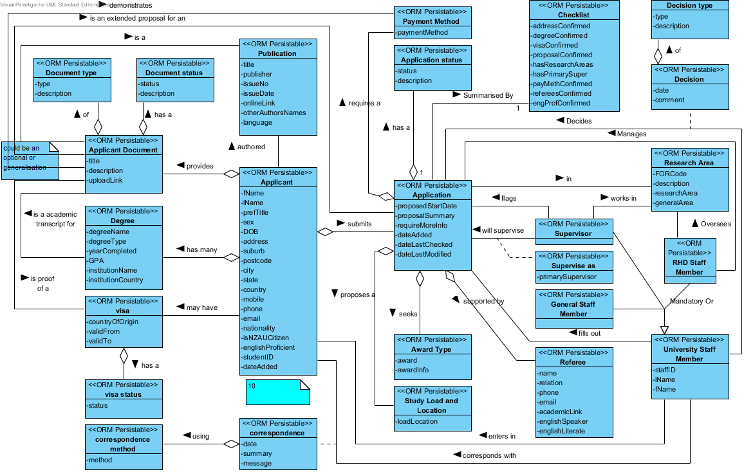
k
i, k
l
n
o, t
a
q
f
a, i, k, l
r
p
b, d, h
a
e, g
a
s
a
e, m
e, m

