Slide 1


Fluency
James Bennett
Zachary Zimmerman
Michael Zlatkovsky
Project Manager,
Computer Science MS
HCId MS
Computer Science PHd

Slide 2
The Problem
Users normally have no way of defining interaction themselves
Software development is a very slow process
Fluency

Slide 3
Fluency
UI Designer for non-programmers
  Designers
  Users
Aims to:
Cost
Speed
Fluency

Slide 4
Creating Functionality
To Create Functionality the user must:
  Select Widgets
  Wire Widgets
  together using
  “Pipes”
Fluency

Slide 5
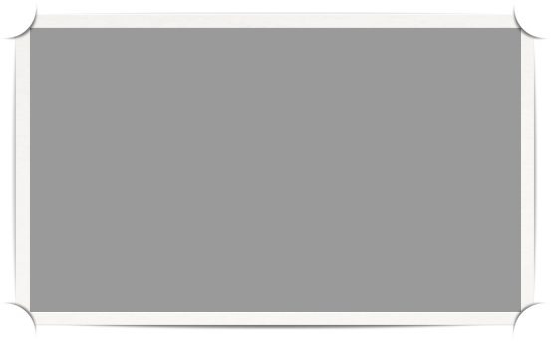


Widgets
Nuggets of functionality
Properties
Actions
Weather Widget
On weather change:
Update Textbox
Textbox Widget
85F
Fluency

Slide 6
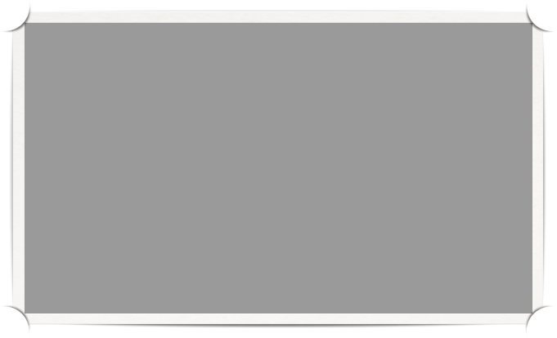
Non-visual Widget
Weather Widget
On weather change:
Update Textbox
Textbox Widget
85F
Visual Widget
Fluency
Weather Icon Source:
http://flukeout.com/free-weather-icons/

Slide 7
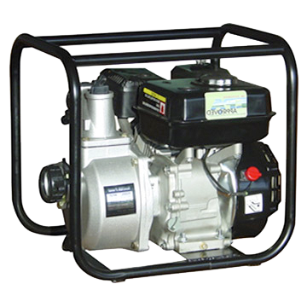


Pipes
Pipe
Faucet
Water Pump
Fluency

Slide 8

Pipes
event happened
event happened
event happened
Pipe
Action
Event Broker
Fluency

Slide 9
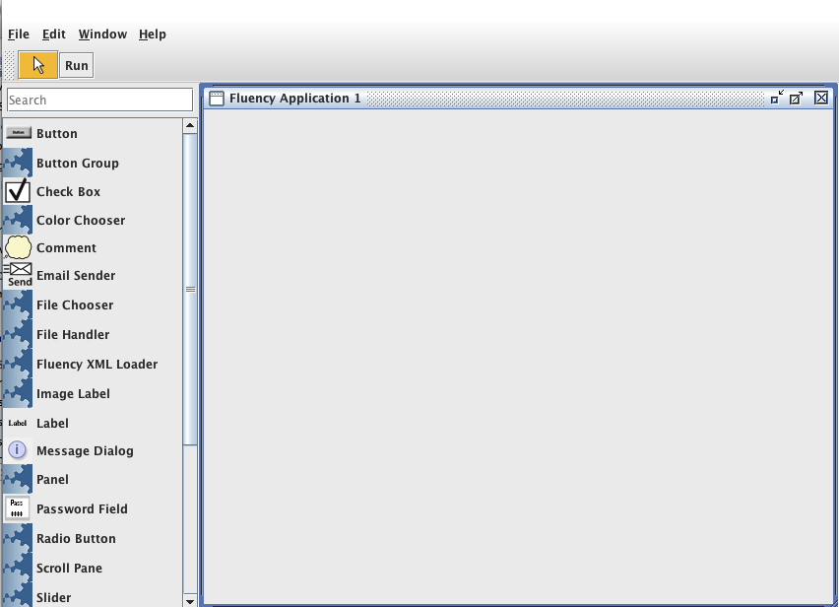
Molecules
Molecule
Fluency

Slide 10
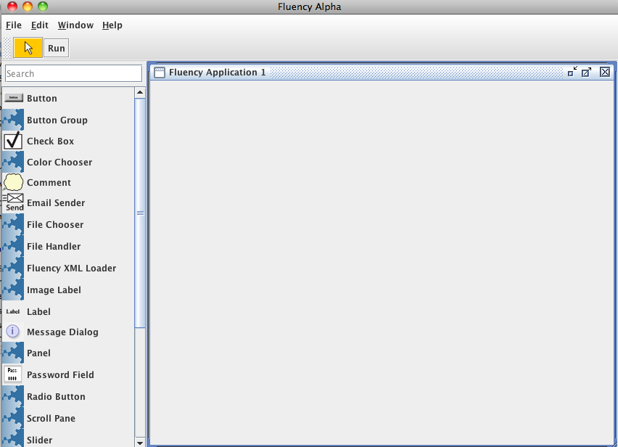
Recursive Fluency

Slide 11
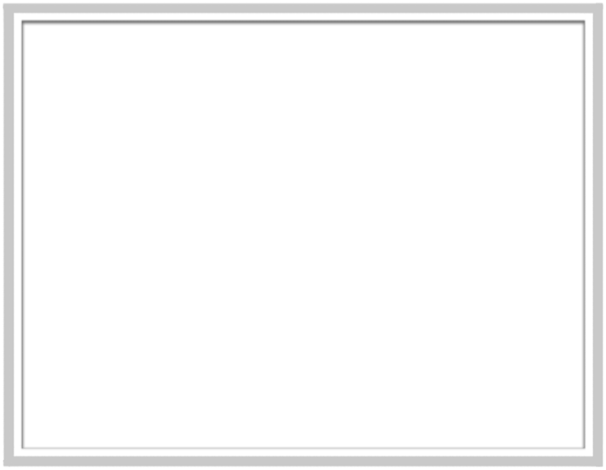
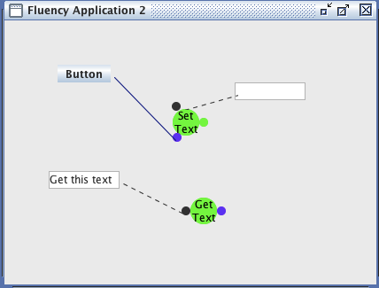
Current State of Pipes
Fluency

Slide 12
This week
Pipe representation mostly redone
Actions can be deleted
Pipe creation GUI simplified
  Trimmed fat
Connect to existing actions
Fluency

Slide 13
Next Week’s Goals
  Connecting arguments to actions
  Finish reworking of the Pipe Representations
  Icons for all widgets!

Slide 14
Thank you

Slide 16

Pipe Concept
Weather Widget
A
Fluency

Slide 17
Pipe Concept
Weather Widget
Set Text
Fluency

Slide 18

Pipe Concept
Weather Widget
On Weather Changed
Set Text
Fluency

Slide 19
Future of Pipes
Weather Widget
A
Fluency

