Slide 1
Efficacy of a Bidder Training Program: Lessons from LINC
Dakshina G. De Silva Timothy P. Hubbard Georgia Kosmopoulou
Presented by Meiyi Zhong and Zach Schutzman

Slide 2
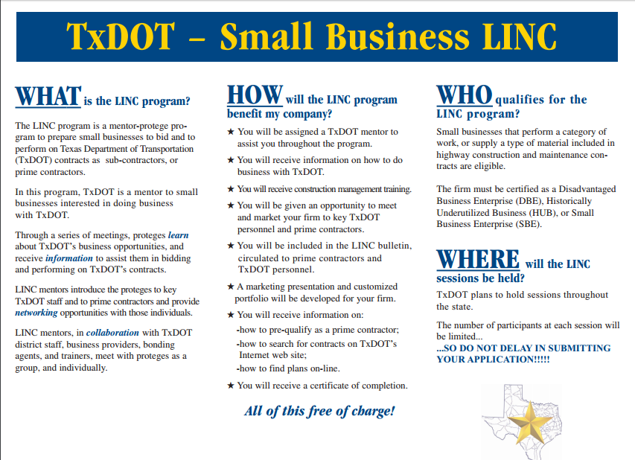
https://ftp.dot.state.tx.us/pub/txdot-info/cmd/lincprogram.pdf

Slide 3
LINC Training is done over six meetings
Introductory: Meet your mentor and sign some paperwork
1: Construction Management training (bids, estimates, record-keeping, materials, etc)
2: Learn how to prepare a business presentation and develop a bid submission
3: Meet individuals from TxDOT to network
4: Develop relationships with contractors
5: Learn about maintenance contracts and bidder qualification

Slide 4
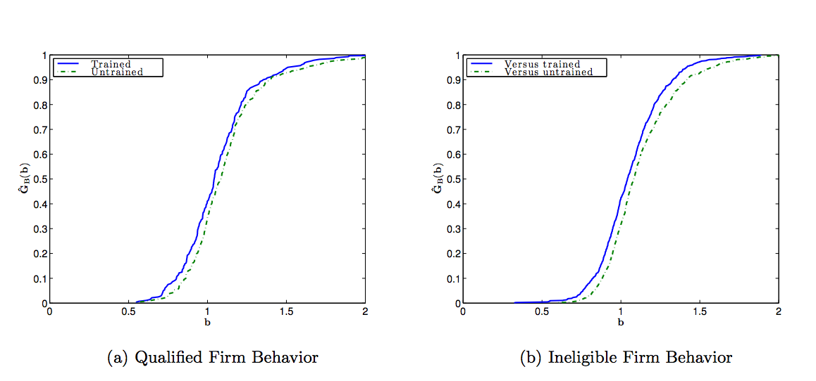
Figure 1: Relative Bid Distributions for n=5

Slide 5
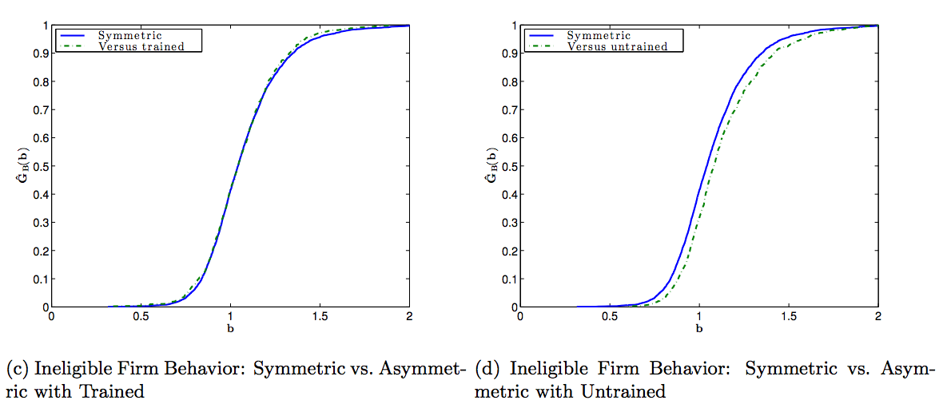
Figure 1: Relative Bid Distributions for n=5

Slide 6
Structure of Auction
Projects are awarded using the low-price, sealed-bid (procurement) auction format
Bidding process opens for 28 days after the plan for a project is posted
Prior to bidding, all bidders learn the location, detailed project description, estimated number of days and costs to complete the projects, and the list of contractors who purchased the documents providing the initial plan description (the plan holders)

Slide 7
Data Description
Data from Sept 1997 to Aug 1998 are used to create bidder-specific histories such as a measure of backlog
Empirical analysis uses data from Sept 1998 to Aug 2007
Author observes the identities of winner and all other firms in each requested plans; also sees estimated costs and time to complete the contract
Total of 1749 unique firms holding plans

Slide 8
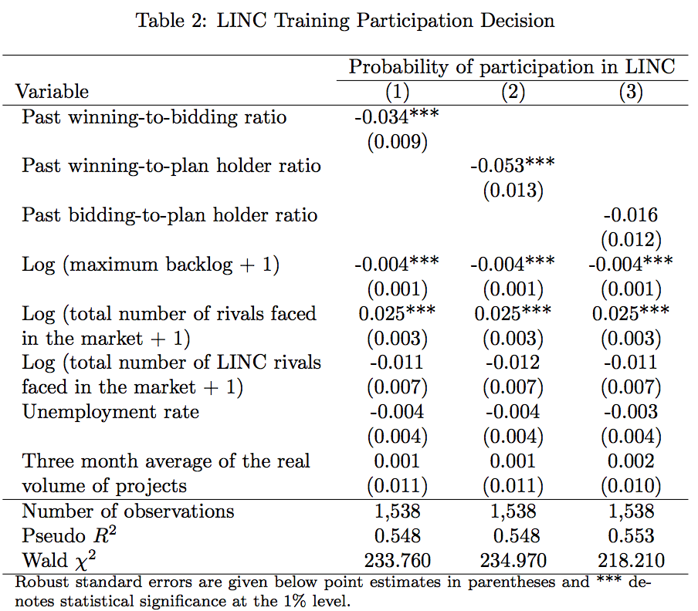
Table 2: LINC Training Participation Decision

Slide 9
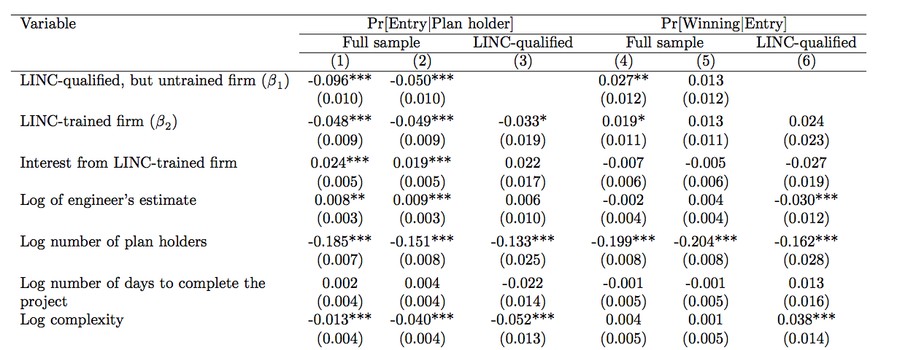
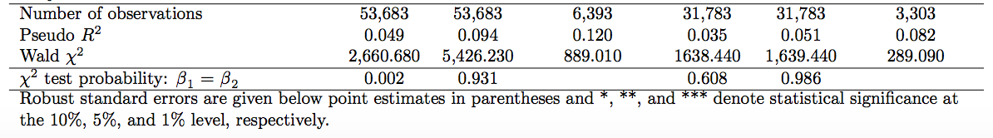
The Effects of LINC Training
Table 3: Results for probability of Entry and Winning Conditional upon Entry

Slide 10
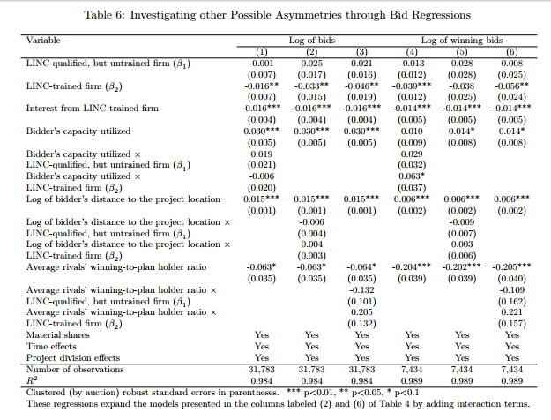

Slide 11
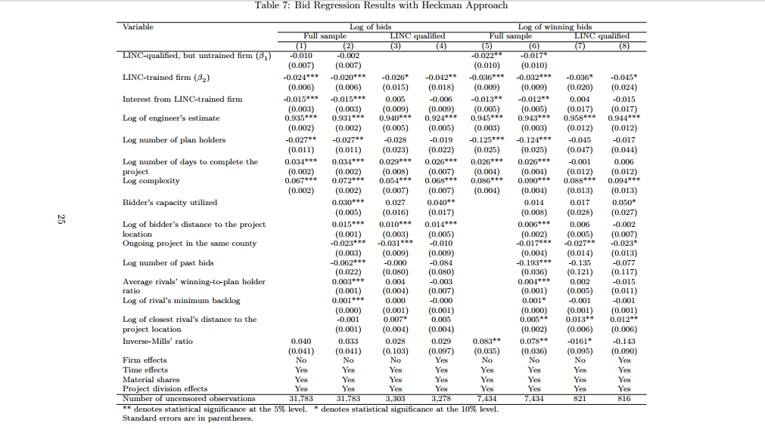

Slide 12
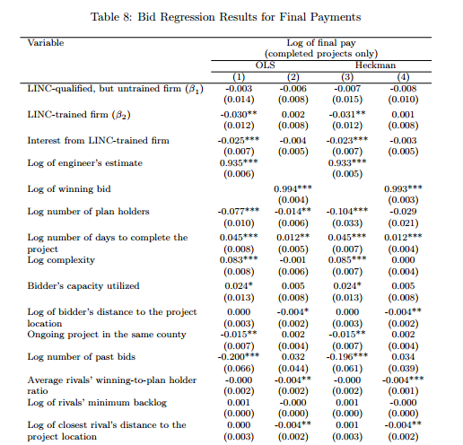
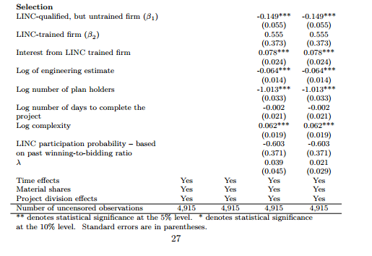

Slide 13
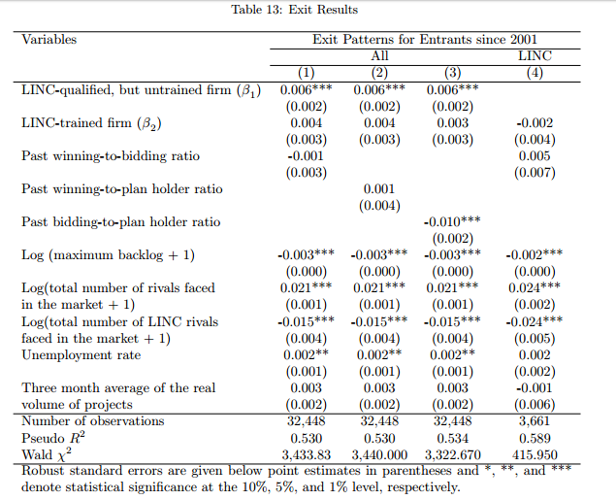

Slide 14
Conclusion
Firms that opt for LINC training are typically less experienced and face many rivals in the market
LINC graduates are more aggressive in their bidding behavior than ineligible firms and LINC-qualified, but untrained firms
LINC training had spillover benefits in the form of an indirect competition effect-- on average, other firms bid more aggressively when a LINC firm expresses interest in a project
The combined effects of this more aggressive bidding has led to massive savings for TxDOT relative to the cost of operating the program

Slide 15
Thank you!

