Slide 1
Last-Minute Bidding and the Rules for Ending Second Price Auctions
Roth and Ockenfels
Presented by Zachary Schutzman
4/5/16

Slide 2
Also see:
“The Timing of Bids in Internet Auctions: Market Design, Bidder Behavior, and Artificial Intelligence” by Ockenfels and Roth, AI Magazine Vol 23 no. 3 (2002)
‘AI Magazine’
“Last Minute Bidding and the Rules for Ending Second-Price Auctions: Theory and Evidence from a Natural Experiment on the Internet” by Roth and Ockenfels” (2002)
‘The Big Paper’

Slide 3
What is a proxy auction?
There is a starting price and an increment value at the outset
Bidders submit proxy bids which are (theoretically) maximum WTPs.
The winner is the individual with the highest proxy. She pays an amount equal to the second highest proxy plus the increment value.

Slide 4
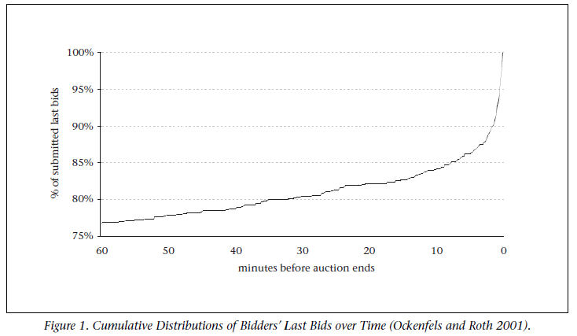
People bid at the last minute!

Slide 5
People bid big at the last minute!

Slide 6
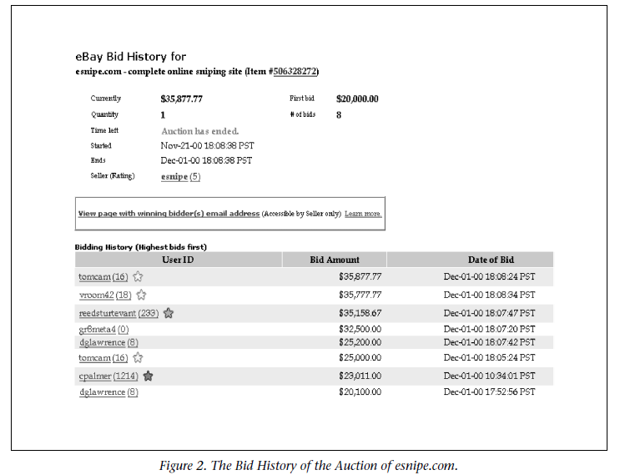
First bid: $23k. 8 hours before expiration.
Last 3 minutes: Bid goes to $25k then to $35k

Slide 7
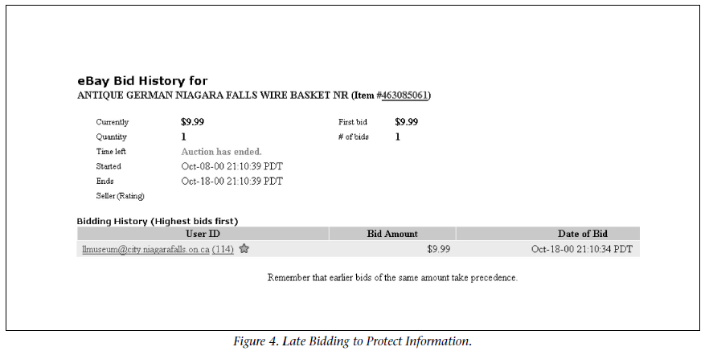
The Last-Minute Expert Bid

Slide 8
What is sniping and why do it?

Slide 9
What is sniping and why do it?
Sniping is the act of bidding at the last moment in an auction with a time expiration.

Slide 10
Strategic and Nonstrategic hypotheses
Avoid a bidding war with incremental bidders
Avoid a bidding war with like-minded bidders
Avoid revealing information
Procrastination
Search engine preferences
Bidders don’t understand the format
Change in WTP
Uncertainty over time (“hanging”)

Slide 11
What is sniping and why do it?
Sniping is the act of bidding at the last moment in an auction with a time expiration with the intent of winning the item.
Avoid driving up the price
Avoid bidding war
Avoid sharing information

Slide 12
Results and Observations:
eBay has more late bids than Amazon

Slide 13
Results and Observations:
eBay has more late bids than Amazon
Amazon still has late bids

Slide 14
Results and Observations:
eBay has more late bids than Amazon
Amazon still has late bids
Antiques have more late bids than computers

Slide 15
A question:
“The authors establish an equilibrium for the bid sniping strategy. … Do you believe the eBay auction format and the bid sniping dominant strategy will violate the Revenue Equivalence Theorem?”

Slide 16
Dealer/expert model
Suppose we have two representative bidders, the Expert bidder and the Uninformed bidder, and an item for auction which may or may not be genuine (think counterfeit coins). Let m be the starting price of the auction.
The Expert bidder can know whether the item is real and values a genuine item at $100. The Uninformed bidder values a genuine item at $110. Both value a fake at $0.
Suppose the probability of the item being fake is sufficiently high to have the expected payoff for the Uninformed bidder at price m always be negative.
In modeling a last-minute bid, we assume that the bid is transmitted with some probability strictly less than 1.

Slide 17
Dealer/expert model - eBay format
The Uninformed bidder can take the Expert’s bid as a signal that the item has non-zero value.
The Uninformed bidder should not bid at the last minute (or at all) if the Expert bidder has not already bid (winning at m has negative expected payoff).
The Expert bidder knows this, so she should not bid early because she has the lower valuation.
It is therefore strategically optimal for the Expert to be a last-minute bidder.

Slide 18
Dealer/expert model - Amazon format
The automatic extension of the auction means that the Expert bidder cannot submit a last-minute bid without provoking an opportunity for the Uninformed bidder to respond.
Therefore, the bidder with the higher valuation will win.
In equilibrium, all bidders should bid their own valuation before the end of the auction.

Slide 19
Some questions for discussion:
What are the implications for bidder IDs being revealed?

Slide 20
Some questions for discussion:
What are the implications for bidder IDs being revealed?
What about the seller?

Slide 21
Some questions for discussion:
What are the implications for bidder IDs being revealed?
What about the seller?
Is sniping ethical? What about the complaints of failed bidders?

Slide 22
Survey responses:
The following are responses to Survey Question 8:
“Is there anything else going on about your bidding experience that you think it would be helpful for us to know, as we try to understand what’s going on?”
(Grammar and spelling errors belong to the respondents)

Slide 23
“Profit is the driving force in auctions. Winning at the game, Out maneuvering an opponent, Being just a little more ‘gutsy’, Holding out until the last possible second thus risking to lose, these are the adrenaline & testosterone of the auction experience.”
Computers

Slide 24
“If I want to buy something on Ebay, I plan my life around the last five minutes of an auction - I rearrange lunch time, I change my evening plans, I get up early in the morning, whatever it takes to BUY the item I want.”
Antiques

Slide 25
“I sometimes bid early on an item but at a low price just to establish that I have found the item first (I have a couple of friends who collect similar things, we have a rule that whomever bids first can ‘go for it’ so we don’t get into a bidding war amongst ourselves...but only if I am really interested in going for it)”
Computers

Slide 26
“Do you have any type of research grant or funding? Would you be interested in purchasing my step by step method?”
Antiques

Slide 27
Thank you!

