Slide 1
Optimization of Land Selection Models
Zachary Schutzman
Independent Study (EC492)
April, 2015

Slide 2
Governments have an interest in purchasing land for conservation
Each site has a variety of features
Price, size, location
Species, access, ecosystem services
Other sites selected, budget
How can we use all the information about the landscape to choose the “best” sites?

Slide 3
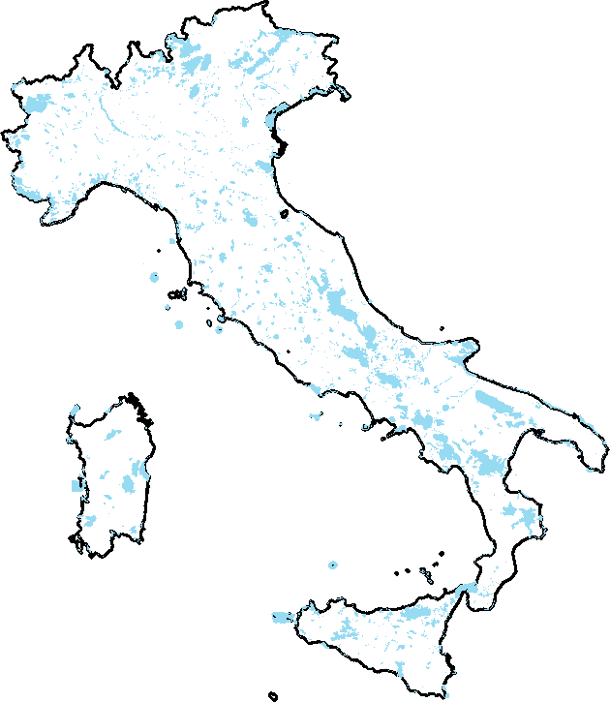
Motivated by a project I worked on last summer using data from Natura2000
Wanted to migrate to a model that incorporated spatial information

Slide 4

We want to maximize the total number of species preserved
We also want to maximize the connectedness of the landscape
Lower perimeter means cheaper to protect
More clustering gives species more room for habitation

Slide 5
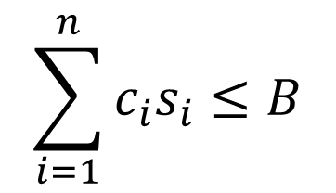

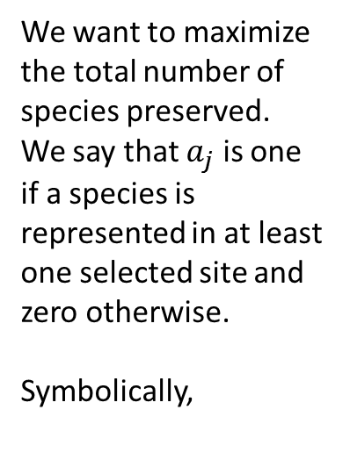
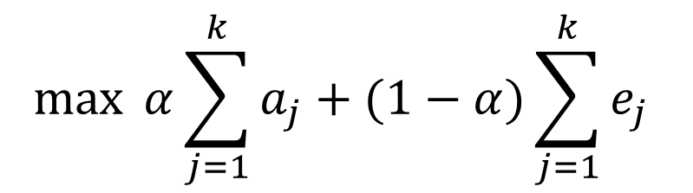

Linear Integer Programming Methods
$$\max{ α}\sum_{j=1}^{k}{a_{j}+(1−α)\sum_{j=1}^{k}{e_{j}} }$$
$$\sum_{i=1}^{n}{c_{i}s_{i}}≤B$$
$$s_{i}∈\{0,1\}$$
The decision variable will be zero if we do not select site i and one if we do select site i.
Multiply the cost of site i by the decision variable of site i. If we have selected site i, the product will be that site’s cost. If we have not selected site i, the product will be zero.
We want the sum of all these costs to be less than or equal to our budget
We want to maximize the total number of species preserved. We say that $a_{j}$ is one if a species is represented in at least one selected site and zero otherwise.
Symbolically,
$$a_{j}=\left\{\begin{aligned}1 if species j is in a chosen s_{i} \\ 0, otherwise\end{aligned}\right.$$
Notes:
Called “integer” programing because the variables (the Si) can only be integers. We assume we cannot buy half of a site. If we were to try to subdivide a site, we lose population information
Define the model technically
Binary variable- either we select the site and give it a value of 1 or we do not and set it equal to zero
Objective- the thing we want to maximize. In this case we want to maximize the total number of species represented
The constraint- we can only spend a certain amount of money. We assume each site costs one unit, so
This is the ‘maximum coverage’ model. Mathematically, we take the set of all interesting species and treat the representation in each site as a subset of all of the species. Given that we can only choose a certain number of sites, we want to find the solution which maximizes the coverage our selected subsets have on the set of species

Slide 6
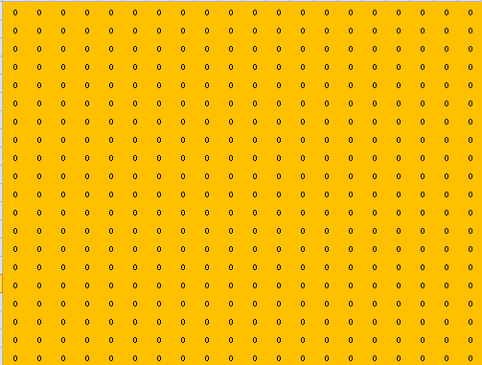
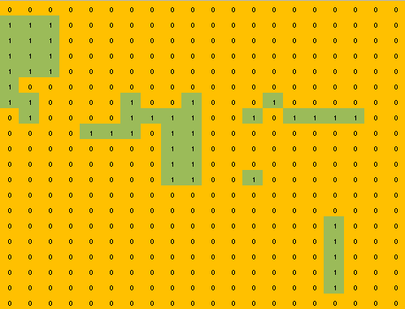
Invented a landscape with 125 species and 400 sites
Each species is pseudorandomly distributed across the landscape
Each site has a cost of 1, 2, 3, or 4
The model takes in the data and chooses the “best” selection, given a budget

Slide 8
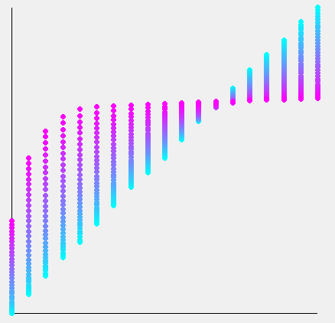
The bluer the dot, the more weighted toward connectedness the model
Implies that for low budget, the value is greater for a species-focused model but the returns fall off quickly
Objective Value
Budget

Slide 9
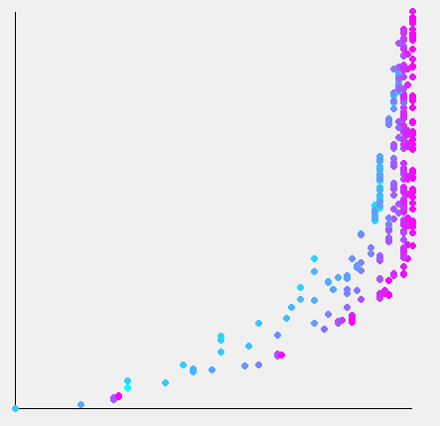
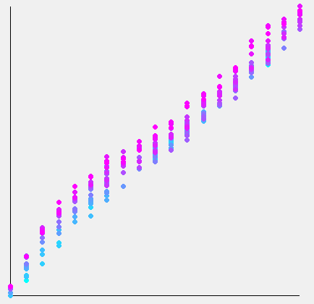
Aggregate Rarity Index
Species Conserved
Budget
Sites are chosen independently of the value of the species in the network

Slide 10
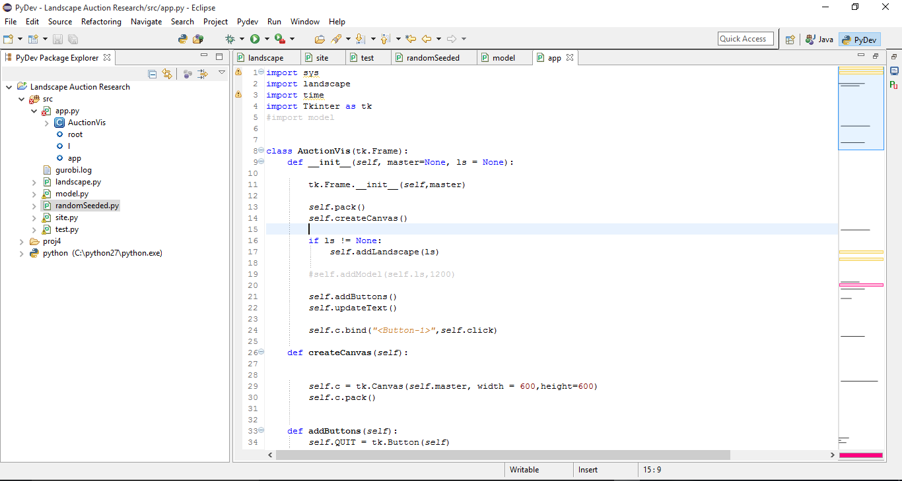

Slide 11
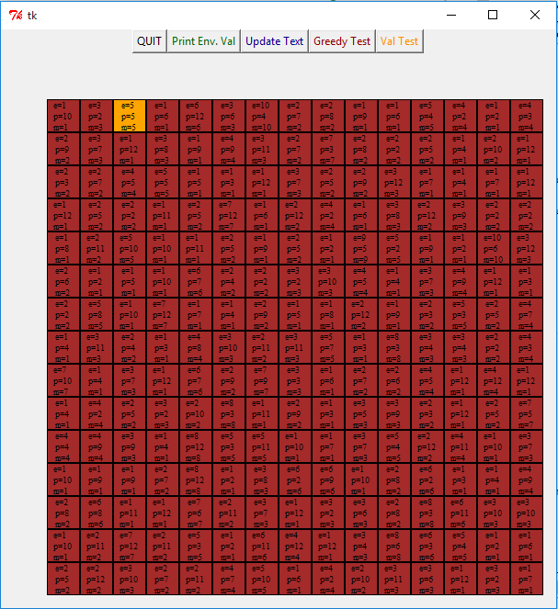

Slide 12
