Slide 1
Systematic Landscape Conservation in Italy
Zachary Schutzman
Department of Economics, Colby College
Professor Sahan Dissanayake, Research Advisor

Slide 2

Research Question
How can we optimally select landscape sites for conservation to both minimize cost and maximize the benefits?
This research is an application of techniques from economics to the Natura 2000 data set.
Notes:
Because economics studies allocations of scarce resources, it is a useful discipline to try to answer questions about optimal usage of those resources

Slide 3
Motivation
Species are disappearing every day
Modern development threatens key landscapes
Natural preserves provide great value through ecosystem services
Notes:
This topic is at the intersection of economics and environmental studies. Species and landscapes have both intrinsic and economic value. We want to find the optimal way to preserve species and landscapes to maximize the net benefit provided.
Ecosystem services include things like oxygen production, medicines from plants and animals, food and water, cultural value, tourism

Slide 4
About Natura 2000
Natura 2000 established networks of protected areas in Europe.
In this research, we use linear optimization methods to prioritize site selection.
Unfortunately, because of economic considerations, it may not be feasible to actively conserve every site.
The objective will be to maximize the total number of species represented in preserved sites
Notes:
Centers around the habitats directive and birds directive.
There is a directory of all of the sites in europe that have populations of the species listed

Slide 5
Methods
To find a solution, there are a number of different methods we can use to determine which sites to select given a budget constraint.
Random selection: randomly select one site after another until the total cost of preserving the selected sites is equal to the budget constraint
Highest individual value: order the sites by most to least valuable and select down the list until the total cost equals the budget constraint
Greedy selection: choose the site with the highest value, then reexamine the values, and choose from the remaining sites the one with the highest value, repeat until the total cost equals the budget constraint
However, none of these provides an optimal solution
Notes:
In my data set, there are a few extremely valuable sites, a bunch of middle value sites, a lot of low value sites, and a few hundred sites with only one or two species.
Random: what if all of your sites are from the pool with one or two species and you don’t select the one with 70 species
Individual: ignores overlap. We only need each species to be represented once, so if your first site has 70 species, you are better off picking a site with 40 species, 30 of which are not in your first site than a site with 65 species but only 10 of which are not in your first site.
Greedy: ignores cost. You simply choose based on the highest value. The greedy heuristic says to pick a site with 51 species that costs $100 before a site with 50 species that costs $1. Because in this research we have assumed that each site has equal cost, a greedy heuristic will provide optimal solutions

Slide 6
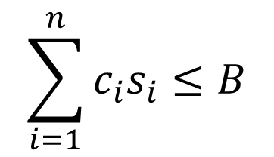

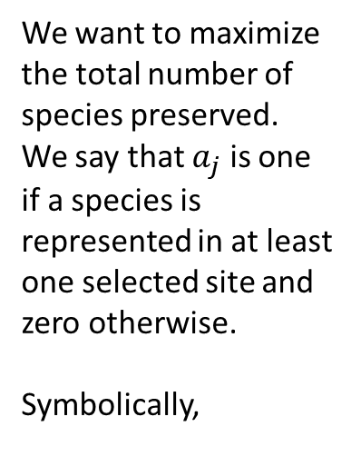
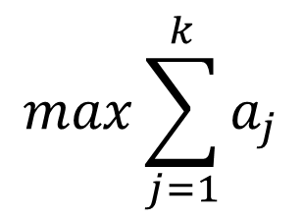

Linear Integer Programming Methods
$$max\sum_{j=1}^{k}{a_{j}}$$
$$\sum_{i=1}^{n}{c_{i}s_{i}}≤B$$
$$s_{i}∈\{0,1\}$$
The decision variable will be zero if we do not select site i and one if we do select site i.
Multiply the cost of site i by the decision variable of site i. If we have selected site i, the product will be that site’s cost. If we have not selected site i, the product will be zero.
We want the sum of all these costs to be less than or equal to our budget
We want to maximize the total number of species preserved. We say that $a_{j}$ is one if a species is represented in at least one selected site and zero otherwise.
Symbolically,
$$a_{j}=\left\{\begin{aligned}1 if species j is in a chosen s_{i} \\ 0, otherwise\end{aligned}\right.$$
Notes:
Called “integer” programing because the variables (the Si) can only be integers. We assume we cannot buy half of a site. If we were to try to subdivide a site, we lose population information
Define the model technically
Binary variable- either we select the site and give it a value of 1 or we do not and set it equal to zero
Objective- the thing we want to maximize. In this case we want to maximize the total number of species represented
The constraint- we can only spend a certain amount of money. We assume each site costs one unit, so
This is the ‘maximum coverage’ model. Mathematically, we take the set of all interesting species and treat the representation in each site as a subset of all of the species. Given that we can only choose a certain number of sites, we want to find the solution which maximizes the coverage our selected subsets have on the set of species

Slide 7
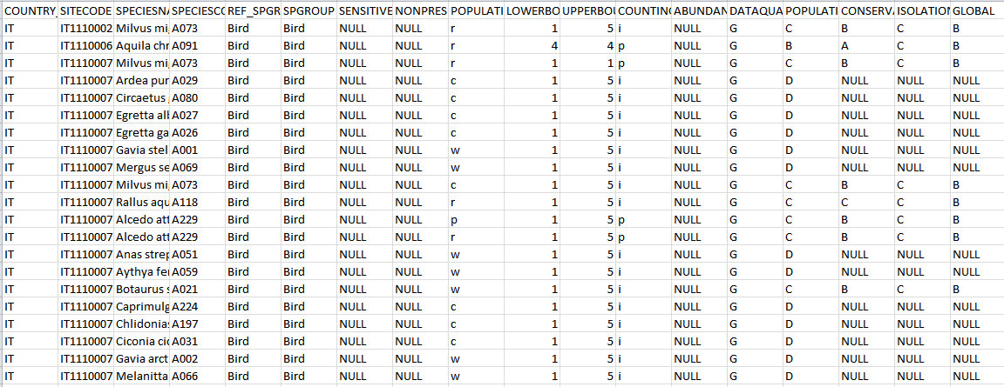
Data
We use as our pool of sites only those with an ‘A’ rating in the ‘GLOBAL’ category
For each site, we have an indicator determining whether a given species is present
Notes:
The information that I have is very qualitative, but it needs to be quantitative to be used modelling work. There are 3 categories which are rated A, B, C, or NULL: CONSERV, which rates the value to the particular species from conserving that site, ISOLATION, which is a scale of how endemic a species is, and GLOBAL, which is a rating of how valuable to the world conserving this site is for this species

Slide 8
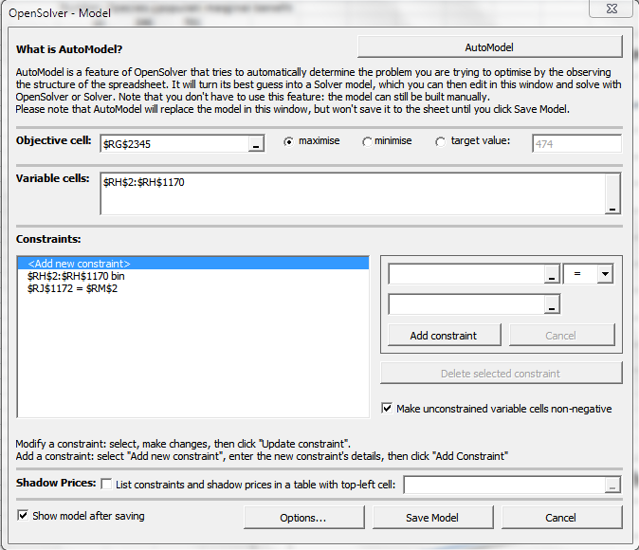
My Process
Parse the data and only select sites with an ‘A’ rating in GLOBAL.
Use an Excel-based solver to set up and solve the model for a variety of budget constraints
Chart the number of species preserved against the number of sites selected
Export the selected sites to ArcGIS to generate spatial maps of selected sites
Screenshot from OpenSolver in Microsoft Excel

Slide 9
Results
Number of Sites (x) | Species preserved (y)
10 | 246
20 | 269
30 | 286
50 | 304
75 | 333
100 | 350
150 | 373
200 | 377
250 | 391
300 | 403
500 | 428
1000 | 468
1169 | 473
We assume that each site has a cost of 1, so our budget constraint is equal to the maximum number of sites we can choose

Slide 10
Number of Sites (x) | Species preserved (y)
10 | 246
20 | 269
30 | 286
50 | 304
75 | 333
100 | 350
150 | 373
200 | 377
250 | 391
300 | 403
500 | 428
1000 | 468
1169 | 473
Notes:
Diminishing marginal returns-we see, and will see again in the next chart, that there are diminishing marginal returns to preservation of species. This means that as the number of sites increases, each additional site provides fewer additional species. This makes sense intuitively because we would expect to choose the sites with the highest values earlier in the process, and only choose those less valuable sites near the end. The gain from 500 to 1000 is the same as the gain from 20 to 30

Slide 11
Notes:
In economics, we are often interest more in the marginal properties of something than the total. In this chart, we see that as we add more and more sites, the additional SPECIES GAINED PER SITE, or MARGINAL SPECIES GAINED falls. Around 70 sites, we see that we gain less than one species per site.

Slide 12
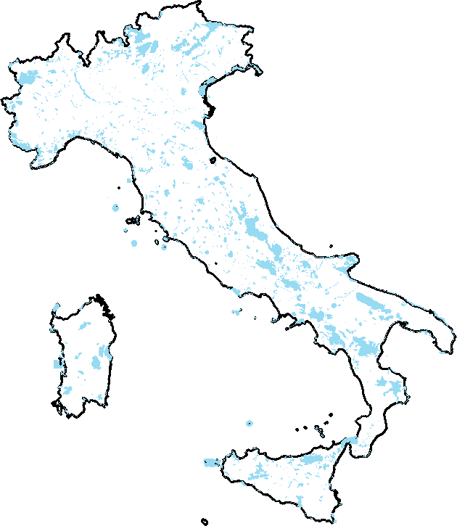
All sites in Natura 2000
Notes:
This is the map of all sites in the Italy Natura 2000 network. Notice this also includes some marine sites off the coast.

Slide 13
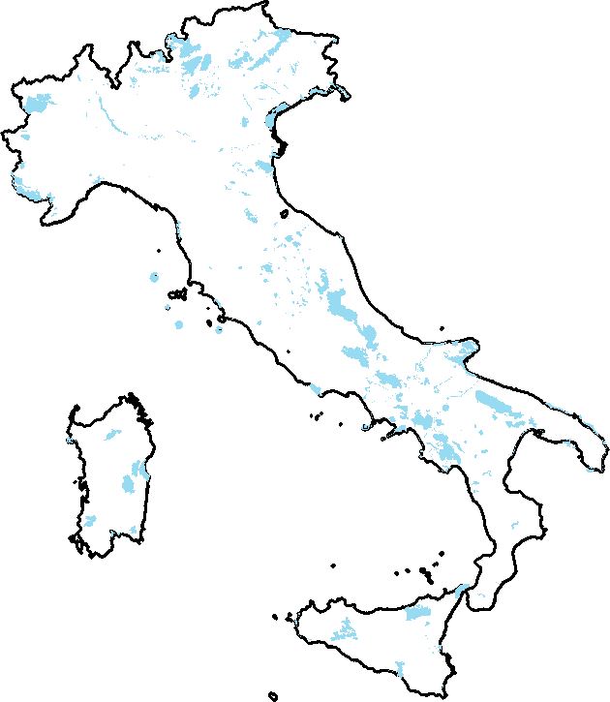
1169 Sites with an ‘A’ Rating in Global
Notes:
1169 sites, 473 species

Slide 14
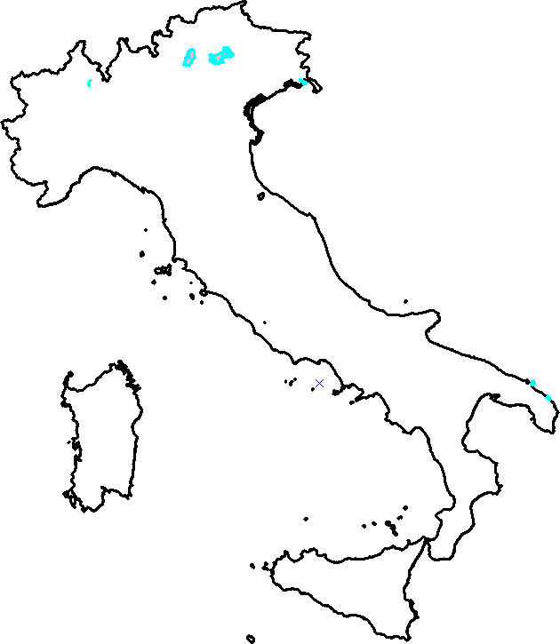
10 sites, 246 species
Notes:
10 sites, 246 species, average 24.6 species per site

Slide 15
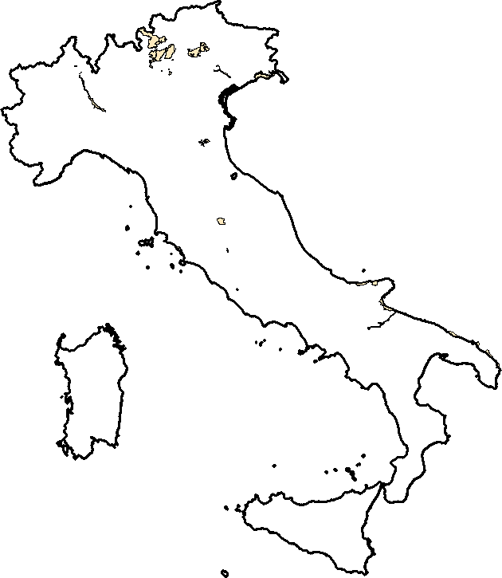
50 sites, 304 species
Notes:
50 sites, 304 species, average 15.2 species per site

Slide 16
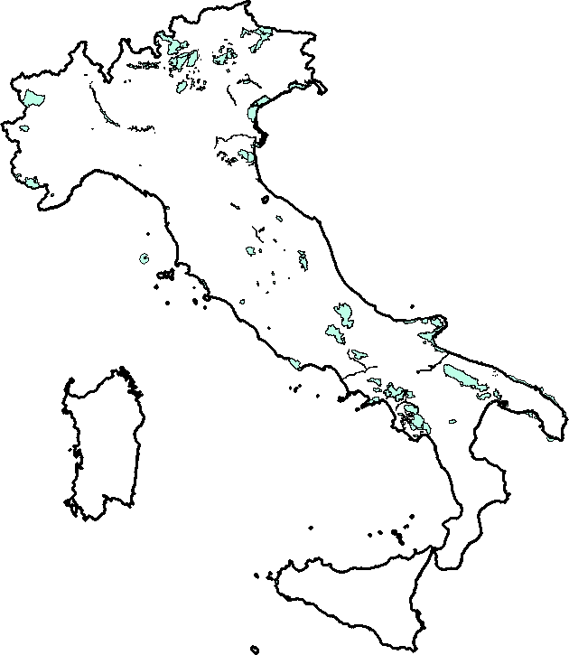
200 sites, 377 species
Notes:
200 sites, 377 species, average 1.89 species per site

Slide 17
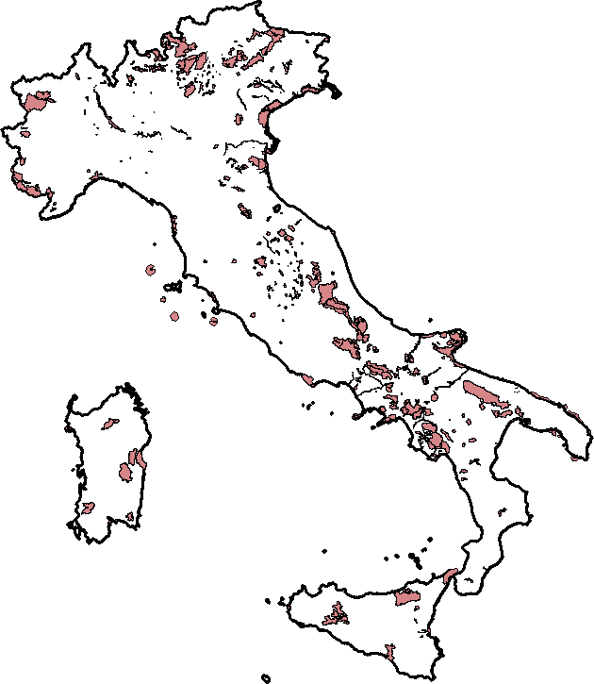
500 sites, 428 species
Notes:
500 sites, 428 species, average .86 species per site

Slide 18
Conclusions
These methods can be used by policymakers to identify sites to be conserved under a budget constraint.
There are decreasing marginal returns to species preserved, which has significant implications for overall budget allocation.

Slide 19
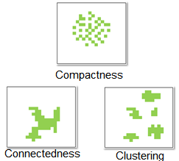
Extensions
Further conditions to be applied include using the spatial data to maximize site connectedness and clustering
Assigning values to species based on endangered status
Incorporating values from ecosystem services
Extracting site cost information

Slide 20
Acknowledgements
Dr. Manny Gimond for GIS assistance
Giovanni Signorello at University of Catania, Italy

