Slide 1
MATH 527 – Project presentation Reinforcement Learning for price impact Zachary Scialom & Yi Zhong
Optimal Execution:
How can an agent optimally liquidate a certain number of shares using only Market Orders (Mos) ?

Slide 2
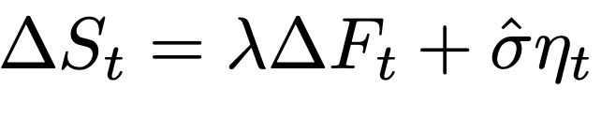
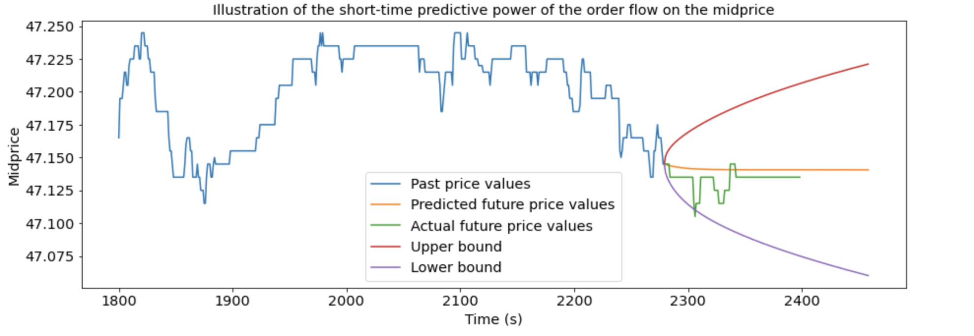
Novelty of the work: including order flow to estimate price impact & work with real-life data

Slide 3
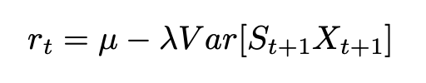
Mathematical Problem Statement
State Variables: Qt (inventory), St (midprice), t (time)
Actions: [0,1,2,3,4] (choosing the number of blocks to sell)
Reward function (+some adjustments):

Slide 4
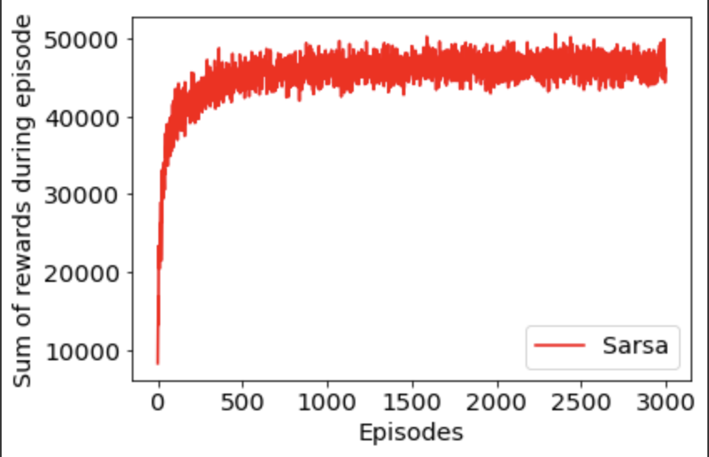
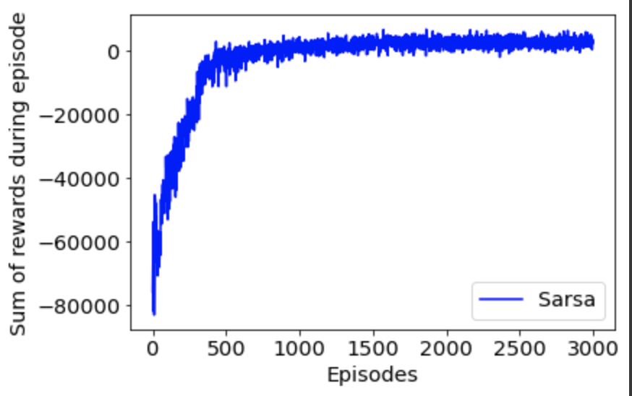
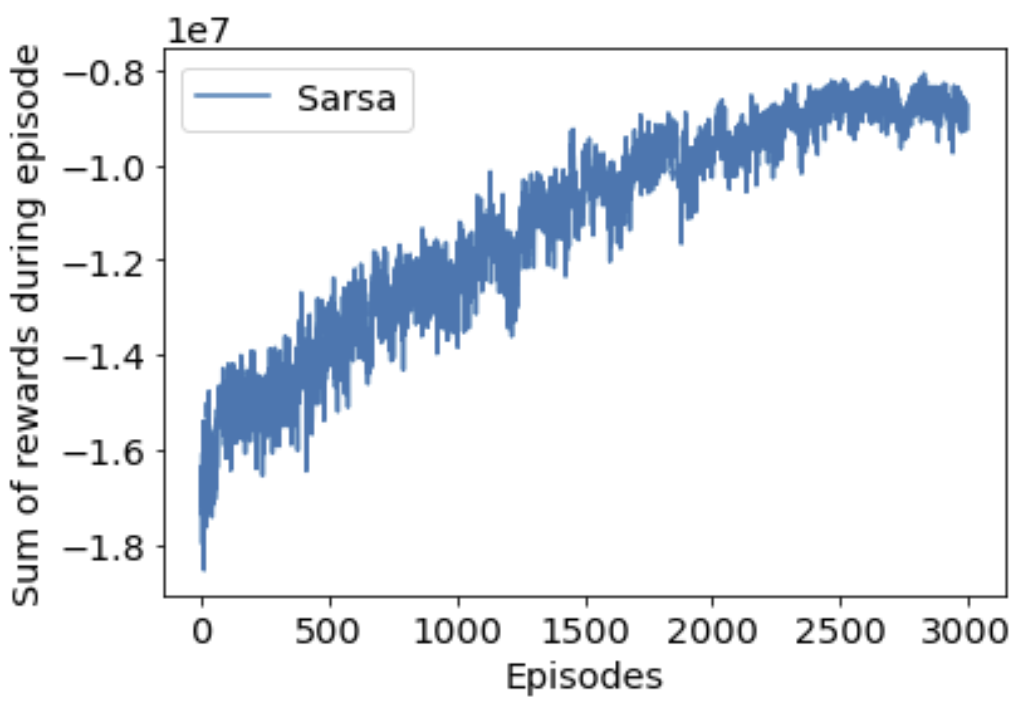
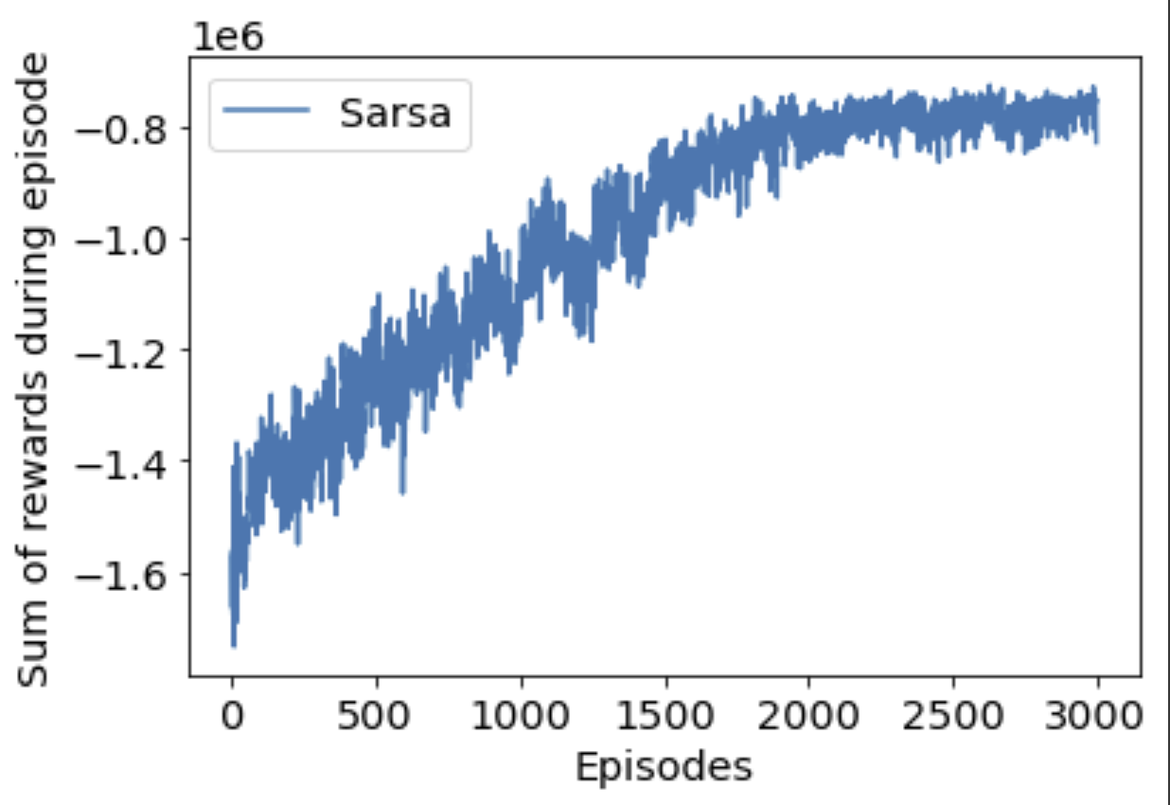




Results & Performances (1)
$λ$= 0.005
$λ$= 0.01
$λ$= 0.1
$λ$= 1

Slide 5
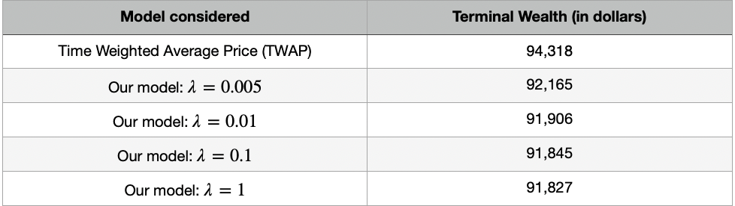
Results & Performances (2)

Slide 6
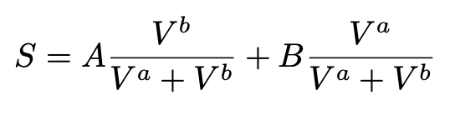
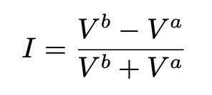
Possible improvements
Including Limit Orders (LOs)
Considering a larger trading window
Working with the microprice and the LO imbalance:

