Slide 1
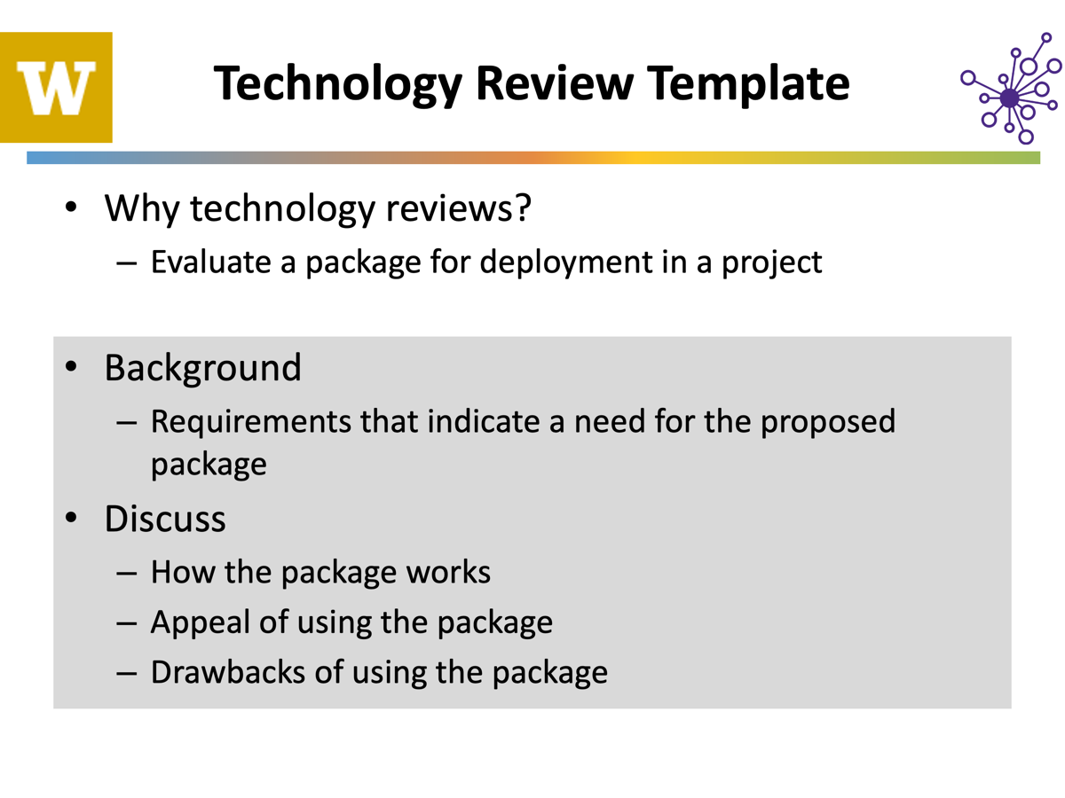

Slide 2
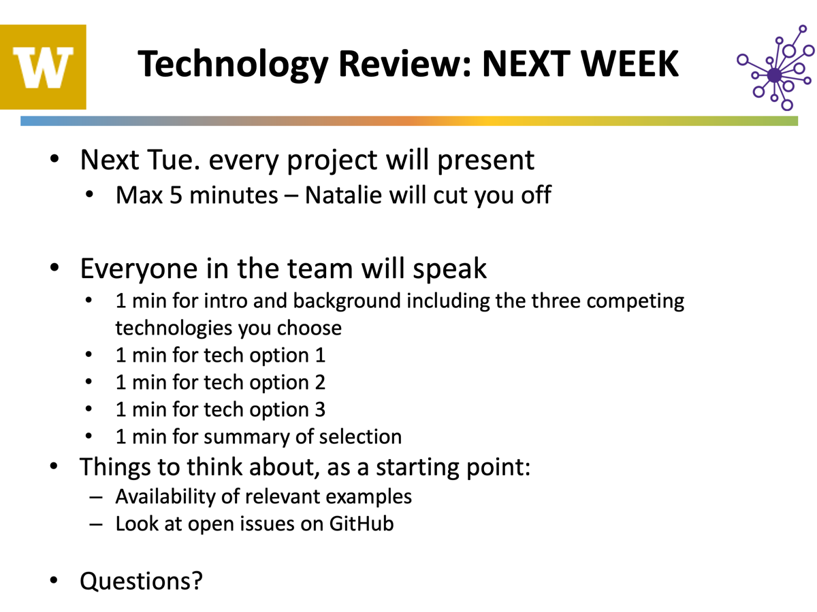

Slide 3
Tech Review: GUIs
PorePythonPeople
Zach Seitz, Riya Patel, Toby Rangel-Guillen, Daniel Mendoza

Slide 4
Application Background
Goal: build a easy-to-use, Python-based tool that allows Gundlach lab members to:
search a large database of historical data by experimental conditions
plot and overlay nanopore trace data from selected experiments
detect and display ‘events’ in trace data with an interactive display
Using a GUI to integrate these functions into one, user-friendly display
3 GUI packages to compare:
Streamlit
PySide/PyQt
Tkinter

Slide 5
Streamlit
Pros:
Great for data visualization
Pre-defined interactive widgets, intuitive design
Well documented, lots of community support
Cons:
Not built for multiple concurrent users
Frequent refreshing results in slow performance for large or complex applications
Limited customizability
Overall:
Mainly used to develop simple web apps to display data
Works for our application as an internal tool for searching and visualizing data
Notes:
Runs the application code from scratch every time the UI state changes

Slide 6
PySide/PyQt
Pros:
Modern, professional aesthetic
Extremely customizable and feature-rich
Easily scales for more complex GUI demands
Large amount of documentation
Cons:
Licensing can be a bit complex: PySide is LGPL licensed while PyQt is commercial
Large library and functionality can be overkill for simpler applications
Overall:
Good option for our application: building GUI to search database and visualize selected data
May not need/utilize all the functionality or customizability

Slide 7
Tkinter
Pros:
Excels in simple applications
Part of the built in standard python library (open source)
Easy to code
Cons:
Less functionality in available widgets/animations
Struggles to scale with complex GUI demands
Outdated aesthetics
Overall:
Good starting point for an internal tool
Could use more customizability and functionality with widgets in the future

Slide 8
Summary
Decided to start with tkinter because it is simple and easy to code
Don’t need the most aesthetic graphics or UI for an internal tool
If we decide to scale up to more complex and interactive visualizations, we would consider streamlit

