Slide 1
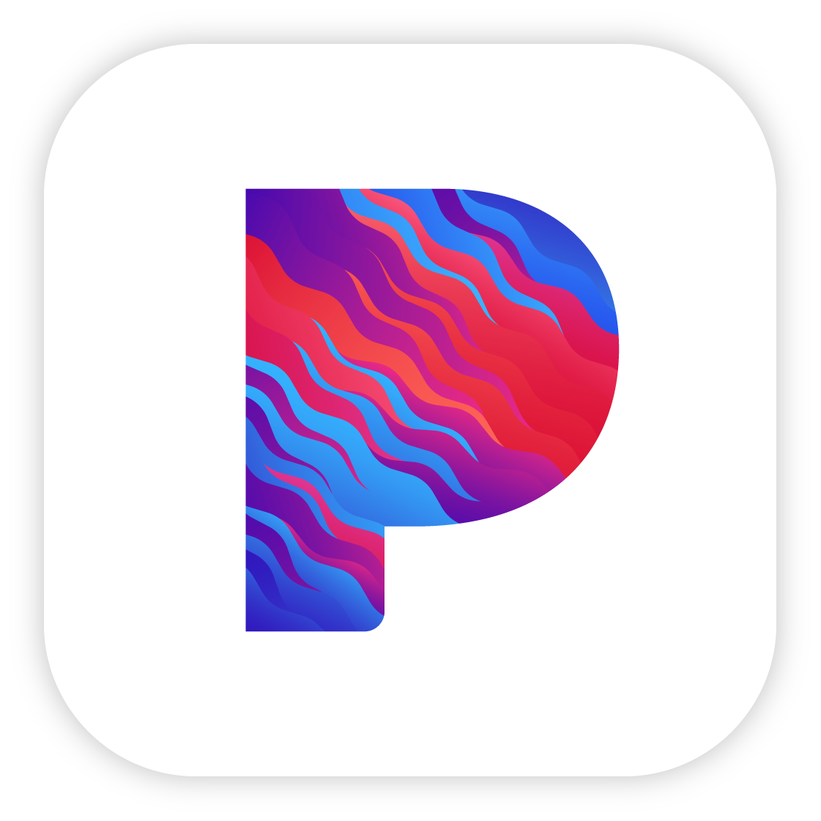

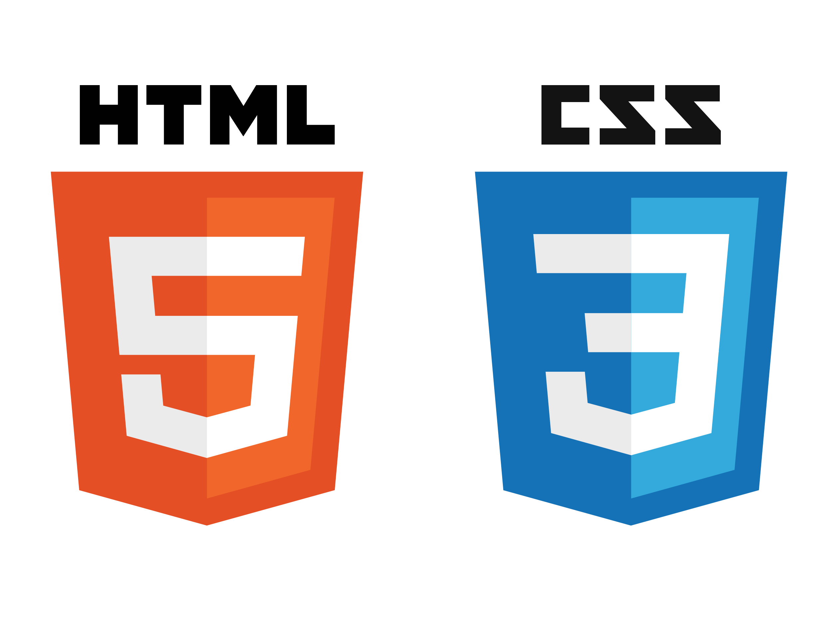
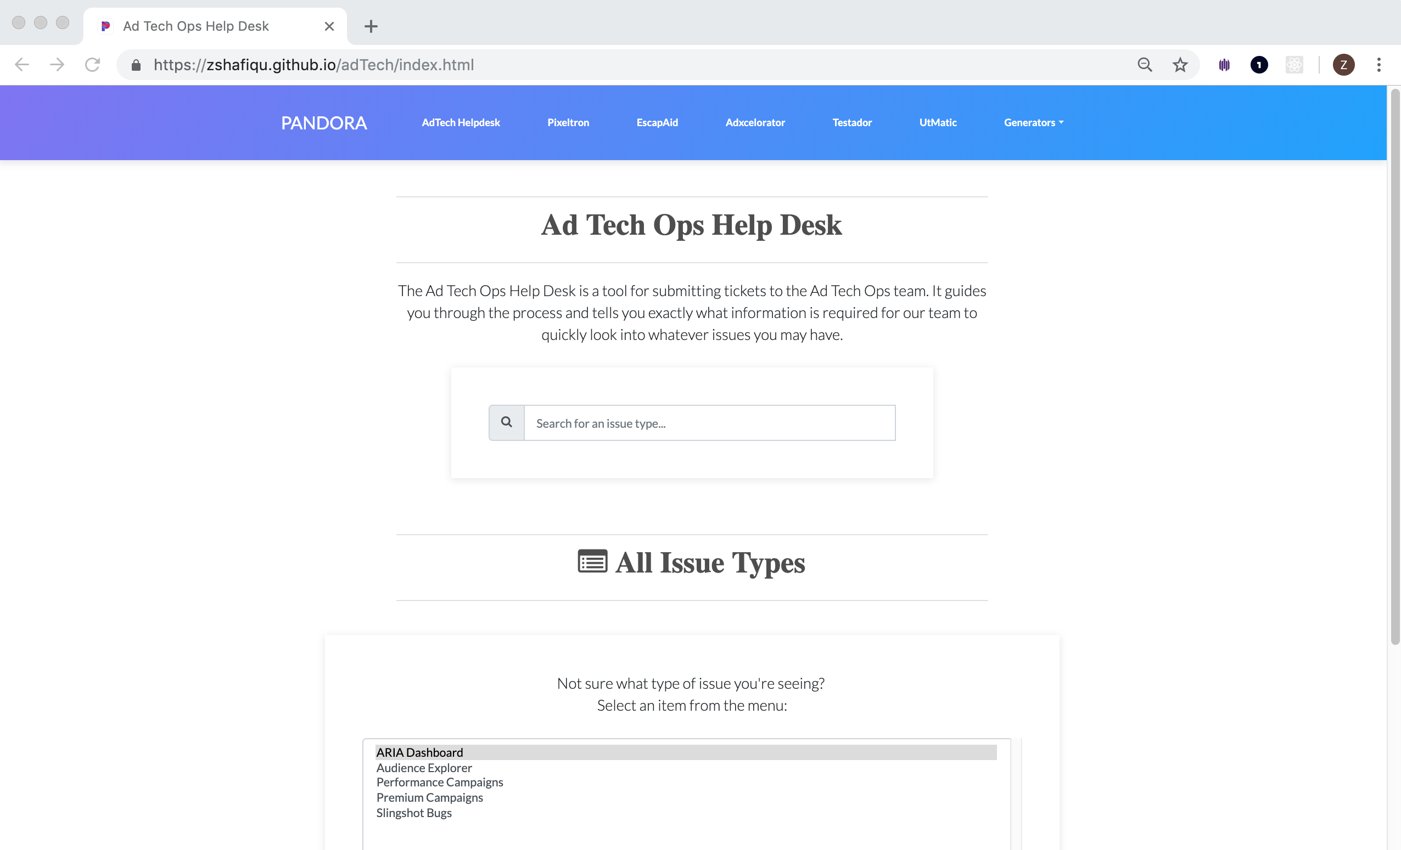

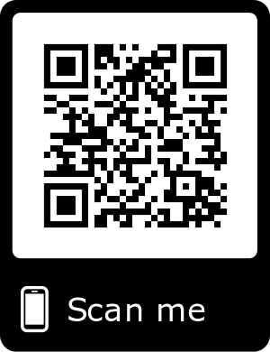

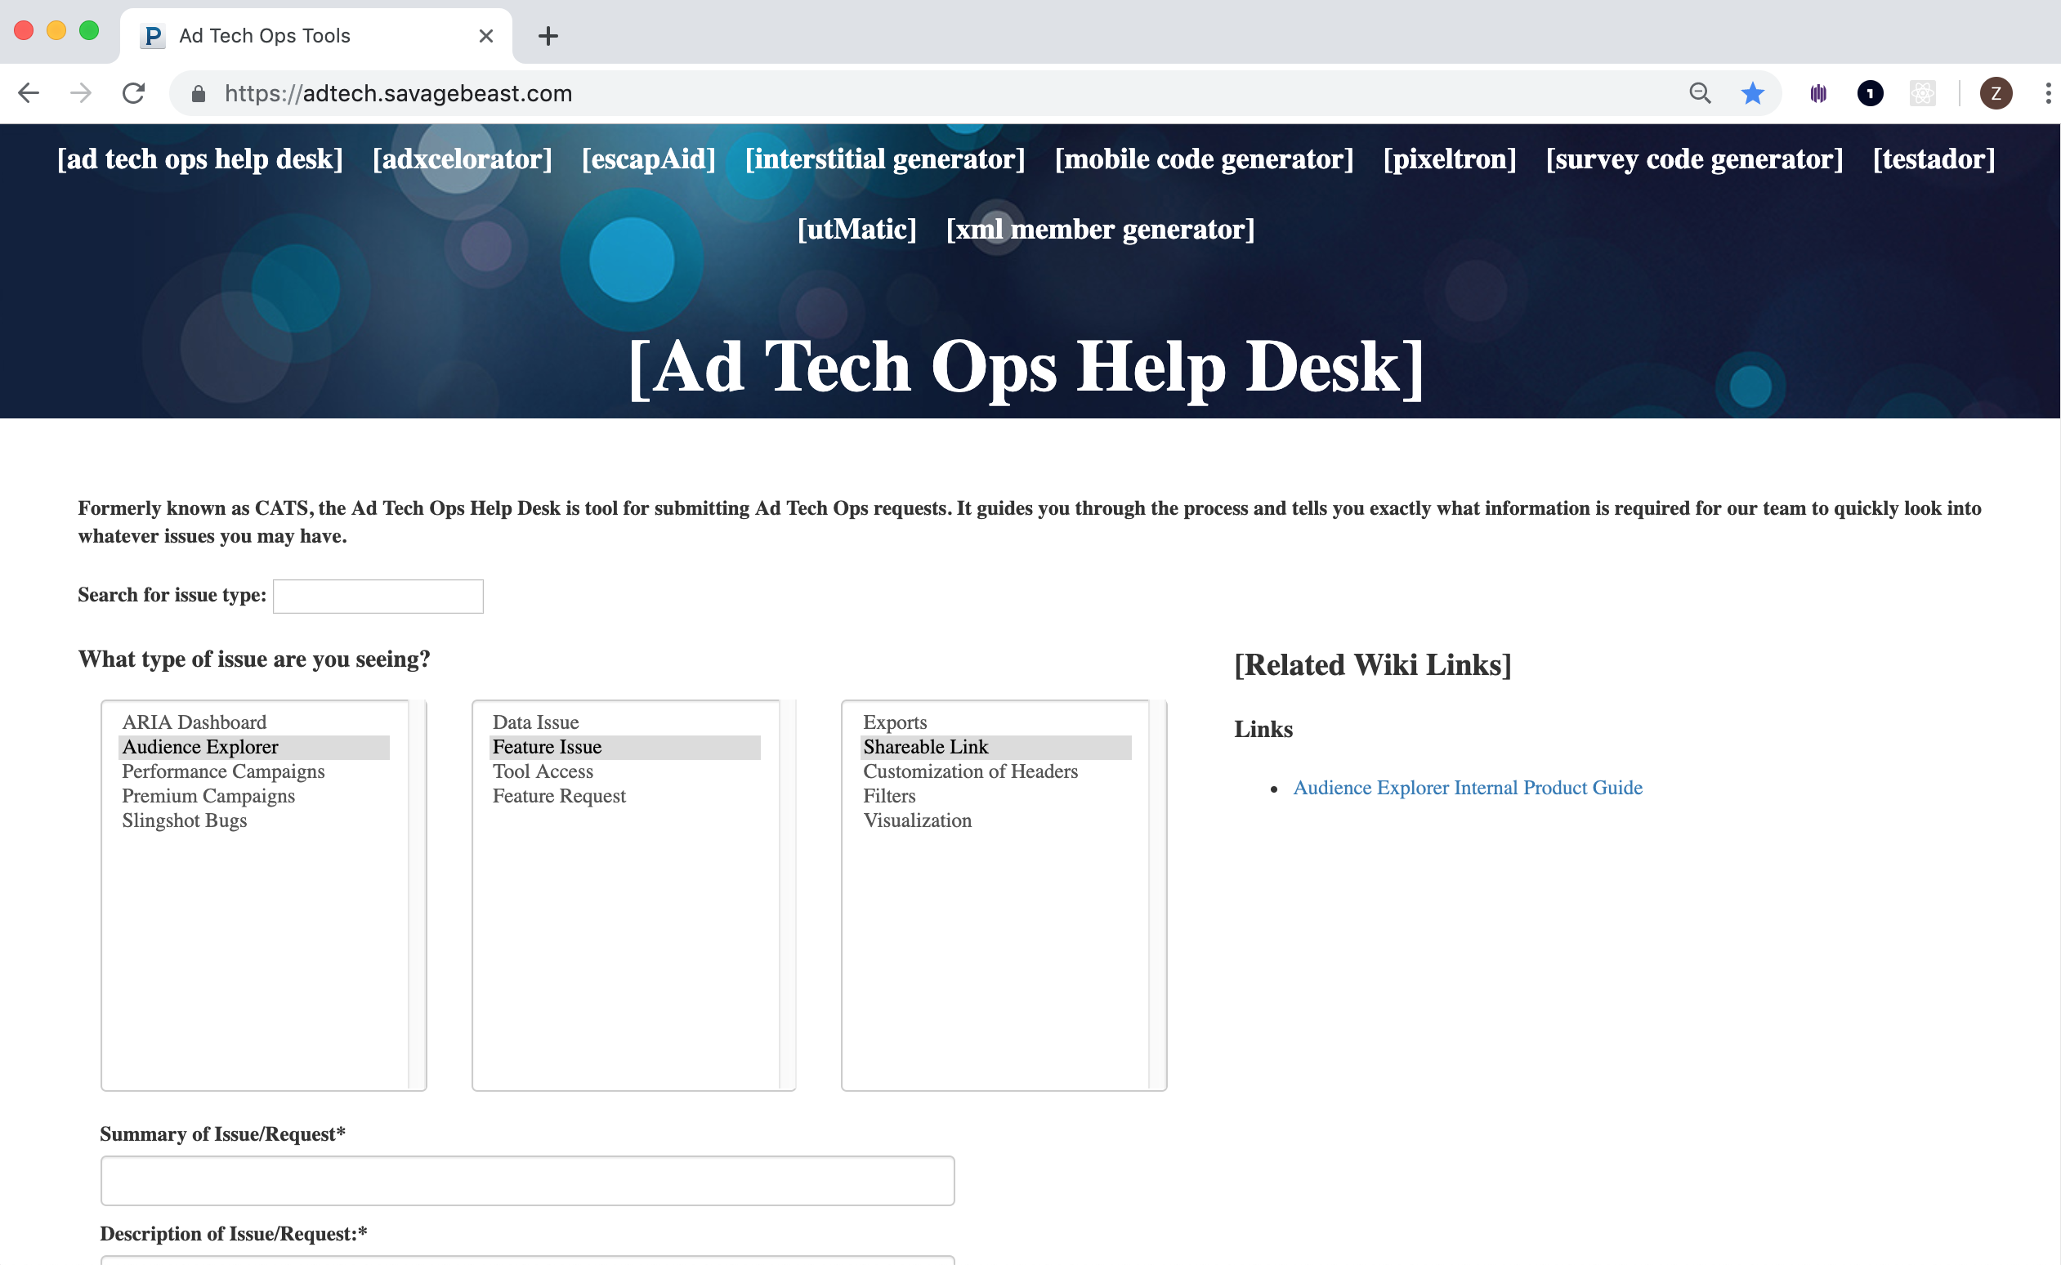

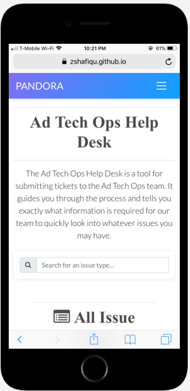

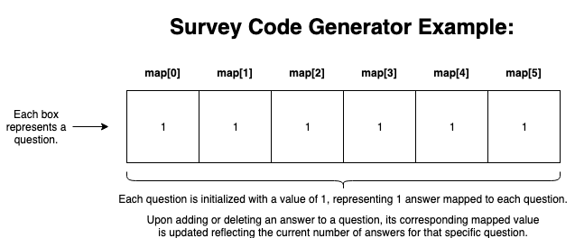
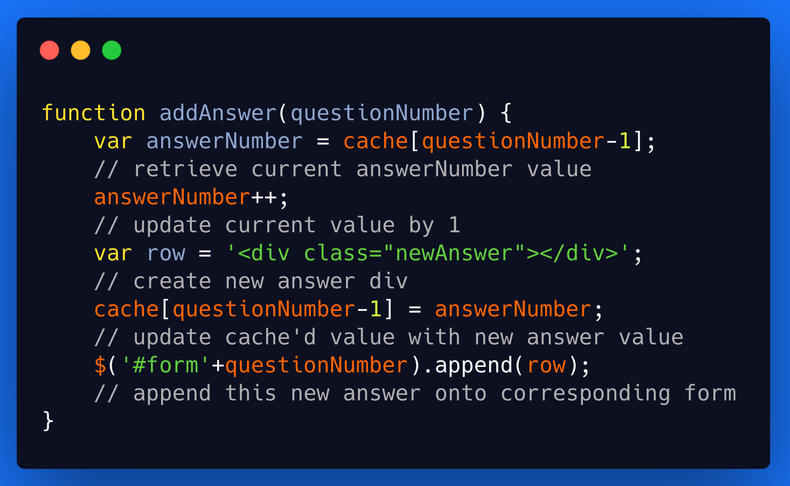
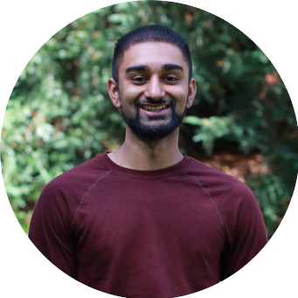


AD TECHNOLOGY OPERATIONS TOOLS PLATFORM OVERHAUL
Introduction:
Primary Technologies Used:
Results:
As an intern on the Ad Technology Operations team, my project for this summer was to redesign and rebuild the existing Ad Tech Ops tools platform. This platform consists of a set of tools that are used internally at Pandora across multiple teams to complete day-to-day tasks. Some of these tools include a help desk page that is used to submit JIRA tickets related to ad issues, as well as other tools such as a translator for third party pixels, a generator for survey code, and other tools used to help the end users’ efficiency.
HTML5 & CSS3 – Serves as the main skeleton of the new site’s structure and style, experimented with many different design patterns before finding the one that felt best.
Bootstrap – Followed the grid model, allowing site’s display to be future proof and friendly with any size screen.
JavaScript – Used jQuery and vanilla JS to redesign and rebuild client side site functionality code. Got rid of long chains of conditional code in favor of more efficient algorithms to solve the same problems.
AngularJS – Implemented certain aspects of Angular such as directives in order to componentize each element of each page so that updating and maintaining the site is much easier in the future.
Git – Committed almost every change made and learned the importance of version control, especially when breaking code and not being able to trace the error.
Issue Requiring Attention:
Developed a new user interface for each existing tool on the Ad Tech Ops platform that brought its overall design up to modern standards.
Restored all existing functionality and implemented new functionality such as an interactive auto-complete search bar.
Bootstrap and Flexbox allow for the platform to maintain all functionality on any device, future proofing the platform if usage needs change.
The existing platform was out of date and showing its age, with certain functionalities across each individual tool not working. Additionally, the software was deployed and maintained through a platform that is rarely used anymore which made updates to the tool much more difficult to complete.
Skills Gained:
Ad Tech Operations – Learned the basics about how digital ad operations work to stay reliable and earn revenue through the usage of tools such as impression trackers and cache busters.
Collaborating Across Teams – Reinforced the importance of being able to collaborate among cross-functional teams that work as a cohesive unit, such as Ad Tech, Engineering, and Client Services.
Software Testing – Tested each bit of code that I wrote for overall robustness as well as edge cases to validate any input behavior.
Software Documentation – Worked on drafting a Product Requirements Document as well as separate documentation for ease of future updates and maintenance of the platform.
Working in Production – [Continuously] learning to work in a professional production environment where software iterates through many different versions within development, and there is an actual deliverable at the end of the pipeline.
In addition to developing a new UI, I rewrote certain functions that consisted of long chains of if-else cases in exchange for simpler more efficient algorithms. For instance, I replaced the original method for keeping track of a specific question and its answers on the Survey Code Generator with an array that dynamically updates a corresponding indexed value when the user adds or removes an answer from a question.
Plan of Action:
Meet with end users and understand the platform’s primary usage
Collect initial end user feedback and user stories
About Me:
Develop new platform blueprints and mockup
College: UC Santa Cruz
Major: Computer Science
Hometown: Richmond, CA
Receive ongoing feedback, focusing on iterative development cycle
Restore existing features as well as implement new features
Testing to ensure we handle edge cases and get expected output
As someone who strives to gain a better understanding of the world around them, I want to be able to develop products that make a difference in people’s day-to-day lives. Outside of this objective, I love music, cars, motorcycles, and exercising.
Deploy platform upon approval & create maintenance documents
Zain Shafique

