Slide 1
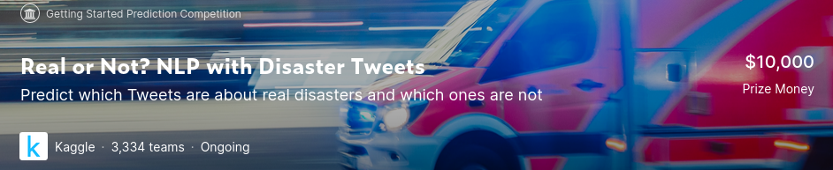
https://github.com/zshamrock/nlp-getting-started
Real or Not?

Slide 2

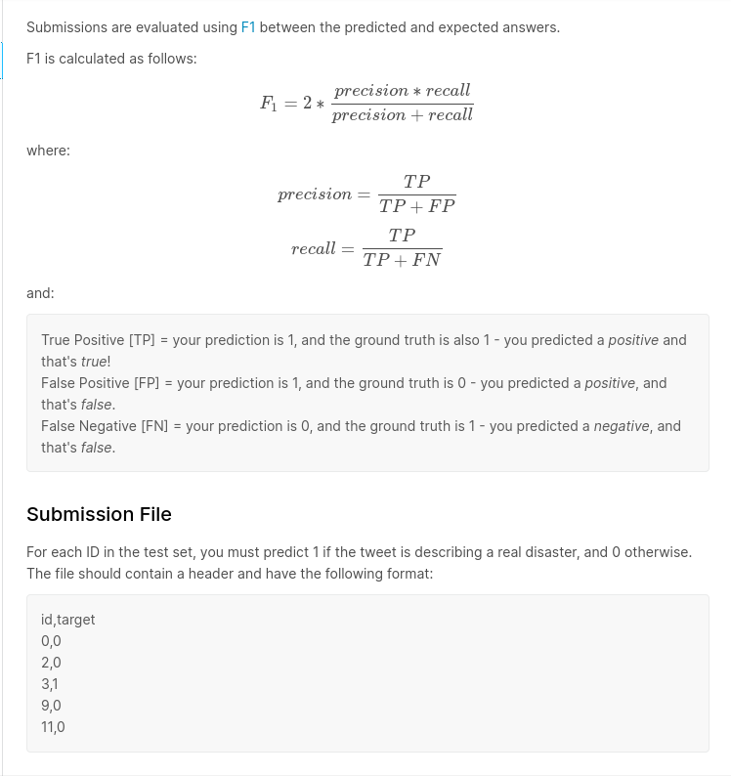
Evaluate

Slide 3
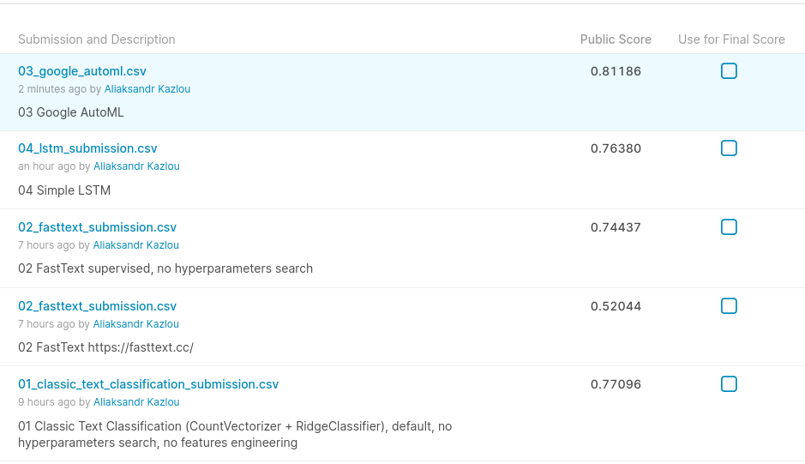
Scores

Slide 4
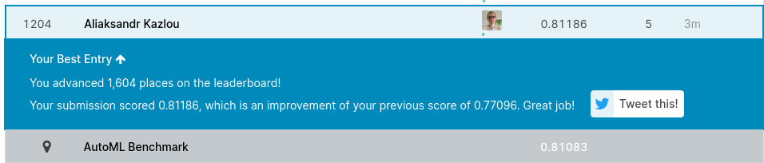
Leaderboard

Slide 5
Models
Linear models – RidgeClassifier (0.77096²)
FastText (0.74437⁴)
Google AutoML (0.81186¹)
LSTM (0.76380³)

Slide 6
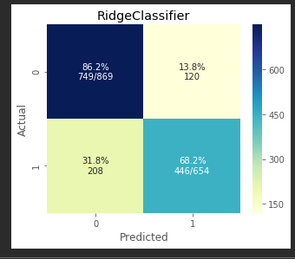
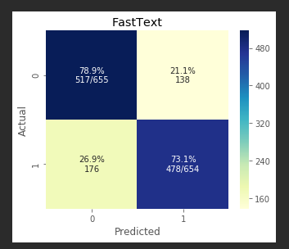
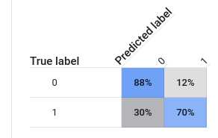
Confusion Matrix

Slide 7
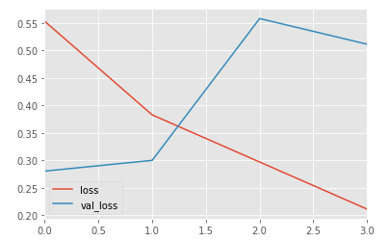
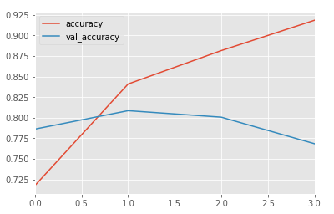
LSTM Evaluate

Slide 8
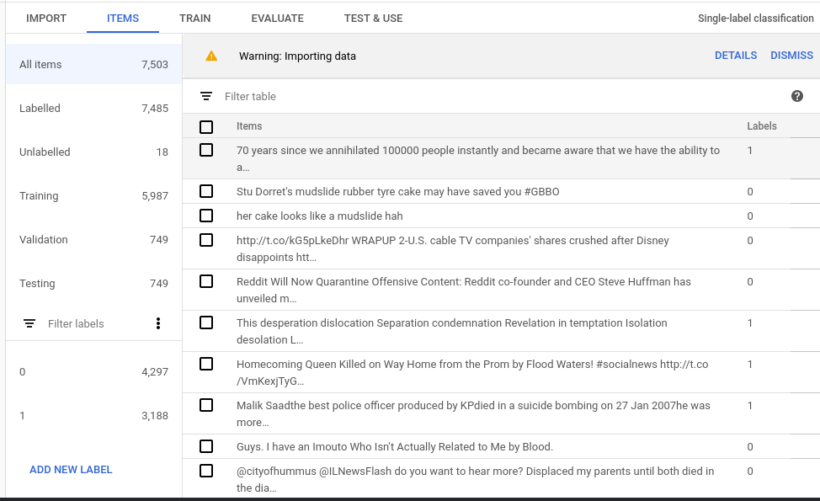
Google AutoML: items

Slide 9
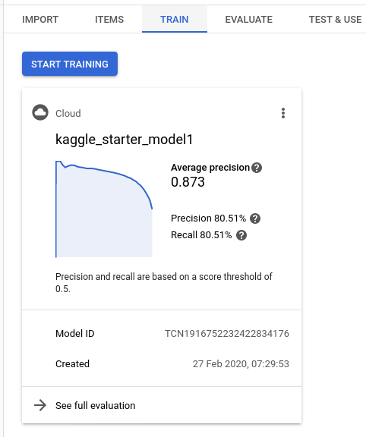
Google AutoML: train

Slide 10
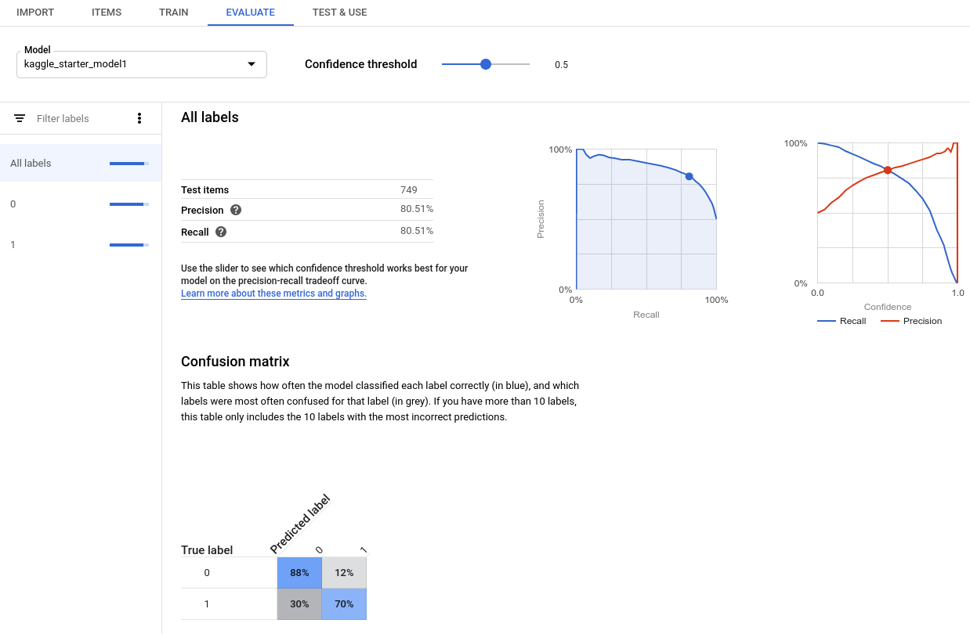
Google AutoML: evaluate

Slide 11
Next Steps
General
  Features engineering
  Preprocessing
Linear Models
  Different classification models, ensembles (random forest, gradient boosting), stacking/voting
FastText
  Following official latest supervised tutorial
  Automatic hyperparameters optimization

Slide 12
Next Steps (contd.)
LSTM
  More complex LSTM with Embeddings
Other Models
  GloVe
  BERT
  H2O AutoML

