Slide 1
Developing log

Slide 2
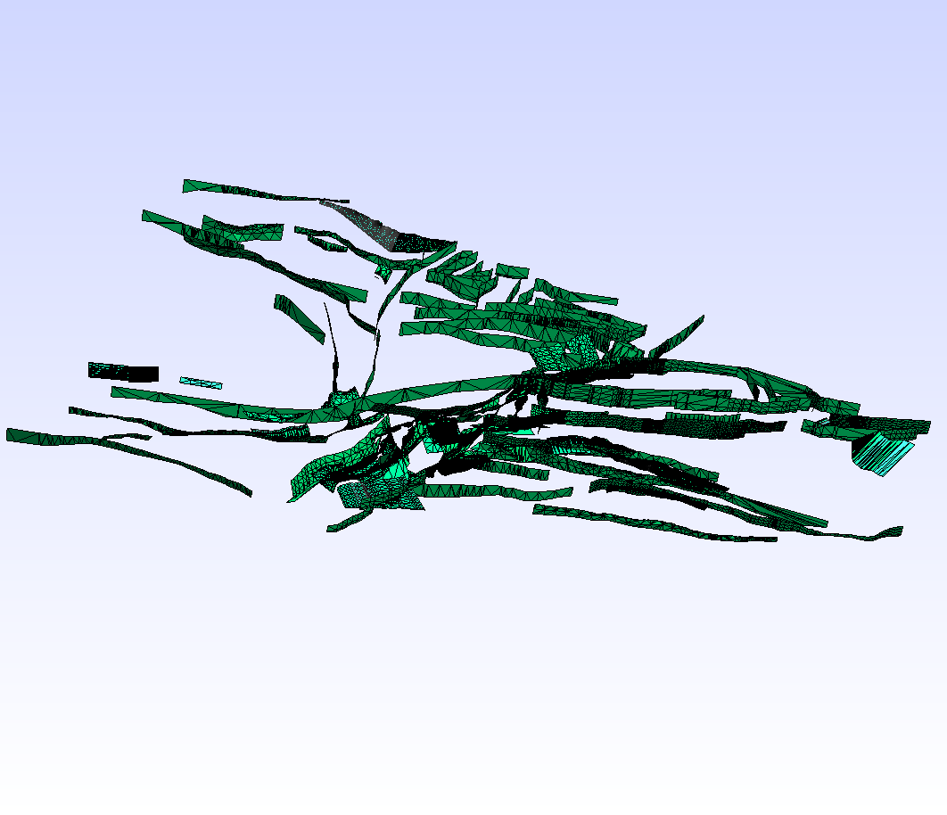
Mesh generation
California CFM VTK scheme
from https://github.com/zshangGEO/scec-vdo to get CFM VTK file
run https://github.com/zshangGEO/vtk_cfm2vtk_gmsh vtk_cfm2vtk_gmsh.py to convert CFM VTK to Gmsh VTK
Gmsh reading VTK CFM file
run gmsh->merge->gmsh_california_cfm.vtk
Gmsh generating 3D meshes
waiting for https://github.com/zshangGEO/scec-vdo to be run to get the part of CFM

Slide 3
Mesh partitioning
Metis application developing
from https://github.com/zshangGEO/METIS to get Metis source code
from https://github.com/zshangGEO/fmetis to get Fortran Metis interface source code
reading the source code of https://github.com/zshangGEO/PFEMFort for mesh partitioning

Slide 4
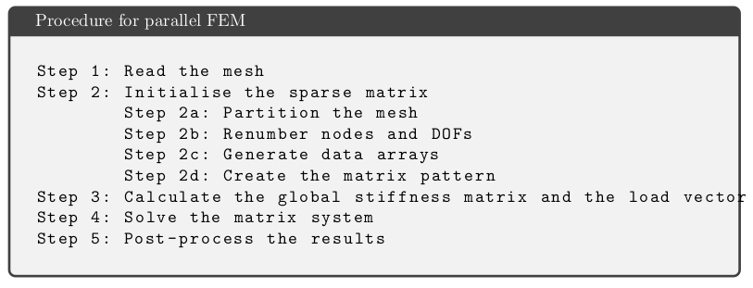
Solver developing
Preparing materials
from https://github.com/zshangGEO/PFEMFort to get FEM source code
reading the source code of https://github.com/zshangGEO/PFEMFort for FEM solver

