Slide 1
Developing log

Slide 2
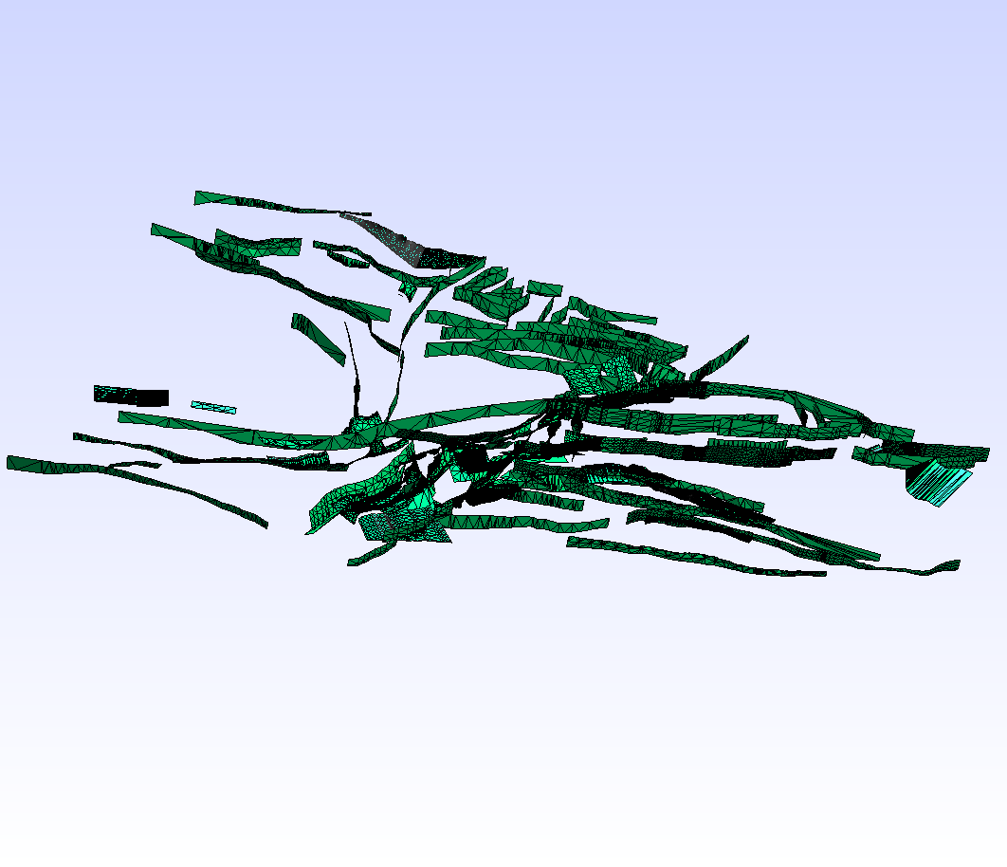
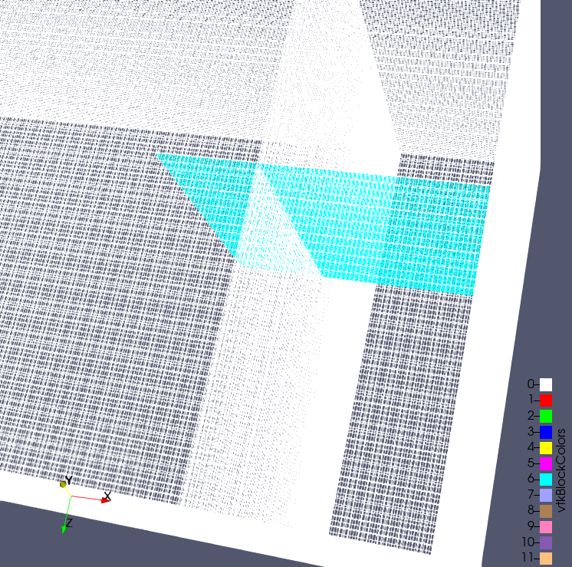
Mesh generation
California CFM VTK scheme
from https://github.com/zshangGEO/scec-vdo to get CFM VTK file
run https://github.com/zshangGEO/vtk_cfm2vtk_gmsh vtk_cfm2vtk_gmsh.py to convert CFM VTK to Gmsh VTK
Gmsh reading VTK CFM file
run gmsh->merge->gmsh_california_cfm.vtk
Gmsh generating 3D meshes
Qingjun fixed the bug for fault .ts converting to .vtk on the python code.
Waiting for the gmsh to generate 3D meshes on fault
Still working on gmsh to generate 3D meshes on fault

Slide 3
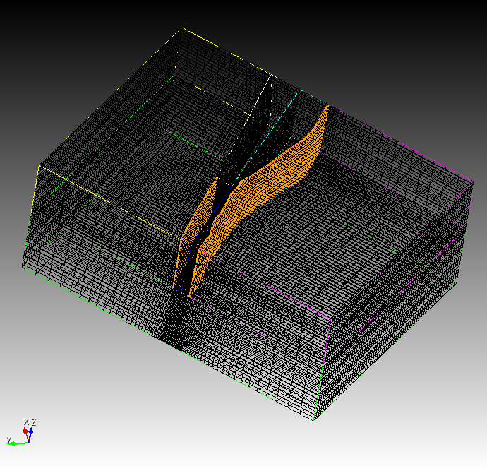
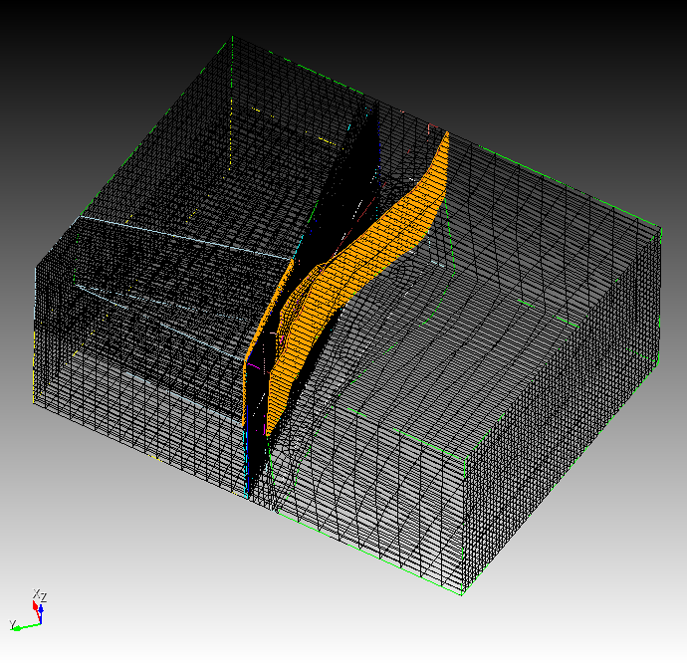
Mesh generation
Cubit mesh for fault

Slide 4
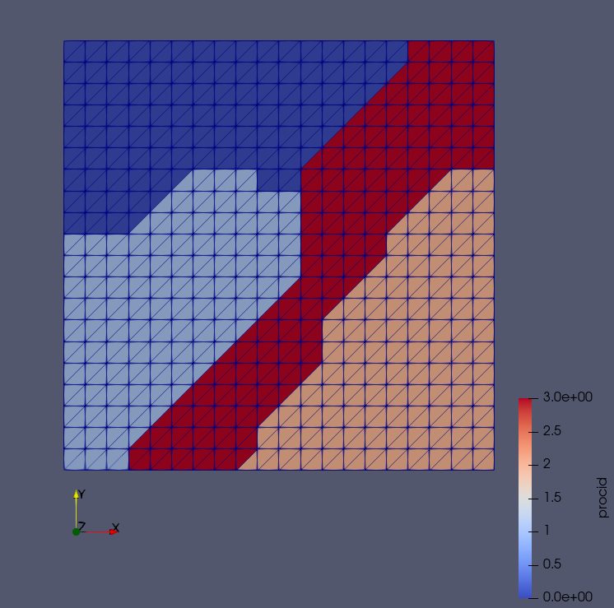
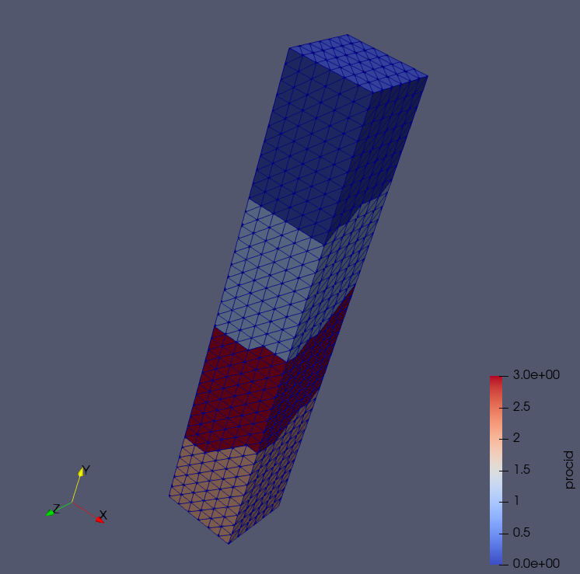
Mesh partitioning
Metis application developing
from https://github.com/zshangGEO/METIS to get Metis source code
from https://github.com/zshangGEO/fmetis to get Fortran Metis interface source code
reading the source code of https://github.com/zshangGEO/PFEMFort for mesh partitioning
Mesh partitioning Fortran codes of ParMetis and Metis were developed and tested

Slide 5
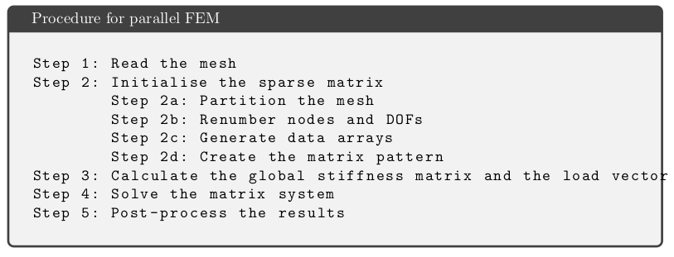
Solver developing
Preparing materials
from https://github.com/zshangGEO/PFEMFort to get FEM source code
reading the source code of https://github.com/zshangGEO/PFEMFort for FEM solver

Slide 6
Solver developing
Frame developing
the frame is separated as preProcess, meshPartition, geoSolver, postProcess
1.. preProcess including gmsh mesh read in
2. meshPartition including Metis mesh partitioning
3. geoSolver including the earth quake solvers
4. postProcesing including VTK mesh and results output.

