Slide 1
Developing log

Slide 2
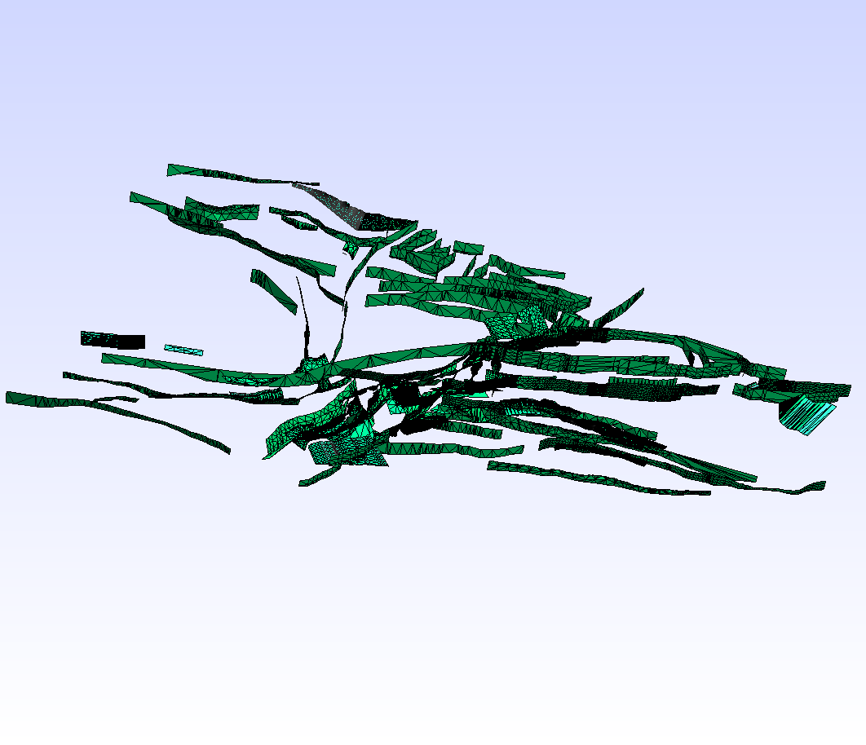
Mesh generation
California CFM VTK scheme
from https://github.com/zshangGEO/scec-vdo to get CFM VTK file
run https://github.com/zshangGEO/vtk_cfm2vtk_gmsh vtk_cfm2vtk_gmsh.py to convert CFM VTK to Gmsh VTK
Gmsh reading VTK CFM file
run gmsh->merge->gmsh_california_cfm.vtk
Gmsh generating 3D meshes

Slide 3
Mesh partitioning
Metis application developing
from https://github.com/zshangGEO/METIS to get Metis source code
from https://github.com/zshangGEO/fmetis to get Fortran Metis interface source code

Slide 4
Solver developing
Preparing materials
from https://github.com/zshangGEO/PFEMFort to get FEM source code

