Slide 1



GeoEasy
Free Surveying Calculations
Zoltán Siki
siki.zoltan@epito.bme.hu
Budapest University of Technology and Economics
Notes:
I would like to introduce you a special piece of software, which is mostly for land surveyors (who are the main data providers for large scale GIS and mapping), but it is useful to fill the gap between land surveyors’ data and GIS, too. There are few open source software in this category and most of them are inactive nowadays. The logo on the right side is the logo of our GeoForAll lab, you may have similar sticker on your laptop. On the left side is the logo of the Civil Engineering Faculty of the Budapest University of Technology and Economics, which is an academic partner of this FOSS4G.

Slide 2

About me
Open source GIS user/teacher/advocate (2005-)
QGIS Hungarian translator (2008-)
FOSS4G Europe conferences (2012-)
QGIS Plug-in developer (2013-)
OSGeo Charter Member (2014-)
OSGeoLab Budapest (2014-)
FOSS4G(-EU) committee member (2015-)
Notes:
I work for the Budapest University of Technology and Economics. I am a land surveyor by profession.
These are my FOSS4G (OSGeo) activities.
Nowadays I run a few OS projects (among others GeoEasy) and I contribute to some OSGeo projects, too.

Slide 3
About GeoEasy
Developed for a small enterprise in 1997 (version 1)
Proprietary software 2002-2016 (version 2)
Open source software from 2017 (version 3)
Written in Tcl/Tk (GUI)
Available in five languages (English, German, Czeh, Russian, Hungarian)
“Binary” releases for Debian/Ubuntu and Windows
https://github.com/zsiki/GeoEasy
Notes:
GeoEasy is a complex open source tool for land surveyor’s calculations. It has a quite long history, its development started in 1997. The license was changed to GPL in 2017. GeoEasy is available on Linux and Windows platforms, too. A graphical user interface GUI makes the program user friendly. Besides the basic surveying calculations it is suitable for 1/2/3D network adjustment, local coordinate transformations, digital terrain models and regression calculations. The program supports several input field-book formats of total stations, csv, dxf and output formats csv, dxf, gpx, kml, vrml, ascii grid , so it can easily be inserted into user’s work-flow and can fill the gap between the surveyor’s data and GIS. GeoEasy is based on other open source projects among others PROJ, GNU GaMa, Triangle and available in five languages English, German, Czech, Russian and Hungarian . The source code is available on GitHub. GeoEasy was used in education at our university from the beginning.

Slide 4
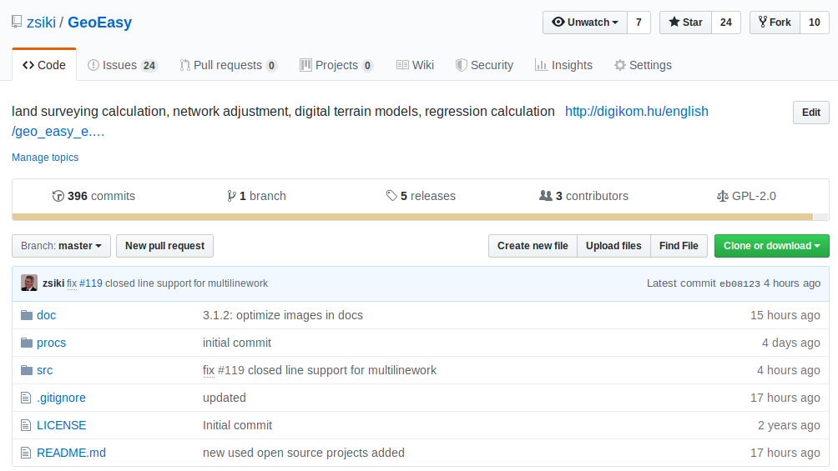
Notes:
This is the github page of the software.
The number of contributors is low. One aim of this presentation is to increase the number of users and contributors. The project primary needs documentation writers and testers but coders and translators are welcome, too. The project is quite active, there were nearly 400 commits in the last two years. There were two releases yearly. Monthly a development version is usually released for testers.

Slide 5
What is GeoEasy for
Surveying calculation (special COGO)
Notes:
At the beginning the surveying calculations were in focus. Coordinate calculation from angle and distance observations. Traversing, intersection etc.

Slide 6




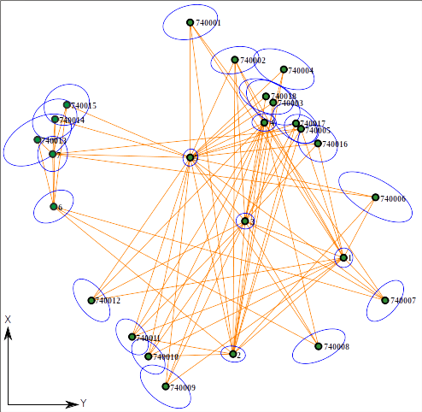
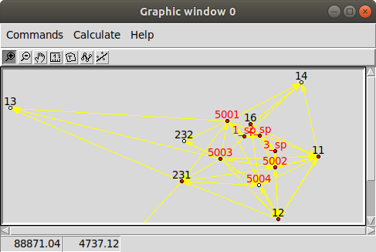
TXT
CAD
GIS
LibreOffice
…
β, θ, dist
x,y,z
X’, Y’, Z’
DXF, GPX, …
β, θ, dist
x,y,z
GeoEasy
x, y, z
TIN
GRID
GeoEasy
Notes:
The calculations on one hand can be very simple, intersection of two lines or circles, conversion from polar to rectangular coordinates.
On the other hand the network adjustment and local coordinate transformation are more complex using LSM. GNU GaMa is used for network adjustment (https://www.gnu.org/software/gama).
Data can be downloaded from the instruments using serial (RS-232) connection, imported from files or entered using the keyboard.
Coordinate transformation between Cartesian systems are important part too. It is different from the GIS approach, common points are used to calculate transformation parameters.

Slide 7
What is GeoEasy for
Surveying calculation (special COGO)
Digital Terrain Models (TIN & GRID)
Notes:
The software is not only for DTM creation, but contour lines, sections and volumes can be calculated. Internally TINs are used, GRIDs are created during export.
We use triangle (https://github.com/PhilipLudington/Triangle) to generate TINs.

Slide 8
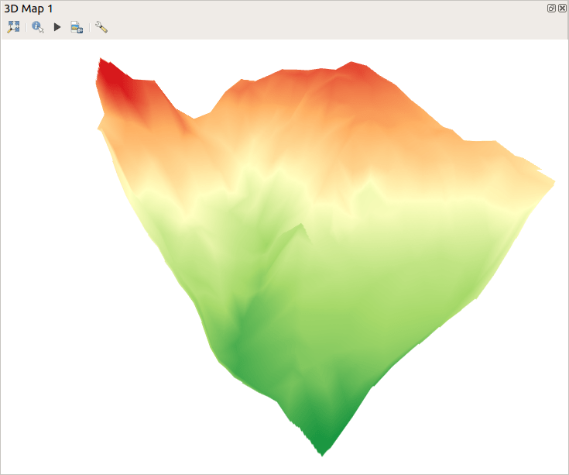
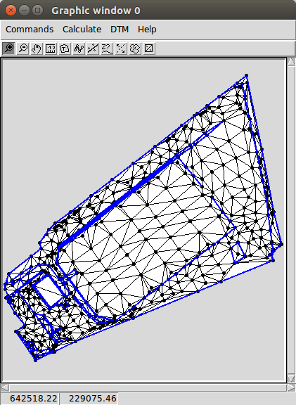
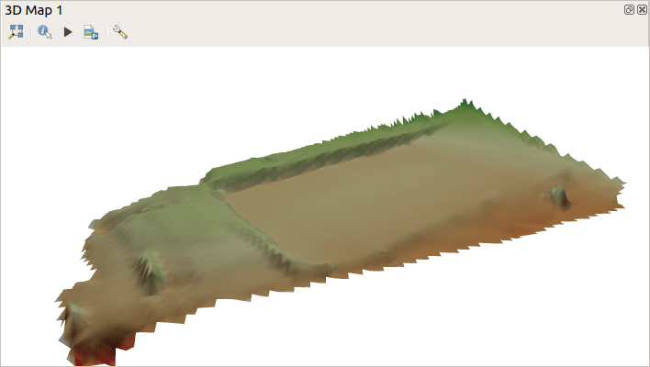
Notes:
TIN shown in GeoEasy on the left and two exported GRIDs in QGIS 3D view, right and down. GRASS and ESRI ASCII GRIDS can be exported.

Slide 9
What is GeoEasy for
Surveying calculation (special COGO)
Digital Terrain Models (TIN & GRID)
Regression calculation (2D/3D)
Notes:
Regression calculation finds the parameters of the best fitting shape to points. This part of the software is the least related to GIS.
2D and 3D lines, planes, circles, spheres are supported.

Slide 10
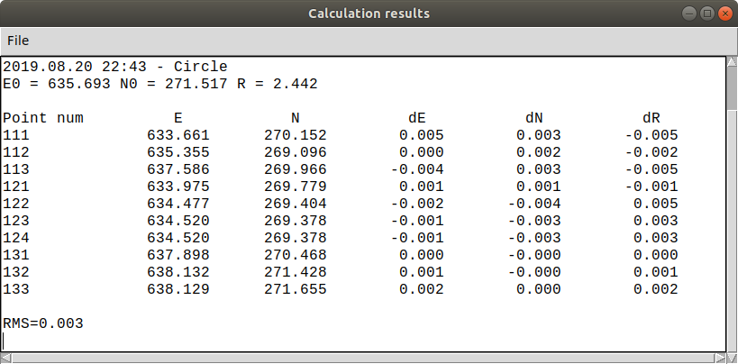
Notes:
This is an example of the best fitting circle on 2D points. You may find similar functionality in R or Octave among the open source software.

Slide 11
What is GeoEasy for
Surveying calculation (special COGO)
Digital Terrain Models (TIN & GRID)
Regression calculation (2D/3D)
Import/Export (various formats)
Notes:
GeoEasy uses only open formats, all of them are simple text files. With these input/output formats it is a bit similar to gpsbabel, which converts GPS data from/to different formats.

Slide 12
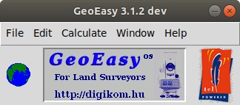
Input
Output
Total station
formats 10+
GeoEasy geo
GeoEasy dmp
Coordinate lists
are/gsi,csv
SurvCE,
N4ce, ...
Geodimeter job/are,
Excel csv,
text file
GPS Trackmaker txt,
GPX
Transformation
parameters prm/all
AutoCAD dxf,
GRASS and
ESRI ASCII GRID
VRML/ KML
Office rtf, csv
Serial line
(RS-232)
GNU Gama xml
Notes:
Most of the output formats can be loaded/imported into FOSS4G desktop GIS software, for example QGIS, GRASS.

Slide 13
What is GeoEasy for
Surveying calculation (special COGO)
Digital Terrain Models (TIN & GRID)
Regression calculation (2D/3D)
Import/Export (various formats)
API with console
Notes:
From 3.1 version a Tcl console is part of the user interface, where pure Tcl commands and GeoEasy functions can be used. API documentation is available for the GeoEasy functions and generated from the comments in the source code.
This part is for advanced users.

Slide 14
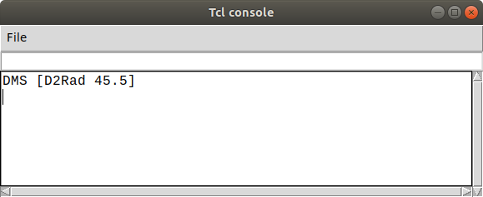
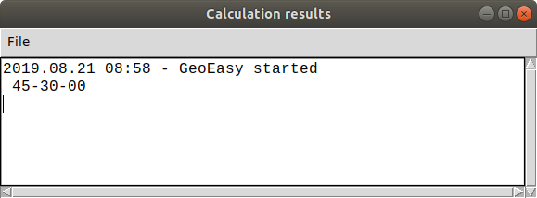
# GeoEasy utility to swap horizontal coordinates
proc SwapXY {dataset} {
global geoChanged
upvar #0 ${dataset}_coo coo
if {! [info exists coo]} {
GeoLog "Dataset not loaded $dataset"
return
}
foreach pn [array names coo] {
upvar #0 ${dataset}_coo($pn) coo_rec
set prelim 0
set east [GetVal 38 $coo_rec]
set north [GetVal 37 $coo_rec]
if {$east == ""} {
# try preliminary coords
set east [GetVal 138 $coo_rec]
set north [GetVal 137 $coo_rec]
set prelim 1
}
if {$east != "" && $north != ""} {
set coo_rec [DelVal {38 138} $coo_rec]
set coo_rec [DelVal {37 137} $coo_rec]
lappend coo_rec [list [expr {$prelim * 100 + 38}] $north]
lappend coo_rec [list [expr {$prelim * 100 + 37}] $east]
set geoChanged($dataset) 1
}
}
}
Ad-hoc TCL commands
Procedures loaded from file
Startup script
Notes:
In the Tcl console the user can enter ad-hoc commands or load a Tcl file. Left side a simple example to change angle unit from decimal degrees to DMS. On the right side a Tcl function can be seen to exchange east and north coordinates.

Slide 15
Other OS projects used
Tcl/Tk
GNU GaMa
Triangle
Proj
NSIS
FreeWrap
bash-deb-build
TclDoc
rst2pdf
pngquant
Notes:
We don’t want to write code which is available in the open source world.
Tcl/Tk is the language, the environment for development,
GNU GaMa for network adjustment,
Triangle to generate TINs,
Proj to export WGS84 coordinates for KML and GPX formats,
NSIS to create Windows set up kit,
FreeWrap to create executable file from Tcl sources,
Bash-deb-build to create deb package,
TclDoc to generate developer docs,
rst2pdf to generate pdf docs,
pngquant to reduce image size in docs.
Thanks to these great project!

Slide 16
Links to GeoEasy
Binary releases (Windows, Ubuntu/debian)
http://www.digikom.hu/english/geo_easy_e.html
Documentation & Wiki
https://github.com/zsiki/GeoEasy/doc
https://github.com/zsiki/GeoEasy/wiki
Source code & API docs
https://github.com/zsiki/GeoEasy
http://www.digikom.hu/tcldoc
Issue tracker
https://github.com/zsiki/GeoEasy/issues
Volunteers are
welcome!
Notes:
So far 5 open source versions were released. The documentation is not finished. An installation guide and a Step by step documentation is available.
A reference guide has been started. Help needed to finish it.

Slide 17

Connecting projects
Geo4All
Surveying Calculation (QGIS plug-in)
http://plugins.qgis.org/plugins/SurveyingCalculation/
Ulyxes
http://www.agt.bme.hu/ulyxes/
Projects of OSGeo Lab Budapest
https://github.com/osgeolabbp
Notes:
We have some other open source projects at our Geo4All (OSGeo) lab:
Surveying calculation plug-in based on partly GeoEasy. Tcl sources were rewritten to Python. Unfortunately available only for QGIS 2.x
Ulyxes is a surveyors’ sensor data collecting autonomous system written in Python. May be interesting for land surveyors.
On our lab’s github page you can find small projects and tutorials for Octave, gawk and Python.

Slide 18

?
Notes:
During the evolution human kind reached the land surveyors’ level. May be the highest level so far (form my point of view:).
What can be the next level?

Slide 19
Join our project!
?
Thank you!

