Slide 1
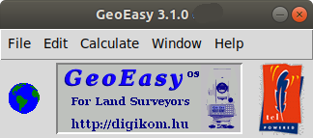

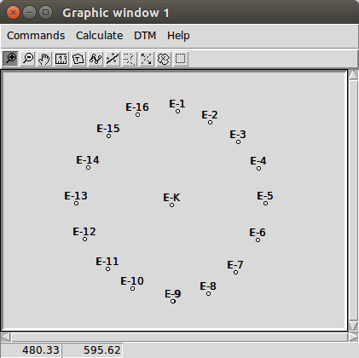
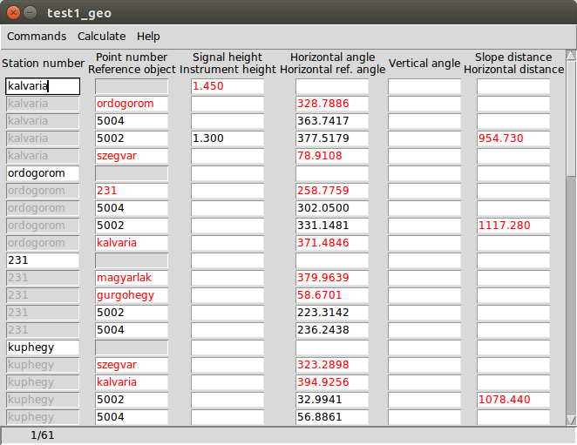
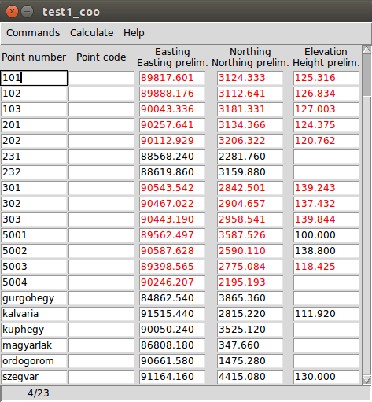

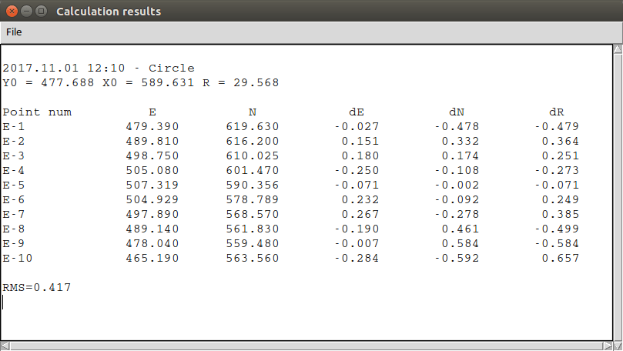
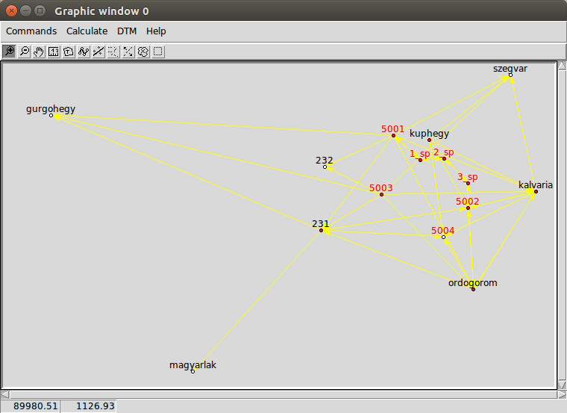
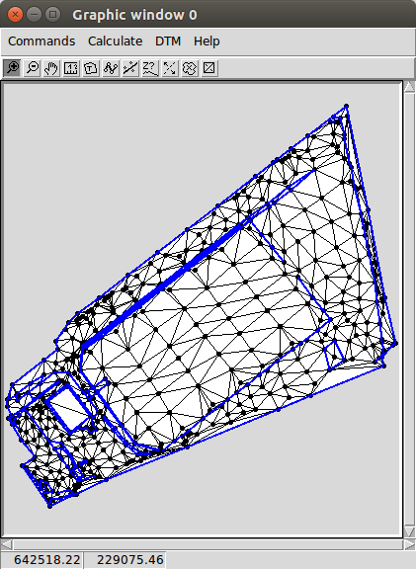
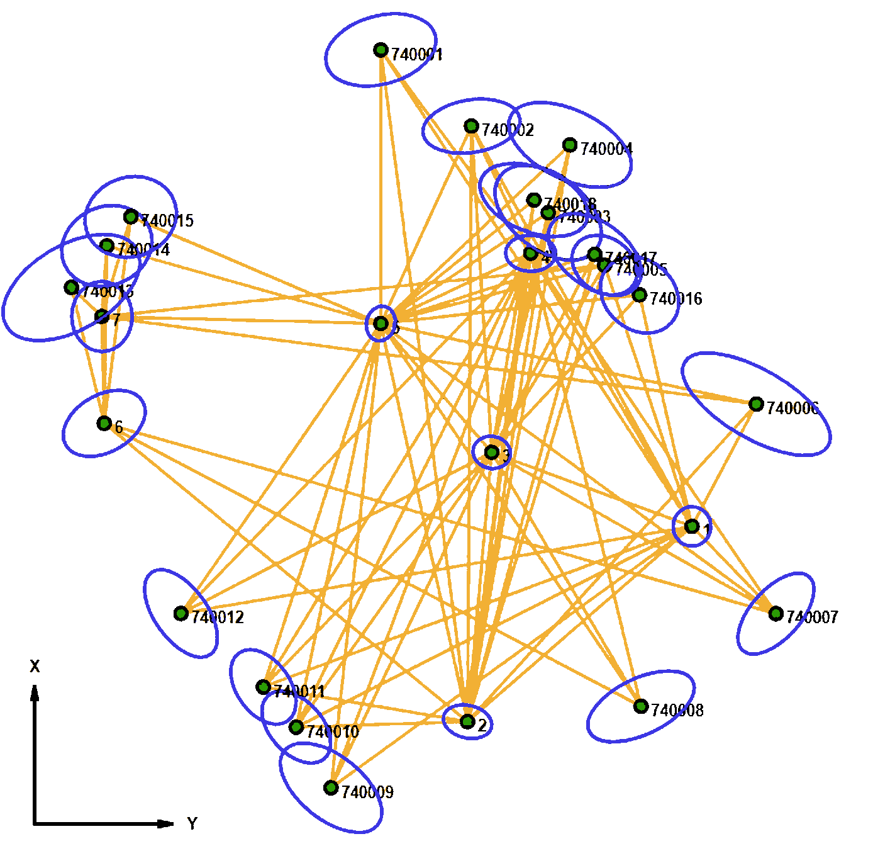
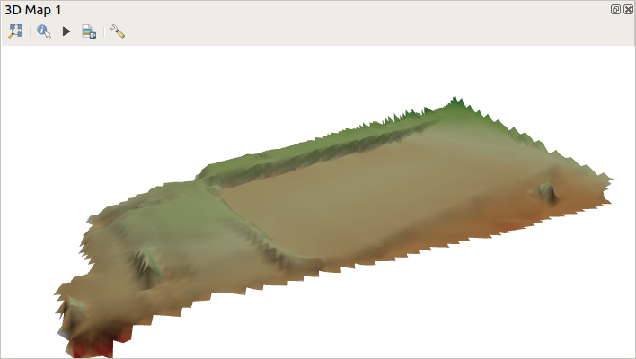
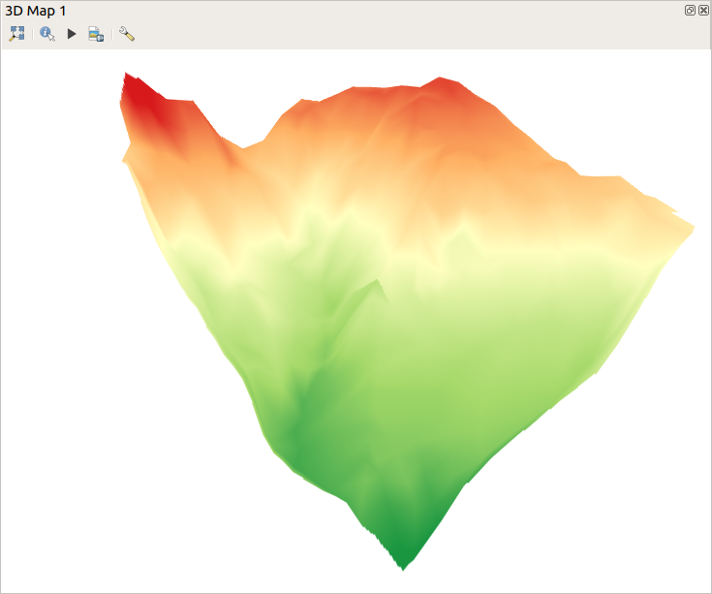

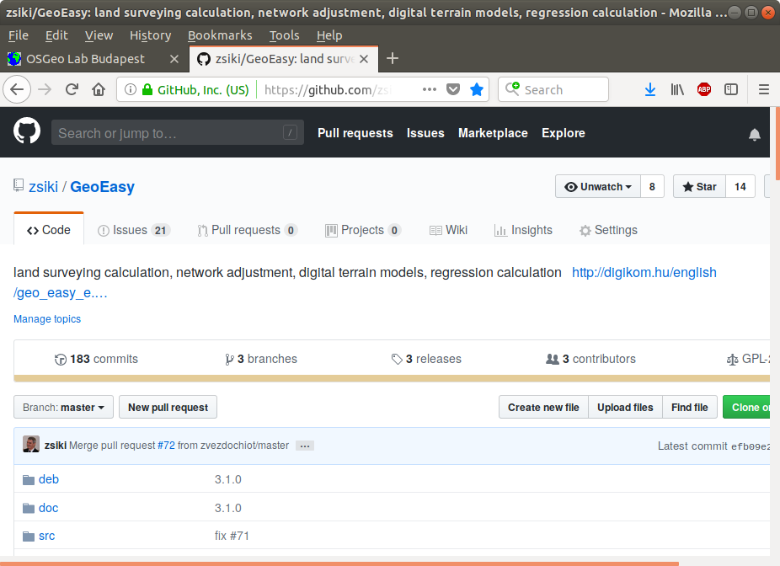
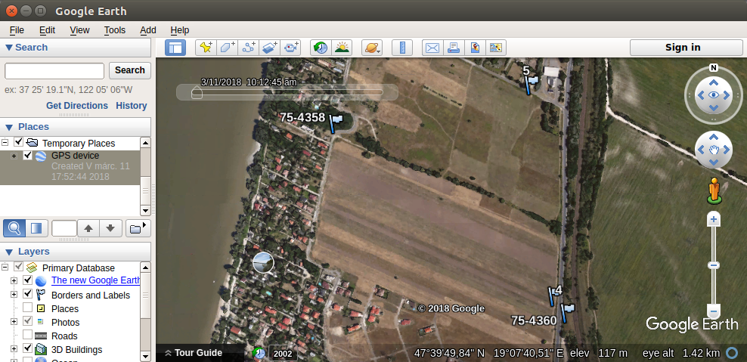
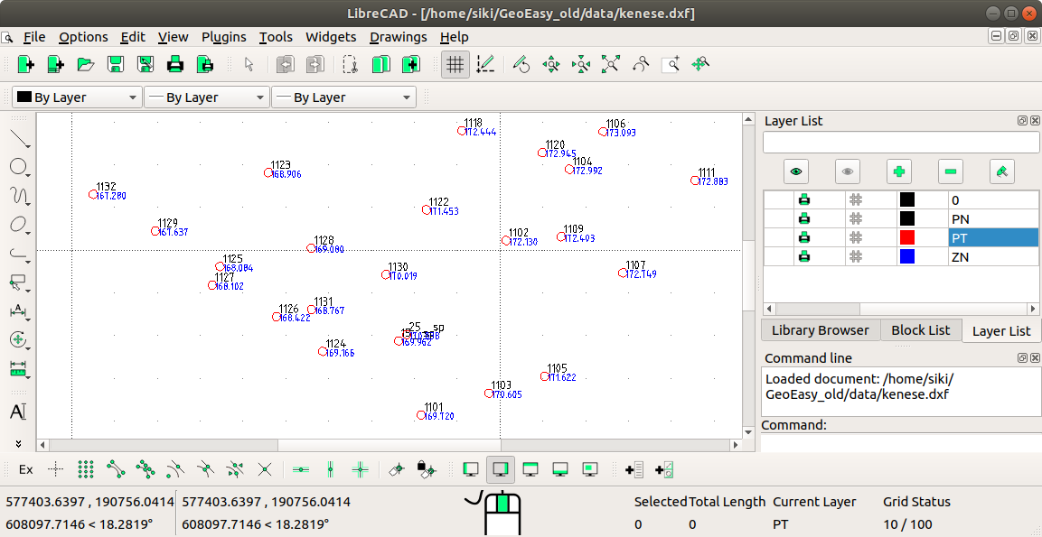
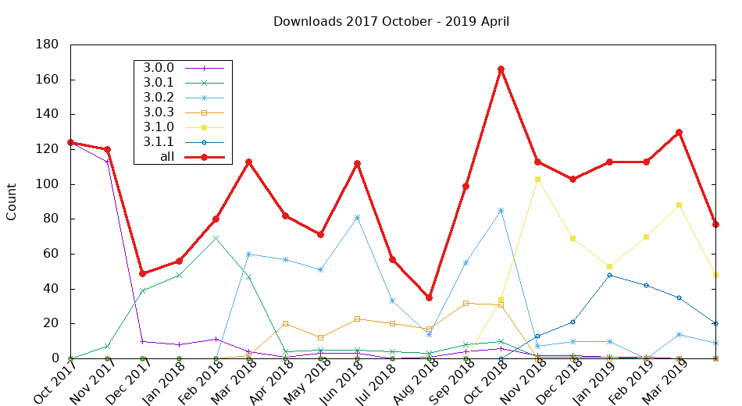
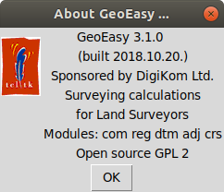
GeoEasy^{os} 3.1
Connections to other programs through data sets
The development of the GeoEasy program started in 1997. Twenty years later in 2017 it has became free software under GPL license, freely available for everybody. The ComEasy module of the project was released under open source license from the beginnings (see https://github.com/zsiki/ComEasy).
The core development of GeoEasy is made on Linux operating system, using Tcl/Tk script language, thanks to the Tcl/Tk ports to several operating system the program can be used on Linux, on Windows (32 and 64 bit version), on Android tablets and on OSX machines. Intensive tests of the code were made on Linux and Windows only.
New features:
German, Czeh, Russian GUI
Tcl console for your scripts
Portable windows release
Variable column widths
in field-books
Parallel line regression
Objectives
User friendly graphical user interface
Modular, extendable structure
Direct process of data from total stations
Flexibility and openness connecting to other programs
Educational and professional usage
Vertical transformation
KML export of coordinate list
Many bugfixes
More than 180 commits and
43 issues solved after 3.0
Graphic window
Field-book
Coordinate list
Download the binary release for Windows and Linux:
http://digikom.hu/english/geo_easy_e.html
Regression circle
Development tool
Console window to run ad-hoc Tcl commands
Extend the functionality of GeoEasy with user defined scripts loaded from file
Write your own app using GeoEasy as a library
Graphic window
Surveying calculations
Edit field-books
Intersection, resection, orientation, ...
Traversing, trigonometric line
Coordinate transformations
Coordinate list and field-book import
(several formats)
DXF export
Regression calculation
Solving engineering surveying tasks
Regression lines, plan, circle, sphere,
3D line, parallel lines
TIN model (Triangle)
GeoEasy
Digital Terrain Models
DXF import
TIN models
Break lines
Contour lines
Volume calculation
Cross sections
VRML, KML, DXF, ASCII GRID export
Update, regenerate
Error ellipses in horizontal network
Network adjustment
1D/2D/3D geodetic network
Normality check
Data snooping
Network sketch with error ellipses
Exported GRID model in QGIS 3
Adjustment results (GNU Gama)
Exported GRID model in QGIS 3
Adjustment results (GNU Gama)
Adjusted coordinates
********************
i point approximate correction adjusted std.dev conf.i.
====================== value ====== [m] ====== value ========== [mm] ===
1
17 X * 735.53500 -0.00002 735.53498 0.4 0.7
18 Y * 598.88300 0.00013 598.88313 0.3 0.7
2
23 X * 673.49900 -0.00001 673.49899 0.3 0.6
24 Y * 527.57600 -0.00087 527.57513 0.4 0.8
3
1 X * 759.06300 -0.00002 759.06298 0.3 0.6
2 Y * 535.25100 -0.00007 535.25093 0.3 0.6
4
36 X * 822.31000 0.00005 822.31005 0.3 0.7
37 Y * 547.62300 -0.00015 547.62285 0.4 0.9
GitHub page of the project
Exported (GPX) points in GoogleEarth
Total station
formats 10+
Input
Output
Coordinate lists
are/gsi,csv
Geoprofi, GeoZseni,
GeoCalc3, SurvCE
GeoEasy geo/coo/par
GeoEasy dmp
Geodimeter job/are,
Exported (DXF) points in LibreCAD
Excel csv,
text file
GPS Trackmaker txt
GPX
Transformation
parameters prm/all
AutoCAD dxf,
ITR txt,
ESRI ASCII GRID
VRML/ KML
Office rtf
GNU Gama xml
OS software used
Tcl/Tk (https://www.tcl.tk/)
GNU Gama (https://www.gnu.org/software/gama/)
Triangle (https://github.com/MrPhil/Triangle)
Proj (https://proj4.org/)
NSIS (http://nsis.sourceforge.net/Main_Page)
Freewrap (http://freewrap.sourceforge.net/)
Let us develope GeoEasy together!
Source code available on GitHub (https://github.com/zsiki/GeoEasy)
Report the errors you found in issue tracker (https://github.com/zsiki/GeoEasy/issues)
Extend and correct the documentation (https://github.com/zsiki/GeoEasy/doc)
Help other users (https://github.com/zsiki/GeoEasy/wiki)

