Slide 1
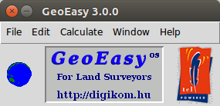


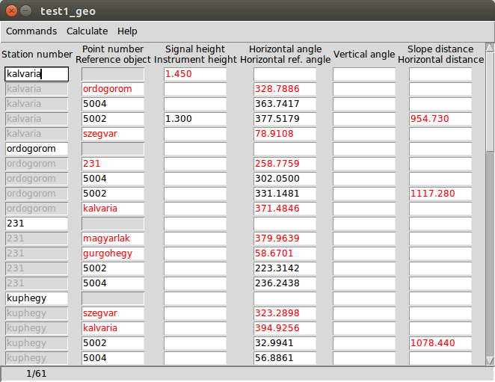
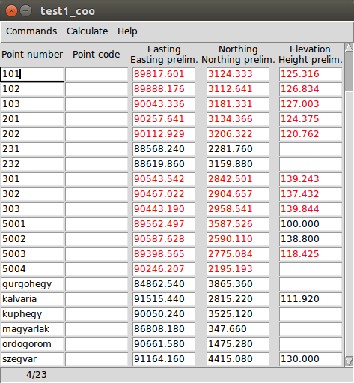
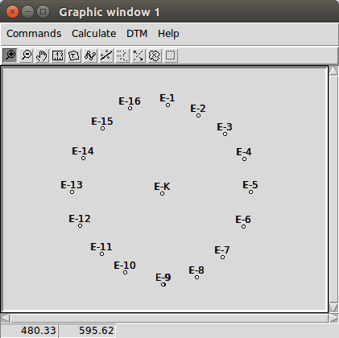
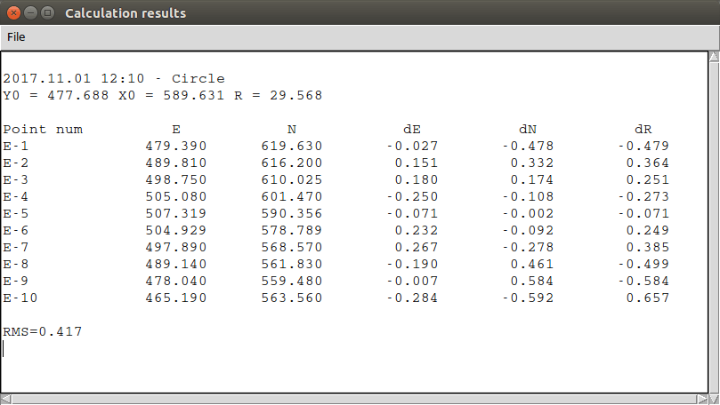
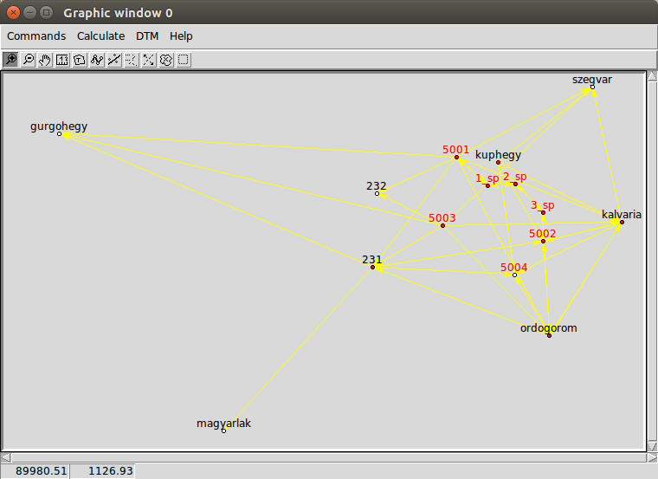
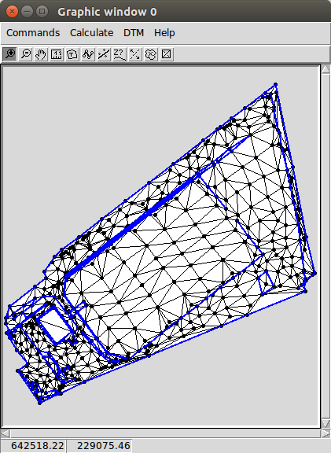

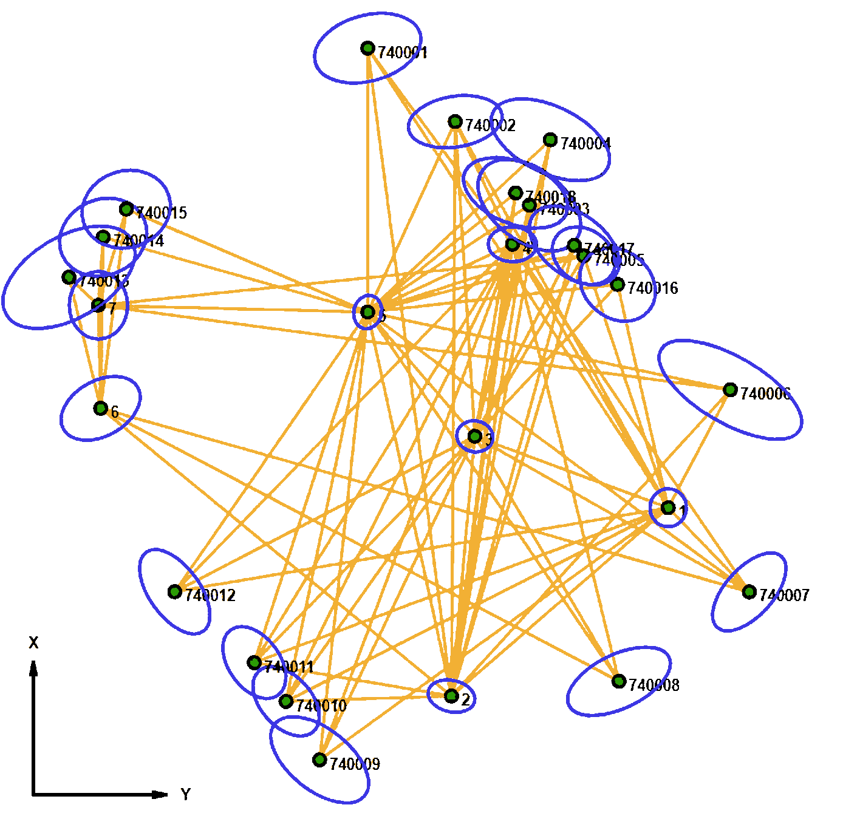
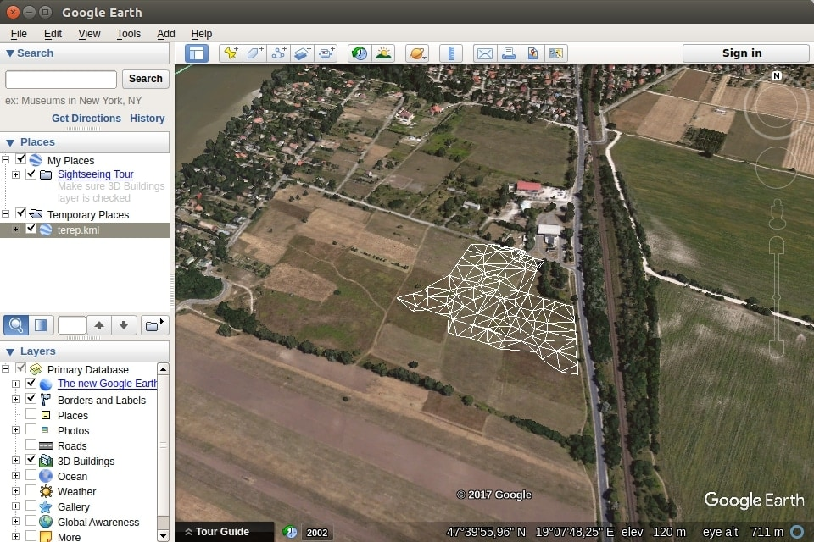



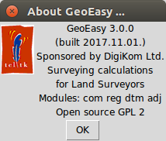
GeoEasy^{os} 3.0
Connections to other programs
The development of the GeoEasy program started in 1997. Twenty years later in 2017 it has became free software under GPL license, freely available for everybody. The ComEasy module of the project was released under open source license from the beginnings (see https://github.com/zsiki/ComEasy).
The core development of GeoEasy is made on Linux operating system, using Tcl/Tk script language, thanks to the Tcl/Tk ports to several operating system the program can be used on Linux, on Windows XP/Vista/7/8/10 (32 and 64 bit version), on Android tablets and on OSX machines. Intensive tests of the code were made on Linux and Windows only.
GeoEasy has nephew project called SurveyingCalculation. It is a QGIS plug-in, some parts of GeoEasy rewritten to Python. This plug-in available from the official QGIS plug-in repository (https://plugins.qgis.org/plugins/SurveyingCalculation/)and a GitHub repo (https://github.com/zsiki/ls).
Download the binary release
Windows: http://digikom.hu/english/geo_easy_e.html or
http://www.agt.bme.hu/siki/Gizi3Setup.exe
Linux: http://digikom.hu/english/geo_easy_e.html or
http://www.agt.bme.hu/siki/Gizi3Linux.tgz
Objectives
User friendly graphical user interface
Modular structure
Direct process of data from total stations
Flexibility and openness connecting to other programs
Educational and professional usage
Field-book
Coordinate list
Graphic window
Regression circle
Graphic window
Surveying calculations
Edit field-books
Intersection, resection, orientation, ...
Traversing, trigonometric line
Coordinate transformations
Coordinate list and field-book import
(several formats)
DXF export
Regression calculation
Solving engineering surveying tasks
Regression lines, plan, circle, sphere,
3D line
TIN model
Geo
Easy
Digital Terrain Models
DXF import
TIN models
Break lines
Contour lines
Volume calculation
Cross sections
VRML, KML, DXF, ASCII GRID export
Update, regenerate
Error ellipses in horizontal network
Network adjustment
1D/2D/3D geodetic network
Normality check
Data snooping
Network sketch with error ellipses
Adjustment results
TIN model in Google Earth (KML)
Adjusted coordinates
********************
i point approximate correction adjusted std.dev conf.i.
====================== value ====== [m] ====== value ========== [mm] ===
1
17 X * 735.53500 -0.00002 735.53498 0.4 0.7
18 Y * 598.88300 0.00013 598.88313 0.3 0.7
2
23 X * 673.49900 -0.00001 673.49899 0.3 0.6
24 Y * 527.57600 -0.00087 527.57513 0.4 0.8
3
1 X * 759.06300 -0.00002 759.06298 0.3 0.6
2 Y * 535.25100 -0.00007 535.25093 0.3 0.6
4
36 X * 822.31000 0.00005 822.31005 0.3 0.7
37 Y * 547.62300 -0.00015 547.62285 0.4 0.9
Typical work flow
Upload coordinates
to the total station
Planner work
Network observations
GeoEasy geo/coo/par
GeoEasy geo/coo/par
Download field-books
from total station
Observations
DXF file
Total station formats
10+
Coordinate list
are, gsi, csv
Calculation of detail points
Geoprofi, GeoZseni,
GeoCalc3, SurvCE
Electric field book
job/are, dmp
Electric
field-books
Collect points
to set out
GPS Trackmaker txt
Excel csv,
text file, dump
AutoCAD dxf
ESRI GRID
DXF file
AutoCAD DXF,
ESRI ASCII GRID
VRML/ KML
Calculating prelim. coordinates
Coordinate
list
Transformation
parameters prm/all
Office rtf
Editing base map
for planning
GNU Gama xml
Network adjustment
and data snooping
Upload coordinate
list to total station
OS software used
Tcl/Tk (https://www.tcl.tk/)
GNU Gama (https://www.gnu.org/software/gama/)
Triangle (https://github.com/MrPhil/Triangle)
NSIS (http://nsis.sourceforge.net/Main_Page)
Freewrap (http://freewrap.sourceforge.net/)
Coordinate
list
DXF file
Setting out
Let us develope GeoEasy together!
Source code available on GitHub (https://github.com/zsiki/GeoEasy)
Report the errors you found in issue tracker (https://github.com/zsiki/GeoEasy/issues)
Extend and correct the documentation (https://github.com/zsiki/GeoEasy/doc)
Help other users (https://github.com/zsiki/GeoEasy/wiki)

