Slide 1



Collecting and Processing
Land Surveyors' Sensor Data
Zoltán Siki
Budapest University of Technology and Economics
Department of Geodesy and Surveying
ICA-OSGeo-ISPRS
Geo for All Lab Budapest

Slide 2
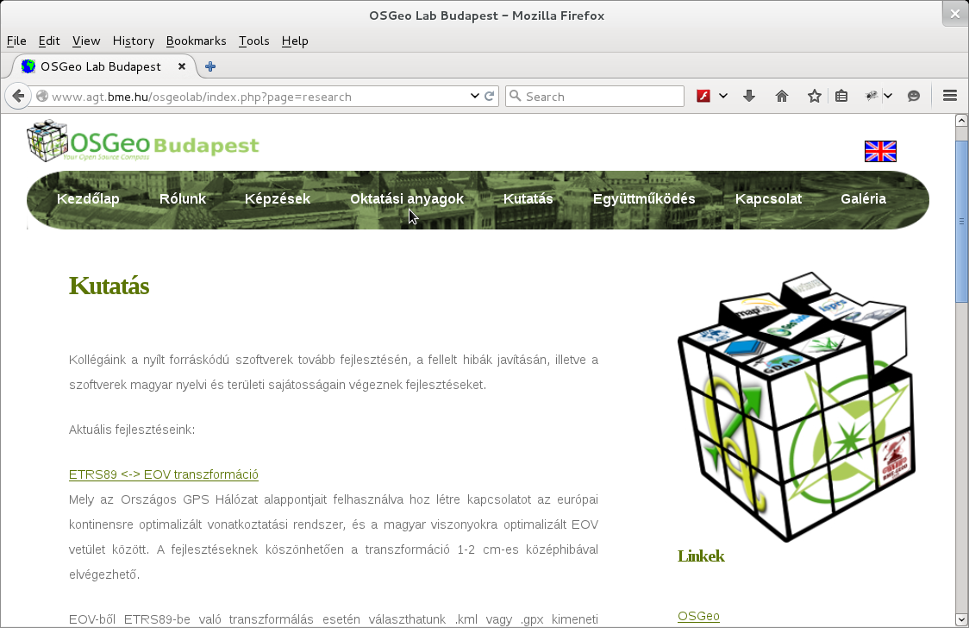
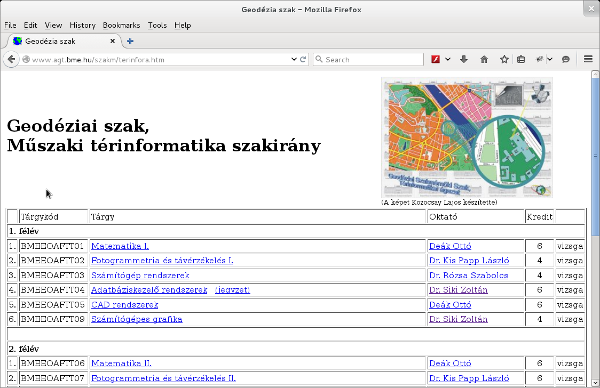
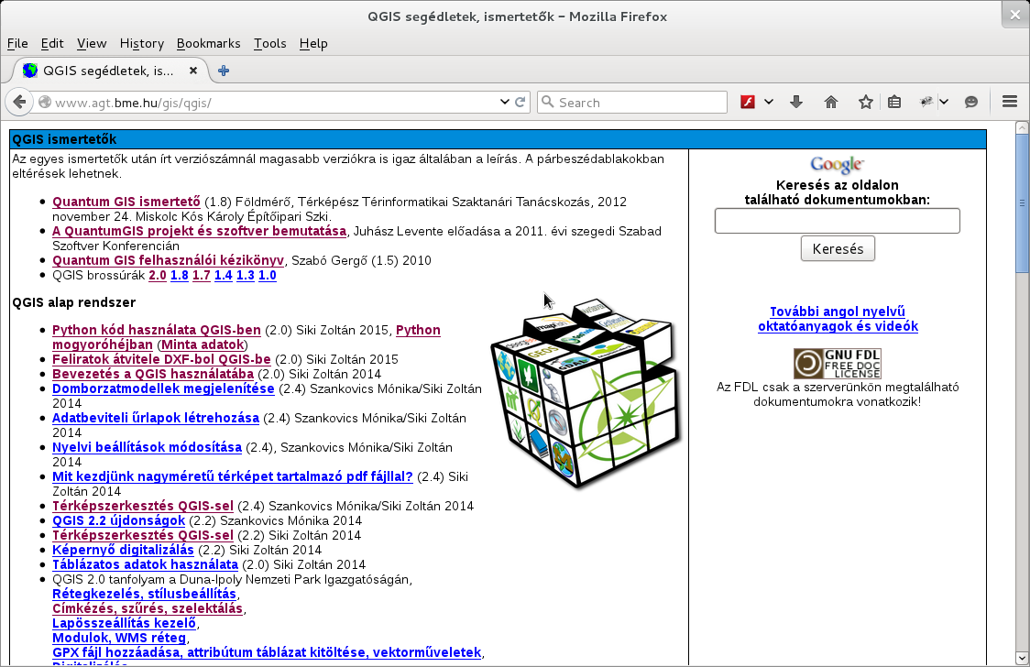
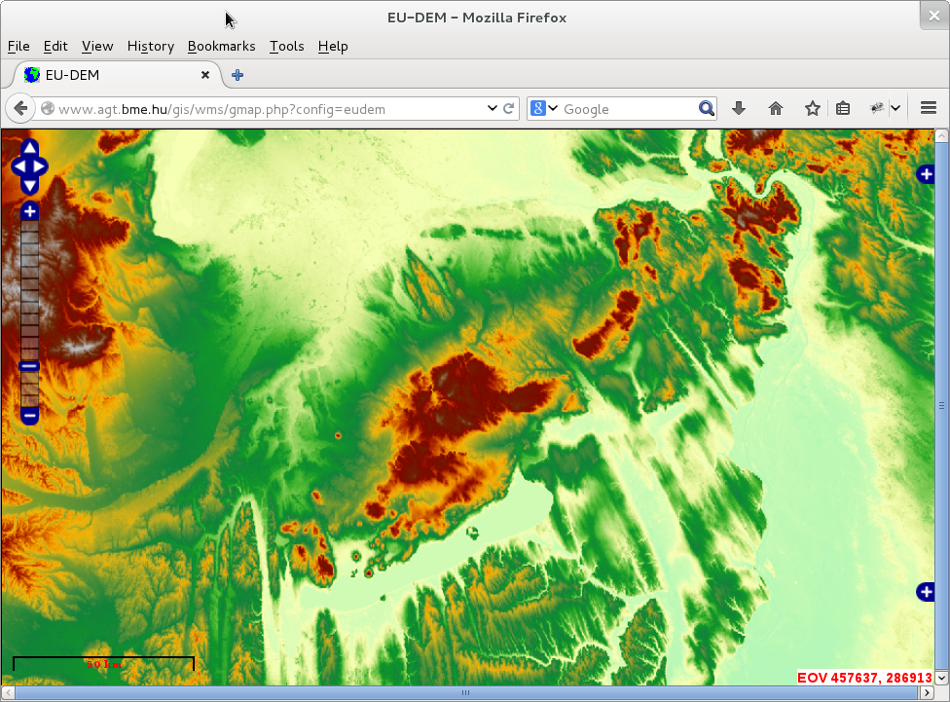
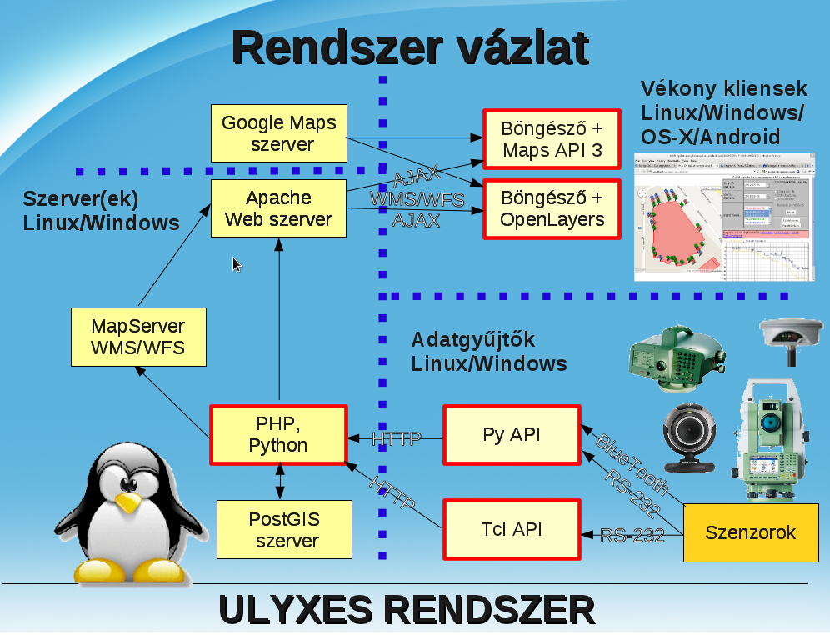


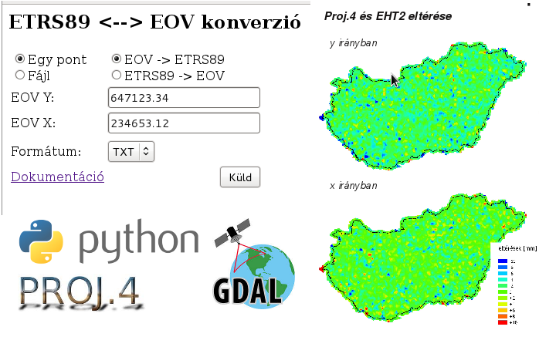
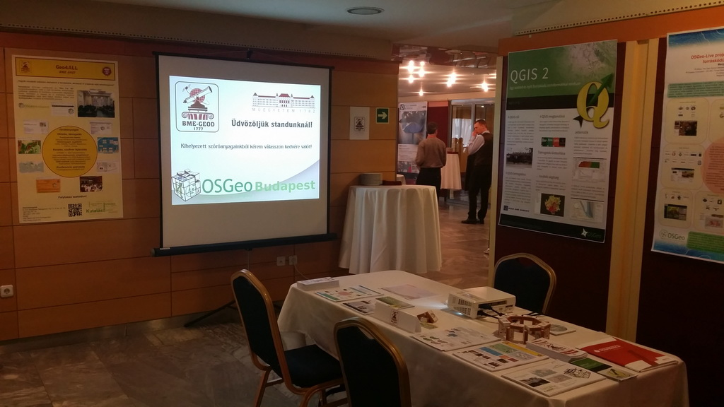



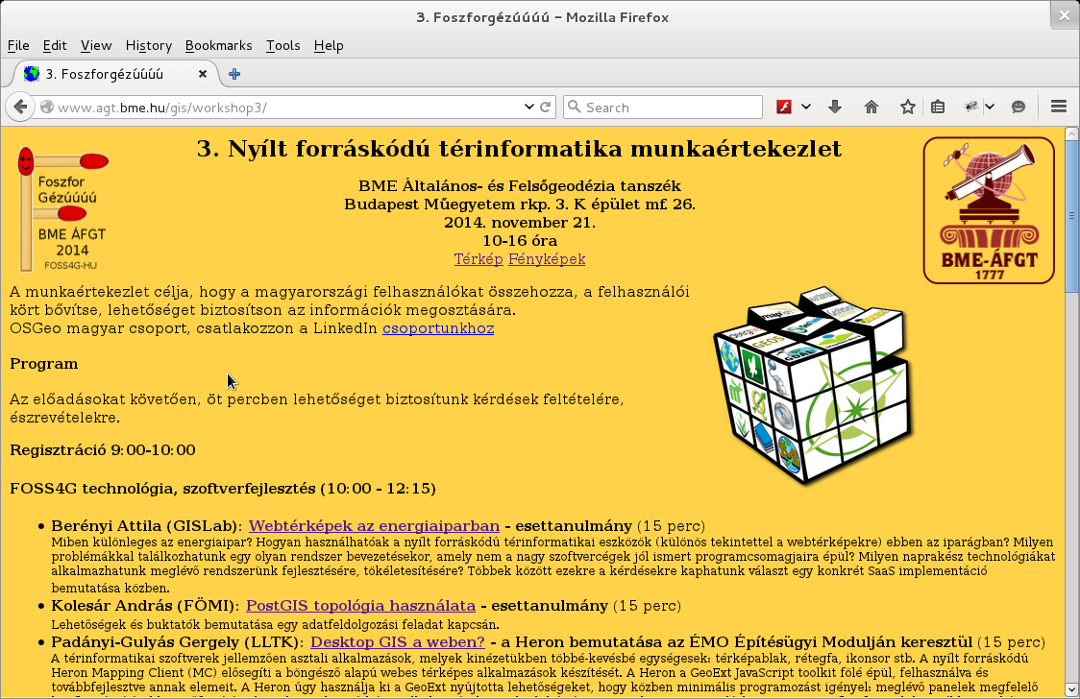
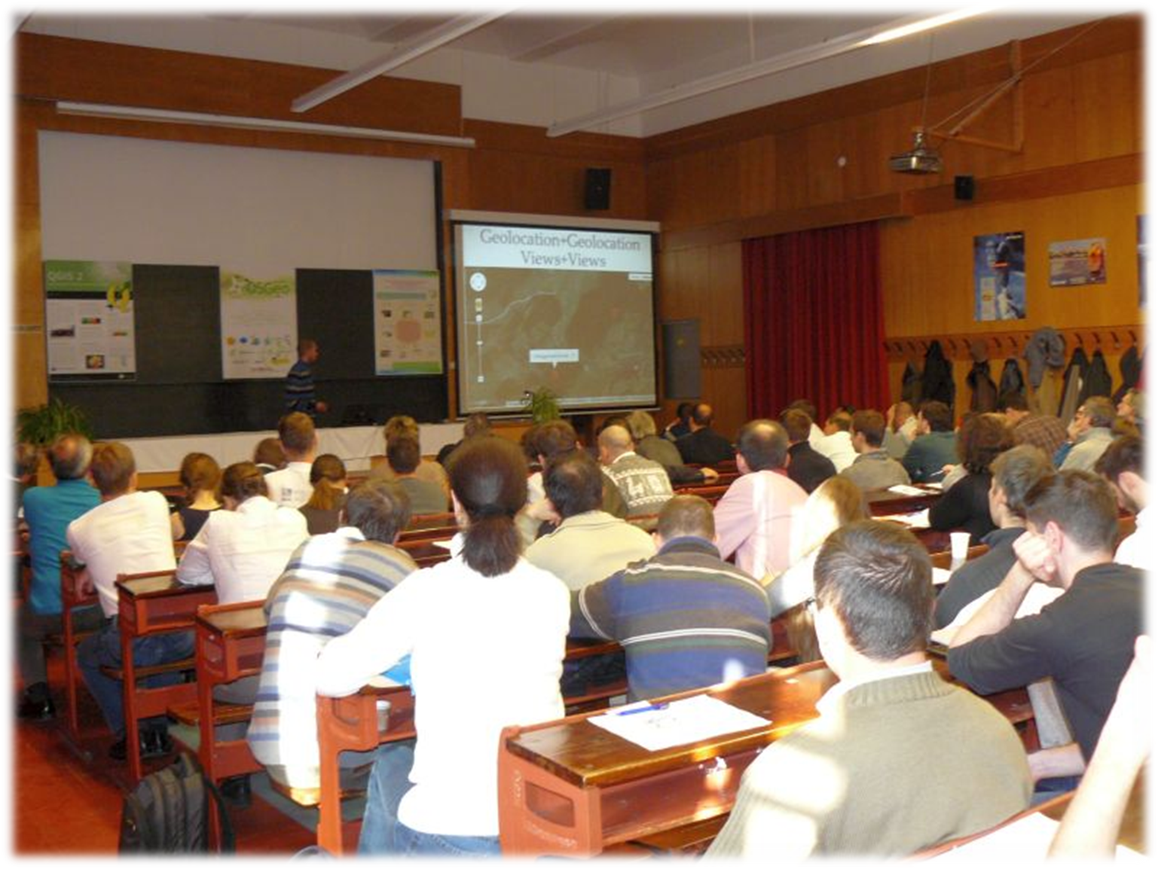
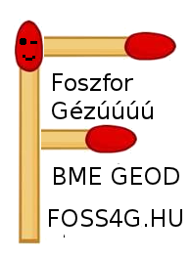





Geo4All Lab Budapest
ICA-OSGeo-ISPRS
Lab
Budapest
Activities
Training and support
Research and development
Conferences
FOSS4G.HU

Slide 3
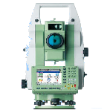
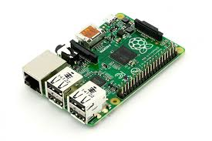
Ulyxes project
An Open Source project (GPL2):
Driving location aware sensors
Started in 2008, driving robotic total stations
First version written in Tcl (finished in 2013)
Second version written in Python (started in 2014)
New aims:
Indoor navigation and mapping
Raspberry Pi
Used sensors:
Robotic total stations (Leica 1800, 1103, 1201)
NMEA GNSS receivers
USB web cameras (e.g. Dino Lite)
MEMS (barometer, 6/9/10 DOF)
WiFi
...
http://www.agt.bme.hu/ulyxes

Slide 4
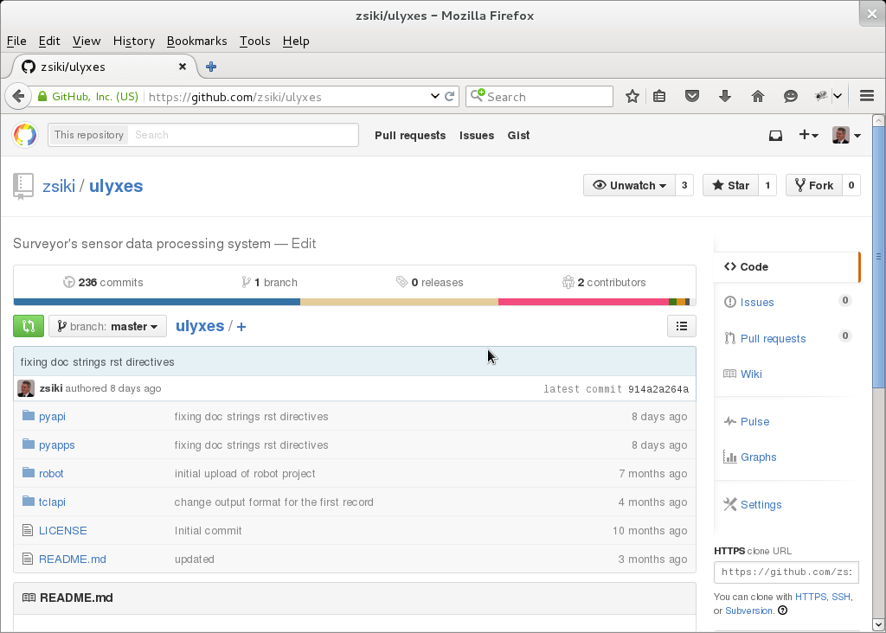
GitHub

Slide 5
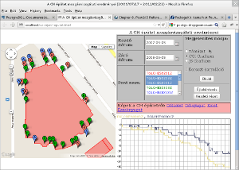


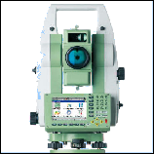
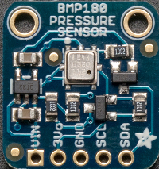
System sketch
Thin clients
Linux/Windows/
OS-X/Android
Google Maps
server
Browser +
Maps API 3
AJAX
Server(s)
Linux/Windows
Apache
Web server
Browser +
OpenLayers
WMS/WFS
AJAX
MapServer
WMS/WFS
Data collectors
Linux/Windows
PHP,
Python
Py API
BlueTooth
HTTP
RS-232
HTTP
PostGIS
server
Tcl API
(obsolate)
Sensors
RS-232

Slide 6
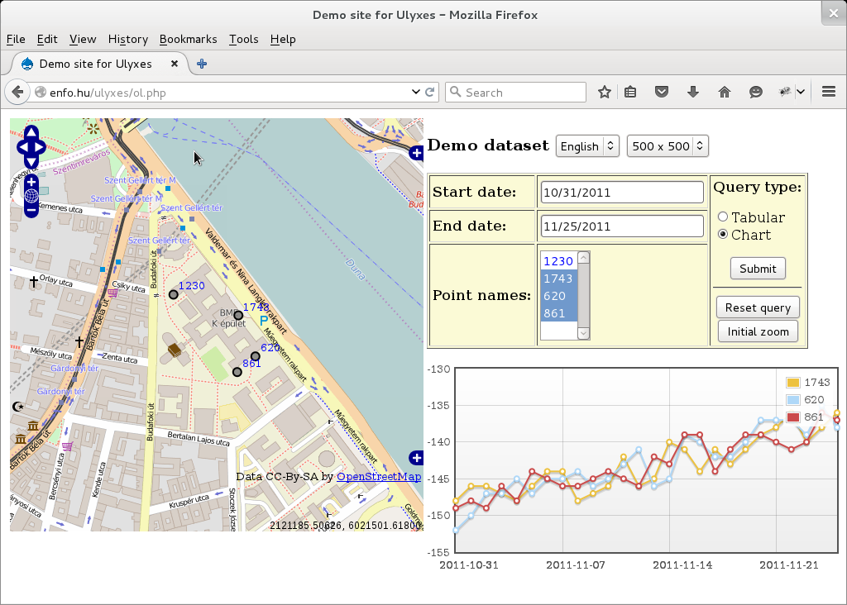
Demo application

Slide 7
Abstraction
Sensors (instruments)
(e.g. Total station, GPS, 9/10 DOF)
Physical
device
Serial/USB/
Bluetooth/i2c
Logical device
Set up messages
Parsing answers
Interface
Measure unit
Writer
(optional)
Reader
(opcionális)
file (CSV, XML),
database, http
Data
file (CSV, XML),
database, http

Slide 8
Process of operation
Sensor
Measure unit
Interface
Writer
Logical message
Sensor dependent
message
Send message
physical
sensor
Device dependent
answer from sensor
Answer
Processed
data
Processed
data
periphery
UML sequence diagram

Slide 9
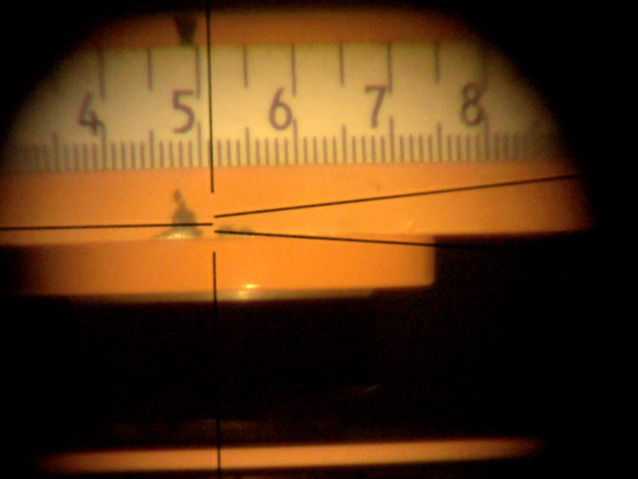
Object model (PyAPI 2015 May)
VideoFile
CSVFile
~4000 line of code
~1200 line comment
~30 module/class
TCRA1100
RDBMS
File
HTTP
TCA1800
TPS1200
WebCAMUnit
Writer
Leica
LevelUnit
BMP180Unit
USBIface
VideoIface
MetUnit
BluetoothInterf
NmeaGps
Trimble5500
BluetoothIface
SerialIface
LocalIface
MeasureUnit
Iface
LSM9DS0Unit
I2CIface
Used Python
modules
Independent
classes
Logging
Angle
DigitalLevel
BMP180
LSM9DS0
Reader
serial
Image
TotalStation
GPS
cv2/cv
Key
pyusb
Sensor
Planned
smbus
Not finished
Base class
Ready

Slide 10
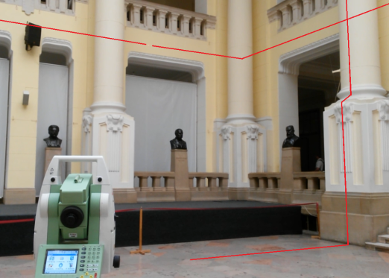
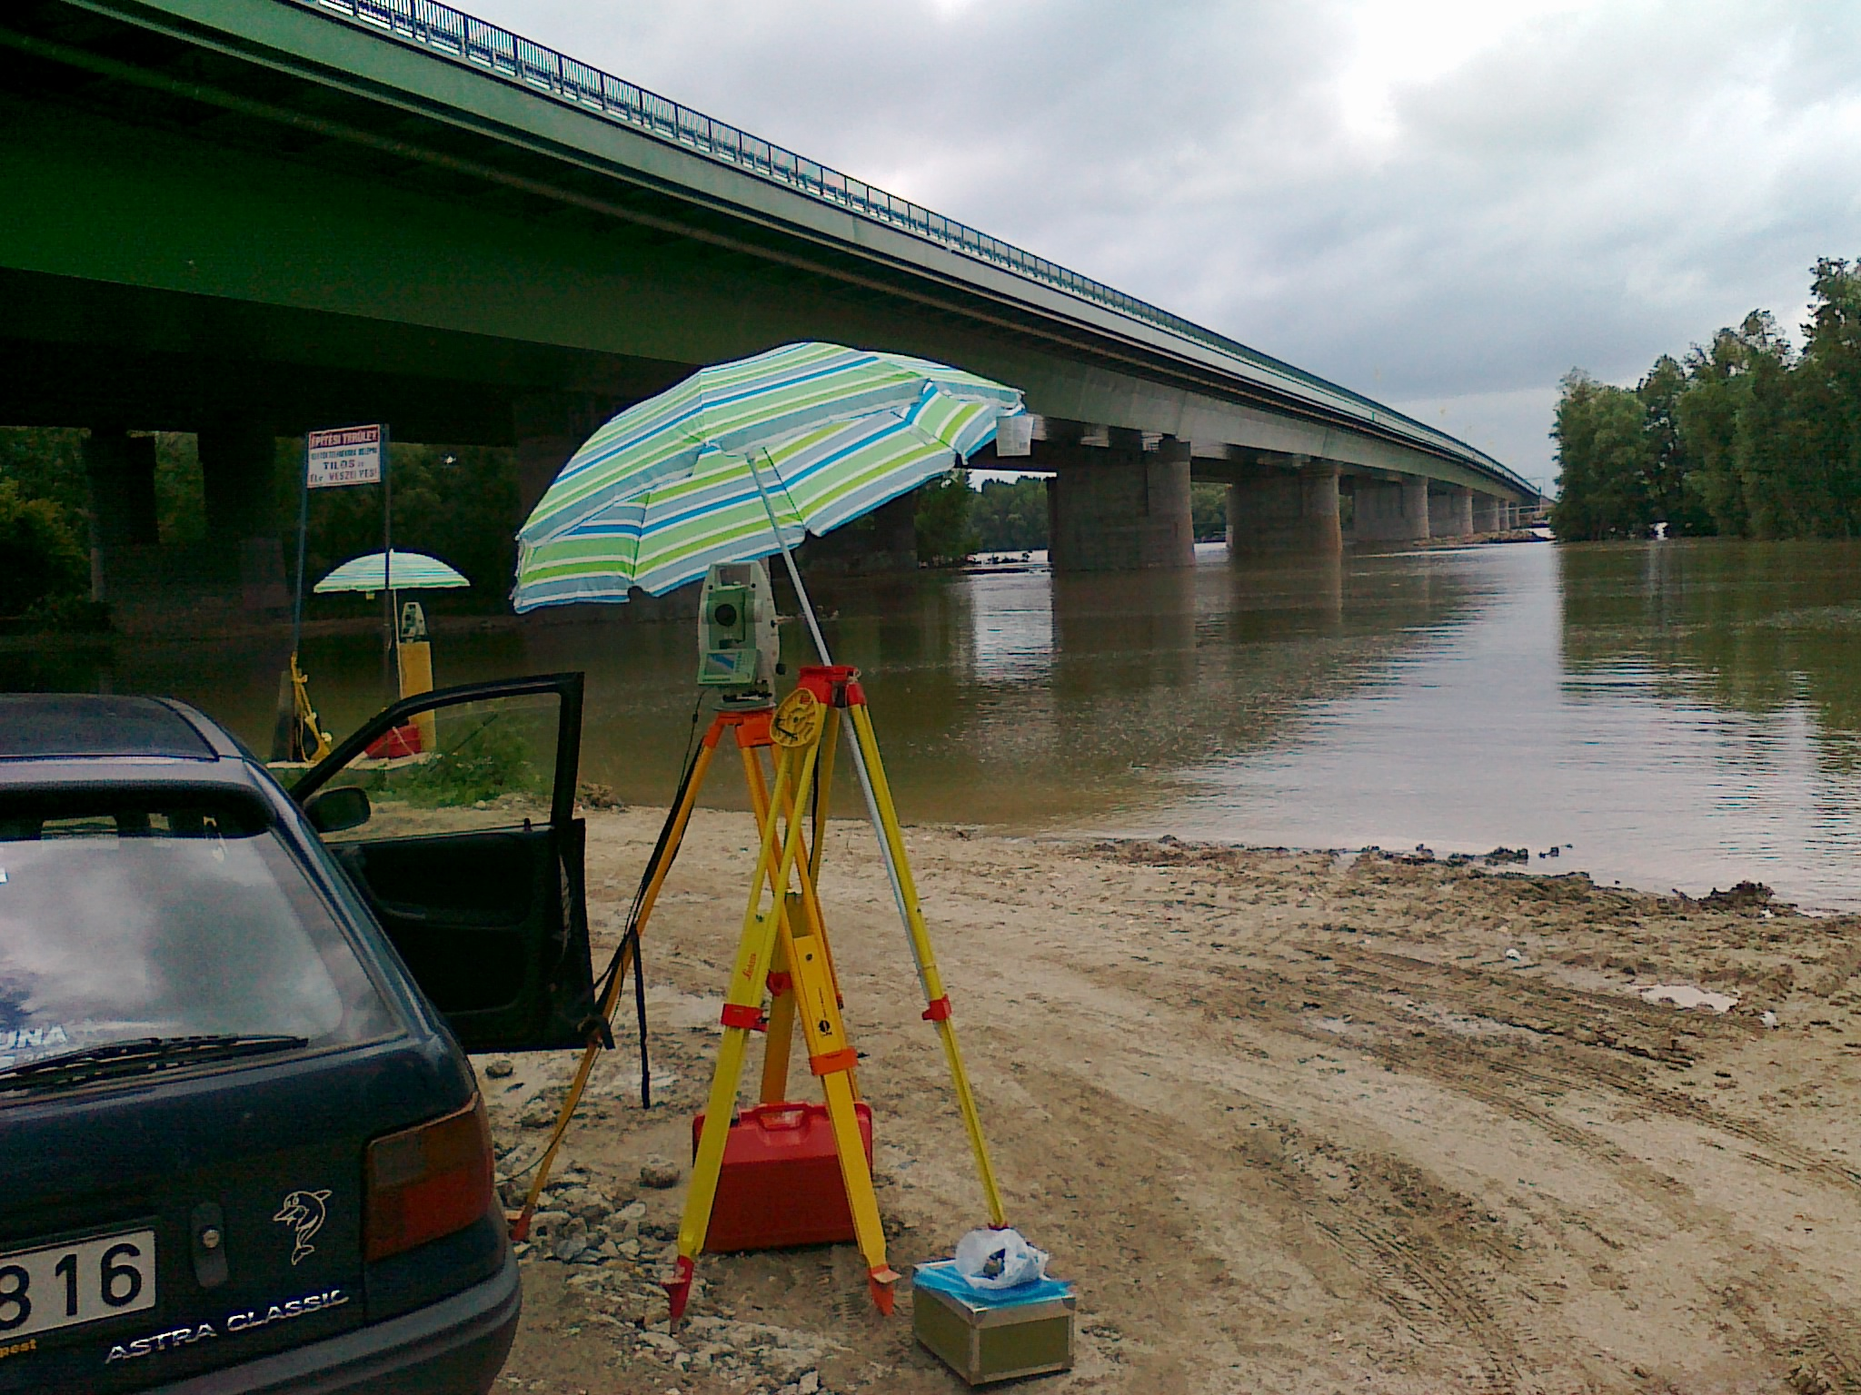
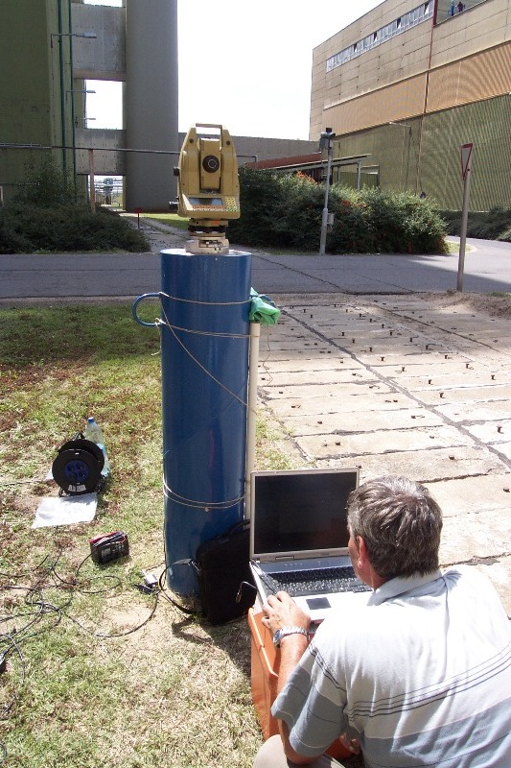
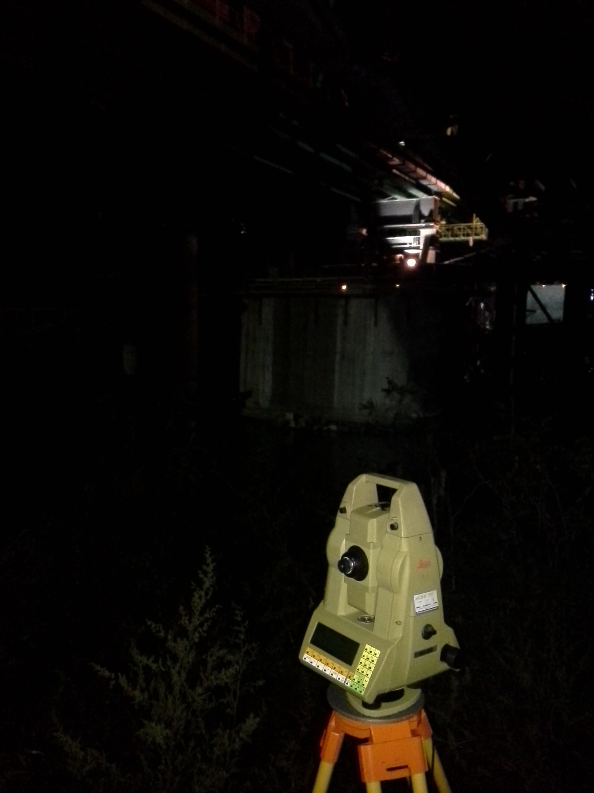
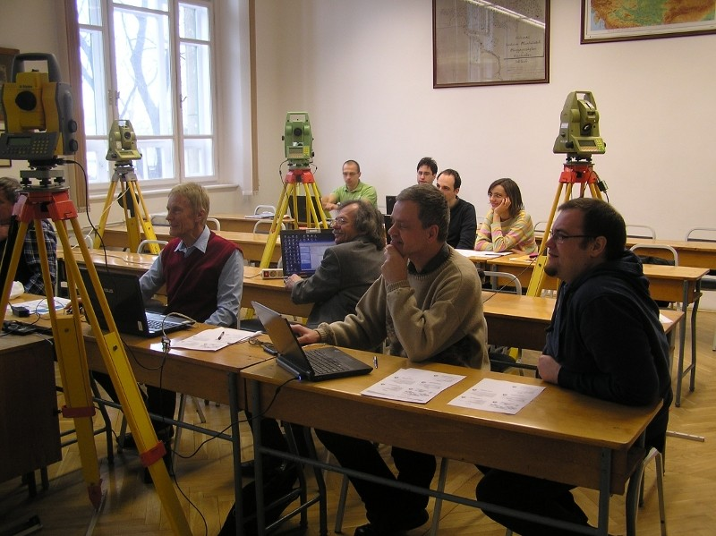
Applications

Slide 11
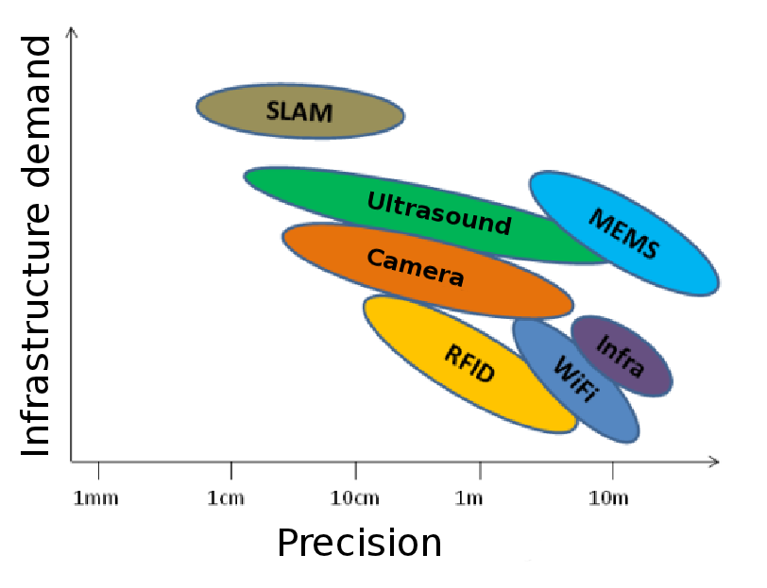
Indoor localization methods
Simultaneous Localization and Mapping
Dead Reckoning (deduced)
WiFi
fingerprinting
Source: Msc diploma work Daniel Moka BME 2015.

Slide 12

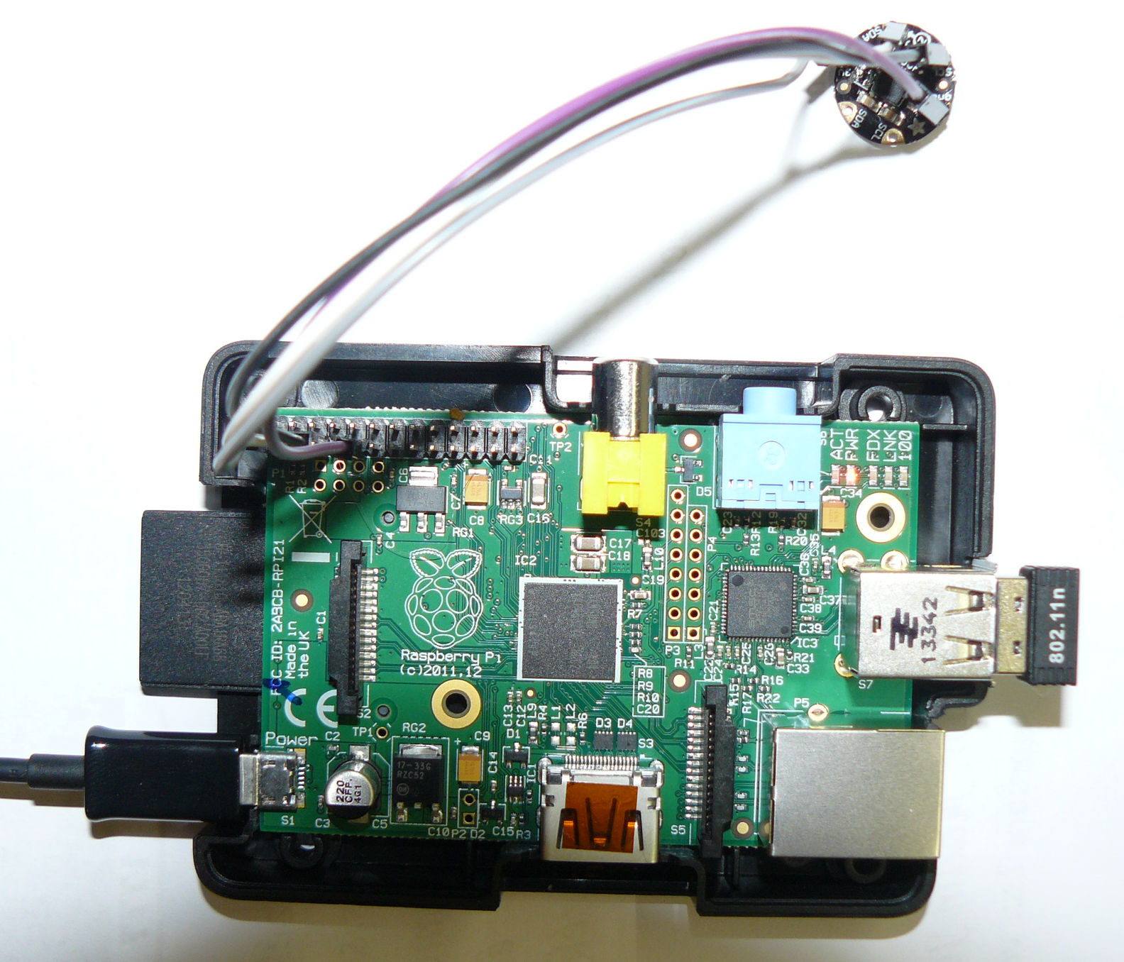
Raspberry Pi and MEMS
Micro
Electro
Mechanical
Sensor
For example:
9/10 DOF sensor
~ 6 cm
Compact system
Cheap components
I2C interface
GPS available, too

Slide 13
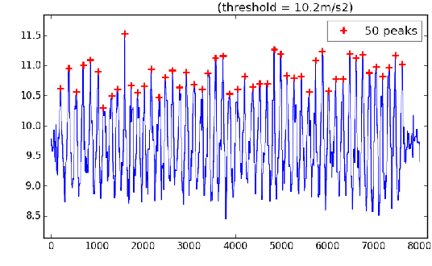
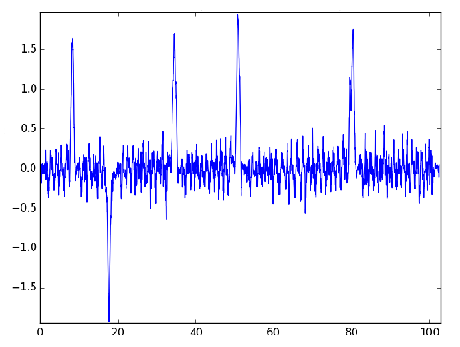

Dead reckoning
distance = step length * step count
Barometric elevation
Direction from
gyroscope or magnetometer
Acceleration in Z direction [m/s2]
Known start point needed
Cumulative errors
Reference points e.g. QR code
to reduce cumulative errors
Roll [radians]
ID= 5;X = 12.34;Y=43.23
Source: Msc diploma work Daniel Moka BME 2015.

Slide 14
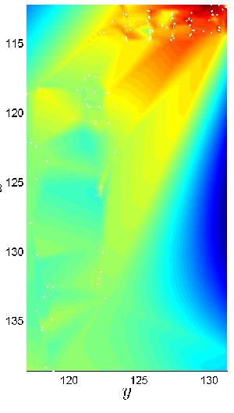
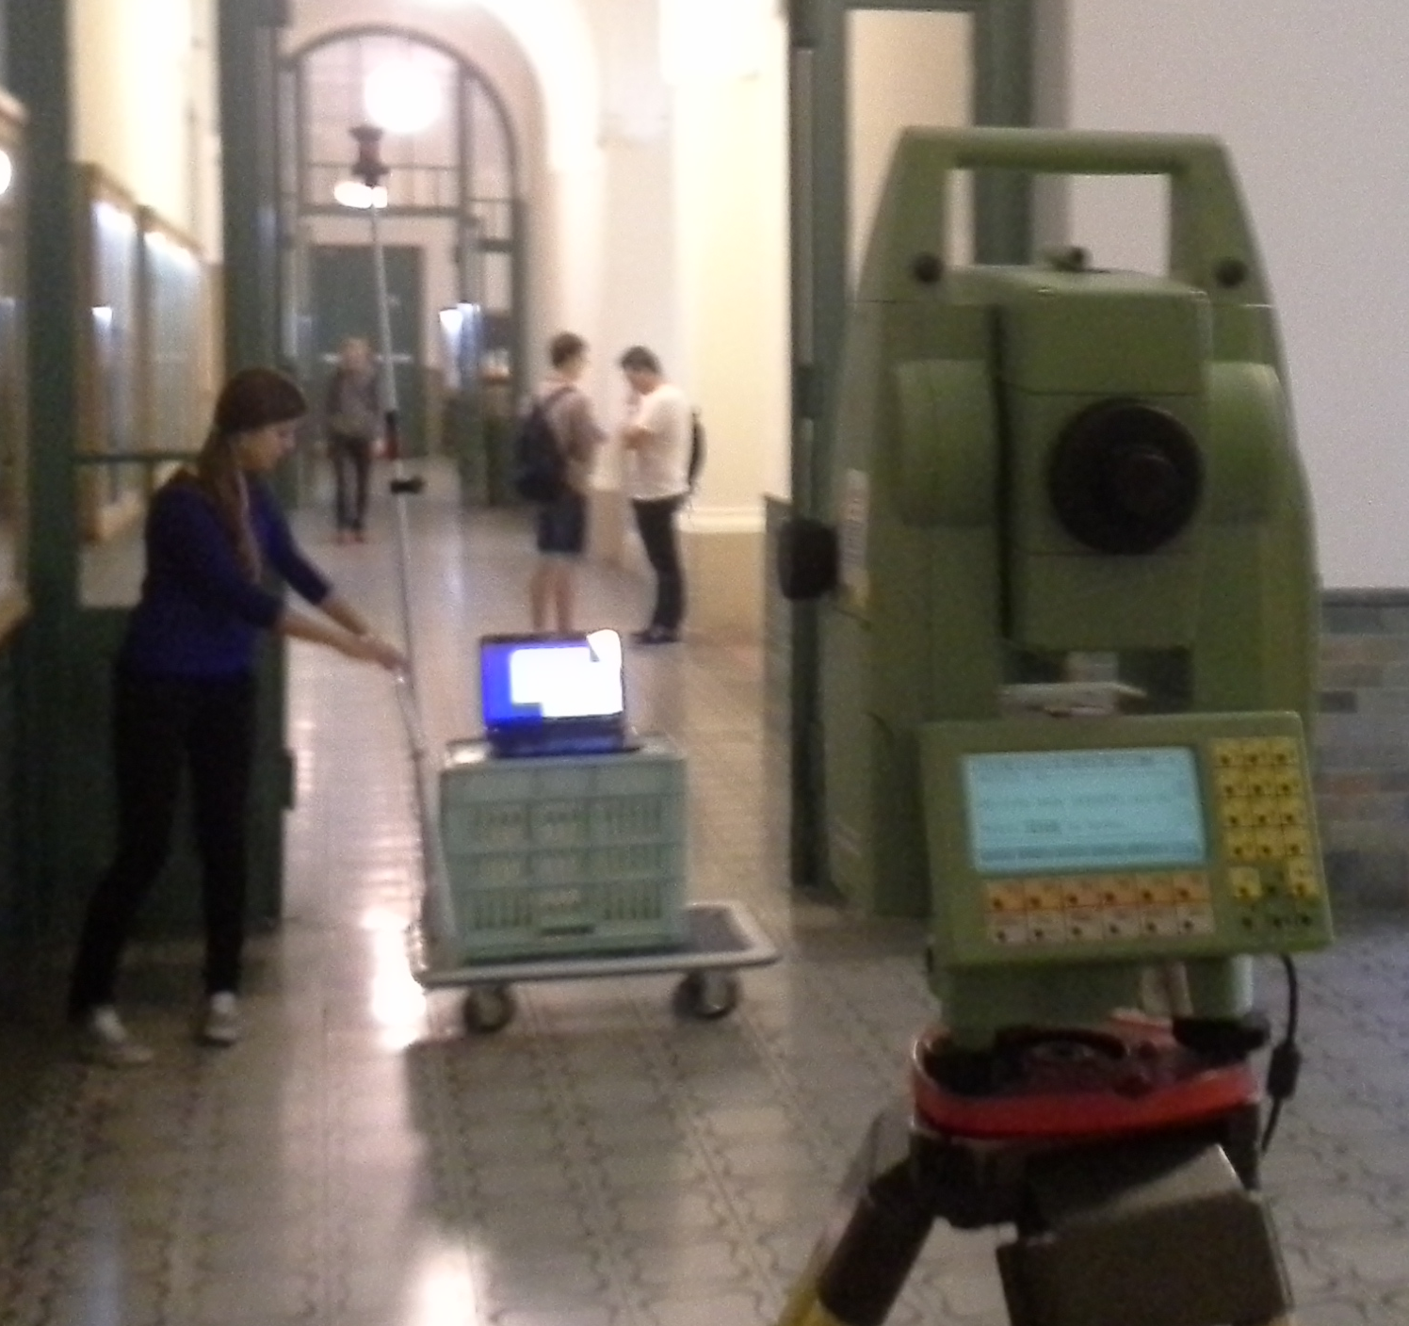
WiFi RSSI survey
RSSI:
Received Signal Strength Indicator
Alternative solution:
Magnetic field
Mobil signal strength
Source: Bsc diploma work Mónika Fanczal BME 2015.

Slide 15
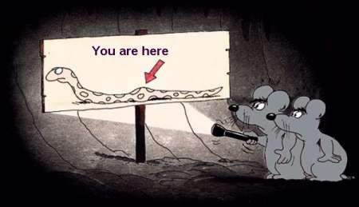
Perfect indoor (insnake) navigation
http://www.funnyzone.org/funny-cartoons/you-are-here-perfect-navigation/

