Slide 1
PWN-栈溢出
张少杰

Slide 2
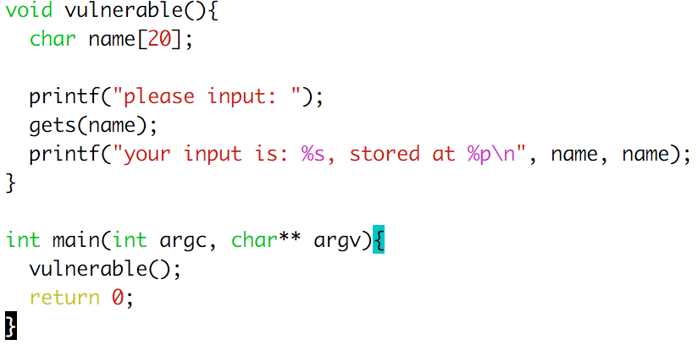
举个栗子
Notes:
gcc test.c -o test
cat input - | ./test
how to feed non-printable chars to program?
python, perl, …
how to feed input to attached process in GDB?
http://stackoverflow.com/questions/593724/redirect-stderr-stdout-of-a-process-after-its-been-started-using-command-lin
execve shell exited normally?
http://stackoverflow.com/questions/2859127/shellcode-for-a-simple-stack-overflow-exploited-program-with-shell-terminates-d
http://users.silenceisdefeat.net/j/security/2040
http://security.stackexchange.com/questions/73878/program-exiting-after-executing-int-0x80-instruction-when-running-shellcode

Slide 3
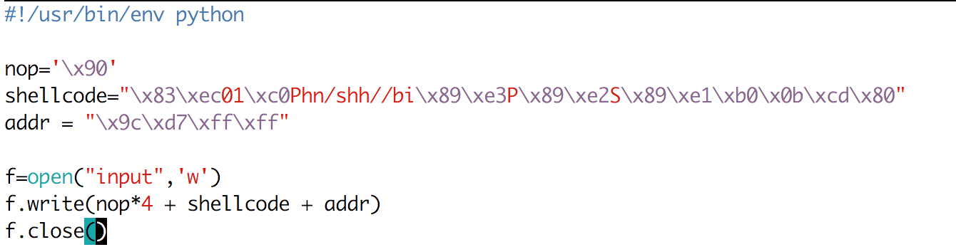
编译
编译
gcc test.c -m32 -fno-stack-protector -z execstack -o test
-m32: 32位
-fno-stack-protector: 禁用栈cookie
-z execstack: 栈可执行
Test
Notes:
http://www.madhur.co.in/blog/2011/08/06/protbufferoverflow.html

Slide 4
Ret2shellcode
shellcode (aka payload) | padding | &buf
computation + control
"\x31\xc9\xf7\xe1\x51\x68\x2f\x2f”
"\x73\x68\x68\x2f\x62\x69\x6e\x89”
"\xe3\xb0\x0b\xcd\x80”;

Slide 5
但是
Compile
gcc test.c -m32 -fno-stack-protector -o test.dep
-m32
-fno-stack-protector
-z execstack
Test
Notes:
http://www.madhur.co.in/blog/2011/08/06/protbufferoverflow.html

Slide 6
DEP: Data Execution Prevention
shellcode | padding | &buf
CRASH
其实增加了拒绝服务攻击
Notes:
execstack

Slide 7
DEP Scorecard
Aspect | 数据执行保护
性能 | 硬件支持 性能损耗：<1%
能力范围 | 特定的程序不适应 JIT 加壳
Notes:
Windows allowed opting-out at runtime. PaX is the linux kernel patch -- Page Exec Project

Slide 8
ROP-2: return-to-libc
覆盖RET变为内存中已有的代码.
临时变量
ret
栈帧
buffer
(stack)
(libc.so)
exec()
printf()
"/bin/shell"

Slide 9
Return-to-libc 攻击
通过覆盖返回地址为一个libc中的函数比如system
在栈上布局参数和函数地址
通过调用ret来调用函数
无代码注入!
“/bin/sh”
fake arg 1
fake ret addr
&system()
caller’s ebp
buf (64 bytes)
Notes:
Return to libc can bypass DEP – you are not executing stack entries, but legitimate code.

Slide 10
ASLR on Linux
未随机化
随机化
Libc
Program Image
Stack
Heap
Notes:
Let’s look at the ASLR implementation in Linux as an example

Slide 11
ret2text
ptr to “/bin/sh”
…
argv
argc
return addr
caller’s ebp
“/bin/sh"
argv[1]
buf
ret transfers control to system, which finds arguments on stack
&system
Overwrite return address with address of libc function
setup fake return address and argument(s)
ret will “call” libc function
No injected code!
%ebp
%esp

Slide 12
Question
Randomized!
ptr to “/bin/sh”
…
argv
argc
return addr
caller’s ebp
“/bin/sh"
argv[1]
buf
&system
%ebp
With ASLR, we cannot forge a correct value for ptr since ASLR will randomize addresses.
What can we do?
%esp

Slide 13
Computed “/bin/sh”
Writes
&system
gadgets to compute ptr to “/bin/sh”
Idea!
Get a copy of ESP to calculate address of “/bin/sh” on randomized stack.
This works because ASLR only protects against knowing absolute addresses, while we will find it’s relative address.
…
argv
argc
return addr
caller’s ebp
buf “/bin/sh”
argv[1]
buf
Notes:
Useful, for example, to get a copy of ESP. If we know relative offset of ptr to esp, we can know use that relative offset knowledge to locate a pointer.
This overcomes ASLR because ASLR only protects against knowing absolute addresses.

Slide 14
Return Oriented Programming Techniques
Return chaining
Semantic equivalence
ROP on Windows

Slide 15
Return Chaining
Suppose we want to call 2 functions in our exploit: foo(arg1, arg2) bar(arg3, arg4)
Stack unwinds up
First function returns into code to advance stack pointer
e.g., pop; pop; ret
arg4
arg3
&(pop-pop-ret)
bar
arg2
arg1
&(pop-pop-ret)
foo
What does this do?
Overwritten ret addr
Notes:
Note that when foo runs, foo thinks &pop-pop-ret as the saved return address. It accesses arg1 and arg2.
When foo returns, it executes &pop-pop-ret to remove the arguments to foo, and then executes bar.

Slide 16
Return Chaining
When foo is executing, &pop-pop-ret is at the saved EIP slot.
When foo returns, it executes pop-pop-ret to clear up arg1 (pop), arg2 (pop), and transfer control to bar (ret)
arg4
arg3
&(pop-pop-ret)
bar
arg2
arg1
&(pop-pop-ret)
foo
Notes:
Note that when foo runs, foo thinks &pop-pop-ret as the saved return address. It accesses arg1 and arg2.
When foo returns, it executes &pop-pop-ret to remove the arguments to foo, and then executes bar.

Slide 17
There are many semantically equivalent ways to achieve the same net shellcode effect
Let’s practice thinking in gadgets

Slide 18
An example operation
...
v₂
...
v₁
Mem[v2] = v1
Desired Logic
esp
Stack
a₁: mov eax, [esp] ; eax has v1
a₂: mov ebx, [esp+8] ; ebx has v2
a₃: mov [ebx], eax ; Mem[v2] = eax
Implementation 1

Slide 19
implementing with gadgets
Suppose a₅ and a₃ on stack
a₅
v₂
a₃
v₁
Mem[v2] = v1
Desired Logic
esp
Stack
a₁: pop eax
a₂: ret
a₃: pop ebx
a₄: ret
a₅: mov [ebx], eax
eax
ebx
eip
v₁
a₁
Implementation 2

Slide 20
implementing with gadgets
a₅
v₂
a₃
v₁
Mem[v2] = v1
Desired Logic
esp
Stack
a₁: pop eax
a₂: ret
a₃: pop ebx
a₄: ret
a₅: mov [ebx], eax
eax
ebx
eip
v₁
a₁
a₃
Implementation 2

Slide 21
implementing with gadgets
a₅
v₂
a₃
v₁
Mem[v2] = v1
esp
Desired Logic
Stack
a₁: pop eax
a₂: ret
a₃: pop ebx
a₄: ret
a₅: mov [ebx], eax
eax
ebx
eip
v₁
v₂
a₃
Implementation 2

Slide 22
implementing with gadgets
a₅
v₂
a₃
v₁
esp
Mem[v2] = v1
Desired Logic
Stack
a₁: pop eax;
a₂: ret
a₃: pop ebx;
a₄: ret
a₅: mov [ebx], eax
eax
ebx
eip
v₁
v₂
a₄
a₅
Implementation 2

Slide 23
implementing with gadgets
esp
a₅
v₂
a₃
v₁
Mem[v2] = v1
Desired Logic
Stack
a₁: pop eax;
a₂: ret
a₃: pop ebx;
a₄: ret
a₅: mov [ebx], eax
Gadget 1
eax
ebx
eip
v₁
v₂
Gadget 2
a₅
Implementation 2
Notes:
Note the gadgets can be in separate locations...gadget 1 does not have to be contiguous with gadget 2.

Slide 24
Equivalence
a₃
v₂
a₂
v₁
Mem[v2] = v1
Desired Logic
semantically equivalent
esp
Stack
“Gadgets”
a₁: mov eax, [esp]
a₂: mov ebx, [esp+8]
a₃: mov [ebx], eax
a₁: pop eax; ret
a₂: pop ebx; ret
a₃: mov [ebx], eax
Implementation 1
Implementation 2

Slide 25
Return-Oriented Programming (ROP)
…
argv
argc
return addr
caller’s ebp
buf (64 bytes)
argv[1]
buf
Mem[v2] = v1
Desired Shellcode
%ebp
Find needed instruction gadgets at addresses a₁, a₂, and a₃ in existing code
Overwrite stack to execute a₁, a₂, and then a₃
%esp

Slide 26
Return-Oriented Programming (ROP)
a₃
v₂
a₂
v₁
a₁
…
argv
argc
return addr
caller’s ebp
buf (64 bytes)
argv[1]
buf
Mem[v2] = v1
Desired Shellcode
%ebp
a₁: pop eax; ret
a₂: pop ebx; ret
a₃: mov [ebx], eax
Desired store executed!
%esp

Slide 27
Equivalence
a₃
v₂
a₂
v₁
Mem[v2] = v1
Desired Logic
Address independent!
Stack
a₁: pop eax; ret
...
a₃: mov [ebx], eax ...
a₂: pop ebx; ret
a₁: pop eax; ret
a₂: pop ebx; ret
a₃: mov [ebx], eax
Implementation 2

Slide 28
Gadgets
A gadget is a set of instructions for carrying out a semantic action
mov, add, etc.
Gadgets typically have a number of instructions
One instruction = native instruction set
More instructions = synthesize <- ROP
Gadgets in ROP generally (but not always) end in return

Slide 29
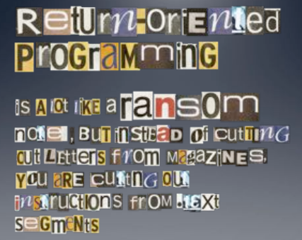
Image by Dino Dai Zovi

Slide 30
Quiz
void foo(char *input){
char buf[512];
...
strcpy (buf, input);
return;
}
a₁: add $0x80, %eax; pop %ebp; ret
a₂: pop %eax; ret
Draw a stack diagram and ROP exploit to pop a value 0xBBBBBBBB into eax and add 0x80.
ret instr
Known Gadgets

Slide 31
Quiz
void foo(char *input){
char buf[512];
...
strcpy (buf, input);
return;
}
a₁: add eax, 0x80; pop %ebp; ret
a₂: pop %eax; ret
<data for pop ebp>
a₁
0xBBBBBBBB
a₂
saved ebp
buf
gadget 1 + data
Overwrite buf
gadget 2
AAAAA ... a₂ 0xBBBBBBBB a₁

Slide 32
RO(P?) Programming
Disassemble code
Identify useful code sequences as gadgets
Assemble gadgets into desired shellcode

Slide 33
Disassembling Code

Slide 34
Recall: Execution Model
Process Memory
Fetch, decode, execute
Code
Processor
EIP
Stack
Heap
read and write

Slide 35
Disassembly
user@box:~/l2$ objdump -d ./file
...
00000000 <even_sum>:
0: 55 push %ebp
1: 89 e5 mov %esp,%ebp
3: 83 ec 10 sub $0x10,%esp
6: 8b 45 0c mov 0xc(%ebp),%eax
9: 03 45 08 add 0x8(%ebp),%eax
c: 03 45 10 add 0x10(%ebp),%eax
f: 89 45 fc mov %eax,0xfffffffc(%ebp)
12: 8b 45 fc mov 0xfffffffc(%ebp),%eax
15: 83 e0 01 and $0x1,%eax
18: 84 c0 test %al,%al
1a: 74 03 je 1f <even_sum+0x1f>
1c: ff 45 fc incl 0xfffffffc(%ebp)
1f: 8b 45 fc mov 0xfffffffc(%ebp),%eax
22: c9 leave
23: c3 ret
Disassemble
Address
Executable instructions

Slide 36
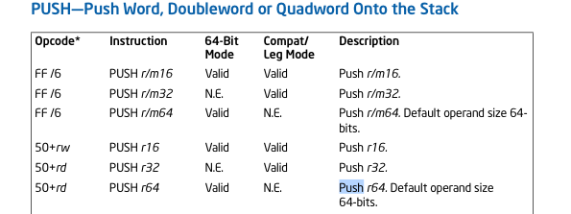
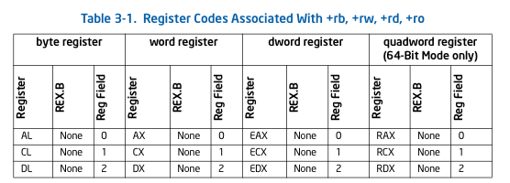
Linear-Sweep Disassembly
Executable Instructions
0x55 | 0x89 | 0xe5 | 0x83 | 0xec | 0x10 | ... | 0xc9
Disassembler EIP
Algorithm:
Decode Instruction
Advance EIP by len
push ebp

Slide 37
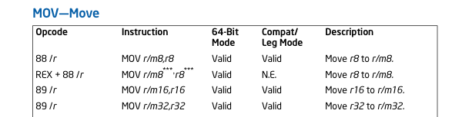
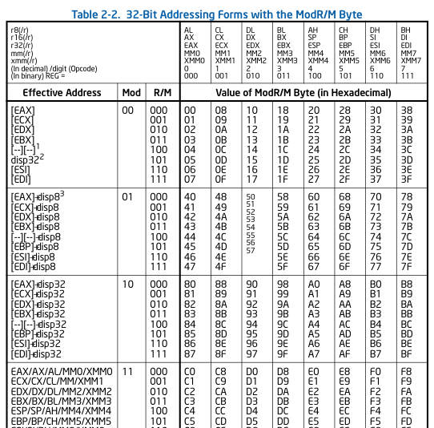
Linear-Sweep Disassembly
Executable Instructions
0x55 | 0x89 | 0xe5 | 0x83 | 0xec | 0x10 | ... | 0xc9
Disassembler EIP
...
push ebp
push ebp
mov %esp, %ebp

Slide 38
Linear-Sweep Disassembly
Executable Instructions
0x55 | 0x89 | 0xe5 | 0x83 | 0xec | 0x10 | ... | 0xc9
Disassembler EIP
Note we don’t follow jumps: we just increment by instruction length
Algorithm:
Decode Instruction
Advance EIP by len
push ebp
push ebp
mov %esp, %ebp

Slide 39
Disassemble from any address
Normal Execution
push ebp
mov %esp, %ebp
0x55 | 0x89 | 0xe5 | 0x83 | 0xec | 0x10 | ... | 0xc9
Disassembler EIP
It’s perfectly valid to start disassembling from any address and all byte sequences will have a
unique disassembly

Slide 40
Recursive Descent
Follow jumps and returns instead of linear sweep
Undecidable: indirect jumps
Where does jmp *eax go?

Slide 41
ROP and Disassembly
Compiler-created gadget: A sequence of instructions inserted by the compiler ending in ret.
Unintended gadget: A sequence of instructions not created by the compiler, e.g., by starting disassembly at an unaligned start.

Slide 42
Example: ecb_crypt()
Intended
Unintended
c7
45
d4
01
00
00
00
f7
c7
07
00
00
00
0f
95
45
c3
movl $0x00000001, -44(%ebp)
add %dh, %bh
test $0x00000007, %edi
movl $0x0F000000, (%edi)
setnzb -61(%ebp)
xchg %ebp, %eax
inc %ebp
ret
Slide credit: Hovav Shacham Blackhat 2008 Talk

Slide 43
ROP Programming
Disassemble code
Identify useful code sequences as gadgets
Assemble gadgets into desired shellcode

Slide 44
Example in 04-exercises
Notes:
See notes onenote dairy

Slide 45
ROPing Windows
BOOL WINAPI VirtualProtect(
LPVOID lpAddress, // dynamically determined base addr to pages to change
SIZE_T dwSize, // size of the region in bytes
DWORD flNewProtect, // 0x40 = EXECUTE_READWRITE
PDWORD flProtect // A ptr to a variable for prev. arg
);
VirtualProtect() can un-DEP a memory region

Slide 46
VirtualProtect Diagram
flProtect (a ptr to mem)
flNewProtect (static)
dwSize (dynamic)
lpAddress (dynamic)
&VirtualProtect
Craft lpAddress
Craft dwSize
LPVOID WINAPI VirtualProtect(
LPVOID lpAddress,
SIZE_T dwSize,
DWORD DWORD flNewProtect,
DWORD flProtect
);

Slide 47
ROPing Windows: An Example Exploit (pre-Win 8)
2. gadgets to get stack pointer and save it to a register (push %esp; pop %eax; ret) & jump below the parameters (add esp, offset; ret)
(data) Pointer to VirtualProtect (static) lpAddress placeholder: base addr to pages to change dwSize placeholder: size of the region in bytes flNewProtect placeholder: EXECUTE_READWRITE flProtect: A ptr to a variable for prev. arg
3. Gadget to overwrite placeholder for Param 1 with value (Pointer to shellcode = saved ESP + offset)
4. Gadget to overwrite placeholder for Param 2 with value
5. Gadget to overwrite placeholder for Param 3 with value
6. Gadget to overwrite placeholder for Param 4
7. Change value of ESP back to where pointer to VirtualProtect is, then ret
Padding/NOPS
Shellcode
1. Stack Pivot
esp
Gadgets to run shellcode (not shown)
Key
Data
Code
From https://www.corelan.be/index.php/2010/06/16/exploit-writing-tutorial-part-10-chaining-dep-with-rop-the-rubikstm-cube/
Notes:
Slide from https://www.corelan.be/index.php/2010/06/16/exploit-writing-tutorial-part-10-chaining-dep-with-rop-the-rubikstm-cube/
Step 1: Set up a stack pivot to point to our attacker-supplied data.
Step 2: Gadgets execute to get and save the stack pointer. Note that we have data just below this that contains placeholder data. This will be overwritten by gadgets.
Step 3: Create values for Param 1
Step 4: Create values for Param 2
Step 5: Create values for Param 3
Step 6: Create values for Param 4
Step 7: Change value of ESP back to where pointer to VirtualProtect is and then ret
Step 8: <gadgets to execute shellcode>

Slide 48
ROPing Windows: An Example Exploit (pre-Win 8)
Shellcode
Padding/NOPS
7. Change value of ESP back to where pointer to VirtualProtect is, then ret
6. Gadget to overwrite placeholder for Param 4
5. Gadget to overwrite placeholder for Param 3 with value
4. Gadget to overwrite placeholder for Param 2 with value
3. Gadget to overwrite placeholder for Param 1 with value (Pointer to shellcode = saved ESP + offset)
flProtect: A ptr to a variable for prev. arg flNewProtect placeholder: EXECUTE_READWRITE dwSize placeholder: size of the region in bytes lpAddress placeholder: base addr to pages to change Pointer to VirtualProtect (static) and space for params:
2. gadgets to get stack pointer and save it to a register (push %esp; pop %eax; ret) & adjust esp (add esp, offset; ret)
Gadgets to run shellcode (not shown)
(initially
placeholder
Values. ROPed)
1. Stack Pivot
esp
From https://www.corelan.be/index.php/2010/06/16/exploit-writing-tutorial-part-10-chaining-dep-with-rop-the-rubikstm-cube/
Notes:
* NOTE Someone could legitimately complain the arguments to VirtualProtect are listed backward.
Slide from https://www.corelan.be/index.php/2010/06/16/exploit-writing-tutorial-part-10-chaining-dep-with-rop-the-rubikstm-cube/
Step 1: Set up a stack pivot to point to our attacker-supplied data.
Step 2: Gadgets execute to get and save the stack pointer. Note that we have data just above this that contains placeholder data. This will be overwritten by gadgets.
Step 3: Create values for Param 1
Step 4: Create values for Param 2
Step 5: Create values for Param 3
Step 6: Create values for Param 4
Step 7: Change value of ESP back to where pointer to VirtualProtect is and then ret
Step 8: <gadgets to execute shellcode>

Slide 49
Stack Pivots Pointing esp to controlled data
Fact: Functions often access arguments with respect to esp
Defn: A stack pivot redirects esp at attacker-controlled data
Example: Attacker controls heap data pointed to be ESI. One stack pivot may be: xchg esi, esp; ret Now esp points to the attacker-controlled data.

Slide 50
Other References
Thorough introduction: https://www.corelan.be/index.php/2010/06/16/exploit-writing-tutorial-part-10-chaining-dep-with-rop-the-rubikstm-cube/
Adopting to Win8:
http://vulnfactory.org/blog/2011/09/21/defeating-windows-8-rop-mitigation/

Slide 51
ROP Programming
Disassemble all sequences ending in ret
Disassemble code
Identify useful code sequences ending in ret as gadgets
Assemble gadgets into desired shellcode

Slide 52
ROP: Shacham et al.
Automatic
Disassemble code
Identify useful code sequences as gadgets ending in ret
Assemble gadgets into desired shellcode
Hard work*
* There is research like Q (a CMU ROP compiler) that automates this

Slide 53

Questions?

Slide 54
END

