Slide 1


Anchors Bring Ease:
An Embarrassingly Simple Approach to Partial Multi-view Clustering
Jun Guo* and Jiahui Ye*
Tsinghua-Berkeley Shenzhen Institute (TBSI),
Tsinghua University, P. R. China
eeguojun@outlook.com , yejiahui079@gmail.com

Slide 2
Outline
Introduction
The proposed method
Experiments and analysis
Summary and future work

Slide 3
Outline
Introduction
The proposed method
Experiments and analysis
Summary and future work

Slide 4
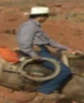





Multi-view Clustering
①
②
③
④
⑤
⑥
The 29-year-old telecoms manager recently sold his motorbike and moved back to home.
Cops are now asking the public's help identifying the two men. One is described as his.
view-
view-
If you have built castles in the air, your work need not be lost; that is where they should be.
③
④
④
⑤
①
Clustering
⑥
⑥
In fact, the cosmic jellyfish is seen to be part of bubble-shaped supernova remnant IC 443.
①
②
③
⑤
②
The penguins porpoised away on all sides. So together, the penguin rows to the south pole.
cluster-1 cluster-2
cluster-2 cluster-1
The courier was walking with a plastic bag filled with cash on Burhe Ave. near Hobart Ave.
In unsupervised scenarios:
  Instances are from diverse domains (views).
  Different views have a unified partition of instances.

Slide 5




Partial Multi-view Clustering
①
②
③
④
⑤
⑥
×
×
view-
view-
If you have built castles in the air, your work need not be lost; that is where they should be.
③
④
④
⑤
①
Clustering
⑥
⑥
In fact, the cosmic jellyfish is seen to be part of bubble-shaped supernova remnant IC 443.
①
②
③
⑤
②
The penguins porpoised away on all sides. So together, the penguin rows to the south pole.
cluster-1 cluster-2
cluster-2 cluster-1
Inconsistent !
×
The courier was walking with a plastic bag filled with cash on Burhe Ave. near Hobart Ave.
Partial multi-view data:
  Each view may suffer from missing some instances.
  Each instance is available in at least one view.
Notes:
The shaded area means ‘missing’.

Slide 6
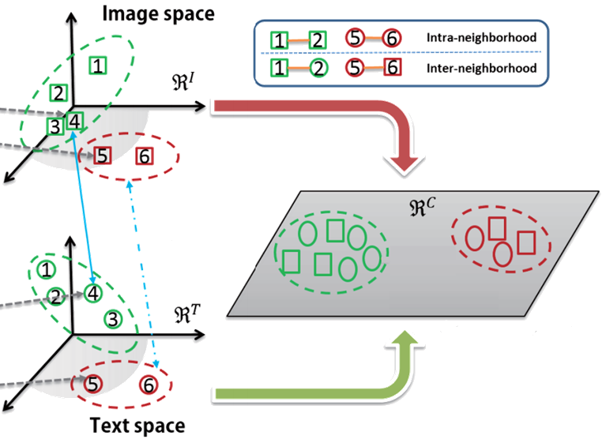
Related Works
①
②
③
④
⑤
⑥
×
×
If you have built castles in the air, your work need not be lost; that is where they should be.
In fact, the cosmic jellyfish is seen to be part of bubble-shaped supernova remnant IC 443.
The penguins porpoised away on all sides. So together, the penguin rows to the south pole.
Common / Latent Space
×
The courier was walking with a plastic bag filled with cash on Burhe Ave. near Hobart Ave.
Based on matrix factorization:
  MultiNMF [SDM’13].
  MIC [ECML/PKDD’15].
  PVC [AAAI’14].
  IMG [IJCAI’16].
  DAIMC [IJCAI’18].
Notes:
[1] “Multi-view clustering via joint nonnegative matrix factorization,” SDM 2013.
[2] “Partial multi-view clustering,” AAAI 2014.
[3] “Multiple incomplete views clustering via weighted NMF with L₂₁ regularization,” ECML/PKDD 2015.
[4] “Incomplete multi-modal visual data grouping,” IJCAI 2016.
[5] “Doubly aligned incomplete multi-view clustering,” IJCAI 2018.

Slide 7
Drawbacks of Related Works
Few non-linear relations among instances.
  Matrix factorization models involving in linear operations can capture various linear correlations among instances, neglecting potential and valuable nonlinear relations.
Relatively high time cost.
  The algorithm is iterative for multi-variable optimization with a quadratic or even cubic time complexity.
Limited generalization ability.
  Some methods cannot directly handle negative entries, such as MultiNMF [SDM’13] and MIC [ECML/PKDD’15].
  Some methods are designed for only two partial views, such as PVC [AAAI’14] and IMG [IJCAI’16].

Slide 8
Drawbacks of Related Works
Few non-linear relations among instances.
  Matrix factorization models involving in linear operations can capture various linear correlations among instances, neglecting potential and valuable nonlinear relations.
Relatively high time cost.
  The algorithm is iterative for multi-variable optimization with a quadratic or even cubic time complexity.
Limited generalization ability.
  Some methods cannot directly handle negative entries, such as MultiNMF [SDM’13] and MIC [ECML/PKDD’15].
  Some methods are designed for only two partial views, such as PVC [AAAI’14] and IMG [IJCAI’16].

Slide 9
Drawbacks of Related Works
Few non-linear relations among instances.
  Matrix factorization models involving in linear operations can capture various linear correlations among instances, neglecting potential and valuable nonlinear relations.
Relatively high time cost.
  The algorithm is iterative for multi-variable optimization with a quadratic or even cubic time complexity.
Limited generalization ability.
  Some methods cannot directly handle negative entries, such as MultiNMF [SDM’13] and MIC [ECML/PKDD’15].
  Some methods are designed for only two partial views, such as PVC [AAAI’14] and IMG [IJCAI’16].

Slide 10
Outline
Introduction
The proposed method
Experiments and analysis
Summary and future work

Slide 11
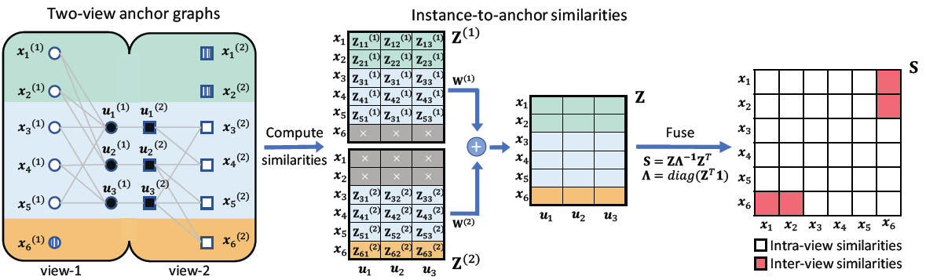
The Proposed APMC Method
Illustration of our proposed Anchor-based Partial Multi-view Clustering (APMC) method
  The figure above shows a non-iterative module called Anchor-based Similarity Reconstruction.
  Then, we can just perform Spectral Clustering on Fused Similarities {S_{ij}} for a unified clustering result.

Slide 12


The Proposed APMC Method
Illustration of our proposed Anchor-based Partial Multi-view Clustering (APMC) method
Establish stationary Markov random walks over each bipartite graph. The one-step transition probabilities p^{<1>} are calculated by instance-to-anchor similarity matrix Z.
Notes:
The instance-to-anchor similarity is defined based on kernel function to capture more nonlinear relations.
In this paper, we adopt the commonly-used Gaussian kernel.

Slide 13
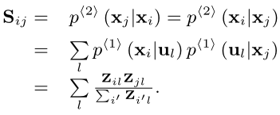
The Proposed APMC Method
Illustration of our proposed Anchor-based Partial Multi-view Clustering (APMC) method
Establish stationary Markov random walks over each bipartite graph. The two-step transition probabilities p^{<2>} serve as similarities {S_{ij}}, which are calculated by

Slide 14
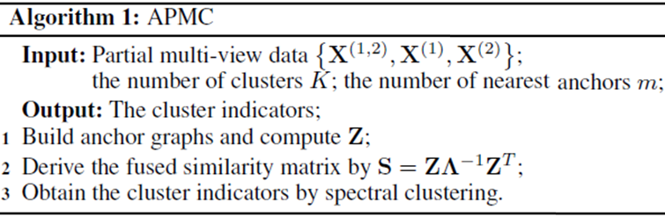


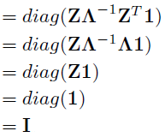

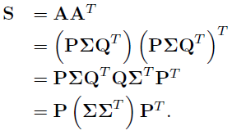
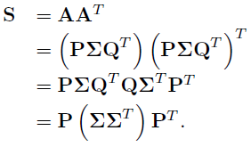
The Proposed APMC Method
The whole algorithm
k-means on F
Fast Spectral Clustering (v1):
1) Perform SVD on A = ZΛ^{-1/2} = PΣQ^{T} ;
2) Select the column vectors of P for F.
[1] “Fast spectral clustering with anchor graph for large hyperspectral images,” IEEE Geoscience and Remote Sensing Letters 2017.
Notes:
Please refer to our paper for more details about Fast Spectral Clustering.

Slide 15

The Proposed APMC Method
The whole algorithm
k-means on F
Fast Spectral Clustering (v2):
1) Compute the K largest eigen values and corresponding eigen vectors of R = A^{T}A = Λ^{-1/2}Z^{T} ZΛ^{-1/2} ;
2) F = ZΛ^{-1/2}BΘ^{-1/2}, where B contains the K eigen vectors, Θ = diag([θ₁,…,θ_{K}]).
[2] “Large graph construction for scalable semi-supervised learning,” ICML 2010.
[3] “Hashing with graphs,” ICML 2011.
Notes:
Please refer to our paper for more details about Fast Spectral Clustering.

Slide 16
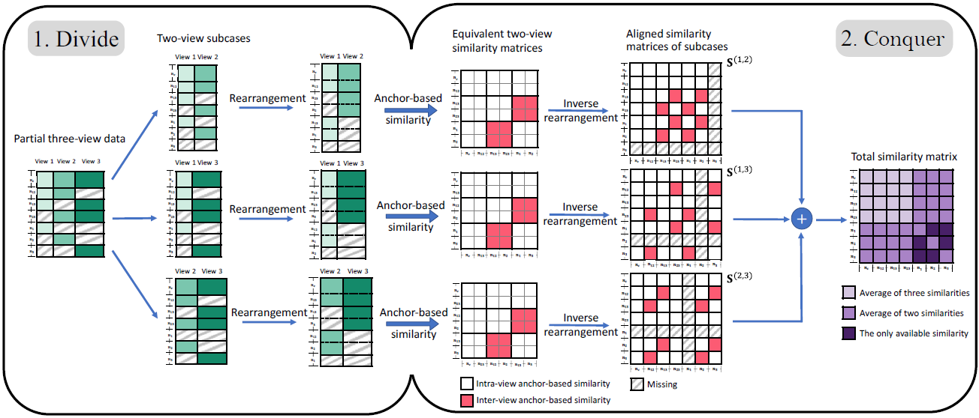
The Proposed APMC Method
Extension for multiple views
  Take three views as an example to show how to conduct Anchor-based Similarity Reconstruction.
Notes:
The final step of spectral clustering is the same as previous description.

Slide 17
Outline
Introduction
The proposed method
Experiments and analysis
Summary and future work

Slide 18
Experimental Setup
Datasets description (Naturally Incomplete)
  3Sources Dataset: News articles covering 416 distinct news stories of six topic classes from three online news sources: BBC, Reuters, and Guardian. Among these distinct stories, 169 are reported in all three sources, 194 are in two sources, and 53 appear in a single news source.
View
 | View-1 | View-2 | View-3 | # of instance
Subset (BBC-Reuters) | 13.51% | 27.76% | --- | 407
Subset (BBC-Guardian) | 12.87% | 25.25% | --- | 404
Subset (Reuters-Guardian) | 23.44% | 21.35% | --- | 384
3Sources | 15.38% | 29.33% | 27.40% | 416
Incomplete Rate
Data

Slide 19
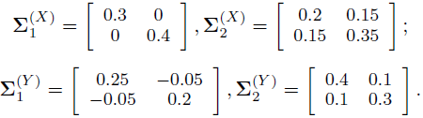

Experimental Setup
Datasets description (Naturally Complete)
  Synthetic Dataset: 200 data points randomly selected from a two-component Gaussian mixture model:
  USPS-MNIST Dataset: 50 images per digit from each dataset (USPS: 16×16, MNIST: 28×28).
  Oxford Flowers Dataset (Flowers): 17 flower classes, with 80 images per class. The χ² distance matrices of color and shape features are regarded as different views.
  Multiple Features Handwritten Dataset (Digit): 200 images per digit. View-1: Fourier coefficients of character shapes. View-2: profile correlations.
Notes:
For synthetic dataset, X and Y denotes View-1 and View-2 respectively.

Slide 20
Experimental Setup
Settings
  Missing instance: delete instances evenly for both views according to a pre-defined setting of Partial Data Ratio (PDR) = [0%, 10%, 30%, 50%, 70%, 90%].
Comparing algorithms
  MultiNMF [SDM’13]
  MIC [ECML/PKDD’15]
  SC[C]: Spectral clustering with concatenated features.
  SC[A]: Spectral clustering on an averaged similarity matrix.
Pre-processing
  Fill missing instances with average features in each view.
  Rescale input data into [0,1], then conduct normalization.
  PVC [AAAI’14]
  IMG [IJCAI’16]
  DAIMC [IJCAI’18]
Notes:
[1] “Multi-view clustering via joint nonnegative matrix factorization,” SDM 2013.
[2] “Partial multi-view clustering,” AAAI 2014.
[3] “Multiple incomplete views clustering via weighted NMF with L₂₁ regularization,” ECML/PKDD 2015.
[4] “Incomplete multi-modal visual data grouping,” IJCAI 2016.
[5] “Doubly aligned incomplete multi-view clustering,” IJCAI 2018.

Slide 21
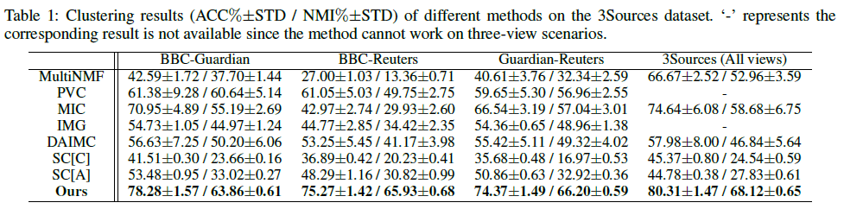
Results and Analysis
  Our proposed method dramatically outperforms two simple baselines SC[C] and SC[A].
  Our proposed method dramatically outperforms two simple baselines SC[C] and SC[A]. This aspect further indicates that it is anchor-based similarity matrix reconstruction, rather than simple spectral clustering, that contributes to the performance improvement.
  When the number of views increases from two to three, our APMC yields even better results, which demonstrates its capability to extend to more than two views.

Slide 22
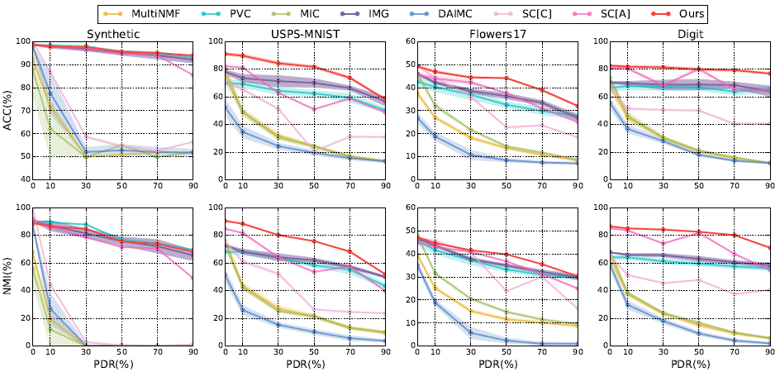
Results and Analysis
  Our proposed APMC method outperforms state-of-the-art methods even though Partial Data Ratio (PDR) increases.
Notes:
Area Under ROC Curve (AUC)

Slide 23
Outline
Introduction
The proposed method
Experiments and analysis
Summary and future work

Slide 24
Summary and Future Work
In this paper,
  A simple yet effective approach dubbed APMC for partial multi-view clustering is proposed.
  Anchors are utilized to integrate intra- and inter- view relations into fused similarities.
  Fast spectral clustering is developed to obtain a unified clustering result.
  A divide-and-conquer strategy is proposed to extend APMC to more than two partial views.
In the future,
  Use adaptive graph to fuse view-specific similarities.
  Adjust APMC to better handle outliers and noise.
  ……

Slide 25


Thank you! (Q&A)
Jun Guo* and Jiahui Ye*
Tsinghua-Berkeley Shenzhen Institute (TBSI),
Tsinghua University, P. R. China
Email: eeguojun@outlook.com , yejiahui079@gmail.com
Source code released at https://sites.google.com/site/eeguojun
Homepage
GitHub

