Slide 1
Dynamic cloud environments with Ansible

Slide 2
Introduction
Me
Dev to Ops
many hops and roles along the way
Infinityworks
DevOps
Create some stuff …

Slide 3
Simple layering
CFT, Terraform, etc.
VPC
Network
ASGs, ELBs, ALBs
RDS
Etc.
The “Physical” layer
Ansible
NTP
Base config
JVM
Packages
The “OS” layer
App deployment
… even with Ansible
Application components
App configuration
The “Application” layer

Slide 4
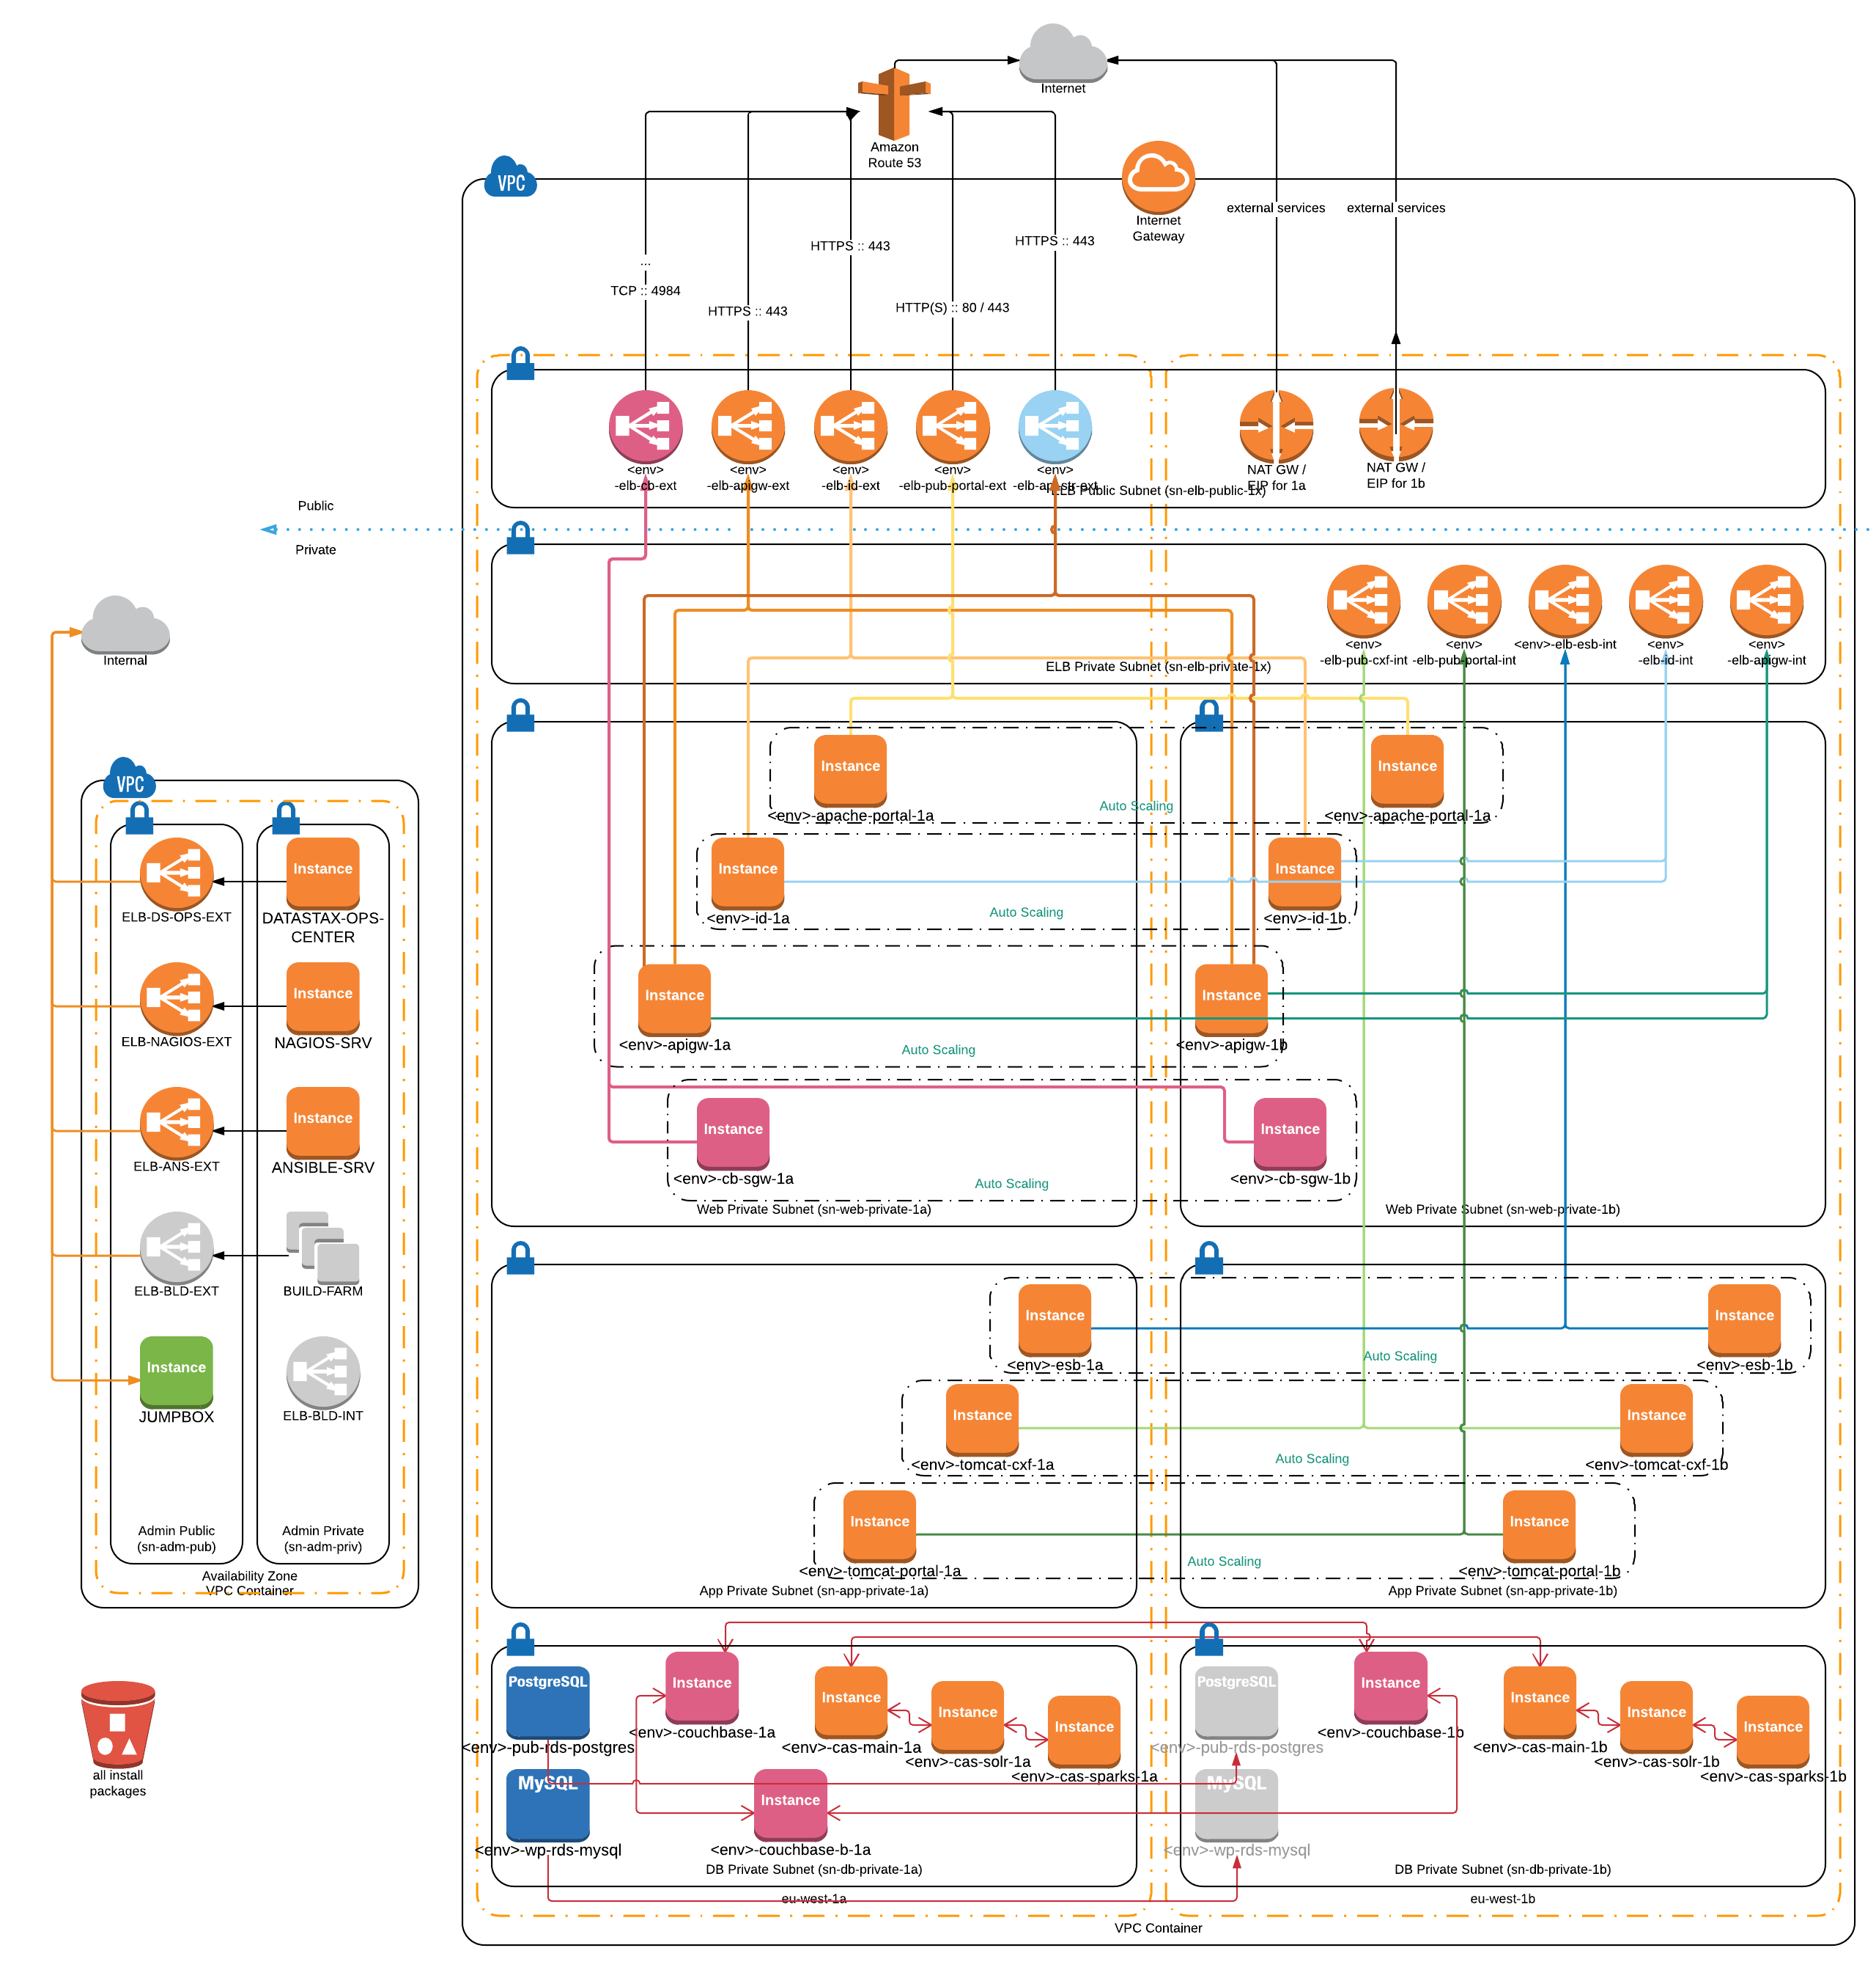
An imaginary environment

Slide 5
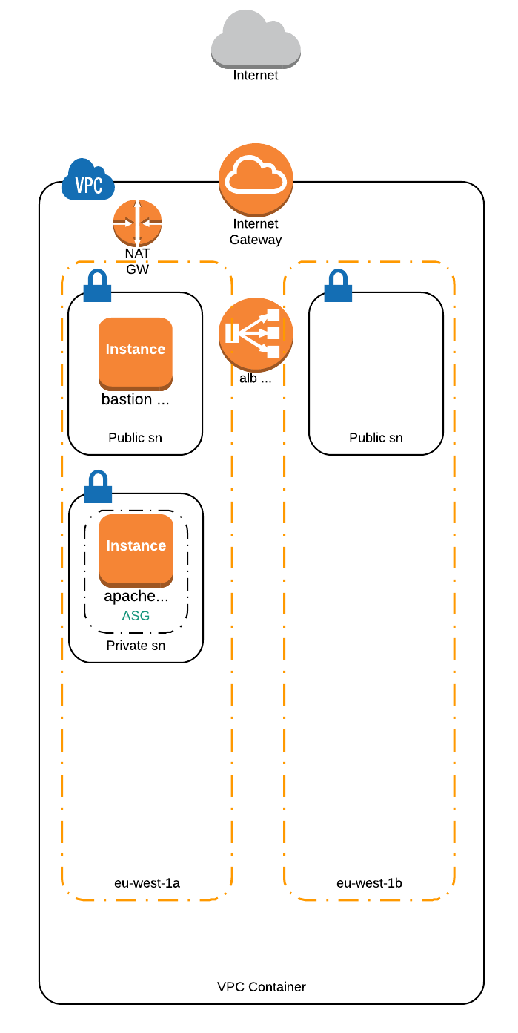
But we’re not building that

Slide 6
Standard Approach
Hostfiles
Multiple Hostfiles
Groups
host_vars / group_vars
This is fairly static. Imagine … that one night

Slide 7
Dynamic Approach
No inventory file … well, It’s being generated
- dynamic inventory script (there are many)
"ec2": [
"10.8.31.10",
"10.8.31.199"
],
"tag_Name_apache_ansible_talk_test_02_dev": [
"10.8.31.199"
],
"tag_Name_bastion_ansible_talk_test_02_dev": [
"10.8.31.10"
],
"tag_aws_cloudformation_stack_name_ansible_talk_test_02": [
"10.8.31.10",
"10.8.31.199"
]
- AWS_PROFILE=iw-main ./inventory/dev/ec2.py
- AWS_PROFILE=iw-main ./inventory/test/ec2.py
tagging, tagging, tagging … C.O.N.S.I.S.T.E.N.T. tagging

Slide 8
SSH Proxy
Host 10.8.31.*
User=ec2-user
ProxyCommand=ssh -i ~/.ssh/zsoltk-iw-main.pem -o StrictHostKeyChecking=no -A ec2-user@$(aws ec2 describe-instances --filters "Name=instance-state-name,Values=running" "Name=tag:Name,Values=bastion-ansible-talk-test-${STACK_ID}" --query "Reservations[0].Instances[0].PublicIpAddress" --output text --profile iw-main) -W %h:%p
Predefined network range
Place by the Ansible playbooks – say no to user / system wide config.
Use AWS CLI to get the info needed
Caveats:
- organize environments into folders with all required files
- have a script …
- it is no fun when you’re testing the new feature in production ...
- cache_path = ~/.ansible/<env>

Slide 9
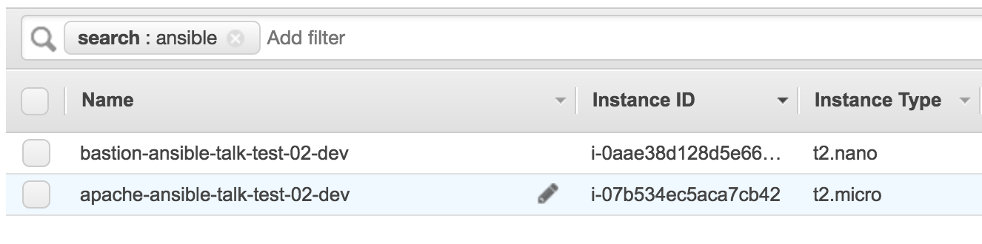
Putting the two three together
SSH:
http://docs.aws.amazon.com/cli/latest/reference/ec2/describe-instances.html :: filters
EC2.PY:
ENVIRONMENT variables
STACK_ID=02-dev ANSIBLE_CONFIG=./ansible.cfg ansible-playbook -i inventory/dev/ec2.py estate.yml
STACK_ID=03-dev ANSIBLE_CONFIG=./ansible.cfg ansible-playbook -i inventory/test/ec2.py estate.yml

Slide 10
But this is still not (really) dynamic
Then came the wolf …
This works fine, but this needs someone pushing the button
AWS EC2 State change as trigger (SNS, Lambda, SES, Poll …)
- still using the same method though this takes less time to go through
- less secure
- although the controller can sit inside the account
- automated …

Slide 11
Bootstrapping to the rescue!
Changes in the CFT … (apply)
EC2 bootstrap (cloud-init :: https://cloud-init.io/ )
- get all files from S3 (or any other source)
- install Ansible;
- install dependencies
- deploy with:
hosts: localhost

Slide 12
Bootstrapping example
Terminate …
Advantages:
- No supervision required
- Quicker
- Pull is safer
- We can even close port 22 ... :D
- No limit to scale

Slide 13

Takeaway
Consistent naming
Tag all your resources in a way you can identify them at least by group
Keep environment separate (use unique ids)
Make it easy but make sure no slips can happen
Simple automation is important
https://github.com/zsoltk-iw/ansible-dynamic-cloud-envs-talk

