Slide 1
Object Metamorphism
Type-safe Modeling of Protean Objects
Zbyněk Šlajchrt

Slide 2
Protean Objects
“Able to change into many different forms or able to do many different things”
“Displaying great diversity or variety”
Adaptive: chemical reactions, mimicry, adaptive services
Evolutionary: fetal development, tutorials
How much is OOP capable of modeling such object?

Slide 3
Airport Scanner Case Study
AS can recognize objects in baggage
Two aspects: Material and Shape
AS outputs a JSON record for each recognized item
{ "id": 0, "shape": "cylinder", "material": "metal", "x": 234.87, "y": 133.4, "z": 12.94, "radius": 13.45, "height": 0.45, "density": 3.8 }

Slide 4
Modeling PO In Java
Poor modeling capabilities
Using mainly delegation and composition
“Has-A/Is-A” dilemma: “A wine bottle box or a wine bottle in a box”
Good at “Has-A” relationships
Poor at “Is-A” relationship
Loosing type information, instanceof is useless
Scattered object identity, i.e. object schizophrenia

Slide 5
Modeling PO In Scala
Using traits to compose items
No delegation, no composition, no schizophrenia
No loss of type information
item.isInstanceOf[Rectangle with Paper]
Problem: Exponential explosion of classes declarations
Proportional to the Cartesian product of all dimensions used to describe the item

Slide 6
Modeling PO In Groovy
Dynamic traits resolve the explosion issue
No schizophrenia, types are preserved
The composition is done step-by-step (imperatively)
However, this “manual” approach is prone to:
Incompleteness; i.e. forgetting some dimension
Redundancy; i.e. adding two mutually exclusive parts
Missing or ambiguous dependencies between parts

Slide 7
Solution: Object Metamorphism
A capability of an object to assume one or more forms specified by the object's morph model
Morph Model
Describes all possible alternative “shapes” of the object
Each alternative consists of a list of traits
Verified at compile-time
Morph
An instance of one alternative from the morph model
May mutate to another alternative to change behavior
Morph Strategy: governs the mutation of the morph
Morpheus: A P-o-C implementation of OM in Scala

Slide 8
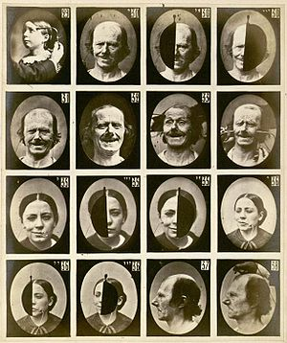
Emotions In Face
Human face as a protean object
Emotions cause electric stimulation of muscles, which are responsible for facial expressions
Studied by Ch. Darwin and G. Duchenne
https://en.wikipedia.org/wiki/Facial_expression

Slide 9
Modeling Emotional Expressions
Emotions
(Joy, Surprise, Fear, Sadness, Disgust, Anger)
Facial Musculature
(Depressor Labii, Levator Palpebrae, etc.)
Facial Features
(Eyebrows, Upper Lid, Lower Lid, Upper Lip etc.)
Each morph model actually represents one view on the human being
The emotions influence the facial musculature, which influences the facial features

Slide 10
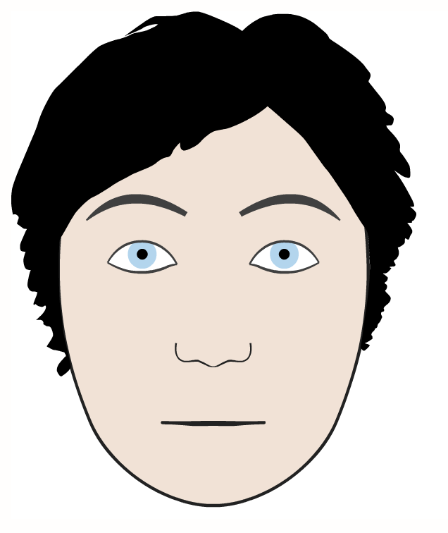
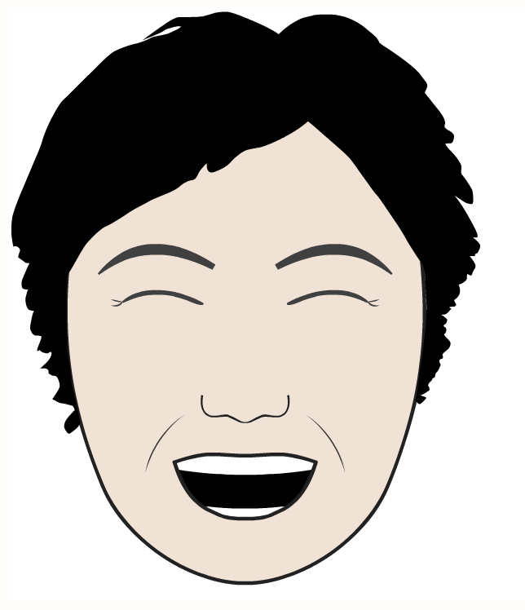
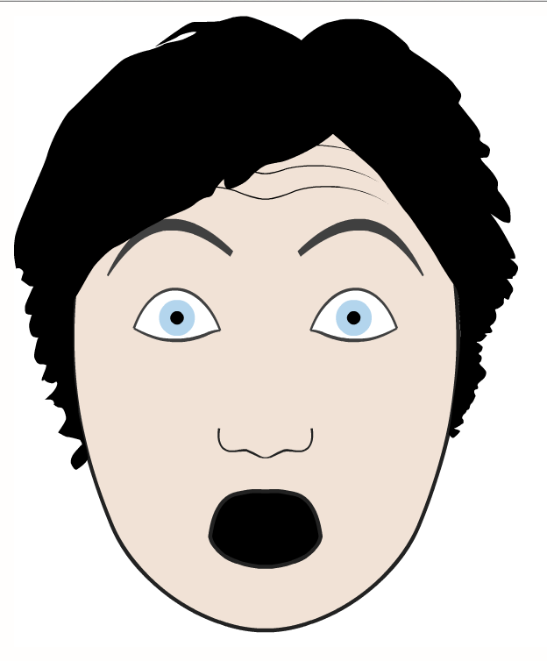
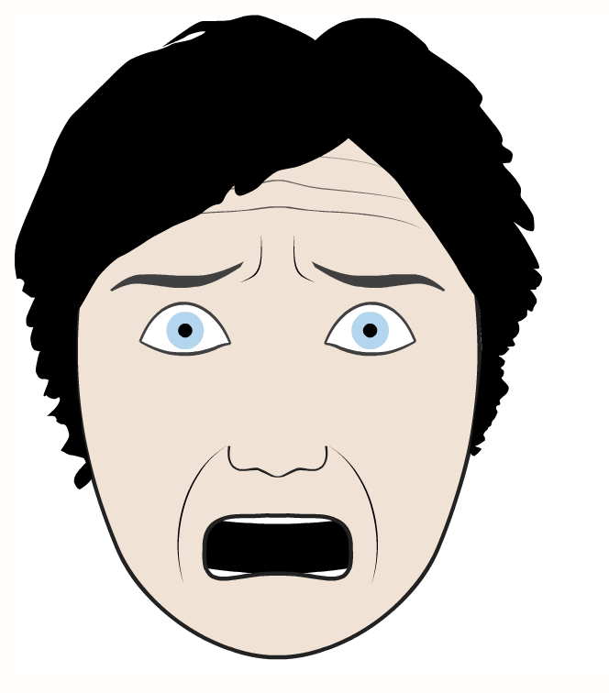
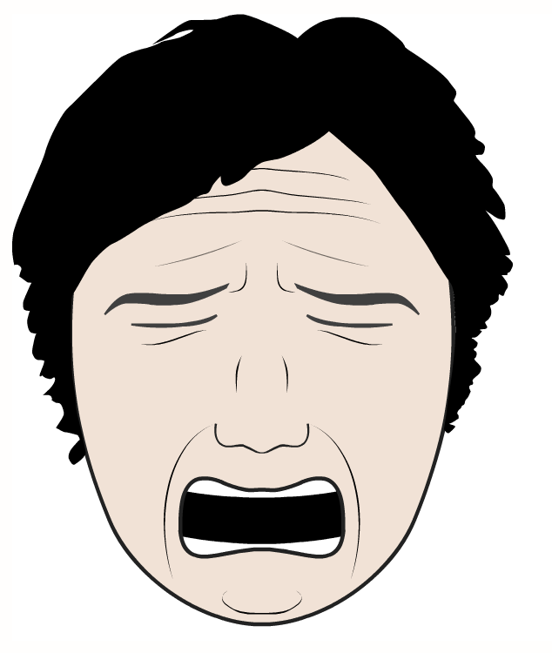
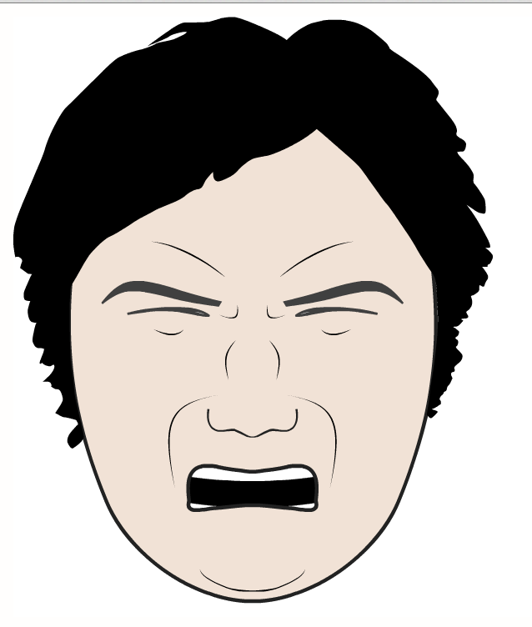
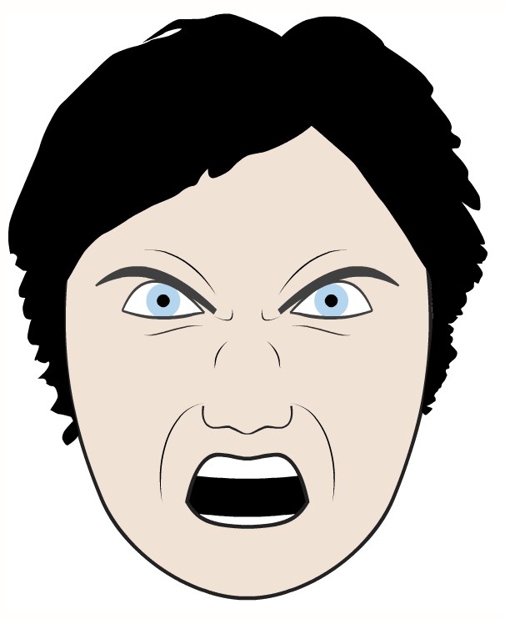
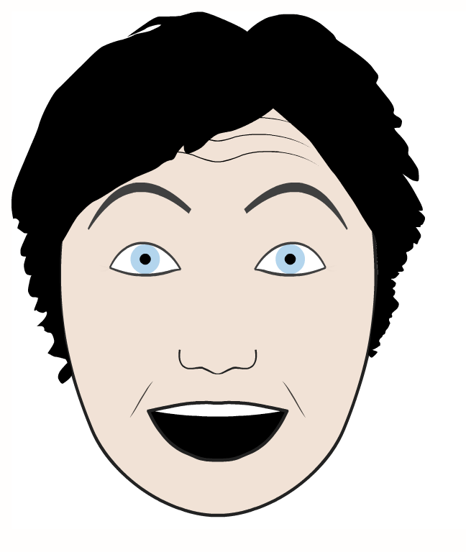


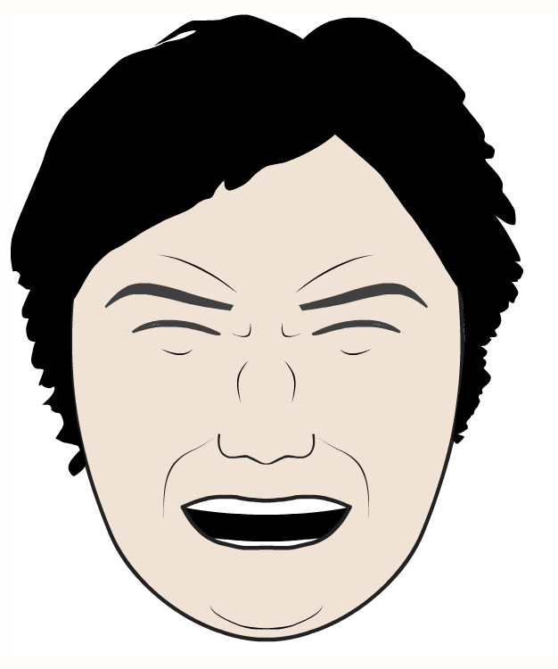
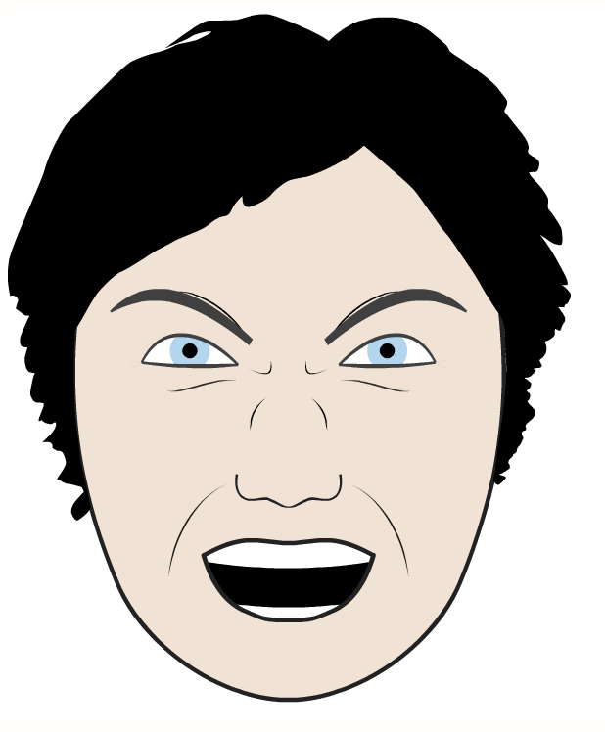
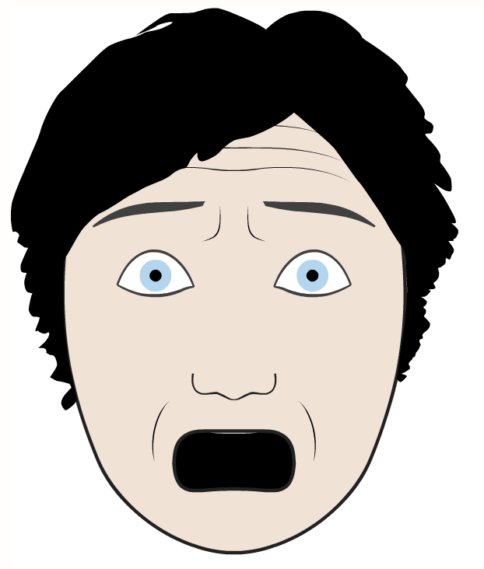


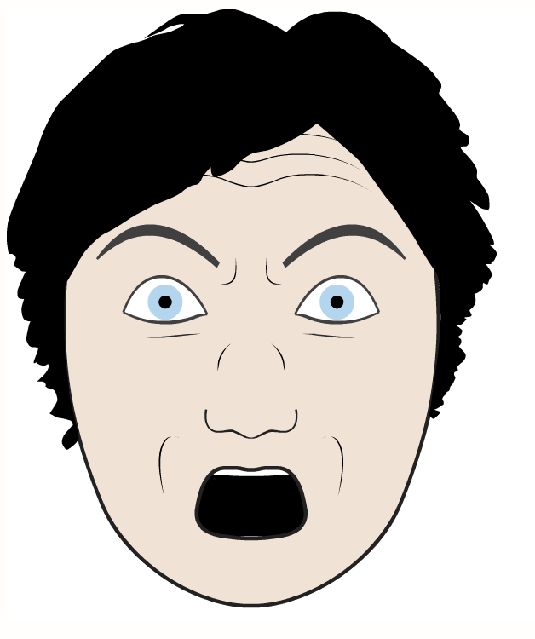
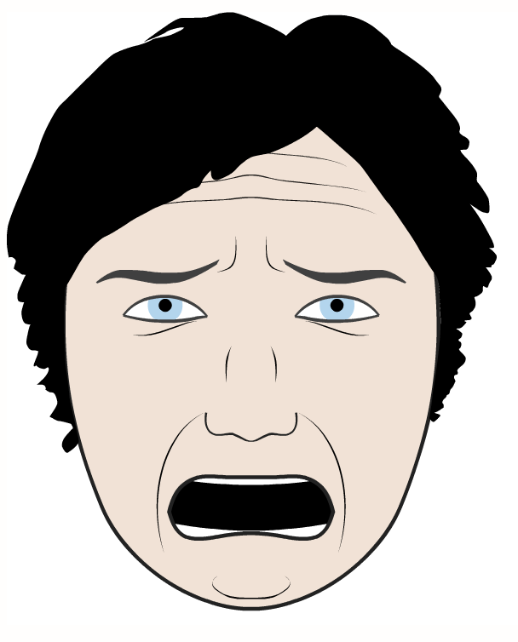


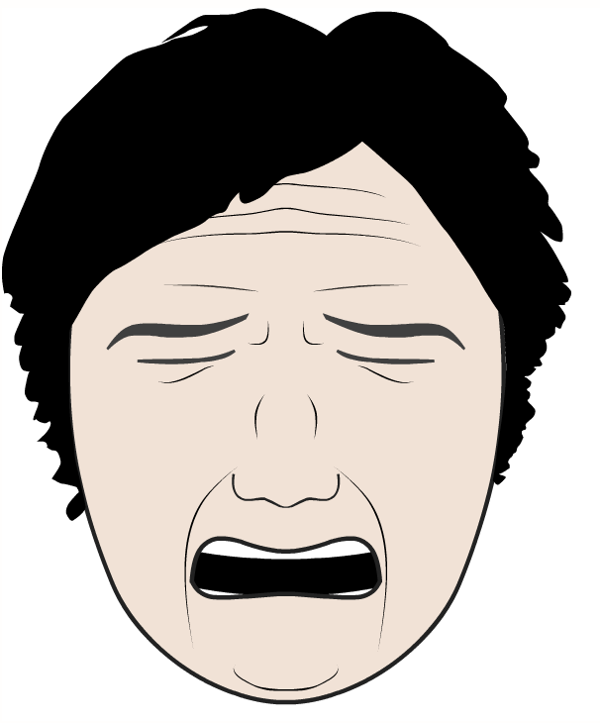
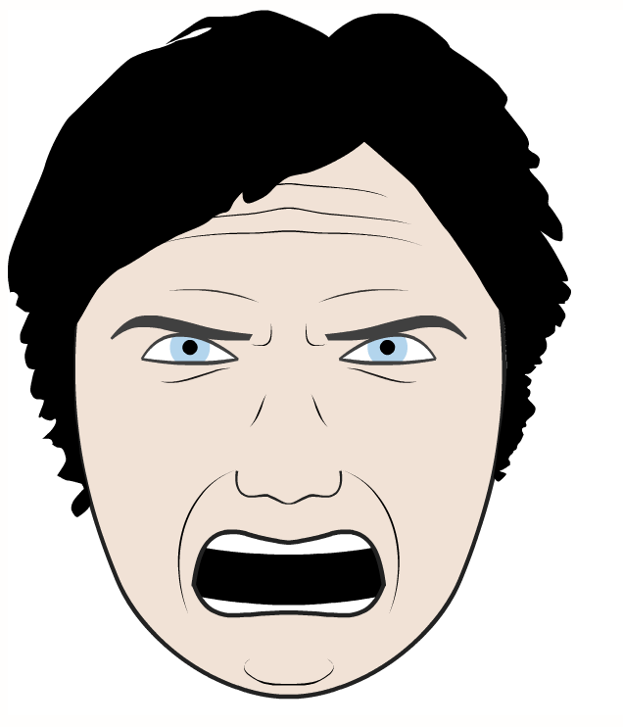

Emotions Model
Joy, Surprise, Fear, Sadness, Disgust, Anger
No more than 2 simultaneous emotions
6 simple + 15 combined = 21 alternatives
http://www.grimace-project.net/

Slide 11
Emotions Model
type Emotions1D = Joy or Surprise or Fear or Sadness or Disgust or Anger
type Emotions2D = Emotions1D with BasicEmotions1D
type Emotions = EmotionBase with TensionCalculator with Emotions2D
@fragment
trait EmotionBase {
// Keeps the selection and intensity of one or two emotions
def setEmoLevel(emoId: Int, intensity: Float) = …
def getEmoLevel(emoId: Int): Float = …
def getFirstEmotion(): Option[Int]
def getSecondEmotion(): Option[Int]
// Propagate the emotions to the muscles
def stimulate(): Unit = {}
}

Slide 12
Emotion Sample
@fragment @wrapper
trait Joy extends Emotion {
this: MuscleBase with TensionCalculator =>
private lazy val tcalc = tensionCalc("joy")(_)
override def influence() = {
// Propagate the joy intensity through the stack of muscles // using applyTension() defined in MuscleBase
this.applyTension(tcalc, joyLevel)
// Invoke the other emotion, if any
super.influence()
}
}

Slide 13
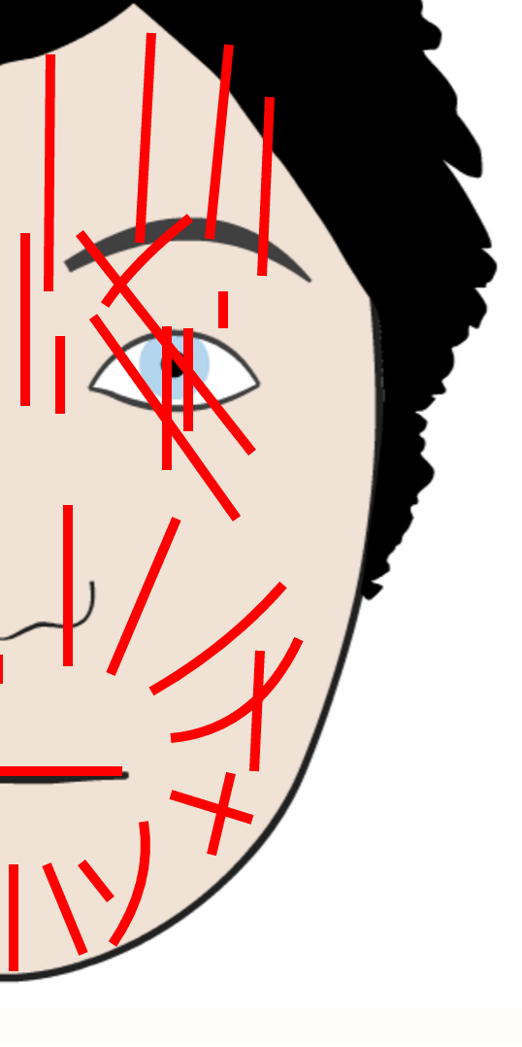
Facial Musculature Model
26 muscles (M0, M1, M2 …)
The simplest approximation model assumes that all muscles may be stimulated simultaneously; i.e. there are no mutually exclusive muscles
The model consists of only one alternative
Splines used to model the muscle contractions
Segments, quadratic and cubic Bezier curves

Slide 14
Facial Musculature Code
type Musculature = MuscleBase with M0 with M1 with M2 with …
@fragment
trait MuscleBase { def applyTension(tensFn: TensionFn, tension: Float) {}
}
@fragment @wrapper
trait M0 extends MuscleBase {
val m0 = new Muscle(Line("m0", (136f, 144f), (140f, 140f)))
override def applyTension(tensFn: TensionFn, tension: Float){
m0.updateTension(tensFn("m0")(tension))
super.applyTension(tensFn, tension)
}
}

Slide 15
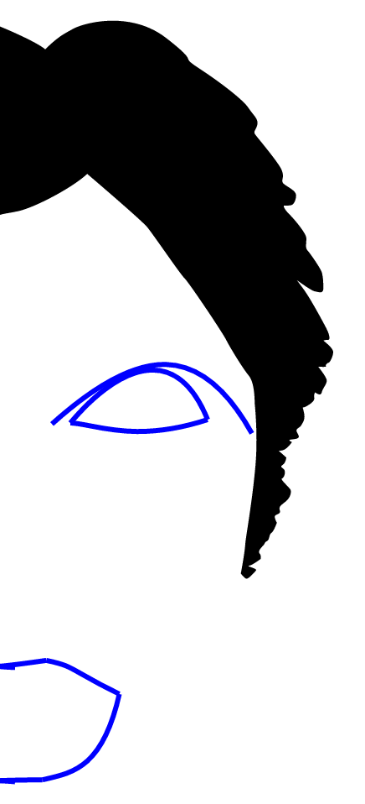
Facial Features Model
7 most basic features
Eyebrow, Upper Lid, Lower Lid, Upper Lip, Upper Lip Joiner, Lower Lip, Lower Lip Joiner
Any combination is possible
2^7 = 128 alternatives
Each feature depends on a certain subset of muscles
Selected features depend on the set of activated muscles
There is only one set with all muscles
This is why all features are activated

Slide 16
Facial Features Code
type /?[T] = T or Unit
type Features = Feature with /?[Eyebrow] with
/?[UpperLidFragment with UpperLid] with
/?[LowerLid] with
/?[LowerLipJoiner] with
/?[LowerLipFragment with LowerLip] with
/?[UpperLipFragment with UpperLip] with
/?[UpperLipJoinerFragment with UpperLipJoiner]
@fragment
trait Feature {
def render(): List[Spline] = Nil
}

Slide 17
Feature Sample
@fragment @wrapper
trait LowerLipJoiner extends Feature {
this: LowerLipFragment with M15 with H_Mli11 =>
private val spline = CBezier((0,0),(12f,400f),(0f,400f),(-10f,401f)))
private lazy val muscleBindings = List(
(3, m15, 1f),
(2, m15, 1f),
(1, m15, 1f),
(3, h_Mli11, 1f),
(2, h_Mli11, 1f),
(1, h_Mli11, 1f)
).groupBy(_._1)
override def render(): List[Spline] = {
val lowerLipSpline = transformLowerLip()
val lowerLipJoinerSpline = spline.copy(p1 = newLowerLipSpline.p4)
lowerLipJoinerSpline.transform(muscleBindings) :: super.render()
}

Slide 18
Putting All Together
// Parse and validate the model at compile-time
val emotionsModel = parse[Emotions with Musculature with Features]
// Instantiate the morph
val emotionsMorph = singleton(emotionsModel, new EmoStrategy()).~
// Select Joy and Surprise and their intensities
emotionsMorph.setEmoLevel(JoyId, 0.9f)
emotionsMorph.setEmoLevel(SurpriseId, 0.7f)
// Remorph the morph
emotionsMorph.remorph
// Stimulate the muscles
emotionsMorph.stimulate()
// Render the face
print(emotionsMorph.render())

Slide 19
Conclusion
Protean object may be modeled in current OOP languages only with difficulties
There is a gap between dynamic and static languages; a need for a hybrid approach
Object Metamorphism addresses this gap
Checking the behavioral model at compile-time
Controlled dynamism at run-time
Downsides and future work:
Compilation time, 10.000 alts ~ 2 minute
To tackle the performance issues
Intelligent elimination of alternatives to speed up

Slide 20
Special Thanks To:
Oliver Spindler and Thomas Fadrus
Authors of project Grimace
http://www.grimace-project.net
This presentation uses Grimace’s pictures and data published in Oliver’s thesis
Spindler O.: Affective space interfaces, Technische Universitat Wien, 2009
http://www.grimace-project.net/assets/affectivespaceinterfaces.pdf

Slide 21
Appendix1: Emotion Model Strategy
val emoStrategy1 = mask[Unit or BasicEmotions]({
case None => None
case Some(morph) => morph.getFirstEmotion
})
val emoStrategy2 = mask[Unit or BasicEmotions](emoStrategy1, {
case None => None
case Some(morph) => morph.getSecondEmotion
})

Slide 22
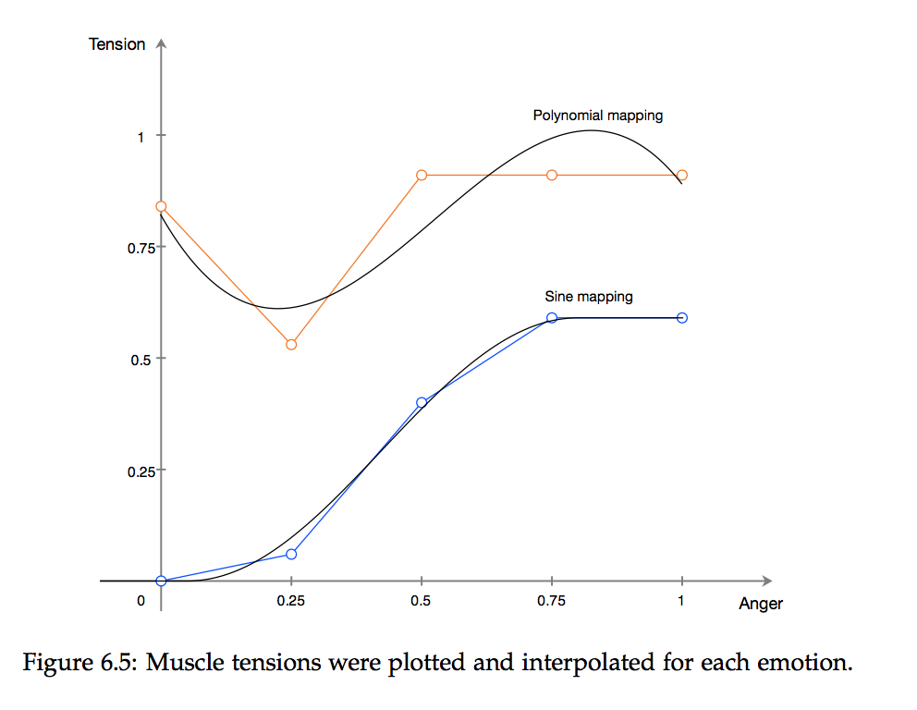
Appendix 2: Muscle Stimulation
http://www.grimace-project.net/assets/affectivespaceinterfaces.pdf

Slide 23
Appendix 3: Morpheus
Project Morpheus: a proof-of-concept of OM
https://github.com/zslajchrt/morpheus

