Slide 1
Object Metamorphism
Type-safe Modeling of Protean Objects
Zbyněk Šlajchrt

Slide 2
Protean Objects
“Able to change into many different forms or able to do many different things”
“Displaying great diversity or variety”
Adaptive: chemical reactions, mimicry, adaptive services
Evolutionary: fetal development, tutorials
How much is OOP capable of modeling such object?
Notes:
TODO: Intro
Since OOP is a prevailing paradigm in software development it is legitimate to ask how much is OPP able to model protean objects.

Slide 3
Airport Scanner Case Study
AS can recognize objects in baggage
Two aspects: Material and Shape
AS outputs a JSON record for each recognized item
{ "id": 0, "shape": "cylinder", "material": "metal", "x": 234.87, "y": 133.4, "z": 12.94, "radius": 13.45, "height": 0.45, "density": 3.8 }
Notes:
In order to answer this question I tried to develop a simple scenario in three OOP languages:
Java as one of the most popular languages,
Scala as a representative of strongly statically typed languages and
Groovy as a representative of dynamic languages
The scenario consists of a hypothetical airport scanner able to recognize object in baggage. It is assumed that the scanner uses two algorithms: one for recognizing material and the other for recognizing the shape.
The goal is to develop an application parsing such records and modeling these two-dimensional objects in the selected languages.

Slide 4
Modeling PO In Java
Poor modeling capabilities
Using mainly delegation and composition
“Has-A/Is-A” dilemma: “A wine bottle box or a wine bottle in a box”
Good at “Has-A” relationships
Poor at “Is-A” relationship
Loosing type information, instanceof is useless
Scattered object identity, i.e. object schizophrenia
Notes:
Now I am going to briefly summarize the outcome of the case study for each language.
Delegation and composition hide the actual type of the modeled baggage item -> instanceof cannot be used to determine the type

Slide 5
Modeling PO In Scala
Using traits to compose items
No delegation, no composition, no schizophrenia
No loss of type information
item.isInstanceOf[Rectangle with Paper]
Problem: Exponential explosion of classes declarations
Proportional to the Cartesian product of all dimensions used to describe the item
Notes:
Scala comes up with the concept of traits, which is something between composition and inheritance.
It allows to avoid the problems mentioned previously. However, there is a big problem concerning the multidimensionality of the modeled objects.
For each combination there must be a class declaration.

Slide 6
Modeling PO In Groovy
Dynamic traits resolve the explosion issue
No schizophrenia, types are preserved
The composition is done step-by-step (imperatively)
However, this “manual” approach is prone to:
Incompleteness; i.e. forgetting some dimension
Redundancy; i.e. adding two mutually exclusive parts
Missing or ambiguous dependencies between parts
Notes:
Let us turn our attention to Groovy. It is a representative from the opposite side of the spectrum. It is a weakly typed dynamic language offering one feature that is very important for our purpose: dynamic traits.
They allow to attach selected traits at run-time to the target objects.
It really solves all previously mentioned problems, however, other problems are looming.
The conclusion is: Traits are exactly the feature that is necessary to model the protean objects.
Therefore, since the absence of traits Java is not suitable for this kind of applications.
As far as Scala is concerned, the exponential explosion of class declarations is virtually prohibitive.
And in terms of Groovy, because of the absence of the trait consistency check it is unusable as well.
It seems there is a gap between the two worlds: the static and dynamic ones. And it seems that the modeling of protean objects falls into this gap.
And it is this gap, which is addressed by the concept of Object Metamorphism, which I have been developing in my thesis and which I am going to briefly introduce in this presentation.

Slide 7
Solution: Object Metamorphism
A capability of an object to assume one or more forms specified by the object's morph model
Morph Model
Describes all possible alternative “shapes” of the object
Each alternative consists of a list of traits
Verified at compile-time
Morph
An instance of one alternative from the morph model
May mutate to another alternative to change behavior
Morph Strategy: governs the mutation of the morph
Morpheus: A P-o-C implementation of OM in Scala
Notes:
Object metamorphism can be described as …
So the pivotal concept of OM is the morph model.
So, according to this concept, an object is created according to the description contained in the morph model.
In this respect the morph model is actually an analogy to the class. The class may actually be considered a special case of the morph model.
Similarly to the class, the morph model is also compiled and verified at compile-time.
A morph is an instance of the morph model. This is an analogy to a class instance with one important distinction that it is able to mutate, in other words to change
Its structure and behavior.
To illustrate OM I have developed a small application simulating the facial expressions of human emotions.
The code samples used in this presentation are developed in Morpheus, which is a proof-concept implementation of OM developed as an extension of the Scala compiler.

Slide 8
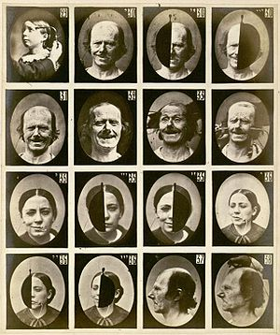
Emotions In Face
Human face as a protean object
Emotions cause electric stimulation of muscles, which are responsible for facial expressions
Studied by Ch. Darwin and G. Duchenne
https://en.wikipedia.org/wiki/Facial_expression
Notes:
The human face is obviously an extremely varying object. The expressions in the face reflect the emotions felt by the human.
The emotions cause electric stimulation of the facial muscles. One end of the muscles is attached to the bones while the other end is connected to the skin or rather various facial features such as lips, lids, eyebrows etc.

Slide 9
Modeling Emotional Expressions
Emotions
(Joy, Surprise, Fear, Sadness, Disgust, Anger)
Facial Musculature
(Depressor Labii, Levator Palpebrae, etc.)
Facial Features
(Eyebrows, Upper Lid, Lower Lid, Upper Lip etc.)
Each morph model actually represents one view on the human being
The emotions influence the facial musculature, which influences the facial features
Notes:
The propagation of emotions to their manifestation on the human face may be described by three morph models.
The models may actually be considered three descriptions of the human face from different angles.
Let us deal with individual morph models in more detail.

Slide 10
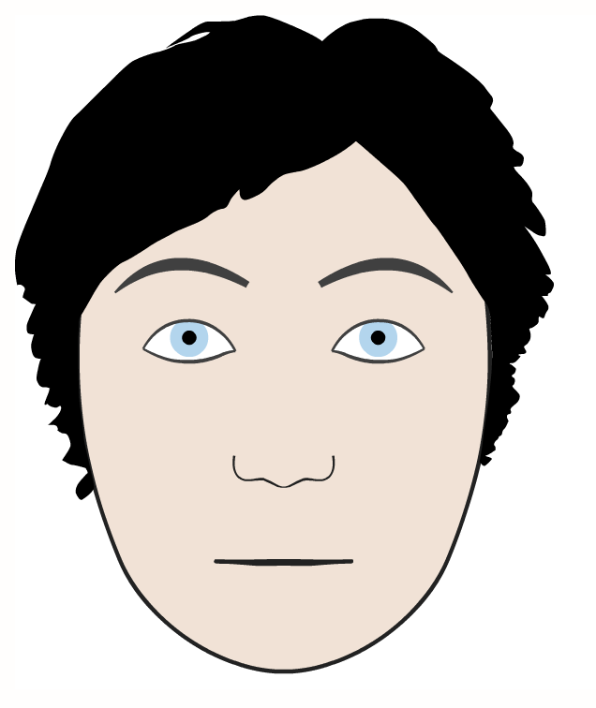
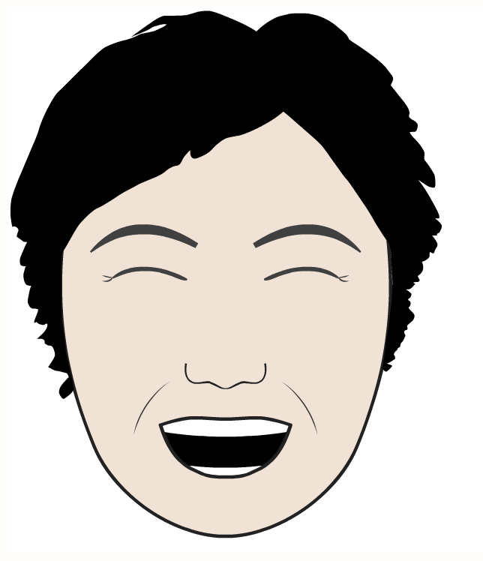
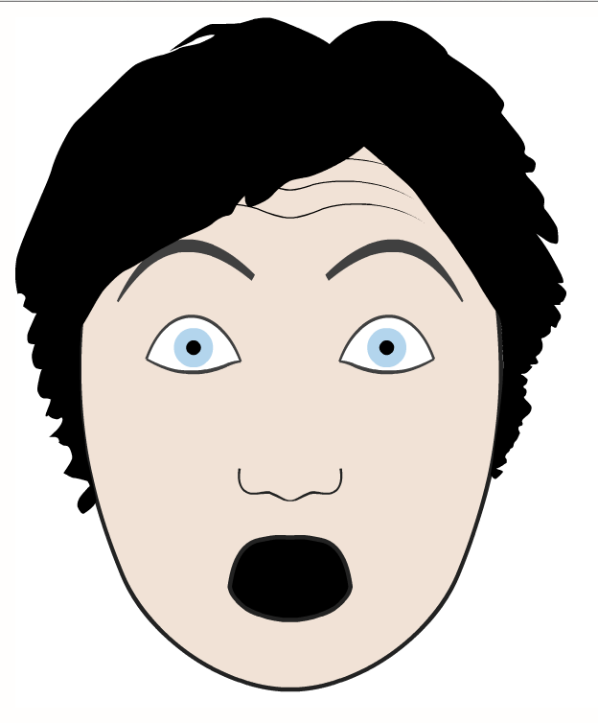
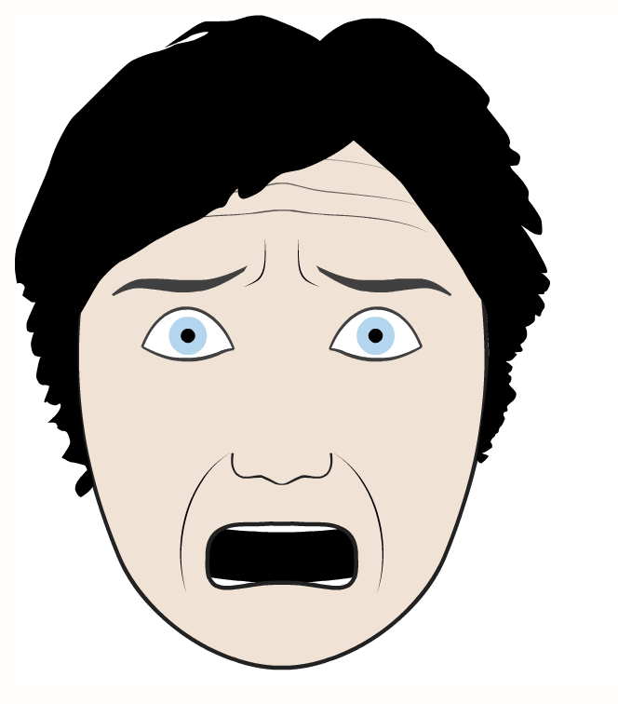
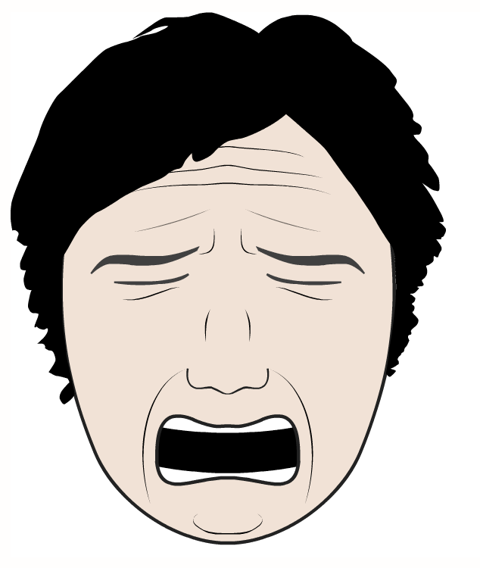
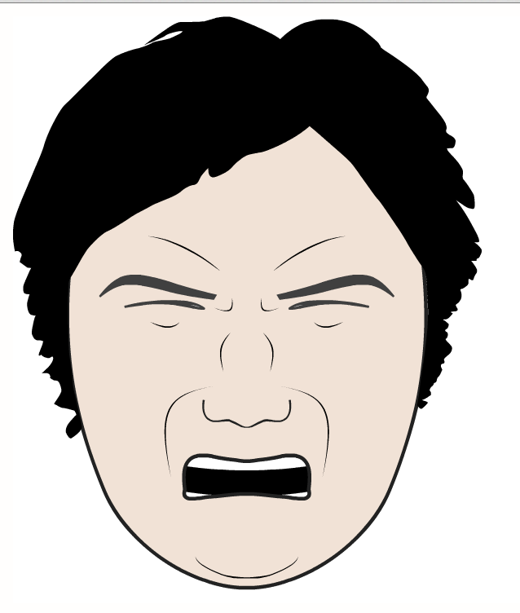
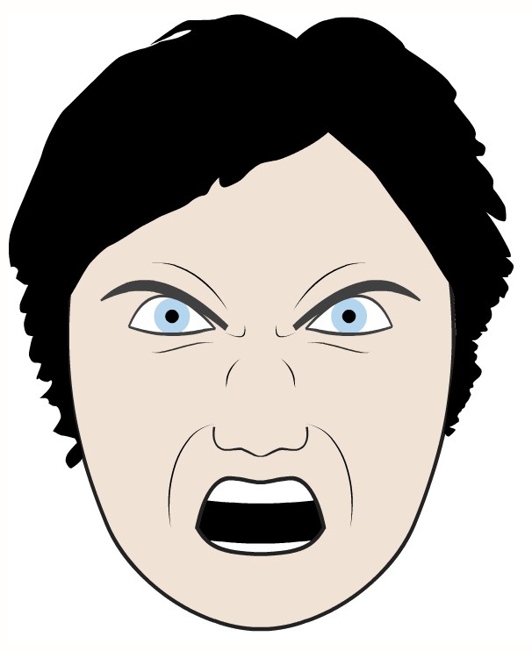
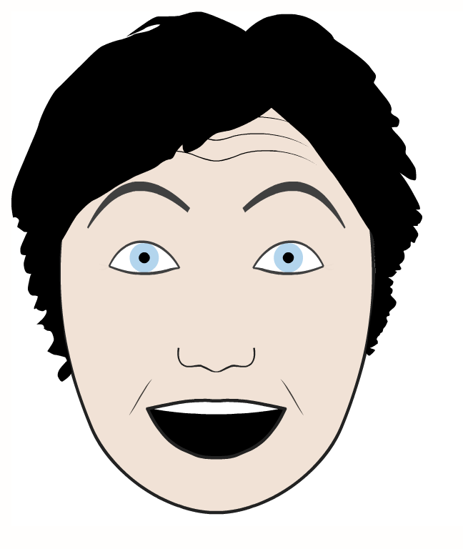


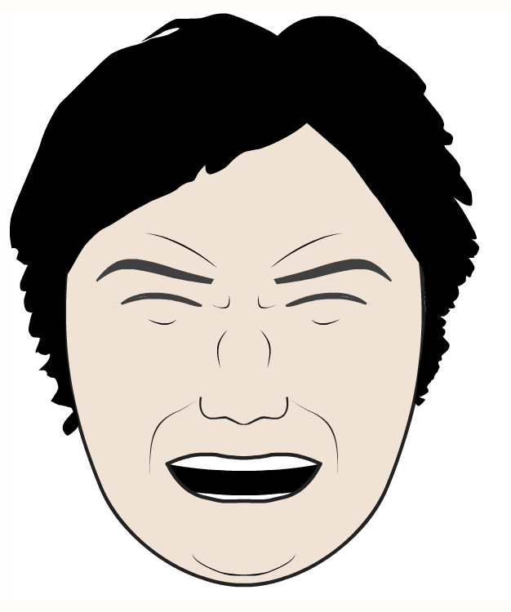
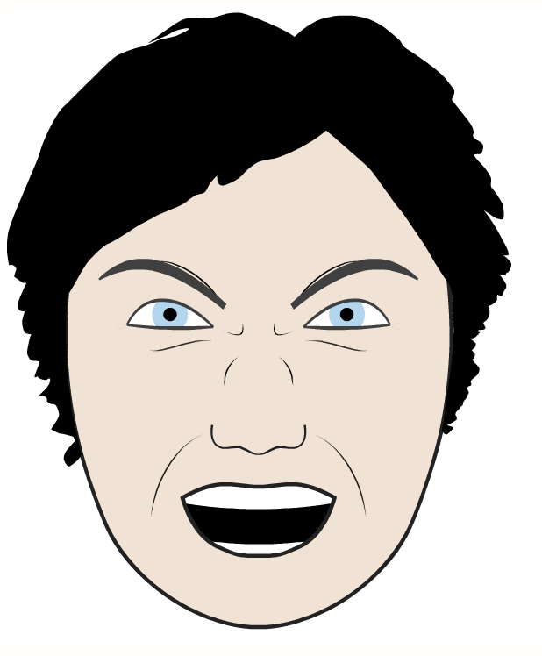
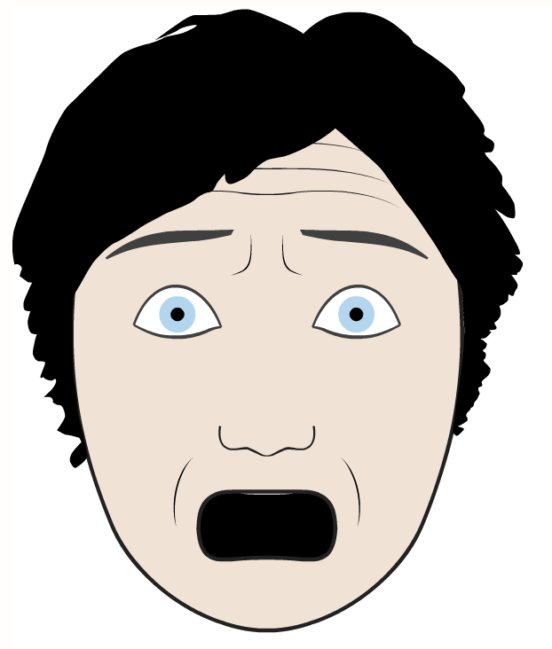


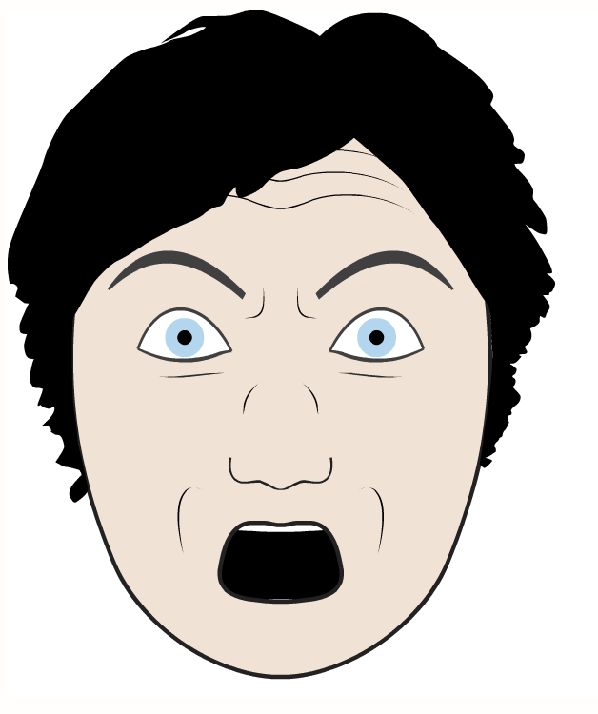
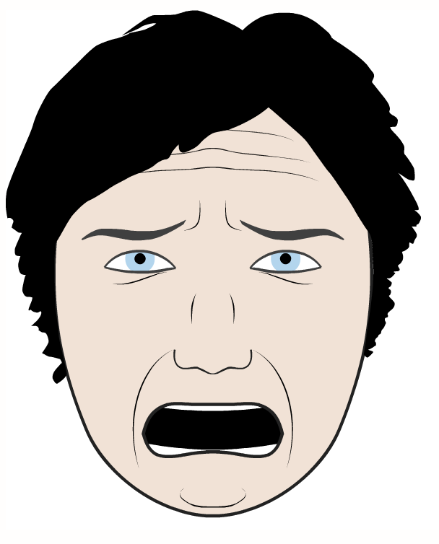


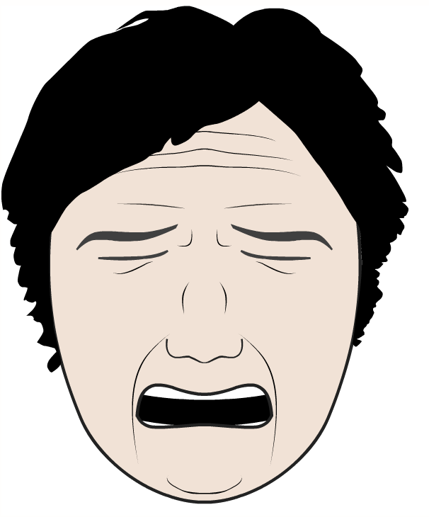
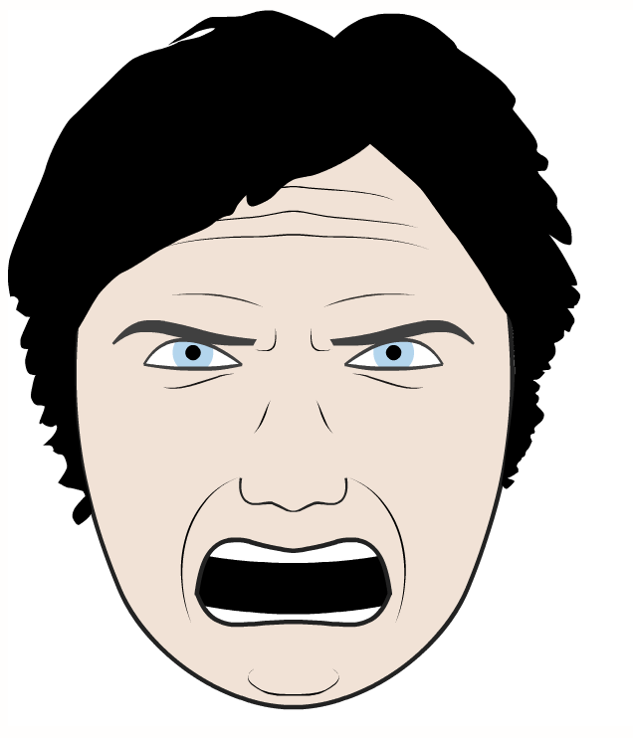

Emotions Model
Joy, Surprise, Fear, Sadness, Disgust, Anger
No more than 2 simultaneous emotions
6 simple + 15 combined = 21 alternatives
http://www.grimace-project.net/
Notes:
The emotion model used in the simulation comprises six emotions:
In contrast to the famous book by Paul Ekman about micro-expressions, this model does not include contempt.

Slide 11
Emotions Model
type Emotions1D = Joy or Surprise or Fear or Sadness or Disgust or Anger
// Emotions2D is Emotions1D “squared”
type Emotions2D = Emotions1D with Emotions1D
// Accompany Emotions2D by additional traits to complete deps
type Emotions = EmotionBase with TensionCalculator with Emotions2D
@fragment
trait EmotionBase {
// Keeps the selection and intensity of one or two emotions
def setEmoLevel(emoId: Int, intensity: Float) = …
def getEmoLevel(emoId: Int): Float = …
def getFirstEmotion(): Option[Int]
def getSecondEmotion(): Option[Int]
// Propagate the emotions to the muscles
def stimulate(): Unit = {}
}
Notes:
The “with” connector functions as the multiplication operator, while the “or” connector is an analogy to the addition operator.
Thus the morph model expressions can be seen as special algebra formulas having the distributive property.

Slide 12
Emotion Sample
@fragment @wrapper
trait Joy extends Emotion {
this: MuscleBase with TensionCalculator =>
private lazy val tcalc = tensionCalc("joy")(_)
override def influence() = {
// Propagate the joy intensity through the stack of muscles // using applyTension() defined in MuscleBase
this.applyTension(tcalc, joyLevel)
// Invoke the other emotion, if any
super.influence()
}
}

Slide 13
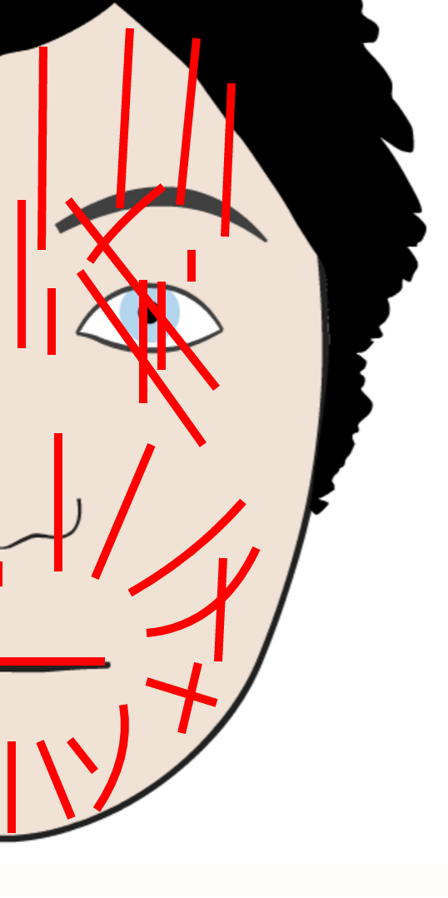
Facial Musculature Model
26 muscles (M0, M1, M2 …)
The simplest approximation model assumes that all muscles may be stimulated simultaneously; i.e. there are no mutually exclusive muscles
The model consists of only one alternative
Splines used to model the muscle contractions
Segments, quadratic and cubic Bezier curves
Notes:
This is not a scar face, but a face model showing muscles influencing one or more facial features.

Slide 14
Facial Musculature Code
type Musculature = MuscleBase with M0 with M1 with M2 with …
@fragment
trait MuscleBase { def applyTension(tensFn: TensionFn, tension: Float) {}
}
@fragment @wrapper
trait M0 extends MuscleBase {
val m0 = new MuscleData(Line("m0", (136f, 144f), (140f, 140f)))
override def applyTension(tensFn: TensionFn, tension: Float){
m0.updateTension(tensFn("m0")(tension))
super.applyTension(tensFn, tension)
}
}

Slide 15
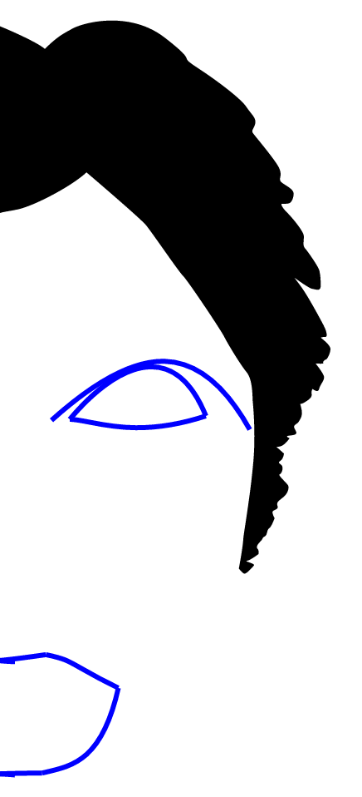
Facial Features Model
7 most basic features
Eyebrow, Upper Lid, Lower Lid, Upper Lip, Upper Lip Joiner, Lower Lip, Lower Lip Joiner
Any combination is possible
2^7 = 128 alternatives
Each feature depends on a certain subset of muscles
Selected features depend on the set of activated muscles
There is only one set with all muscles
This is why all features are activated
Notes:
I deliberately omitted wrinkles, nose, cheeks and other features for the sake of simplicity.

Slide 16
Facial Features Code
type /?[T] = T or Unit
type Features = Feature with /?[Eyebrow] with
/?[UpperLidFragment with UpperLid] with
/?[LowerLid] with
/?[LowerLipJoiner] with
/?[LowerLipFragment with LowerLip] with
/?[UpperLipFragment with UpperLip] with
/?[UpperLipJoinerFragment with UpperLipJoiner]
@fragment
trait Feature {
def render(): List[Spline] = Nil
}

Slide 17
Feature Sample
@fragment @wrapper
trait LowerLipJoiner extends Feature {
this: LowerLipFragment with M15 with H_Mli11 =>
private val spline = CBezier((0,0),(12f,400f),(0f,400f),(-10f,401f)))
private lazy val muscleBindings = List(
(3, m15, 1f),
(2, m15, 1f),
(1, m15, 1f),
(3, h_Mli11, 1f),
(2, h_Mli11, 1f),
(1, h_Mli11, 1f)
).groupBy(_._1)
override def render(): List[Spline] = {
val lowerLipSpline = transformLowerLip()
val lowerLipJoinerSpline = spline.copy(p1 = newLowerLipSpline.p4)
lowerLipJoinerSpline.transform(muscleBindings) :: super.render()
}

Slide 18
Putting All Together
// Parse and validate the model at compile-time
val emotionsModel = parse[Emotions with Musculature with Features]
// Instantiate the morph
val emotionsMorph = singleton(emotionsModel, new EmoStrategy()).~
// Select Joy and Surprise and their intensities
emotionsMorph.setEmoLevel(JoyId, 0.9f)
emotionsMorph.setEmoLevel(SurpriseId, 0.7f)
// Remorph the morph
emotionsMorph.remorph
// Stimulate the muscles
emotionsMorph.stimulate()
// Render the face
print(emotionsMorph.render())

Slide 19
Conclusion
Protean object may be modeled in current OOP languages only with difficulties
There is a gap between dynamic and static languages; a need for a hybrid approach
Object Metamorphism addresses this gap
Checking the behavioral model at compile-time
Controlled dynamism at run-time
Downsides and future work:
Compilation time, 10.000 alts ~ 2 minute
To tackle the performance issues
Intelligent elimination of alternatives to speed up

Slide 20
Special Thanks To:
Oliver Spindler and Thomas Fadrus
Authors of project Grimace
http://www.grimace-project.net
This presentation uses Grimace’s pictures and data published in Oliver’s thesis
Spindler O.: Affective space interfaces, Technische Universitat Wien, 2009
http://www.grimace-project.net/assets/affectivespaceinterfaces.pdf

Slide 21
Appendix1: Emotion Model Strategy
val emoStrategy1 = mask[Unit or BasicEmotions]({
case None => None
case Some(morph) => morph.getFirstEmotion
})
val emoStrategy2 = mask[Unit or BasicEmotions](emoStrategy1, {
case None => None
case Some(morph) => morph.getSecondEmotion
})

Slide 22
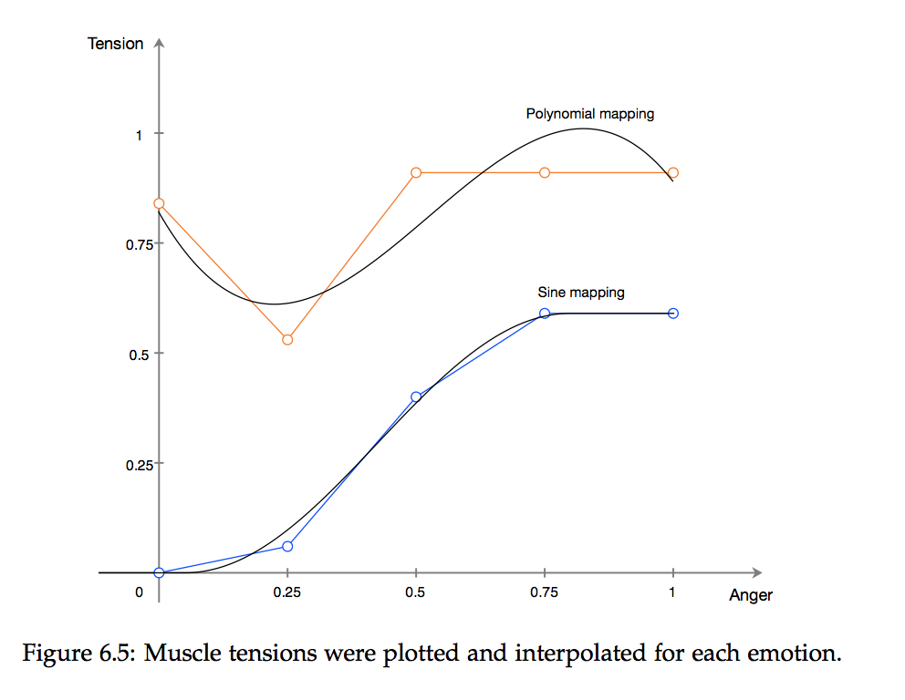
Appendix 2: Muscle Stimulation
http://www.grimace-project.net/assets/affectivespaceinterfaces.pdf

Slide 23
Appendix 3: Morpheus
Project Morpheus: a proof-of-concept of OM
https://github.com/zslajchrt/morpheus

