Slide 1
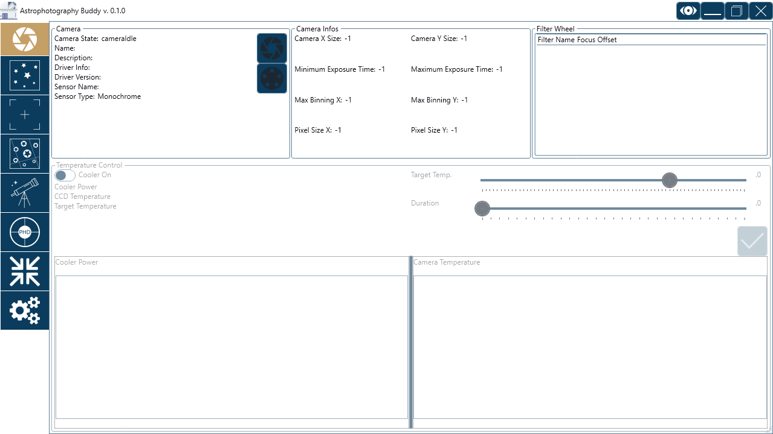
Astrophotography Buddy
Camera & Filter Wheel
Imaging
Frame & Focus
Plate Solving
Telescope
PHD2 Listener
Overview Mode
Settings

Slide 2
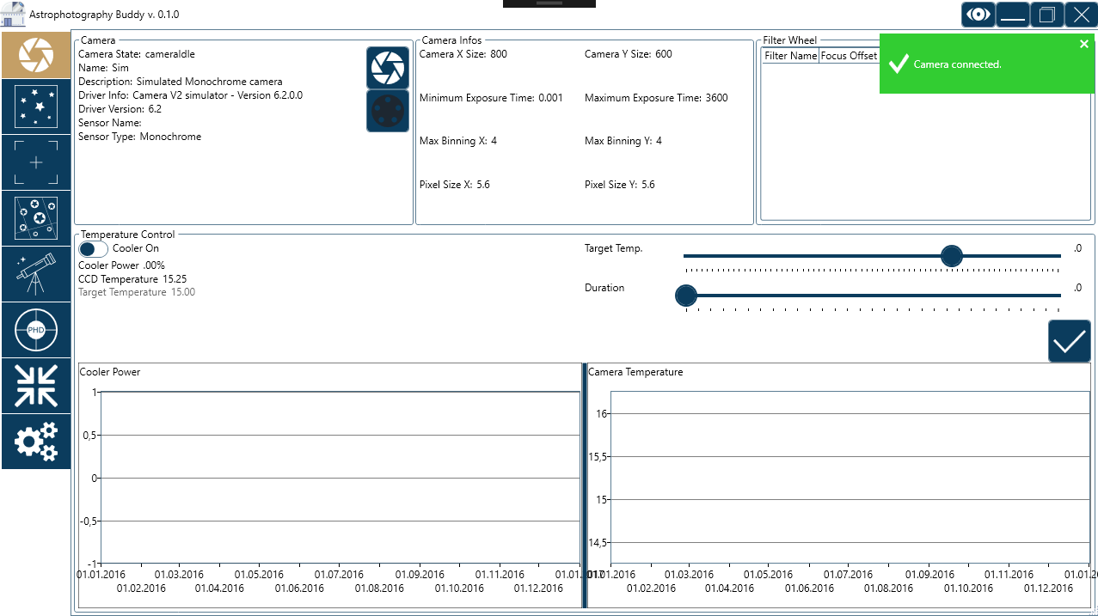
Connect Camera
Connect filter wheel
Notification Toaster

Slide 3
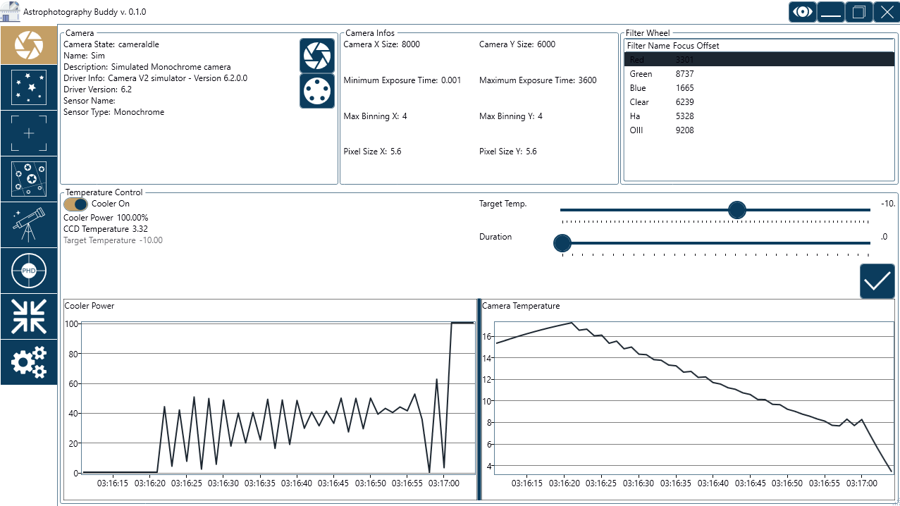
Camera screen
Filter Wheel
Start cooling camera
(If duration is 0 it will set
target temp directly, otherwise
it will slowly cool sensor for the
set duration)

Slide 4
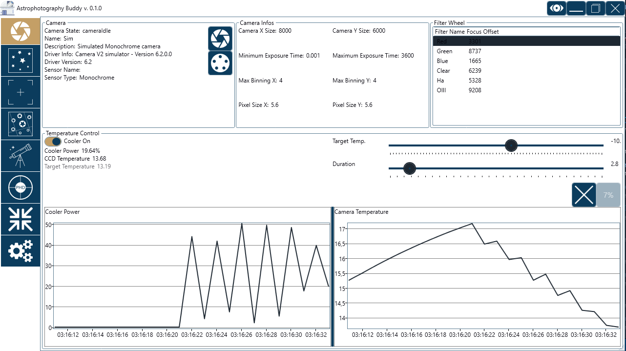
Camera screen
Slow Cooling in progress

Slide 5
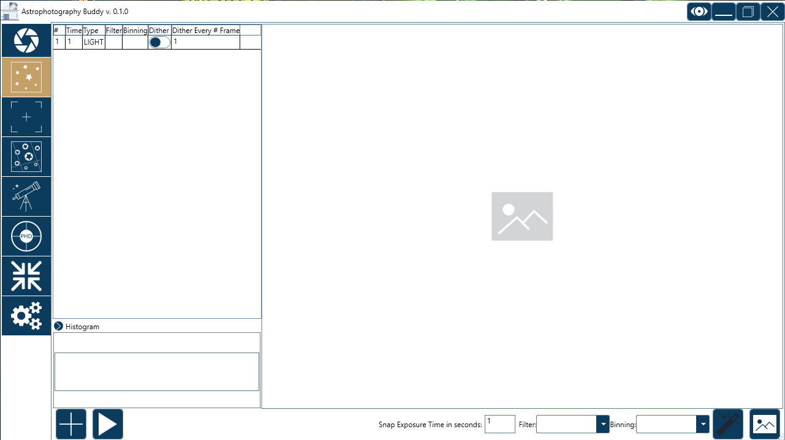
Imaging screen
Define Sequence
Image Area
Toggle Autostretch
Start Sequence
Take snapshot and save to disk

Slide 6
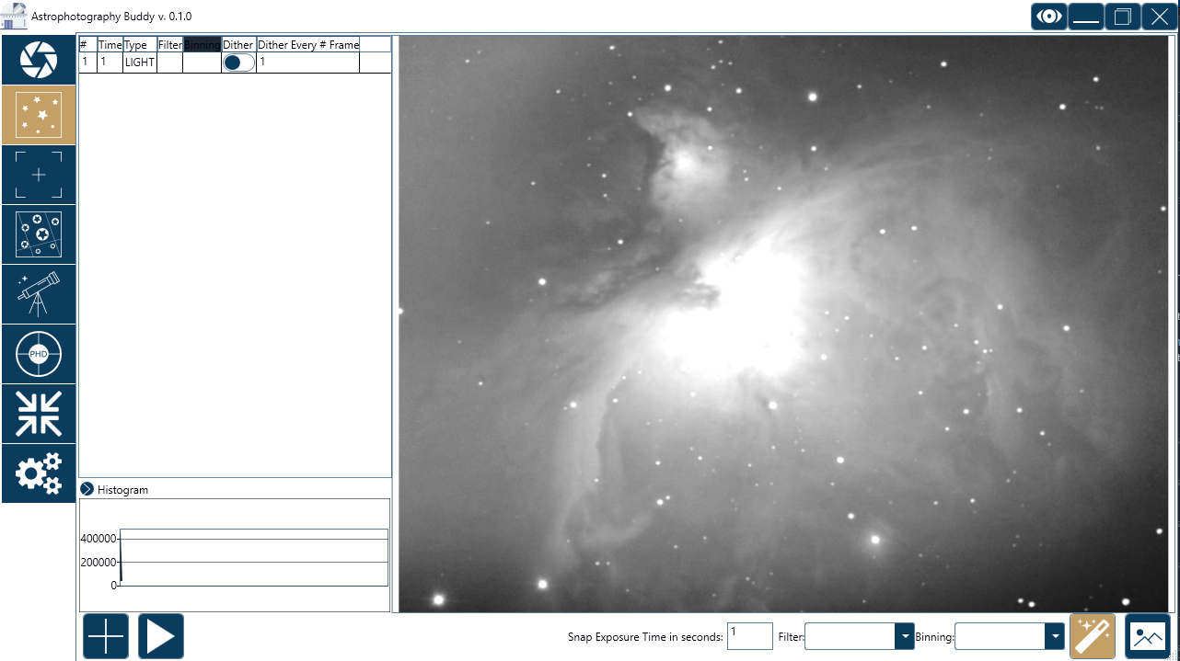
Imaging screen
Example Image

Slide 7
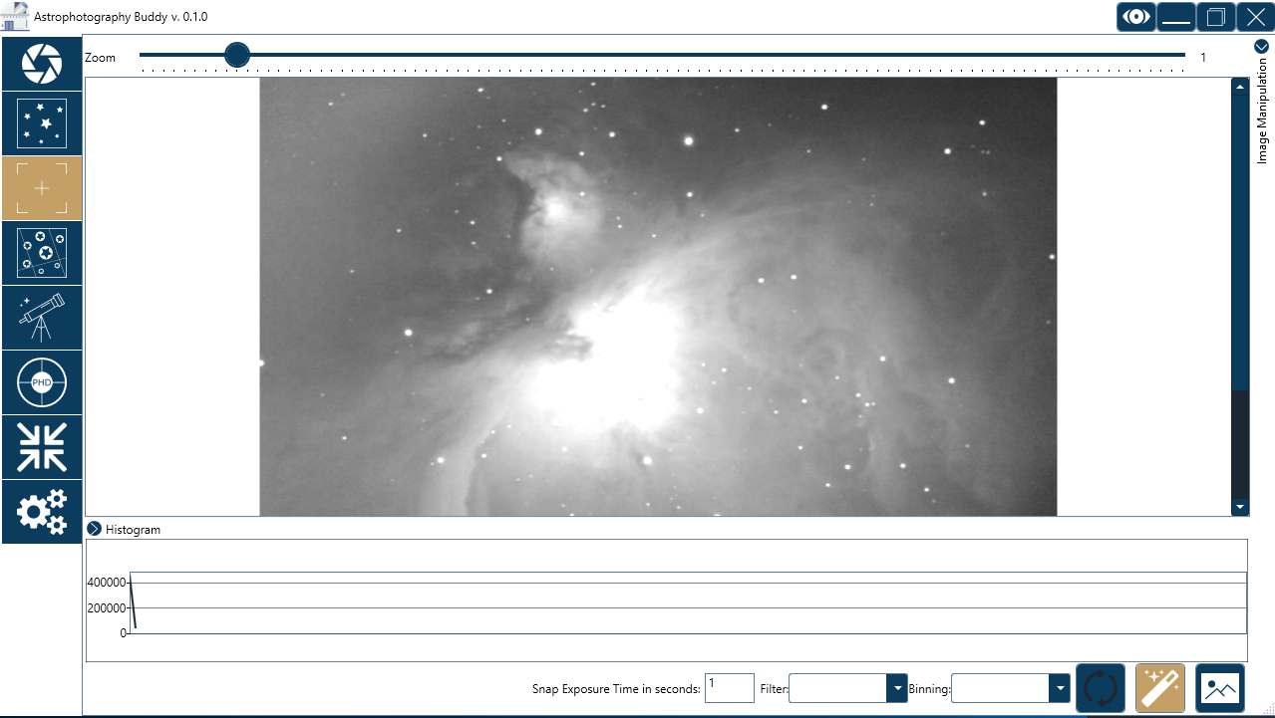
Frame & Focus
Image Area
Toggle looping exposures
Take snapshot without save

Slide 8
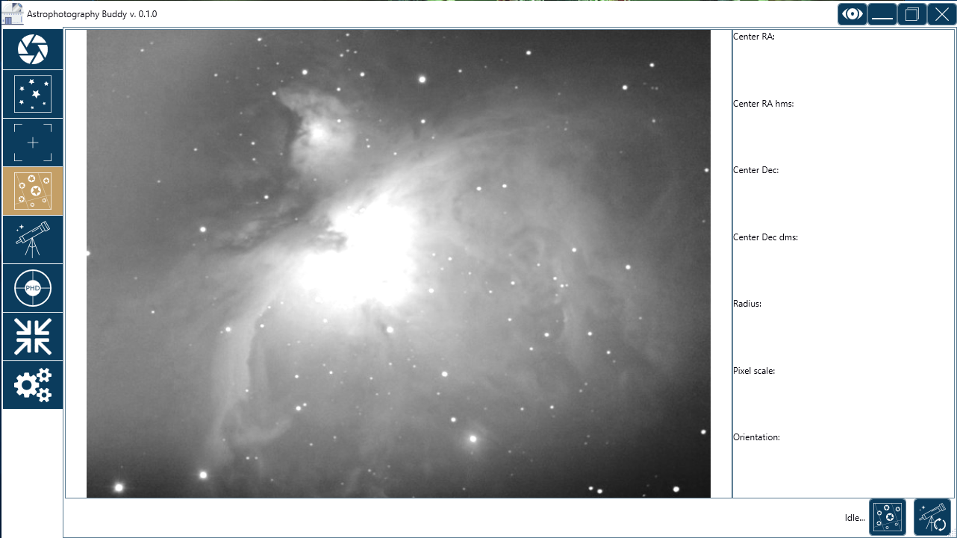
Plate Solving
Image Area
Sync scope to solved coords
Start plate solve

Slide 9
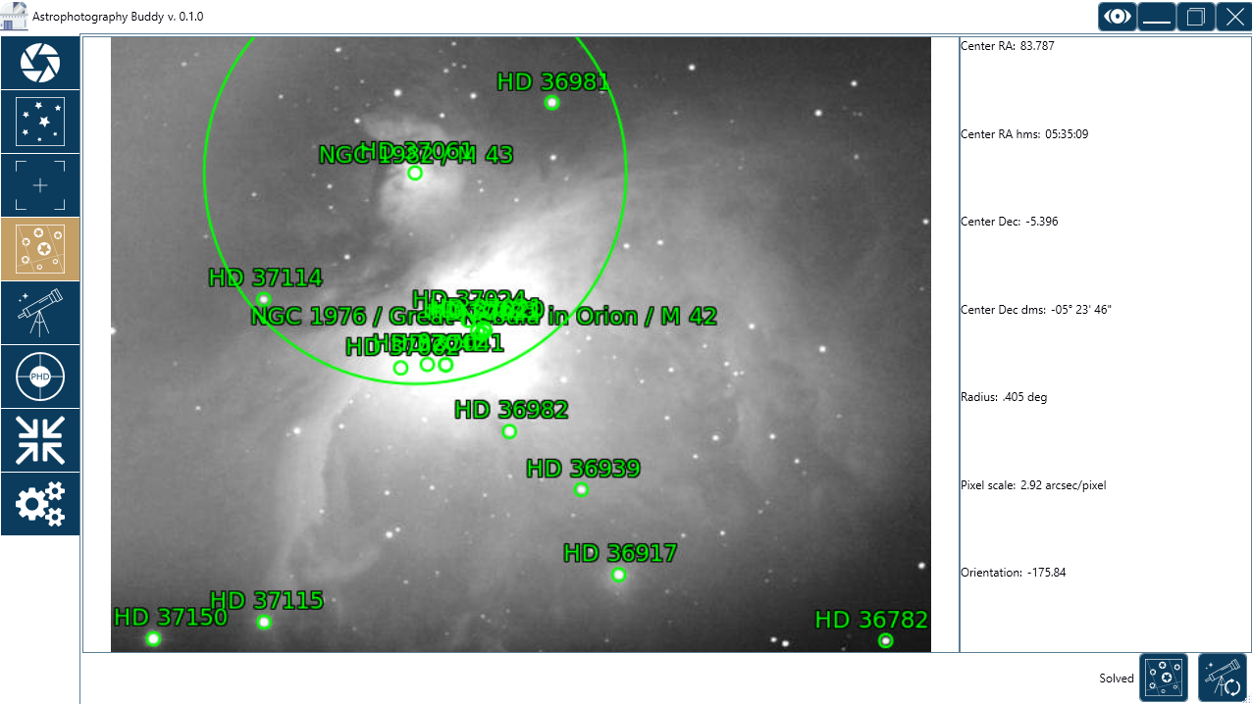
Plate Solving
Solved image example

Slide 10
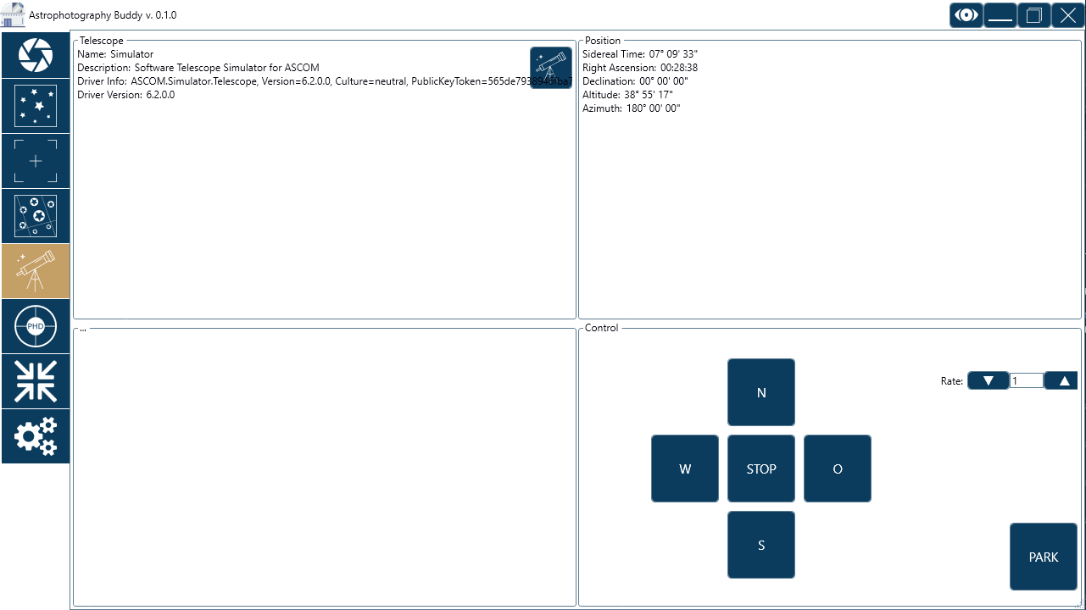
Telescope control
Connect telescope
Manual slew controls

Slide 11
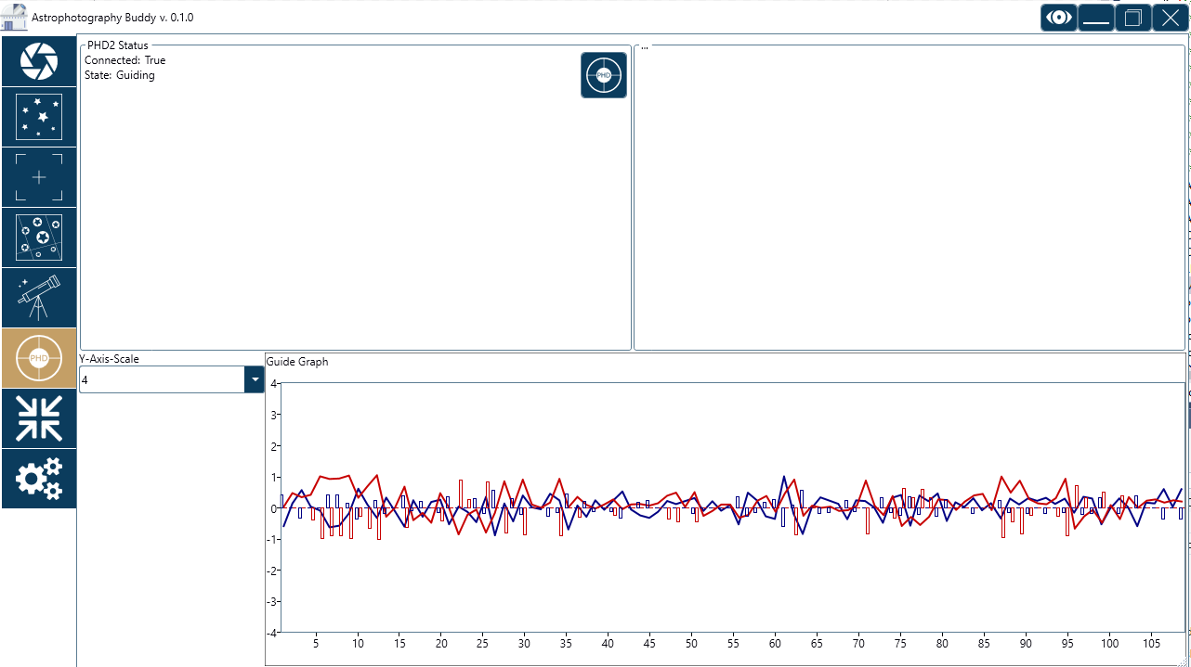
PHD2 Screen
Connect PHD2
Guiding graph sent by PHD2

Slide 12
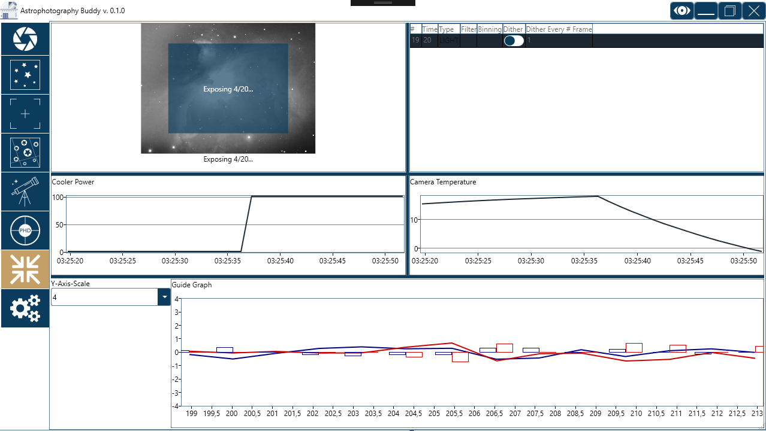
Overview Mode

Slide 13
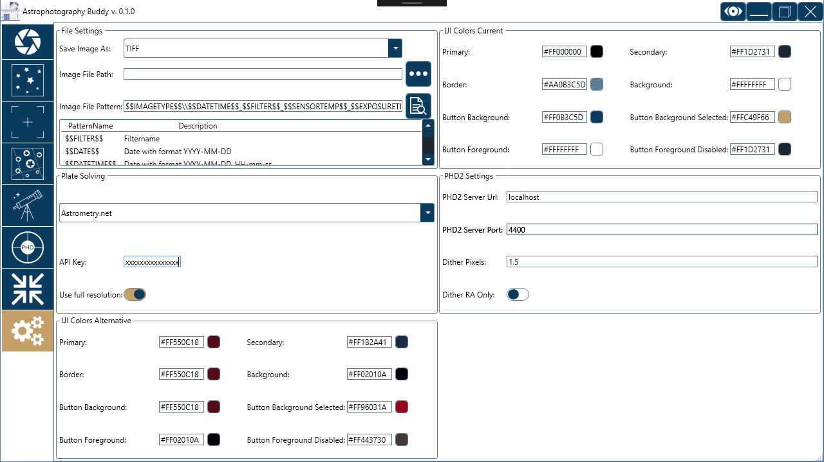
Settings
Current color schema
Alternative color schema

