Slide 1
Window Interfaces
Using Swing Objects
Swing Basics and Demo Programs
Event-Driven Programming and Demo Programs
Layout Managers
Text I/O and Menus

Slide 2
GUIs—Graphical User Interfaces
Most modern programs use a GUI(WIMP, Windows, Icons, Menus and Pointing devices)
Graphical—not just text or characters: windows, menus, buttons, etc.
User—person using the program
Interface—way to interact with the program
Typical graphical elements:
Window—portion of screen that serves as a smaller screen within the screen
Menu—list of alternatives offered to user
Button—looks like a button that can be pressed

Slide 3
Swing
Special library of classes that allows Java programs to have a windowing interface
Part of larger collection called Java Foundation Classes or JFC
An improved version of older library called Abstract Window Toolkit (AWT)
Standard part of all versions of Java 2 (JDK 1.2)

Slide 4
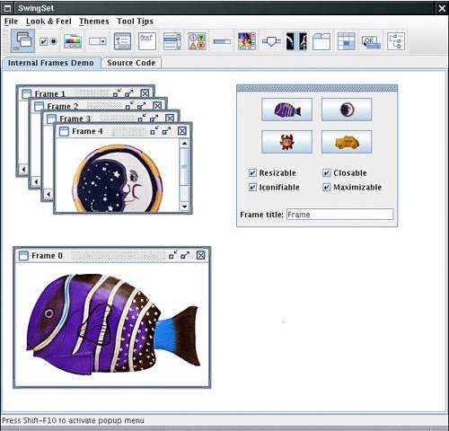
SwingSet

Slide 5
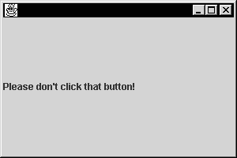
Very Simple Swing Demonstration
import javax.swing.*;
public class FirstSwingDemo
{
public static final int WIDTH = 300;
public static final int HEIGHT = 200;
public static void main(String[] args)
{
JFrame myWindow = new JFrame();
myWindow.setSize(WIDTH, HEIGHT);
JLabel myLabel = new JLabel(“Please don’t…”);
myWindow.add(myLabel);
//myWindow.setDefaultCloseOperation(JFrame.EXIT_ON_CLOSE);
myWindow.setVisible(true);
}
}

Slide 6
import javax.swing.*;
public class CenteredFrameTest{
public static void main(String[] args) {
CenteredFrame frame = new CenteredFrame();
// frame.setDefaultCloseOperation(JFrame.EXIT_ON_CLOSE);
frame.setVisible(true);
}
}
class CenteredFrame extends JFrame{
public CenteredFrame() {
Toolkit kit = Toolkit.getDefaultToolkit();
Dimension screenSize = kit.getScreenSize();
int screenHeight = screenSize.height;
int screenWidth = screenSize.width;
setSize(screenWidth / 2, screenHeight / 2);
setLocation(screenWidth / 4, screenHeight / 4);
Image img = kit.getImage("icon.gif");
setIconImage(img);
setTitle("CenteredFrame");
}
}
Another Example

Slide 7
Window Interfaces
Using Swing Objects
Swing Basics and Demo Programs
Event-Driven Programming and Demo Programs
Layout Managers
Text I/O and Menus

Slide 8
Event-Driven Programming
Programs with GUIs often use Event-Driven Programming
Program waits for events to occur and then responds
Examples of events:
  Clicking a mouse button
  Dragging the mouse
  Pressing a key on the keyboard
Firing an event—when an object generates an event
Listener—object that waits for events to occur
Event handler—method that responds to an event

Slide 9
A New Approach to Programming
Previous Style of Programming:
List of instructions performed in order
Next thing to happen is next thing in list
Program performed by one agent—the computer
Event-Driven Style of Programming:
Objects that can fire events and objects that react to events
Next thing to happen depends on next event
Program is interaction between user and computer

Slide 10
Simple Demo Program- Windows Event
import javax.swing.*;
public class FirstSwingDemo
{
public static final int WIDTH = 300;
public static final int HEIGHT = 200;
public static void main(String[] args)
{
JFrame myWindow = new JFrame();
myWindow.setSize(WIDTH, HEIGHT);
JLabel myLabel = new JLabel(“Please don’t…”);
myWindow.getContentPanel().add(myLabel);
WindowDestroyer myListener = new WindowDestroyer();
myWindow.addWindowListener(myListener);
myWindow.setVisible(true);
}
}

Slide 11
Window Listeners
Must have seven methods
Each method is associated with a window event, such as a window closing
Can inherit all seven methods from WindowAdapter and override some methods
WindowDestroyer (in the Simple Demo Program) inherits from WindowAdapter and overrides only the windowClosing method.

Slide 12
Window Listeners
voidwindowActivated(WindowEvent e)
将 Window 设置为活动 Window 时调用。
voidwindowClosed(WindowEvent e)
因对窗口调用 dispose 而将其关闭时调用。
voidwindowClosing(WindowEvent e)
用户试图从窗口的系统菜单中关闭窗口时调用。
voidwindowDeactivated(WindowEvent e)
当 Window 不再是活动 Window 时调用。
voidwindowDeiconified(WindowEvent e)
窗口从最小化状态变为正常状态时调用。
voidwindowIconified(WindowEvent e)
窗口从正常状态变为最小化状态时调用。
voidwindowOpened(WindowEvent e)
窗口首次变为可见时调用。

Slide 13
The WindowDestroyer Class
public class WindowDestroyer extends WindowAdapter
{
public void windowClosing(WindowEvent e)
{
System.exit(0);
}
}
WindowAdapter is a class that includes all the methods required for window events.
When a window closing event occurs, this method will be called and the program will quit.

Slide 14
Buttons and ActionListeners
Basic steps for using a button in a Swing program:
Create a Button object
Add the Button object to a container
Create an ActionListener object that has an actionPerformed method
Register the listener for the Button object
The following slides show an example of each step.

Slide 15
Create a Button Object and
Add the Button to a Container
JButton stopButton = new JButton(“Red”);
this.add(stopButton);
String that will appear on the button
JButton is a predefined Swing class for buttons.
This example uses the Flow Layout so the add method needs only one parameter.
The button will be added to this container.

Slide 16
Create an ActionListener Object
Make a class into an ActionListener:
Add the phrase implements ActionListener to the beginning of the class definition:
Define a method named actionPerformed
public class ButtonDemo extends JFrame
implements ActionListener
{ . . .
public void actionPerformed(ActionEvent e)
{ . . .

Slide 17
The actionPerformed Method
An actionPerformed method must have only one parameter
The parameter must be of type ActionEvent
The parameter can be used to find the command for the ActionEvent:
public void actionPerformed(ActionEvent e)
{
if (e.getActionCommand().equals(“Red”))
. . .
}

Slide 18
Register the Listener for the Button Object
If a button has no listener registered for it, there will be no response when the user clicks on the button.
An example of registering a listener for a button:
JButton stopButton = new JButton(“Red”);
stopButton.addActionListener(this);
add(stopButton);
this refers to the object that includes this code in a method. In this example the object is a JFrame class that implements ActionListener.

Slide 19
public class ButtonDemo extends JFrame implements ActionListener
{
public static final int WIDTH = 300;
public static final int HEIGHT = 200;
public static void main(String[] args)
{
ButtonDemo buttonGui = new ButtonDemo();
buttonGui.setVisible(true);
}

Slide 20
public ButtonDemo()
{
setSize(WIDTH, HEIGHT);
addWindowListener(new WindowDestroyer());
setTitle("Button Demo");
setBackground(Color.blue);
setLayout(new FlowLayout());
JButton stopButton = new JButton("Red");
stopButton.addActionListener(this);
add(stopButton);
JButton goButton = new JButton("Green");
goButton.addActionListener(this);
add(goButton);
}

Slide 21
public void actionPerformed(ActionEvent e)
{
if (e.getActionCommand().equals("Red"))
setBackground(Color.red);
else if (e.getActionCommand().equals("Green"))
setBackground(Color.green);
else
System.out.println("Error in button interface.");
}
}

Slide 22
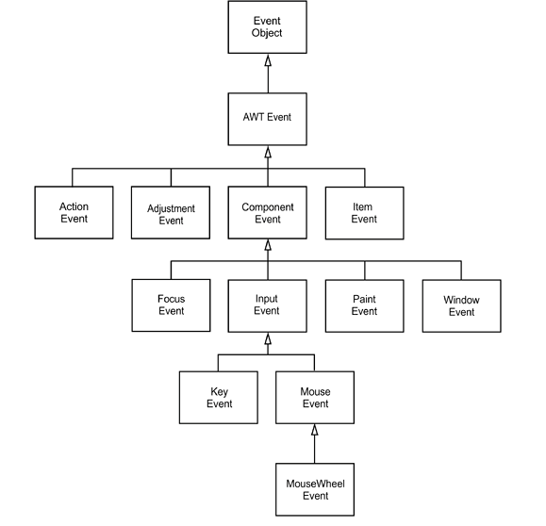

Slide 23
commonly used events
ActionEvent (for a button click, a menu selection, selecting a list item, or ENTER typed in a text field)
AdjustmentEvent (the user adjusted a scrollbar)
ItemEvent (the user made a selection from a set of checkbox or list items)

Slide 24
commonly used events
KeyEvent (a key was pressed or released)
MouseEvent (the mouse button was pressed, released, moved, or dragged)
MouseWheelEvent (the mouse wheel was rotated)
FocusEvent (a component got focus, or lost focus).
WindowEvent (the window state changed)

Slide 25
Window Interfaces
Using Swing Objects
Swing Basics and Demo Programs
Event-Driven Programming and Demo Programs
Layout Managers
Text I/O and Menus

Slide 26
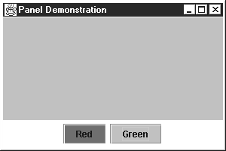
JPanel
Used for hierarchical organization of GUIs:
  A panel can contain other components
  A panel can be added to another container
JPanel buttonPanel = new JPanel();
buttonPanel.setLayout(new FlowLayout());
buttonPanel.add(stopButton);
buttonPanel.add(goButton);
add(buttonPanel, BorderLayout.SOUTH);
Red
Green

Slide 27
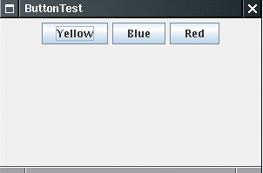
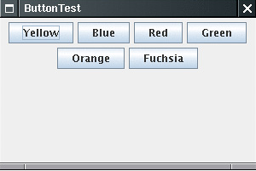
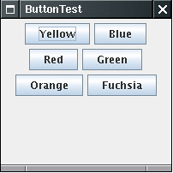
panel.setLayout(new FlowLayout(FlowLayout.LEFT));
FlowLayout(int align)
  LEFT, CENTER, or RIGHT
FlowLayout(int align, int hgap, int vgap)

Slide 28
Layout Managers
Layout Manager—an object that decides how components will be arranged in a container
Used because containers can change size
Some types of layout managers:
  BorderLayout
  FlowLayout
  GridLayout
Each type of layout manager has rules about how to rearrange components when the size or shape of the container changes.

Slide 29
The Border Layout Manager
Five regions that can each have one component added to them:
BorderLayout.NORTH
BorderLayout.
WEST
BorderLayout.CENTER
BorderLayout.
EAST
BorderLayout.SOUTH
content.setLayout(new BorderLayout());
. . .
content.add(label1, BorderLayout.NORTH);
The CENTER region grows the most when the container grows and shrinks the most when the container shrinks

Slide 30
The Flow Layout Manager
The simplest layout manager
Displays components from left to right in the order they are added to the container
Add method has one parameter which is the component to add
Container content = getContentPane();
content.setLayout(new FlowLayout());
JLabel label1 = new JLabel(“First label here”);
content.add(label1);
JLabel label2 = new JLabel(“Second label there”);
content.add(label2);

Slide 31
The Grid Layout Manager
Specify a number of rows and columns
All regions in the grid are equal size
When the container changes size, each region grows or shrinks by the same amount
aContainer.setLayout(new GridLayout(2, 3));
. . .
aContainer.add(label1);
aContainer.add(label2);
Creates a grid layout with two rows and three columns.
Rows are filled before columns.
aContainer.setLayout(null); 绝对定位

Slide 32
Box Layout
The box layout lets you lay out a single row or column of components with more flexibility than the grid layout affords.
Box b = Box.createHorizontalBox();
Box b = Box.createVerticalBox();
b.add(okButton); b.add(cancelButton);
Each component has three sizes
  The preferred size— the width and height at which the component would like to be displayed
  The maximum size— the largest width and height at which the component is willing to be displayed
  The minimum size— the smallest width and height at which the component is willing to be displayed
Notes:
It computes the maximum (!) height of the tallest component.
It tries to grow all components vertically to that height.
If a component does not actually grow to that height when requested, then its y-alignment is queried by a call to its getAlignmentY method. That method returns a floating-point number between 0 (align on top) and 1 (align on bottom). The default in the Component class is 0.5 (center). The value is used to align the component vertically.
The preferred width of each component is obtained. All preferred widths are added up.
If the total preferred width is less than the box width, then the components are expanded by being allowed to grow to their maximum width. Components are then placed, from left to right, with no additional space between them. If the total preferred width is greater than the box width, the components are shrunk, potentially down to their minimum width but no further. If the components don't all fit at their minimum width, some of them will not be shown.

Slide 33
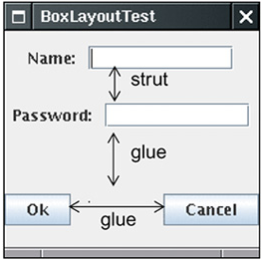
Fillers
To space the components out, you add invisible fillers. There are three kinds of fillers:
  Struts: separate adjacent components by a fixed amount
  Rigid areas:
  Glue : separates components as much as possible
b.add(label); b.add(Box.createHorizontalStrut(10)); b.add(textField);
b.add(button1); b.add(Box.createGlue()); b.add(button2);
b.add(Box.createRigidArea(new Dimension(5, 20)); //If added into a horizontal box, it acts like a strut of width 5 and also forces the minimum height of the box to be 20 pixels.

Slide 34
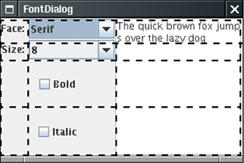
The Grid Bag Layout
the mother of all layout managers
the rows and columns can have variable sizes. You can join adjacent cells to make room for larger components.
using grid bag layouts can be incredibly complex.

Slide 35
Window Interfaces
Using Swing Objects
Swing Basics and Demo Programs
Event-Driven Programming and Demo Programs
Layout Managers
Text I/O and Menus

Slide 36
Text I/O for GUIs
JTextComponent
JTextArea
JTextField
Text fields and text areas
  getText method retrieves text in component
  setText changes text in component
If memo1 is a String and theText is either a JTextField or a JTextArea, then you could write:
memo1 = theText.getText();
theText.setText(“Hi Mom”);

Slide 37
JTextField and JTextArea
Both inherit from JTextComponent
Both have setText and getText methods
Both can have initializing text as parameter to constructor
JTextField can only have one line of text
JTextArea can have many lines of text
JTextArea can have scroll bars
Big enough to hold 40 m characters
JTextField someText = new JTextField(40);
JTextArea someMoreText = new JTextArea(10, 40);
Big enough to hold 10 lines where each line can hold 40 m characters

Slide 38
Inputting and Outputting Numbers
To get an int from a TextArea or TextField:
Get a String using getText
Trim extra white space using trim
Convert the String to an int using parseInt
int n = Integer.parseInt(field.getText().trim());
To put an int into a TextArea or TextField:
Convert the int to a String using toString
Put the String in the text component using setText
field.setText(Integer.toString(total));

Slide 39
Menus
Three Swing classes used to put a menu in a program:
  JMenuBar
  JMenu
  JMenuItem
Menu items behave in the same way as buttons
AbstractButton
JMenuItem
JButton
JMenu

Slide 40
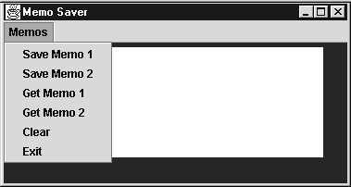
A GUI with a Menu
JMenu memoMenu = new JMenu("Memos");
JMenuItem m;
m = new JMenuItem("Save Memo 1");
m.addActionListener(this);
memoMenu.add(m);
m = new JMenuItem("Save Memo 2");
m.addActionListener(this);
memoMenu.add(m);
. . .
JMenuBar mBar = new JMenuBar();
mBar.add(memoMenu);
setJMenuBar(mBar);
Create a menu
Create a menu item
A menu item uses an action listener the same way a button does.

Slide 41
A GUI with a Menu
JMenu memoMenu = new JMenu("Memos");
JMenuItem m;
m = new JMenuItem("Save Memo 1");
m.addActionListener(this);
memoMenu.add(m);
m = new JMenuItem("Save Memo 2");
m.addActionListener(this);
memoMenu.add(m);
. . .
JMenuBar mBar = new JMenuBar();
mBar.add(memoMenu);
setJMenuBar(mBar);
Each menu item is added to the menu.
The menu is added to the menu bar.
One way to add a menu bar to a JFrame

Slide 42
Nested Menus
JMenu is a descendant of JMenuItem
Every JMenu object is also a JMenuItem
A JMenu can be a menu item in another menu
This allows nested menus
Clicking on a nested menu shows the items in the nested menu and allows them to be selected.
AbstractButton
JMenuItem
JButton
JMenu

Slide 43
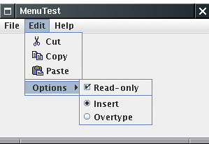
other Menu Items
editMenu.addSeparator();
JMenuItem cutItem = new JMenuItem("Cut", new ImageIcon("cut.gif"));
JCheckBoxMenuItem readonlyItem = new JCheckBoxMenuItem("Read-only");
ButtonGroup group = new ButtonGroup();
JRadioButtonMenuItem insertItem = new JRadioButtonMenuItem("Insert");
insertItem.setSelected(true);
JRadioButtonMenuItem overtypeItem = new JRadioButtonMenuItem("Overtype");
group.add(insertItem); group.add(overtypeItem);
optionsMenu.add(insertItem); optionsMenu.add(overtypeItem);

Slide 44
other Menu Items
Pop-Up Menus
  JPopupMenu popup = new JPopupMenu();
  JMenuItem item = new JMenuItem("Cut"); item.addActionListener(listener); popup.add(item);
  popup.show(panel, x, y);
  component.setComponentPopupMenu(popup);
Keyboard Mnemonics and Accelerators
Enabling and Disabling Menu Items

Slide 45
Hierarchy of
Swing Classes
Object
Component
AWT
Container
Layout manager classes are in the AWT.
Class
Window
Abstract Class
Frame
JFrame
JComponent
Swing
JPanel
AbstractButton
JLabel
JMenuBar
JMenuItem
JTextComponent
JButton
JMenu
JTextArea
JTextField

Slide 46
JList & JTree

Slide 47

Lists - JList
To construct this list component
  String[] words= { "quick", "brown", "hungry", "wild", ... };
  JList wordList = new JList(words);
To make a list box scroll
  JScrollPane scrollPane = new JScrollPane(wordList);
wordList.setVisibleRowCount(4); // display 4 items
wordList.setSelectionMode(ListSelectionModel.SINGLE_SELECTION);
wordList.setLayoutOrientation(JList.VERTICAL )

Slide 48
Lists - JList
wordList.addListSelectionListener(new ListSelectionListener() {
public void valueChanged(ListSelectionEvent event){
Object[] values = wordList.getSelectedValues();
…
}
});
Very long lists
Lists with changing contents
Lists that don‘t contain strings（will not be covered here）
ListModel

Slide 49
Lists – JList- ListModel
The JList class is responsible for the visual appearance of the data.
It actually knows very little about how the data are stored
all it knows is that it can retrieve the data through some object that implements the ListModel interface
public interface ListModel {
  int getSize();
  Object getElementAt(int i);
  void addListDataListener(ListDataListener l);
  void removeListDataListener(ListDataListener l);
}

Slide 50
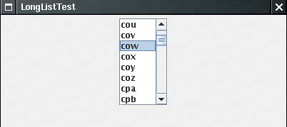
共 26 * 26 * 26 项 ！！
wordList = new JList(new WordListModel(3));
wordList.setSelectionMode(ListSelectionModel.SINGLE_SELECTION);
wordList.setPrototypeCellValue(“www”); //固定宽度

Slide 51
class WordListModel extends AbstractListModel { //动态计算所需要的
public WordListModel(int n) { length = n; } //n-letter words
public int getSize() {
return (int) Math.pow(LAST - FIRST + 1, length);
}
public Object getElementAt(int n) {
StringBuilder r = new StringBuilder();;
for (int i = 0; i < length; i++) {
char c = (char)(FIRST + n % (LAST - FIRST + 1));
r.insert(0, c);
n = n / (LAST - FIRST + 1);
}
return r;
}
private int length;
public static final char FIRST = 'a';
public static final char LAST = 'z';
}

Slide 52
JList- ListModel - Inserting and Removing Values
construct a DefaultListModel object, fill it with the initial values, and associate it with the list
  DefaultListModel model = new DefaultListModel();
  model.addElement("quick");
  model.addElement("brown"); . . .
  JList list = new JList(model);
add or remove values from the model object. The model object then notifies the list of the changes, and the list repaints itself.
  model.removeElement("quick");
  model.addElement("slow");

Slide 53
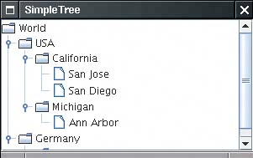
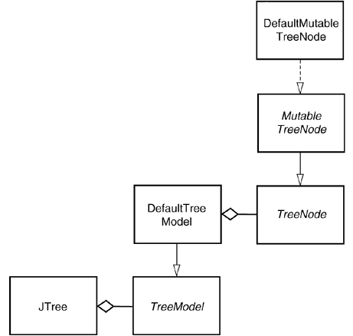
Simple Trees
Tree Classes

Slide 54
Simple Trees
DefaultMutableTreeNode root = new DefaultMutableTreeNode("World");
DefaultMutableTreeNode country = new DefaultMutableTreeNode("USA");
root.add(country);
DefaultMutableTreeNode state = new DefaultMutableTreeNode("California");
country.add(state);
DefaultTreeModel treeModel = new
DefaultTreeModel(root); JTree tree = new JTree(treeModel);
// shortcut JTree tree = new JTree(root);

Slide 55
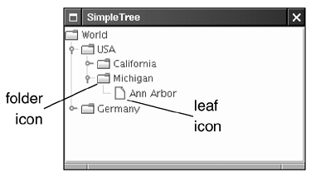
Simple Trees- leaf determination
node.setAllowsChildren(false);
model.setAsksAllowsChildren(true);

Slide 56
Demo
SwingSet2
Java2D

