Slide 1
Window Interfaces
Applet
Java 2D

Slide 2
Applets and HTML
HTML
Applets

Slide 3
Overview
Applets: Java programs designed to run from a document on the Internet
HTML: Hypertext Markup Language
  a language used to create Internet documents
Applets run within an HTML document
HTML documents are run by a web browser, e.g.
  Netscape Navigator or
  Microsoft Internet Explorer

Slide 4
HTML:
HyperText Markup Language
Hypertext: text with items you can click with a mouse to send you to another document
Link: an item you can click with the mouse to go to another document
  also called hyperlink
Page: an HTML document
  it is not equal to a page of print or a single screen of display
  HTML page and HTML document mean the same thing
HTML is a "suggestive formatting" language
  it is not a full-blown(成熟的) programming language like Java
  it suggests to the browser how to display text or other objects

Slide 5
HTML Basics
Most HTML commands are of the form
<Command>
some text
</Command>
Some commands do not require the </Command> part
HTML is not case sensitive
  i.e. the commands are not
  text displays in whatever case it is in the document
HTML files are plain text files created with any text editor
HTML file names should follow the operating system's rules and end in .html

Slide 6
A Few HTML Commands
<H1> Page Title </H1> Heading 1-
largest, most prominent（突出的） heading
<H2> text </H2> Heading 2 - a sub-heading
<H3>, etc. Additional sub-headings
<BR> Break - begin a new line
(</BR> not required)
<P> Paragraph - begin a new paragraph
(</P> not required)
<!-- comments --> Comment field
- not displayed by browser
<CENTER>text</CENTER> Center text horizontally on page
<TITLE> Used for browser "book marks"
(displays in browser title bar)

Slide 7
Outline of a Basic Page and a Few More HTML Commands
<HTML> begin an HTML document
<HEAD> begin the document's header
(title usually goes here)
</HEAD> end of document's header
<BODY> begin stuff that will appear in the main window of the browser
blank lines are ignored - use them to make code more readable
(body of html document: html commands, text, applets, etc.)
</BODY> end stuff that displays in main window of browser
<ADDRESS> date and link to the email address that follows
(email address of person maintaining the page)
</ADDRESS> end email address
</HTML> end the HTML document

Slide 8
Applets
Applet: small application
Applets are Java programs embedded in HTML documents
  therefor they run in a browser that views the document
They are a derived class of the class JApplet, which is derived from Applet. Applet is in turn derived from Panel.
  therefor it is both a Container and Component
JApplet class is not in the AWT, Swing, or basic Java
  it is in the applet library, so import java.applet.*

Slide 9
Applet Basics
When writing applets your list of import statements will usually look like this:
import javax.swing.*;
import java.awt.*;
import java.awt.event.*;
Applets do not normally have a main method

Slide 10
Applet Basics
Applets do not normally use constructors but they do use a method named init for similar purposes:
  setting colors
  adding buttons
  adding text fields, etc.
  the init method has no parameters
Th HTML document takes care of sizing the applet
Use a layout manager when defining an applet
  use the setLayout method

Slide 11
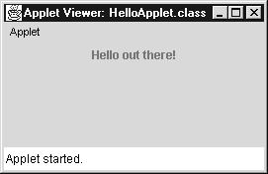
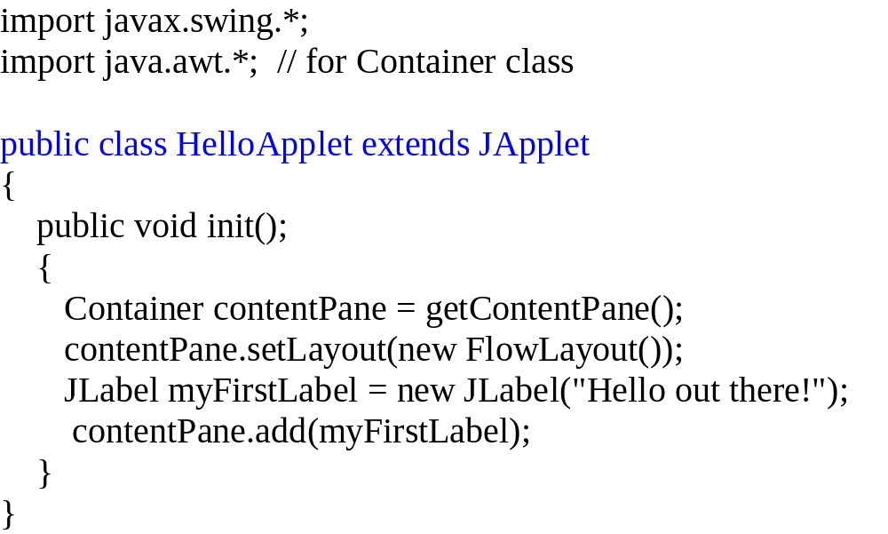
Example: a Trivial Applet
HelloApplet.java
Defining an applet

Slide 12
Running an Applet from an HTML Page
The normal way to run an applet is from an HTML document.
Syntax:
<APPLET CODE="Name_Of_.class_File" WIDTH=Integer HEIGHT=Integer>
</APPLET>
Example:
<APPLET CODE="FirstApplet.class" WIDTH=300 HEIGHT=200>
</APPLET>
Note:use the compiled file extension .class, not the source extension .java

Slide 13
Testing a Java Applet
Another way to run an applet is usually used just to test it:
  put the applet in an HTML document
    good practice is to name the HTML document the same as the applet, but with ".html" instead of ".java"
  then run it using appletviewer
  like javadoc, javac, and java, appletviewer comes with the JDK (Java Development Kit)
Syntax:
appletviewer Applet_File_Name.html
Example:
appletviewer FirstApplet.html

Slide 14
Another Way to Test an Applet
Use the appletviewer in an integrated Java development environment
There are many commercial development environments that provide handy tools to write, compile, run and debug Java programs
Typically they have a menu selection something like "Run" or "Execute" to run an application
  usually they will automatically create an applet viewer if you run an applet

Slide 15
Adding Icons to an Applet
import javax.swing.*;
import java.awt.*;
public class DukeApplet extends JApplet
{
public void init()
{
Container contentPane = getContentPane();
contentPane.setLayout(new BorderLayout());
JLabel spacer = new JLabel(" ");
contentPane.add(spacer, "West");
JLabel niceLabel = new JLabel("Java is fun!");
ImageIcon dukeIcon =
new ImageIcon("duke_waving.gif");
niceLabel.setIcon(dukeIcon);
getContentPane().add(niceLabel, BorderLayout.CENTER);
}
}
Uses content pane as JFrame does
Add icon to label
Add label to content pane of applet

Slide 16
The Older Applet Class
Older versions of web browsers can‘t run applets that use JApplet and other Swing classes.（现在的IE也不可以）
Using the old Applet class instead of JApplet will allow your applet to run in more browsers.
To convert a JApplet program to an Applet program:
  Replace:
  import javax.swing.*;
  with
  import java.applet.*;
  Replace Swing classes that start with J (JButton, JPanel, etc.) with AWT classes that don't start with J (Button, Panel, etc.)
  Remove references to the content pane of the applet.

Slide 17
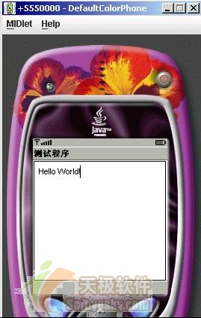
J2ME GUI
import javax.microedition.midlet.MIDlet;
import javax.microedition.midlet.MIDletStateChangeException;
public class HelloWorldMIDlet extends MIDlet {
private TextBox textbox;
public HelloWorldMIDlet() {
super();
textbox = new TextBox("测试程序", "Hello World!", 20, 0);
}
protected void startApp() throws MIDletStateChangeException {
Display.getDisplay(this).setCurrent(textbox);
}
protected void pauseApp() {
}
protected void destroyApp(boolean arg0) throws MIDletStateChangeException {
}
}

Slide 18
Window Interfaces
Applet
Java 2D

Slide 19
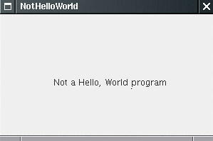
class NotHelloWorldPanel extends JPanel {
  public void paintComponent(Graphics g) {
    super.paintComponent(g);
    g.drawString("Not a Hello, World program", MESSAGE_X, MESSAGE_Y);
  }
  public static final int MESSAGE_X = 75;
  public static final int MESSAGE_Y = 100;
}

Slide 20
class NotHelloWorldFrame extends JFrame
{
public NotHelloWorldFrame()
{
setTitle("NotHelloWorld");
setSize(DEFAULT_WIDTH, DEFAULT_HEIGHT);
NotHelloWorldPanel panel = new NotHelloWorldPanel();
add(panel);
}
public static final int DEFAULT_WIDTH = 300;
public static final int DEFAULT_HEIGHT = 200;
}

Slide 21
Working with 2D
Since JDK version 1.0, the Graphics class had methods to draw lines, rectangles, ellipses, and so on.
But those drawing operations are very limited.
For example, you cannot vary the line thickness and you cannot rotate the shapes.
JDK 1.2 introduced the Java 2D library, which implements a powerful set of graphical operations.

Slide 22
The Java 2D rendering pipeline
Obtain an object of the Graphics2D class.
  public void paintComponent(Graphics g){
    Graphics2D g2 = (Graphics2D) g; . . .
  }
Use the setRenderingHints method to set rendering hints: trade-offs between speed and drawing quality.
  RenderingHints hints = . . .;
  g2.setRenderingHints(hints);

Slide 23
The rendering pipeline
Use the setStroke method to set the stroke. The stroke draws the outline of the shape. You can select the thickness and choose among solid and dotted lines .
  Stroke stroke = . . .;
  g2.setStroke(stroke);
Use the setPaint method to set the paint. The paint fills areas such as the stroke path or the interior of a shape. You can create solid color paint, paint with changing hues, or tiled fill patterns.
  Paint paint = . . .;
  g2.setPaint(paint);

Slide 24
The rendering pipeline
Use the clip method to set the clipping region.
  Shape clip = . . .;
  g2.clip(clip);
Use the transform method to set a transformation from user space to device space.
  AffineTransform transform = . . .;
  g2.transform(transform);

Slide 25
The rendering pipeline
Use the setComposite method to set a composition rule that describes how to combine the new pixels with the existing pixels.
  Composite composite = . . .;
  g2.setComposite(composite);
Create a shape.
  Shape shape = . . .;
Draw or fill the shape.
  g2.draw(shape);
  g2.fill(shape);

Slide 26
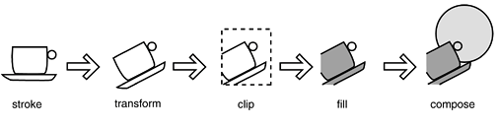
The rendering pipeline

Slide 27
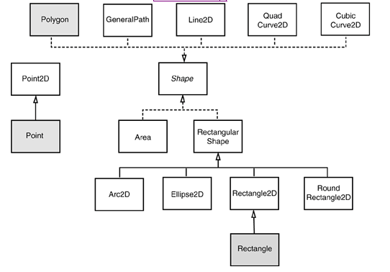
Java 2D Shapes
Legacy classes from the pre-2D library are marked with a gray fill

Slide 28
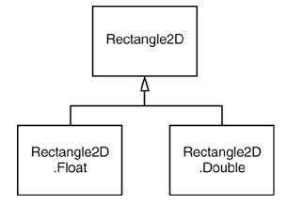
Java 2D Shapes
public void paintComponent(Graphics g) {
  Graphics2D g2 = (Graphics2D) g;
  g2.draw(rect);
  g2.fill(rect);
}
Rectangle2D is an abstract class
Rectangle2D doubleRect = new Rectangle2D.Double(10.0, 25.0, 22.5, 20.0);
Rectangle2D rect = new Rectangle2D.Double(); rect.setFrameFromDiagonal(px, py, qx, qy); //利用对角线创建矩形

Slide 29
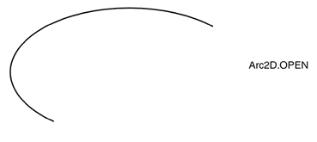
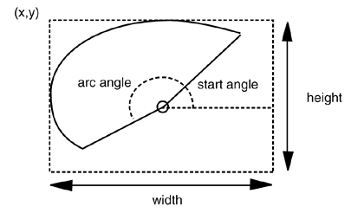
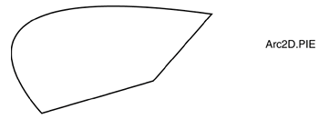
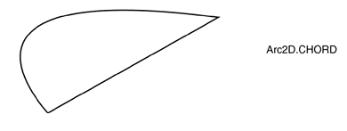
Using the Shape Classes
Arc2D a = new Arc2D(x, y, width, height, startAngle, arcAngle, closureType);

Slide 30

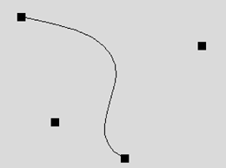
Using the Shape Classes
QuadCurve2D q = new QuadCurve2D.Double(startX, startY, controlX, controlY, endX, endY);
CubicCurve2D c = new CubicCurve2D.Double(startX, startY, control1X, control1Y, control2X, control2Y, endX, endY);

Slide 31
Using the Shape Classes
GeneralPath path = new GeneralPath();
path.moveTo(10, 20);
path.lineTo(20, 30);
path.curveTo(control1X, control1Y, control2X, control2Y, endX, endY);
Rectangle2D r = . . .; path.append(r, false); //是否与当前path连接
path.closePath() //是否与第一个点连接闭合

Slide 32
Fonts and Other Text Details
A font is a style of text.
A program can use the drawString method to display text on the screen.
The first parameter tells which characters to display.
The last two parameters to drawString are coordinates that tell where on the screen to put the text.
g.drawString(theText, X_START, Y_START);

Slide 33
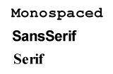
Setting the Font
The method setFont in a Graphics object can be used to change the current font.
Java guarantees that at least three fonts will be available:
  Monospaced
  SanSerif
  Serif
  Dialog
  DialogInput

Slide 34
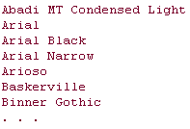
List fonts
import java.awt.*;
public class ListFonts {
  public static void main(String[] args) {
  String[] fontNames = GraphicsEnvironment.getLocalGraphicsEnvironment() .getAvailableFontFamilyNames();
  for (String fontName : fontNames)
  System.out.println(fontName);
  }
}

Slide 35
Using the Font Constructor
To specify a font with a particular name, style, and size, use the Font constructor.
Size of the font is specified in points.
Each point is 1/72 of an inch, but point sizes are only approximate.
Name of the font
Font f = new Font(“Serif”, Font.BOLD|Font.ITALIC,
POINT_SIZE);
g2.setFont(f);
String message = "Hello, World!";
g2.drawString(message, 75, 100);
Style of the font: bold and italic
Size of the font in points (an integer)

Slide 36
Using Fonts
Font sansbold14 = new Font("SansSerif", Font.BOLD, 14);
g2.setFont(sansbold14);
String message = "Hello, World!";
g2.drawString(message, 75, 100);

Slide 37
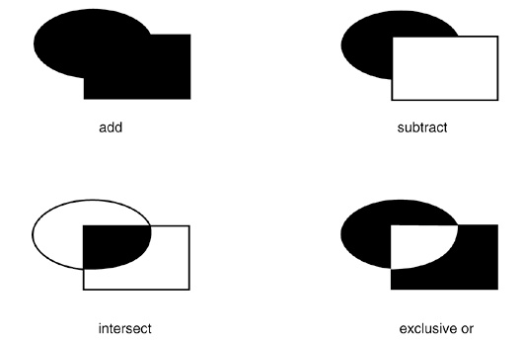
Areas
Area a = new Area();
a.add(new Rectangle2D.Double(. . .));
a.subtract(path);

Slide 38
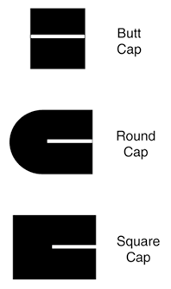
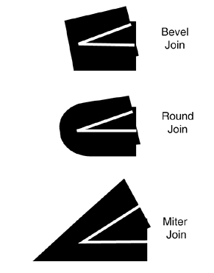
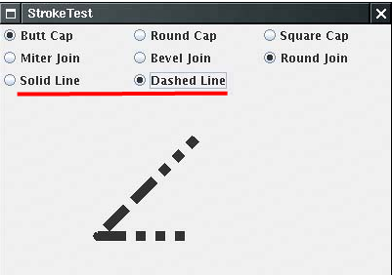
Strokes

Slide 39
Using Colors
The setPaint method of the Graphics2D class lets you select a color that is used for all subsequent drawing operations on the graphics context
g2.setPaint(Color.RED);
g2.drawString("Warning!", 100, 100);
MyPanel p = new MyPanel();
p.setBackground(Color.PINK);
p.setBackground(SystemColor.window)// 利用操作系统的配色方案进行着色

Slide 40
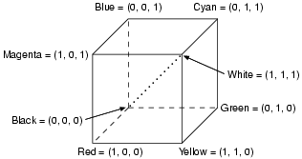
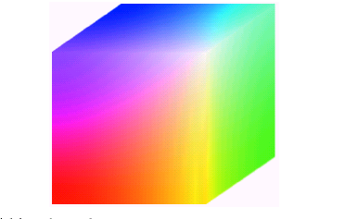
RGB 颜色模型
通常用于彩色CRT显示器。
采用直角坐标系
RGB是加性原色：各个原色的光能叠加在一起产生符合色

Slide 41
Defining Colors
The Color class mixes amounts of red, green, and blue to produce a new color.
Since colors are made by combing different amounts of red, green, and blue, this is called the RGB color system.
BLACK GREEN RED BLUE LIGHT_GRAY WHITE CYAN MAGENTA YELLOW DARK_GRAY ORANGE GRAY PINK
Color brown = new Color(204, 102, 0);

Slide 42
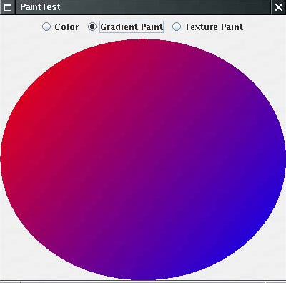
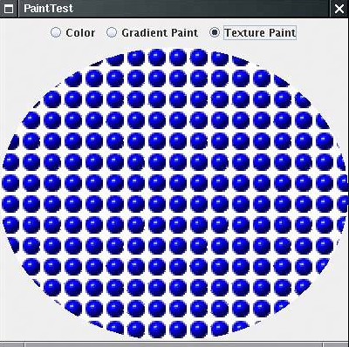
Paint
g2.setPaint(Color.red);
g2.setPaint(new GradientPaint(p1, Color.red, p2, Color.blue));
bufferedImage = ImageIO.read(new File("blue-ball.gif"));
g2.setPaint(new TexturePaint(bufferedImage, anchorRectangle));

Slide 43
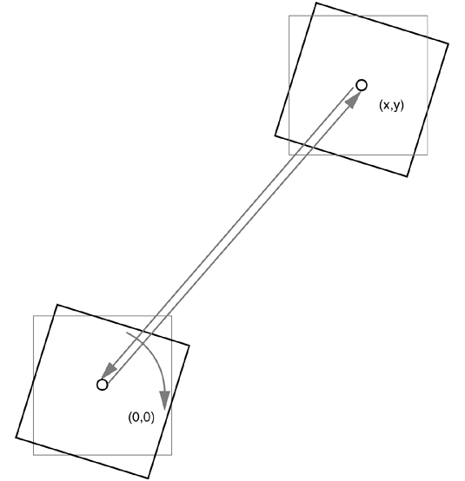
Transformations
g2.translate(x, y);
g2.rotate(a);
g2.translate(-x, -y);
g2.draw(. . .);

Slide 44
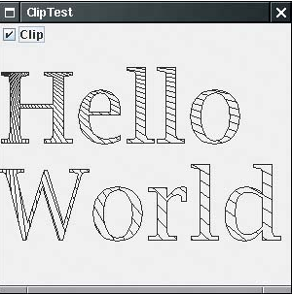
Clipping
Shape oldClip = g2.getClip(); // save old clip
g2.clip(clipShape); // apply temporary clip
draw on g2
g2.setClip(oldClip); // restore old clip
Clipping using the outline of the String

Slide 45
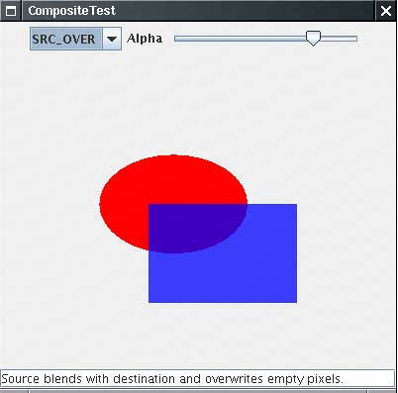
Transparency and Composition

Slide 46
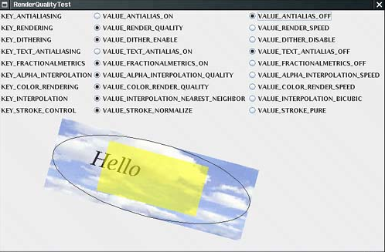
Rendering Hints
Notes:
选择是尽快绘制对象，还是倾向于以尽可能高的质量绘制对象

Slide 47
Readers and Writers for Images
  ImageIcon bk = new ImageIcon("Images/boardBk.gif");
  //Image bk= getToolkit().getImage("myImage.jpg"));
  g.drawImage(bk.getImage(), x, y, this);
Reading File
  BufferedImage image = ImageIO.read(new File("blue-ball.gif"));
Saving File
  File f = . . .;
  String format = . . .; //JPG jpeg jpg PNG JPEG png
  ImageIO.write(image, format, f);

Slide 48



Image Manipulation
Accessing Image Data-get and set
  WritableRaster raster = image.getRaster();
  int[] black = { 0, 0, 0, 255 }; raster.setPixel(i, j, black);
  int[] sample = new int[4]; raster.getPixel(x, y, sample);
Filtering Images
Rotate Blur Edge Detection

Slide 49
Exercise: PaintBrush
MouseListener
  mousepressed mousereleased mouseentered mouseexited mouseclicked
MouseEvent
  getClickCount
  getX
  getY
  getPoint
  TRanslatePoint
Component

