Slide 1
Java基本网络编程

Slide 2
基本概念
标识Internet上的一台机器
  IP 地址
    202。194。7。231
  Domain Name System (DNS)域名系统
    vr.sdu.edu.cn(Domain)
  获得机器的IP地址
    static InetAddress.getByName( )
      InetAddress a = InetAddress.getByName(“vr.sdu.edu.cn”);
      192.168.100.196
  服务器：提供服务的机器，等待客户端的连接
  客户端：享受服务的机器，寻找服务器

Slide 3
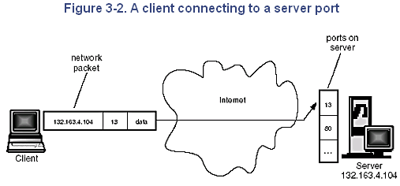
基本概念
本地主机：（没有网络的情况下测试程序）
  InetAddress.getByName(null)
  InetAddress.getByName(“localhost”)
  InetAddress.getByName(“127.0.0.1”)
端口:机器中的独一无二的地点（第二层地址，1~1024 系统）

Slide 4
基本概念
Socket
  软件抽象，表示建立连接的两台机器的 “terminals” （连接点）
  ServerSocket that a server uses to “listen” for incoming connections
  Socket that a client uses in order to initiate a connection
  accept( )
  getInputStream( )
  getOutputStream( )

Slide 5
//: c15:JabberServer.java Very simple server that just echoes whatever the client sends.
import java.io.*;
import java.net.*;
public class JabberServer {
// Choose a port outside of the range 1-1024:
public static final int PORT = 8080;
public static void main(String[] args)
throws IOException {
ServerSocket s = new ServerSocket(PORT);
System.out.println("Started: " + s);
try {
// Blocks until a connection occurs:
Socket socket = s.accept();
try {
System.out.println("Connection accepted: "+ socket);
BufferedReader in = new BufferedReader(
new InputStreamReader(socket.getInputStream()));

Slide 6
// Output is automatically flushed by PrintWriter:
PrintWriter out = new PrintWriter(new BufferedWriter(
new OutputStreamWriter(socket.getOutputStream())),true);
while (true) {
String str = in.readLine();
if (str.equals("END")) break;
System.out.println("Echoing: " + str);
out.println(str);
}
// Always close the two sockets...
} finally {
System.out.println("closing...");
socket.close();
}
} finally {
s.close();
}
}
}

Slide 7
//: c15:JabberClient.java Very simple client that just sends lines to the server and reads lines that the server sends.
import java.net.*;
import java.io.*;
public class JabberClient {
public static void main(String[] args)
throws IOException {
InetAddress addr = InetAddress.getByName(null);
System.out.println("addr = " + addr);
Socket socket =
new Socket(addr, JabberServer.PORT);
try {
System.out.println("socket = " + socket);
BufferedReader in =new BufferedReader(new InputStreamReader(socket.getInputStream()));
PrintWriter out = new PrintWriter(new BufferedWriter(
new OutputStreamWriter(socket.getOutputStream())),true);

Slide 8
for(int i = 0; i < 10; i ++) {
out.println("howdy " + i);
String str = in.readLine();
System.out.println(str);
}
out.println("END");
} finally {
System.out.println("closing...");
socket.close();
}
}
}

Slide 9
//: 处理来自多个客户端的请求
import java.io.*;
import java.net.*;
class ServeOneJabber extends Thread {
private Socket socket;
private BufferedReader in;
private PrintWriter out;
public ServeOneJabber(Socket s)
throws IOException {
socket = s;
in =
new BufferedReader(
new InputStreamReader(
socket.getInputStream()));

Slide 10
// Enable auto-flush:
out =
new PrintWriter(
new BufferedWriter(
new OutputStreamWriter(
socket.getOutputStream())), true);
// If any of the above calls throw an
// exception, the caller is responsible for
// closing the socket. Otherwise the thread
// will close it.
start(); // Calls run()
}

Slide 11
public void run() {
try {
while (true) {
String str = in.readLine();
if (str.equals("END")) break;
System.out.println("Echoing: " + str);
out.println(str);
}
System.out.println("closing...");
} catch(IOException e) {
System.err.println("IO Exception");
} finally {
try { socket.close();
} catch(IOException e) {
System.err.println("Socket not closed");
}
}
}}

Slide 12
public class MultiJabberServer {
static final int PORT = 8080;
public static void main(String[] args)
throws IOException {
ServerSocket s = new ServerSocket(PORT);
System.out.println("Server Started");
try {
while(true) {
Socket socket = s.accept();
try { new ServeOneJabber(socket);
} catch(IOException e) {
socket.close();
}
}
} finally { s.close(); }
}
}

Slide 13
//: c15:MultiJabberClient.java
// Client that tests the MultiJabberServer
// by starting up multiple clients.
import java.net.*;
import java.io.*;
class JabberClientThread extends Thread {
private Socket socket;
private BufferedReader in;
private PrintWriter out;
private static int counter = 0;
private int id = counter++;
private static int threadcount = 0;
public static int threadCount() {
return threadcount;
}

Slide 14
public JabberClientThread(InetAddress addr) {
System.out.println("Making client " + id);
threadcount++;
try {
socket =
new Socket(addr, MultiJabberServer.PORT);
} catch(IOException e) {
System.err.println("Socket failed");
// If the creation of the socket fails,
// nothing needs to be cleaned up.
}
try {
in =
new BufferedReader(
new InputStreamReader(
socket.getInputStream()));

Slide 15
// Enable auto-flush:
out = new PrintWriter(
new BufferedWriter(
new OutputStreamWriter(
socket.getOutputStream())), true);
start();
} catch(IOException e) {
// The socket should be closed on any
// failures other than the socket
// constructor:
try {
socket.close();
} catch(IOException e2) {
System.err.println("Socket not closed");
}
}
}

Slide 16
public void run() {
try {
for(int i = 0; i < 25; i++) {
out.println("Client " + id + ": " + i);
String str = in.readLine();
System.out.println(str);
}
out.println("END");
} catch(IOException e) {
System.err.println("IO Exception");
} finally {
try {
socket.close();
} catch(IOException e) {
System.err.println("Socket not closed");
}
threadcount--; // Ending this thread
}
}
}

Slide 17
public class MultiJabberClient {
static final int MAX_THREADS = 40;
public static void main(String[] args)
throws IOException, InterruptedException {
InetAddress addr =
InetAddress.getByName(null);
while(true) {
if(JabberClientThread.threadCount()
< MAX_THREADS)
new JabberClientThread(addr);
Thread.currentThread().sleep(100);
}
}
}

Slide 18
Java支持的其他基本网络功能
UDP通讯
SMTP（Simple Mail Transfer Protocol ）
HTTP\FTP\TelNet

Slide 19
连接到一个SMTP邮件服务器
简单邮件传输协议SMTP（Simple Mail Transfer Protocol）
  SMTP服务器发送初始识别字符串
  你告知发送所在的机器来应答
  如果OK，则服务器回答告知收到
  你应答一个From:e_mail地址（发送方地址）
  如果OK,服务器告知收到。
  你回答一个To:e_mail地址（接收方地址）
  如果OK，服务器告知收到
  然后发送Data整个E_mail信息，一行一行发，最后用包含句号（‘.’）的一个行来结束信息
  服务器再次告知收到信息
  发送QUIT签退

Slide 20
class SMTP{
public final static int SMTP_PORT = 25;
InetAddress mailHost,ourselves;
BufferedReader in;
PrintWriter out;
public SMTP(String host) throws UnkownHostException{
mailHost = InetAddress.getName(host);
ourselves = InetAddress.getLocalHost();
System.out.println("Mailhost=" + mailHost);
System.out.println("localHost=" + ourselves);
System.out.println("SMTP constructor done\n");
}

Slide 21
public boolean send(FileReader msgg, String from, String to)
throws IOException{
Socket smtpPipe;
InputStrram inn;
OutputStream outt;
BufferReader msg;
msg = new BufferedReader(msgg);
smtpPipe = new Socket(mailHost, SMTP_PORT);
if(smtpPipe == null )
return false;
inn = smtpPipe.getInoutStream();
outt = smtpPipe.getOutputStream();
in = new BufferedReader(new InputStreamReader(inn));
out = new PrintWriter(new OutputStramWriter(outt),true); if(inn = null || outt == null){
System.out.println("Failed to open Strams to soket.");
return false;
}

Slide 22
//SMTP服务器发送初始识别字符串
String initialID = in.readLine();
System.out.println(initialID);
System.out.println("HELO" + ourseleves.getHostName());
//你告知发送所在的机器来应答
out.println("HELO" + ourseleves.getHostName());
//如果OK，则服务器回答告知收到
String welcom = in.readLine();
System.out.println(welcom);
//你应答一个From:e_mail地址（发送方地址）
out.println(" Mail From:<" + from + >" );
//如果OK,服务器告知收到。
String senderOK = in.readLine();
System.out.println(senderOK );

Slide 23
//你发送一个To:e_mail地址（接收方地址）
out.println(" RCPT TO:<" + to + >" );
//如果OK，服务器告知收到
String recipientOK = in.readLine();
System.out.println(" DATA" );
//发送Data，标记信息开始
out.println(" DATA" );
String line;
//逐行发送整个E_mail信息
while((line = msg.readLine()) != null){
out.println(line);
}
//最后用包含句号（‘.’）的一个行来结束信息
out.println(".");
//服务器再次告知收到信息
String acceoteOK = in.readLine();
//发送QUIT签退
out.println("QUIT" );
return true;}}
Notes:
然后发送整个E_mail信息，一行一行发，

Slide 24
连接HTTP Web服务器
基于多行的请求和响应头的交换
客户机发送请求给服务器来启动通讯
GET头的格式
  "GET" <URL> "HTTP/1.0"
    请求方法（GET)
    资源URL
    交换用的HTTP协议版本（HTTP/1.0)

Slide 25
连接HTTP Web服务器
服务器发送响应头应答这个请求
  HTTP/1.0 200 OK
  SERVER:Apache/1.0.2
  Contet-type:text/html
  Last-Modified:Fri, 04 Sep 1998 12:34:56 PST
  <HTML><HEAD>
  …
下载Web页面

Slide 26
import java.io.*;
import java.net.*;
public class GetWebPage{
public static void main(String args[])
throws IOException, UnknownHostException{
String resource, host, file;
int slashPos;
if(args.length !=1){
System.out.println("Usage: java GetWebPage<URL>");
System.exit(10);
}
if(!args[0].startsWith("http://")){
System.out.println("Please specify a legal http URL.");
System.exit(10);
}
resource = args[0].substring(7);
slashPos = resource.indexOf('/');
if(slashPos < 0){
resource = resource + "/index.html";
slashPos = resource.indexOf('/');
}
file = resource.substring(slashPos+1);
host = resource.substring(0,slashPos);

Slide 27
System.out.println("Host to contact:'" + host + "'");
System.out.println("File to Fetch:'" + file + "'");
HTTP webConnection = new HTTP(host);
if(webConnection != null){
BufferedReader in = webConnection.get(file);
String line;
while((line = in.readLine())!= null)
System.out.println(line);
}
System.out.println("\nDone");
}
}
class HTTP{
public final static int HTTP_PORT = 80;
InetAddress wwwHost;
DataInputStream in;
PrintStream out;
public HTTP(String host) throws UnknownHostException{
wwwHost = InetAddress.getByName(host);
System.out.println("WWW host = " + wwwHost);
}
public BufferedReader get(String file) throws IOException{
Socket httpPipe;

Slide 28
InputStream inn;
OutputStream outt;
BufferedReader ir;
PrintWriter out;
httpPipe = new Socket(wwwHost, HTTP_PORT);
if(httpPipe == null)
return null;
inn = httpPipe.getInputStream();
outt = httpPipe.getOutputStream();
ir = new BufferedReader(new InputStreamReader(inn));
out = new PrintWriter(new OutputStreamWriter(outt),true);
if(inn==null || out==null || ir ==null || out== null){
System.out.println("Failed to open streams to socket.");
return null;
}
System.out.println("GET " + file + "HTTP/1.0\n");
out.println("GET " + file + "HTTP/1.0\n");
String response;
while((response = ir.readLine()).length()>0){
System.out.println(response);
}
return ir;
}
}

Slide 29
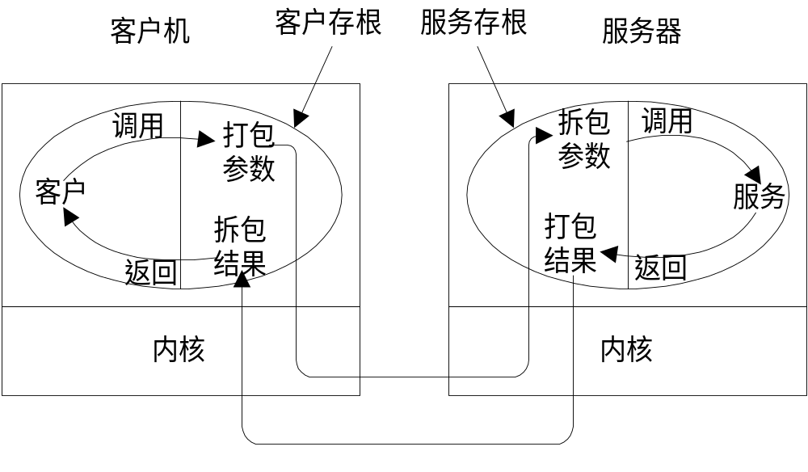
RPC
RPC中的调用与消息

Slide 30
RMI

Slide 31
RMI (Remote Method Invocation)
客户端使用服务器端的对象和方法，就像是本地的一样
2
Registry
客户端
3
1
服务程序

Slide 32
RMI组成
一个正常工作的RMI系统由下面几个部分组成：
  远程服务的接口定义
  远程服务接口的具体实现
  桩（Stub）和框架（Skeleton）文件
  一个运行远程服务的服务器，提供RMI命名服务，它允许客户端去发现这个远程服务
  一个需要这个远程服务的客户端程序

Slide 33
步骤
1、 编写并且编译接口的Java代码
2、 编写并且编译接口实现的Java代码
3、 从接口实现类中生成桩（Stub）和框架（Skeleton）类文件
4、 编写远程服务的主运行程序
5、 编写RMI的客户端程序
6、 安装并且运行RMI系统

Slide 34
1-编写接口
import java.rmi.Remote;
public interface Calculator extends Remote
{
public long add(long a, long b)
throws java.rmi.RemoteException;
public long sub(long a, long b)
throws java.rmi.RemoteException;
public long mul(long a, long b)
throws java.rmi.RemoteException;
public long div(long a, long b)
throws java.rmi.RemoteException;
}
这个接口继承自Remote，每一个定义的方法
都必须抛出一个RemoteException异常对象。

Slide 35
2-接口的具体实现
import java.rmi.server.UnicastRemoteObject
public class CalculatorImpl extends UnicastRemoteObject implements Calculator
{
//实现必须有一个显式的构造函数，并且要抛出一个RemoteException异常
public CalculatorImpl()
throws java.rmi.RemoteException {
super();
}
public long add(long a, long b)
throws java.rmi.RemoteException {
return a + b;
}
。。。
}
Notes:
这个实现类使用了UnicastRemoteObject去联接RMI系统。在我们的例子中，我们是直接的从UnicastRemoteObject这个类上继承的，事实上并不一定要这样做，如果一个类不是从UnicastRmeoteObject上继承，那必须使用它的exportObject()方法去联接到RMI。
如果一个类继承自UnicastRemoteObject，那么它必须提供一个构造函数并且声明抛出一个RemoteException对象。当这个构造函数调用了super()，它久激活UnicastRemoteObject中的代码完成RMI的连接和远程对象的初始化。

Slide 36
3-桩（Stubs）
运行
rmic CalculatorImpl
产生Calculator_stub.class文件，拷贝到客户端，
作为客户端访问服务器的存根

Slide 37
4-主机服务器
import java.rmi.Naming;
public class CalculatorServer {
public CalculatorServer() {
try {
//LocateRegistry.createRegistry(int port);
Calculator c = new CalculatorImpl();
Naming.rebind("rmi://localhost:1099/CalculatorService", c);
} catch (Exception e) {
System.out.println("Trouble: " + e);
}
}
public static void main(String args[]) {
new CalculatorServer();
}
}

Slide 38
5-客户端
import java.rmi.Naming;
import java.rmi.RemoteException;
import java.net.MalformedURLException;
import java.rmi.NotBoundException;
public class CalculatorClient {
public static void main(String[] args) {
try {
Calculator c = (Calculator) Naming.lookup(
"rmi://localhost/CalculatorService");
System.out.println( c.sub(4, 3) );
System.out.println( c.add(4, 5) );
System.out.println( c.mul(3, 6) );
System.out.println( c.div(9, 3) );
}
catch (Exception e) { }
}
}

Slide 39
6-运行RMI系统
开启三个控制台窗口，一个运行服务器，一个运行客户端，一个运行RMIRegistry
  rmiregistry
  制定安全访问策略（ policy.txt ）
    grant {
    permission java.security.AllPermission "", "";
    };
    permission java.net.SocketPermission "*:1024-65535", "connect,accept";
Notes:
permission java.net.SocketPermission "*:1024-65535",
"connect,accept";
permission java.net.SocketPermission "*:80", "connect";

Slide 40
6-运行RMI系统
  运行服务端，需要除客户类(CalculatorClient.class)之外的所有的类文件。
    java -Djava.security.policy=policy.txt CalculatorServer
  服务器就开始工作，把接口的实现加载到内存等待客户端的联接。
  现在切换到第三个控制台，启动客户端。为了在其他的机器运行客户端程序你需要一个远程接口(Calculator.class) 和一个stub(CalculatorImpl_Stub.class)。 使用如下命令
    java -Djava.security.policy=policy.txt CalculatorClient

Slide 41
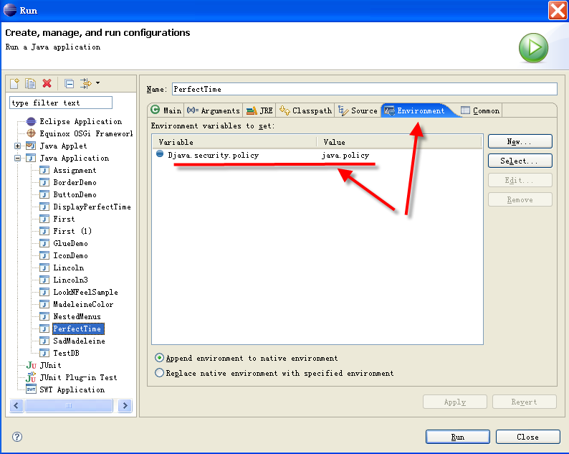
Eclipse环境中的RMI执行

Slide 42
RMI小结
即使你运行在同一个计算机上，RMI还是使用了你的网络堆栈和TCP/IP去进行通讯，并且是运行在三个不同的Java虚拟机上。这已经是一个完整的RMI系统。
另外有一点要注意：RMI服务器与客户机之间传递的Java对象必须是可序列化的对象（implements Serializable）。
2
Registry
客户端
3
1
服务程序
From: http://community.csdn.net/Expert/topic/4671/4671927.xml?temp=.8511621

