Slide 1
接口和内类

Slide 2
Interface—inner class
Interface是abstract class的进一步抽象
  无实现，无变量
  一个类可以实现多个interface，(可以向上转型为多个基本类别)
Inner class（类中类）
  更完善的代码隐藏
  与外围class的方便沟通
构架和细节的完美结合（同一构架下的不同实现）

Slide 3
什么是Interface
Interfaces
  pure abstract class
  field :static final
  Method-public, no body
  establish a protocol between class

Slide 4
Interface定义与使用
[public] interface If{
  double PI=3.14;// static final，常用于定义常量群，不能是 “blank finals,”
  //(int)(Math.random()*10)
  Void m(); // public abstract
}
interface Is extends If, If2{
  。。。
}
interface Vampire extends Monster, Lethal
class C implements Is{
}

Slide 5
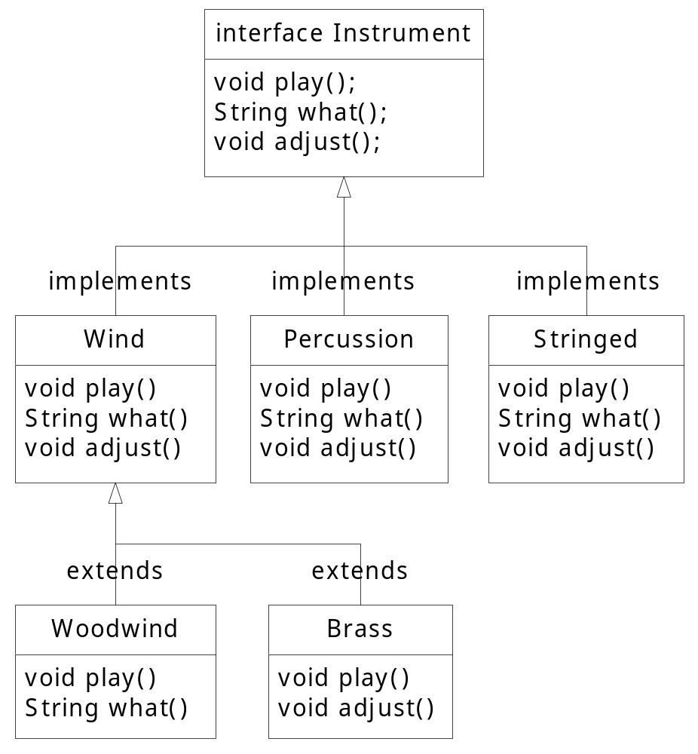
语法

Slide 6
import java.util.*;
interface Instrument {
// Compile-time constant:
int i = 5; //static & final Cannot have method definitions:
void play(); // Automatically public
String what();
void adjust();
}
class Wind implements Instrument {
public void play() {
System.out.println("Wind.play()"); }
public String what() { return "Wind"; }
public void adjust() {}
}
class Percussion implements Instrument {
public void play() {
System.out.println("Percussion.play()"); }
public String what() { return "Percussion"; }
public void adjust() {}}

Slide 7
class Stringed implements Instrument {
public void play() {
System.out.println("Stringed.play()"); }
public String what() { return "Stringed"; }
public void adjust() {}
}
class Brass extends Wind {
public void play() {
System.out.println("Brass.play()"); }
public void adjust() {
System.out.println("Brass.adjust()"); }
}
class Woodwind extends Wind {
public void play() {
System.out.println("Woodwind.play()"); }
public String what() { return "Woodwind"; }
}

Slide 8
public class Music5 {
// Doesn't care about type, so new types
// added to the system still work right:
static void tune(Instrument i) {
  i.play(); }
static void tuneAll(Instrument[] e) {
for(int i = 0; i < e.length; i++)
tune(e[i]);
}
public static void main(String[] args) {
Instrument[] orchestra = new Instrument[5];
int i = 0;
orchestra[i++] = new Wind();
orchestra[i++] = new Percussion();
orchestra[i++] = new Stringed();
orchestra[i++] = new Brass();
orchestra[i++] = new Woodwind();
tuneAll(orchestra);
}
}

Slide 9
//: c08:Adventure.java // 多重继承.
import java.util.*;
interface CanFight { void fight();}
interface CanSwim { void swim();}
interface CanFly { void fly();}
class ActionCharacter { public void fight() {}}
class Hero extends ActionCharacter
implements CanFight, CanSwim, CanFly {
public void swim() {} public void fly() {}}
public class Adventure {
static void t(CanFight x) { x.fight(); }
static void u(CanSwim x) { x.swim(); }
static void v(CanFly x) { x.fly(); }
static void w(ActionCharacter x) { x.fight(); }
public static void main(String[] args) {
Hero h = new Hero();
t(h); // Treat it as a CanFight
u(h); // Treat it as a CanSwim
v(h); // Treat it as a CanFly
w(h); // Treat it as an ActionCharacter }}

Slide 10
Inner Classes
将某个class的定义置于另一个class定义之中
将逻辑相关的类组织起来，内类可以访问外类的所有方法和属性
在其他类中如何引用内类的对象？OuterClassName.InnerClassName

Slide 11
//: c08:Parcel2.java
// Returning a reference to an inner class.
public class Parcel2 {
class Contents {
private int i = 11;
public int value() { return i; }
}
class Destination {
private String label;
Destination(String whereTo) { label = whereTo;}
String readLabel() { return label; }
}
public Destination to(String s) {
return new Destination(s);
}
public Contents cont() {
return new Contents();
}

Slide 12
public static void main(String[] args) {
Parcel2 q = new Parcel2();
Parcel2.Contents c = q.cont();
Parcel2.Destination d = q.to("Borneo");
}
}

Slide 13
深入认识Inner class
Inner class 可以是 private, protected, public, friendly
引入Inner class可以更好的将接口与实现分离，达到隐藏细节的目的（不能直接访问实现子类，只能通过接口访问）
内类和向上转型
  //c08:Parcel3.java

Slide 14
//: c08:Parcel3.java
// Returning a reference to an inner class.
public class Parcel3 {
private class PContents implements Contents {
private int i = 11;
public int value() { return i; }
}
protected class PDestination implements Destination {
private String label;
private PDestination(String whereTo) {
label = whereTo;
}
public String readLabel() { return label; }
}
public Destination dest(String s) {
return new PDestination(s);
}
public Contents cont() { return new PContents(); }
}

Slide 15
class Test {
public static void main(String[] args) {
Parcel3 p = new Parcel3();
Contents c = p.cont();
Destination d = p.dest("Tanzania");
// Illegal -- can't access private class:
//! Parcel3.PContents pc = p.new PContents();
}
}
只允许有权限的客户直接访问实现类，普通用户只能通过接口访问
Java Test

Slide 16
特殊的内类
Inner classes 可以置于methods或任意范围
  定义于函数之内
  定义于函数某段范围之内
  定义于return语句中
  Example
    c08:Parcel4.java (in Method)
    c08:Parcel5.java (with a scope)
学习语法，思考作用（例如从利于继承和多态出发去思考，从利于封装和隐藏去思考）

Slide 17
//: c08:Parcel4.java
//定义于函数之内的类。
public class Parcel4 {
public Destination dest(String s) {
class PDestination
implements Destination {
private String label;
private PDestination(String whereTo) {
label = whereTo;
}
public String readLabel() { return label; }
}
return new PDestination(s);
}
public static void main(String[] args) {
Parcel4 p = new Parcel4();
Destination d = p.dest("Tanzania");
}
}

Slide 18
//: c08:Parcel5.java定义于函数某段范围之内的类.不是条件编译
public class Parcel5 {
private void internalTracking(boolean b) {
if(b) {
class TrackingSlip {
private String id;
TrackingSlip(String s) {id = s; }
String getSlip() { return id; }
}
TrackingSlip ts = new TrackingSlip("slip");
String s = ts.getSlip();
}
// Can't use it here! Out of scope:
//! TrackingSlip ts = new TrackingSlip("x");
}
public void track() { internalTracking(true); }
public static void main(String[] args) {
Parcel5 p = new Parcel5();
p.track(); }
}

Slide 19
匿名（ Anonymous ） inner classes
//: c08:Parcel6.java
// A method that returns an anonymous inner class.
public class Parcel6 {
public Contents cont() {
return new Contents() {
private int i = 11;
public int value() { return i; }
}; // Semicolon required in this case
}
public static void main(String[] args) {
Parcel6 p = new Parcel6();
Contents c = p.cont();
}
}
Class MyContents implements Contents{
…
}
Return new MyContents()
用于类似GUI中的事件处理机制中

Slide 20
public class ButtonDemo extends JFrame implements ActionListener
{
public static final int WIDTH = 300;
public static final int HEIGHT = 200;
public static void main(String[] args)
{
ButtonDemo buttonGui = new ButtonDemo();
buttonGui.setVisible(true);
}

Slide 21
public ButtonDemo()
{
setSize(WIDTH, HEIGHT);
addWindowListener(new WindowDestroyer());
setTitle("Button Demo");
setBackground(Color.blue);
setLayout(new FlowLayout());
JButton stopButton = new JButton("Red");
stopButton.addActionListener(this);
add(stopButton);
JButton goButton = new JButton("Green");
goButton.addActionListener(this);
add(goButton);
}

Slide 22
public void actionPerformed(ActionEvent e)
{
if (e.getActionCommand().equals("Red"))
setBackground(Color.red);
else if (e.getActionCommand().equals("Green"))
setBackground(Color.green);
else
System.out.println("Error in button interface.");
}
}

Slide 23
public ButtonDemo()
{
……
JButton stopButton = new JButton("Red");
// stopButton.addActionListener(this);
stopButton.addActionListener(new ActionListener(){
public void actionPerformed(ActionEvent e) {
setBackground(Color.red);
}
}
)
JButton goButton = new JButton("Green");
goButton.addActionListener(new ActionListener(){
public void actionPerformed(ActionEvent e) {
setBackground(Color.green);
}
}
);
add(goButton);
}

Slide 24
Inner class 命名
    InheritInner.class
    WithInner$Inner.class
    WithInner.class
    Parcel8$1.class
    Parcel8$IInterface$Inner.class
    如果变成Parcel.IInterface.Inner.class ?

Slide 25
Why inner classes
    内类可以操作outer class的对象，进一步完善了封装和隐藏机制
    每个 inner class 能独立的继承实现类，不受outer class的影响
    部分解决了多重继承问题
    类之间的逻辑关系更多样化，可以编写更简洁和灵活的程序（GUI Event环境中被大量应用）。

Slide 26
public static void bubbleSort(int[] number){
int temp,bottom,i;
boolean exchanged=true;
bottom=number.length -2;
while (exchanged){
exchanged=false;
for (i=0;i<=bottom;i++){
    if (number[i]>number[i+1]){
temp=number[i];
number[i]=number[i+1];
number[i+1]=temp;
exchanged=true;
}
}
bottom--;
}
一般的排序算法，变与不变分离

Slide 27
interface MyCompare{
boolean largethan(Object o1,Object o2);
}
public static void bubbleSort(Object[] number, MyCompare mc){
int bottom,i;
Object temp;
boolean exchanged=true;
bottom=number.length -2;
while (exchanged){
exchanged=false;
for (i=0;i<=bottom;i++){
if (mc.largethan(number[i],number[i+1])){
temp=number[i];
number[i]=number[i+1];
number[i+1]=temp;
exchanged=true;
}
}
bottom--;
}
}

Slide 28
public static void main(String[] args){
Object test[]={new Integer(6),new Integer(3),new Integer(5),new Integer(1)};
bubbleSort(test,new MyCompare(){
public boolean largethan(Object o1,Object o2){
return ((Integer)o1).intValue() > ((Integer)o2).intValue() ;
}
});
for (int i=0;i<test.length;i++)
System.out.print(test[i]+ " ");
}

