Slide 1
mmir: An R-package for Simple Biological Metric Calculations
Zachary M. Smith

Slide 2
Objective
Objective: Demonstrate the functionality provided by the mmir R-package for calculating biological metrics for the development and/or use in an MMI or IBI.

Slide 3
What is an MMI?
Multi-Metric Indices (MMIs) or Indices of Biotic Integrity (IBIs) are models that summarize multiple aspects of a biological community of interest (e.g., richness, diversity, relative abundance, tolerance, and functional feeding group) into a single numeric or categorical value representing ecological condition.
considered a robust measure of water quality becuase it represents more than a snapshot in time
have been around for nearly 40 years

Slide 4
Need
Need: MMIs are widely used by U.S. federal and state agencies to assess water quality but there is no R-package available to simplify and standardize metric calculations.

Slide 5
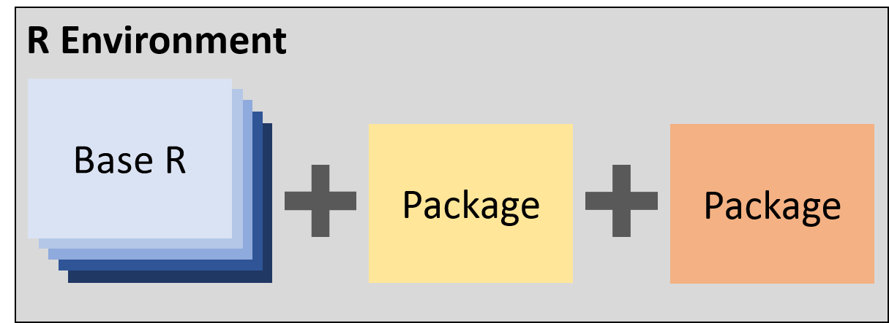
R Packages: Brief Description

Slide 6
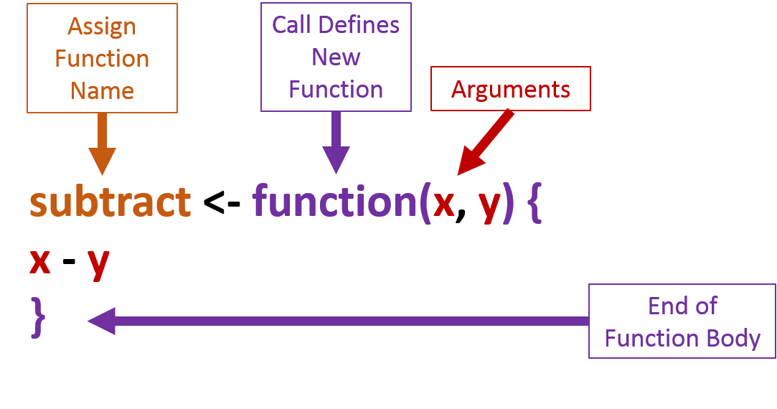
R Functions: Brief Description

Slide 7
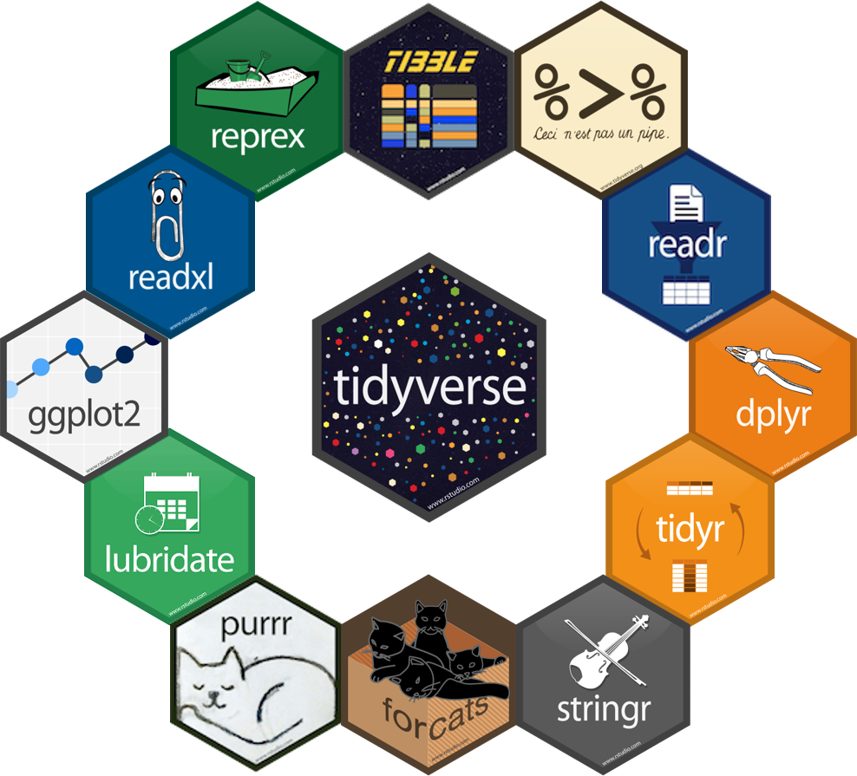
Tidyverse

Slide 8
mmir
Install the Multi-Metric Index (MMI) package, mmir, that I am developing from GitHub (https://github.com/zsmith27/mmir).
devtools::install_github("zsmith27/mmir")
Once mmir is installed, load the package with library().
library(mmir)

Slide 9
mmir: Required Data Format
Requirements
Each row should represent the number of individuals enumerated for a single taxon collected during a single sampling event.
There should be columns representing:
a unique ID for a sampling event (i.e., key)
taxonomic counts
various taxonomic ranks (e.g., individual columns for order, family, genus)
various taxonomic groups (e.g., tolerance values and functional feeding groups)

Slide 10
mmir: Required Data Format Example
unique_id | reporting_value | final_id | order | family | genus
caz_1_1 | 1 | physa | basommatophora | physidae | physa
caz_1_1 | 1 | gyraulus | basommatophora | planorbidae | gyraulus
caz_1_1 | 5 | bezzia | diptera | ceratopogonidae | bezzia
onon_1_1 | 1 | valvata | heterostropha | valvatidae | valvata
onon_1_1 | 40 | chironomus | diptera | chironomidae | chironomus
onon_1_1 | 2 | cryptotendipes | diptera | chironomidae | cryptotendipes

Slide 11
mmir: Getting Started
Load example data included within the package.
data("onondaga", package = "mmir")
Prepare the data for metric calculation.
nest.df <- onondaga %>% group_nest(unique_id, .key = "data")

Slide 12
mmir: Metric Function Arguements
.data = A data frame where each row should represent the number of individuals enumerated for a single taxon collected during a single sampling event.
.key_col = A single column that represents a unique ID or key (i.e., site ID) that can be used to group the data.
.counts_col = A single numeric column that represents taxonomic counts.
.group_col = A single column that represents a taxomic rank or group of interest.
.keep_col = A column name used in combination with .keep_vec to subset the .data.
.keep_vec = A vector of values found in .keep_col that will be used to subset .data.
.drop_col = A column name used in combination with .drop_vec to exclude rows from the calculation.
.drop_vec = A vector of values found in .drop_col that will be removed from the calculation.

Slide 13
mmir: Metric Function List
Richness: taxa_rich()
Relative Richness: taxa_pct_rich()
Abundance: taxa_abund()
Relative Abundance: taxa_pct()
Diversity Indices: taxa_div()
Dominance: taxa_dom()
Tolerance Indices: taxa_tol()

Slide 14
mmir: Richness Code
taxa_rich(.data = nest.df, .key_col = unique_id, .group_col = family)
## [1] 13 13 21 19 11 12 13 11 14 13 11 9 10 13 14 10 14 10 12 11 11 10 13 13 9 ## [26] 7 14 13 16 10 13 7 2 2 2 3 3 6 2 3 4 3 3 2 7 7 6 5 5 9 ## [51] 5 9 5 7 5 6 9 6 7 7 5 7 2 2 12 15 8 6 10 6 5 8 8 4 10 ## [76] 6 12 6 6 9 2 3 5 9 13 7 8 11 8 7 9 6 7 10 5 4

Slide 15
mmir: Richness Code Continued
nest.df <- nest.df %>% mutate(rich_fam = taxa_rich( .data = ., .key_col = unique_id, .group_col = family ))

Slide 16
mmir: Richness Results
unique_id | data | rich_fam
caz_1_1 | List of 35 Variables | 13
caz_1_2 | List of 35 Variables | 13
caz_10_1 | List of 35 Variables | 21
caz_10_2 | List of 35 Variables | 19
caz_11_1 | List of 35 Variables | 11
caz_11_2 | List of 35 Variables | 12

Slide 17
mmir: EPT Richness Code
nest.df <- nest.df %>% mutate( rich_ept_genus = taxa_rich( .data = ., .key_col = unique_id, .group_col = family, .keep_col = order, .keep_vec = c("ephemeroptera", "plectoptera", "trichoptera") ) )

Slide 18
mmir: EPT Richness Results
unique_id | data | rich_fam | rich_ept_genus
caz_1_1 | List of 35 Variables | 13 | 3
caz_1_2 | List of 35 Variables | 13 | 3
caz_10_1 | List of 35 Variables | 21 | 5
caz_10_2 | List of 35 Variables | 19 | 4
caz_11_1 | List of 35 Variables | 11 | 3
caz_11_2 | List of 35 Variables | 12 | 2

Slide 19
mmir: Relative Abundance Code
nest.df <- nest.df %>% mutate( pct_ept = taxa_pct( .data = nest.df, .key_col = unique_id, .counts_col = reporting_value, .keep_col = order, .keep_vec = c("ephemeroptera", "plecoptera", "trichoptera") ) )

Slide 20
mmir: Relative Abundance Results
unique_id | data | rich_fam | rich_ept_genus | pct_ept
caz_1_1 | List of 35 Variables | 13 | 3 | 16.964286
caz_1_2 | List of 35 Variables | 13 | 3 | 6.000000
caz_10_1 | List of 35 Variables | 21 | 5 | 8.875740
caz_10_2 | List of 35 Variables | 19 | 4 | 8.571429
caz_11_1 | List of 35 Variables | 11 | 3 | 5.932203
caz_11_2 | List of 35 Variables | 12 | 2 | 6.603774

Slide 21
mmir: Diverisity Indices Code
nest.df <- nest.df %>% mutate( div_simpson_genus = taxa_div( .data = nest.df, .key_col = unique_id, .group_col = genus, .counts_col = reporting_value, .job = "simpson" ), div_shannon_genus = taxa_div( .data = nest.df, .key_col = unique_id, .group_col = genus, .counts_col = reporting_value, .job = "shannon", .base = 2 ) )

Slide 22
mmir: Diverisity Indices Results
unique_id | data | rich_fam | rich_ept_genus | pct_ept | div_simpson_genus | div_shannon_genus
caz_1_1 | List of 35 Variables | 13 | 3 | 16.964286 | 0.1417411 | 3.488295
caz_1_2 | List of 35 Variables | 13 | 3 | 6.000000 | 0.1188000 | 3.740104
caz_10_1 | List of 35 Variables | 21 | 5 | 8.875740 | 0.1001716 | 3.883571
caz_10_2 | List of 35 Variables | 19 | 4 | 8.571429 | 0.0848073 | 4.102988
caz_11_1 | List of 35 Variables | 11 | 3 | 5.932203 | 0.2219190 | 2.871120
caz_11_2 | List of 35 Variables | 12 | 2 | 6.603774 | 0.1181915 | 3.667286

Slide 23
mmir:

Slide 24
Acknowledgements
Interstate Commission on the Potomac River Basin (ICPRB)
With a special thank you to Dr. Claire Buchanan
New York State Department of Environmental Conservation (NYSDEC)
With a special thank you to Dr. Alexander J. Smith

Slide 25
Contact Information
Name: Zachary M. Smith
Email: zachary.smith2@dec.ny.gov
GitHub: https://github.com/zsmith27
mmir: https://github.com/zsmith27/mmir

