Slide 1
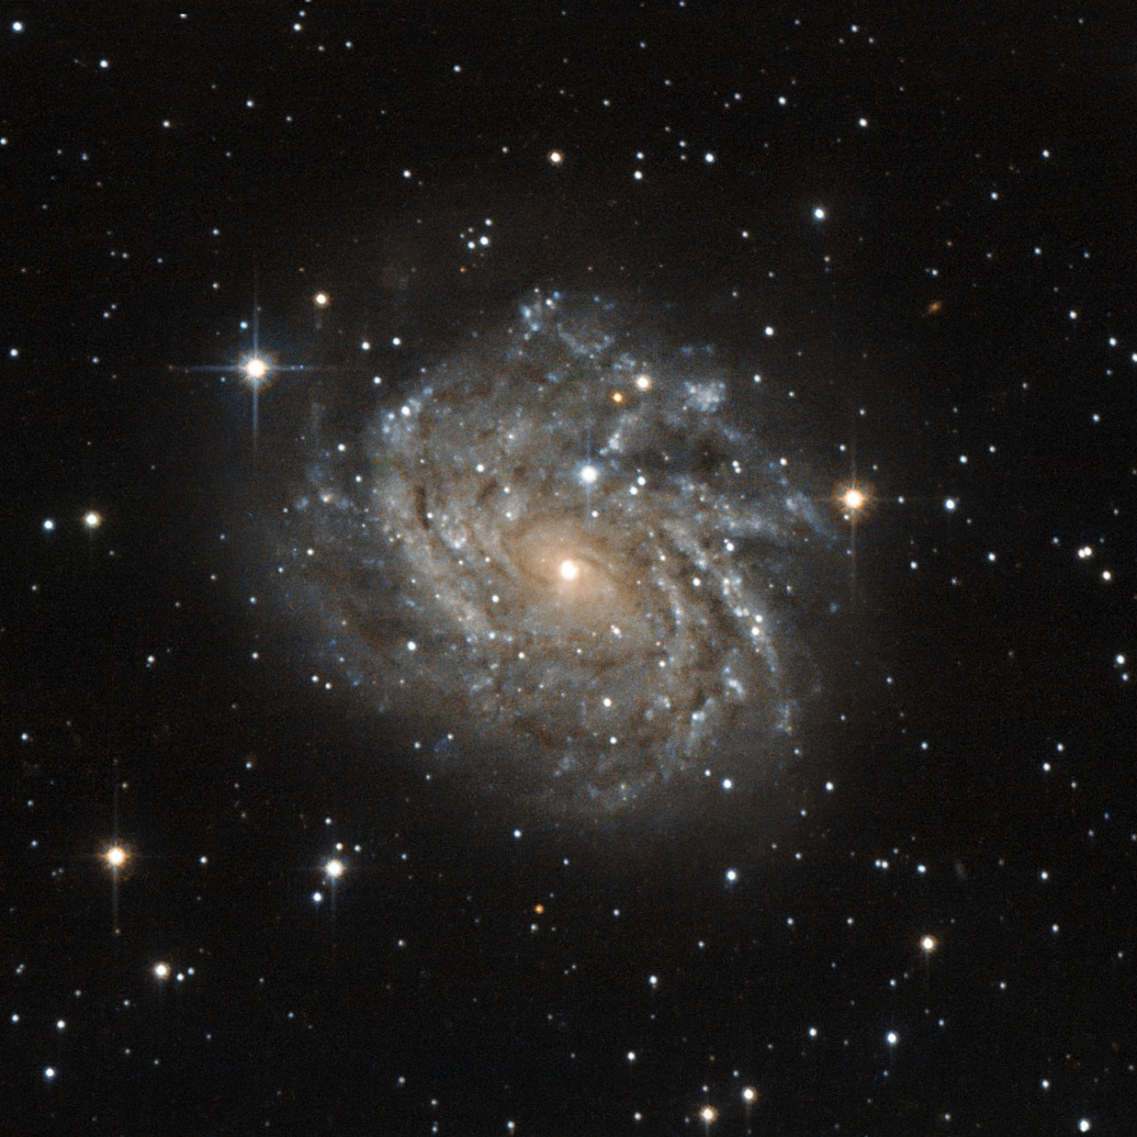
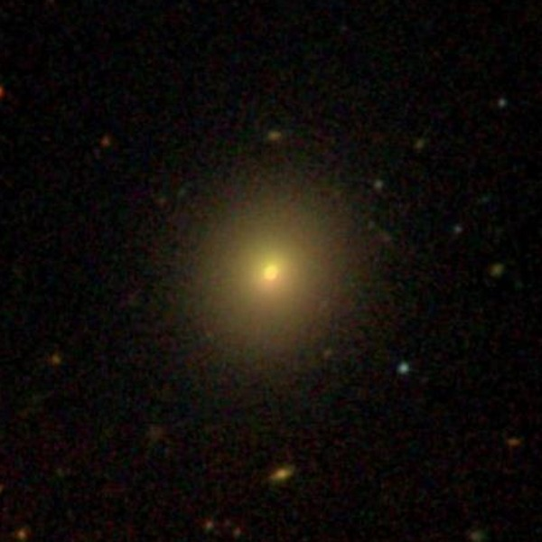
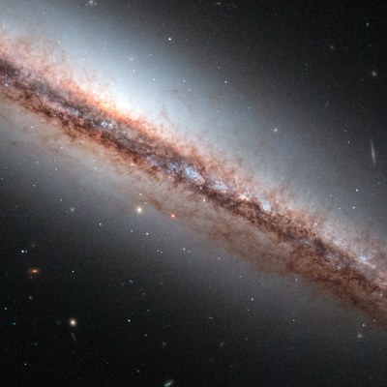
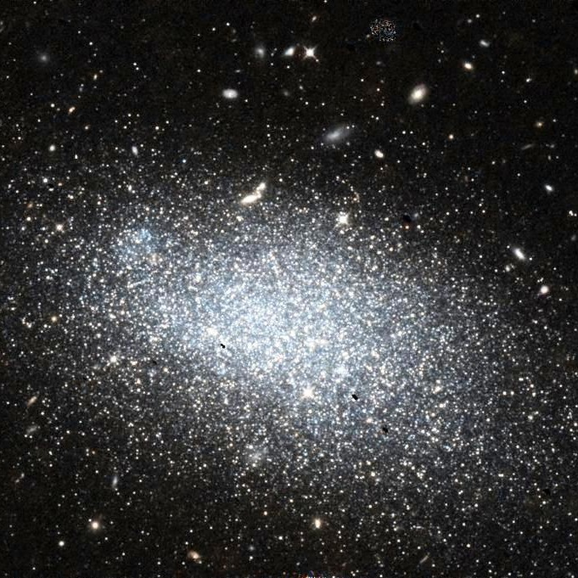
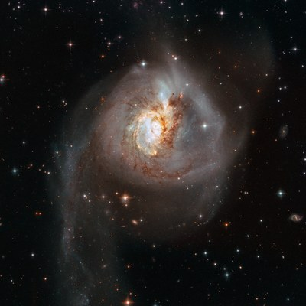
AI AND VISUALIZATION · PHASE I
Where does a galaxy classifier
fail, and why?
Probing AstroVision-Advanced by hand, with ChatGPT and with Claude Code
Spiral
Elliptical
Edge-on Disk
Irregular
Merger
Two Dimensional Thinkers

Slide 2
HUMAN ONLY · no AI tools, black box
First, by hand: same split, same 92.9%
We rebuilt the author's 80/20 split (same seed as train.py) and only looked at what goes in and what comes out.
3,547
92.9%
4
91
validation images the model never trained on
our accuracy, exactly the author's number
image properties per galaxy: distance, size, core brightness, redness
wrong irregular answers labelled by eye, prediction hidden
What we stored for every image
How we looked for causes
Predicted class and confidence (probability of that class)
True class and the ten original Galaxy10 subtypes
Redshift, galaxy size, core brightness, red minus blue
Confusion matrix and confidence of right vs wrong answers
Accuracy split by each property, then near/far × blue/red
Looked at the images and labelled the mistakes ourselves

Slide 3
HUMAN ONLY · TAKEAWAY 1 · training set and validation set
The rarest class is also the weakest
Training images per class
Share recognised correctly (validation set)
876 training images, 6× fewer than spirals. The class with the most varied shapes has the fewest examples, and is recognised only 56% of the time.

Slide 4
HUMAN ONLY · TAKEAWAY 1 · validation set
Four classes work, irregular galaxies don't
Where the answers go: true class (rows) → model's answer (columns), share of the row
 | Spiral | Elliptical | Edge-on | Irregular | Merger
Spiral | 95% (1239) | 2% (22) | 1% (11) | 1% (19) | 1% (9)
Elliptical | 3% (26) | 95% (937) | 1% (5) | 1% (10) | 1% (6)
Edge-on | 2% (11) | 0% (3) | 98% (632) | 0% (1) | 0% (1)
Irregular | 24% (49) | 18% (36) | 1% (3) | 56% (114) | 1% (3)
Merger | 3% (12) | 3% (12) | 1% (6) | 2% (7) | 91% (373)
56% vs 91–98%
of irregular galaxies are recognised, against the four other classes
A third of all mistakes
85 of 252 mistakes are irregulars called Spiral or Elliptical
876 training images: the rarest class (5,200 spirals)
9% of Cigar Smooth ellipticals called Edge-on: the only other weak spot

Slide 5
HUMAN ONLY · TAKEAWAY 2 · confidence of right vs wrong answers
On irregular galaxies, the model is confidently wrong
Median confidence of the model's answer, by true class
87% vs 95%
median confidence of wrong against right irregular answers: almost the same
Elsewhere, low confidence warns
69–78% wrong answers in the other classes
97–100% right answers in the other classes
So confidence flags mistakes, except for the class that fails most.

Slide 6
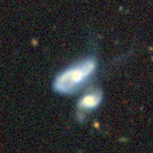
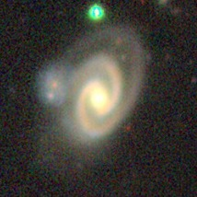
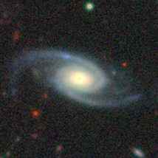
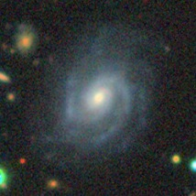
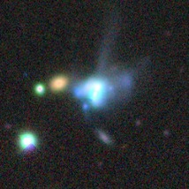
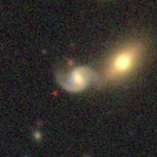
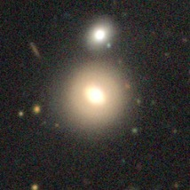
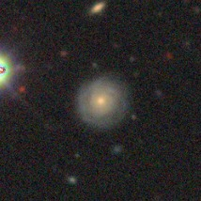
HUMAN ONLY · TAKEAWAY 2 · the most confident mistakes, 99–100%
The surest mistakes often look like fair answers
Label → model's answer and confidence
What the images show
Spirals with a close neighbour are called Merger.
Disturbed galaxies with clear arms are called Spiral.
A few are real errors, like a round smooth galaxy called Spiral.
High confidence on a mistake often points to a galaxy that fits two classes.
Loose Spiral
→ Merger 100%
Barred Spiral
→ Merger 100%
Disturbed
→ Spiral 100%
Disturbed
→ Spiral 100%
Merging
→ Irregular 100%
Barred Spiral
→ Merger 99%
Merging
→ Elliptical 99%
Round Smooth
→ Spiral 99%

Slide 7
HUMAN ONLY · TAKEAWAY 3 · four image properties, each split into five equal groups
Image properties barely matter, except for irregulars
Share recognised correctly, from the lowest to the highest fifth of each property
Distance (redshift)
Galaxy size
Core brightness
Redness
Grey: the four other classes, 94–96% in every group. Blue: irregular galaxies, best when near, large, faint-cored or blue. About 40 per group, so noisy.

Slide 8
HUMAN ONLY · TAKEAWAY 3 · 205 irregular galaxies, split in four
Colour matters more than distance
Irregular galaxies: share recognised, and share called Elliptical
Blue
Red
What the split shows
Near
Over all classes, distance, size, brightness and colour barely matter: every group lands at 92–95%.
Near and blue is the only group the model handles well.
Red ones are called Elliptical about 30% of the time, near or far. The model seems to use "red and smooth means Elliptical".
Spiral mistakes appear in all four groups (20–30%): colour and distance don't explain them.
70%
43%
recognised
3% called Elliptical · n=73
recognised
27% called Elliptical · n=30
Far
53%
47%
recognised
13% called Elliptical · n=30
recognised
31% called Elliptical · n=72

Slide 9
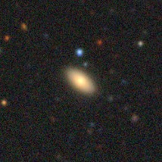
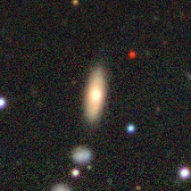
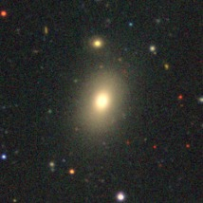
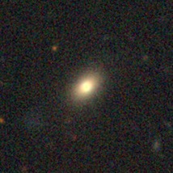
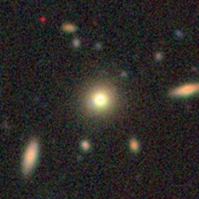
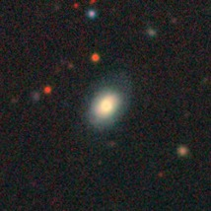
HUMAN ONLY · TAKEAWAY 4 · 91 mistakes labelled by eye
Most irregulars called Elliptical don't look disturbed
Wrong irregular answers, by the model's answer: do they look disturbed?
Labelled Irregular, answered Elliptical
Elliptical 94%
Elliptical 91%
Elliptical 95%
Only 24 of 91 clearly look disturbed. For most Elliptical answers, the model is at least as plausible as the label.
Elliptical 95%
Elliptical 83%
Elliptical 93%
Smooth, round and reddish: they look like ordinary ellipticals

Slide 10
PHASE I
Two AI tools: ChatGPT, Claude Code
AstroVision-Advanced: Zoobot (ConvNeXt-Nano) fine-tuned on Galaxy10 DECals.
Spiral · Elliptical · Edge-on Disk · Irregular · Merger.
ChatGPT
Claude Code
Data
25 independent images 5 per class
Data
Full validation set: 3,547 images the model never trained on
Tests
One merger image edited: quality, crop, background, scale
Tests
1,820 galaxies edited one change at a time; volunteer votes
AI role
Designed and generated the edits
AI role
Read the model code, built the pipeline, ran the tests itself

Slide 11
CHATGPT · 25 images, 5 per class
On independent images, mergers look irregular
Spiral
Elliptical
Edge-on
Irregular
Merger
Where the 25 answers go: true class (rows) → model's answer (columns)
Spiral
Elliptical
Edge-on
Irregular
Merger
Spiral
5
·
·
·
·
Elliptical
1
2
·
1
1
Edge-on
1
·
4
·
·
Irregular 97.4%
Merger 0.04%
Irregular
·
1
1
3
·
3 of 5 mergers are called Irregular, with high confidence
Merger
·
·
·
3
2
Grey = correct · blue = mistakes · redrawn from ChatGPT's confusion matrix

Slide 12
CHATGPT · every edit of the same merger, in one view
Image quality didn't change the answer, framing did
Image quality
Greyscale
Irregular
Lower res.
Irregular
Lower contrast
Irregular
Mild blur
Irregular
Crop, enlarged
85%
Irregular
72%
Spiral
55%
Spiral
Crop, original size
72% on black
Irregular
72% on grey
Spiral
Background brightness
0
Irregular
16
Irregular
32
Spiral
48
Spiral
64
Spiral
96
Spiral
Apparent scale
0.60×
Irregular
0.75×
Irregular
0.90×
Irregular
1.00×
Spiral
1.15×
Spiral
1.30×
Spiral
1.45×
Spiral
Irregular (original answer)
Spiral
Merger, the true class, is never the answer. Redrawn from ChatGPT's summary figure.

Slide 13
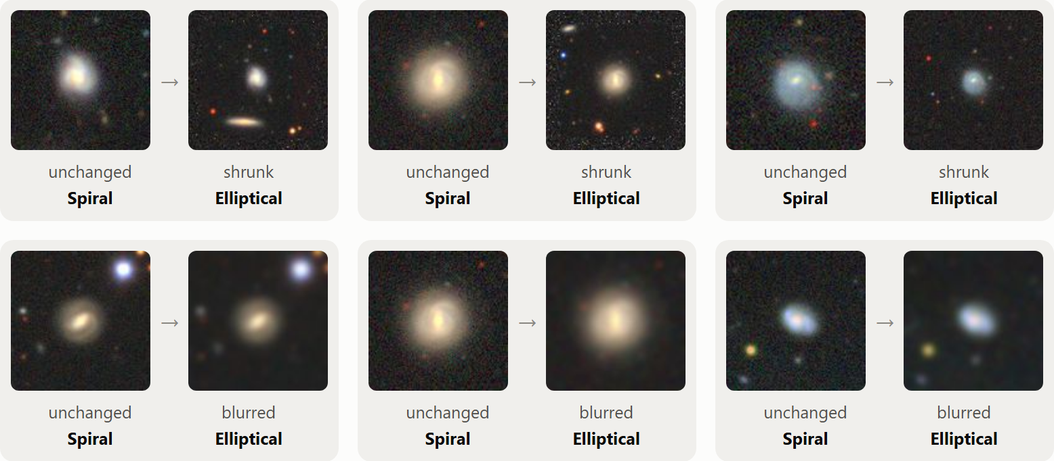
CLAUDE CODE · TAKEAWAY 1 · tested by editing images
When a galaxy loses detail, the model calls it an elliptical
250 spirals: share called Elliptical
Same spiral before and after shrinking (top) or blurring (bottom)
Cause: loss of detail, not size. Without visible arms or structure, a galaxy looks like a smooth blob, which is what the model learned to call an elliptical.
Real ellipticals are not affected: 95% stay Elliptical.

Slide 14
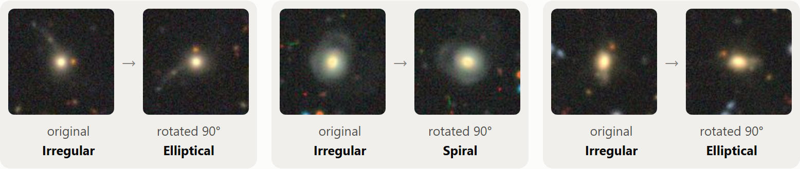
CLAUDE CODE · TAKEAWAY 2 · tested by editing images
Harmless edits flip the answer for irregular galaxies
Share of answers that change after the edit
Close to a tipping point
70% vs 94%
median confidence of irregular galaxies whose answer flips when rotated, against those that stay the same
Only rotated by 90°
The same irregular galaxy becomes Elliptical or Spiral

Slide 15
CLAUDE CODE · TAKEAWAY 3 · checked with volunteer votes
The model is often very sure even when it is wrong
Are the mistakes really wrong labels? Volunteers' verdict on 202 mistakes (validation + training)
86 of 252
mistakes are made with at least 90% confidence (34%)
2%
average calibration gap: confidence fits accuracy overall, but it cannot be used to catch the mistakes
Wrong labels explain only about 1 in 10 mistakes. Irregular galaxies called Spiral are mostly disturbed spirals: volunteers saw both the disturbance (68%) and arms (51%).

Slide 16
CLAUDE CODE · TAKEAWAY 4 · tested by editing images
What does not confuse the model
Change | Measure | Before | After
Red irregular galaxies made bluer | called Elliptical | 33% | 32%
Round ellipticals squashed flat | called Edge-on | 0% | 1.5%
Small galaxy added next to spirals | called Merger | 0.8% | 0.8%
Surroundings removed around mergers | still called Merger | 91% | 90%
Nearest vs farthest fifth (real images) | answered correctly | 93% | 92%
Why colour seemed to matter
33% vs 2%
red vs blue irregular galaxies called Elliptical in the real images
But recolouring changed nothing. A smoother shape is the likely reason: volunteers call red irregulars smooth more often (37% vs 28%).
A pattern in the data is not a cause: only the edit tells them apart.

Slide 17
WORKING WITH AI
What the two AI tools did, and where we had to step in
ChatGPT
Claude Code
Both tools
Proposed hypotheses and controlled experiments
Designed and generated every edited image
Read the author's code, rebuilt the split exactly
Built the pipeline and the interactive pages, ran the tests
Broke the black-box rule once, its own label judgement was wrong
Suggested testing patterns by editing images
Kept digging into one topic: we decided when to move on
Every prompt and decision is in the AI-use log
The AI's strongest contribution was proposing tests, its weakest was judging images by eye.

Slide 18
HUMAN ONLY VS AI-AIDED · same model, same question
Humans saw the patterns, AI tested the causes
 | Human only | AI-aided · ChatGPT + Claude Code
Irregular blind spot | Found: 56% recognised, the rarest class | Found: 56%, and answers flip under rotation, moving and blur
Colour | Red irregulars called Elliptical ~30%: colour seems to matter | Recolouring changed nothing: a smoother shape is the likely cause
Size and detail | Size barely matters in the real images | Shrunk or blurred spirals become Elliptical (14%, 10%): loss of detail
Wrong labels? | By eye: 67 of 91 irregular mistakes don't look disturbed | Volunteer votes: the label is wrong in only 1 in 10 mistakes
How | One notebook, 3,547 images, observing patterns | 1,820 edited images, votes, interactive pages; every output had to be checked
Summary
Both found the same blind spot.
Editing images let the AI-aided pair test causes, and it ruled out colour.
Still open: humans saw debatable labels, the votes say few. They checked different galaxies.
Human-only: our notebook and eye labels. AI-aided: ChatGPT and Claude Code.

Slide 19
CONCLUSION
92.9% hides one weak, unstable class
1
2
3
4
Irregular is the blind spot
Test, don't just observe
Not just bad labels
Sure isn't the same as right
56% recognised, answers flip under cropping, rotation, moving and blur, with both AI tools
Editing images showed loss of detail matters and colour does not
Votes back the model in only 10% of mistakes; many galaxies fit two classes
A third of the mistakes have over 90% confidence; the Hubble merger was called Irregular at 97%
Questions for Phase II: what does the model look at?
On irregular galaxies: core and colour, or tidal tails?
Does it need the arms to say Spiral?
Why does framing flip the answer?
Are irregulars their own group inside the model?

