Slide 1
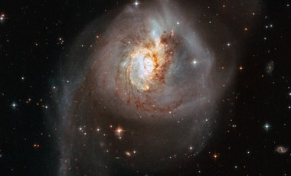
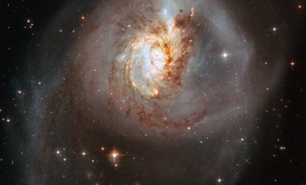
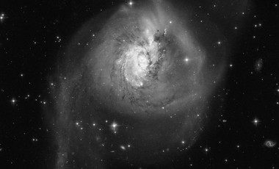
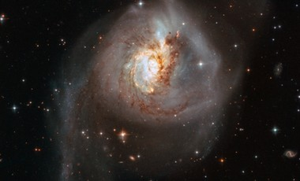
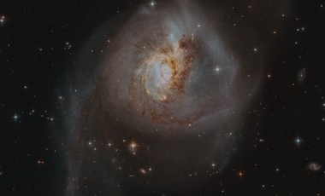

Merger image m001 — image degradation
Grayscale, resolution, contrast and blur changes
#
Input image
Transformation
Prediction
Top confidence
Merger
1
Original
Irregular
97.40%
0.04%
2
Center crop (72%)
Spiral
50.99%
3.95%
3
Grayscale
Irregular
97.06%
0.06%
4
Downsample + upscale
Irregular
97.29%
0.04%
5
Lower contrast
Irregular
98.10%
0.05%
6
Mild blur
Irregular
97.27%
0.04%
AstroVision black-box outputs • m001_heic1811a • Reported probabilities

Slide 2
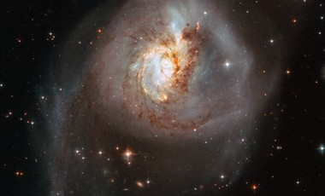

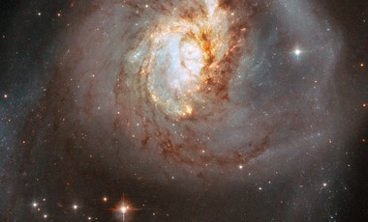
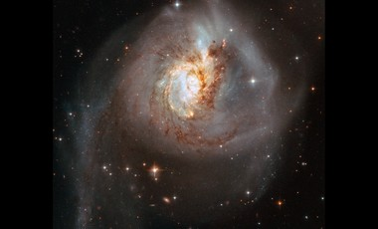


Merger image m001 — crop and framing
Different crop sizes and framing treatments
#
Input image
Transformation
Prediction
Top confidence
Merger
1
Original reference
Irregular
97.40%
0.04%
2
Crop 85% → resize
Irregular
85.24%
0.57%
3
Crop 72% → resize
Spiral
55.52%
4.00%
4
Crop 55% → resize
Spiral
88.01%
8.68%
5
Crop 72%, original scale, black
Irregular
80.03%
0.31%
6
Crop 72%, original scale, gray
Spiral
64.72%
0.93%
7
Original zoom 1.39×
Spiral
56.48%
3.88%
AstroVision black-box outputs • m001_heic1811a • Reported probabilities

Slide 3

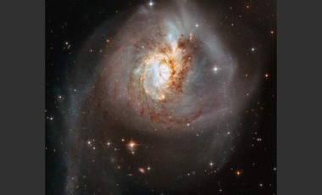
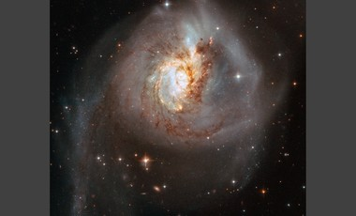

Merger image m001 — background sensitivity
Same central crop on canvases with different background brightness
#
Input image
Transformation
Prediction
Top confidence
Merger
1
Original reference
Irregular
97.40%
0.04%
2
Background RGB 0
Irregular
80.03%
0.31%
3
Background RGB 16
Irregular
79.68%
0.26%
4
Background RGB 32
Spiral
64.72%
0.93%
5
Background RGB 48
Spiral
80.10%
1.80%
6
Background RGB 64
Spiral
82.93%
1.85%
7
Background RGB 96
Spiral
84.39%
1.61%
AstroVision black-box outputs • m001_heic1811a • Reported probabilities

Slide 4
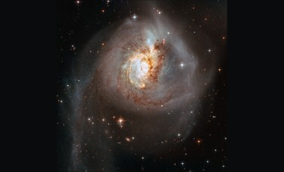
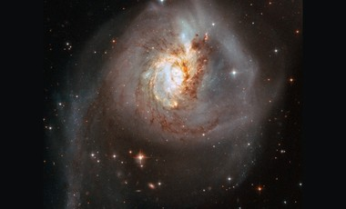
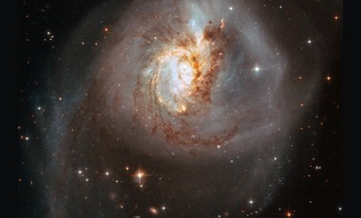
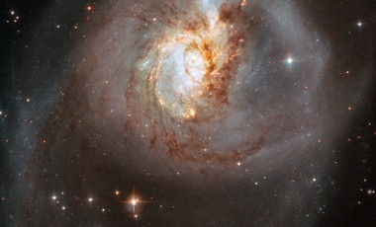
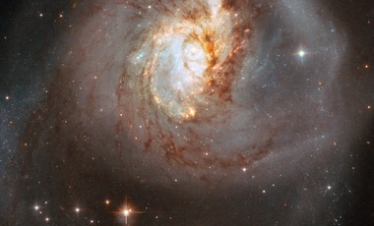
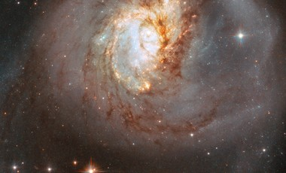
Merger image m001 — apparent scale
Central subject rescaled and centered on a fixed-size canvas
#
Input image
Transformation
Prediction
Top confidence
Merger
1
Original reference
Irregular
97.40%
0.04%
2
Apparent scale 0.60×
Irregular
97.61%
0.04%
3
Apparent scale 0.75×
Irregular
89.92%
0.27%
4
Apparent scale 0.90×
Irregular
53.34%
1.38%
5
Apparent scale 1.00×
Spiral
55.52%
4.00%
6
Apparent scale 1.15×
Spiral
79.12%
9.26%
7
Apparent scale 1.30×
Spiral
86.80%
9.45%
8
Apparent scale 1.45×
Spiral
80.32%
17.82%
AstroVision black-box outputs • m001_heic1811a • Reported probabilities

