Slide 1
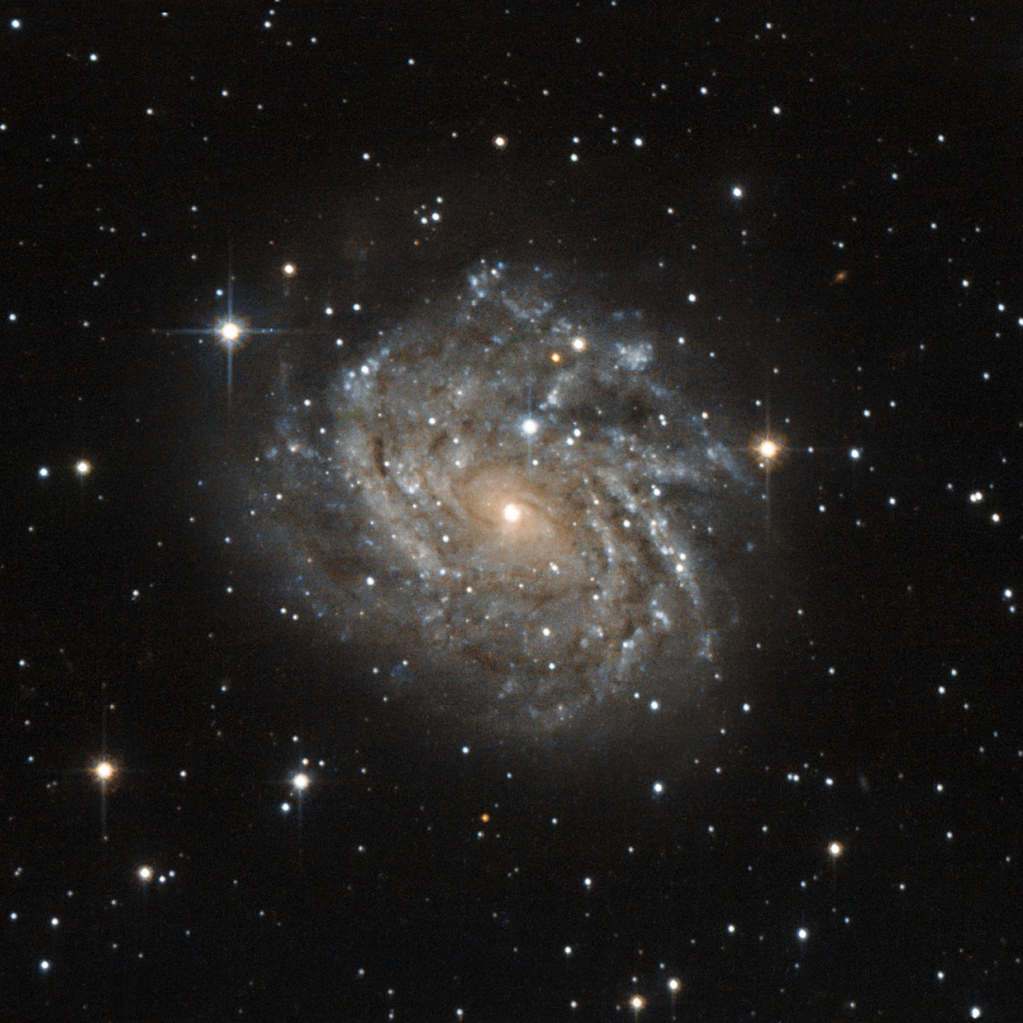
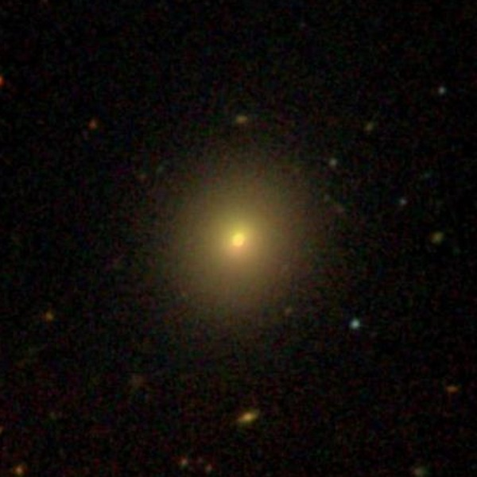
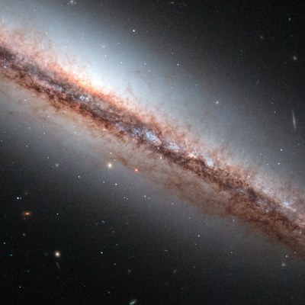
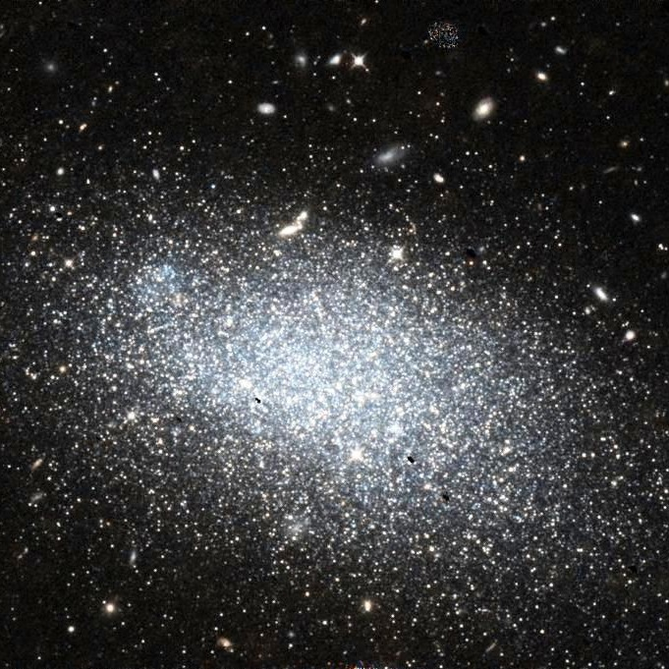
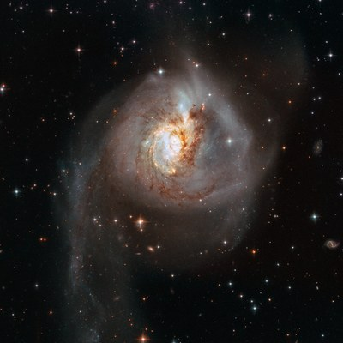
AI AND VISUALIZATION · PHASE I
Where does a galaxy classifier
fail, and why?
Probing AstroVision-Advanced with ChatGPT and Claude Code
Spiral
Elliptical
Edge-on Disk
Irregular
Merger
Two Dimensional Thinkers

Slide 2
PHASE I
One model, two AI tools
AstroVision-Advanced: Zoobot (ConvNeXt-Nano) fine-tuned on Galaxy10 DECals.
Spiral · Elliptical · Edge-on Disk · Irregular · Merger.
A
Part A ChatGPT
B
Part B Claude Code
Data
25 independent images 5 per class
Data
Full validation set: 3,547 images the model never trained on
Tests
One merger image edited: quality, crop, background, scale
Tests
1,820 galaxies edited one change at a time; volunteer votes
AI role
Designed and generated the edits
AI role
Read the model code, built the pipeline, ran the tests itself

Slide 3
PART A · CHATGPT · 25 images, 5 per class
On independent images, accuracy drops to 64%
64% vs 92.9%
16 of 25 independent images right, against the reported accuracy
Spiral
Elliptical
Edge-on
Irregular
Merger
Where the 25 answers go: true class (rows) → model's answer (columns)
Spiral
Elliptical
Edge-on
Irregular
Merger
Spiral
5
·
·
·
·
Irregular 97.4%
Merger 0.04%
Elliptical
1
2
·
1
1
Edge-on
1
·
4
·
·
Irregular
·
1
1
3
·
Merger
·
·
·
3
2
3 of 5 mergers are called Irregular, with high confidence
Grey = correct · blue = mistakes · redrawn from ChatGPT's confusion matrix

Slide 4
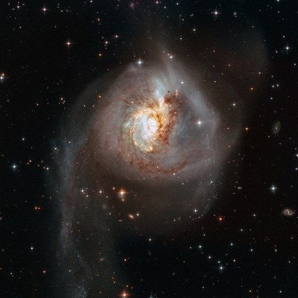
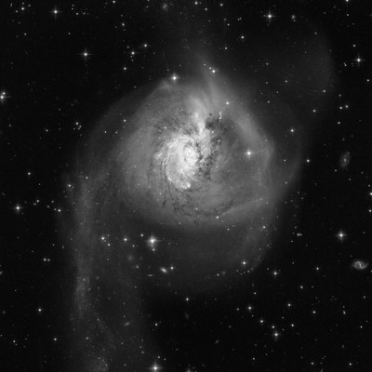


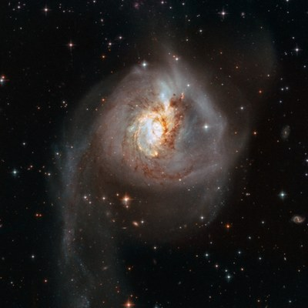
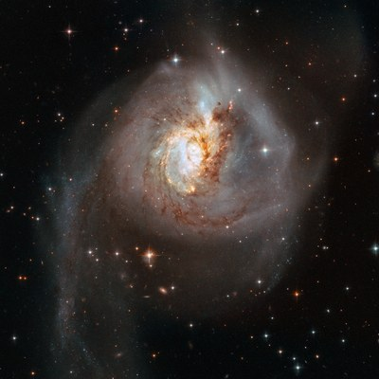
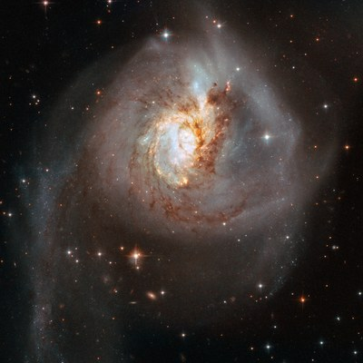
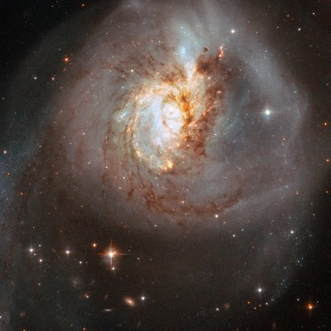
PART A · CHATGPT · one merger image, edited
Image quality barely matters, but cropping flips the answer
Image quality
no change
Merger probability
0.04%
original
8.7%
crop 55%
original
Irregular 97.4%
greyscale
Irregular 97.1%
lower res.
Irregular 97.3%
lower contrast
Irregular 98.1%
mild blur
Irregular 97.3%
Cropping
answer flips
original
Irregular 97.4%
crop 85%
Irregular 85.2%
crop 72%
Spiral 55.5%
crop 55%
Spiral 88.0%

Slide 5
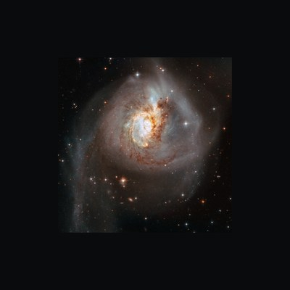
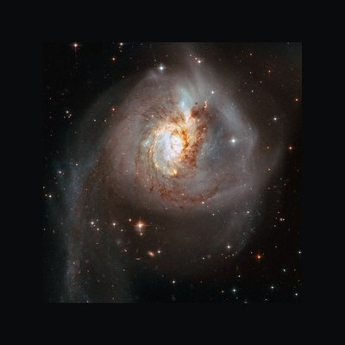
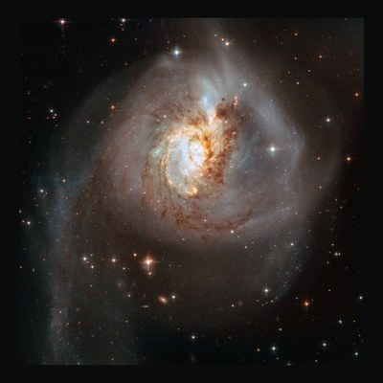
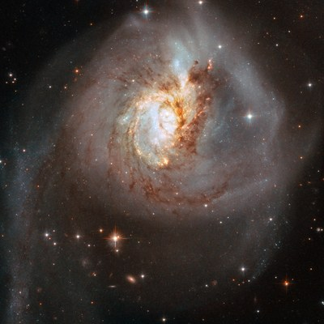

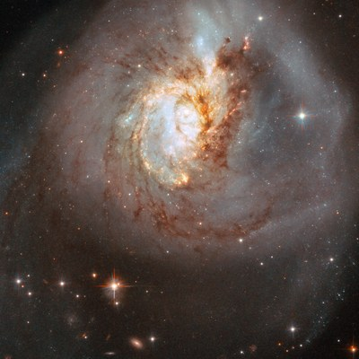
PART A · CHATGPT · same galaxy, rescaled on a fixed canvas
The answer depends on the galaxy's size in the frame
0.60×
Irregular 98%
0.75×
Irregular 90%
0.90×
Irregular 53%
1.00×
Spiral 56%
1.15×
Spiral 79%
1.30×
Spiral 87%
1.45×
Spiral 80%
AstroVision's response to apparent scale
Two confident answers for the same galaxy: Irregular when small, Spiral when large.
Scale and framing are mixed here: zooming in also removes background.
Confidence dips to about 55% where the answer switches from Irregular to Spiral.
answer switches

Slide 6
PART A · CHATGPT · every edit of the same merger, in one view
Image quality didn't change the answer, framing did
Image quality
Greyscale
Irregular
Lower res.
Irregular
Lower contrast
Irregular
Mild blur
Irregular
Crop, enlarged
85%
Irregular
72%
Spiral
55%
Spiral
Crop, original size
72% on black
Irregular
72% on grey
Spiral
Background brightness
0
Irregular
16
Irregular
32
Spiral
48
Spiral
64
Spiral
96
Spiral
Apparent scale
0.60×
Irregular
0.75×
Irregular
0.90×
Irregular
1.00×
Spiral
1.15×
Spiral
1.30×
Spiral
1.45×
Spiral
Irregular (original answer)
Spiral
Merger, the true class, is never the answer. Redrawn from ChatGPT's summary figure.

Slide 7
PART B · CLAUDE CODE
Same model, same split, same 92.9%
Galaxy10 DECals, the survey the model was trained on. The author's split rebuilt exactly (random 20%, seed 42).
17,736
3,547
92.9%
1,820
images in Galaxy10 DECals
validation images the model never trained on
our accuracy, exactly the author's number
galaxies edited one change at a time (705 + 1,115)
What we looked at (black box only)
How we tested causes
Predicted probabilities and true labels
Six image properties: size, roundness, colour, core brightness, surroundings, distance
Volunteer votes from Galaxy Zoo DECaLS (about 45% of galaxies)
Edit one thing: shrink, blur, recolour, squash, rotate, move off-centre, add a neighbour, remove surroundings
Compare the answer before and after the edit
Map of the model's answers (t-SNE) with a cluster analysis

Slide 8
PART B · TAKEAWAY 1 · validation set
The model often fails to recognise irregular galaxies
Share recognised correctly, by true class
56% vs 95%
of irregular galaxies are recognised, against all other types
Where the misses go
24% called Spiral
18% called Elliptical
876 training images, the second-rarest class

Slide 9
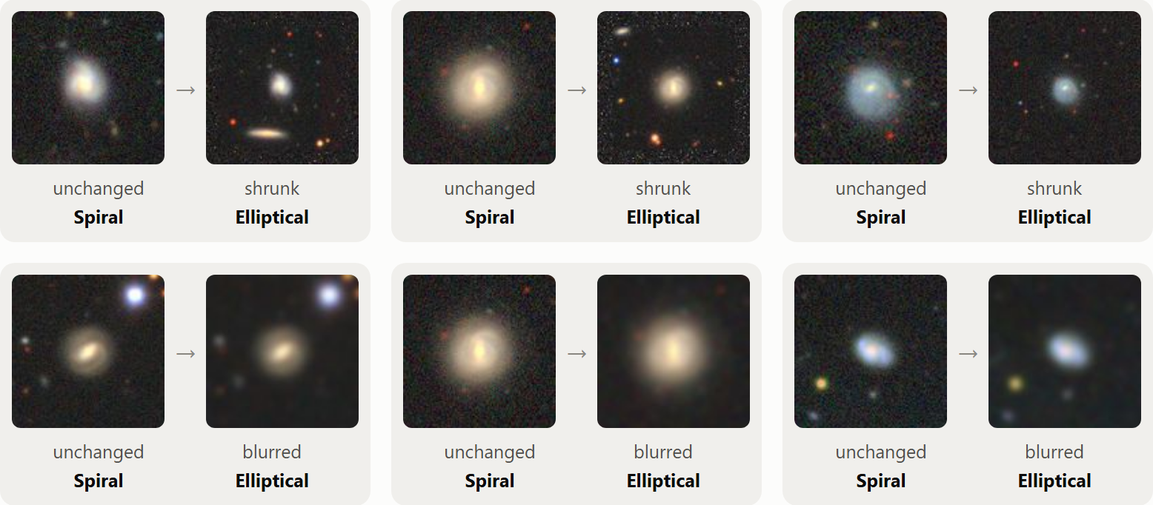
PART B · TAKEAWAY 2 · tested by editing images
When a galaxy loses detail, the model calls it an elliptical
250 spirals: share called Elliptical
Same spiral before and after shrinking (top) or blurring (bottom)
Cause: loss of detail, not size. Without visible arms or structure, a galaxy looks like a smooth blob, which is what the model learned to call an elliptical.
Real ellipticals are not affected: 95% stay Elliptical.

Slide 10
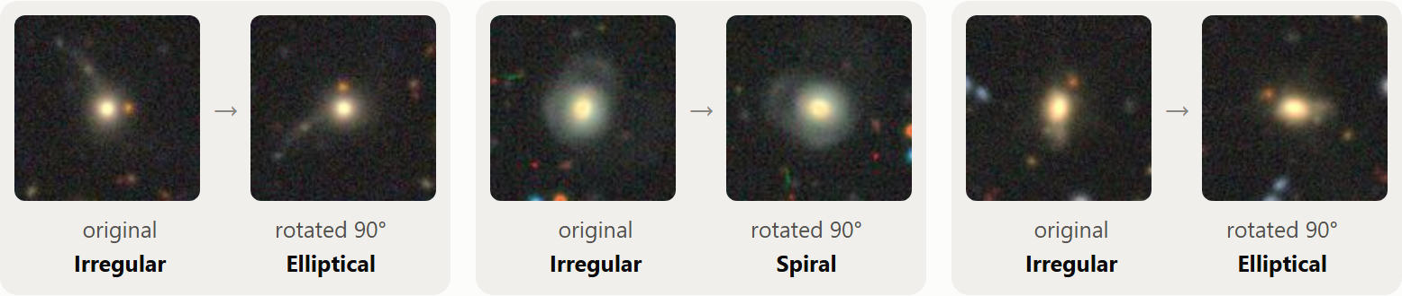
PART B · TAKEAWAY 3 · tested by editing images
Harmless edits flip the answer for irregular galaxies
Share of answers that change after the edit
Close to a tipping point
70% vs 94%
median confidence of irregular galaxies whose answer flips when rotated, against those that stay the same
Only rotated by 90°
The same irregular galaxy becomes Elliptical or Spiral

Slide 11
PART B · TAKEAWAY 4 · checked with volunteer votes
The model is often very sure even when it is wrong
Are the mistakes really wrong labels? Volunteers' verdict on 202 mistakes
86 of 252
mistakes are made with at least 90% confidence (34%)
2%
average calibration gap: confidence fits accuracy overall, but it cannot be used to catch the mistakes
Wrong labels explain only about 1 in 10 mistakes. Irregular galaxies called Spiral are mostly disturbed spirals: volunteers saw both the disturbance (68%) and arms (51%).

Slide 12
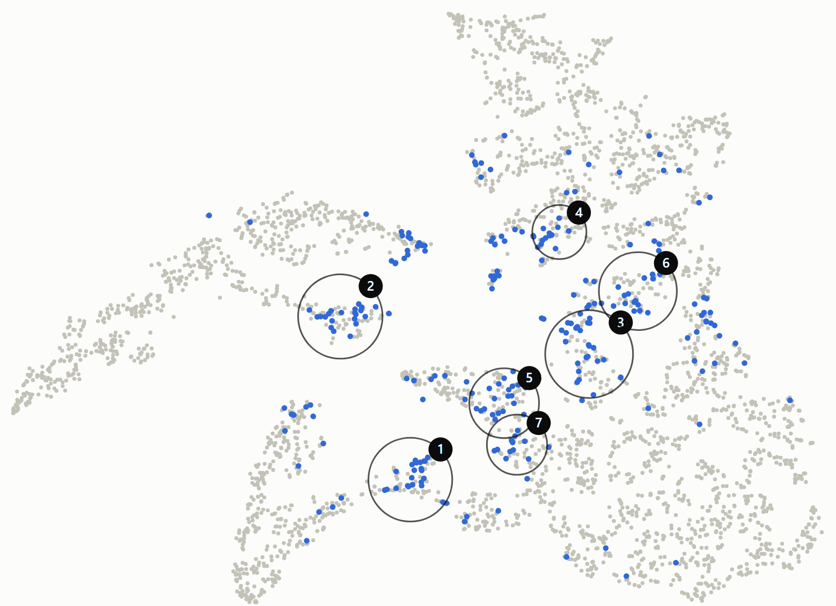
PART B · TAKEAWAY 5 · map + cluster analysis
On the answer map, mistakes sit in two kinds of places
1
Bridges between two classes
The model hesitates between exactly two answers (82% of unsure cases)
Spiral ↔ Edge-on: genuinely tilted disks, volunteers split too (27%)
2
Groups hidden among spirals
Model is confident, yet about a quarter are labelled irregular
They look like the spirals around them; too few votes to say why

Slide 13
PART B · TAKEAWAY 6 · tested by editing images
What does not confuse the model
Change | Measure | Before | After
Red irregular galaxies made bluer | called Elliptical | 33% | 32%
Round ellipticals squashed flat | called Edge-on | 0% | 1.5%
Small galaxy added next to spirals | called Merger | 0.8% | 0.8%
Surroundings removed around mergers | still called Merger | 91% | 90%
Nearest vs farthest fifth (real images) | answered correctly | 93% | 92%
Why colour matters most
red vs blue irregular galaxies called Elliptical in the real images
But recolouring changed nothing. A smoother shape is the likely reason: volunteers call red irregulars smooth more often (37% vs 28%).
A pattern in the data is not a cause: only the edit tells them apart.

Slide 14
BOTH PARTS
Two parts, one pattern: irregular answers are unstable
 | Part A · ChatGPT | Part B · Claude Code
Images | 25 from other telescopes; 1 edited | 3,547 from the training survey; 1,820 edited
Accuracy | 16 of 25 (64%) | 92.9%
Blur, lower resolution | No change on one large, detailed image | Flips 38% of irregular answers
Framing | Crop and zoom flip Irregular → Spiral | Moving off-centre flips 17% of irregular answers
Background | Canvas brightness flips the answer | Removing mergers' surroundings changes nothing
Shared
Irregular answers flip under harmless edits, and the flips go to Spiral

Slide 15
WORKING WITH AI
What the two AI tools did, and where we had to step in
ChatGPT Part A
Claude Code Part B
Both tools
Proposed hypotheses and controlled experiments
Designed and generated every edited image
Read the author's code, rebuilt the split exactly
Built the pipeline and the interactive pages, ran the tests
Broke the black-box rule once, its own label judgement was wrong
Suggested testing patterns by editing images
Kept digging into one topic: we decided when to move on
Every prompt and decision is in the AI-use log
The AI's strongest contribution was proposing tests, its weakest was judging images by eye.

Slide 16
CONCLUSION
92.9% hides one weak, unstable class
1
2
3
4
Irregular is the blind spot
Test, don't just observe
Not just bad labels
Sure isn't the same as right
56% recognized, answers flip under cropping, rotation, moving and blur, in both parts
Editing images showed loss of detail matters and colour does not
Votes back the model in only 10% of mistakes; many galaxies fit two classes
A third of the mistakes have over 90% confidence; the Hubble merger was called Irregular at 97%
Next, Phase II: look inside the model to see why. Explore: ai_aided/claude/vis/findings.html

