Slide 1
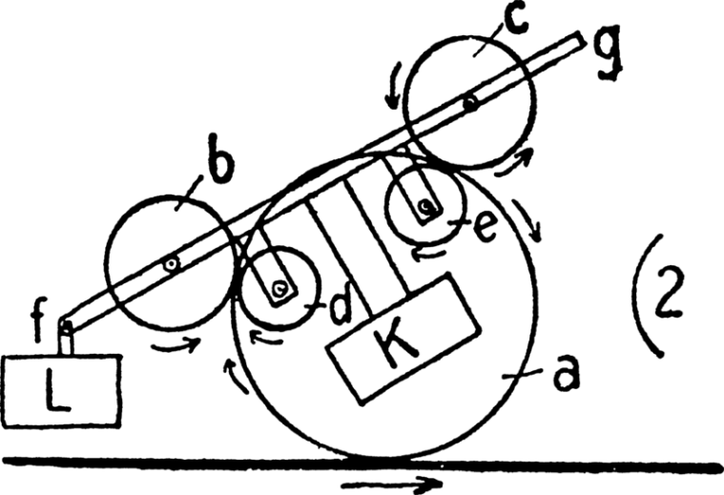
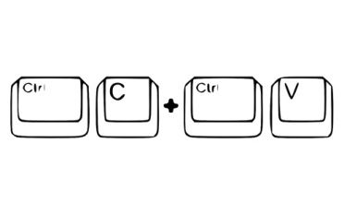
Let’s make releases non-events
Notes:
For many of us, the cartoon with the overcomplicated process chart with the step reading “some miracle happens here” (the one that “you might want to be a little more detailed about”) is a reminder of the late night caffeine powered releases finishing at dawn due to similarly well documented release procedure.
This talk will highlight some steps on one of the possible paths from that can be taken to get from the above described situation to the 50 (or more) releases some companies (e.g.: Facebook, IMVU, etc.) do daily.
----
Images of this presentation are all attributed with the URLs on each side, and each image is licensed under the terms that can be found on the source website, unless otherwise noted.
http://commons.wikimedia.org/wiki/File:Paul_Scheerbart_-_Perpetuum_mobile_(1910).png
http://www.flickr.com/photos/cwest666/1458716901/

Slide 2

Notes:
The evolution of code sharing
A single developer, working on her own copy, or directly in production
Multiple developers, sharing code via email, portable media, network folders, etc. frequent change overwrites and code loss, and resulting scratching of heads
Multiple developers, sharing code via some VCS.
http://en.wikipedia.org/wiki/File:Tiktaalik_roseae_life_restor.jpg

Slide 3

Notes:
http://www.codinghorror.com/blog/2007/03/the-works-on-my-machine-certification-program.html

Slide 4

Notes:
Some causes are:
I forgot to check in that file...
I forgot to check in that dependency...
Oh, I've upgraded to use library X...
I've changed the API...
You need to update the configuration in [file, registry, environment variable, ...]
...
We need some proper (executable) documentation and also at least learn about problems if they exist.
Building outside the IDE
Be able to build from the command line – msbuild, ant, nant, make, psake, rake, etc.
Nightly build
Have all your dependencies in the repository
Have a build machine
http://www.flickr.com/photos/chrisjohnbeckett/514914659/

Slide 5

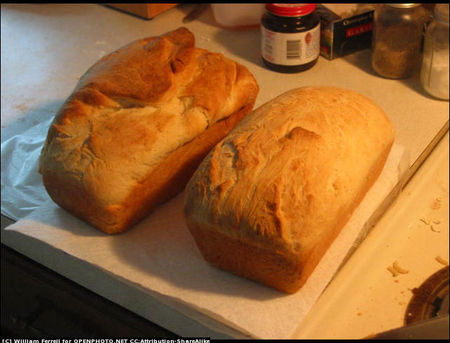
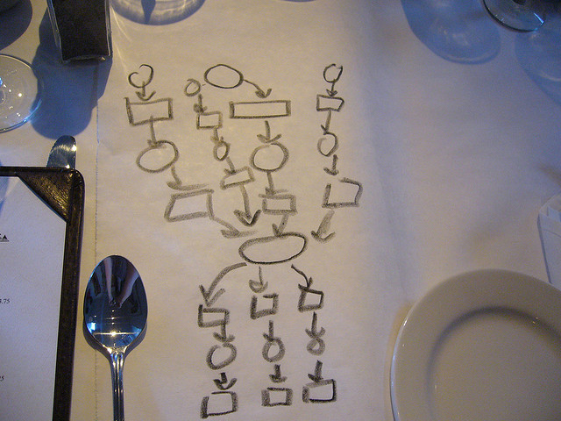
Notes:
Nightly build 101
Set up a scheduled task on the build machine that gets the latest version of the software from the VCS
Perform the pre defined steps (build, test, etc.)
Notify interested parties of the results
http://openphoto.net/gallery/image.html?image_id=7628
http://www.flickr.com/photos/schneertz/679692806/
http://www.flickr.com/photos/funtik/1175522045/

Slide 6
Beyond compiling & unit testing
code coverage, mutation testing, static code analysis, coding standards enforcement, document generation, multi platform build, building on dependency's source code change, acceptance testing, trend comparison, xDepend, ...
Notes:
And we can go totally crazy adding additional quality checks ☺ As [Jason] Gorman's Law of Software Design says - Any aspect of software design that is not expressed in code does not exist.
Most build server software make it easy to track the trends of these metrics. However, only enable such analysis if you are prepared to fix the violations. Unless you treat these warnings as errors, in most teams they'll remain in the build, and once you get a couple of thousands warnings, nobody will ever look at any of them (aka.: signal vs. noise).

Slide 7

Notes:
Now, the nightly build is nice, but the feedback is delayed
If time to market rules elsewhere, so should here
It takes time to identify the offending commit that broke the build (only to find he is already on holiday…)
We actually need to act on the feedback we receive
http://commons.wikimedia.org/wiki/File:1_1_54b.png

Slide 8

Notes:
Continuous Integration is just a minor enhancement technically on top of the nightly build (let’s call it nightlyBuild++)
The build is kicked off whenever there is a change in the tracked VCS. The trigger can be pull, or push, before or after the commit.
That was easy.
Oh, and there are a lot of ready made, free (and commercial) CI servers. Team City, Bamboo, Hudson, etc. These have support for all major languages and tools via their plugins.
However, if you find something missing, they all have APIs you could write your tasks in. Or you can get a command prompt, so you can script whatever needs to be done (shell scripting is fun! And more importantly, might be faster than to reinvent the wheel. Have I already told you to keep everything under source control?).
http://commons.wikimedia.org/wiki/File:Boy-with-binoculars.png

Slide 9
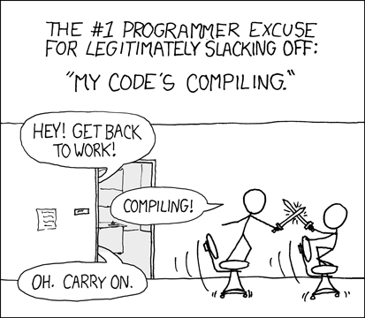
Notes:
The experts say that a build shouldn’t take longer than a coffee break. I personally find even over minute builds slow, but I’m learning patience ☺
If the build takes long, people will run it less frequently before commits, which will more likely lead to broken builds, of which will get notified much later, which will make it longer to get back to the context of what went wrong – well, you get the basic idea
Some basic ideas to speed things up are
Parallelize (if makes sense and doable)
Instead of a big bang approach, create milestones and provide feedback after each – e.g.: compile, run unit tests, run smoke tests, run all integration tests, run all integrated acceptance tests.
http://xkcd.com/303/

Slide 10

Lets release!
Notes:
Now only if we could do something about those manual release (and verification) steps… wait, can’t we automate that too?
http://www.flickr.com/photos/cwest666/1458716901/

Slide 11
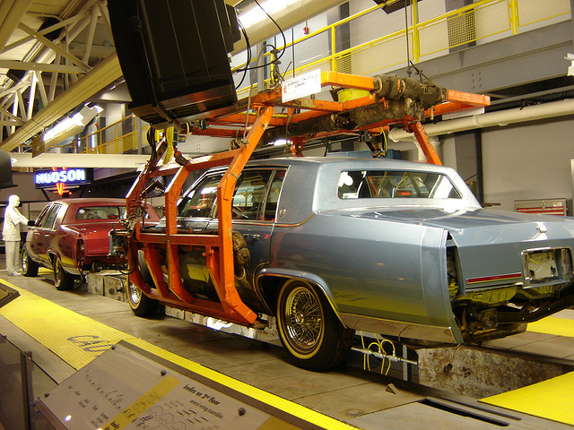
Notes:
Much better.
Release automation might be much more difficult, and present a greater risk to our reputation if something slips through (if we fail automating a build, that isn’t such a big deal given our prior track record); but exactly for these reasons it’s worth it even more than in the build’s case.
And you’ll be surprised what you can learn about your own release process ☺
http://www.flickr.com/photos/harry_nl/3030267182/

Slide 12
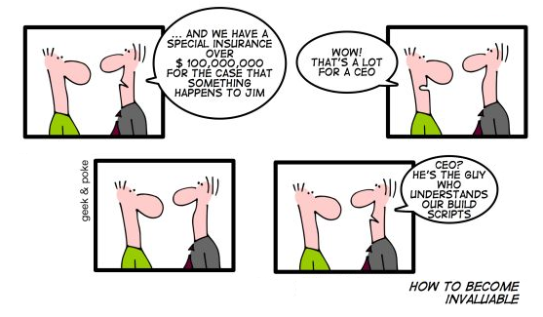
Notes:
Release code is code, just like any other. Treat it the same as production code. KISS, Refactor.
Cartoon is taken with the emailed permission of the author. Original cartoon can be found at http://geekandpoke.typepad.com/geekandpoke/2010/05/how-to-become-invaluable.html

Slide 13

Notes:
Ok. Now that we can build and release from the command line, how do we tie all this together?
Build Promotion
Given we have already built and thoroughly verified the built artifact, there isn’t really a reason why we should go through the same procedure. After all, we would just run the same checks again.
That’s all, we are ready for space travel!.
How do we revert to the previous version if things go South?
Don’t panic!
Just automate that too. Follow the pattern used by the Machine.Migrations .NET library (among many other libraries). StepUp, StepDown methods for each change. Or use the Memento pattern for undo/redo. Or just write one off scripts.
http://www.flickr.com/photos/61057813@N00/153001143/

Slide 14

Notes:
Checks
So far we have only talked about pre-release checks, but there are things that should be verified afterwards. If deploying to a live application, there should some more checks –
The usual suspects - file permissions, can connect to the database, etc.
I found that if the prior release is available, having an expected diff on the file system level can be useful
Roll it out bit by bit, segment your audience – monitor the performance, and compare and contrast against the prior baseline and auto rollback if performance degrades noticeably
All other things you have been burnt by before ☺
Constraints
These might be operational (company policy) or psychological (releases shouldn’t happen automatically!). That is fine. If we can push things out as far as possible (e.g.: releasing to the QA environment), that is also quite a big step forward. Note you might not want to actually pull out the app from under the QA people though
As Yoda says, I’m only showing (a possible way), you have to walk on it to make it fit your context.
http://www.flickr.com/photos/harry_nl/3030267182/

Slide 15

Questions?
Notes:
Some useful links
http://martinfowler.com/articles/continuousIntegration.html
http://www.extremeprogramming.org/rules/integrateoften.html
http://c2.com/cgi/wiki?ContinuousIntegration
http://continuousdelivery.com/
Some experience reports
http://timothyfitz.wordpress.com/2009/02/10/continuous-deployment-at-imvu-doing-the-impossible-fifty-times-a-day/
http://www.infoq.com/presentations/Facebook-Moving-Fast-at-Scale
http://www.hanselman.com/blog/HanselminutesPodcast230ContinuousDeploymentWithJonT%C3%B8rresdal.aspx
Feel free to contact me! I’m on twitter (@zsepi), and I blog (http://zsoldosp.blogspot.com).

