Slide 1
SOFTWARE DEVELOPMENT 3
Interfaces

Slide 2
Interfaces
An abstract class is used to achieve partial abstraction (hiding irrelevant details from user)
Interfaces are used for achieving full abstraction
An Interface looks like a class but it is not a class
An interface can have methods and variables just like the class but the methods declared in interface are by default abstract (only method signature, no body)
Also, the variables declared in an interface are public, static & final by default
Most of the time, you will use API supplied Java interfaces
Sometimes you will want to design your own
You would write an interface if you want classes of various types to all have a certain set of capabilities

Slide 3
Why use Interfaces?
As mentioned earlier they are used for abstraction
Since methods in interfaces do not have body, they have to be implemented by the class before you can access them
The class that implements the interface must implement all the methods of that interface
Also, Java does not support multiple inheritance, using interfaces we can achieve this as a class can implement more than one interfaces, however it cannot extend more than one class

Slide 4
Import Interface Example 1
An interface is like an abstract class with nothing but abstract methods and final static data members
All methods and data of an interface are public
For example, you can define an ImportDuty interface with the single method calculateDuty()

Slide 5
Interfaces
You might want to use this interface on many different classes, cars among them but also for clothes, food, electronics and more
It would be inconvenient to make all these objects derive from a single class. Furthermore, each different type of item is likely to have a different means of calculating the tariff. Therefore you define an Import interface and declare that each class implements the Import interface

Slide 6
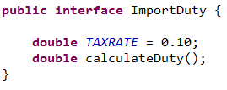
Import Interface 2 Example 1
data members are final and static by default
The methods in an interface are always public and abstract, so you do not need to specify them as such
The method will be implemented in each class that implements the interface

Slide 7
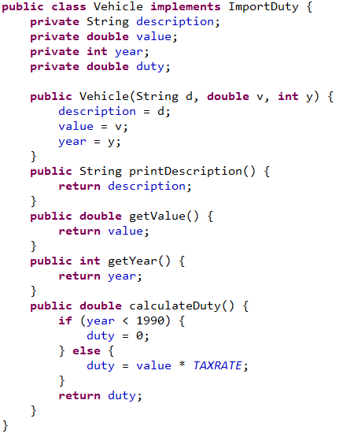
Implementing Interfaces
To make use of the "ImportDuty" interface, you need to create a class that will declare that it implements ImportDuty. Note the use of the keyword implements
Here is a class Vehicle which includes the calculateDuty() method.

Slide 8
Interfaces
The syntax is simple
The Import interface's access modifier is public
This means that the interface is accessible outside the package containing it
If you omit the keyword public, your interface is only accessible from within its containing package
Almost all interfaces will be public
The interface keyword takes the place of the class keyword

Slide 9
Interfaces
You can declare many different methods in an interface. These methods must be overridden in the class that implements the interface.
An interface can also have fields, but if so they must be public, final and static (in other words constants)
A class can implement more than one interface
If the class implements more than one interface, then all of the interfaces are listed after the implements keyword

Slide 10
Interfaces vs. Inheritance
Use Interfaces to share common behaviour(only method headers)
One class can implement multiple interfaces
    E.G. class Person implements Driver, Bike
Using inheritance to share common code among related classes
  Data
  Methods
A single subclass can extend at most one superclass
    class PTEmployee extends Employee
A subclass “isa” superclass
  A dog “isa” animal
The “isa” relationship does not have to exist between the interface and the class that implements it

Slide 11
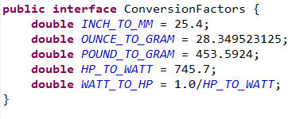
Implementing Interfaces-Example 2
This initial interface contains only constants:
Here we have five constants for conversions of various kinds - remember that these are public, static, and final by default
You might also want to define an interface containing methods for conversion

Slide 12
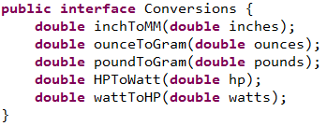
Implementing Interfaces-Example 2
You can extend one interface based on another by using the keyword extends to identify the base interface name.
For example, the interface Conversions would perhaps be more useful if it contained the constants that the interface ConversionFactors contains

Slide 13
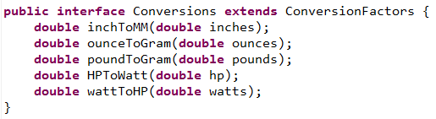
Implementing Interfaces-Example 2
We could do this by defining the interface Conversions as:
Now the interface Conversions also contains the members of the interface ConversionFactors
Any class implementing the Conversions interface will have the constants from ConversionFactors available to implement the methods
The interface ConversionFactors is referred to as a super-interface of the interface Conversions

Slide 14
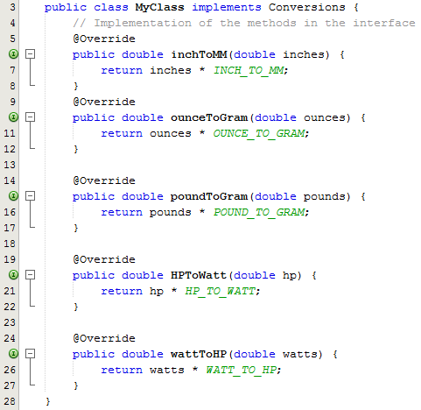
Implementing Interfaces-Example 2
All the constants defined in the interface ConversionFactors are available in MyClass as though they were data members of the class
You can reference them freely in any of the methods in the class
Because they are public they will also be accessible members of objects of type MyClass.
When the interface contains
methods, we have to
implement the methods that
are in the interface

Slide 15
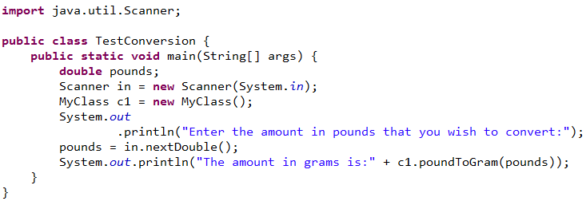
Implementing Interfaces-Example 2
Program Output:
Enter the amount in pounds that you wish to convert:
80
The amount in grams is:36287.392

