Slide 1
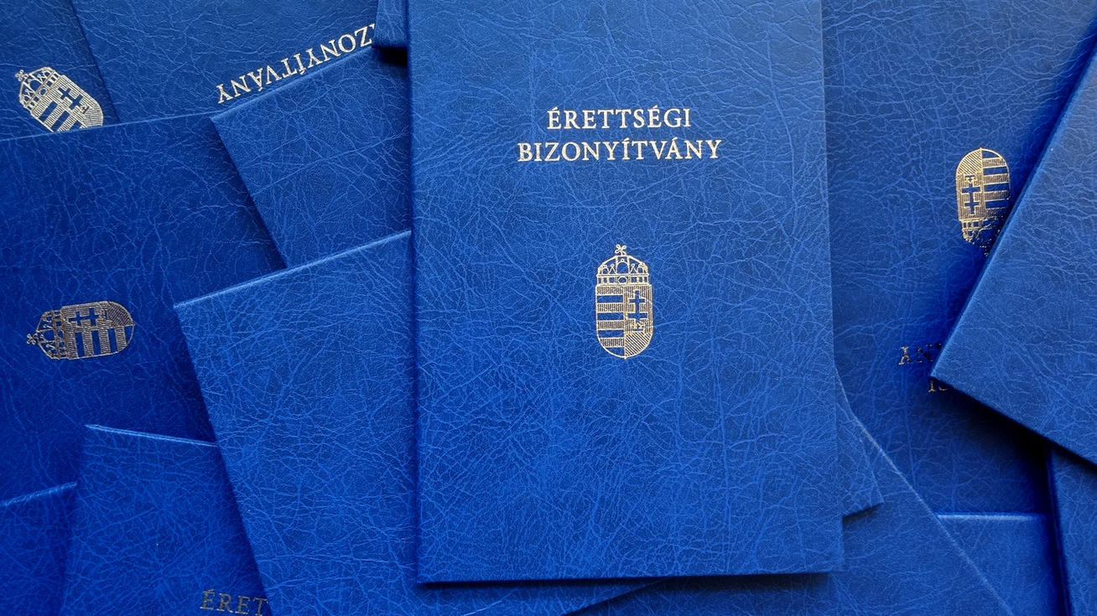
Let’s Graduate
By: Dárius Lipták, Zsolt Gáspár, Olivér Bernát

Slide 2

Learning Assistance Software
A preparation program for students preparing for final exams.
Covers subjects such as Mathematics, History, and Hungarian language and literature
It summerizes the revised final exam tasks from previous years in an interactive format, making it easier for students to practise tests and recieve immediate feedback.

Slide 3
Functions - Ideas
Main functions:
Main menu
User guide
Quiz interface
Task list, Review
Task randomizer
Extras:
Progress reset
Adverts
Newletter registration
Spaced repetition
Daily streak (duolingo style)

Slide 4
Development Environments, Programming Languages
Two main Environments:
Visual Studio
Visual Studio Code
Used Languages:
C#
SQL
HTML
REACT, JS

Slide 5
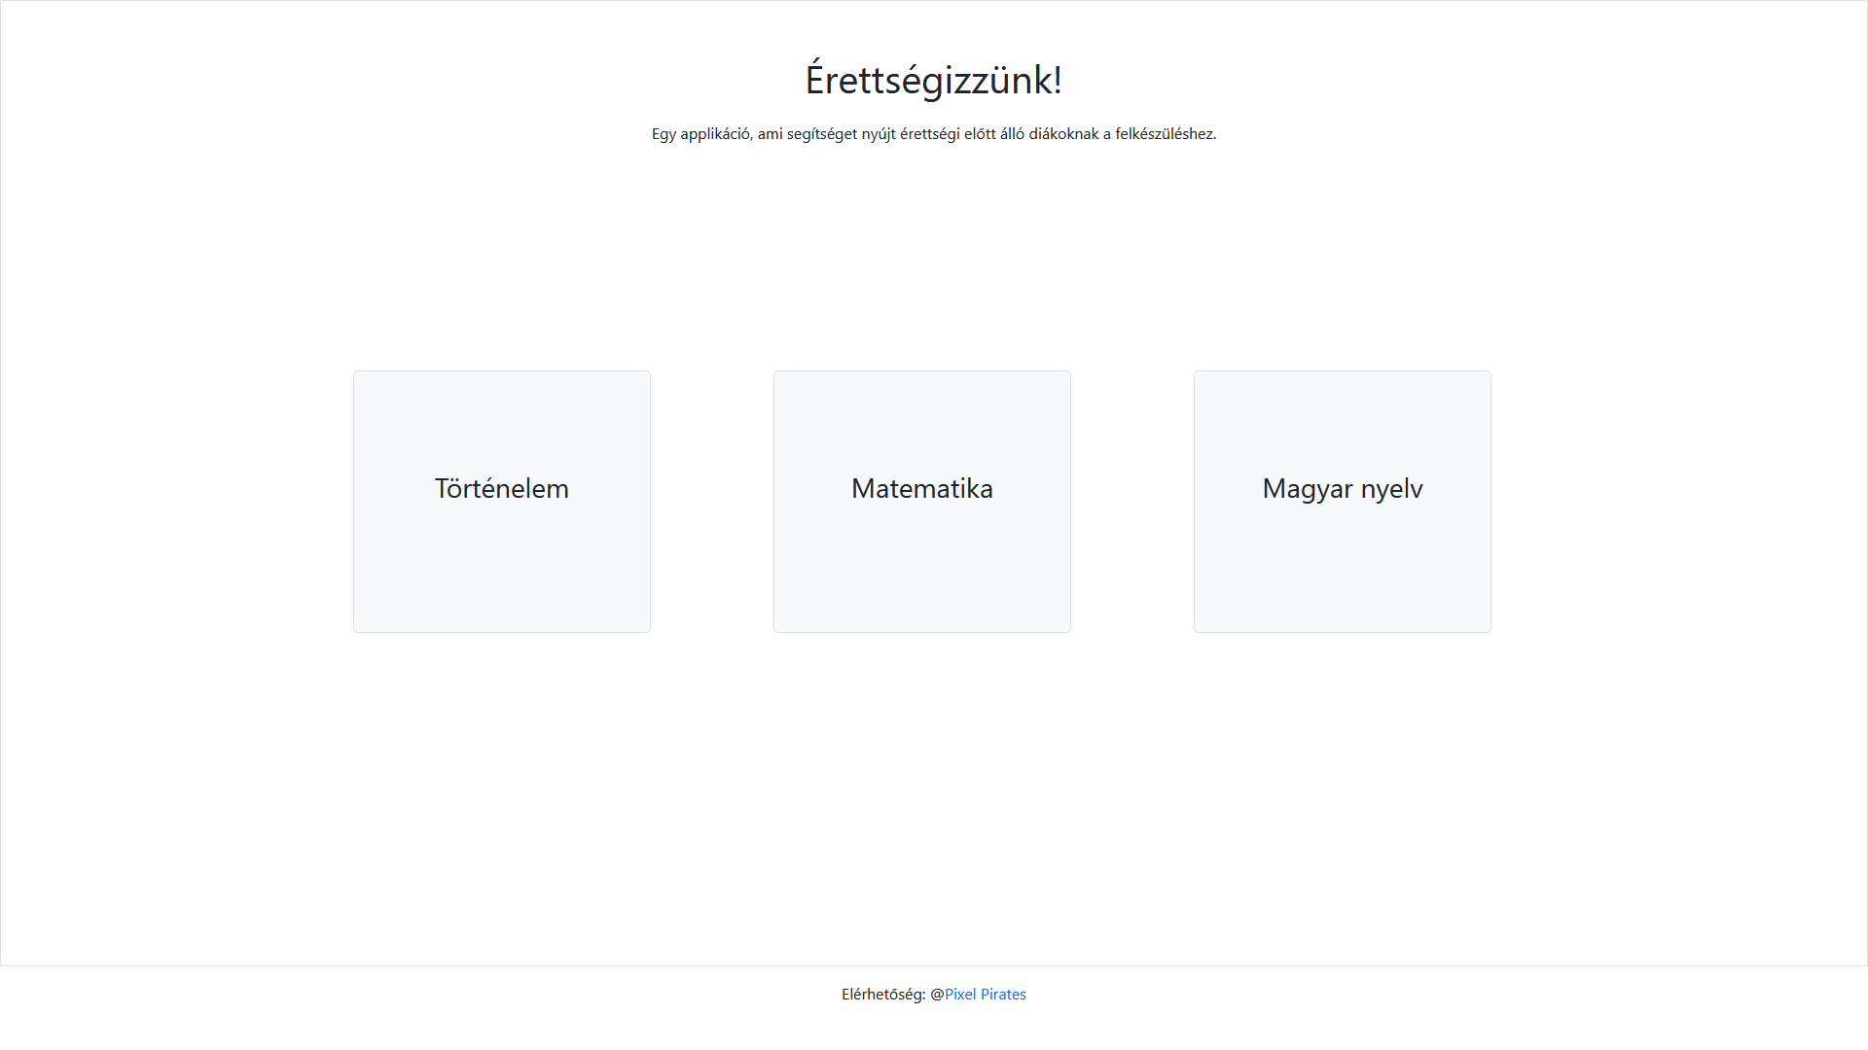
First static webpage

Slide 6
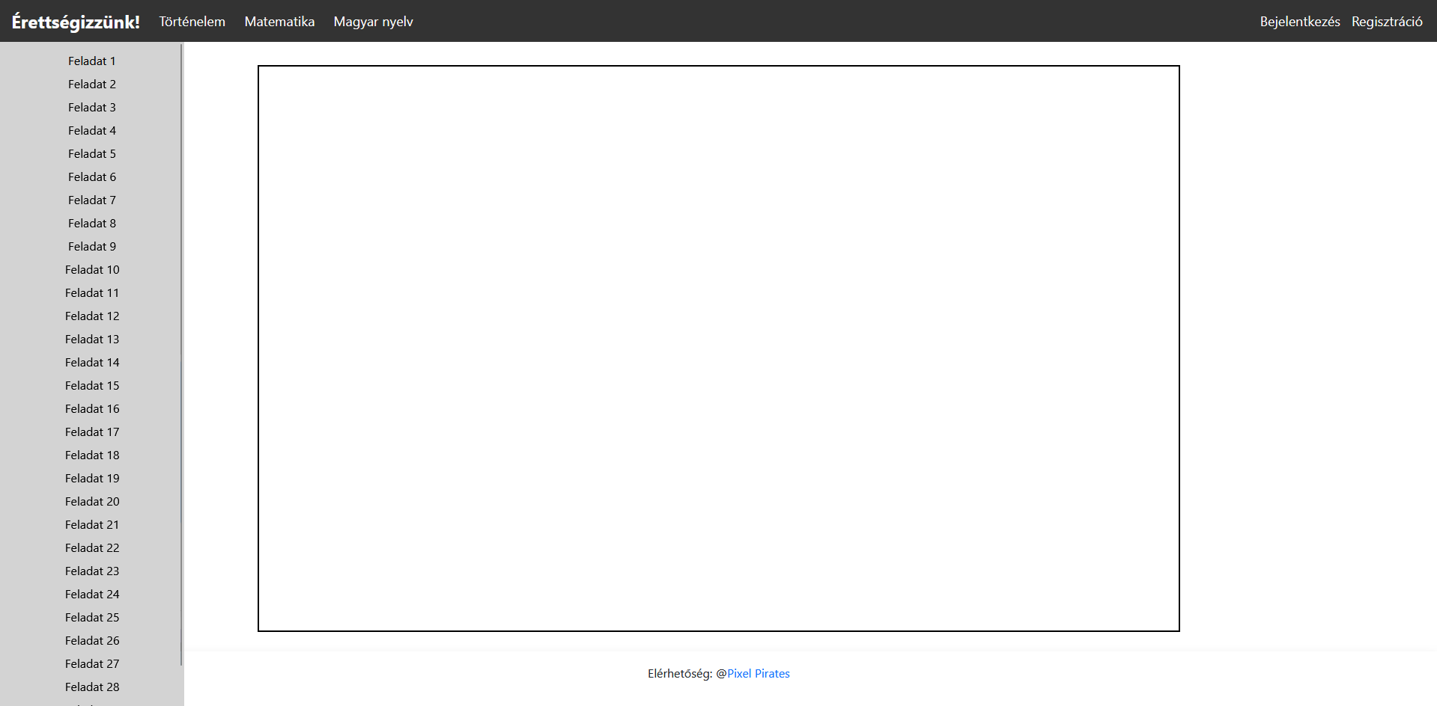
First static test interface

Slide 7
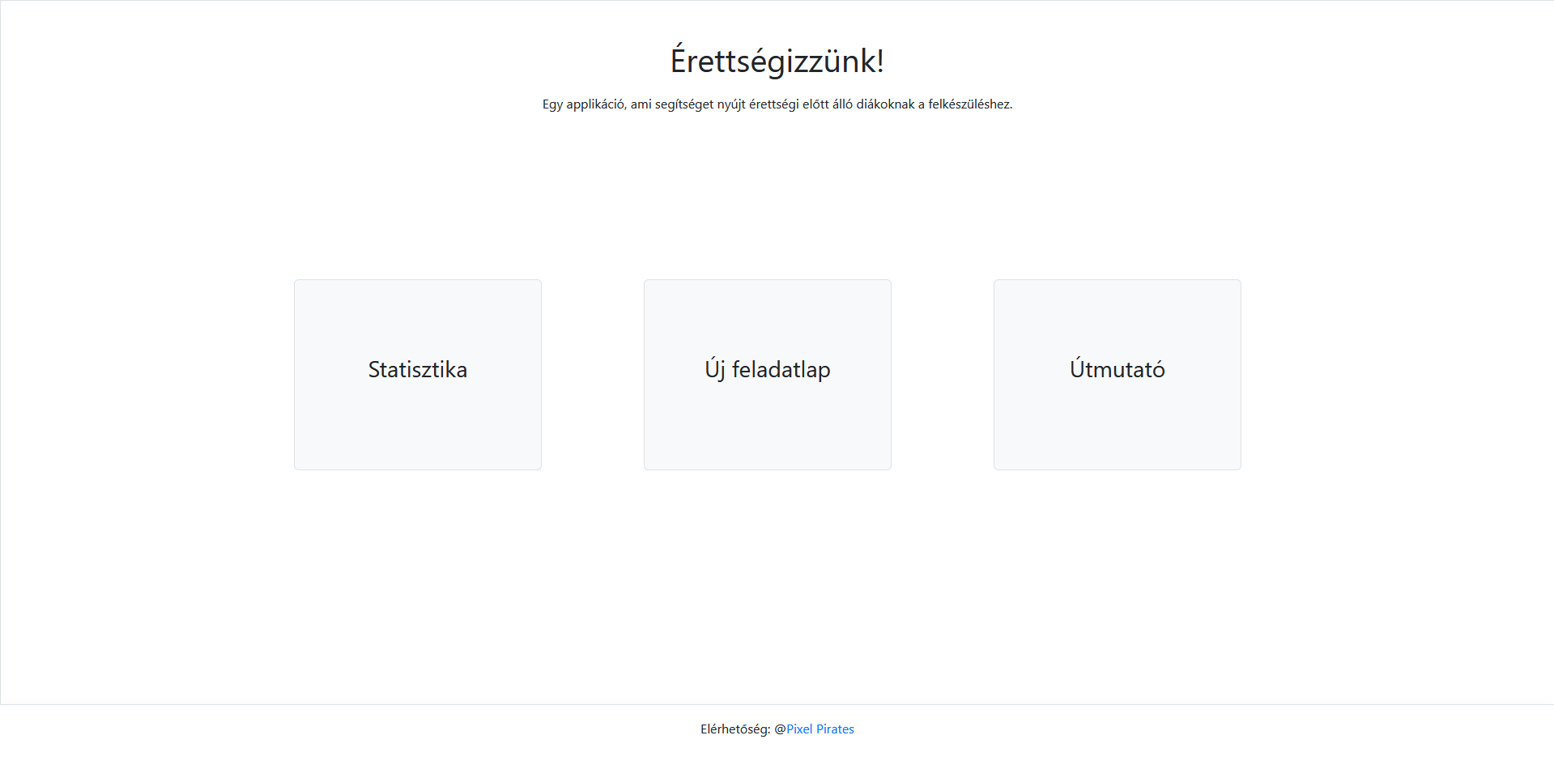
Redesigned homepage

Slide 8
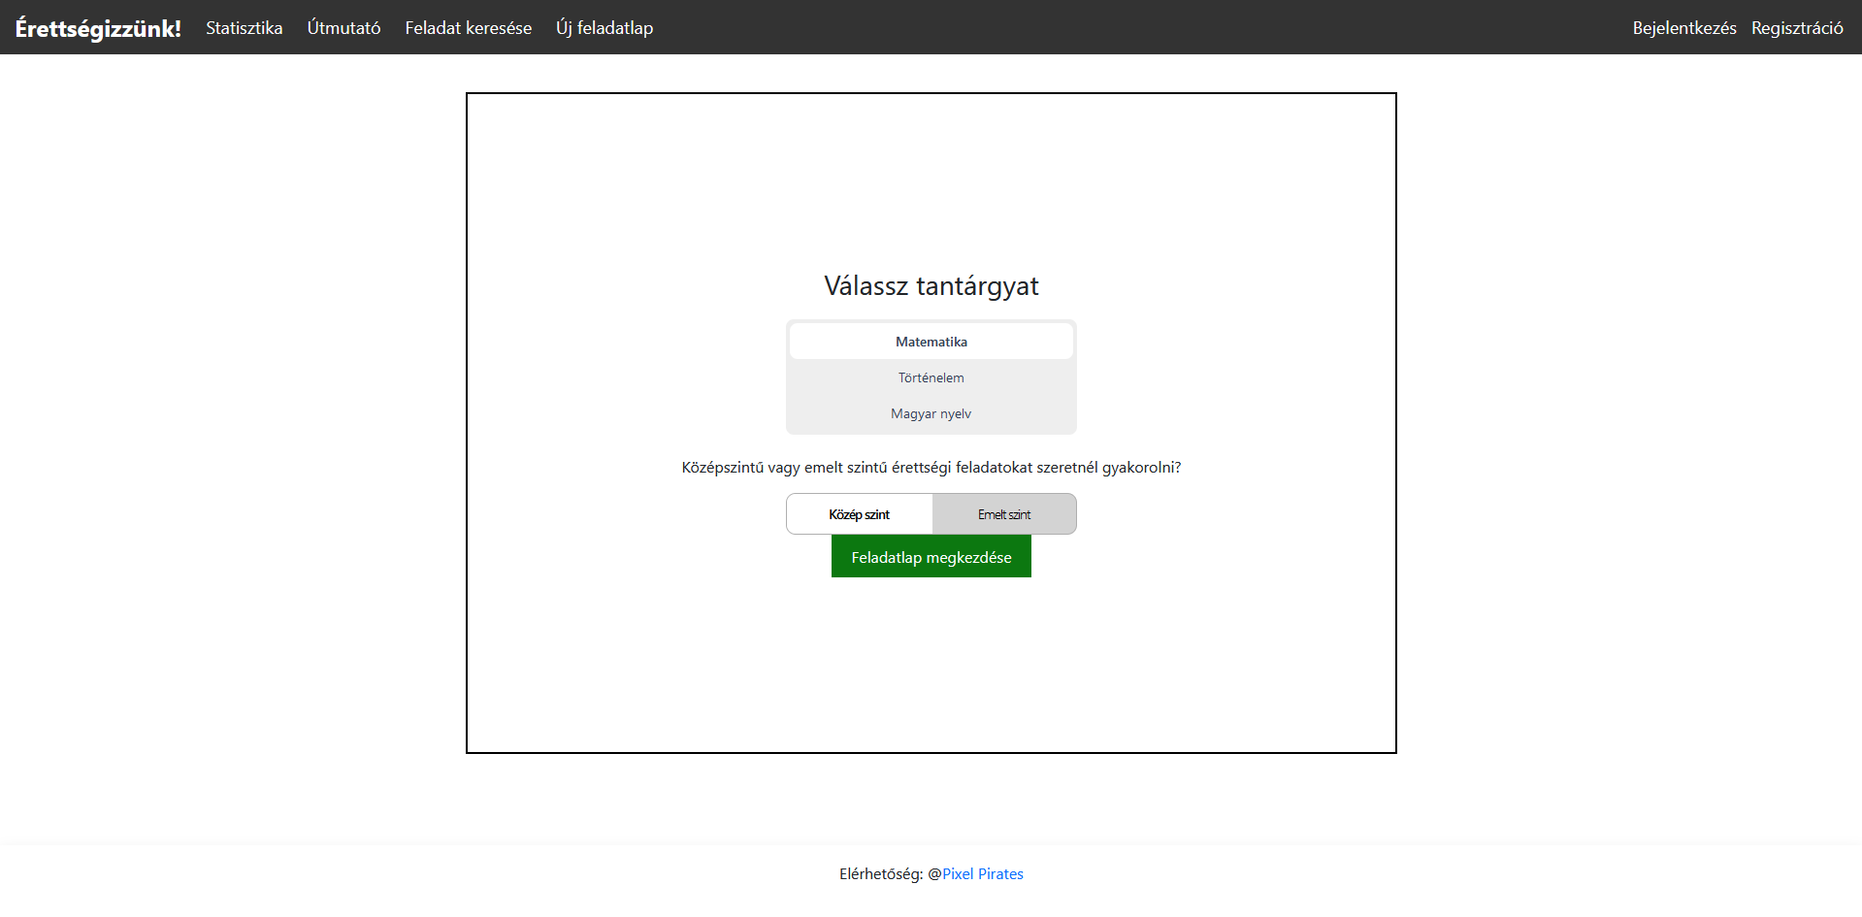
Test selection interface

Slide 9
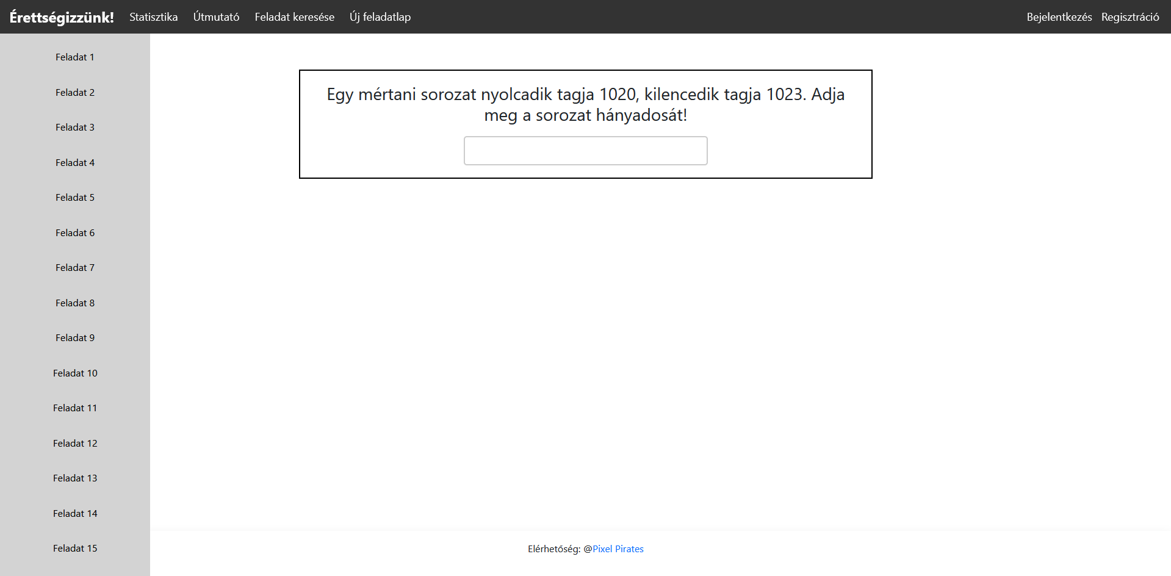
Test interface loaded from database

Slide 10
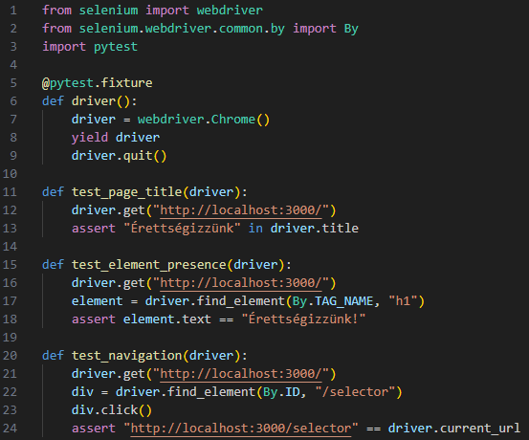
First functional testing

Slide 11
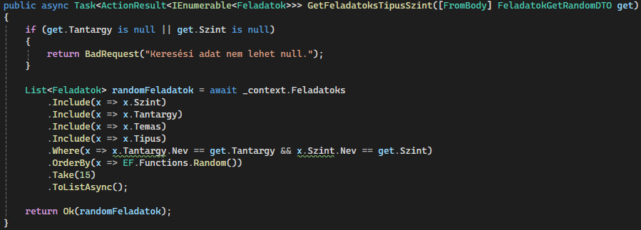
Fetching of the 15 random tasks

