Slide 1


Data Structures and Algorithms
INTRODUCTION AND BASIC CONCEPTS
www.arobs.com
Notes:
Welcome
Prezentare individuale
Asteptari de la training

Slide 2

Content
Methods
Collections and Data Structures
Input/Output with files
Algorithms
Operations with Linq
Concepts Summary
Homework
Useful links
www.arobs.com

Slide 3
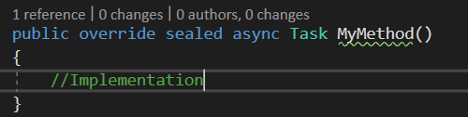
Methods
A method is a code block that contains a series of statements.
A program causes the statements to be executed by calling the method and specifying any required method arguments.
In C#, every executed instruction is performed in the context of a method.
Signature of a method consists of:
access level : private, public, internal
optional modifiers: static, abstract, sealed, async etc.
return value
name of the method
parameters
www.arobs.com

Slide 4
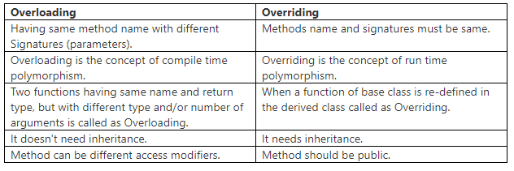
Methods
www.arobs.com

Slide 5
Collections
Similar data can often be handled more efficiently when stored and manipulated as a collection.
Especially handy if we have large sets of data
There are two main types of collections; generic collections and non-generic collections.
Generic Collections are type safe at compile and offer better performance, non- generic Collections store elements internally in object arrays.
Generic Collection examples:
List<T> ex:List<string>
Dictionary<T1,T2> ex: Dictionary<int,string>
Stack<T> ex: Stack<Car>
www.arobs.com

Slide 6
Common Collection Features
The ability to enumerate the collection
.NET Framework collections either implement System.Collections.IEnumerable or System.Collections.Generic.IEnumerable<T> to enable the collection to be iterated through.
Capacity and Count properties
The capacity of a collection is the number of elements it can contain. The count of a collection is the number of elements it actually contains. Some collections hide the capacity or the count or both.
A consistent lower bound (zero index)
All indexed collections in the System.Collections namespaces are 0-indexed.
The ability to copy the collection contents to an array
www.arobs.com

Slide 7
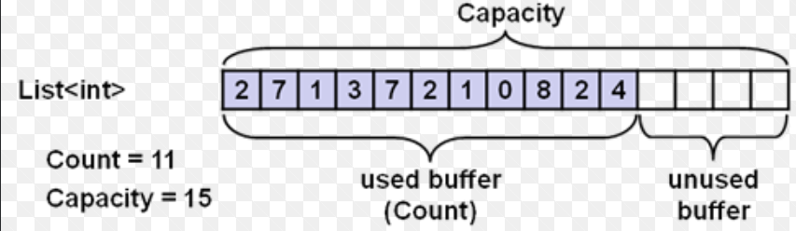
List
(List<T> ,eg. List<int>)
Can have any amount of objects.
Under the hood, the List is an array whose size is doubled every time it runs out of space.
Represents a strongly typed list of objects that can be accessed by index.
Provides methods to search, sort, and manipulate lists.
Supported operations:
Add one or more elements at a time
Access the items in the list
Insert an element at a specified index
Delete an element
Etc.
www.arobs.com

Slide 8
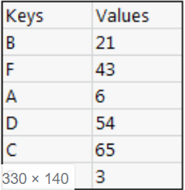
Dictionary
(Dictionary<TKey,TValue, eg. Dictionary<int,string>)
Represents a collection of keys and values.
Basically lets us specify the keys, which can be any type of object, providing us a mapping from a set of keys to a set of values.
Keys must be unique and cannot be null.
Supported operations:
Adding a new key/value pair
Removing a key/value pair
Finding a value through it's key
Enumerate through the keys only,or values only
Etc.
www.arobs.com

Slide 9
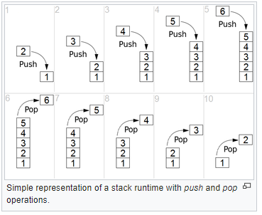
Stack
Stack<T> , eg. Stack<Car>
Represent a first-in, last-out collection of objects.
Resembles a List.
Has Push / Pop instead of Add / Remove .
Has Peek method for seeing the top value without removing it.
www.arobs.com

Slide 10
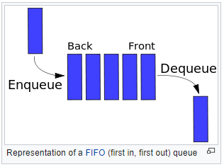
Queue
Queue<T>, eg.Queue<Animal>
Similar to stack.
Represent a first-in, first-out collection of objects.
Has Enqueue / Dequeue for Add / Remove.
Peek method returns top value without removing it.
www.arobs.com

Slide 11
File and Stream I/O
File and stream I/O (input/output) refers to the transfer of data either to or from a storage medium.
In the .NET Framework, the System.IO namespaces contain types that enable reading and writing, both synchronously and asynchronously.
You should always provide robust exception handling when calling filesystem methods.
www.arobs.com

Slide 12
Files and Directories
You can use the types in the System.IO namespace to interact with files and directories
File - provides static methods for creating, copying, deleting, moving, and opening files, and helps create a FileStream object.
FileInfo - provides instance methods for creating, copying, deleting, moving, and opening files, and helps create a FileStream object.
Directory - provides static methods for creating, moving, and enumerating through directories and subdirectories.
DirectoryInfo - provides instance methods for creating, moving, and enumerating through directories and subdirectories.
Path - provides methods and properties for processing directory strings in a cross-platform manner.
www.arobs.com
Notes:
Generally if you are performing a single operation on a file, use the File class. If you are performing multiple operations on the same file, use FileInfo.
When you create an instance of FileInfo, the check is only performed once. However, each time you use a static File method the check is performed.

Slide 13
Streams
The abstract base class Stream supports reading and writing bytes.
All classes that represent streams inherit from the Stream class.
The Stream class and its derived classes provide a common view of data sources and repositories, and isolate the programmer from the specific details of the operating system and underlying devices.
Streams involve three fundamental operations:
Reading - transferring data from a stream into a data structure, such as an array of bytes.
Writing - transferring data to a stream from a data source.
Seeking - querying and modifying the current position within a stream.
www.arobs.com

Slide 14
Streams - Commonly uses Classes
FileStream – for reading and writing to a file.
IsolatedStorageFileStream – for reading and writing to a file in isolated storage.
MemoryStream – for reading and writing to memory as the backing store.
BufferedStream – for improving performance of read and write operations.
NetworkStream – for reading and writing over network sockets.
PipeStream – for reading and writing over anonymous and named pipes.
CryptoStream – for linking data streams to cryptographic transformations.
www.arobs.com

Slide 15
Stream - Readers and Writers
The System.IO namespace provides types for reading encoded characters from streams and writing them to streams.
Commonly used reader and writer classes
BinaryReader and BinaryWriter – for reading and writing primitive data types as binary values.
StreamReader and StreamWriter – for reading and writing characters by using an encoding value to convert the characters to and from bytes.
StringReader and StringWriter – for reading and writing characters to and from strings.
TextReader and TextWriter – serve as the abstract base classes for other readers and writers that read and write characters and strings, but not binary data.
www.arobs.com

Slide 16
Algorithms
Definition: A process or set of rules to be followed in calculations or other problem-solving operations
Sorting algorithms:
Quick Sort
Merge Sort
Heap Sort
Bubble Sort
Selection Sort
Insertion Sort
Shell Sort
etc.
Searching algorithms:
Linear Search
Binary Search
Jump Search
Interpolation Search
Exponential Search
Fibonacci Search
etc.
www.arobs.com

Slide 17
Algorithms - LINQ
Filtering with Linq(where)
Ordering with Linq(orderby)
Grouping with Linq(group)
var filteredResult = studentList.Where(s => s.Age > 12 && s.Age < 20);
var studentsInAscOrder = studentList.OrderBy(s => s.StudentName);
var studentsInDescOrder = studentList.OrderByDescending(s => s.StudentName);
var groupedResult = studentList.GroupBy(s => s.Age);
www.arobs.com

Slide 18
Algorithms - LINQ
Selecting with Linq (select)
All, Any with Linq
var selectResult = studentList.Select(s => new { Name = s.StudentName , Age = s.Age });
bool isAnyStudentTeenAger = studentList.Any(s => s.age > 12 && s.age < 20);
bool areAllStudentsTeenAger = studentList.All(s => s.Age > 12 && s.Age < 20);
www.arobs.com

Slide 19
Homework
Write a program that reads the list of people from a file and gives the users the option to check if a person is older than 18 or not.
The result will be printed to the console (yes/no, name of the person and age) and also exported to a file.
the file with the data will be provided
you must have 2 methods (1 for import, 1 for export)
for search you must use LINQ
for storing the data in memory you must use a generic collection
www.arobs.com

Slide 20
Useful links
Methods:
c# - https://docs.microsoft.com/en-us/dotnet/csharp/programming-guide/classes-and-structs/methods
java - https://www.tutorialspoint.com/java/java_methods.htm
Collections and Data Structures:
c# - https://docs.microsoft.com/en-us/dotnet/standard/collections/
java - https://www.geeksforgeeks.org/java-collection-tutorial/
Input/Output with files:
c# - https://csharp.net-tutorials.com/file-handling/reading-and-writing/
java - https://www.tutorialspoint.com/java/java_files_io.htm
Linq: http://www.tutorialsteacher.com/linq/linq-tutorials
www.arobs.com

Slide 21
Q&A
www.arobs.com

Slide 22





THANK YOU!
GET IN TOUCH
Vasile Dit
.NET Team Leader
+40 723 456 789
contact@arobs.com

