Slide 1



PROGRAMMING LANGUAGE
INTRODUCTION TO C#
www.arobs.com

Slide 2

Content
Hello word - basics
Input/Output
Types
Statements
Operators
Concepts Summary
Homework
Useful links
www.arobs.com

Slide 3
Hello Word - basics
Namespaces are used in C# to organize and provide a level of separation of codes. They can be considered as a container which consists of other namespaces, classes, etc.
We can define a namespace in C# using the namespace keyword (eg. “Test”)
The members of a namespace can be accessed using the dot(.) operator.
A namespace can be included in a program using the using keyword.
The Main method is the entry point of a C# application.
When the application is started, the Main method is the first method that is invoked.
There can only be one entry point in a C# program.
using System;
namespace Test{
public class Hello {
public static void Main( ) {
Console.WriteLine("Hello world");
System.Console.ReadLine();
}
}
}
www.arobs.com

Slide 4
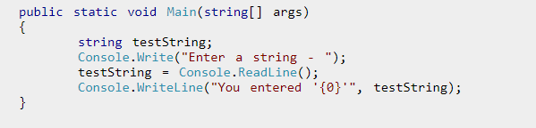
Input/Output
In order to output something in C#, we can use Write() or WriteLine().
The simplest method to get input from the user is by using the ReadLine() method of the Console class. However, Read() and ReadKey() are also available for getting input from the user.
All of this are methods of Console class from System namespace.
www.arobs.com

Slide 5
Types Overview
A C# program is a collection of types
Classes, structs, enums, interfaces, delegates
C# provides a set of predefined types
int, byte, char, string, object, …
You can create your own types. All data and code is defined within a type
www.arobs.com

Slide 6
Types - Unified Type System
Value types
Directly contain data
Cannot be null
Reference types
Contain references to objects
May be null
int i = 123;
string s = "Hello world";
i
123
s
"Hello world"
www.arobs.com

Slide 7
Types - Unified Type System
Value types
Primitives int i; float x;
Enums enum State { Off, On }
Structs struct Point {int x,y;}
Reference types
Root object
String string
Classes class Foo: Bar, IFoo {...}
Interfaces interface IFoo: IBar {...}
Arrays string[] a = new string[10];
Delegates delegate void Empty();
www.arobs.com

Slide 8
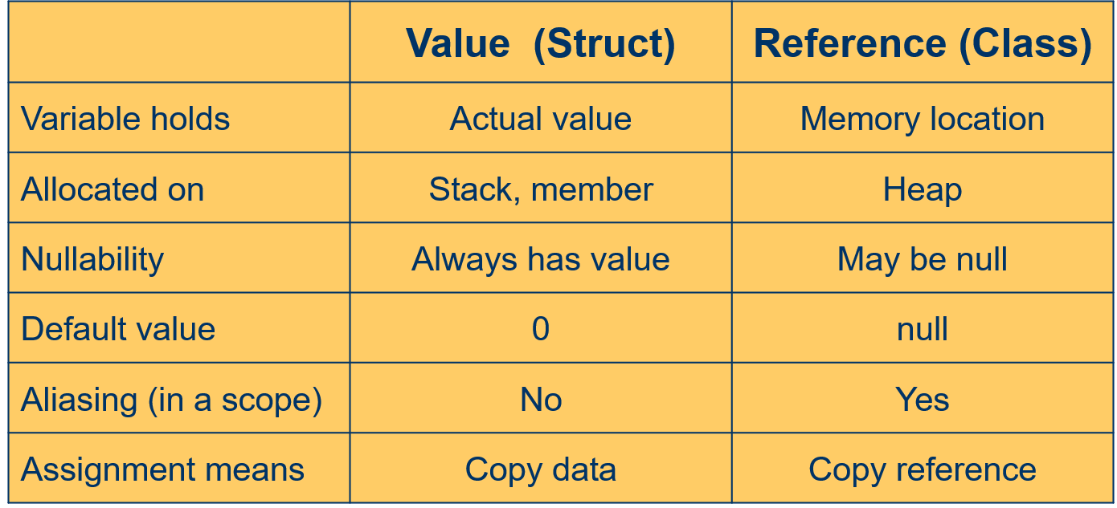
Types - Unified Type System
www.arobs.com

Slide 9
Types - Unified Type System
Boxing
Copies a value type into a reference type (object)
Each value type has corresponding “hidden” reference type
Value type is converted implicitly to object, a reference type
Essentially an “up cast”
Unboxing
Reverse operation of boxing
Copies the value out of the box
Copies from reference type to value type
Requires an explicit conversion
May not succeed (like all explicit conversions)
Essentially a “down cast”
www.arobs.com

Slide 10
Types Boxing - Unboxing
Boxing and unboxing
int i = 123;
object o = i;
int j = (int)o;
i
123
o
System.Int32
123
j
123
www.arobs.com

Slide 11
Types – Predefined Types
Value
Integral types
Floating point types
decimal
bool
char
Reference
object
string
www.arobs.com

Slide 12
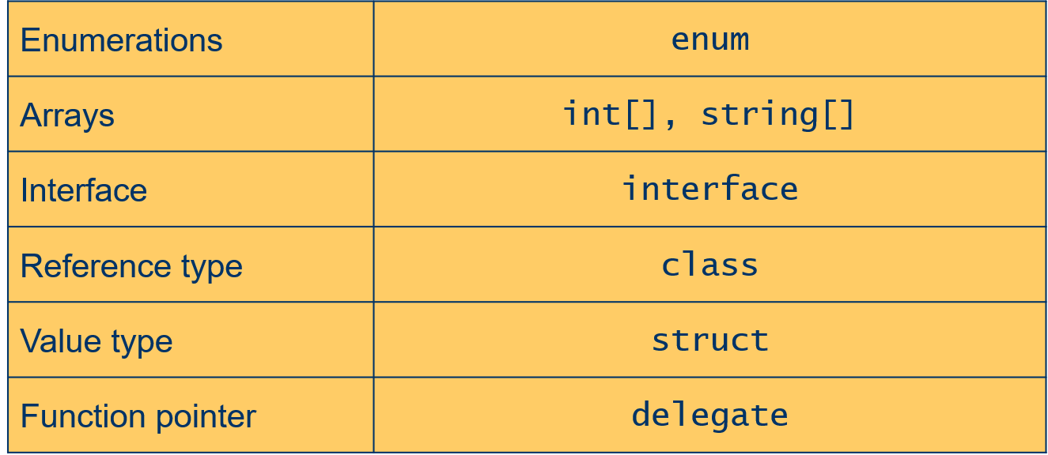
Types – User-defined Types
User-defined types
www.arobs.com

Slide 13
Types – Enums
An enum defines a type name for a related group of symbolic constants
Choices must be known at compile-time
Strongly typed
No implicit conversions to/from int
Can be explicitly converted
Operators: +, -, ++, --, &, |, ^, ~, …
Can specify underlying type
byte, sbyte, short, ushort, int, uint, long, ulong
www.arobs.com

Slide 14
Types – Enums
enum Color: byte {
Red = 1,
Green = 2,
Blue = 4,
Black = 0,
White = Red | Green | Blue
}
Color c = Color.Black;
Console.WriteLine(c); // 0
Console.WriteLine(c.Format()); // Black
www.arobs.com

Slide 15
Types – Arrays
Arrays allow a group of elements of a specific type to be stored in a contiguous block of memory
Arrays are reference types
Derived from System.Array
Zero-based
Can be multidimensional
Arrays know their length(s) and rank
Bounds checking
www.arobs.com

Slide 16
Types – Arrays
Declare
Allocate
Initialize
Access and assign
int[] primes;
int[] primes;
int[] prime = new int[] {1,2,3,5,7,11,13,17,19}; int[] prime = {1,2,3,5,7,11,13,17,19};
prime2[i] = prime[i];
www.arobs.com

Slide 17
Types – Interfaces
An interface defines a contract
Includes methods, properties, indexers, events
Any class or struct implementing an interface must support all parts of the contract
Interfaces provide polymorphism
Many classes and structs may implement a particular interface
Contain no implementation
Must be implemented by a class or struct
www.arobs.com

Slide 18
Types – Classes
User-defined reference type
Similar to C++, Java classes
Single class inheritance
Multiple interface inheritance
Members
Constants, fields, methods, operators, constructors
Properties, indexers, events
Static and instance members
Member access
public, protected, private, internal, protected internal
Instantiated with new operator
www.arobs.com

Slide 19
Statements Syntax
Statements are terminated with a semicolon (;)
Just like C, C++ and Java
Block statements { ... } don’t need a semicolon
Comments
// Comment a single line, C++ style
/* Comment multiple lines, C style */
www.arobs.com

Slide 20
Statements – Statement Lists and Block Statements
Statement list: one or more statements in sequence
Block statement: a statement list delimited by braces { ... }
static void Main() {
F();
G();
{ // Start block
H();
; // Empty statement
I();
} // End block
}
www.arobs.com

Slide 21
Statements – Variables and Constants
The scope of a variable or constant runs from the point of declaration to the end of the enclosing block
Within the scope of a variable or constant it is an error to declare another variable or constant with the same name
Variables must be assigned a value before they can be used
{
int x;
{
int x; // Error: can’t hide variable x
}
}
www.arobs.com

Slide 22
Statements – If Statement
Requires bool expression
int Test(int a, int b)
{
if (a > b)
return 1;
else if (a < b)
return -1;
else
return 0;
}
www.arobs.com

Slide 23
Statements – switch Statement
Can branch on any predefined type (including string) or enum
User-defined types can provide implicit conversion to these types
Must explicitly state how to end case
With break, goto case, goto label, return, throw or continue
www.arobs.com

Slide 24
Statements – switch Statement
int Test(string label)
{
int result;
switch(label) {
case null:
goto case “runner-up”;
case “fastest”:
case “winner”:
result = 1; break;
case “runner-up”:
result = 2; break;
default:
result = 0;
}
return result;
}
www.arobs.com

Slide 25
Statements – while Statement
Requires bool expression
int i = 0;
while (i < 5) {
...
i++;
}
int i = 0;
do {
...
i++;
}
while (i < 5);
while (true) {
...
}
www.arobs.com

Slide 26
Statements – for Statement
for (int i=0; i < 5; i++) {
...
}
for (;;) {
...
}
www.arobs.com

Slide 27
Statements – foreach Statement
Iteration of arrays
Iteration of user-defined collections
Created by implementing IEnumerable
public static void Main(string[] args) {
foreach (string s in args)
Console.WriteLine(s);
}
foreach (Customer c in customers.OrderBy("name")) {
if (c.Orders.Count != 0) {
...
}
}
www.arobs.com

Slide 28
Statements – Jump Statements
break
Exit inner-most loop
continue
End iteration of inner-most loop
goto <label>
Transfer execution to label statement
return [<expression>]
Exit a method
throw
See exception handling
www.arobs.com

Slide 29
Statements – Exception Handling
Exceptions are the C# mechanism for handling unexpected error conditions
Superior to returning status values
Can’t be ignored
Don’t have to be handled at the point they occur
Can be used even where values are not returned (e.g. accessing a property)
Standard exceptions are provided
www.arobs.com

Slide 30
Statements – Exception Handling
try...catch...finally statement
try block contains code that could throw an exception
catch block handles exceptions
Can have multiple catch blocks to handle different kinds of exceptions
finally block contains code that will always be executed
Cannot use jump statements (e.g. goto) to exit a finally block
throw statement raises an exception
www.arobs.com

Slide 31
Statements – Exception Handling
try {
Console.WriteLine("try");
throw new Exception(“message”);
}
catch (ArgumentNullException e) {
Console.WriteLine(“caught null argument");
}
catch {
Console.WriteLine("catch");
}
finally {
Console.WriteLine("finally");
}
www.arobs.com

Slide 32
Operators Overview
C# provides a fixed set of operators, whose meaning is defined for the predefined types
Some operators can be overloaded (e.g. +)
The following table summarizes the C# operators by category
Categories are in order of decreasing precedence
Operators in each category have the same precedence
www.arobs.com

Slide 33
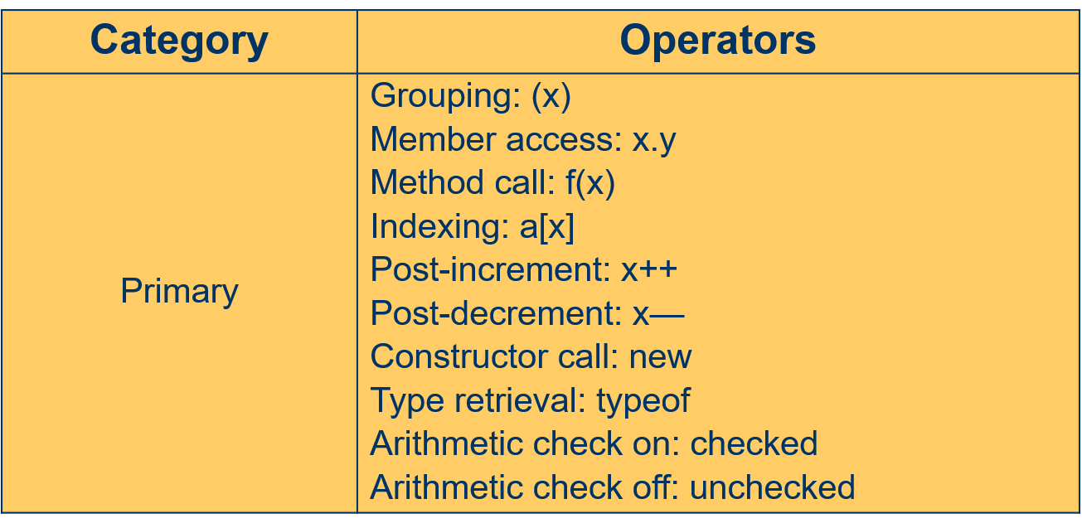
Operators - Precedence
www.arobs.com

Slide 34
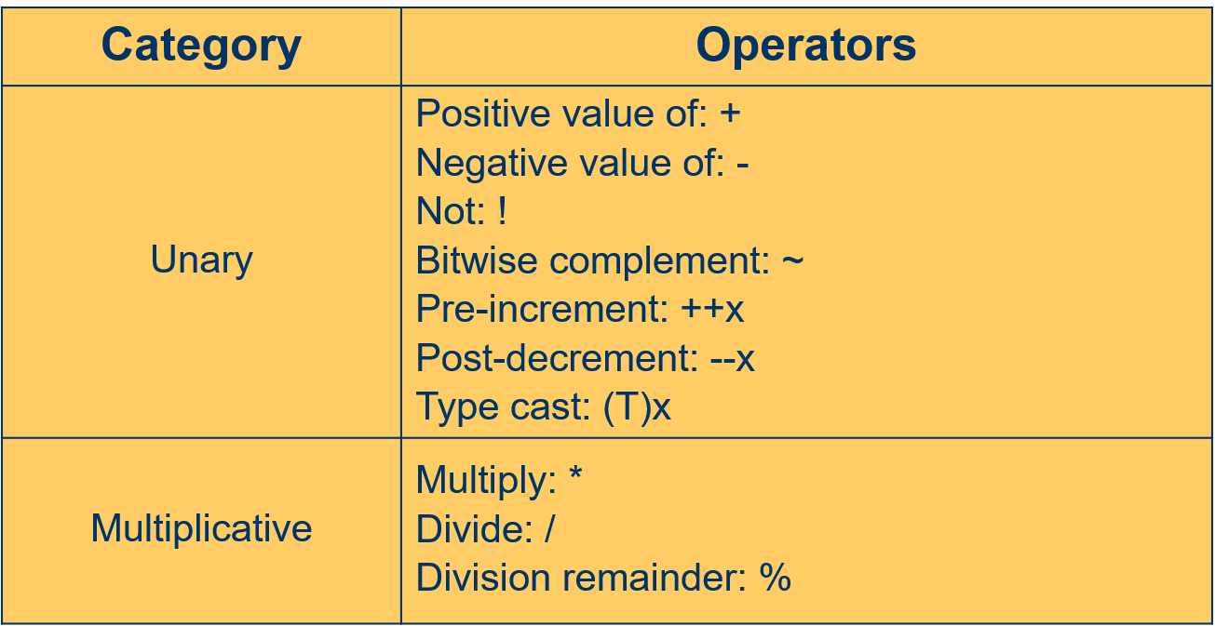
Operators - Precedence
www.arobs.com

Slide 35
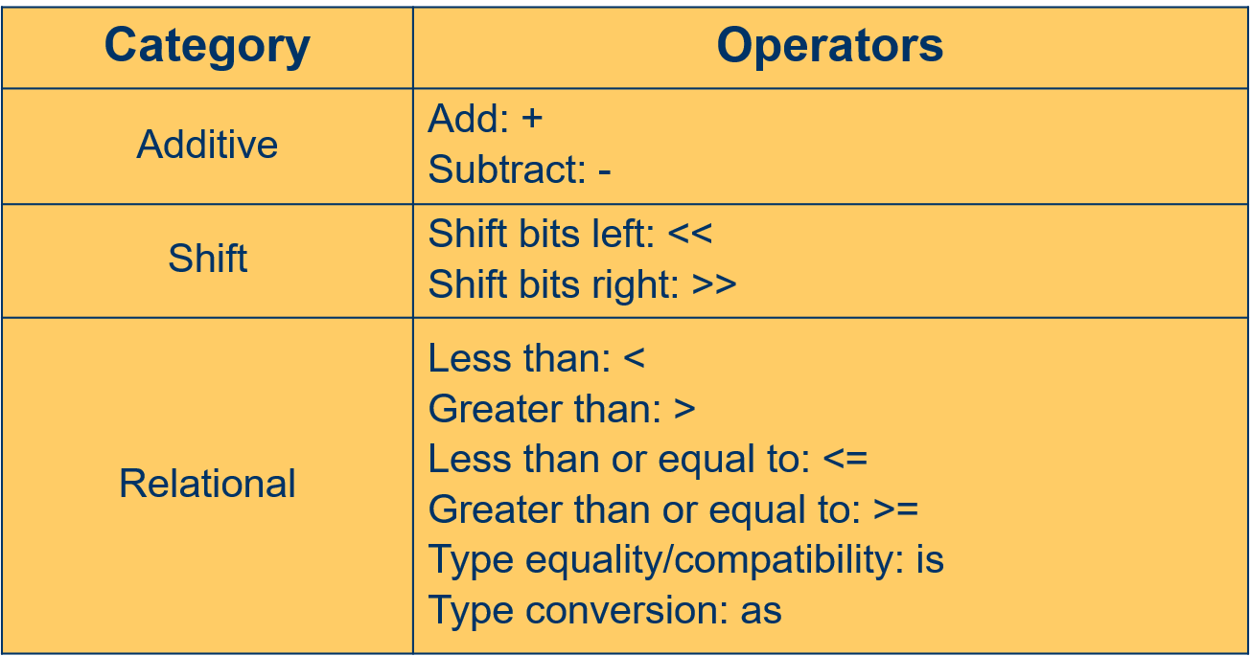
Operators - Precedence
www.arobs.com

Slide 36
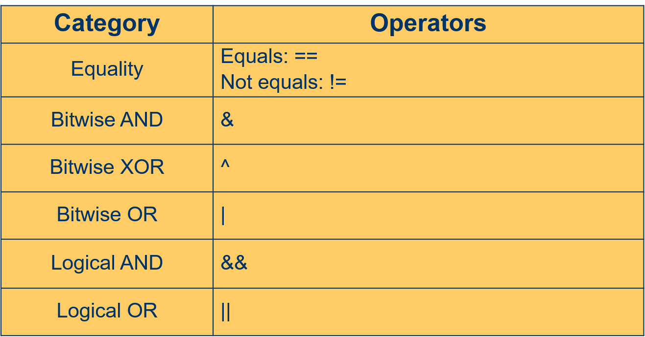
Operators - Precedence
www.arobs.com

Slide 37
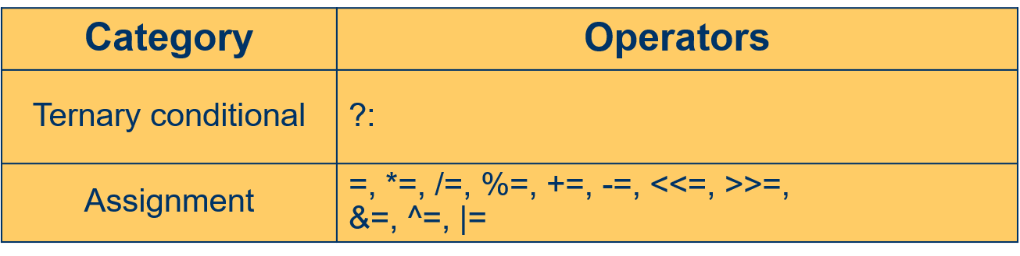
Operators - Precedence
www.arobs.com

Slide 38
Concepts Summary
In order to output something in c# we use Write() and WriteLine(), to get input from the user we user ReadLine(), Read() and ReadKey().
In c# there are Value types (cannot be null) and Reference types (may be null).
Boxing Copies a value type into a reference type, Unboxing is reverse operation of boxing.
Statements are terminated with a semicolon (;).
Block statements { ... } don’t need a semicolon.
The scope of a variable or constant runs from the point of declaration to the end of the enclosing block, and they must be assigned before they can be used.
Exceptions are the C# mechanism for handling unexpected error conditions.
www.arobs.com

Slide 39
Homework
Write a C# program to print the odd numbers from 1 to 99. Prints one number per line.
Write a shot program that reads a number n and than a list that contains n numbers. Find the minimum and maximum of this list and print it out on the console. Handle the cases when a different value than a number is added in the list, so the program doesn’t crash.
Write a C# Sharp program to find whether a given year is a leap year or not.
www.arobs.com

Slide 40
Useful links
Flow control – C# - http://zetcode.com/lang/csharp/flowcontrol/
Java - http://zetcode.com/lang/java/flow/
Reference and value types - http://www.albahari.com/valuevsreftypes.aspx
Boxing and unboxing - https://www.geeksforgeeks.org/c-sharp-boxing-unboxing/
Exception hierarchy – Java - https://airbrake.io/blog/java-exception-handling/the-java-exception-class-hierarchy
C# - https://airbrake.io/blog/dotnet-exception-handling/exception-class-hierarchy
www.arobs.com

Slide 41
Q&A
www.arobs.com

Slide 42




THANK YOU!
GET IN TOUCH
Vasile Dit
.NET Team Leader
+40 723 456 789
contact@arobs.com

