Slide 1



OBJECT-ORIENTED PROGRAMMING
INTRODUCTION AND BASIC CONCEPTS
www.arobs.com
Notes:
Welcome
Prezentare individuale
Asteptari de la training

Slide 2

Content
1. Definition and concepts
2. What is a class?
3. What is an object?
4. Inheritance
5. Polymorphism
6. Abstraction
7. Encapsulation
8. Concepts Summary
9. Homework
10. Useful links
www.arobs.com

Slide 3
Definition and concepts
Object-oriented programming (OOP) is a programming paradigm based upon objects that aims to incorporate the advantages of modularity and reusability.
Is a way to organize and conceptualize a program as a set of interacting objects.
It simplifies the software development and maintenance by providing some concepts:
Object
Class
Inheritance
Polymorphism
Abstraction
Encapsulation
www.arobs.com

Slide 4
What is a class?
A class is
a blueprint from which you can create an individual object.
the generic definition for a set of similar objects
i.e. Person as a generic definition for Jane, Mitch and Sue
a template used to create a set of objects
a static definition; a piece of code written in a programming language
Class-Object
Class- the pan
Object – the cake
www.arobs.com

Slide 5
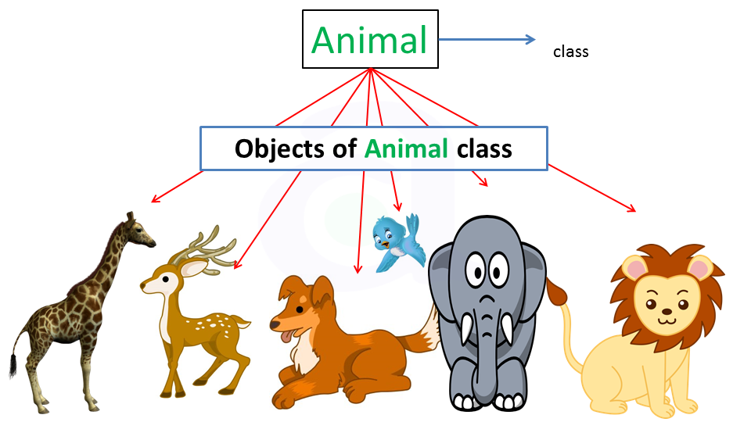
What is an object?
An object:
is an instance of a class
represents an entity in the real world that can be distinctly identified and that has attributes and behaviors
Each instance will have its own distinct set of attributes.
Every instance of the same class will have the same set of attributes;
every object has the same attributes but,
each instance will have its own distinct values for those attributes.
www.arobs.com
Notes:
Ce ii atributul
Ce ii behaviorul

Slide 6
Example
The "account" class describes the attributes and behaviors of bank accounts.
The “account” class defines two state variables (account number and balance) and two methods (deposit and withdraw).
Each instance will have its own account number and balance (object state)
Methods can only be invoked .
class: Account
number:
balance:
deposit()
Instance #1
Instance #2
Instance #3
withdraw()
number: 054
number: 712
number: 036
balance: $19
balance: $240
balance: $941
www.arobs.com

Slide 7
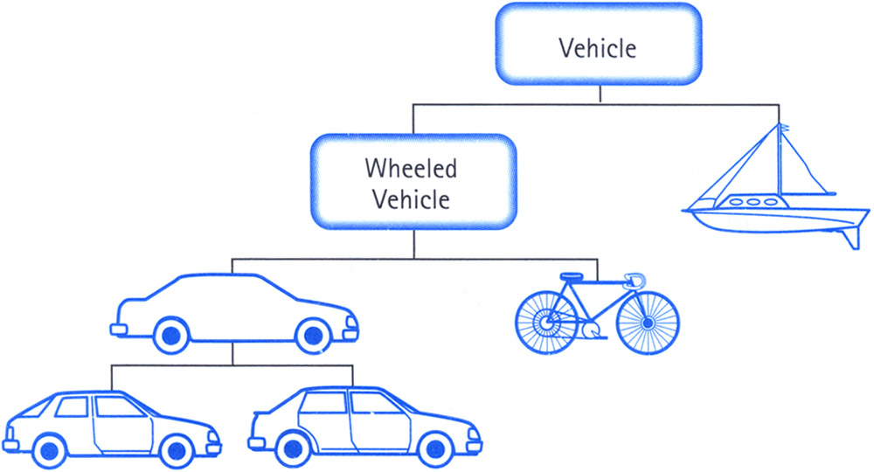
Inheritance
Allows new classes to be derived from pre-existing classes thereby reducing the need to what might be otherwise repeated code of one class in another.
Subclasses extend existing classes in three ways:
By defining new (additional) attributes and methods.
By overriding (changing the behavior) existing attributes and methods.
By hiding existing attributes and methods.
www.arobs.com

Slide 8
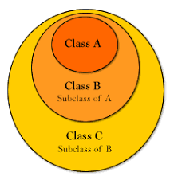
Example
Suppose we define SavingsAccount and CheckingAccount as two new subclasses of the Account class.
class SavingsAccount extends Account { method rate() {…} }
class Account { method acctNum() {…} method balance() {…} method deposit() {…} method withdraw() {…} }
class CheckingAccount extends Account { method withdraw() {…} }
www.arobs.com

Slide 9
Polymorphism
Polymorphism is one of the essential features of an object-oriented language; Polymorphism is a Greek word that means "many-shaped"
Forms of polymorphism:
True Polymorphism:
Same method signature defined for different classes with different behaviors (i.e. draw() for the Classes Circle and Square)
Parametric Polymorphism:
This is the use of the same method name within a class, but with a different signature (different parameters).
Overloading:
Refers to the ability to use a single identifier to define multiple methods of a class that differ in their input and output parameters.
Overriding:
This refers to the feature of subclasses that replace the behavior of a parent class with new or modified behavior.
www.arobs.com

Slide 10


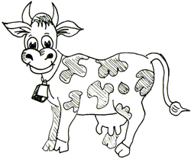
Example
Animal
makeSound()
Meow Woof Muuu
www.arobs.com

Slide 11
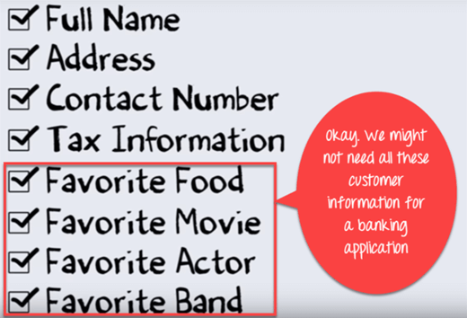
Abstraction
At a higher level, abstraction is a process of hiding the implementation details and showing only functionality to the user. It only indicates important things to the user and hides the internal details,
ie. While sending SMS, you just type the text and send the message. Here, you do not care about the internal processing of the message delivery.
www.arobs.com

Slide 12
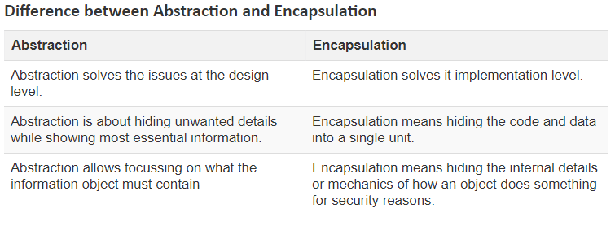
Encapsulation
Is the process of combining data and functions into a single unit called class.
Makes the data to be not accessed directly; it is accessed through the functions present inside the class. In simpler words, attributes of the class are kept private and public getter and setter methods are provided to manipulate these attributes.
Makes the concept of data hiding possible.
Visible Methods
Hidden State Variables and Methods
Visible Variables
Class Definition
www.arobs.com

Slide 13
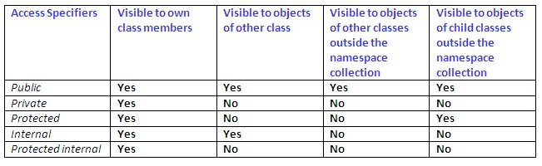
Access Modifiers
Access modifiers – keywords that define the level of accessibility of a class, the methods and the fields inside a class with other components
www.arobs.com

Slide 14
Concepts Summary
Object-oriented programming is a way of conceptualizing a program as groups of objects that interact with one another.
A class is a general template used to create objects.
An object is an instance of a class
The combination of collecting all the attributes of an object into a single class definition, combined with the ability to hide some definitions within the class, is known as encapsulation.
Inheritance allows classes to “inherit” attributes and methods from their base (parent) class. This provides a clean mechanism for code re-use and extension.
www.arobs.com

Slide 15
Homework
Try to get a good understanding about the concept presented in this session (more details can be found in the read materials from next slide)
Download and Install Visual Studio Community – link
Create a “Hello world” console application. - link
If you have any questions or you need help, please contact me!!! ☺
www.arobs.com

Slide 16
Useful links
Object-Oriented Programming (C#)
https://docs.microsoft.com/en-us/dotnet/csharp/programming-guide/concepts/object-oriented-programming
Java and C# comparison:
https://www.harding.edu/fmccown/java_csharp_comparison.html
Introduction to Object Oriented Programming Concepts in C#
https://www.c-sharpcorner.com/UploadFile/mkagrahari/introduction-to-object-oriented-programming-concepts-in-C-Sharp/
www.arobs.com

Slide 17
Q&A
www.arobs.com

Slide 18

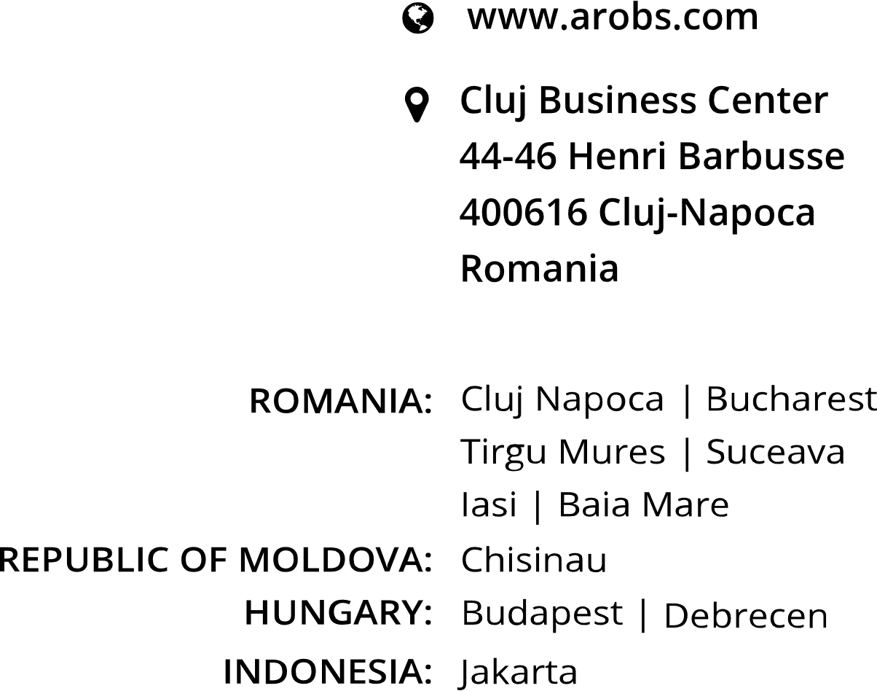


THANK YOU!
GET IN TOUCH
Vasile Dit
.NET Team Leader
+40 723 456 789
contact@arobs.com

