Slide 1
Binding LLM for TQA
Zhiwei Song, Wenjie Hu, Xincheng Xie
Notes:
Hi everyone! It’s a great pleasure to introduce our group project. The topic of our project is binding large language model for table question answering. Our team members are zhiwei song, wenjie hu and xincheng xie

Slide 2
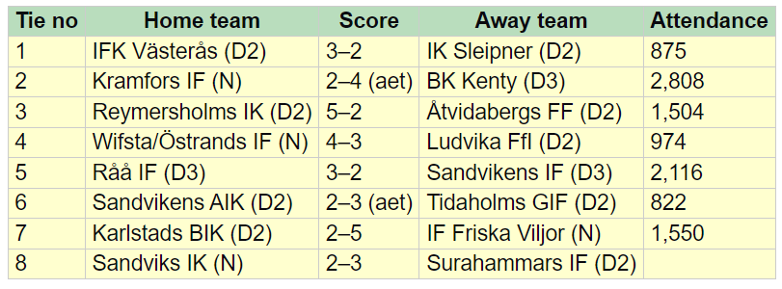
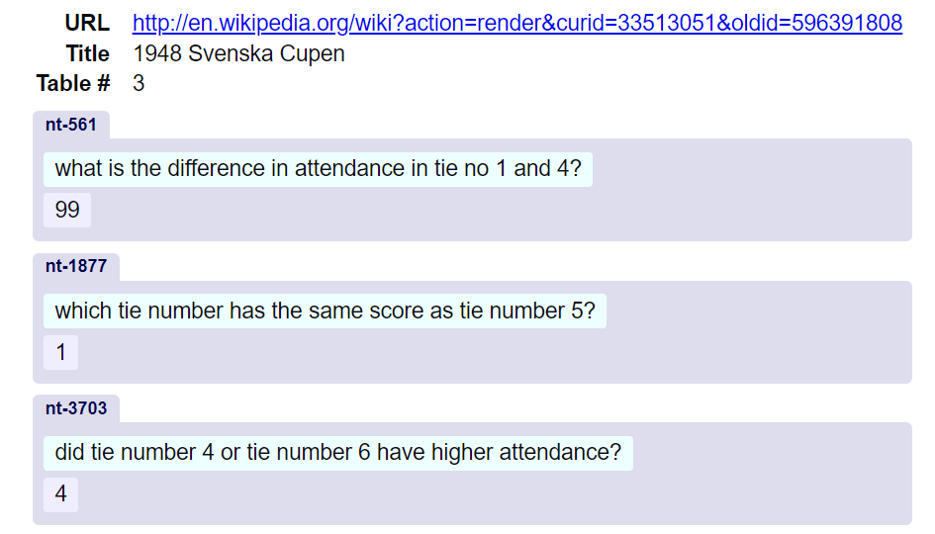
Task Description: Table-Question Answering
Input
Table (csv tables, html tables, etc.)
Question (questions related to the table)
Output: Answer
Notes:
Table question answering (TQA) is a type of natural language processing, which is used to generalize database utilization. In other words, users can ask questions in human language, and the TQA model will provide a correct response leveraging the information in databases. The whole model is a total black box to users.
the inputs are normally the tables with their schema and a question described in natural language. The expected output is the precise answer to the question. The example in the slide shows a table of matches with team info, scores and attendance. Several sample questions can be like what’s the difference in attendance in tie number 1 and 4? The correct answer is 99, which comes from 974 - 875
However, not every question can be as clear as the samples in this slide. Some questions can be vague and not be answered through searching tables.
Our motivation is to find a better method that can produce answers with higher precision using a shorter time.

Slide 3
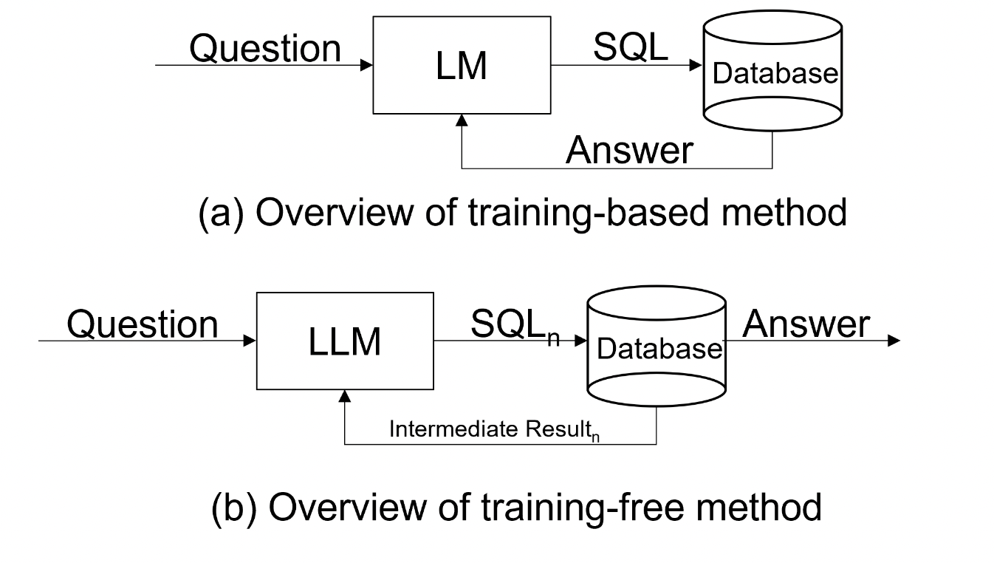
Existing Works
Two categories of existing approaches for TQA :
pre-training and finetuning a neural language model
e.g., TaPas(Herzig et al., 2020), Tapex(Liu et al., 2021)
employs a more generalized Language Learning Model (LLM)
e.g., Binder(Cheng et al., 2023)
Notes:
Generally, two types of methods are used to tackle TQA problems, shown in the Figure.
The initial approach involves pre-training and finetuning a neural language model to transform questions into SQL format. However, this method encounters challenges when dealing with complex datasets that cannot be solved by simple SQL searches. The second approach employs a more general- ized Language Learning Model, like chat- GPT. This approach addresses the issue mentioned above. These models operate through interaction with LLM with prompts and generates SQL as a result. However, to generate precise answers, this method requires frequent communication with the LLM, which can lead to considerable delays in response.

Slide 4
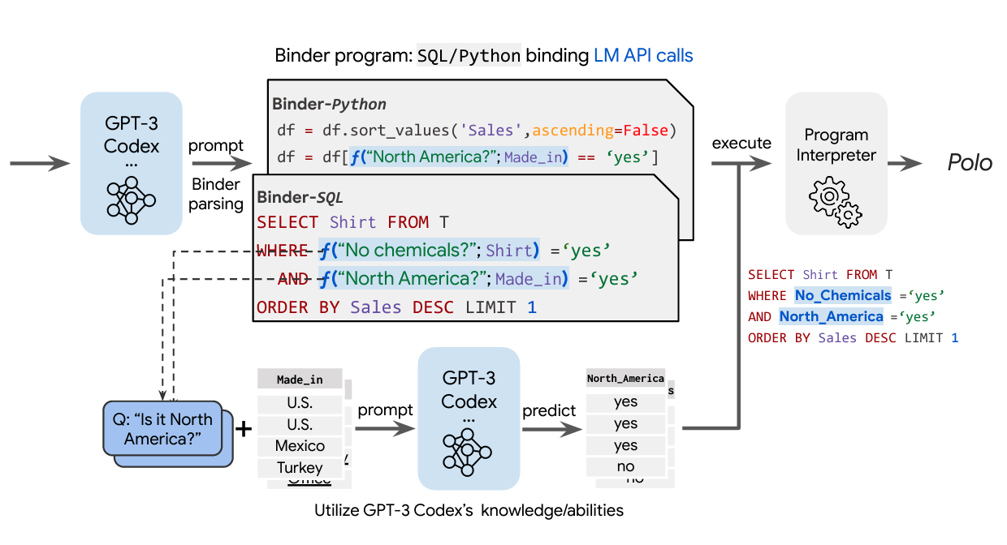
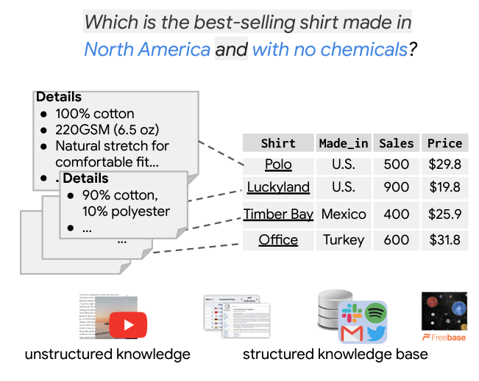
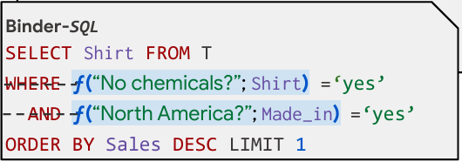
Existing Works -- Binder
Annotation Phase
Generate SQL with specialized functions via LLM.
Execution Phase
Execute SQL. When encountering the specialized functions, call LLM again with the table.
Binder program: SQL binding LM API calls
Zhoujun Cheng, Tianbao Xie, Peng Shi, Chengzu Li, Rahul Nadkarni, Yushi Hu, Caiming Xiong, Dragomir Radev, Mari Ostendorf, Luke Zettlemoyer, Noah A. Smith, and Tao Yu. 2023. Binding language models in symbolic languages
Notes:
We choose one state-of-the-art work, called Binder, as our primary baseline.
Binder(Cheng et al., 2023) is a representative work which use LLMs to generate SQL to query table data
An overview of the BINDER pipeline of two stages. (1) In the parsing stage, the language model maps the input to a BINDER program given the question and (optional) knowledge sources. The expressions with blue backgrounds in the program are LLM calls to acquire external results. (2) In the execution stage, LM realizes the API calls given the prompt and the return values feed back into the sql. A deterministic program interpreter executes the sql to generate the final answer

Slide 5
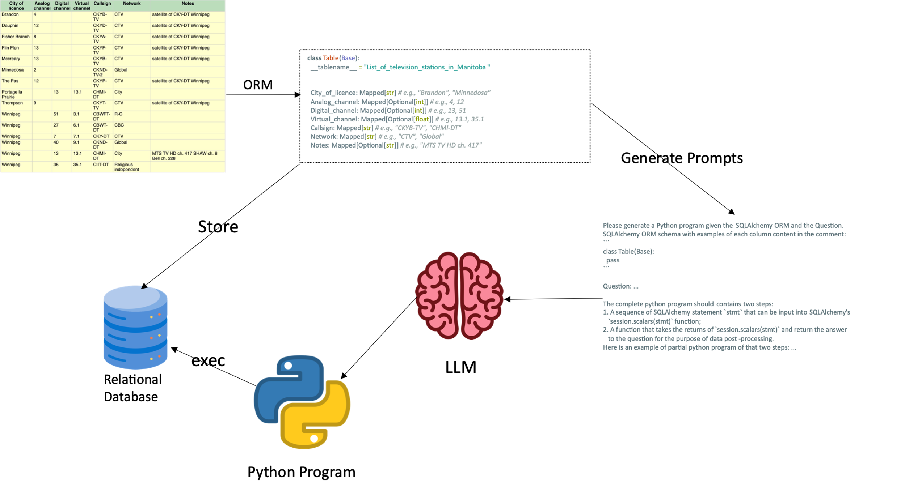
Our Design
Drawbacks of Binder
Additional Call to LLM with full table
Waste of cost & time
Inflexibility of SQL to complicate or vague queries
Affect Accuracy
Our method
Generate a Python program by prompting LLM
Run locally, eliminate the additional call, richer expression
Make use of Object Relational Mapper (ORM)
Combine high query performance of SQL and flexibility of Python
Notes:
However, here are several drawbacks of Binder. For example, it needs two rounds of LLM calls to generate the final SQL before executing sql, which can be a waste of time and costs. Besides, the expression of sql is restricted and not suitable for complicate queries or vague queries. The restrictions and inflexibility of sql can even affect accuracy especially for fuzzy queries and tables with dirty data.
We propose a method with a single call of LLM for each TQA. The essential idea is to generate a python program by prompting. This method can eliminate the additional LLM calls. A key technique to enable this method is to leverage ORM, which is object relational mapper. It can extend the table query to accommodate Python queries.
Specifically, We utilize SQLAlchemy as the ORM library. This allows us to create standardized Python-style code, bypassing the SQL.

Slide 6
Details
Data pre-processing
Use pandas to read HTML/CSV tables and guess types (str, float, int)
Generate SQLAlchemy Class and Create tables
Call LLM to generate a program
Prompt: (1) Database schema; (2) Samples of the table; (3) The Question; (4) Instructions on how to generate the program
Parse the message of LLM and execute
Extract the necessitated functions from the message
Execute the string functions via `exec` in Python
Notes:
Our pipeline is composed of three major parts. We describe these steps in details.
Preprocessing: We store each CSV file as a database table. Smaller tables are loaded into memory for speed, while larger ones use SQLite for disk storage. Python is crucial in determining data types, and enhancing our Language Learning Model's (LLM) efficiency. This step uses pandas to read cvs tables, infer data types, and then generate SQLAlchemy class.
Parsing and Python Generation: Using a few-shot learning, we convert user queries into a python program. The LLM receives structured prompts, including the table schema and sample column data.
LLM Output Execution: The final step involves executing the Python program from the LLM's output using the exec command

Slide 7
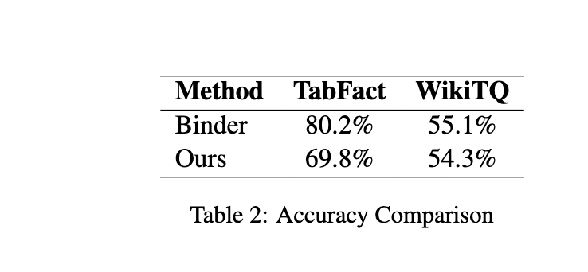
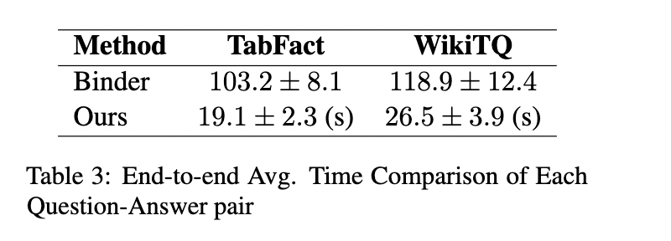
Results and Analysis
Accuracy
Our method performs at about 10% below Binder on TabFact and 1% less on WikiTQ
Time
Our method has a significant promotion, requiring approximately 4-6x less time than the Binder
Notes:
For accuracy, Our method performs at about 10% below the Binder on TabFact and 1% less on WikiTQ. There are several reasons behind this phenomenon. The primary reason is that due to time constraints and a limited cost budget, we decided not to use a large value for the top-K voting algorithm. Specifically, we used a K of 3, while Binder uses 10. This leads to less variation for Binder.
Other reasons stem from the poor quality of code produced by the LLM and the absence of background knowledge.
From the perspective of time, we have a significant advantage, requiring approximately 4-6x less time than the Binder. That’s because our method only requires a single round of LLM calls, whereas Binder needs at least two rounds of LLM calls.

Slide 8
Limitations and Future Directions
Both WikiTQA and TabFact mainly limit their questions to one table
Unable to test complex SQL operations such as Join
SQL query is underutilized
Tables of the datasets have a limited number of records
It is impossible for Binder to be run under numerous records
SQL query is not fully used
Tables of the datasets restricted to Structured Data
With the prevalence of Data Lake, data sources become more diverse, e.g., semi-structured data (JSON, YAML) and unstructured data

Slide 9
Thank You

Slide 10
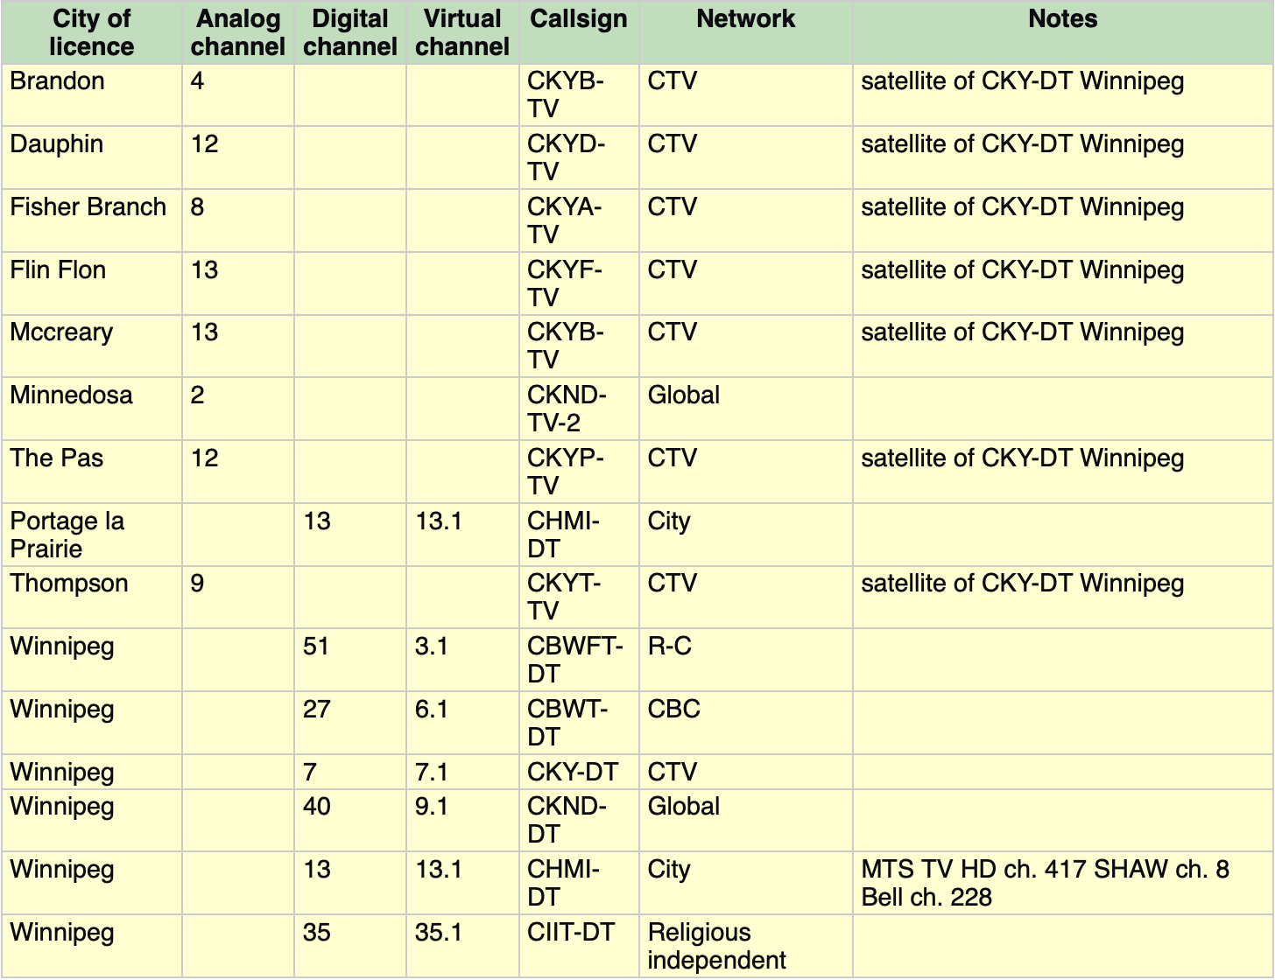



class Table(Base):
__tablename__ = "List_of_television_stations_in_Manitoba"
City_of_licence: Mapped[str] # e.g., "Brandon", "Minnedosa"
Analog_channel: Mapped[Optional[int]] # e.g., 4, 12
Digital_channel: Mapped[Optional[int]] # e.g., 13, 51
Virtual_channel: Mapped[Optional[float]] # e.g., 13.1, 35.1
Callsign: Mapped[str] # e.g., "CKYB-TV", "CHMI-DT"
Network: Mapped[str] # e.g., "CTV", "Global"
Notes: Mapped[Optional[str]] # e.g., "MTS TV HD ch. 417"
ORM
Generate Prompts
Store
Please generate a Python program given the SQLAlchemy ORM and the Question.
SQLAlchemy ORM schema with examples of each column content in the comment:
```
class Table(Base):
pass
```
Question: ...
The complete python program should contains two steps:
1. A sequence of SQLAlchemy statement `stmt` that can be input into SQLAlchemy's
`session.scalars(stmt)` function;
2. A function that takes the returns of `session.scalars(stmt)` and return the answer
to the question for the purpose of data post-processing.
Here is an example of partial python program of that two steps: ...
exec
LLM
Relational Database
Python Program

