Slide 1
Azure Key Vault
Azure Key Vault i .NET Core

Slide 2
Sadržaj
O predavaču
Šta je Azure Key Vault
O bezbednosti aplikacija
Integracija sa .NET Core aplikacijama (demo)
Deployment i konfigurisanje App servisa i Key Vault-a (demo)
Iskustva iz development procesa
Cena
QA

Slide 3


O predavaču:
Software craftsman (I wish)
Dev-ops (TeamCity, Azure devops)
4 godine Azure iskustva
App service, Key vault, Azure Service Bus, Redis, Docker, Azure Sql server, Azure search…
14 godina Microsoft .NET
Osnivač
Nisam predavač

Slide 4
Šta je Azure Key Vault
Microsoft Cloud servis za čuvanje tajni (ključevi, tajne, sertifikati)
Nema održavanja HSM i softvera za upravljanje kjučevima
Potpuna kontrola:
access policies
monitoring
notifications
Kako se čuvaju tajne:
hardware security modules (HSMs)
Microsoft ne vidi niti može da izvuče ključeve
Performanse i globalno skaliranje

Slide 5
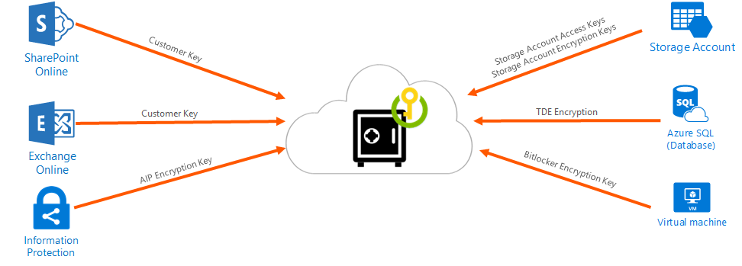
Upravljanje ključevima
Notes:
Create and control encryption keys that encrypt your data.

Slide 6
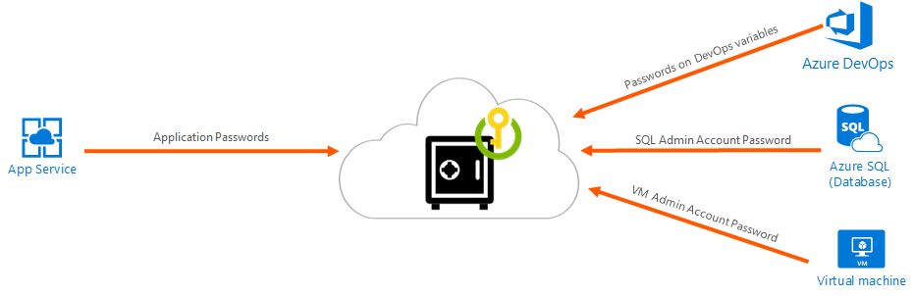
Upravljanje tajnama
Notes:
Securely store and tightly control access to tokens, passwords, certificates, API keys, and other secrets.

Slide 7
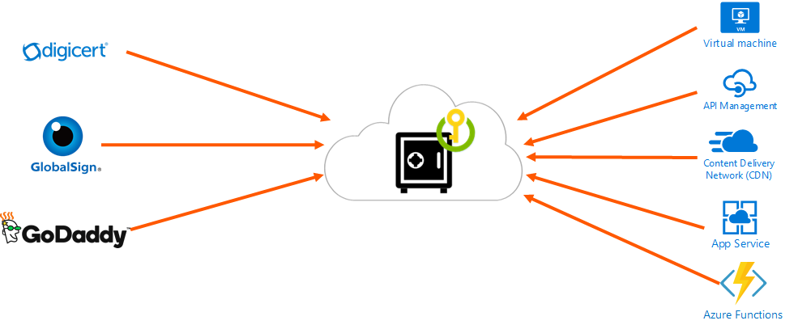
Upravljanje sertifikatima
Notes:
Provision, manage, and deploy public and private Secure Sockets Layer/Transport Layer Security (SSL/TLS) certificates for use with Azure and your internal connected resources.

Slide 8
Osnovni principi bezbednosti

Slide 9
Čija je odgovornost bezbednost aplikacija

Slide 10
Two content layout with table
First bullet point here
Second bullet point here
Third bullet point here
Class | Group 1 | Group 2
Class 1 | 82 | 95
Class 2 | 76 | 88
Class 3 | 84 | 90

Slide 12
Title and content layout with SmartArt
Step 1 Title
Task description
Step 2 Title
Task description
Step 3 Title
Task description

Slide 13
Add a Slide Title - 1

Slide 14
Add a Slide Title - 2

Slide 15
Add a Slide Title – 3

Slide 17
Add a Slide Title - 5

