Slide 1
Azure Key Vault
Azure Key Vault i .NET Core

Slide 2

Sadržaj
O predavaču
Šta je Azure Key Vault
O bezbednosti aplikacija na cloud-u
Integracija sa .NET Core aplikacijama (demo)
Deployment i konfigurisanje App servisa i Key Vault-a (demo)
Najbolja praksa
Cena
QA

Slide 3

O predavaču:
Software craftsman (I wish)
Dev-ops (TeamCity, Azure devops)
4 godine Azure iskustva
App service, Key vault, Azure Service Bus, Redis, Docker, Azure Sql server, Azure search…
14 godina Microsoft .NET
Osnivač
Nisam predavač

Slide 4
Šta je Azure Key Vault
Alat za čuvanje tajni (ključevi, tajne, sertifikati)
Potpuna kontrola:
access policies with RBAC
monitoring
notifications
Kako se čuvaju tajne:
hardware security modules (HSMs)
Microsoft ne vidi niti može da izvuče ključeve
Nema održavanja HSM i softvera za upravljanje kjučevima
Performanse i globalno skaliranje
Notes:
Alat – cloud servis, Microsoft, sertifikovan
Kontrola-
Access to a key vault is controlled through two interfaces: the management plane and the data plane. The management plane is where you manage Key Vault itself. Operations in this plane include creating and deleting key vaults, retrieving Key Vault properties, and updating access policies. The data plane is where you work with the data stored in a key vault. You can add, delete, and modify keys, secrets, and certificates.

Slide 5
Osnovna terminologija
Tenant
Vault owner
Vault consumer
Resource
Resource Group
Service principal
Azure tenant ID
Managed Identities
Notes:
Tenant: A tenant is the organization that owns and manages a specific instance of Microsoft cloud services. It's most often used to refer to the set of Azure and Office 365 services for an organization.
Vault owner: A vault owner can create a key vault and gain full access and control over it. The vault owner can also set up auditing to log who accesses secrets and keys. Administrators can control the key lifecycle. They can roll to a new version of the key, back it up, and do related tasks.
Vault consumer: A vault consumer can perform actions on the assets inside the key vault when the vault owner grants the consumer access. The available actions depend on the permissions granted.
Resource: A resource is a manageable item that's available through Azure. Common examples are virtual machine, storage account, web app, database, and virtual network. There are many more.
Resource group: A resource group is a container that holds related resources for an Azure solution. The resource group can include all the resources for the solution, or only those resources that you want to manage as a group. You decide how you want to allocate resources to resource groups, based on what makes the most sense for your organization.
Service principal: An Azure service principal is a security identity that user-created apps, services, and automation tools use to access specific Azure resources. Think of it as a "user identity" (username and password or certificate) with a specific role, and tightly controlled permissions. A service principal should only need to do specific things, unlike a general user identity. It improves security if you grant it only the minimum permission level that it needs to perform its management tasks.
Azure Active Directory (Azure AD): Azure AD is the Active Directory service for a tenant. Each directory has one or more domains. A directory can have many subscriptions associated with it, but only one tenant.
Azure tenant ID: A tenant ID is a unique way to identify an Azure AD instance within an Azure subscription.
Managed identities: Azure Key Vault provides a way to securely store credentials and other keys and secrets, but your code needs to authenticate to Key Vault to retrieve them. Using a managed identity makes solving this problem simpler by giving Azure services an automatically managed identity in Azure AD. You can use this identity to authenticate to Key Vault or any service that supports Azure AD authentication, without having any credentials in your code. For more information, see the following image and the overview of managed identities for Azure resources.

Slide 6
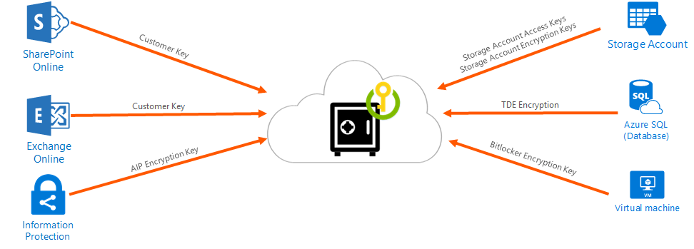
Upravljanje ključevima
Notes:
Create and control encryption keys that encrypt your data.

Slide 7
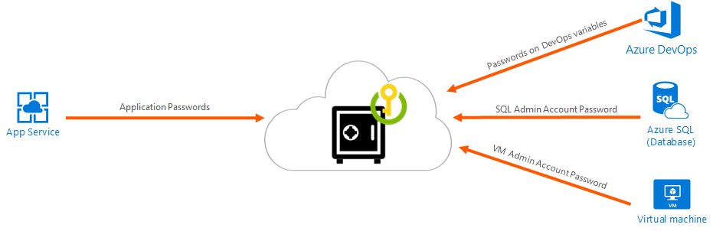
Upravljanje tajnama
Notes:
Securely store and tightly control access to tokens, passwords, certificates, API keys, and other secrets.

Slide 8
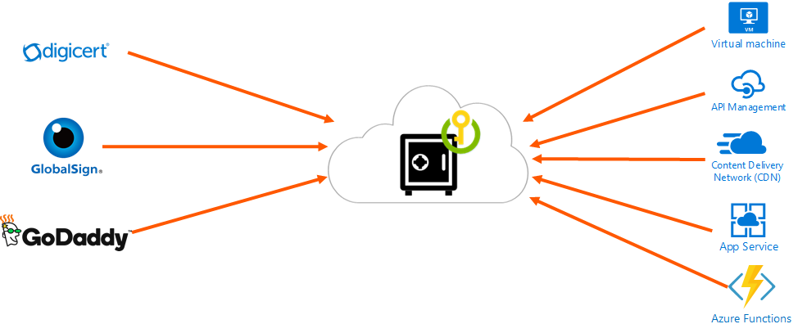
Upravljanje sertifikatima
Notes:
Provision, manage, and deploy public and private Secure Sockets Layer/Transport Layer Security (SSL/TLS) certificates for use with Azure and your internal connected resources.

Slide 9
Cloud bezbednost
Gartner predictions:
Through 2025, 90% of the organizations that fail to control public cloud use will inappropriately share sensitive data
Through 2024, the majority of enterprises will continue to struggle with appropriately measuring cloud security risks
Through 2025, 99% of cloud security failures will be the customer’s fault
Notes:
CIOs need to ensure their security teams are not holding back cloud initiatives with unsubstantiated cloud security worries. Exaggerated fears can result in lost opportunity and inappropriate spending.
Data breaches occur due to targeted attacks, human errors, application vulnerabilities, or poor security practices. A majority of breaches in the cloud have been reported due to misconfigurations from the user’s end that lead to SQL injection, brute force attacks, etc. These data breaches were never a cloud provider’s fault!

Slide 10
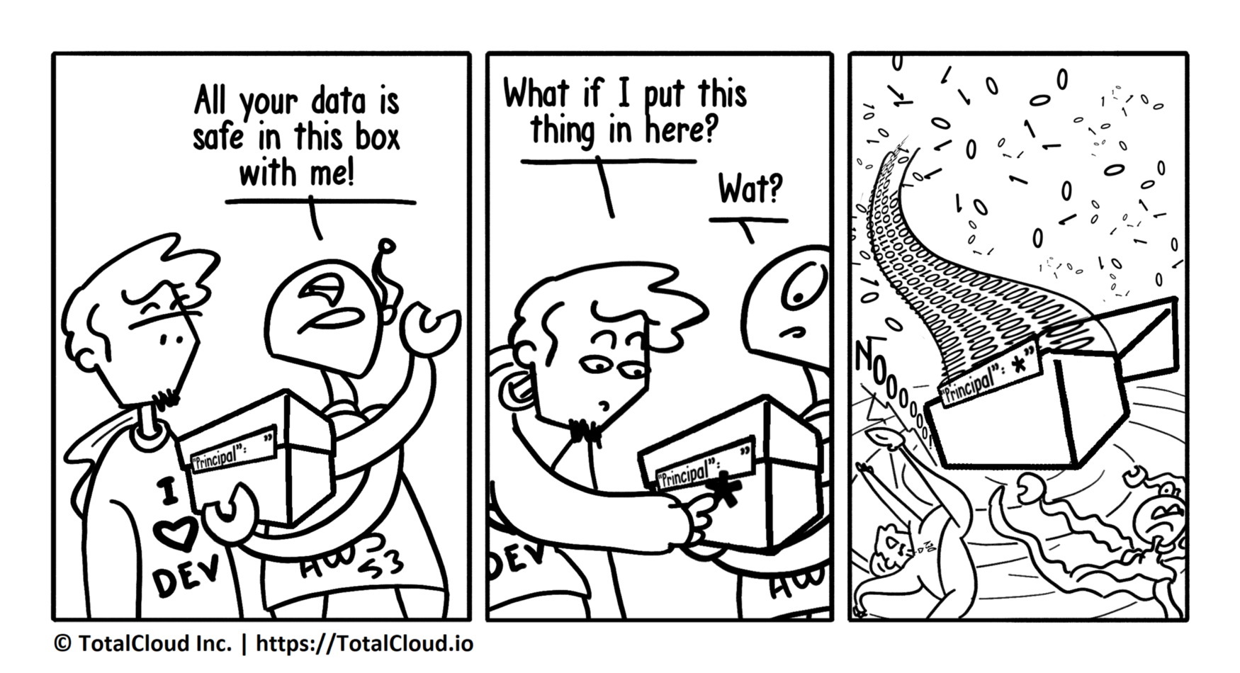
Ko je odgovoran za bezbednost aplikacije?
Notes:
Svih
Klijent
Product owners
Testeri
Developeri
Ko popravlja stetu
Developeri
https://arstechnica.com/information-technology/2020/06/machine-learning-clusters-in-azure-hijacked-to-mine-cryptocurrency/
https://securityboulevard.com/2020/01/microsoft-leaks-250m-customer-details-in-azure-fat-finger-faux-pas/
We want to be transparent about this incident with all customers and reassure them that we are taking it very seriously and holding ourselves accountable. … Upon notification of the issue, engineers remediated the configuration on December 31.

Slide 11
Ko popravlja sigurnosne probleme?
[referenca na dogadjaj]
Management: “We want to be transparent about this incident with all customers and reassure them that we are taking it very seriously and holding ourselves accountable”
Engineer on New Year’s eve: [ubaci ovde sliku]
Notes:
CIOs need to ensure their security teams are not holding back cloud initiatives with unsubstantiated cloud security worries. Exaggerated fears can result in lost opportunity and inappropriate spending.
Data breaches occur due to targeted attacks, human errors, application vulnerabilities, or poor security practices. A majority of breaches in the cloud have been reported due to misconfigurations from the user’s end that lead to SQL injection, brute force attacks, etc. These data breaches were never a cloud provider’s fault!
https://arstechnica.com/information-technology/2020/06/machine-learning-clusters-in-azure-hijacked-to-mine-cryptocurrency/
https://securityboulevard.com/2020/01/microsoft-leaks-250m-customer-details-in-azure-fat-finger-faux-pas/
We want to be transparent about this incident with all customers and reassure them that we are taking it very seriously and holding ourselves accountable. … Upon notification of the issue, engineers remediated the configuration on December 31.

Slide 12
Integracija sa .NET Core aplikacijama
demo
Notes:
CIOs need to ensure their security teams are not holding back cloud initiatives with unsubstantiated cloud security worries. Exaggerated fears can result in lost opportunity and inappropriate spending.
Data breaches occur due to targeted attacks, human errors, application vulnerabilities, or poor security practices. A majority of breaches in the cloud have been reported due to misconfigurations from the user’s end that lead to SQL injection, brute force attacks, etc. These data breaches were never a cloud provider’s fault!
https://arstechnica.com/information-technology/2020/06/machine-learning-clusters-in-azure-hijacked-to-mine-cryptocurrency/
https://securityboulevard.com/2020/01/microsoft-leaks-250m-customer-details-in-azure-fat-finger-faux-pas/
We want to be transparent about this incident with all customers and reassure them that we are taking it very seriously and holding ourselves accountable. … Upon notification of the issue, engineers remediated the configuration on December 31.

Slide 13
Najbolja praksa
Kontrola pristupa vault-u
Različit Key Vault po okruženju (Dev, Acc, Prod)
Backup
Uključiti Logging
Uključiti recovery options
Podesiti isticanje trajanja ključeva
Notes:
Control Access to your vault
Lock down access to your subscription, resource group and Key Vaults (RBAC)
Create Access policies for every vault
Use least privilege access principal to grant access
Turn on Firewall and VNET Service Endpoints
Use separate Key Vault
Our recommendation is to use a vault per application per environment (Development, Pre-Production and Production).
This helps you not share secrets across environments and also reduces the threat in case of a breach.
Backup
Make sure you take regular back ups of your vault on update/delete/create of objects within a Vault.
Turn on Logging
Turn on logging for your Vault. Also set up alerts.
Turn on recovery options
Turn on Soft Delete.
Turn on purge protection if you want to guard against force deletion of the secret / vault even after soft-delete is turned on.

Slide 14
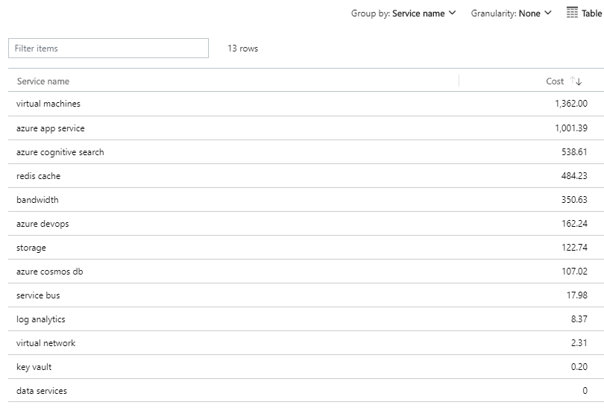
Cena

Slide 15
Kraj
Nema izgovora, vaš je posao da čuvate osetljive podatke na bezbedan način
Pitanja?
Izvorni kod, skripte i prezentacija: GitHub
Kontakt: srdjan.zivojinovic@crafters.cloud

