Slide 1


Here's your outline to get started
Key facts about your topic
In meteorology, a cloud is an aerosol consisting of a visible mass of minute liquid droplets, frozen crystals, or other particles suspended in the atmosphere of a planetary body or similar space. Water or various other chemicals may compose the droplets and crystals. On Earth, clouds are formed as a result of saturation of the air when it is cooled to its dew point, or when it gains sufficient moisture from an adjacent source to raise the dew point to the ambient temperature.
See more: Open the Notes below for more information.
Notes:
QuickStarter has created an outline to help you get started on your presentation. Some slides include information here in the notes to provide additional topics for you to research.

Slide 2
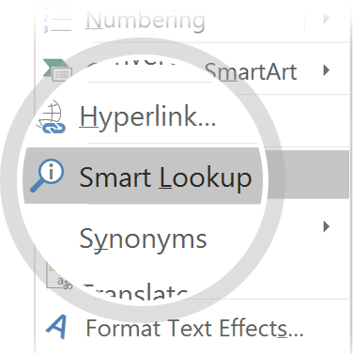
Related topics to research
Cirrus
Weather
Lightning
Kelvin–Helmholtz instability
International Cloud Atlas
Cloud atlas
Use Smart Lookup to learn more
1
Highlight one of the related topics
Right-click on the topic
Choose "Smart Lookup"
2
3

Slide 3

Cloud

Slide 4
Contents
Etymology and history of cloud science and nomenclature
Formation in the homosphere: How air becomes saturated
Classification: How clouds are identified in the troposphere
Distribution: Where tropospheric clouds are most and least prevalent
Luminance, reflectivity, and coloration
Effects on the troposphere, climate, and climate change
Polar stratospheric
Polar mesospheric
Extraterrestrial
In culture and religion

Slide 5
Etymology and history of cloud science and nomenclature
Look in the slide notes below for topics to consider talking about
Notes:
Consider talking about:
Etymology
Aristotle
First comprehensive classification

Slide 6
Formation in the homosphere: How air becomes saturated
Look in the slide notes below for topics to consider talking about
Notes:
Consider talking about:
Adiabatic cooling
Non-adiabatic cooling
Adding moisture to the air

Slide 7
Classification: How clouds are identified in the troposphere
Look in the slide notes below for topics to consider talking about
Notes:
Consider talking about:
Physical forms
Levels and genera
Species and varieties
Accessory clouds, supplementary features, and other derivative types

Slide 8
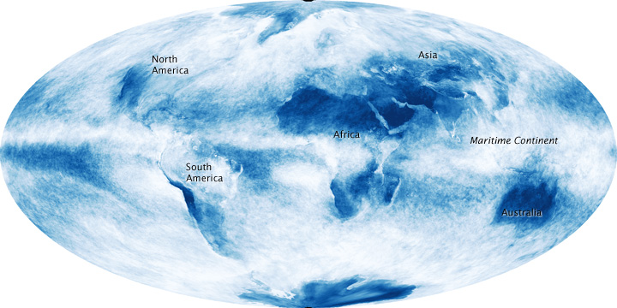
Distribution: Where tropospheric clouds are most and least prevalent
Look in the slide notes below for topics to consider talking about
Notes:
Consider talking about:
Convergence along low-pressure zones
Divergence along high pressure zones

Slide 9
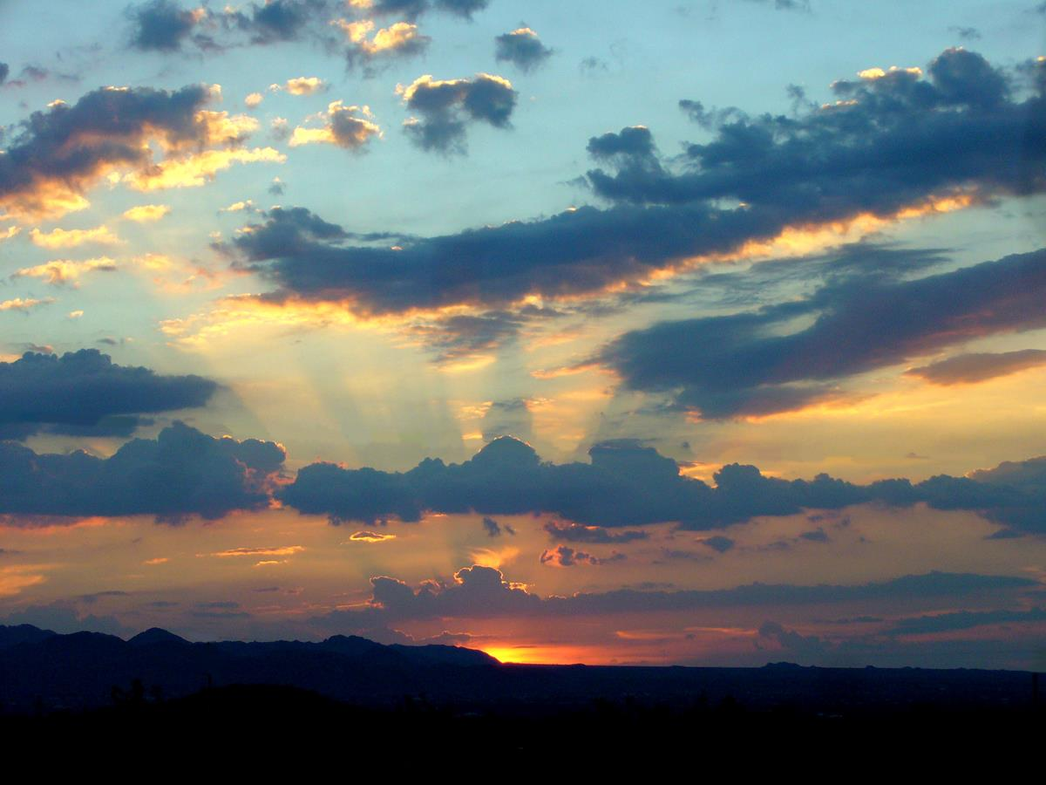
Luminance, reflectivity, and coloration

Slide 10

Effects on the troposphere, climate, and climate change

Slide 11
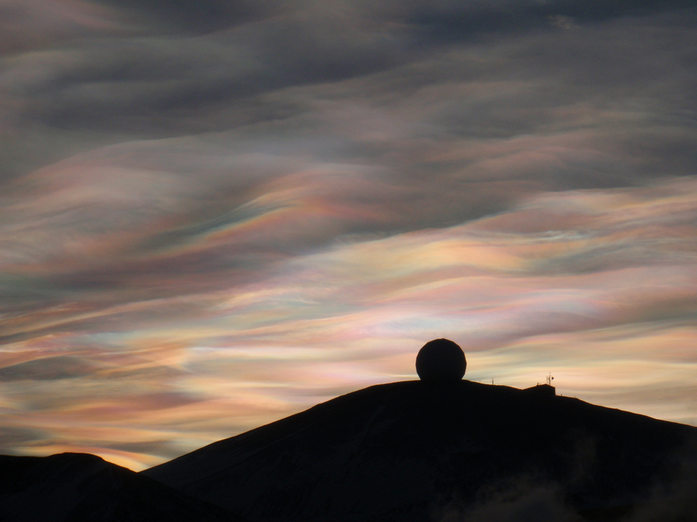
Polar stratospheric

Slide 12
Polar mesospheric

Slide 13
Extraterrestrial

Slide 14
In culture and religion

Slide 15
Works cited

