Slide 1
Multimodal-driven Talking Face Generation via a Unified Diffusion-based Generator

Slide 2
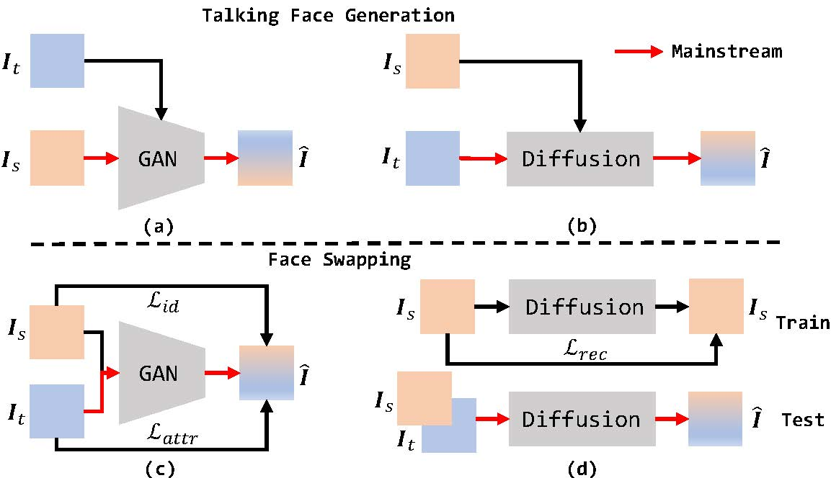

Slide 3
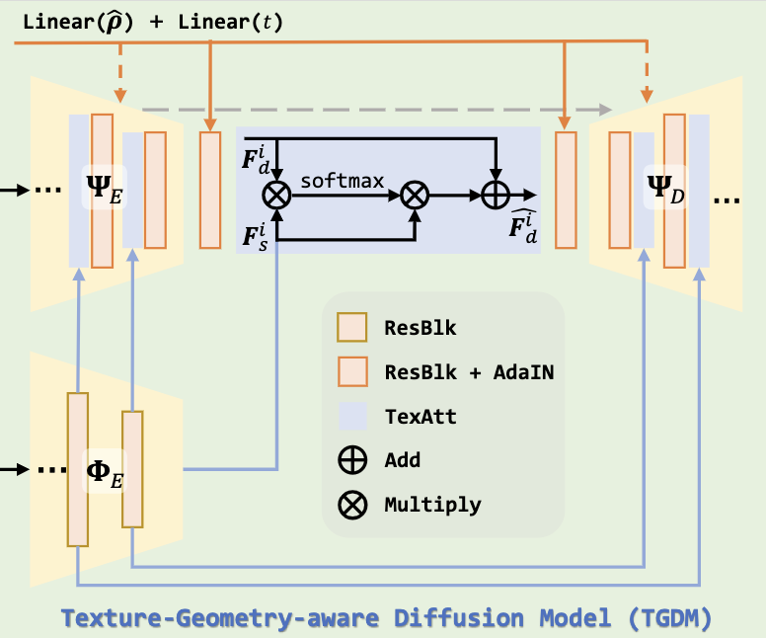

Slide 4
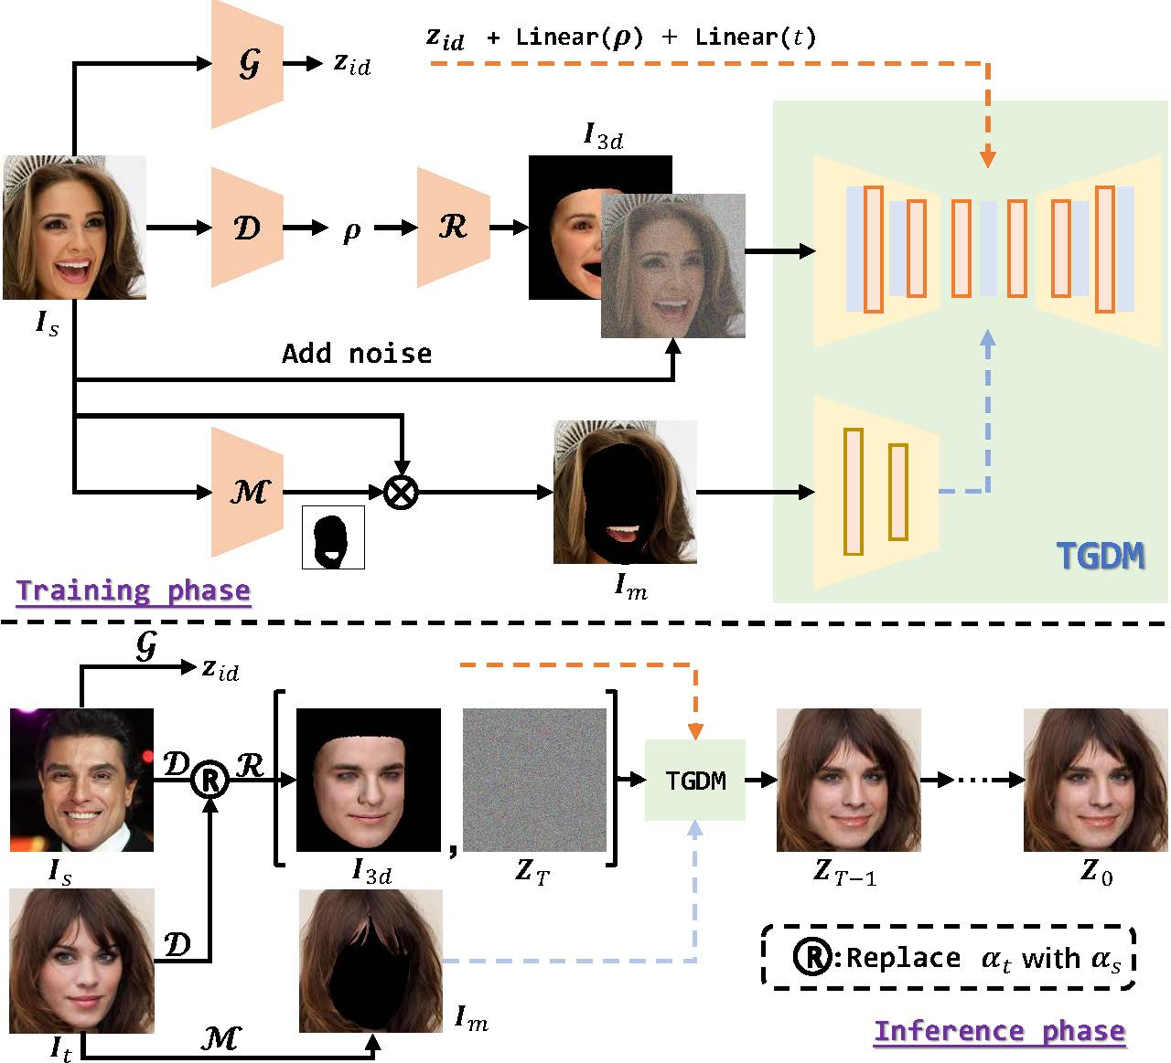

Slide 5
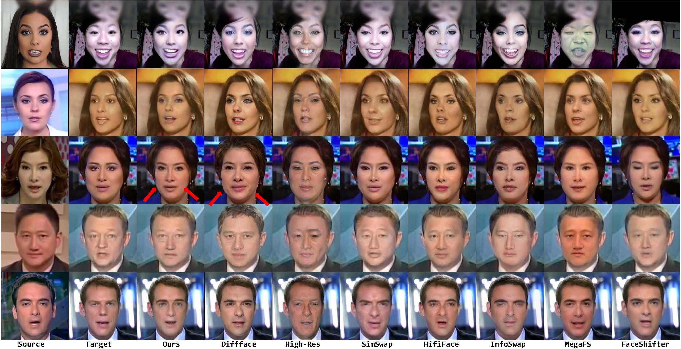

Slide 6
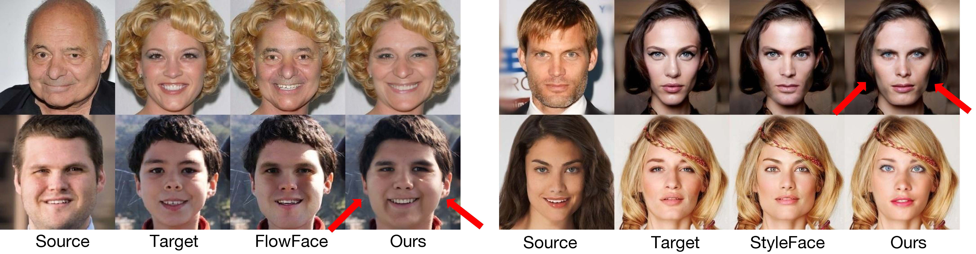
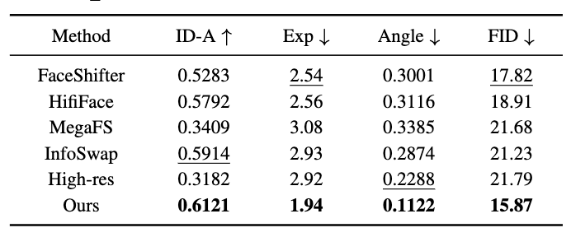
Our method can handle face shape changes, while remains high quality.

Slide 7
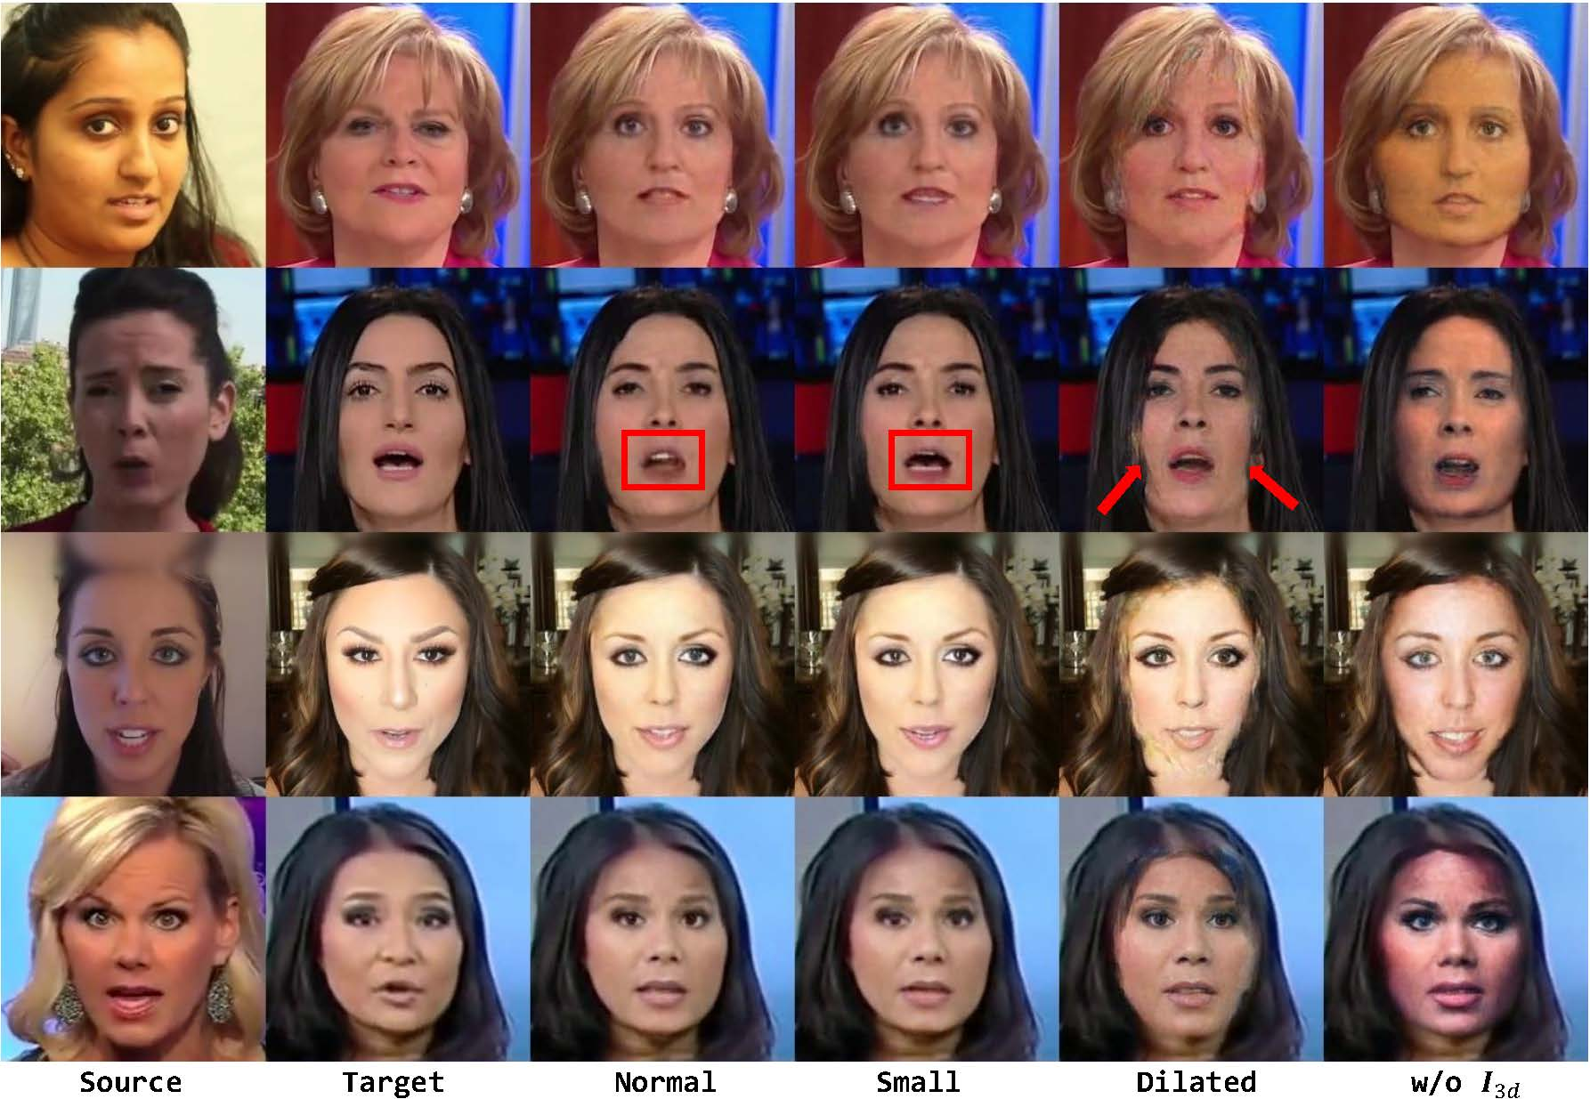
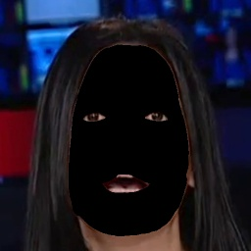


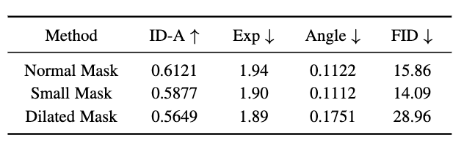
small mask
normal mask
dilated mask
Small Mask is the best

Slide 8
Limitations
Our method retains some disadvantages of the diffusion model. For example, it takes about 30 seconds to generate a single face under the T = 1000 DDPM setting, which is unacceptable in the real application. We also do not train the model for a longer time, considering the high consumption of diffusion model. For efficiency, our model only support 256 × 256 image generation. Although DDIM and LDMs have alleviated the above problems, we hope to propose an intuitive design like StyleGAN to allow efficient high-resolution face generation

