Slide 1
Optimizing quantile function

Slide 2
Optimizing for bad cases

Slide 3
Smoothed quantile function

Slide 4
Smoothed quantile function

Slide 5
Solving the lower optimization problem
Can save computing by storing this

Slide 6
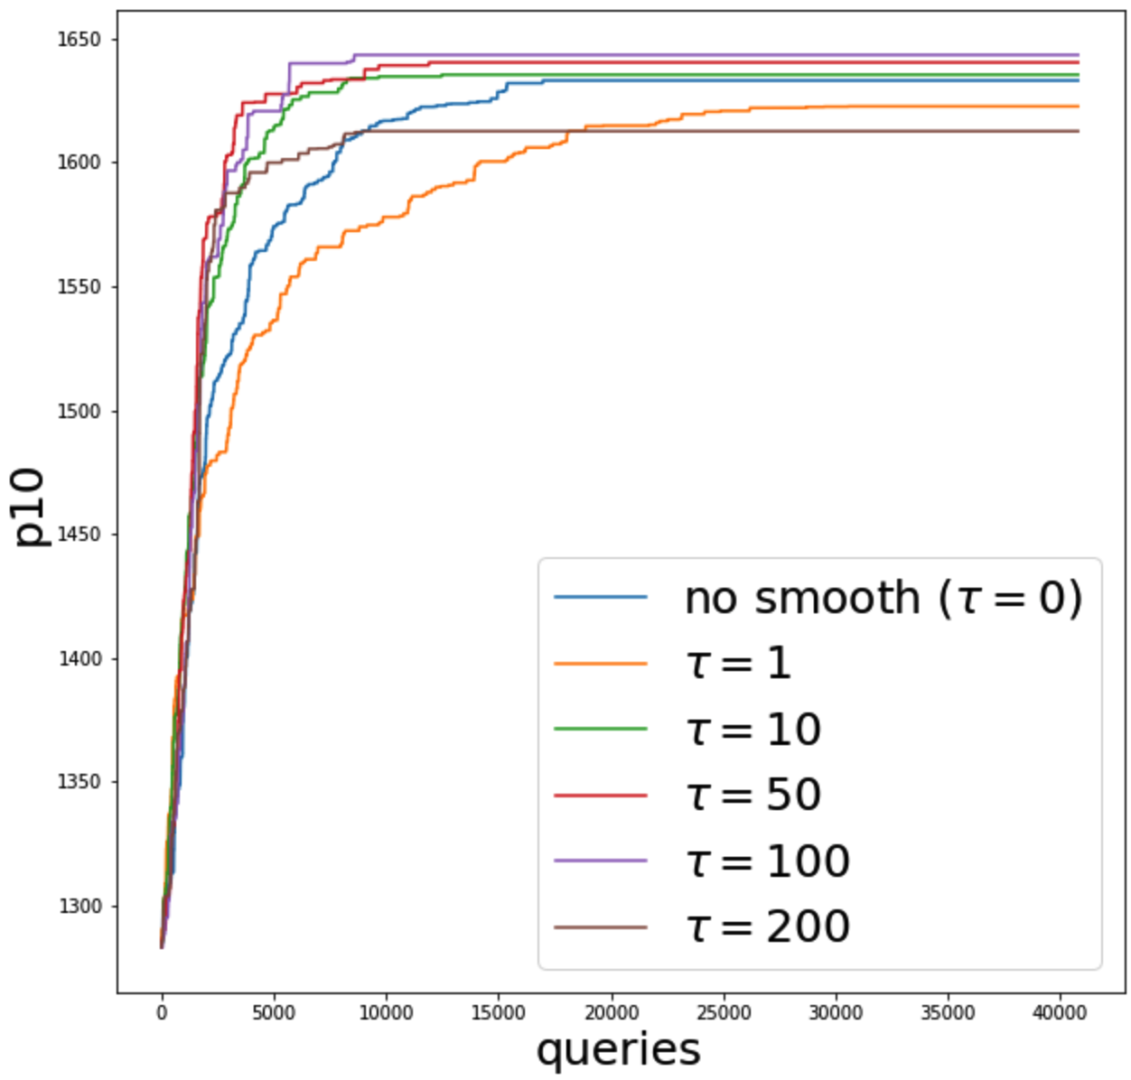
Results
Algorithm: Coordinate Ascent.
Using properly smoothed objective can lead to better p10.
Computation Time:

