Slide 1
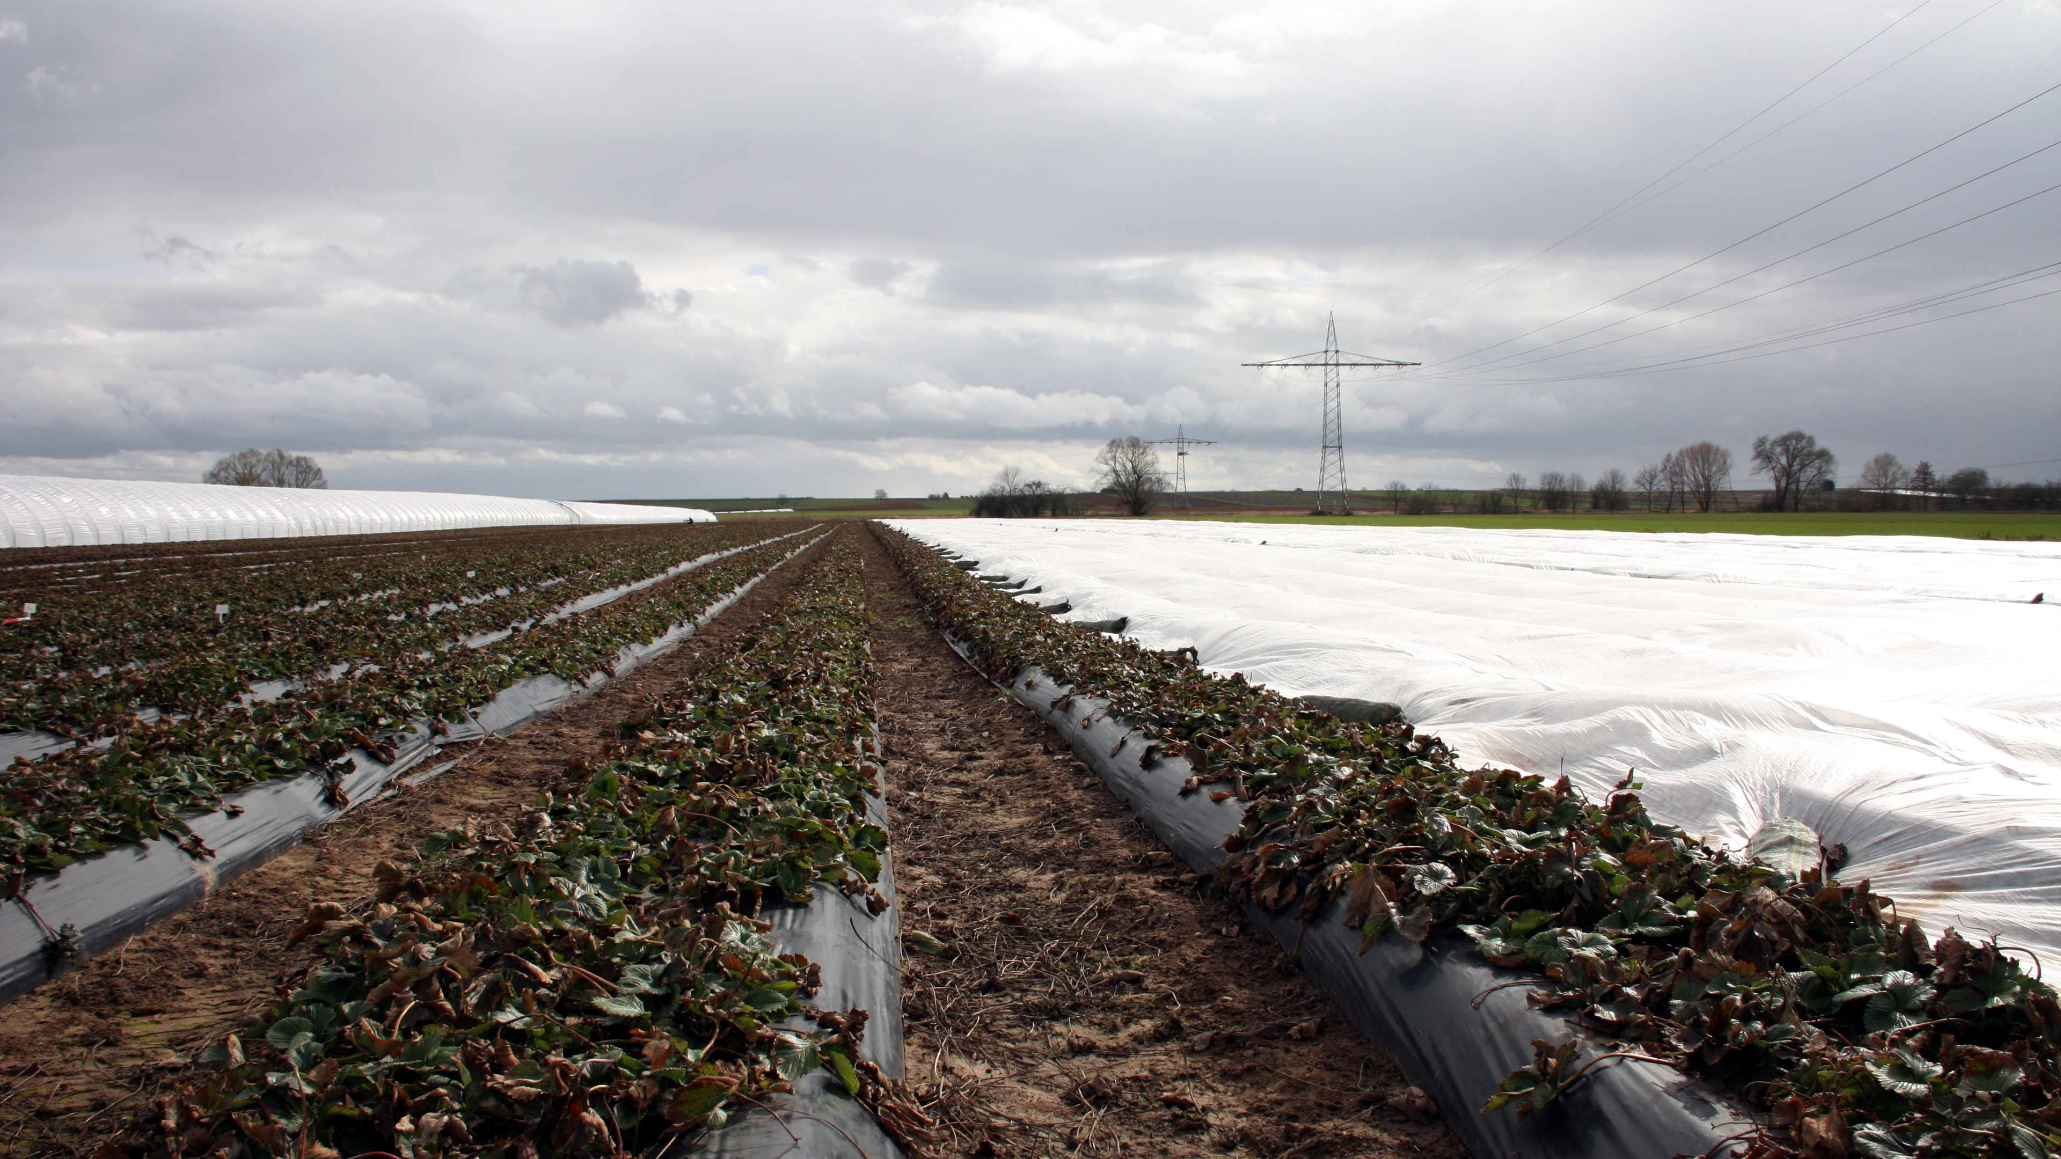


Agricultural Plastic Covers—Source of Plastic Debris in Soil?
Zacharias Steinmetz
Examiners: Prof. Dr. Gabriele E. Schaumann, Prof. Dr. Geert Cornelis, and Prof. Dr. Denise M. Mitrano

Slide 2
Landau Mörlheim (March 2018)

Slide 3
German agriculture consumes 550 kt plastic films y^{–1}
4600 km²
of European
crops covered
with plastics
Bertling et al. (2021) Fraunhofer UMSICHT, N-633611
Razza et al. (2019) Acta Hortic 1252, 77–84

Slide 4
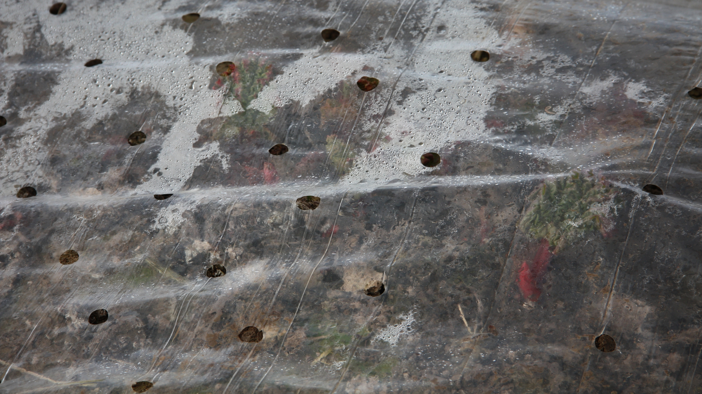
Yield
T
H₂O
Steinmetz et al. (2016) Sci Total Environ 550, 690–705

Slide 5

€ ?
Ecosystem services?
Yield
T
H₂O
Plastic debris?
Runoff
Pesticides?
CO₂↑
N₂O↑
SOM
?
Steinmetz et al. (2016) Sci Total Environ 550, 690–705

Slide 6
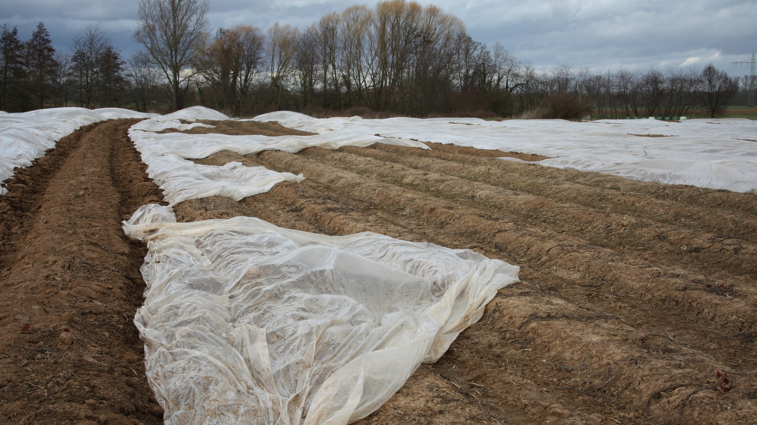
?
Empirical studies
UV
Modeled emissions
4–9 kg ha^{–1} y^{–1}
Plastic debris?
Physical
stress
>50% PE and PP
Steinmetz et al. (2016) Sci Total Environ 550, 690–705
Bertling et al. (2021) Fraunhofer UMSICHT, N-633611
Zhang et al. (2021) J Haz Mat 409, 124525

Slide 7
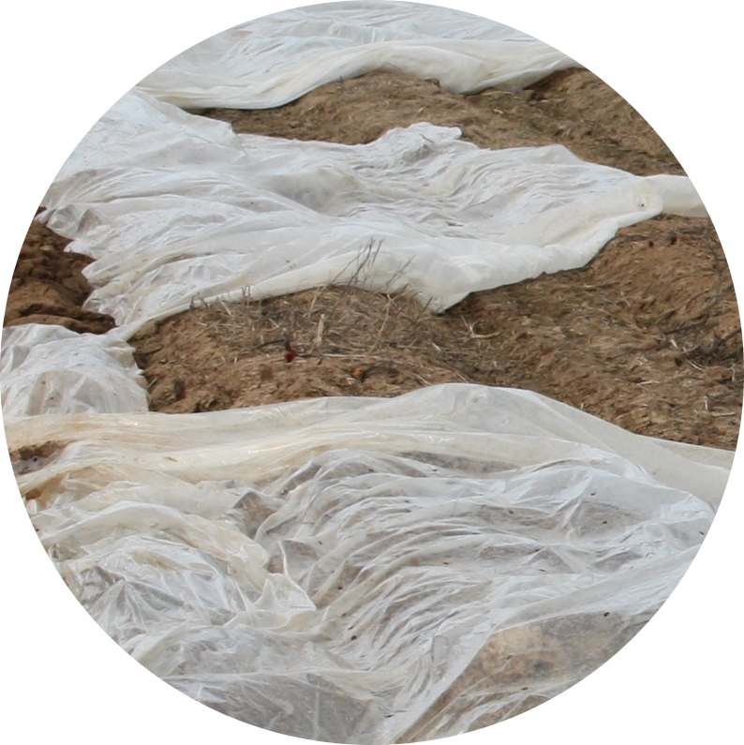
Hypothesis
?
Agricultural plastic covers pollute the surrounding soil with plastic debris at micrometer scale
Steinmetz et al. (2016) Sci Total Environ 550, 690–705

Slide 8
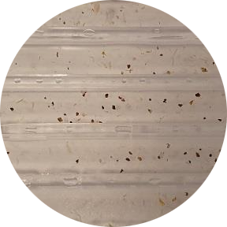
Problem
!
Available particle-based methods
not validated for complex matrices like soil
not comparable to modeling and effect data
Steinmetz et al. (2016) Sci Total Environ 550, 690–705
Photo: M.T. Nguyen

Slide 9
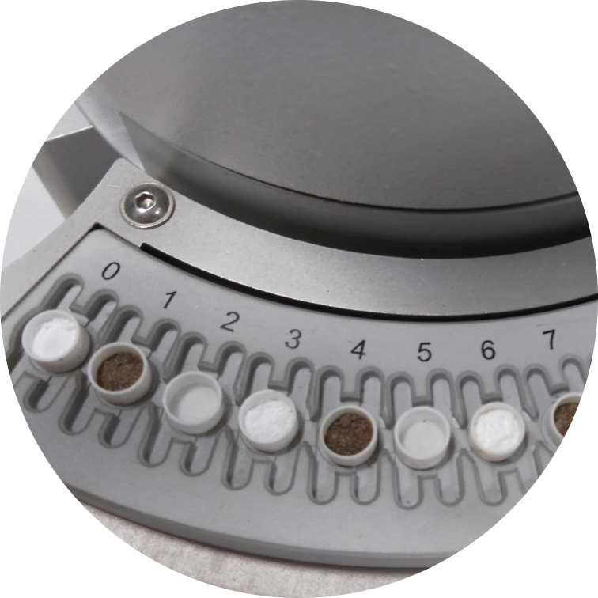
Problem
!
Mass-based methods for the quantification of plastic debris in soil still at an early stage
Steinmetz et al. (2016) Sci Total Environ 550, 690–705
Photo: J. David

Slide 10
Objectives
Develop and validate a mass-based method for the quantification of plastic debris in soil
Scrutinize the extent to which agricultural plastic covers function as a source of plastic debris in soil
Photo: J. David

Slide 11
Overview
Environmental relevance
Feasibility study

Increasing use of plastic covers

Mass-based quantification needed

Release of plastic debris?
Develop

Direct TGA/MS viable?
Steinmetz et al. (2016) Sci Total Environ
David et al. (2018) Anal Chem
Method validation

Polymer mixtures require chromatography
Method review

Solvent-based Py-GC/MS better?

Preparation methods
Refine
(Re-)
Evaluate
Steinmetz et al. (2020) J Anal Appl Pyrol

What to consider?
Field application
Thomas et al. (2020) Sustainability
Add density separation for a first screening of plastic-covered fields

Steinmetz et al. (2022) SOIL
Literature review
Original research

Slide 12
Overview
Environmental relevance
Feasibility study

Increasing use of plastic covers

Mass-based quantification needed

Release of plastic debris?
Develop

Direct TGA/MS viable?
Steinmetz et al. (2016) Sci Total Environ
David et al. (2018) Anal Chem
Method validation

Polymer mixtures require chromatography
Method review

Solvent-based Py-GC/MS better?

Preparation methods
Refine
(Re-)
Evaluate
Steinmetz et al. (2020) J Anal Appl Pyrol

What to consider?
Field application
Thomas et al. (2020) Sustainability
Add density separation for a first screening of plastic-covered fields

Steinmetz et al. (2022) SOIL
Literature review
Original research

Slide 13
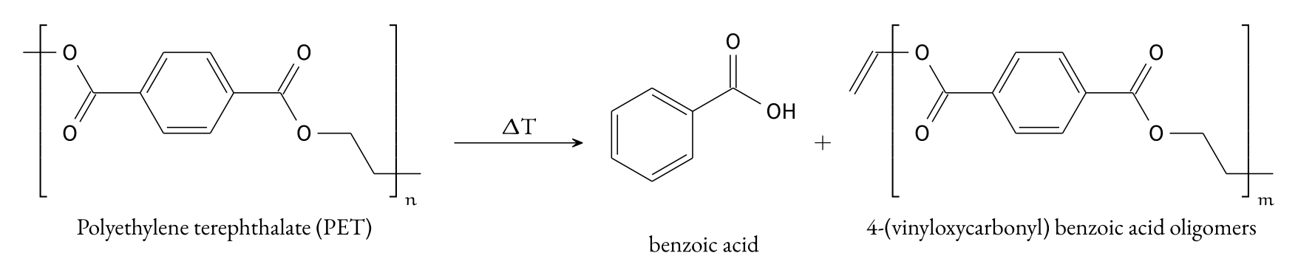
Thermoanalysis for Polymer Quantification
Feasibility study
Method validation
Field application
Tsuge et al. (2011)
Pyrolysis–GC/MS Data Book

Slide 14
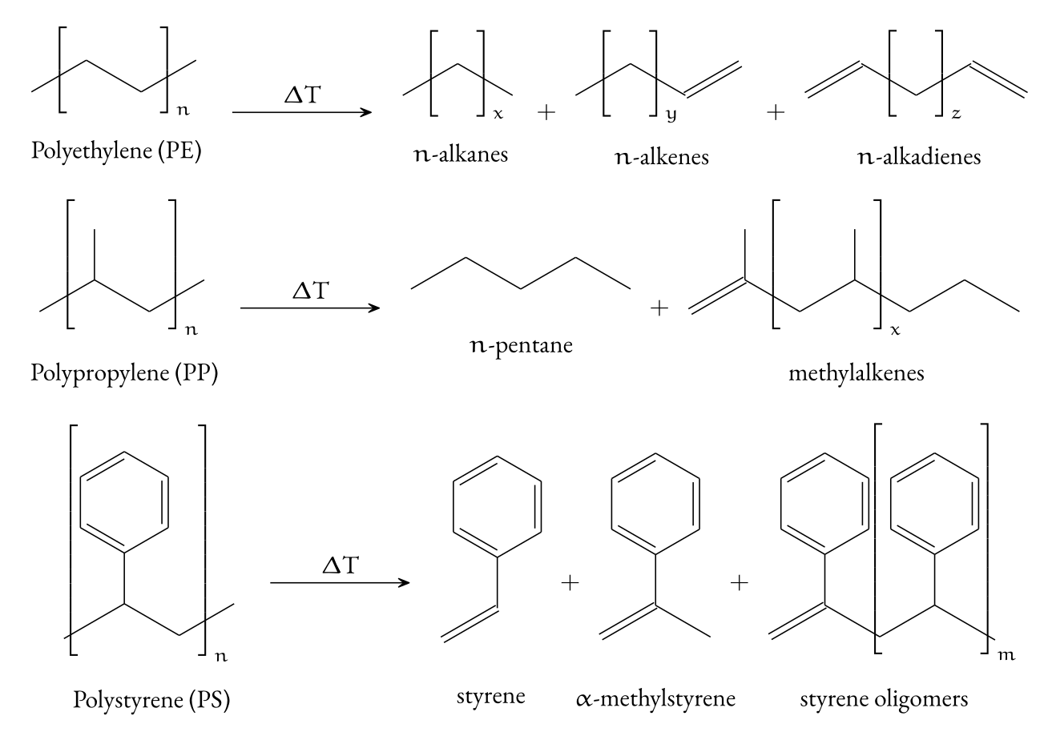
Thermoanalysis for Polymer Quantification
Feasibility study
Method validation
Field application
Tsuge et al. (2011)
Pyrolysis–GC/MS Data Book

Slide 15
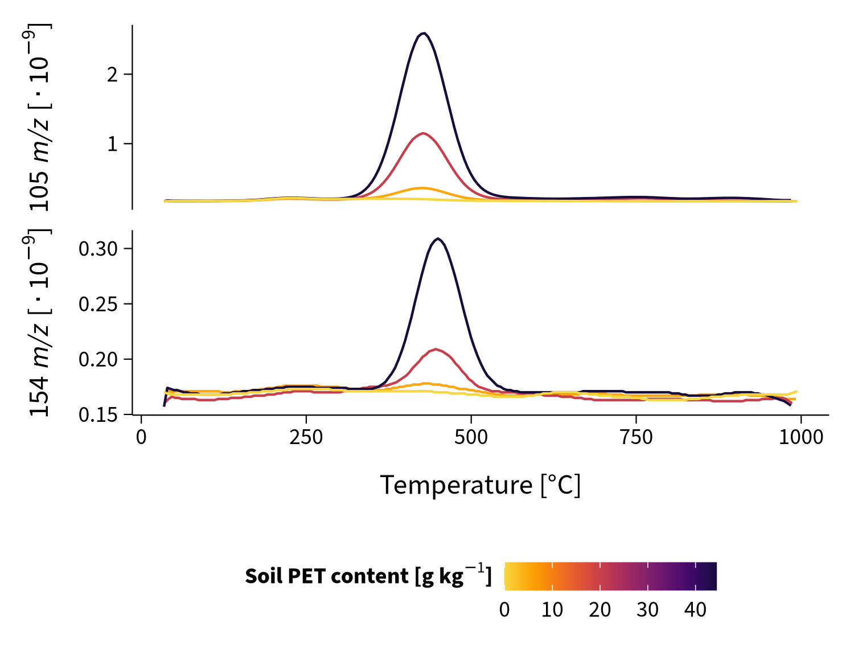
Direct TGA/MS
Feasibility study
Method validation
cysteine as internal standard
Field application
David et al. (2018) Anal Chem 90, 8793–8799
Photo: J. David

Slide 16
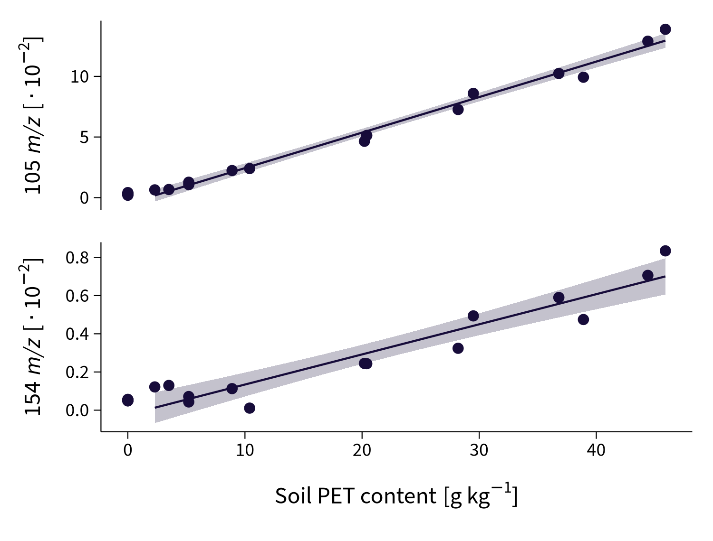
Direct TGA/MS
50 mg soil
Feasibility study
No sample preparation
Method validation
Field application
LOD = 0.7 g kg^{–1}
Only one polymer
Steinmetz (2018) envalysis 0.3.3
David et al. (2018) Anal Chem 90, 8793–8799
Photo: J. David

Slide 17
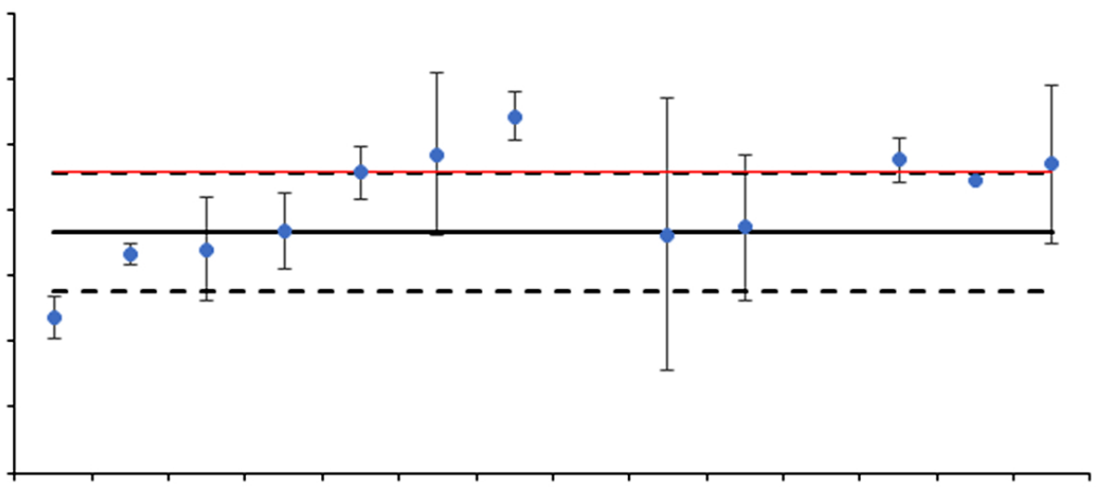
Direct TGA/MS
Round robin test
Feasibility study
70
Py- or TED-GC/MS
TGA/MS
DSC and others
60
50
40
Method validation
Total polymer content [g kg^{–1}]
30
20
10
0
Field application
a
b
c
d
e
f
g
h
i
k
l
m
PE, PP, PS, PET
Laboratory
Becker et al. (2020) J Anal Appl Pyrol 148, 104829

Slide 18
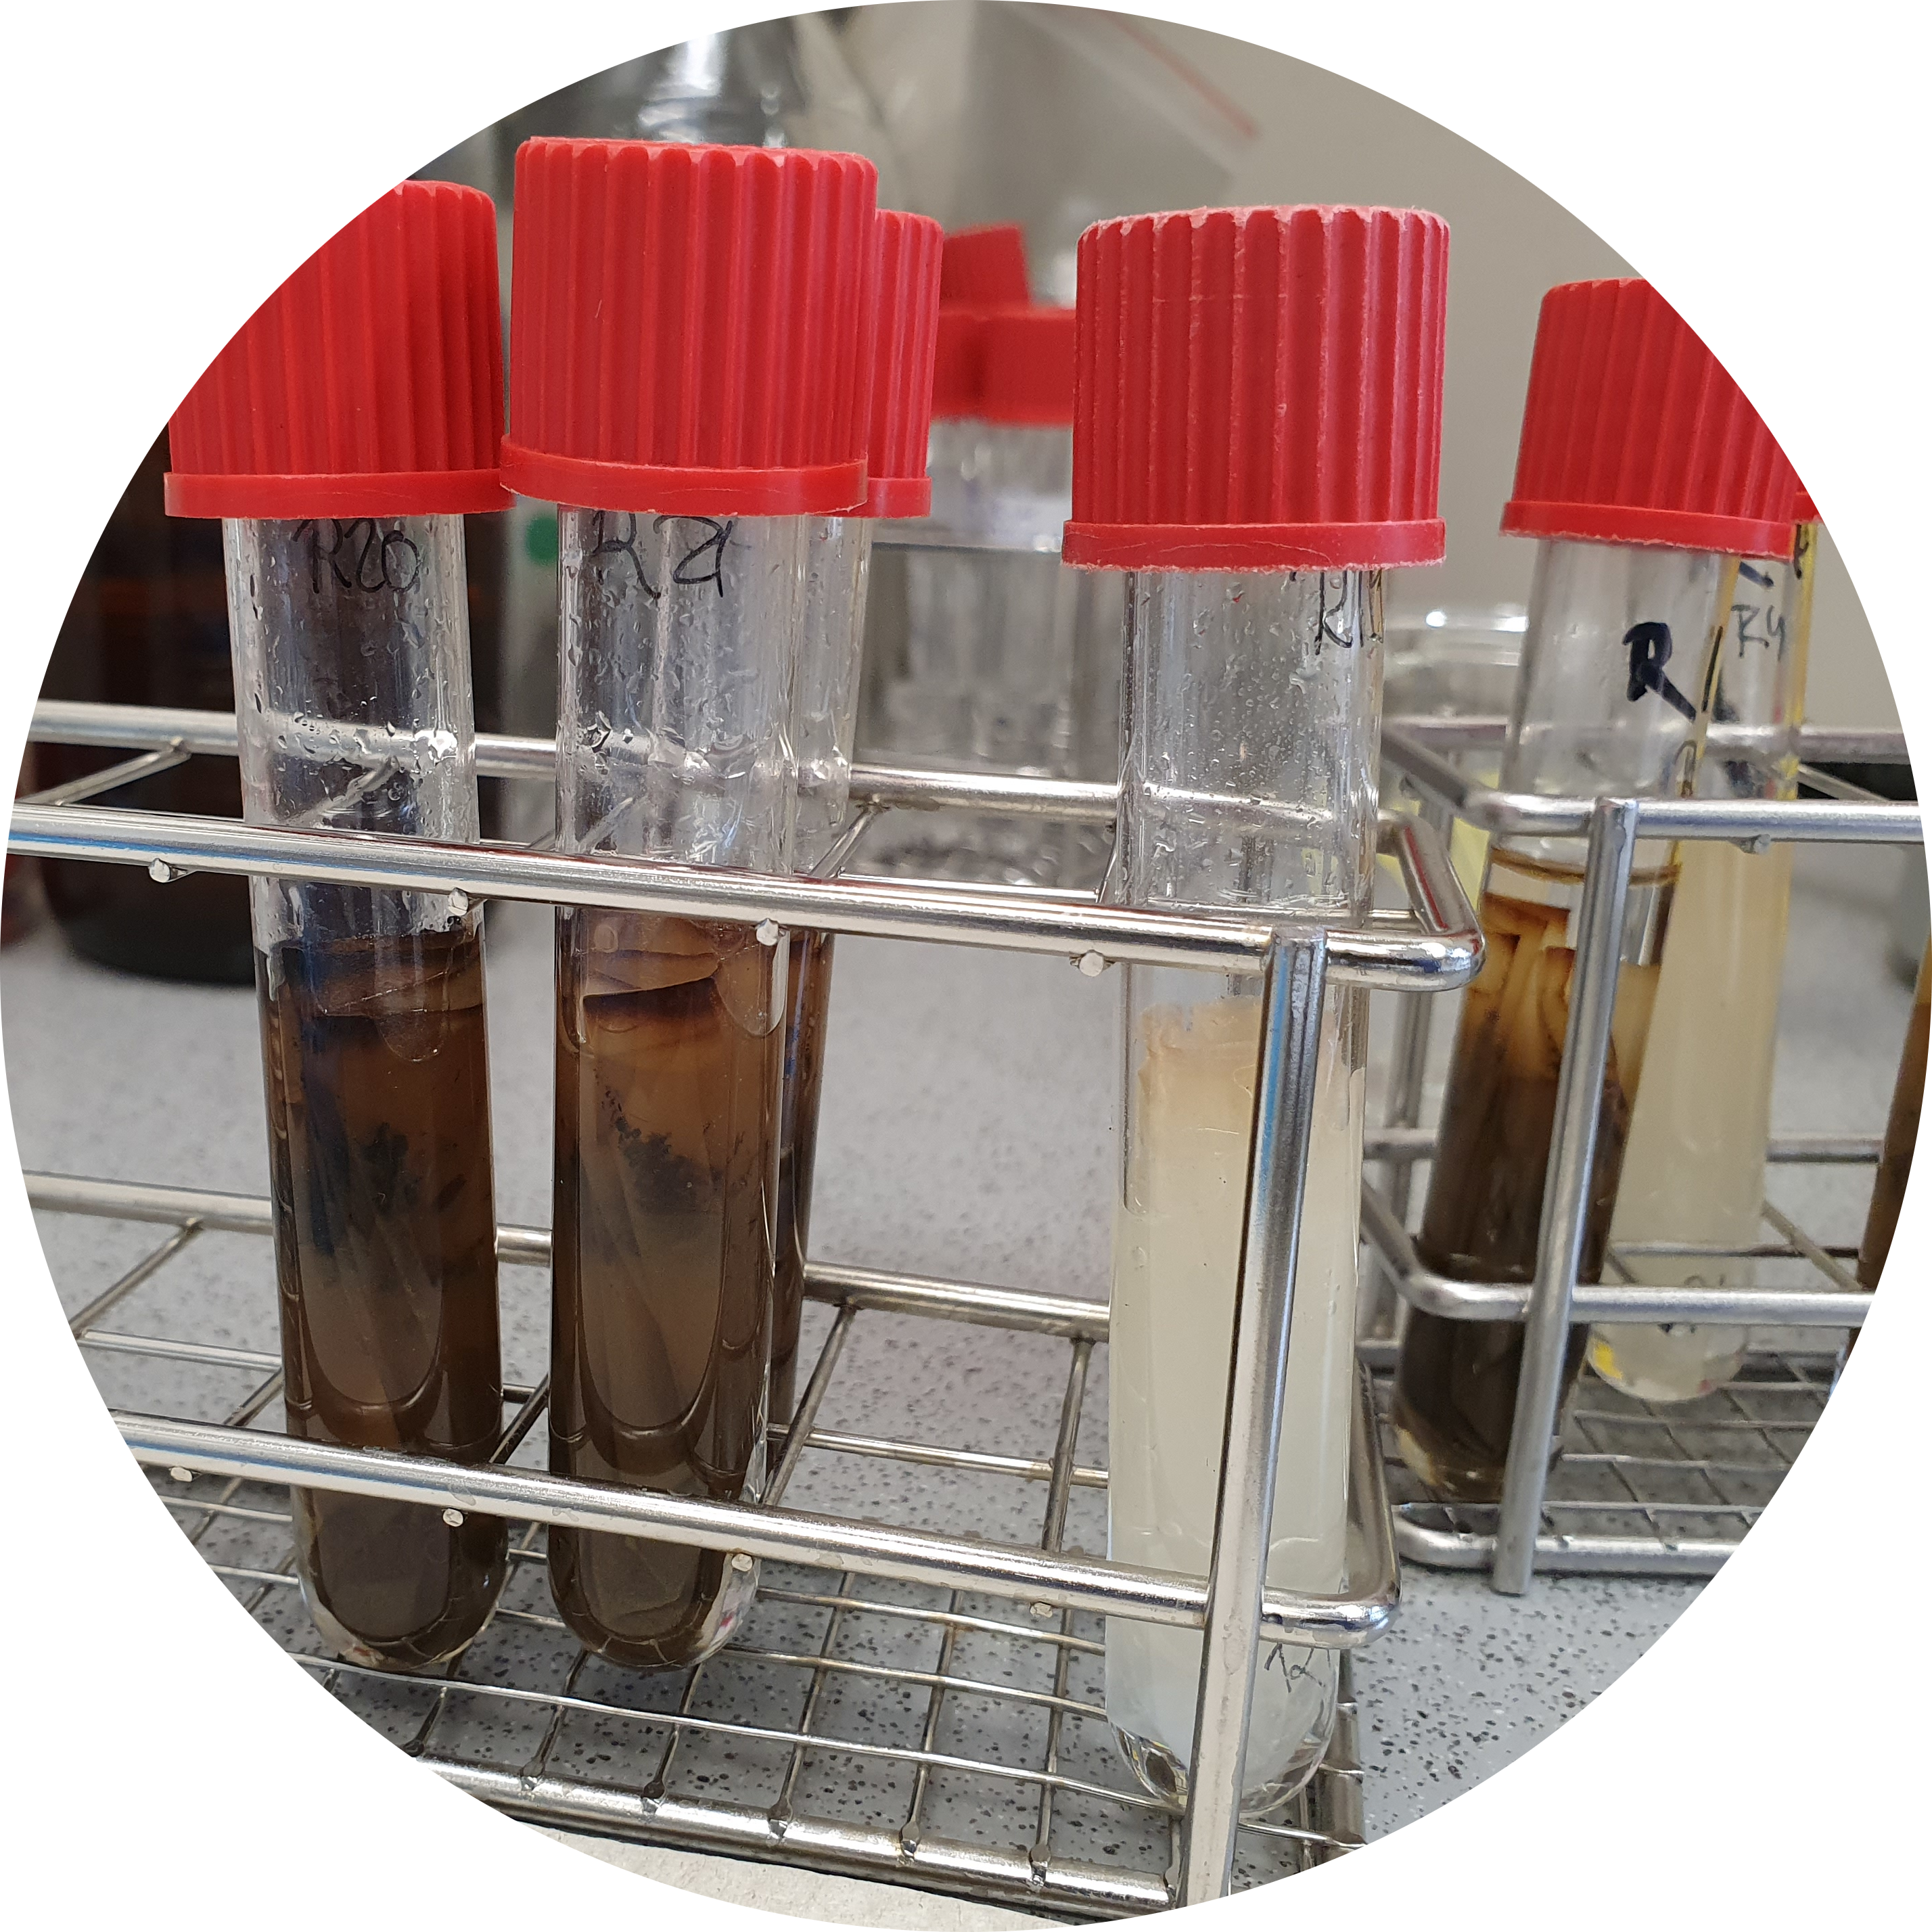
Solvent-based Py-GC/MS
Feasibility study
PE
PS
PP
(+ soil)
trichloro-
benzene
Method validation
Field application
Steinmetz et al. (2020) J Anal Appl Pyrol 147, 104803
Photos: W.M. Heinze

Slide 19
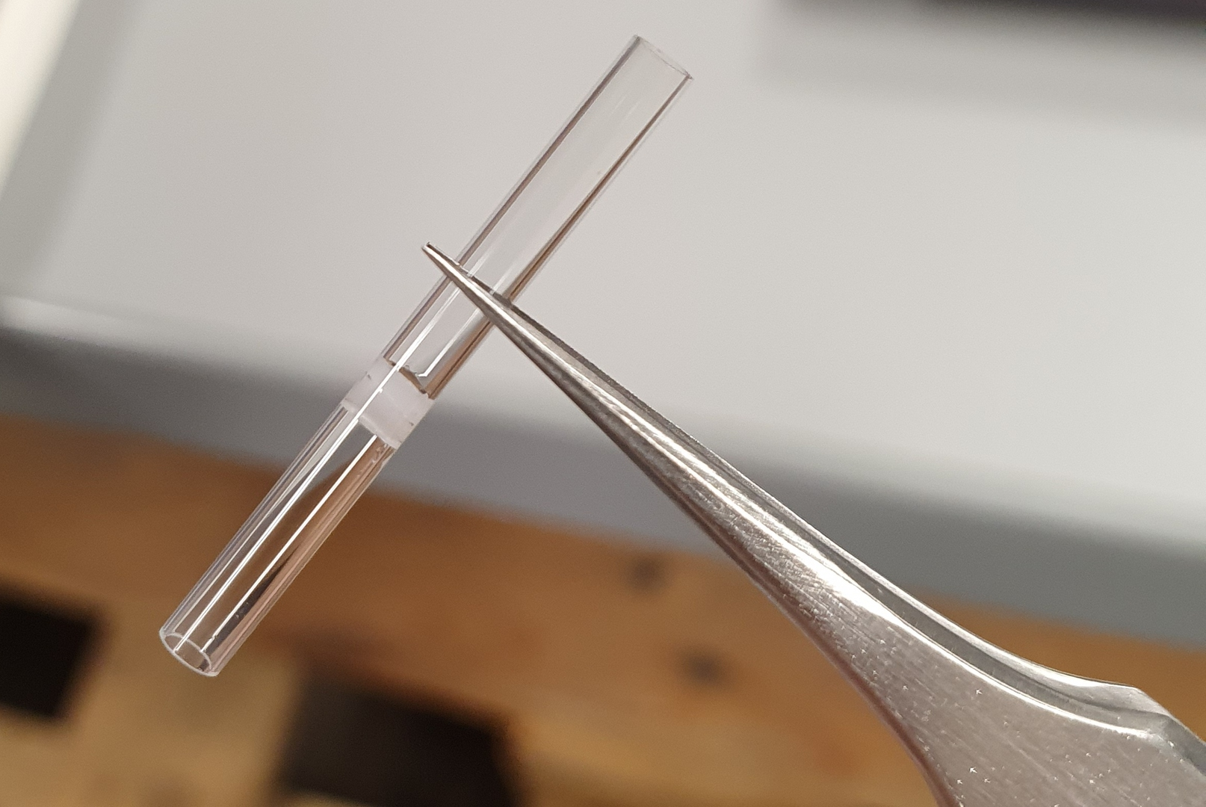
Solvent-based Py-GC/MS
Feasibility study
PE
PS
PP
(+ soil)
trichloro-
benzene
Method validation
2 µL
120 °C, 1 h
Field application
Aliquotation
Steinmetz et al. (2020) J Anal Appl Pyrol 147, 104803
Photos: W.M. Heinze

Slide 20
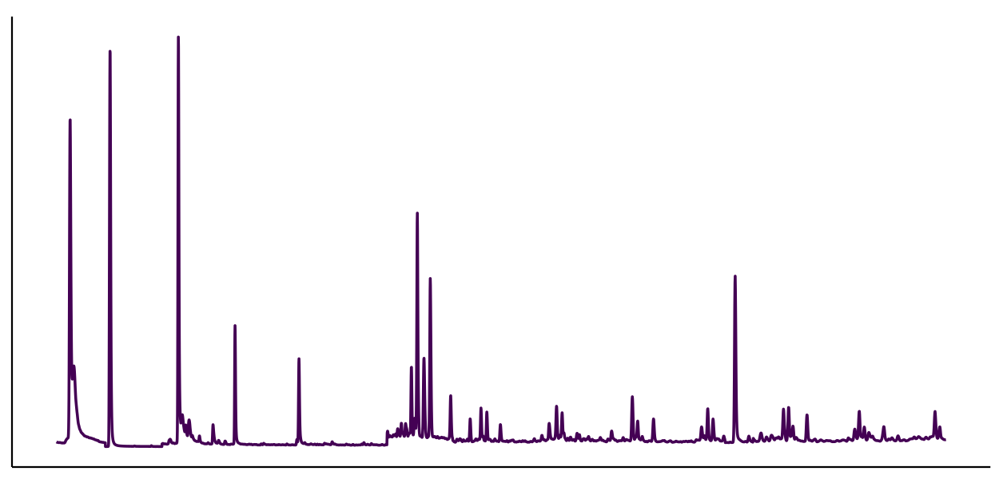
Solvent-based Py-GC/MS
2,4-dimethyl-1-heptene (PP)
styrene (PS)
Feasibility study
PE
PS
PP
n-alkadienes (PE)
(+ soil)
trichloro-
benzene
Method validation
2 µL
Flash pyrolysis
at 750 °C
120 °C, 1 h
Field application
Steinmetz et al. (2020) J Anal Appl Pyrol 147, 104803
Photos: W.M. Heinze

Slide 21
Solvent-based Py-GC/MS
2,4-dimethyl-1-heptene (PP)
styrene (PS)
Feasibility study
PE
PS
PP
c
n-alkadienes (PE)
(+ soil)
trichloro-
benzene
Method validation
2 µL
120 °C, 1 h
Field application
4 g soil
Representative subsample
Steinmetz et al. (2020) J Anal Appl Pyrol 147, 104803
Photos: W.M. Heinze

Slide 22
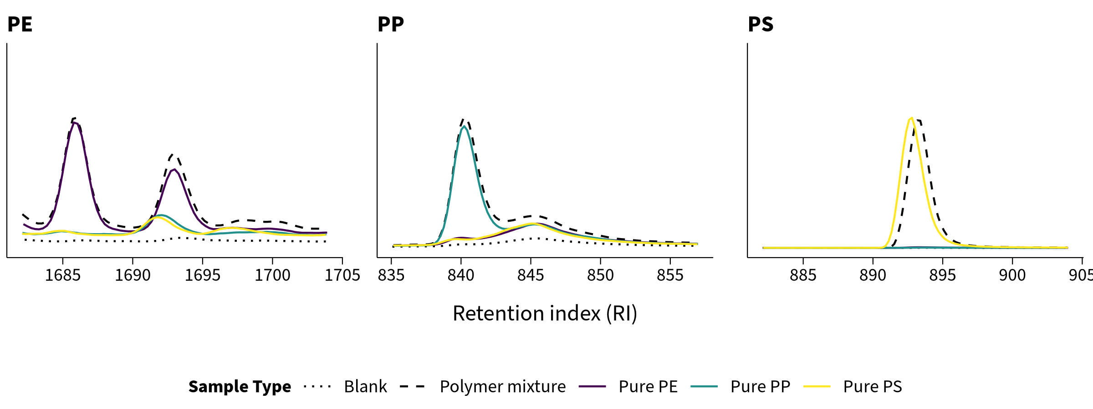
Solvent-based Py-GC/MS
Feasibility study
Selective for each polymer
octadecadiene
2,4-dimethyl-1-heptene
styrene
Method validation
Field application
Steinmetz et al. (2020) J Anal Appl Pyrol 147, 104803

Slide 23
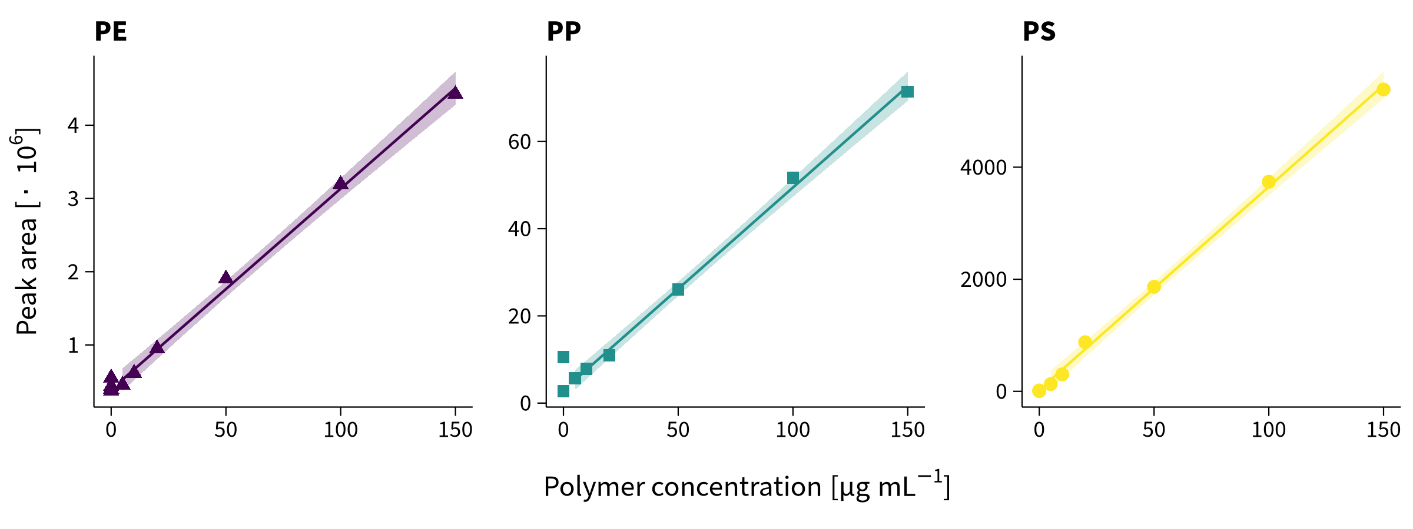
Solvent-based Py-GC/MS
Feasibility study
RSDs = 3–7%
Method validation
Field application
LODs = 1–86 mg kg^{–1}
Steinmetz (2020) envalysis 0.4.0
Steinmetz et al. (2020) J Anal Appl Pyrol 147, 104803

Slide 24
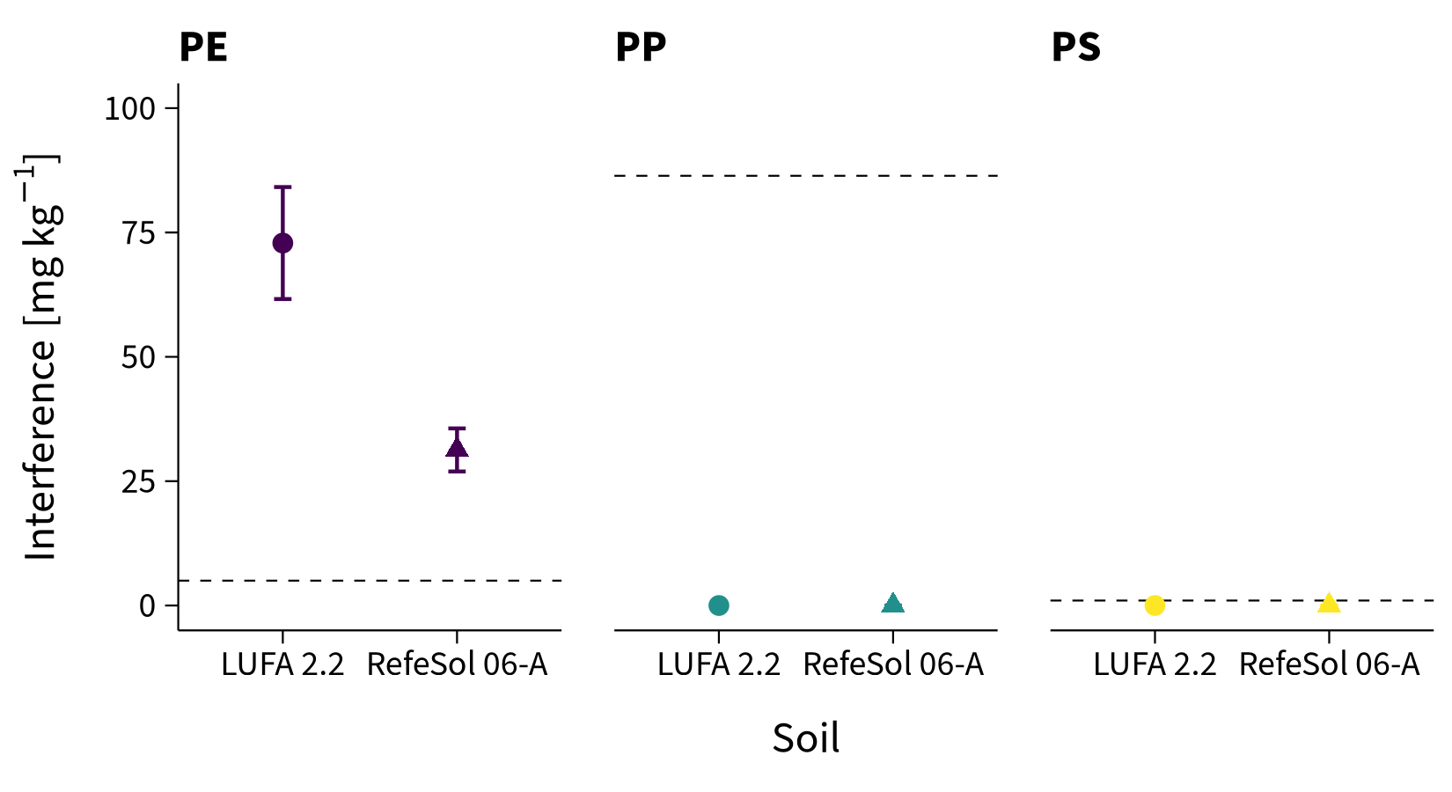
Solvent-based Py-GC/MS
Feasibility study
LOD
Method validation
LOD
LOD
Field application
False positive signals from blank soil
Steinmetz et al. (2020) J Anal Appl Pyrol 147, 104803

Slide 25
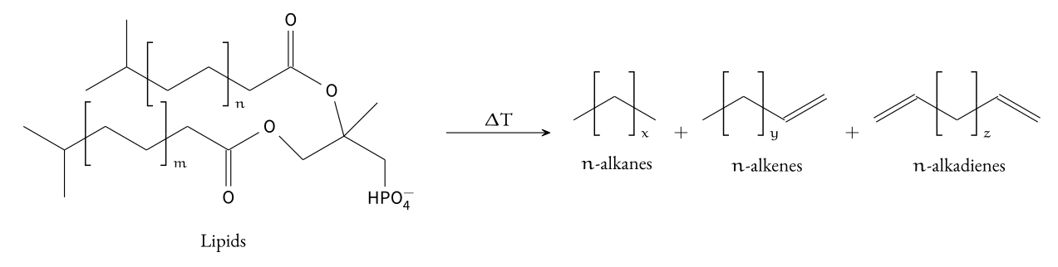
SOM Pyrolysis
Feasibility study
Method validation
Same as PE
Field application
Ceccanti et al. (2007) Soil Tillage Res 97(1), 71–78
Hatcher et al. (2001) Soil Sci 166(11), 770–794

Slide 26
Additional Steps
Feasibility study
Additional sample purification required
Higher sample amounts for more representative measurements
Method validation
Field application
Thomas et al. (2020) Sustainability 12(21), 9074

Slide 27
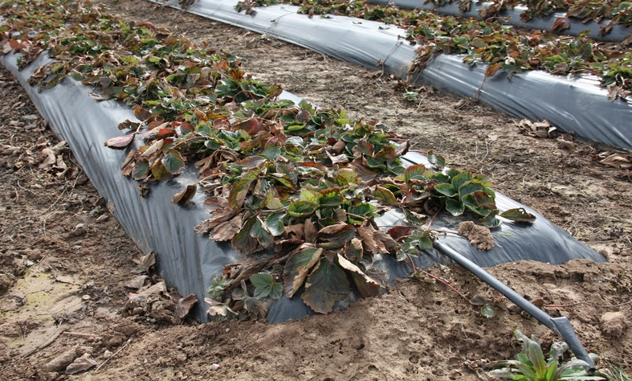
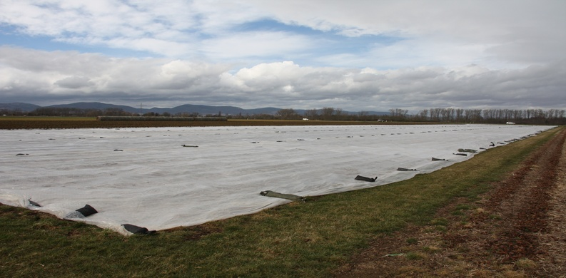
Final Method Validation and Field Application
Feasibility study
LUFA 2.2 Loamy sand, 1.7% Corg
+
RefeSol 06-A Silty clay, 2.5% Corg
Method validation
8 sites covered for 1–2 seasons
Mostly clayey silts,
0.9–1.5% Corg
Located in Landau and Schifferstadt, Germany
Field application
Steinmetz et al. (2022) SOIL 8(1), 31–47

Slide 28
Field Sampling
Feasibility study
Spatial distribution
Method validation
5 samples per transect
Field application
240 samples
Steinmetz et al. (2022) SOIL 8(1), 31–47

Slide 29
Field Sampling
I. Soil Sampling
I. Soil sampling
~150 g cores (0–5 cm topsoil)
Feasibility study
Method validation
5 samples per transect
Field application
Thomas et al. (2020) Sustainability 12(21), 9074
Steinmetz et al. (2022) SOIL 8(1), 31–47

Slide 30
Sample Preparation
I. Soil Sampling
I. Soil sampling
~150 g cores (0–5 cm topsoil)
Feasibility study
II. a) Sample preparation
Soil characterization
texture, Corg
Method validation
Drying
at room temperature
Manual homogenization
Field application
Thomas et al. (2020) Sustainability 12(21), 9074
Steinmetz et al. (2022) SOIL 8(1), 31–47

Slide 31
Sample Preparation
I. Soil Sampling
I. Soil sampling
~150 g cores (0–5 cm topsoil)
Feasibility study
II. a) Sample preparation
Soil characterization
texture, Corg
Method validation
Drying
at room temperature
Manual homogenization
II. b) Separation per sieve fraction
≤2 mm >2 mm
Field application
LUFA 2.2 and
RefeSol 06-A
Aggregate Dispersion
with Na-hexametaphosphate
FTIR–ATR
Thomas et al. (2020) Sustainability 12(21), 9074
Steinmetz et al. (2022) SOIL 8(1), 31–47

Slide 32
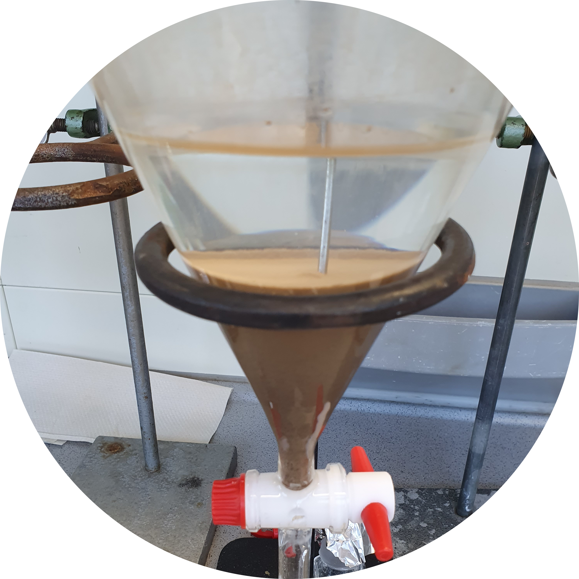
Extraction
II. b) Separation per sieve fraction
≤2 mm
Dominant soil constituent?
Feasibility study
50 g soil
Inorganic
+ 250 mL NaCl solution
1 L separation funnels
Filtration at 4–12 µm
Density
separation
ρ = 1.2 g cm⁻³
Method validation
Field application
Thomas et al. (2020) Sustainability 12(21), 9074
Steinmetz et al. (2022) SOIL 8(1), 31–47
Photos: W.M. Heinze

Slide 33


Solvent-based Py-GC/MS
II. b) Separation per sieve fraction
≤2 mm
Dominant soil constituent?
Feasibility study
Inorganic
Density
separation
ρ = 1.2 g cm⁻³
Method validation
Chemical extraction
with trichlorobenzene/xylene
Batch extraction
150 °C / 1 h
Field application
Thomas et al. (2020) Sustainability 12(21), 9074
Steinmetz et al. (2022) SOIL 8(1), 31–47
Photos: W.M. Heinze

Slide 34
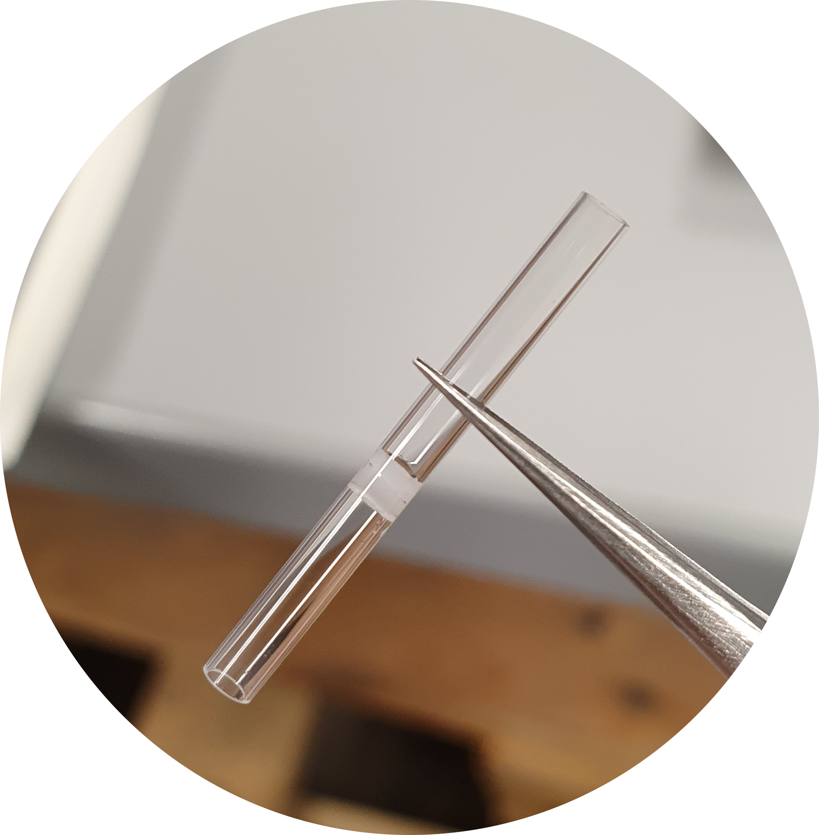
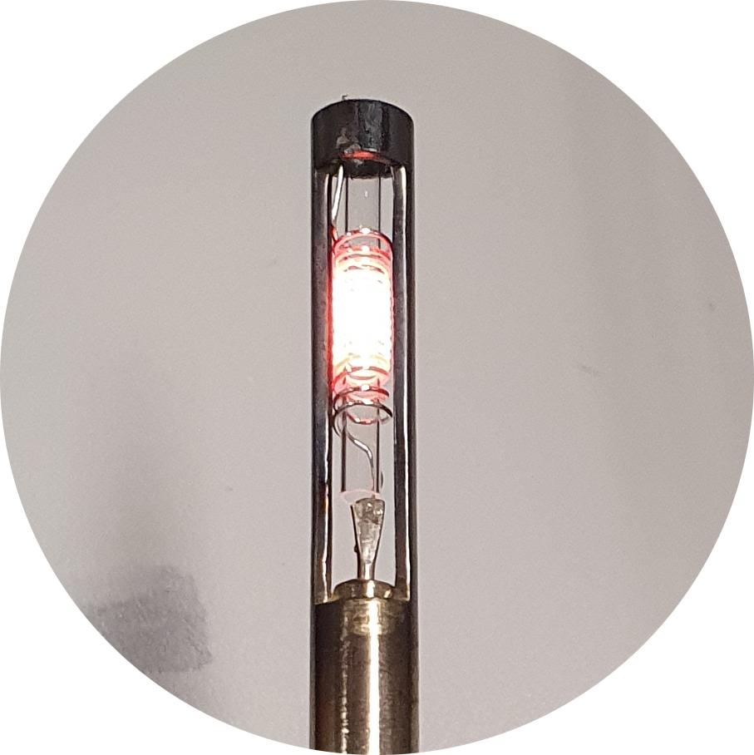
Solvent-based Py-GC/MS
II. b) Separation per sieve fraction
≤2 mm
Dominant soil constituent?
Feasibility study
Inorganic
Density
separation
ρ = 1.2 g cm⁻³
Method validation
Chemical extraction
with trichlorobenzene/xylene
PS-d5 as internal standard
III. Quantification
2 µL aliquot
Field application
Mass
Py-GC/MS
700 °C
Steinmetz et al. (2022) SOIL 8(1), 31–47
Photos: W.M. Heinze

Slide 35
Final Method Validation
Feasibility study
Polymer | LOD | LOQ | Interference | Recovery
 | [mg kg^{–1}] | [mg kg^{–1}] | [mg kg^{–1}] | at 20 mg kg^{–1} [%]
LUFA 2.2
PE | 1.9 | 9.5 | 0.9±0.3 | 105±3
PP | 2.9 | 2.9 | 0±0 | 93±5
PS | 3.3 | 6.2 | 0±0 | 86±4
RefeSol 06-A
PE | 1.2 | 9.5 |  | 50±10
PP | 0.8 | 2.5 |  | 62±1
PS | 0.7 | 6.2 |  | 12±5
Method validation
Field application
Steinmetz et al. (2022) SOIL 8(1), 31–47

Slide 36
Final Method Validation
Blank soil + 40 mg kg^{–1} non-target polymers
Feasibility study
Polymer | LOD | LOQ | Interference | Recovery
 | [mg kg^{–1}] | [mg kg^{–1}] | [mg kg^{–1}] | at 20 mg kg^{–1} [%]
LUFA 2.2
PE | 1.9 | 9.5 | 0.9±0.3 | 105±3
PP | 2.9 | 2.9 | 0±0 | 93±5
PS | 3.3 | 6.2 | 0±0 | 86±4
RefeSol 06-A
PE | 1.2 | 9.5 |  | 50±10
PP | 0.8 | 2.5 |  | 62±1
PS | 0.7 | 6.2 |  | 12±5
PET,
PVC,
PMMA,
TWD
Method validation
< LOD
Field application
Steinmetz et al. (2022) SOIL 8(1), 31–47

Slide 37
Final Method Validation
Feasibility study
Polymer | LOD | LOQ | Interference | Recovery
 | [mg kg^{–1}] | [mg kg^{–1}] | [mg kg^{–1}] | at 20 mg kg^{–1} [%]
LUFA 2.2
PE | 1.9 | 9.5 | 0.9±0.3 | 105±3
PP | 2.9 | 2.9 | 0±0 | 93±5
PS | 3.3 | 6.2 | 0±0 | 86±4
RefeSol 06-A
PE | 1.2 | 9.5 |  | 50±10
PP | 0.8 | 2.5 |  | 62±1
PS | 0.7 | 6.2 |  | 12±5
9% clay
Method validation
47% clay
Field application
Clay–polymer interactions
Steinmetz et al. (2022) SOIL 8(1), 31–47

Slide 38
Final Method Validation
Feasibility study
Polymer | LOD | LOQ | Interference | Recovery
 | [mg kg^{–1}] | [mg kg^{–1}] | [mg kg^{–1}] | at 20 mg kg^{–1} [%]
LUFA 2.2
PE | 1.9 | 9.5 | 0.9±0.3 | 105±3
PP | 2.9 | 2.9 | 0±0 | 93±5
PS | 3.3 | 6.2 | 0±0 | 86±4
RefeSol 06-A
PE | 1.2 | 9.5 |  | 50±10
PP | 0.8 | 2.5 |  | 62±1
PS | 0.7 | 6.2 |  | 12±5
Method validation
Clay content in the field: 10–36%
Field application
Steinmetz et al. (2022) SOIL 8(1), 31–47

Slide 39
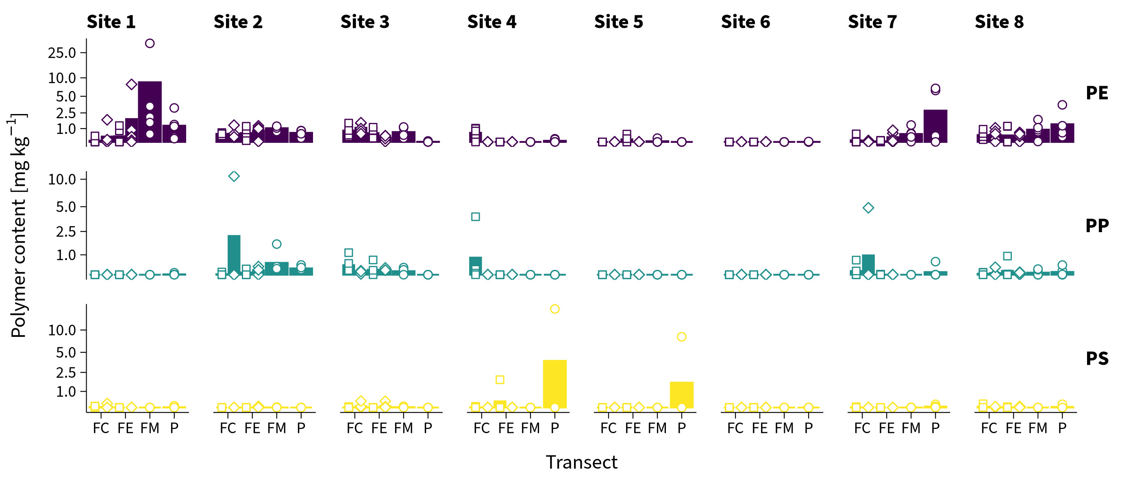
Soil-associated Plastic Debris ≤2 mm
Feasibility study
Method validation
Field application
Steinmetz et al. (2022) SOIL 8(1), 31–47

Slide 40
Soil-associated Plastic Debris ≤2 mm
Feasibility study
6% positive detections > LOD
Method validation
Field application
Steinmetz et al. (2022) SOIL 8(1), 31–47

Slide 41
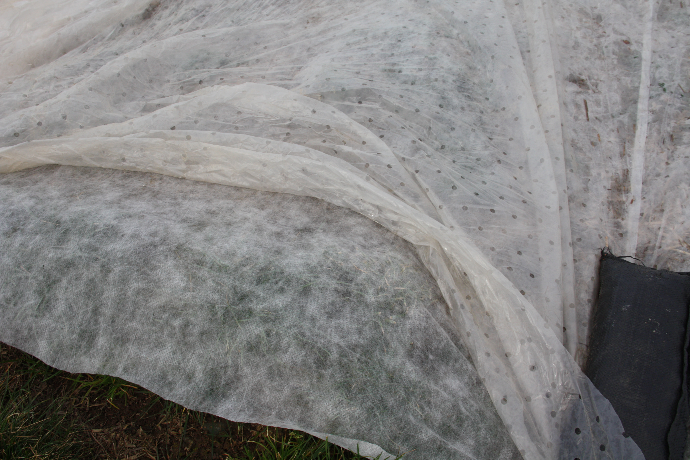
Soil-associated Plastic Debris ≤2 mm
Feasibility study
35 mg kg^{–1} PE max.
Method validation
Field application
Steinmetz et al. (2022) SOIL 8(1), 31–47

Slide 42
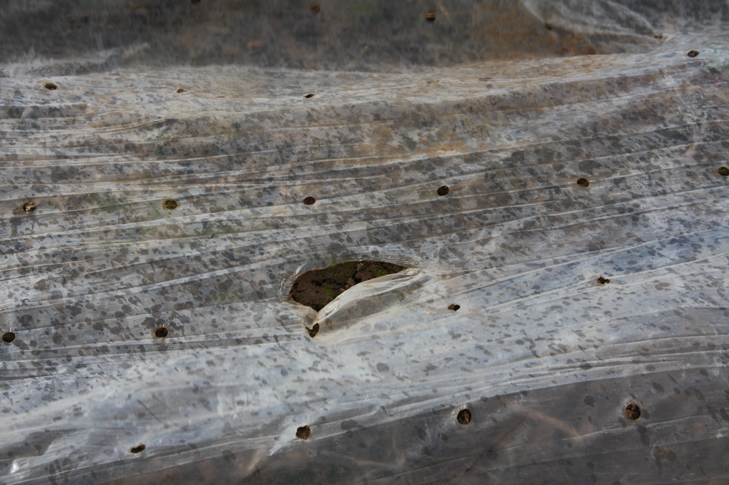
Soil-associated Plastic Debris ≤2 mm
Feasibility study
Method validation
Elevated PE levels associated with the use of thinner and perforated films (40 µm)
Field application
Indistinct PE distribution across transects
Steinmetz et al. (2022) SOIL 8(1), 31–47

Slide 43
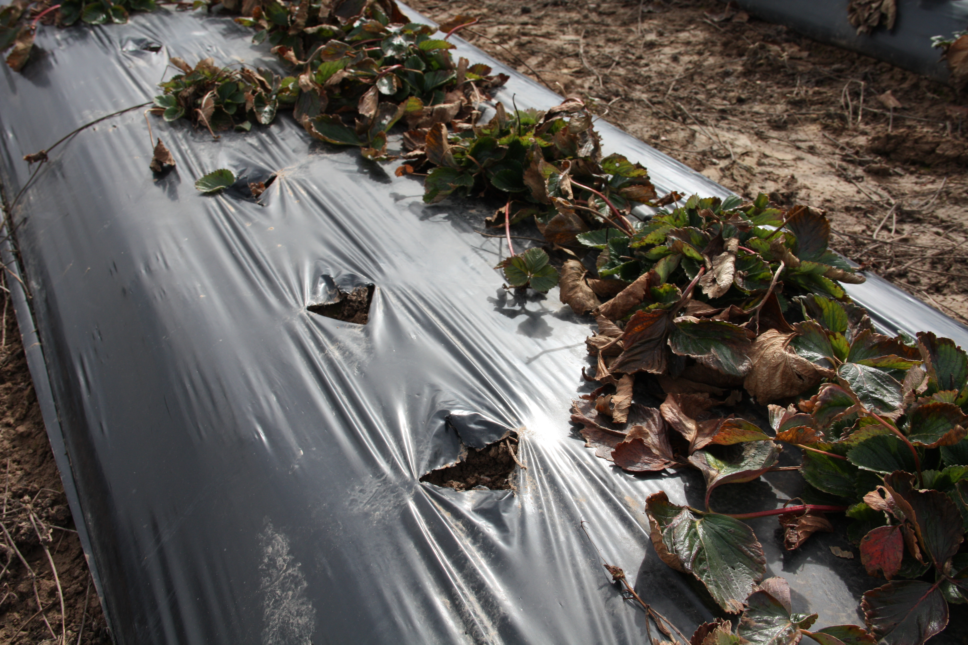
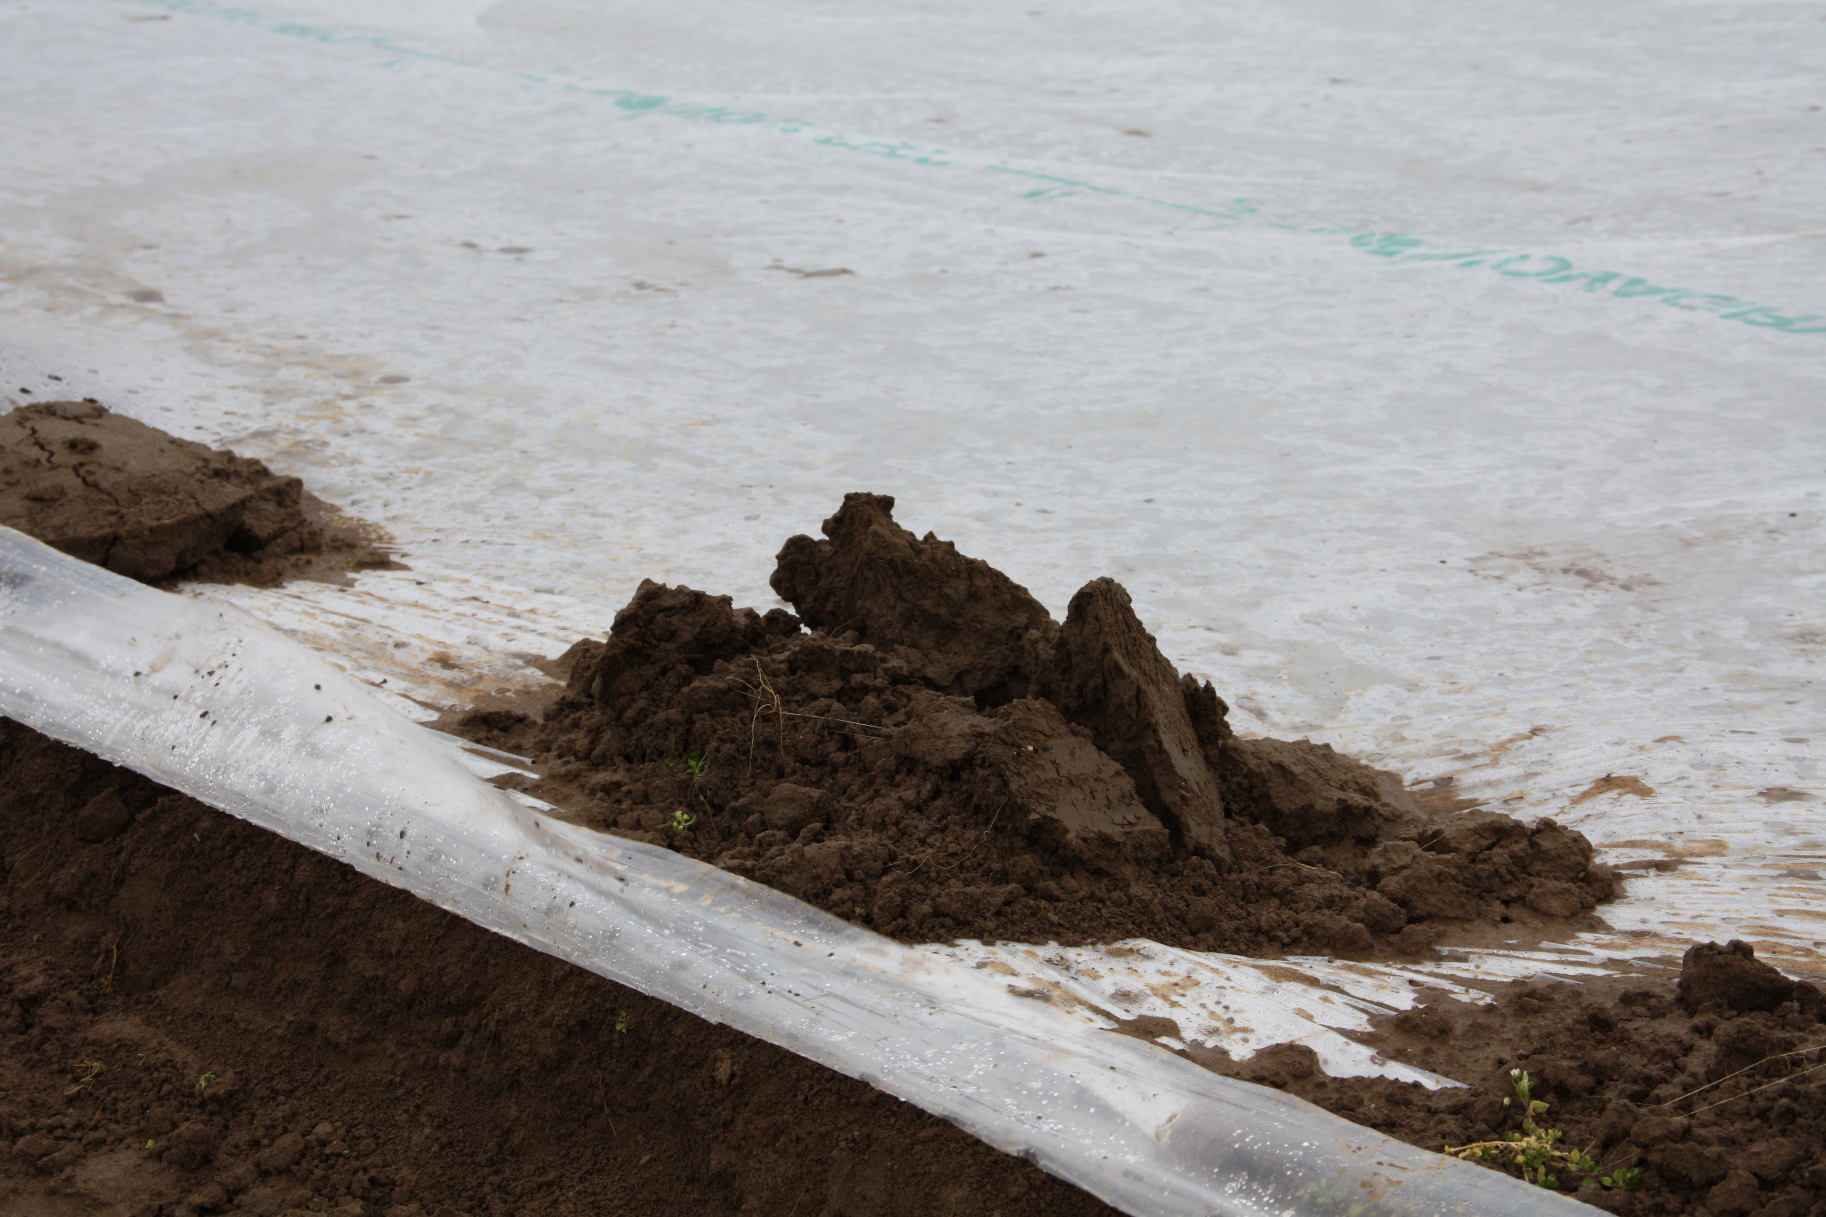
Soil-associated Plastic Debris ≤2 mm
Feasibility study
Method validation
50–100 µm film thickness
Field application
Steinmetz et al. (2022) SOIL 8(1), 31–47

Slide 44
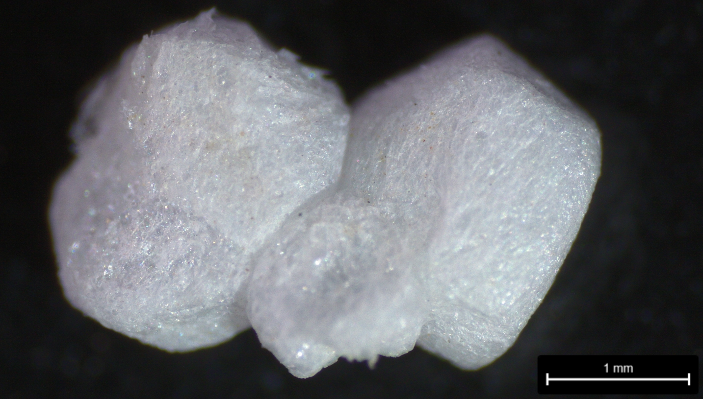
Soil-associated Plastic Debris ≤2 mm
Feasibility study
Single observations of PP and PS
Method validation
Field application
PS only qualitative
Steinmetz et al. (2022) SOIL 8(1), 31–47

Slide 45
Synthesis
Feasibility study
Mass-based quantification needed
Direct TGA/MS viable?
David et al. (2018) Anal Chem
Method validation
Polymer mixtures require chromatography
Solvent-based Py-GC/MS better?
Refine
Steinmetz et al. (2020) J Anal Appl Pyrol
Field application
Add density separation for a first screening of plastic-covered fields
Steinmetz et al. (2022) SOIL

Slide 46
Synthesis
0.7 g kg^{–1}
50 mg
Direct TGA/MS
1–86 mg kg^{–1}
4 g
Solvent-based GC/MS
Refine
1–3 mg kg^{–1}
50 g
Density separation
+ solvent-based Py-GC/MS
Sample
amounts
LODs
Photos: J. David & W.M. Heinze

Slide 47
Synthesis
Refine
Easy sample handling
Corg?
Clay content?
High sample throughput
Density separation
+ solvent-based Py-GC/MS
Photos: J. David & W.M. Heinze

Slide 48
Synthesis
Solvent-based Py-GC/MS viable for simple & fast mass-based plastic analyses in soil
Further development required for
  polymers other than PE, PP (and PS)
  more “complicated” matrices
Refine
Easy sample handling
Corg?
Clay content?
High sample throughput
Density separation
+ solvent-based Py-GC/MS
Photos: J. David & W.M. Heinze

Slide 49
Synthesis
Solvent-based Py-GC/MS viable for simple & fast mass-based plastic analyses in soil
Further development required for
  polymers other than PE, PP (and PS)
  more “complicated” matrices
More systematic field studies to discriminate sources better
Refine

Slide 50
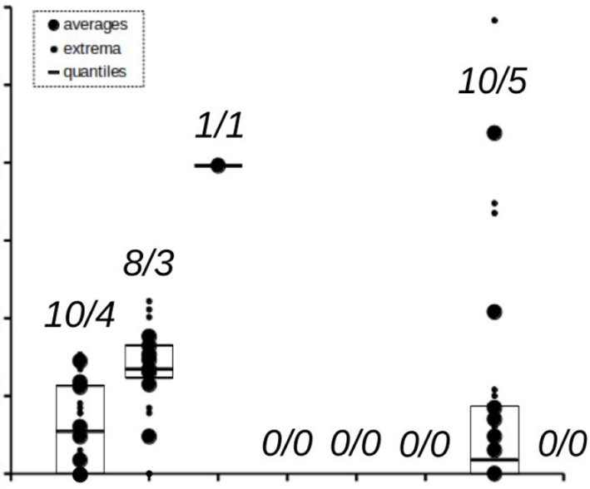
Estimated Plastic Contents in Soil
Difficult to exclude other sources
Continuous plastic mulching (<10 µm thick) in China
10⁵
10⁴
10³
Plastic content [mg kg^{–1}]
10²
10¹
10⁰
Particle-to-mass conversions error-prone
0
Plasti-culture
Sludge
Road
NA
Büks & Kaupenjohann (2020) SOIL 6(2), 649–662

Slide 51
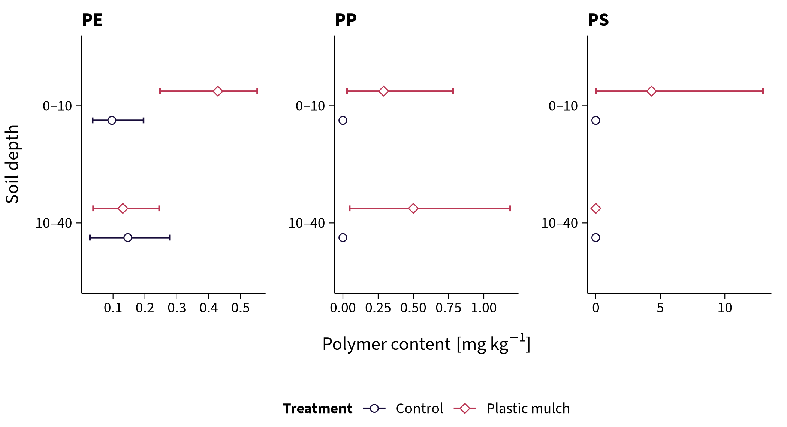
More Mass-based Field Studies
Sampling scheme per field
No sewage sludge or compost applied
Steinmetz & Schröder (in revision) PeerJ

Slide 52
Agricultural Plastic Covers—Source of Plastic Debris in Soil?
Yes but limited
Particularly for films <40 µm
Explains drastic findings from China (<10 µm films)

Slide 53
Outlook
Nano-
plastics
Biodegrad-
ables
Long-
term fate &
monitoring
Water-
soluble
polymers
?
Risk
assessment
Re-
mediation
Regulation

Slide 54
Outlook
Nano-
plastics
Biodegrad-
ables
Long-
term fate &
monitoring
Water-
soluble
polymers
Risk
assessment
Re-
mediation
Regulation
Photo: W.M. Heinze

Slide 55


Thank you
Gabi Schaumann, Katherine Muñoz, Geert Cornelis, Denise Mitrano, Silvia Eichhöfer, Angelika Holderle, Julius Albert, Orasai Faikhaw, Aaron Kintzi, Sven Korz, Paul Löffler, Nguyen Minh Trang, Simon Rudolph, Heike Schröder, Christian Buchmann, Kilian Kenngott, Maximilian Meyer, Dörte Diehl, Jan David, Mathilde Knott, Mirka Viitala, Yuri Park, Wiebke Mareile Heinze, Berit Schütze, Daniela Thomas, Elke Brandes, Win Cowger, my family and friends, and many many more ...

Slide 56
Appendix

Slide 57
Solubility Experiments
Polymer | 1,2,4-TCB at 120 °C | 1,2,4-TCB/p-xylene (1:1) at 150 °C
LDPE |  | 
LLDPE |  | 
HDPE |  | 
PP |  | 
UHDPE |  gel formation at RT | 
Black PE mulch |  | 
Perforated PE foil |  | 
Agricultural PE fleece |  | 
Agricultural PP fleece |  | 
>1 mg mL^{–1}

Slide 58
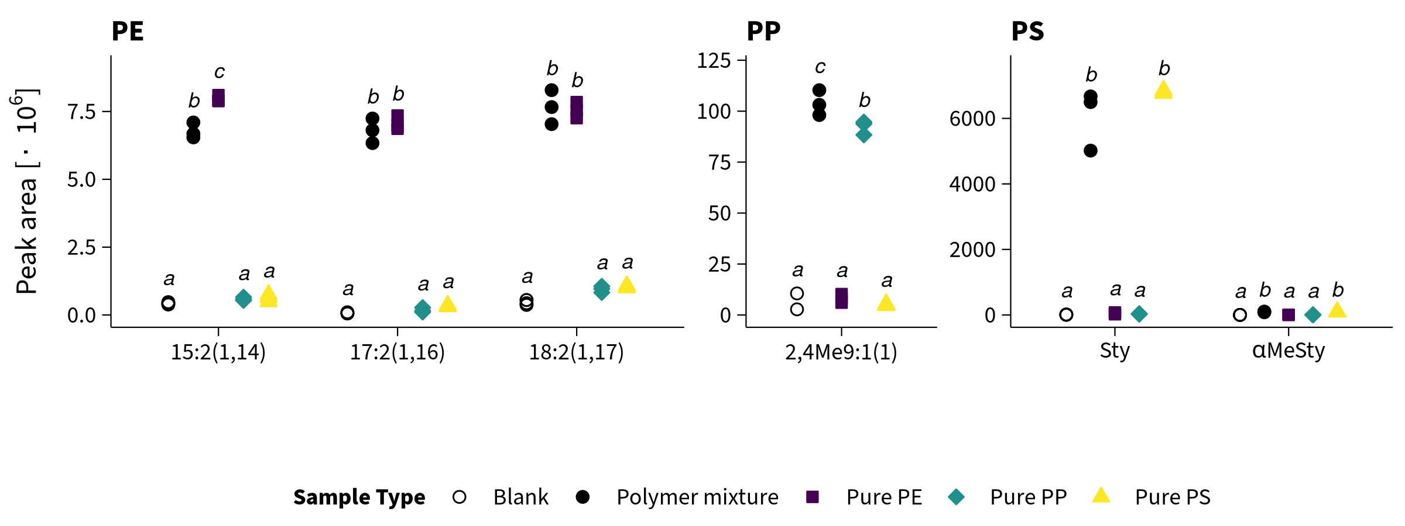
Solvent-based Py-GC/MS
Steinmetz et al. (2020) J Anal Appl Pyrol 147, 104803

Slide 59
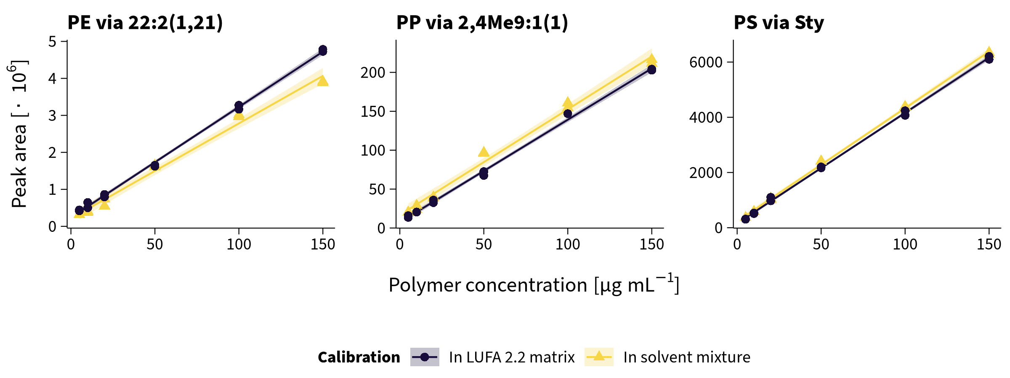
Solvent-based Py-GC/MS
Steinmetz et al. (2022) SOIL 8(1), 31–47

Slide 60
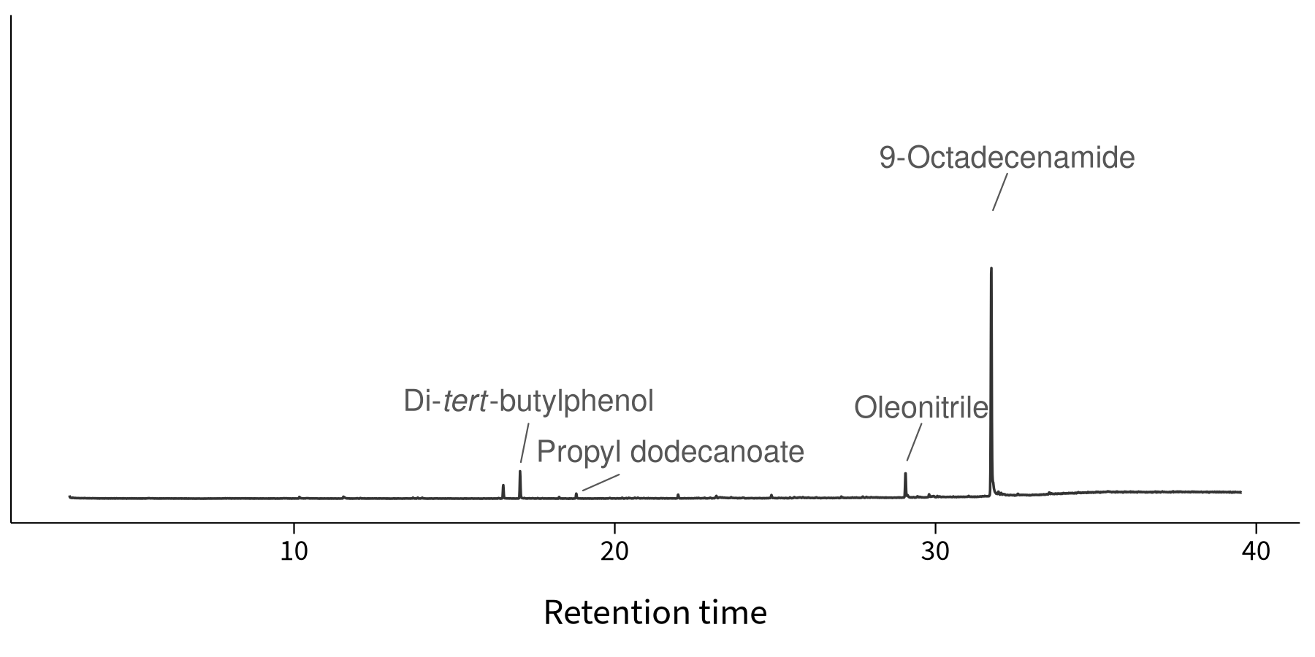
Film Additives
Steinmetz et al. (2022) SOIL 8(1), 31–47

