Slide 1
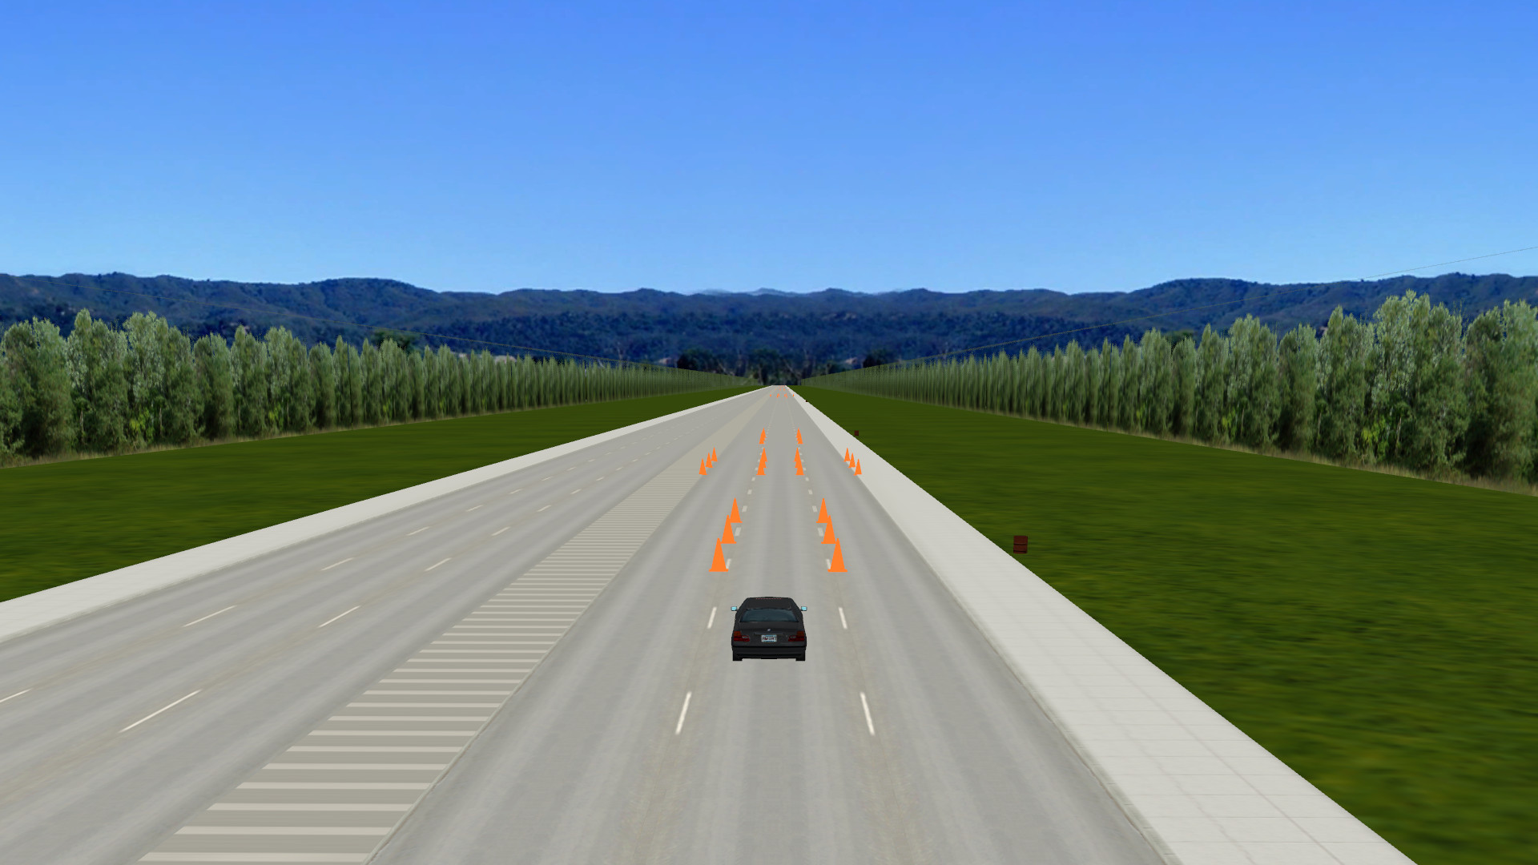

Driving Simulation Task
Double Lane Change

Slide 2
Steering State
Congruent
Normal steering
Incongruent
Reversed steering
Congruent
Incongruent

