Slide 1
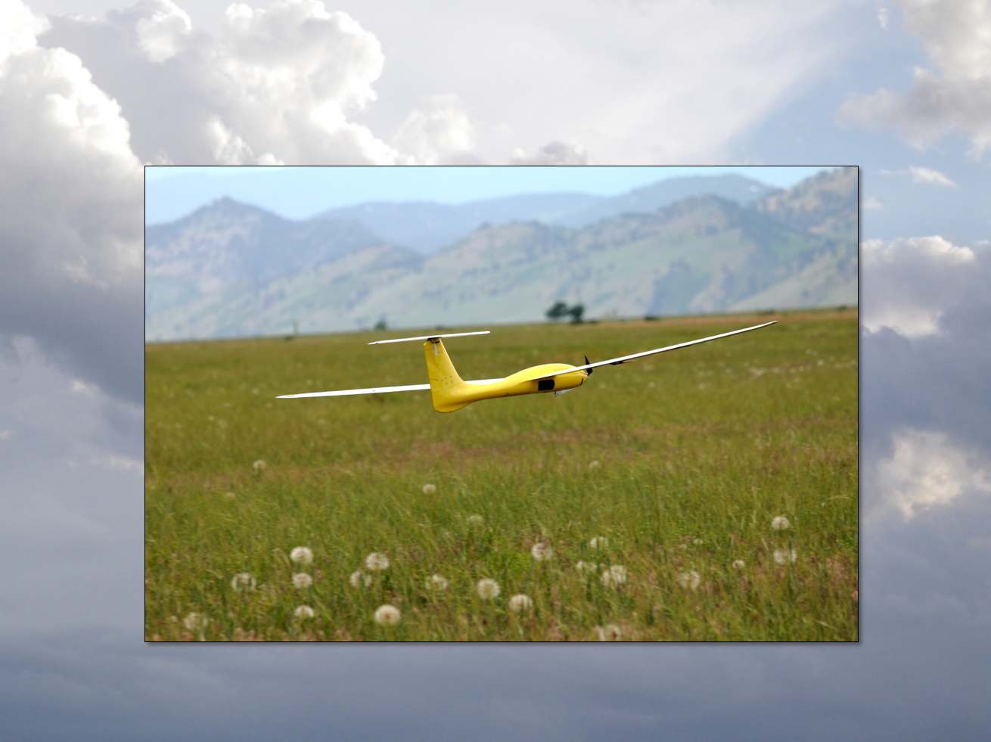
Controlled Quadrotor ODEs
Aircraft Dynamics
UNIVERSITY OF COLORADO BOULDER

Slide 2

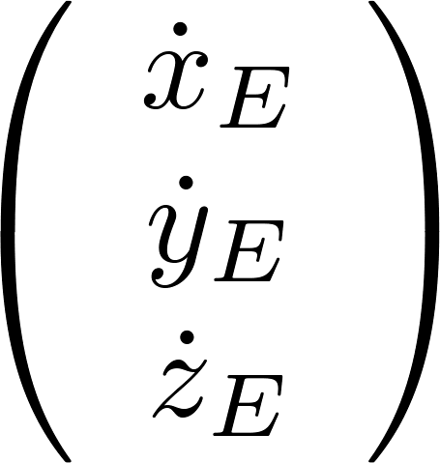
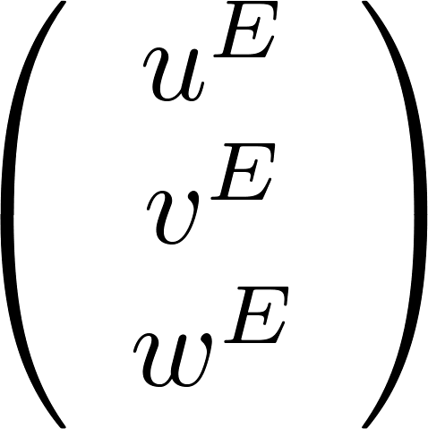

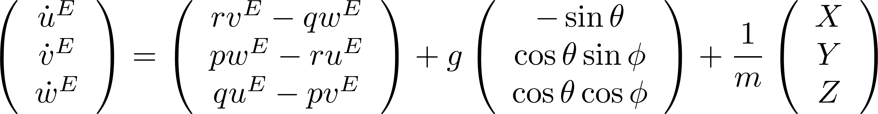

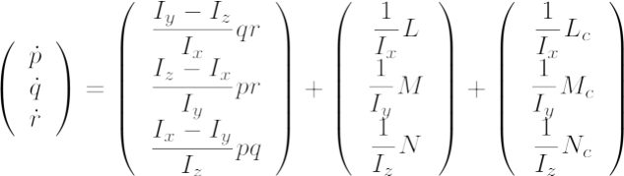


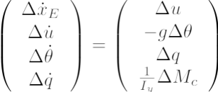
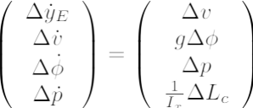

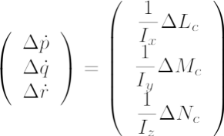


Last time: Linearization
Hover Trim Condition
+
Taylor Series Expansion
Nonlinear Quadrotor Equations of Motion
Longitudinal
Lateral
Vertical
Spin

Slide 3
Linearized Quadrotor EOM
Longitudinal
Lateral
Today: Solution of 2nd order linear ODEs
Vertical
Spin

Slide 4
Linear ODEs
Aircraft dynamics (mostly) uses this one
It is called a “state space” model.
These contain (roughly) the same information!
Always keep this in mind!

Slide 5

Roll Angle State Space Model
=
+
=
+
Notes:
At the beginning of class, I told them that there are two ways to change the dynamics of an aircraft: change the design, or add automatic control. At the end of this slide, you could ask them “What can we do here?

Slide 6

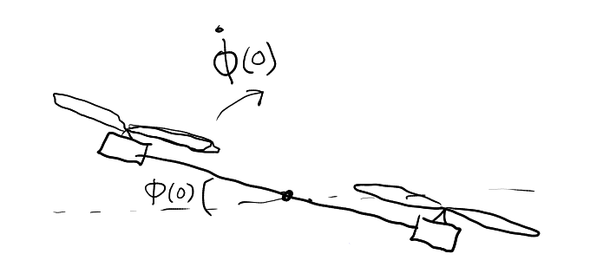
Open Loop Solution
What are the solutions?
Depends on
(hover control)
If initial conditions are nonzero, quad will crash!
(This is not usually what we want)
Notes:
At the beginning of class, I told them that there are two ways to change the dynamics of an aircraft: change the design, or add automatic control. At the end of this slide, you could ask them “What can we do here?

Slide 7

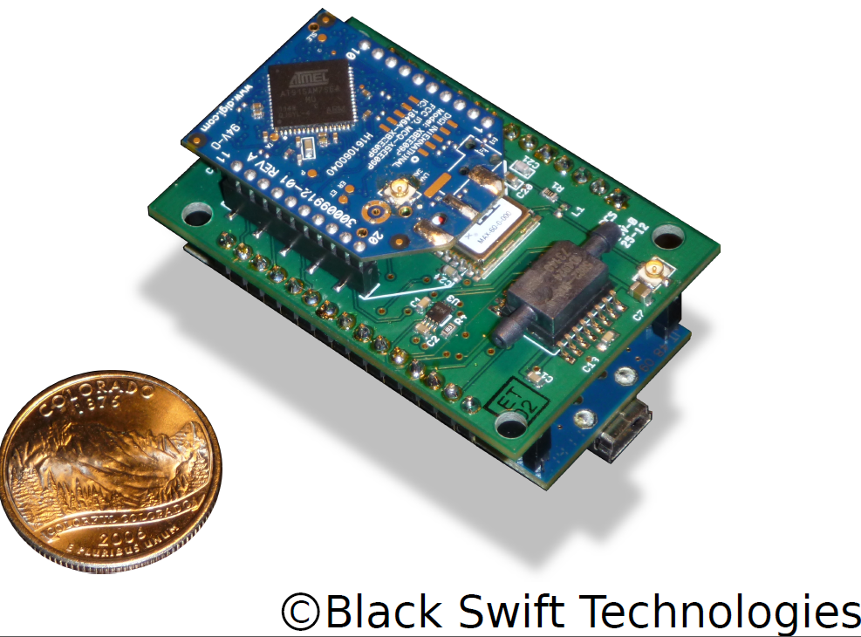


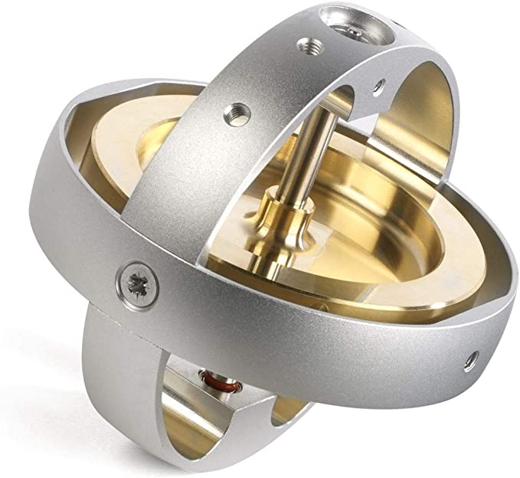
Feedback Control
Electronic System
Physical System
Aircraft
Algorithms in the flight computer
Sensors

Slide 8
Feedback Control
Electronic System
Physical System
Aircraft
Autopilot
Control
Algorithms
Algorithms in the flight computer
This is the mathematical model of the actual aircraft

Slide 9
Feedback Control
Electronic System
Physical System
Aircraft
Autopilot
Control
Algorithms
Algorithms in the flight computer
This is the mathematical model of the actual aircraft

Slide 10

Control Strategy for Roll Angle
-
-
k₁
k₂
is the closed loop dynamics matrix
Derivative
Proportional
is the closed loop state space model with controller integrated

Slide 11





Closed Loop Behavior
There are two ways mathematically to describe the resulting “closed loop behavior”

Slide 12
Closed Loop Behavior
There are two ways mathematically to describe the resulting “closed loop behavior”
Mathematically equivalent!

Slide 13




Closed Loop Behavior
2nd Order System perspective
which has roots
The response to an initial condition is determined by the natural frequency and damping ratio.

Slide 14
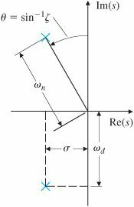
Review: Poles of a system
The roots of the characteristic equation are called the “poles” of the system and determine the dynamic stability properties
ωd = “damped natural frequency”
Im
(notation in textbook)
decaying oscillation
growing oscillation
x
x
exponential decay
exponential growth
Re
x
x
x
x
x
x

Slide 15
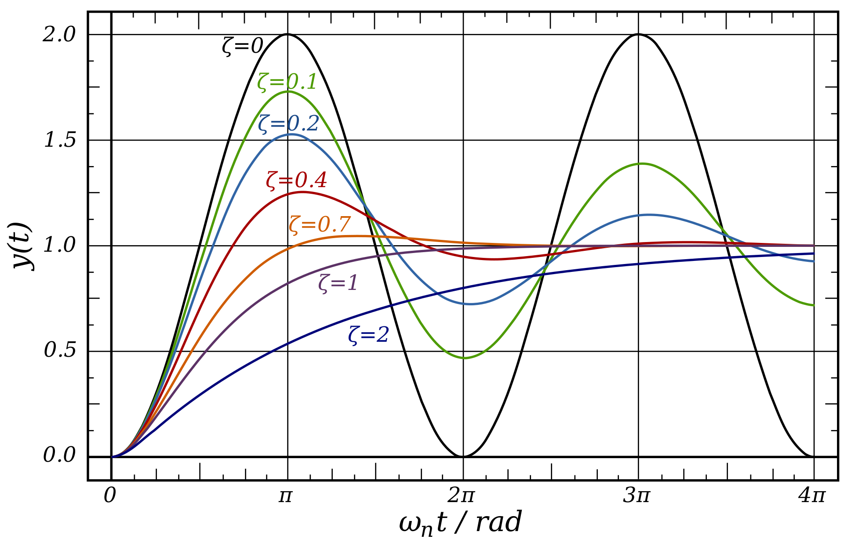
Review: Damping Ratio

Slide 16
Closed Loop Behavior
There are two ways mathematically to describe the resulting “closed loop behavior”
This closed loop state space model can be analyzed with tools from linear algebra

Slide 17

Break

Slide 18
Closed Loop Behavior
There are two ways mathematically to describe the resulting “closed loop behavior”
This “state space model” can be analyzed with tools from linear algebra

Slide 19

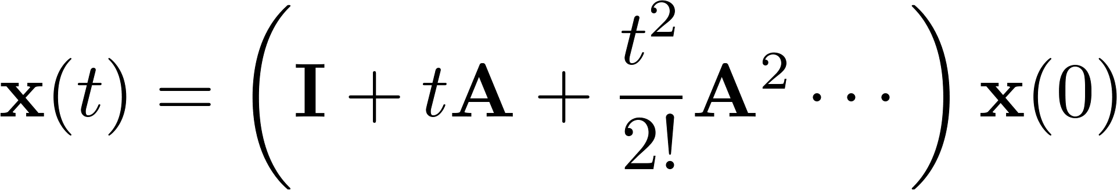

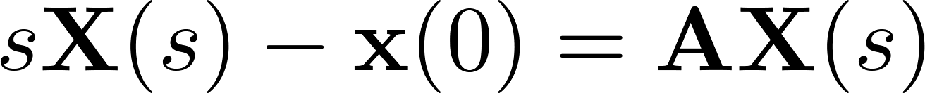
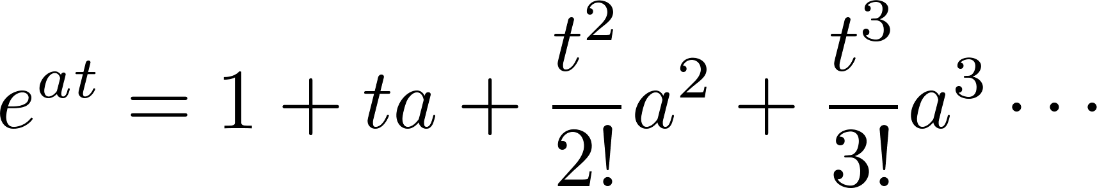
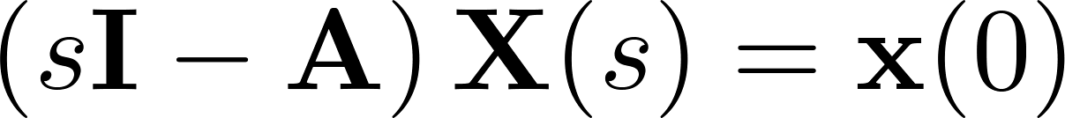
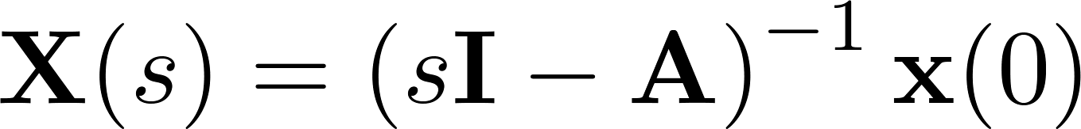
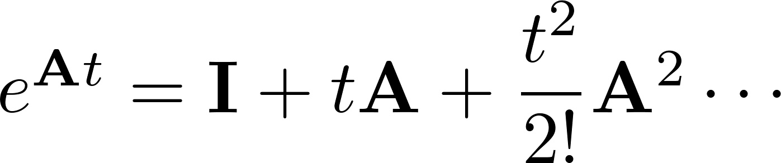
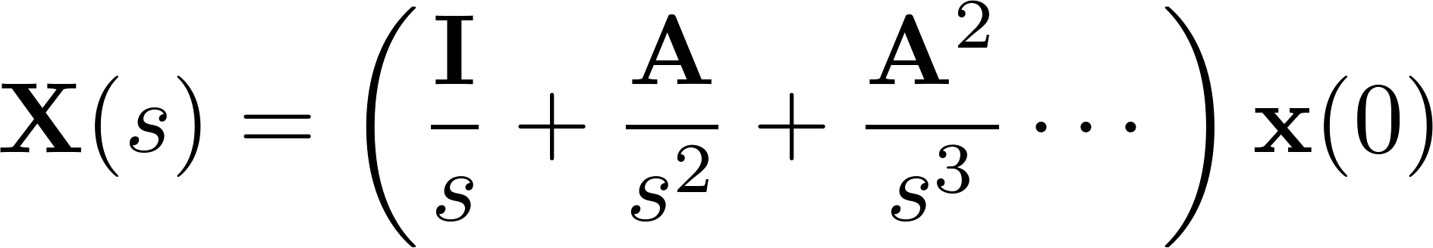
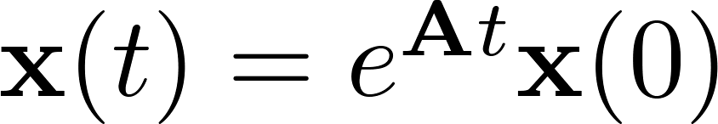
Linear System Natural Response
Take the inverse Laplace transform
Consider natural response
Take the Laplace transform
This looks familiar…
We make the definition (need to be careful not to infer too many properties
Taylor series expansion
So we have

Slide 20
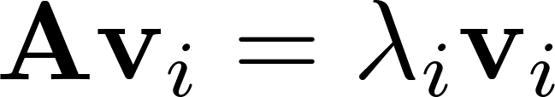
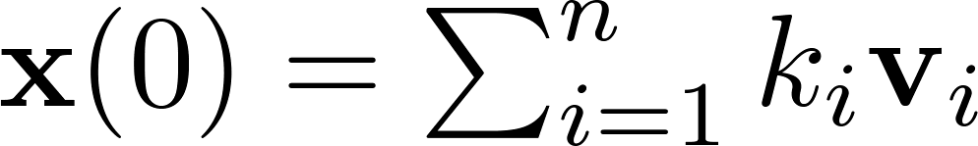
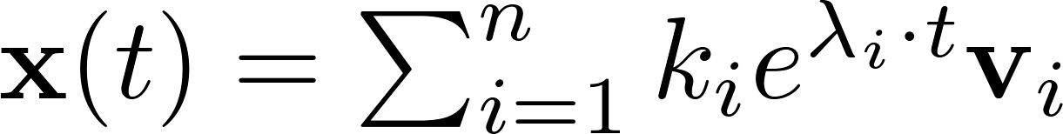
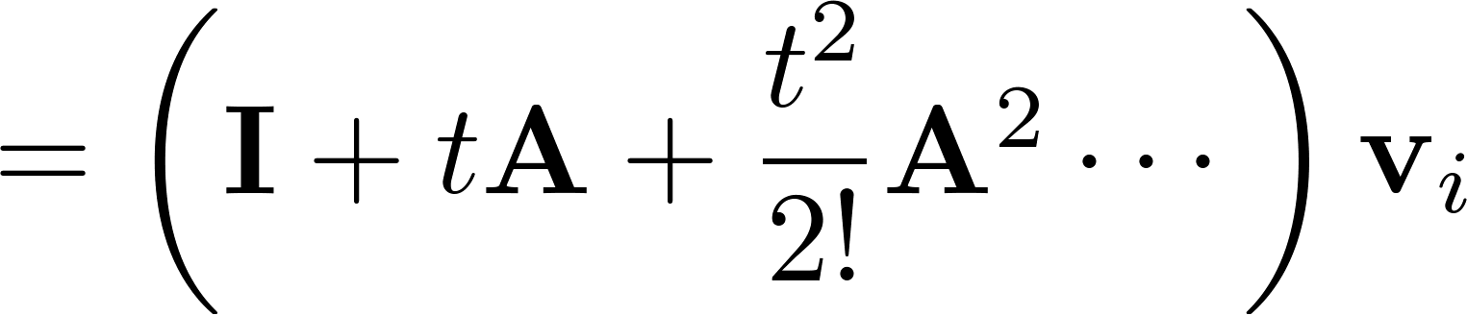
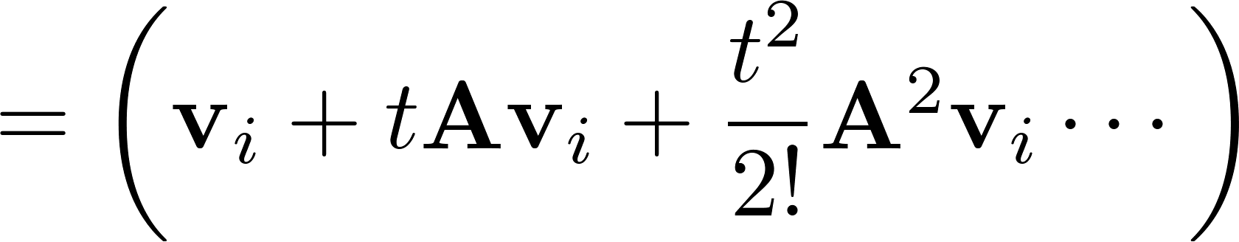
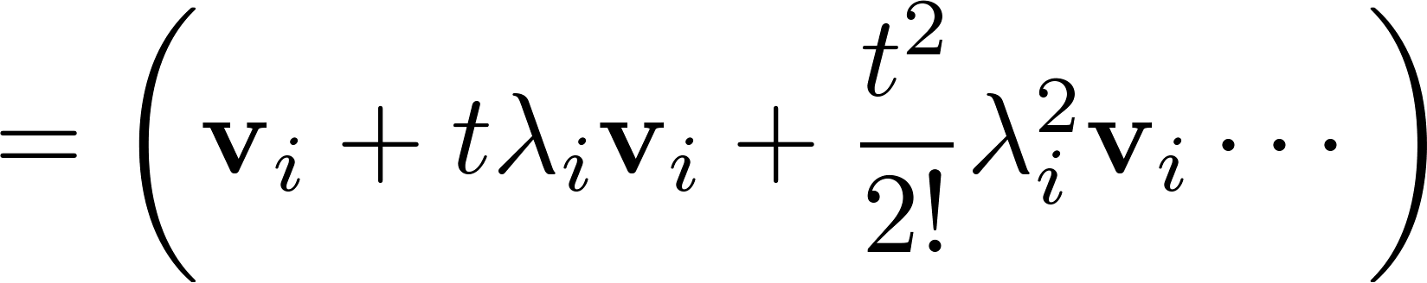
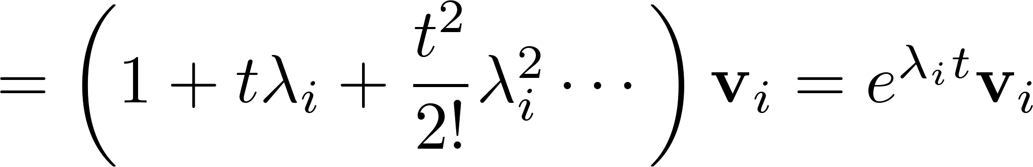
Modal Analysis
Recall eigenvectors and eigenvalue
When initial condition is
Consider the initial condition vector as one of the eigenvalues
The solution is
This is a critical fact! For eigenvector, matrix exponential solution becomes scalar exponential times the vector -> components stay in relative proportion

Slide 21
Review: Eigen Analysis
Only has solutions when the determinant of A – λ I is zero.
For a 2x2 matrix:
Solve via quadratic formula

Slide 22
Control via Pole Assignment
Given: State-Space System, Desired pole locations (or natural frequency and damping ratio)
Task: Find gains to place poles in desired locations
Desired:
Quadratic Formula

Slide 23
Next Time:
State space analysis of entire quadrotor linear system

