Slide 1

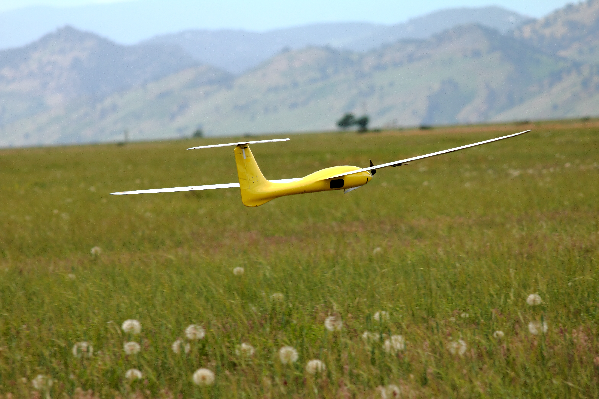
Final Review
ASEN 3128 Aircraft Dynamics
UNIVERSITY OF COLORADO BOULDER

Slide 2
Announcements
Final Exam: Saturday, May 4th 7:30-10pm
Last Reading Quiz due Tonight
FCQs, TA feedback due tonight (see Piazza)

Slide 3
Outline
Learning Goals
Summary of Material

Slide 4
Aircraft Dynamics
Newton’s Laws (ASEN 2703)
Inertial
Reference Frame
+ Aerodynamics (ASEN 2702,
ASEN 3711)
Body
Reference Frame
Aircraft Dynamics (ASEN 3128)

Slide 5
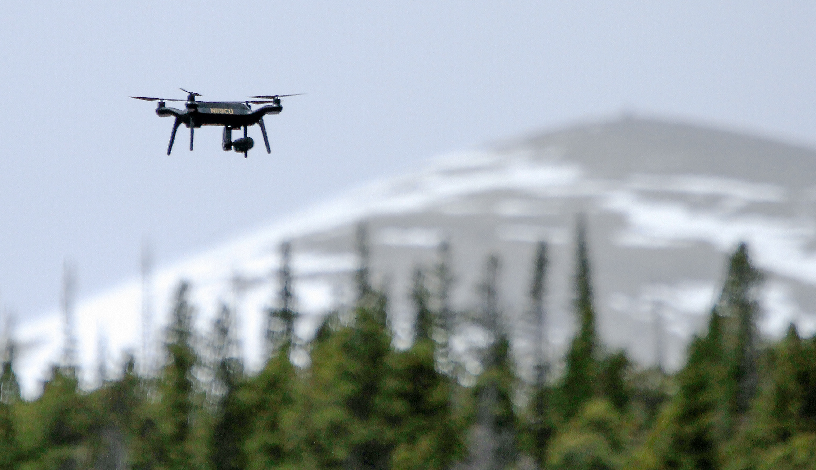
Learning Goals
How aircraft dynamics models are constructed
How dynamics are simulated numerically
How dynamical behavior is understood and specified
How control is designed to achieve behavioral objectives
Specific understanding of “how aircraft work” for a multirotor drone and a conventional (fixed-wing) airplane

Slide 6
Course Material
Nomenclature
Aircraft Static Stability
Euler Angles
Aircraft Equations of Motion (Kinematics + Dynamics)
Linearized Equations
Quadrotor Equations of Motion
Quadrotor Stability and Control
Longitudinal Dynamics of Conventional (Fixed-Wing) Aircraft
Lateral Dynamics of Conventional (Fixed Wing) Aircraft
State Space and Transfer Function-based Analysis
Mode Approximations
Conventional Aircraft Control

Slide 7
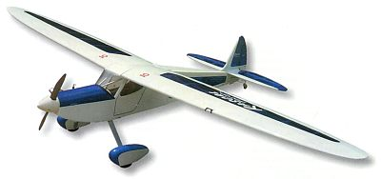
Nomenclature and Notation
The single best way to succeed in this class is to pay attention to the nomenclature and notation.
Precision in notation is critical, both to understanding a problem and in presenting a solution.

Slide 8
Body Axes
Note, vectors are denoted by the arrow (lectures) or bold
Aircraft dynamics and control are best described in a coordinate system defined by the aircraft body
  Often called the “body coordinate system”
  Defines positive sign convention for all vectors (velocity, acceleration, force)

Slide 9
Coordinate Systems
F_{E}=F_{I}
F_{B}
Two main reference frames / coordinate systems
  F_{B} = Body coordinate system: Aerodynamic forces determined best
  F_{E} = F_{I} = Inertial coordinate system: Newton’s Laws apply
Superscripts denote what frame vector is relative to
Subscripts denote what coordinate system vector is written in
= inertial velocity written in body coordinate system

Slide 10
Coordinate Systems
F_{E}=F_{I}
F_{B}
Two main reference frames / coordinate systems
  F_{B} = Body coordinate system: Aerodynamic forces determined best
  F_{E} = F_{I} = Inertial coordinate system: Newton’s Laws apply
Source of most confusion deriving A/C equations of motion is representing inertial vectors in body coordinate systems
Superscripts denote what frame vector is relative to
Subscripts denote what coordinate system vector is written in
= inertial velocity written in body coordinate system

Slide 11
Aerodynamic Forces and Moments
Y
y
M
L
X
x
N
z
Z
Aerodynamic Force and moment components are represented by capital letters

Slide 12
Inertial Velocity Components
v^{E}
y
u^{E}
x
Note: Diagram denotes variable association to body axes. Value of (u^{E} v^{E},w^{E}) is projection of velocity vector onto appropriate axis. Many students get this wrong on exams!
z
w^{E}
The inertial (linear) velocity is express in body coordinates
  Aircraft ground speed V_{g} can be derived from GPS measurements

Slide 13
Inertial Angular Velocity
y
q
p
x
r
z
The inertial angular velocity is also expressed in body coordinates
  Components can be measured by rate gyros

Slide 14
Four Control Surfaces
Y
Rudder δ_{r}
+ δ_{r} = toward -y = negative moment, positive force
Elevator δ_{e}
+ δ_{e} = down = negative moment, negative force
x
Aileron δ_{a}
+ δ_{a} = right (+ y) down = negative moment
Throttle δ_{t}
+ δ_{t} = no moment, positive force
z
We will focus on a standard aircraft with four control surfaces
  3 actual surfaces plus throttle

Slide 15
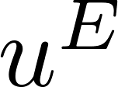
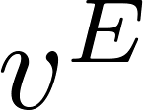
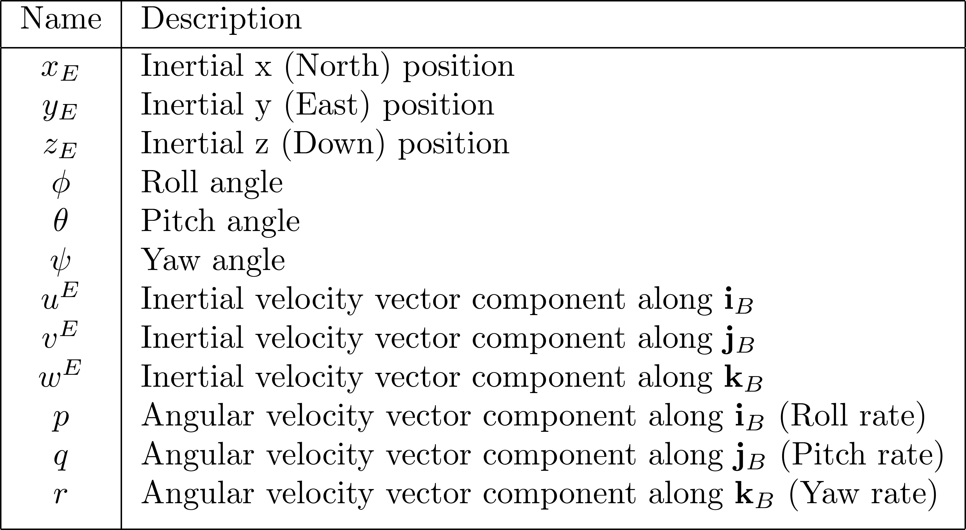
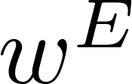
Aircraft State Variables

Slide 16
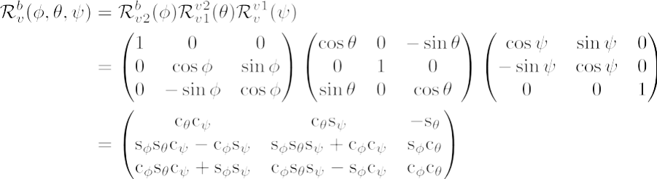
Inertial Frame to Body Frame Transformation
x_{b}
x
y_{b}
y
z_{b}
z
“1” “2” “3”
B
B
E
E
etc.

Slide 17

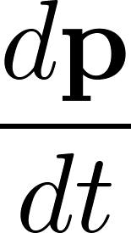
Vector Derivatives
Consider the vector
is the time rate of change of the vector
If was the inertial position of an aircraft, then
would be the inertial velocity.

Slide 18

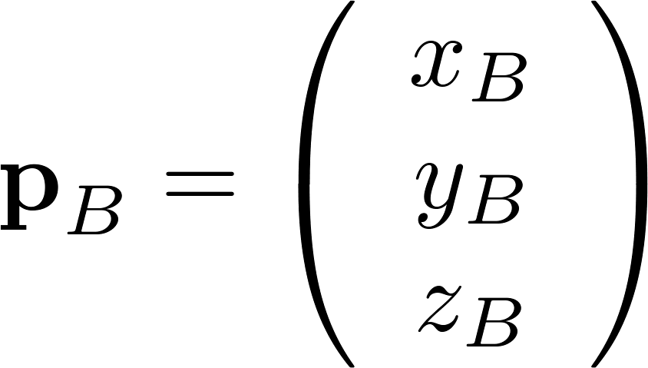
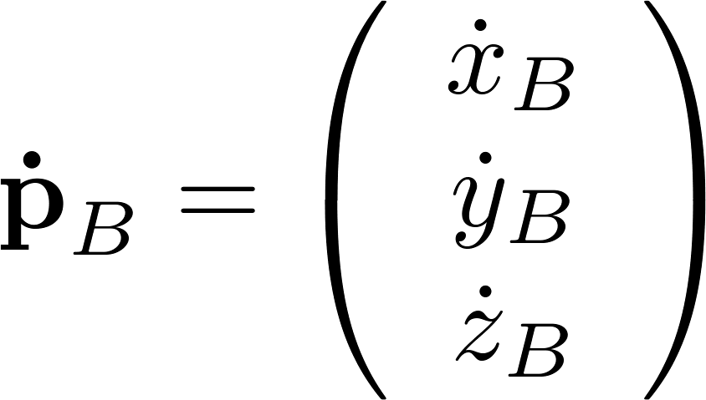
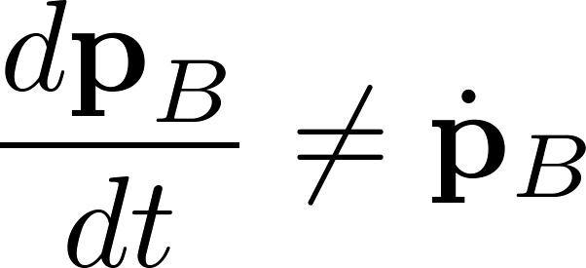
Vector Derivatives
Now consider the vector written in a particular coordinate frame, e.g. the body coordinate system
The time rates of change of the individual components of the vector is defined to be
If the reference frame F_{B} is rotating then

Slide 19
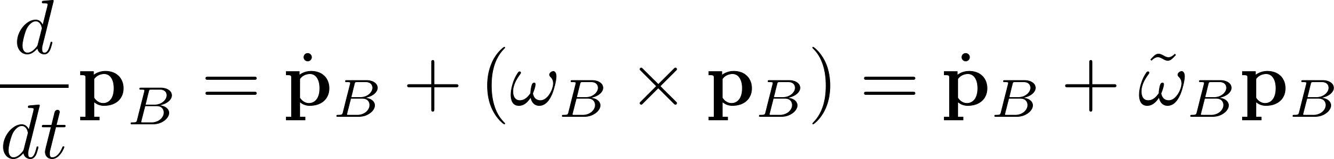
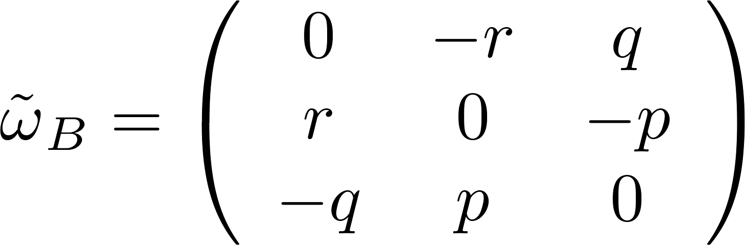
Differentiation of a Vector

Slide 20
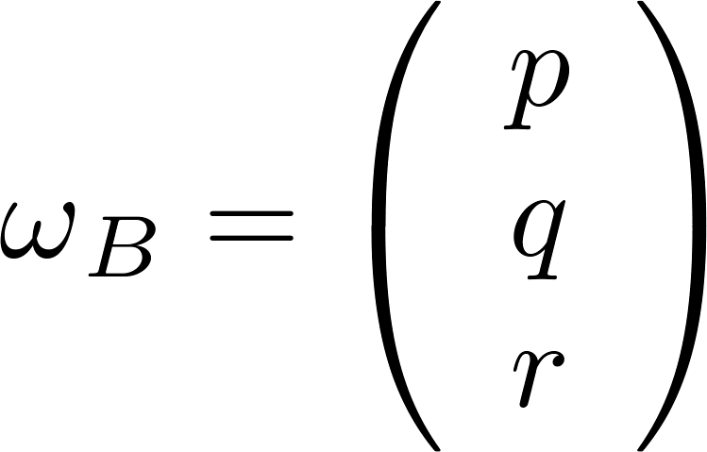
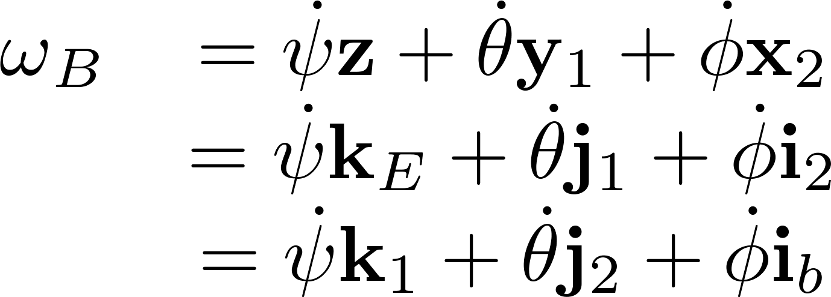
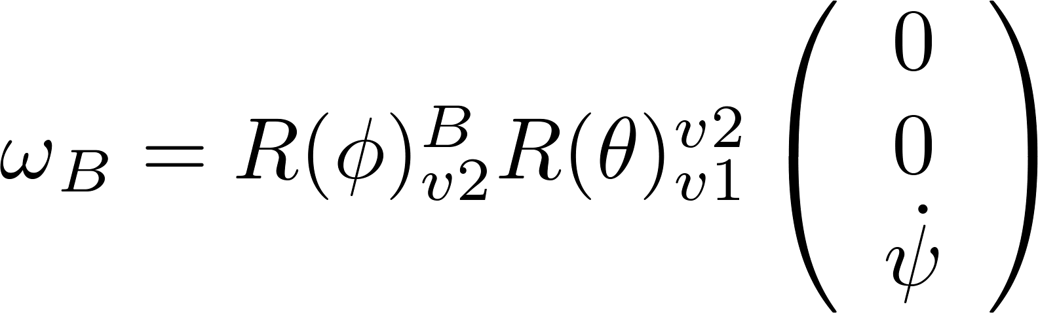
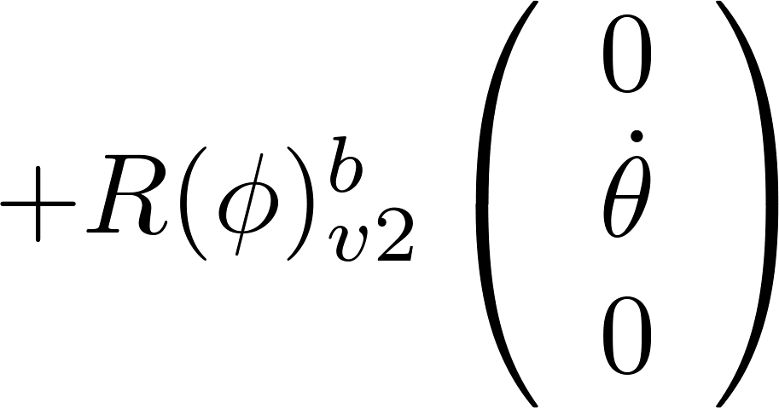
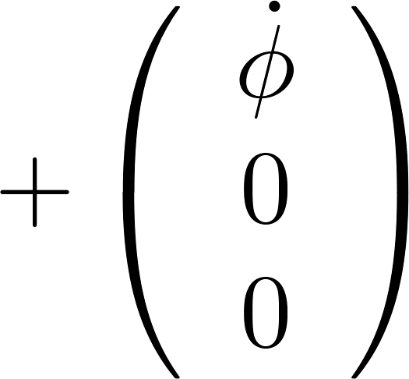
Rotational Kinematics
x₂, x_{b}
θ
x
Angular velocity of the aircraft (body coordinate system) with respect to the inertial coordinate system, expressed in body coordinates.
ψ
y_{b}
φ
x₁
y₁, y₂
ψ
y
φ
z_{b}
θ
z, z₁
z₂
book’s notation

Slide 21
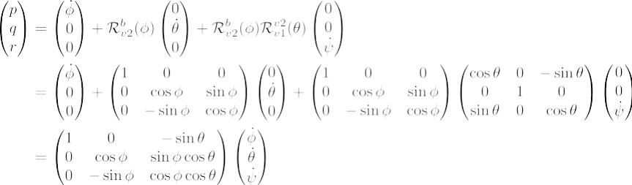


Rotational Kinematics
Inverting gives:
Not rotation matrices (not orthonormal)
Vector form:
My notation

Slide 22

Kinematic Equations
Six of the 12 state equations for the aircraft come from the kinematic
equations relating positions and velocities:
“Orientation vector” not in a coordinate system
(Also referred to as “attitude” or just “Euler angles”)
The remaining six equations will come from applying Newton’s 2nd law
to the translational and rotational motion of the aircraft.

Slide 23
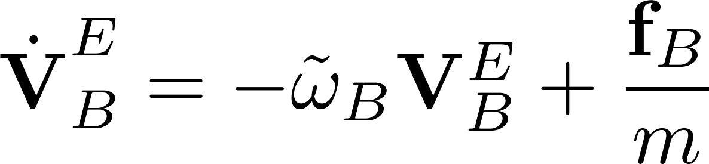
Dynamic Equations
The remaining six equations for the aircraft come from the dynamic
equations relating derivatives of velocities and forces and moments:

Slide 24
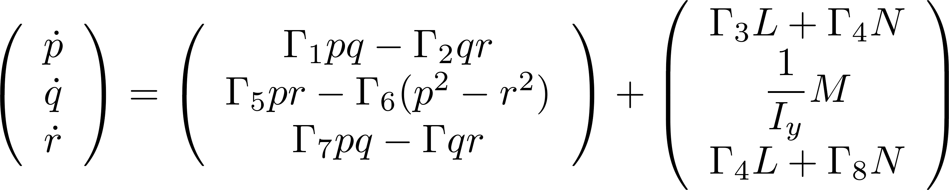
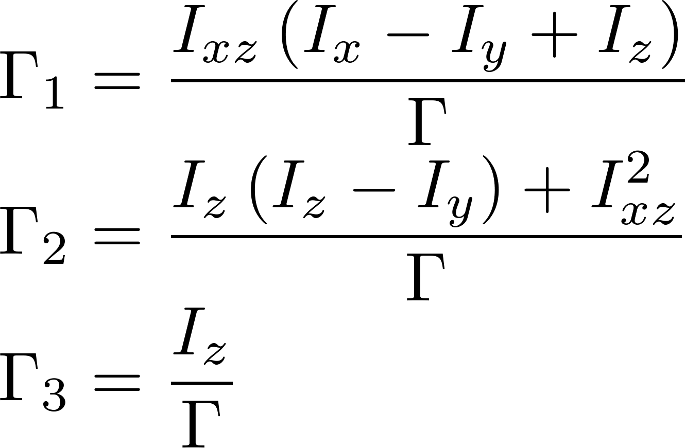
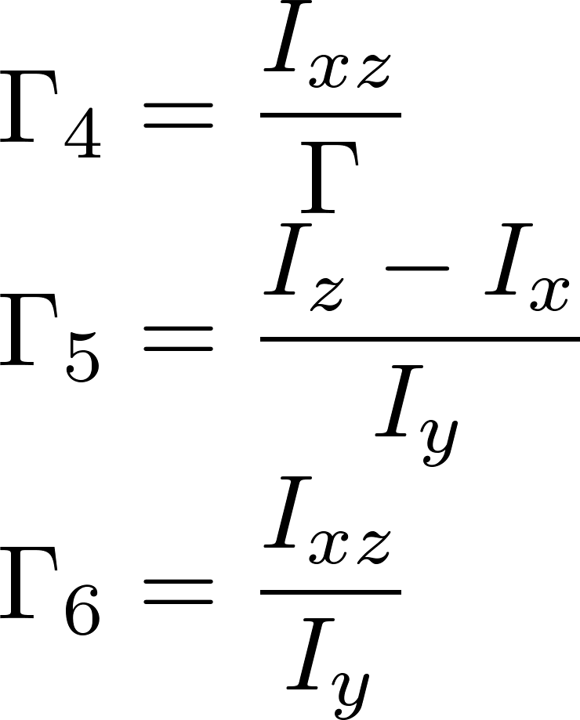
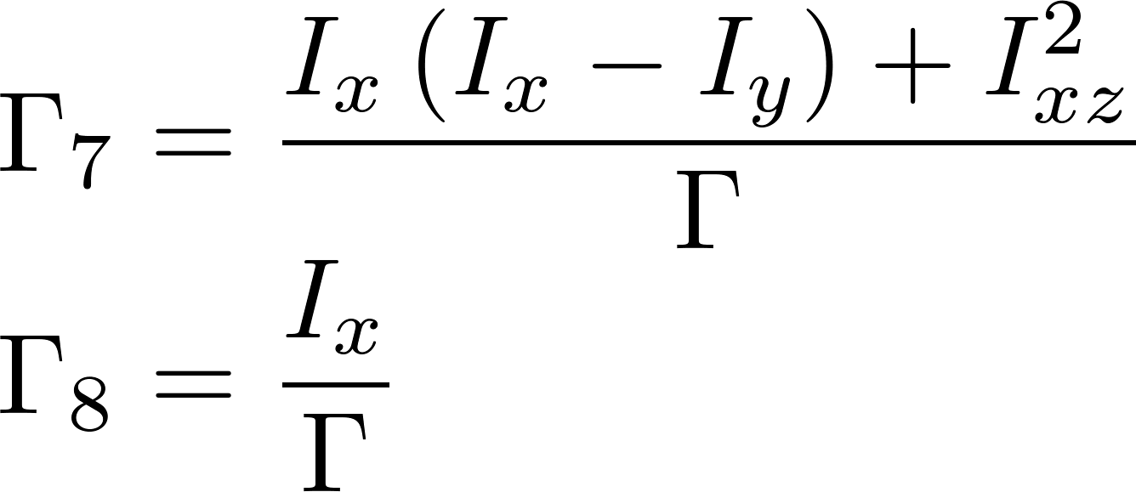
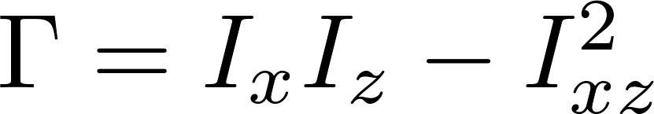
Rotational Dynamics
1
Same as Eq. 4.5,9, though book does not give the equations in this form

Slide 25

Equation of Motion in Vector Form

Slide 26

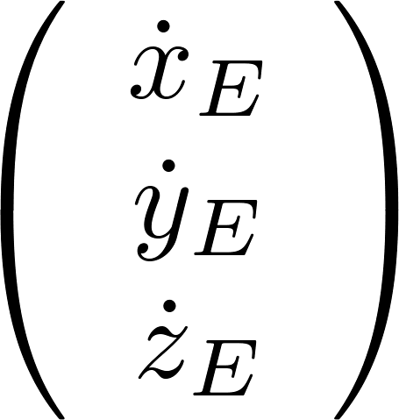
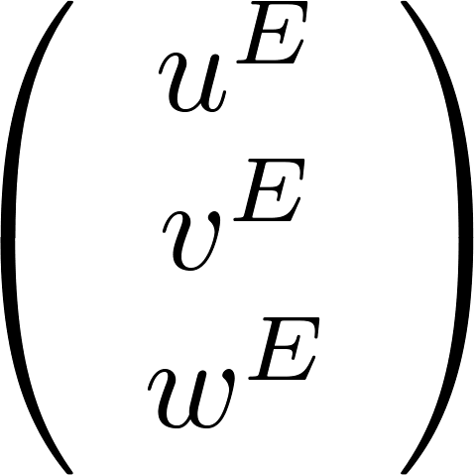

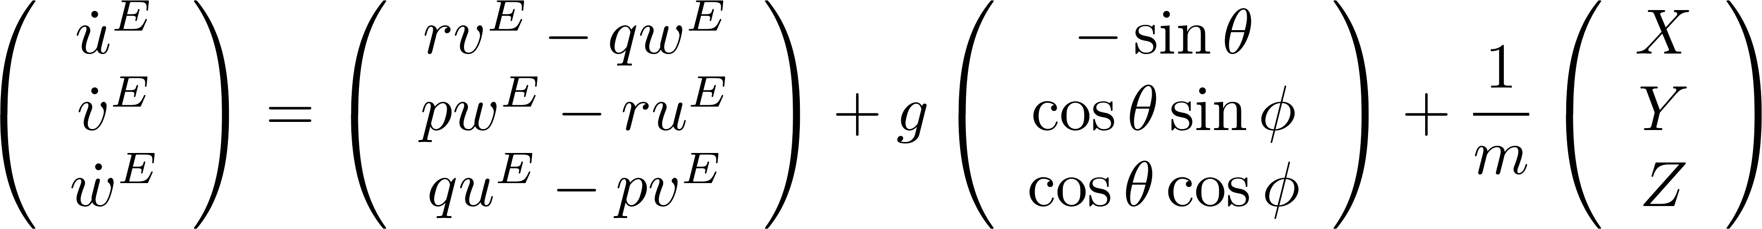
Equation of Motion Summary
1

Slide 27

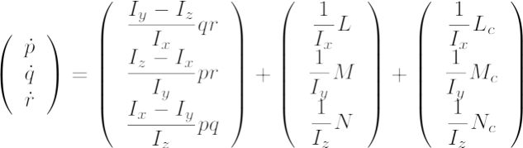
Quadrotor Equations of Motion

Slide 28
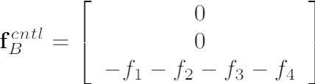



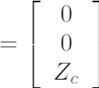



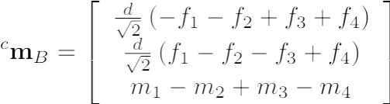


Control Forces and Moments
4
1
d
3
2

Slide 29
Equilibrium and Static Stability
Equilibrium = The states do not change without a disturbance or control action
  Derivative of the state vector is zero (almost)
Static stability = Consider the equilibrium condition and whether aircraft returns to condition after small perturbation
Dynamic Stability = Details of how a system returns to equilibrium
For aircraft we call the equilibrium condition the “trim condition”
For fixed-wing aircraft the trim condition is
  “Straight, level, unaccelerated flight (SLUF)”
For a quadrotor the trim state is
  “Hovering”
  “Steady hover”

Slide 30






Trim Condition
In a “steady hover” equilibrium condition
Subscript 0 denotes trim value
Any constant value

Slide 31
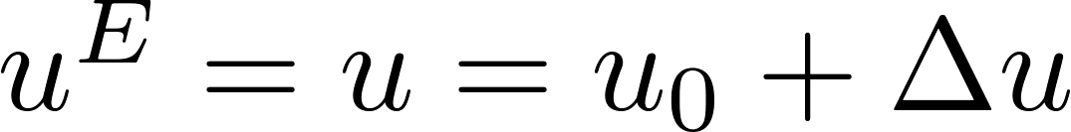
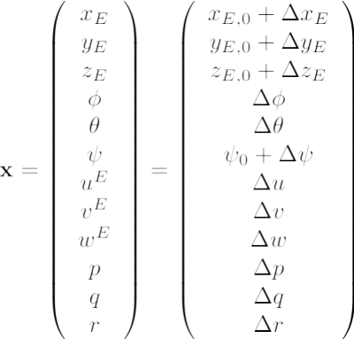

Small Variations
Can describe variables as reference condition (“trim condition”) plus small variation, e.g

Slide 32
Linearization

Slide 33
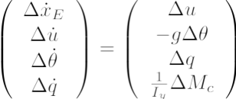
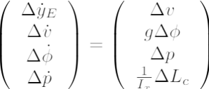


Linearized Quadrotor EOM
Longitudinal
Lateral
Vertical
Spin

Slide 34

Unleash the Memes!

Slide 35

My understanding of control systems:

Slide 36
Longest Flight Ever?

Slide 37
Longest Flight Ever?
64 days, 22 hours, 19 minutes

Slide 38

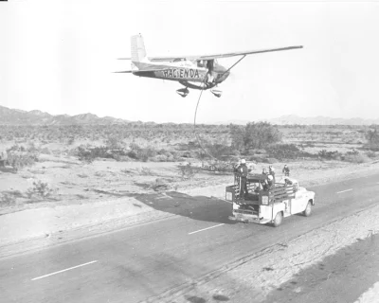
Longest Flight Ever?
64 days, 22 hours, 19 minutes
Oil changes
Several hours when both pilots were asleep

Slide 39
Break

Slide 40
Course Material
Nomenclature
Aircraft Static Stability
Euler Angles
Aircraft Equations of Motion (Kinematics + Dynamics)
Linearized Equations
Quadrotor Equations of Motion
Quadrotor Stability and Control
Longitudinal Dynamics of Conventional (Fixed-Wing) Aircraft
Lateral Dynamics of Conventional (Fixed Wing) Aircraft
State Space and Transfer Function-based Analysis
Mode Approximations
Conventional Aircraft Control

Slide 41
Linear ODEs
Aircraft dynamics (mostly) uses this one
It is called a “state space” model.
These contain (roughly) the same information!
Always keep this in mind!

Slide 42





MIMO Linear Systems
Two representations
State Space Model
Transfer Function
Matrix

Slide 43

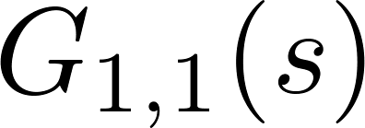



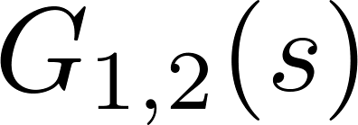
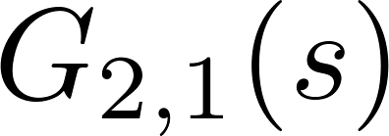

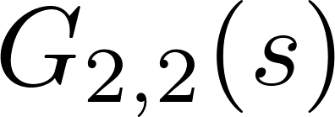
MIMO Linear Systems
Two representations
Each transfer function has same denominator, different numerator

Slide 44
Translating between representations

Slide 45
Laplace Transforms

Slide 46

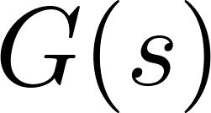

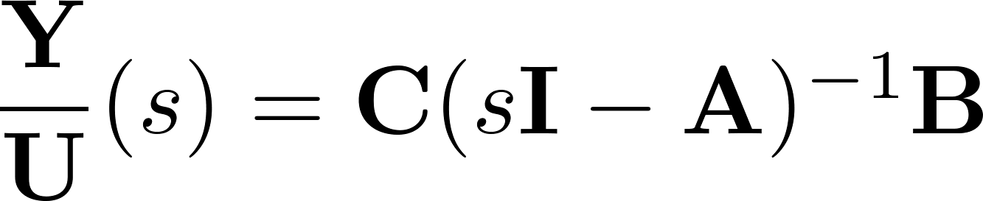
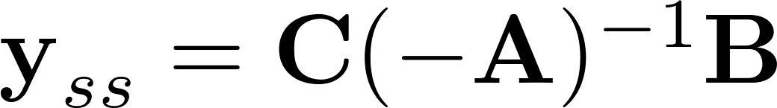
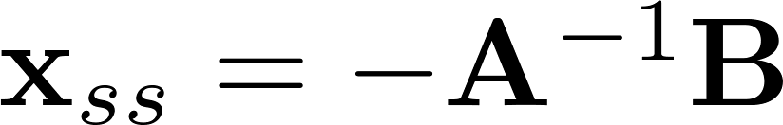
Final Value Theorem
Given a stable transfer function , the final value in steady state
for a unit step input is
Intuition: In steady state all derivatives, which as represented by ‘s’, are zero

Slide 47
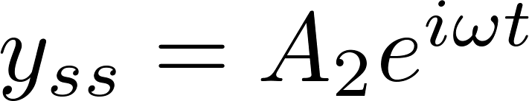
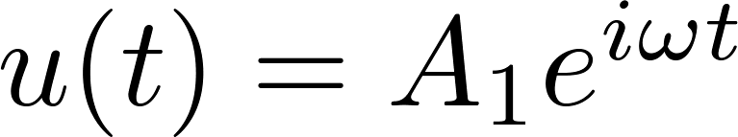
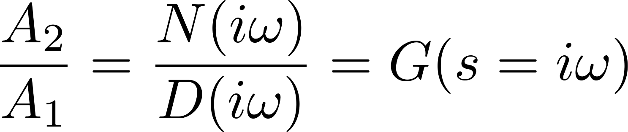
Frequency Response

Slide 48
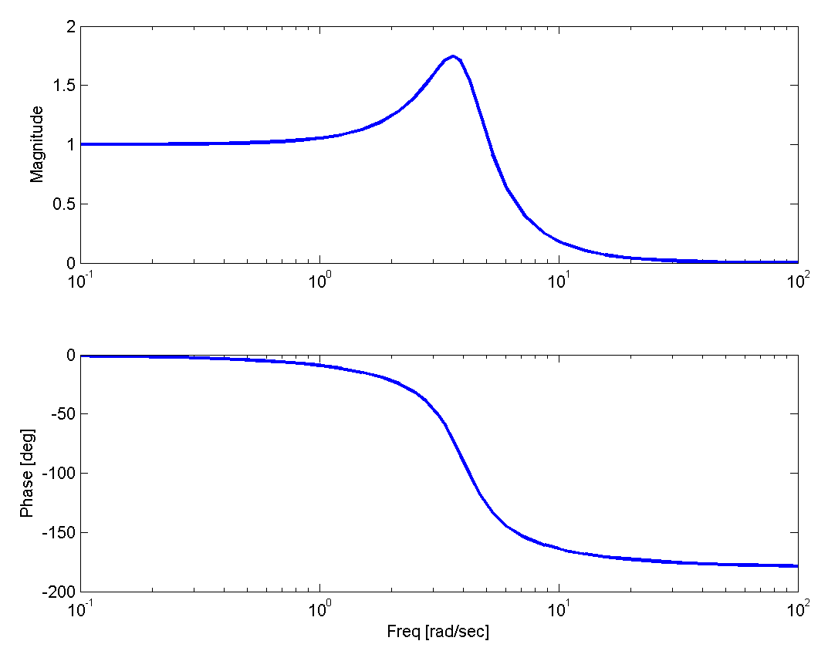


Frequency Response Example
Second order system

Slide 49



Modal Analysis
When initial condition is
Eigenvalues are solutions to the characteristic equation,
The solution is
For second order system,
but the characteristic equation could be higher order!
eigenvalue
eigenvector
Image from Franklin, Powell, and Emami-Naeini
Roots of the transfer function denominator are the eigenvalues of A!

Slide 50

Root Locus: Effect of CG Location
Open-loop (A) eigenvalues
Two nominal poles hidden under blue markers
Both the damped and undamped natural frequencies increase.

Slide 51

Impulse Response Example
Second order system

Slide 52

Step Response Example
Second order system

Slide 53



Phasor Plot

Slide 54
Feedback control
Let’s consider a feedback control law
which we can implement by measuring the roll rate and roll angle and "feeding them back” into the command for the roll moment.

Slide 55






Closed Loop Behavior
There are two ways mathematically to describe the resulting “closed loop behavior”
Mathematically equivalent!

Slide 56

Closed Loop Behavior
Original system, “plant”
Control law
Closed loop dynamics
The eigenvalues and eigenvectors of this closed loop state space matrix describe the “closed loop behavior”.

Slide 57






Feedback Control: Pitch
Should be able to
derive transfer functions for simple block diagrams
pick gains for simple controllers

Slide 58
General Approach to Control Design by Hand
Write down the control law
Determine the closed-loop representation of the system
Find the performance indicating variables (usually eigenvalues of closed-loop system)
Calculate gains to achieve goal
or

Slide 59
Optimal Control: LQR

Slide 60
Questions

Slide 61

Question from Piazza

Slide 62

Most Missed Quiz Questions

Slide 63

Most Missed Quiz Questions

Slide 64

Most Missed Quiz Questions

Slide 65

Most Missed Quiz Questions

Slide 66

Most Missed Quiz Questions

Slide 67

Most Missed Quiz Questions

Slide 68

Most Missed Quiz Questions

Slide 69

Most Missed Quiz Questions

Slide 70
Outline
Example Problems
Questions

Slide 71
From 2019 Exam
TRUE or FALSE?
Improving the damping ratio of the spiral mode is a major design objective of lateral stability augmentation system design.

Slide 72
From 2019 Exam
TRUE or FALSE?
Improving the damping ratio of the spiral mode is a major design objective of lateral stability augmentation system design.
The spiral mode has a real eigenvalue, so it does not have a damping ratio.

Slide 73
From 2019 Exam
TRUE or FALSE?
For the augmented lateral dynamical system with x_{lat} = [Δv, Δp, Δr, Δφ, Δψ, Δy]^{T}, the control law u = -K* x_{lat} may have no effect on certain eigenvalues of the system.

Slide 74
From 2019 Exam
TRUE or FALSE?
For the augmented lateral dynamical system with x_{lat} = [Δv, Δp, Δr, Δφ, Δψ, Δy]^{T}, the control law u = -K* x_{lat} may have no effect on certain eigenvalues of the system.
Feedback of the first four terms does not change the eigenvalues associated with the last two terms, ie the zero eigenvalues.

Slide 75
From 2019 Exam
TRUE or FALSE?
Near trim for straight and level airplane flight, the rate of change in bank angle at time t depends on the bank angle at time t.

Slide 76

From 2019 Exam
TRUE or FALSE?
Near trim for straight and level airplane flight, the rate of change in bank angle at time t depends on the bank angle at time t.
Bank angle not in the linear equation for time rate of change of bank angle

Slide 77
From 2019 Exam
TRUE or FALSE?
For straight and level flight, an airplane’s change in roll rate near trim at time t generally depends on the change in sideslip angle near trim at time t.

Slide 78


From 2019 Exam
TRUE or FALSE?
For straight and level flight, an airplane’s change in roll rate near trim at time t generally depends on the change in sideslip angle near trim at time t.

Slide 79

From 2019 Exam
TRUE or FALSE?
Aircraft 1 and Aircraft 2 are identical except for one feature: the vertical tail for Aircraft 1 is above the centerline of the fuselage whereas the vertical tail for Aircraft 2 is below. .

Slide 80
From 2019 Exam
TRUE or FALSE?
Aircraft 1 and Aircraft 2 are identical except for one feature: the vertical tail for Aircraft 1 is above the centerline of the fuselage whereas the vertical tail for Aircraft 2 is below. .

Slide 81
Advanced Bonus Question
The augmented (six state) state space matrices for the lateral and longitudinal dynamics of an aircraft both have two eigenvalues of zero (λ₅ = 0, λ₆ = 0). Further, they both have the same eigenvector x₆ = [0, 0, 0, 0, 0, 1]^{T} associated with one of these eigenvalues. Why are the other eigenvectors associated with λ₅ = 0 different?

Slide 82

Advanced Bonus Question
The augmented (six state) state space matrices for the lateral and longitudinal dynamics of an aircraft both have two eigenvalues of zero (λ₅ = 0, λ₆ = 0). Further, they both have the same eigenvector x₆ = [0, 0, 0, 0, 0, 1]^{T} associated with one of these eigenvalues. Why are the other eigenvectors associated with λ₅ = 0 different?

Slide 83
Questions?

