Slide 1
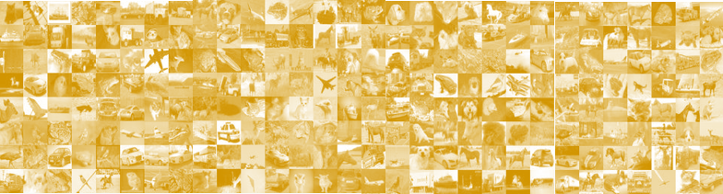
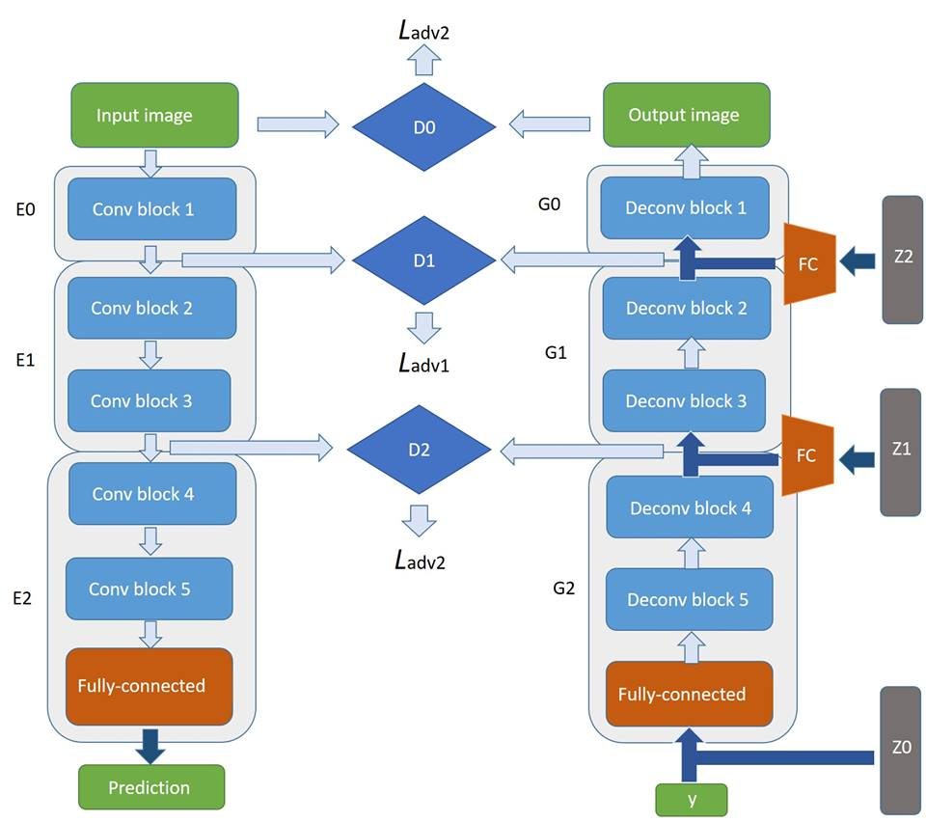
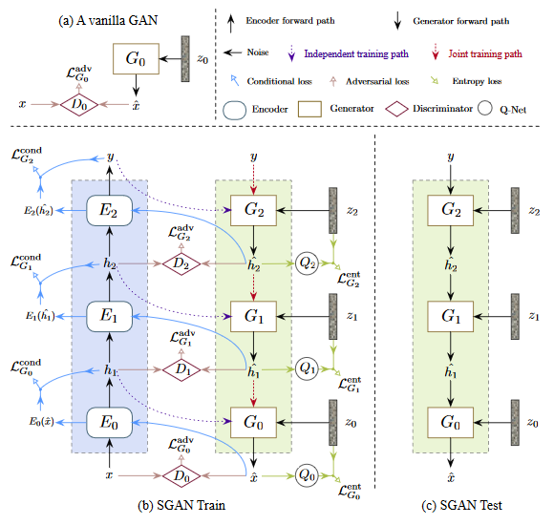
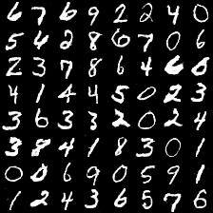
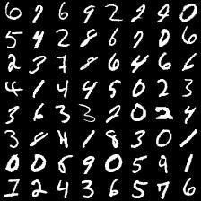
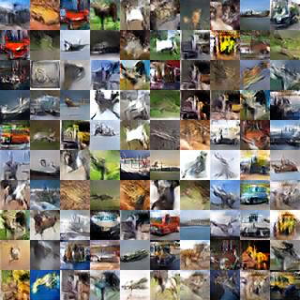
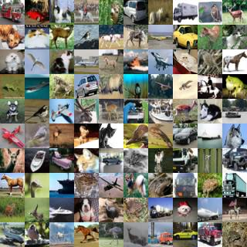
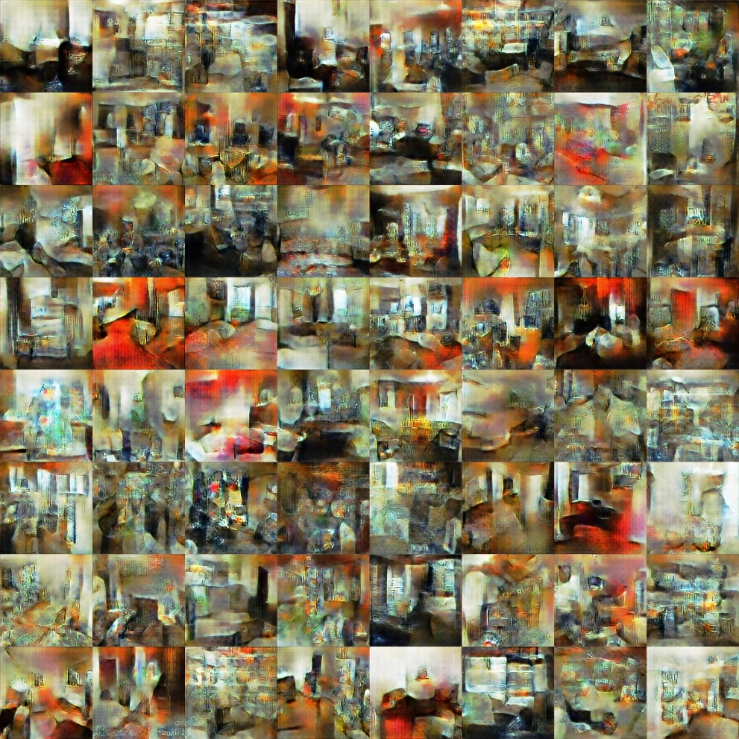
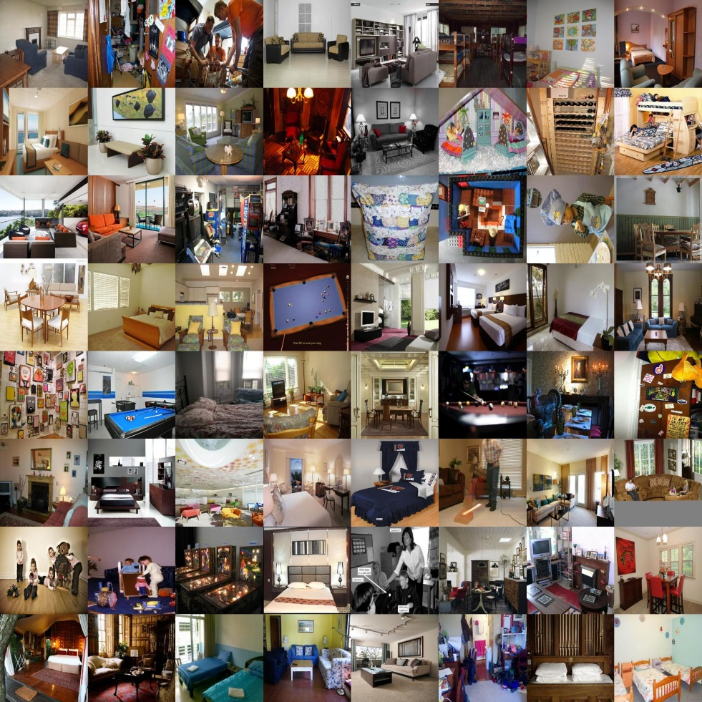
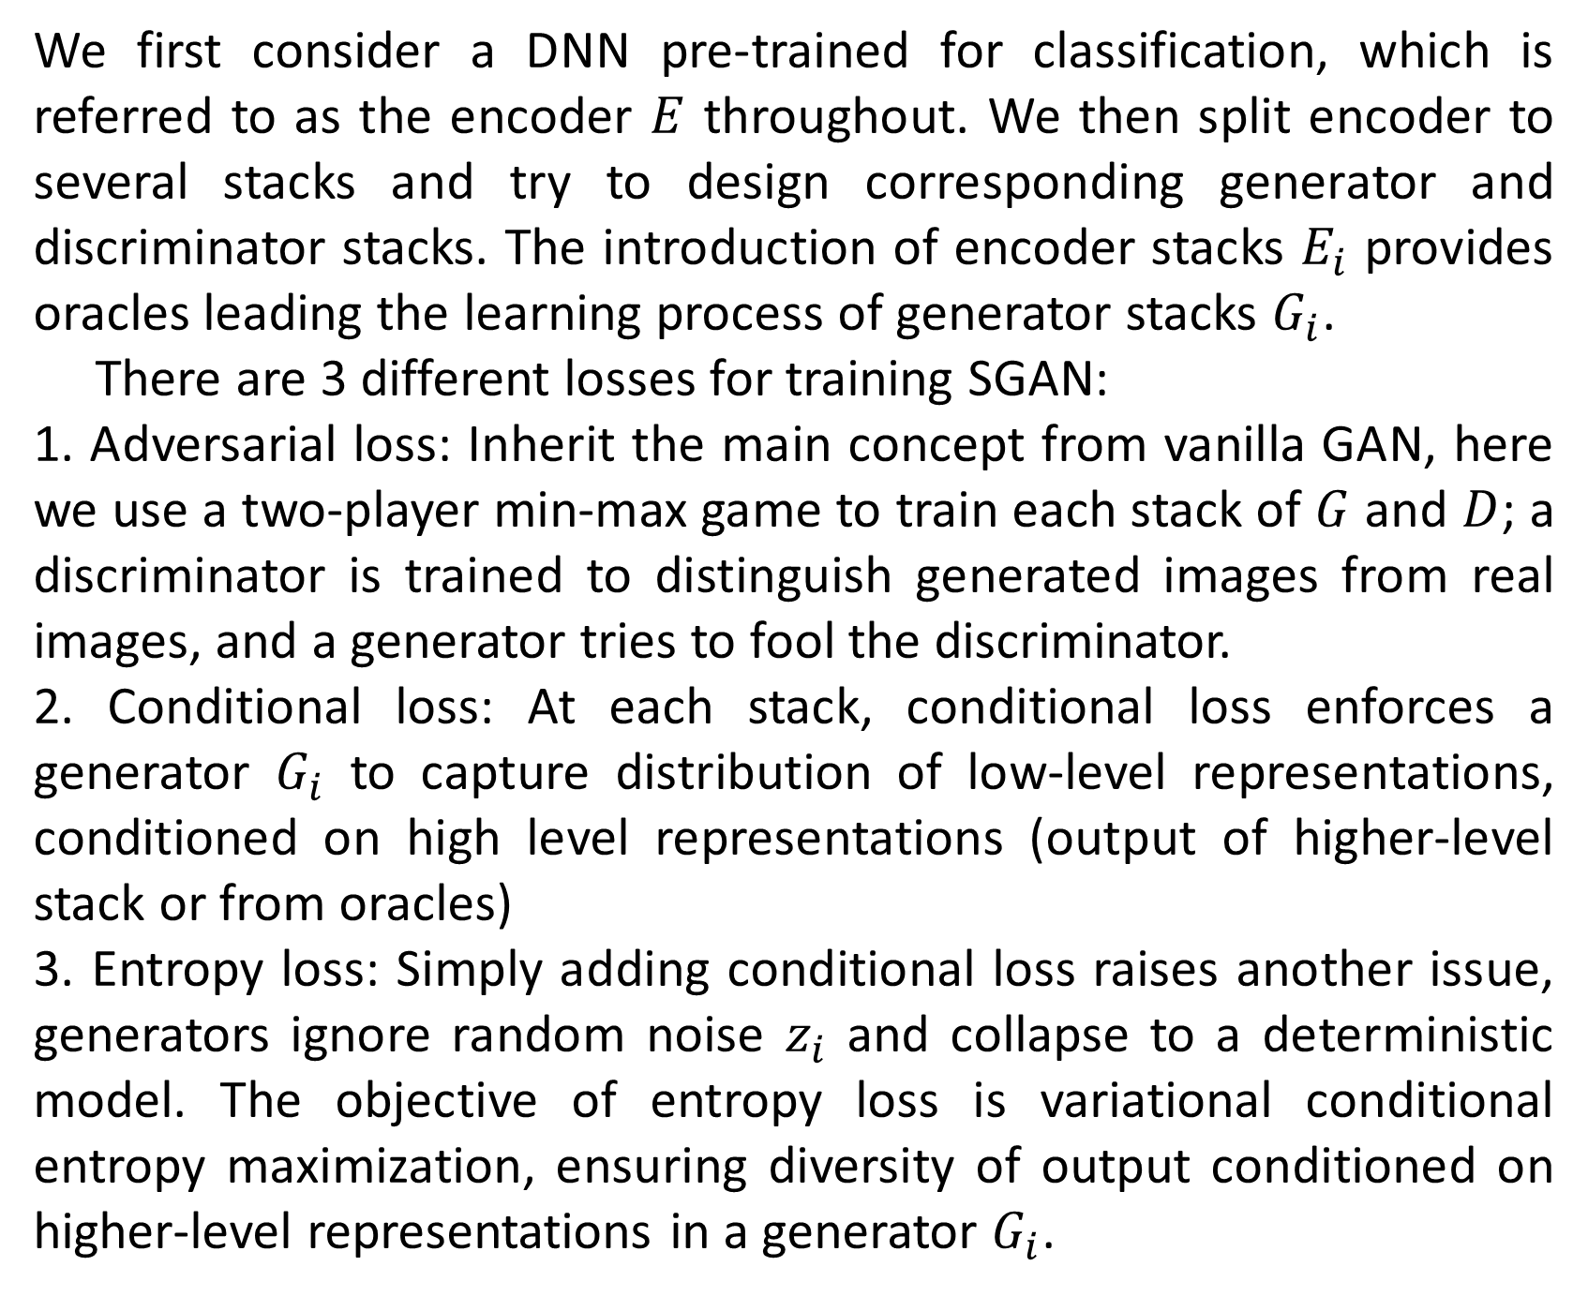
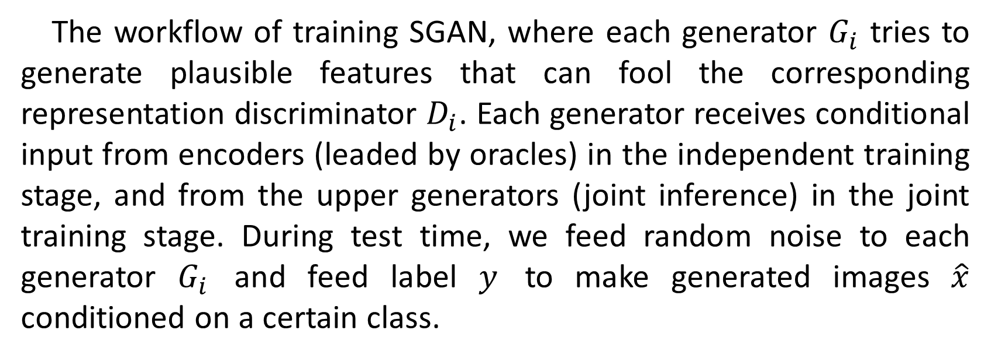
LEARNING TO GENERATE RICH-CONTENT IMAGES CONDITIONED ON SEMANTIC LABELS
組員: 王尊玄 胡展維 林秉言
Abstract
We first consider a DNN pre-trained for classification, which is referred to as the encoder $E$ throughout. We then split encoder to several stacks and try to design corresponding generator and discriminator stacks. The introduction of encoder stacks $E_{i}$ provides oracles leading the learning process of generator stacks $G_{i}$.
There are 3 different losses for training SGAN:
1. Adversarial loss: Inherit the main concept from vanilla GAN, here we use a two-player min-max game to train each stack of $G$ and $D$; a discriminator is trained to distinguish generated images from real images, and a generator tries to fool the discriminator.
2. Conditional loss: At each stack, conditional loss enforces a generator $G_{i}$ to capture distribution of low-level representations, conditioned on high level representations (output of higher-level stack or from oracles)
3. Entropy loss: Simply adding conditional loss raises another issue, generators ignore random noise $z_{i}$ and collapse to a deterministic model. The objective of entropy loss is variational conditional entropy maximization, ensuring diversity of output conditioned on higher-level representations in a generator $G_{i}$.
There has been a large interest in generative models recently. These are models that can learn to create data that is similar to data that we give them. The intuition behind this is that if we can get a model to generate high-quality image for example, then it must have also learned a lot about images in general. Or in other words, the model should also have a good internal representation of images. We can then hopefully use this representation to help us with other related tasks, such as some unsupervised learning tasks.
A discriminative model learns a function that maps the input data x to some desired output class label y. In GAN, it tries to distinguish the real image or the generated image.
A generative model tries to learn the joint probability of the input data and labels simultaneously, i.e. P(x,y). In GAN, it tries to fool the discriminative model.
noise
generator
Real image
discriminator
Generated image
Going deeper with SGAN
Real or fake?
Asides from generating low-resolution images, e.g. MNIST and CIFAR10, we have designed and experimented on a deeper and more-stacks SGAN. We first
An overview of SGAN
fine-tune a pretrained VGG-16 on our dataset and use it as the encoder. We then design stacked generator and stacked discriminator associated with the architecture of stacked encoder (VGG16), shown as the right figure.
Experimental results
Generated MNIST
Real MNIST
Generated CIFAR10
Real CIFAR10
The workflow of training SGAN, where each generator $G_{i}$ tries to generate plausible features that can fool the corresponding representation discriminator $D_{i}$. Each generator receives conditional input from encoders (leaded by oracles) in the independent training stage, and from the upper generators (joint inference) in the joint training stage. During test time, we feed random noise to each generator $G_{i}$ and feed label $y$ to make generated images $\hat{x}$ conditioned on a certain class.
Generated indoor
Real indoor
References
[1] A. Radford, L. Metz, and S. Chintala. Unsupervised representation learning with deep convolutional generative adversarial networks. In ICLR, 2016.
[2] Xun Huang, Yixuan Li, Omid Poursaeed, John Hopcroft, Serge Belongie. Stacked Generative Adversarial Networks
[3] T.Salimans,I.Goodfellow,W.Zaremba,V.Cheung,A.Rad- ford, and X. Chen. Improved techniques for training gans. In NIPS, 2016.

